Slide 1
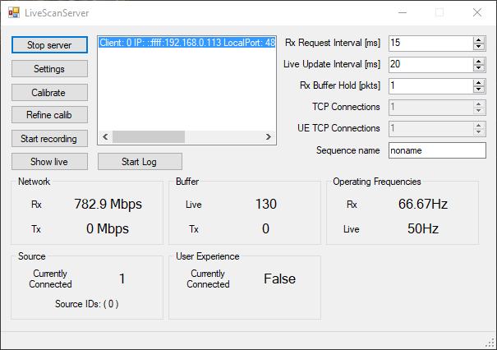
Server UI
https://github.com/Sarsoo/LiveScan3D, https://github.com/Sarsoo/LiveScan3D-Android

Slide 2
Client to Server
Header
Message Type
Data Length
Compression
Timestamp
Payload
Source ID
Size of Point Cloud
Point Cloud
Bodies
Notes:
Red is new
In payload of packet as there are lots of message types, save space and seems to make more sense to only include with relevant types

Slide 3
Server to UE
Header
Message Type
Source ID
Data Length
Compression
Timestamp
Payload
Point Cloud
Notes:
All packets to UE are frames, makes sense to include in header,
processing of payload is already well defined

Slide 4
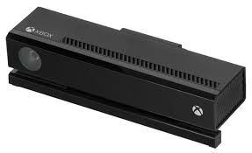

Obstacles
Notes:
One Kinect
No Android

Slide 5

Suggestions
?
Notes:
One Kinect
No Android

Slide 6




Notes:
Static dependency injection
AR Core in theory compatible with iOS, not in practice

Slide 7
?
Notes:
Static dependency injection
AR Core in theory compatible with iOS, not in practice

Slide 8

AR Foundation

Slide 9


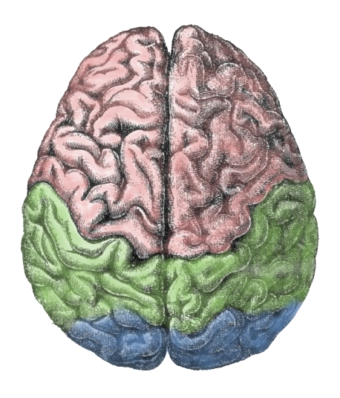
Client
Server
UE
Notes:
Current Behaviour

Slide 10

Client
Server
UE
Notes:
Add random at client at least, will reduce bandwidth throughout pipeline

Slide 11
Client
Server
UE
Client
Notes:
How will source/multi-view coherence be maintained when opposite frames could be dropped and none can be reassembled

Slide 12
Client
Server
UE
Client
Notes:
Would allow coherent reconstruction of frames, however bandwidth is not saved from client to server

Slide 13
Client
Server
UE
Notes:
Adding random drop at server could also help, depending on UE

Slide 14
Questions
How should Ioannis’ buffer work be referenced?
What sort of quantitative results can I now gather?

