Slide 1
LiveScan3D
Initial Structure
MainWindowForm
OpenGLWindow
lAllVertices
lAllColors
lAllCameraPoses
lAllBodies
vertices
colors
cameraPoses
bodies
KinectServer
Display
KinectSocket
LiveScanClient

Slide 2
Initial Testing
MainWindowForm
OpenGLWindow
lAllVertices
lAllColors
lAllCameraPoses
lAllBodies
vertices
colors
cameraPoses
bodies
Local
Storage
Display
KinectServer
Divert live frames to local storage
LiveScanClient

Slide 3
Initial Testing
MainWindowForm
OpenGLWindow
lAllVertices
lAllColors
lAllCameraPoses
lAllBodies
vertices
colors
cameraPoses
bodies
Local
Storage
Display
KinectServer
Load frames from local storage
Merge with live frames
KinectClient
LiveScanClient

Slide 4
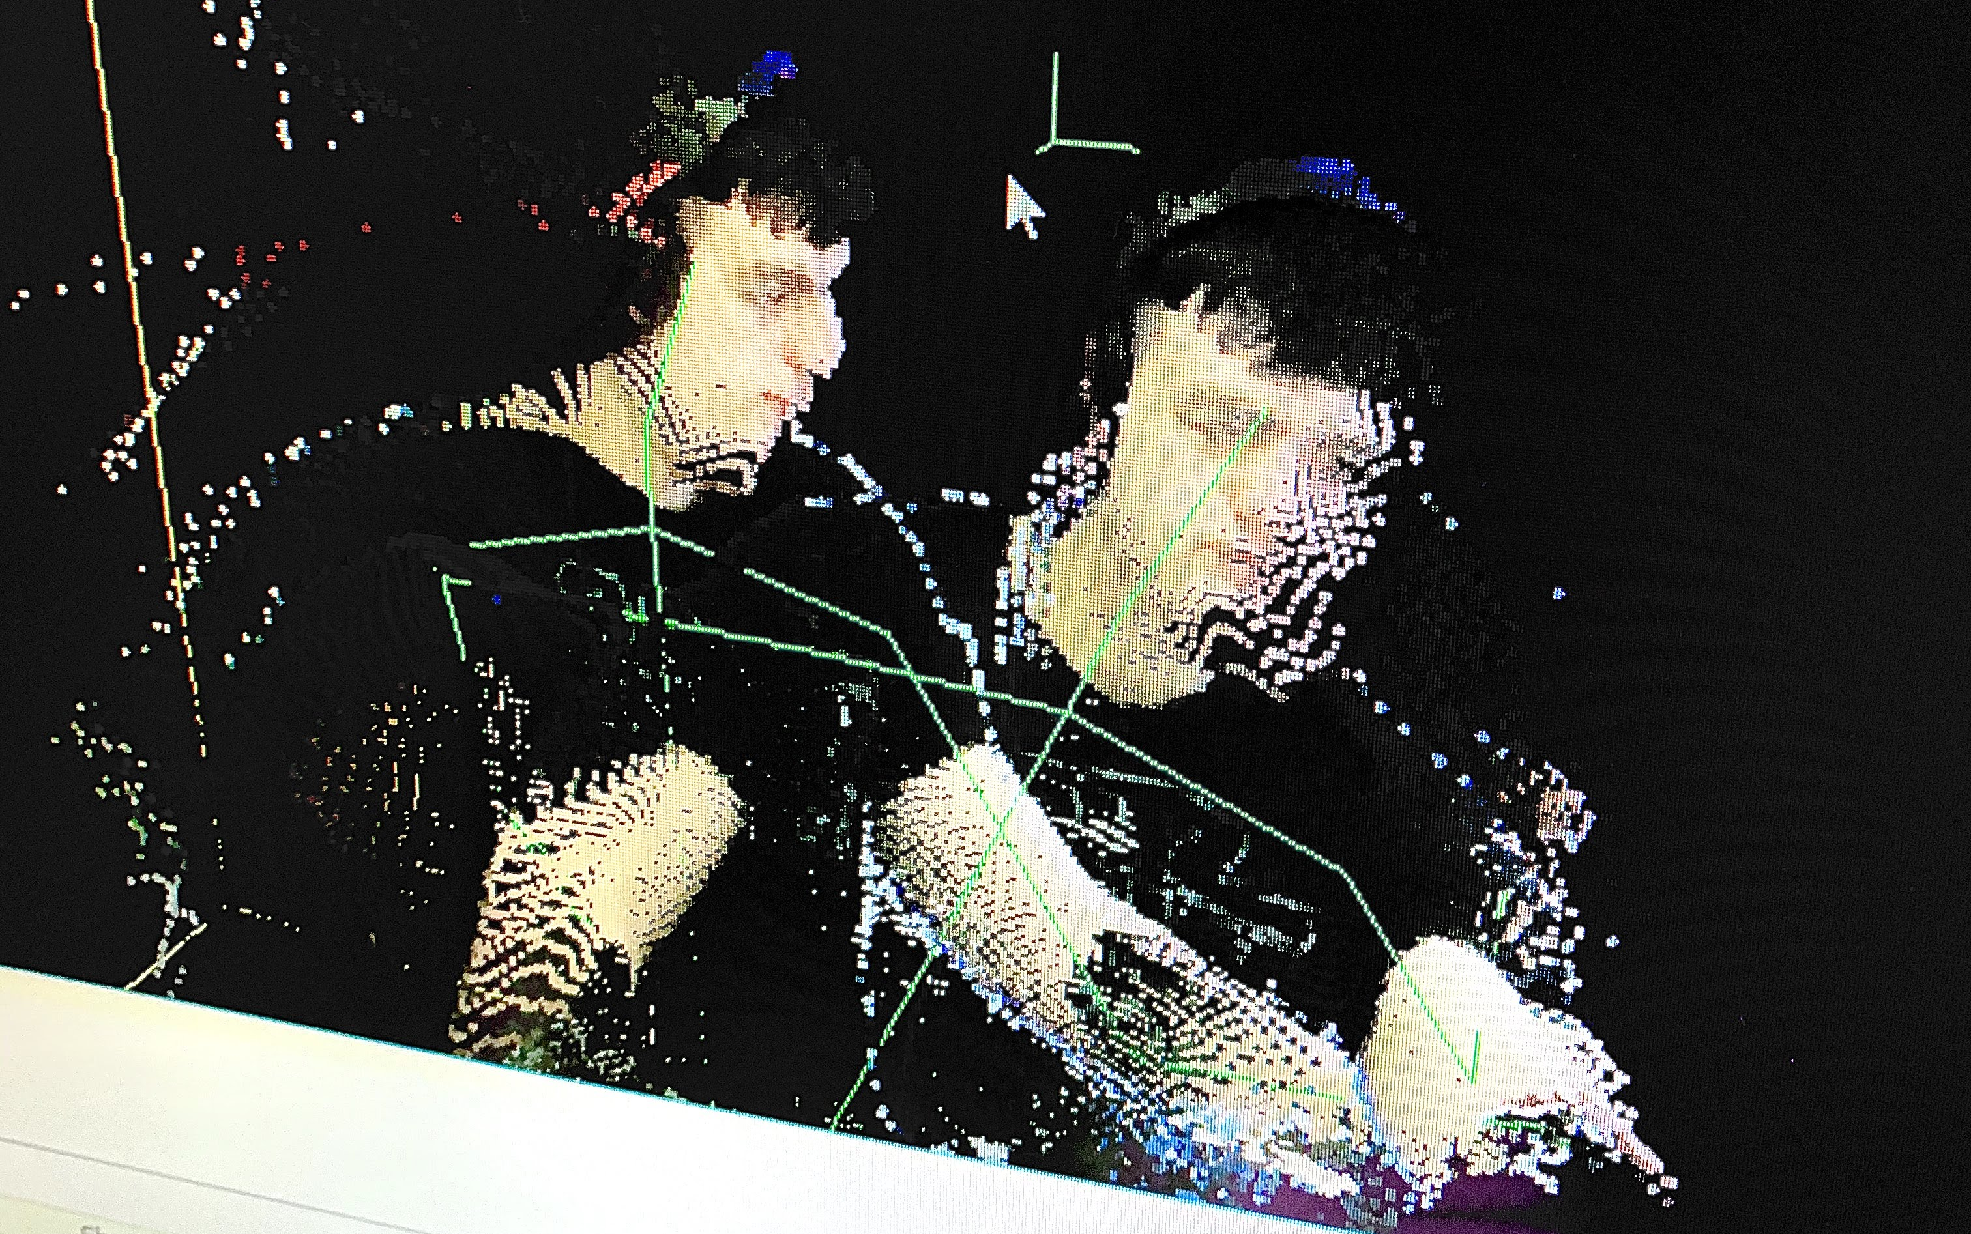
Initial Testing
MainWindowForm
OpenGLWindow
lAllVertices
lAllColors
lAllCameraPoses
lAllBodies
vertices
colors
cameraPoses
bodies
Local
Storage
Display
KinectServer
Load frames from local storage
Merge with live frames
KinectClient
KinectClient
LiveScanClient

Slide 5
Figure
Arrangement
MainWindowForm
OpenGLWindow
lAllVertices
lAllColors
lAllCameraPoses
lAllBodies
vertices
colors
cameraPoses
bodies
Local
Storage
Affine
Transform
Display
KinectServer
LiveScanClient
Rotate local frames 180° in y axis

Slide 6
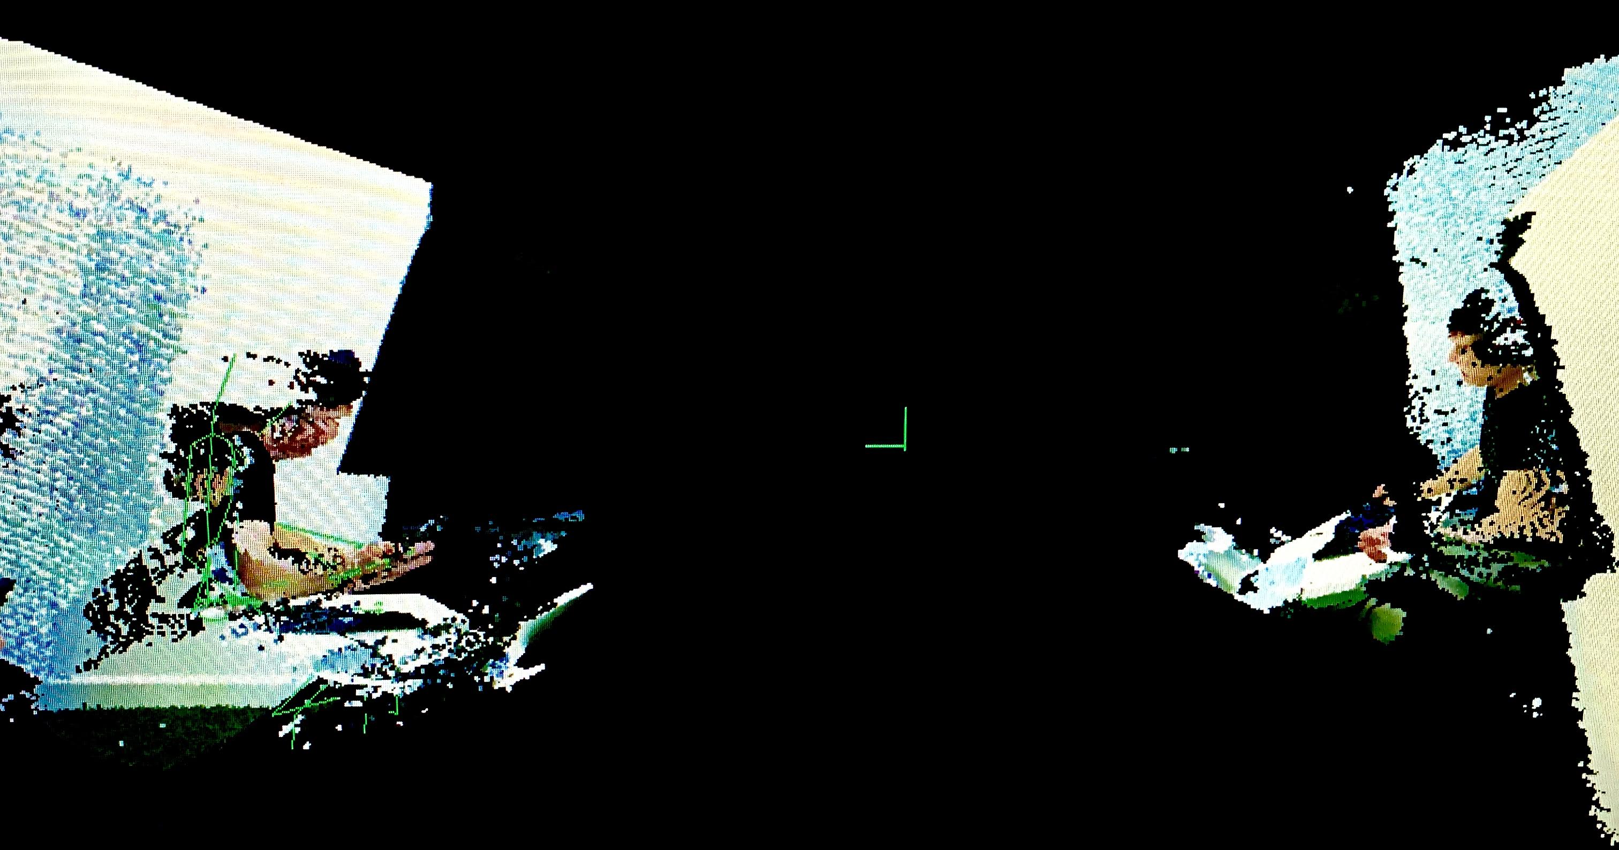

Slide 7
Figure
Arrangement
MainWindowForm
lAllVertices
LallColors
lAllCameraPoses
lAllBodies
ClientID
OpenGLWindow
Logical
Client
Frames
Logical
Client
Frames
Logical Client Frame =
Local
Storage
Transformer
KinectServer
Display
Wrap point cloud variables in structure with client group ID
Perform rotation and arragement within OpenGL window
Use DisplayFrameTransformer to retrieve transformations for each client
LiveScanClient

Slide 8
Figure
Arrangement
MainWindowForm
lAllVertices
LallColors
lAllCameraPoses
lAllBodies
ClientID
OpenGLWindow
Logical
Client
Frames
Logical
Client
Frames
Logical Client Frame =
Local
Storage
Transformer
KinectServer
Display
Wrap point cloud variables in structure with client group ID
Perform rotation and arragement within OpenGL window
Use DisplayFrameTransformer to retrieve transformations for each client
LiveScanClient

Slide 9
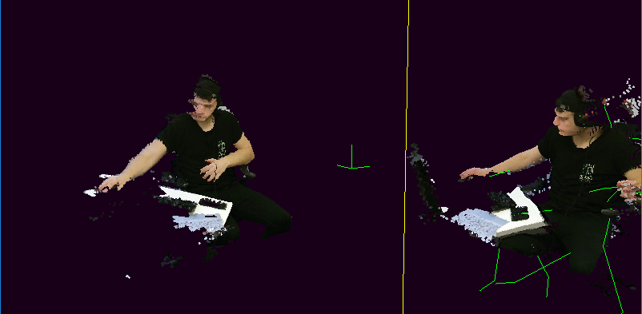
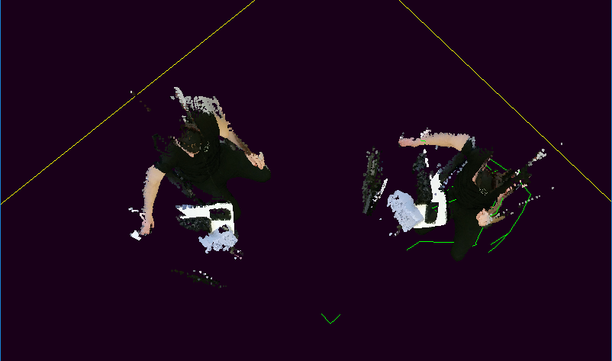

Slide 10
Separation of Network and Display
MainWindowForm
Generic
Display
Separate logic for network and display
Make multi-source system agnostic to display method
  Hololens
  Mobile AR
Allows OpenGL to individually control source display
Leave frames in own co-ordinate reference frame and allow display method to process and arrange
Logical
Client
Frames
KinectServer
LiveScanClient
LiveScanClient
LiveScanClient
Group of clients (Source)

Slide 11
OpenGL Arrangement
OpenGL display with origin in center

Slide 12
OpenGL Arrangement
Single client, single sensor
Origin represents camera
Objects in front
Camera
Object

Slide 13
OpenGL Arrangement
Further single sensor clients rotated about origin

Slide 14
OpenGL Arrangement
Further single sensor clients rotated about origin

Slide 15
OpenGL Arrangement
Further single sensor clients rotated about origin
Multi-view configurations make calibration marker origin of space
  Additional translation required
Calibration
Marker

Slide 16
OpenGL Arrangement
Further single sensor clients rotated about origin
Multi-view configurations make calibration marker origin of space
  Additional translation required
Rotation and translation away from origin separate sources

Slide 17
OpenGL Arrangement
Automatic placement can be overridden and objects arbitrarily rotated and translated

