Slide 1
MainWindowForm
OpenGLWindow
lAllVertices
LallColors
lAllCameraPoses
lAllBodies
vertices
colors
cameraPoses
bodies
Display
KinectServer
KinectClient

Slide 2
MainWindowForm
OpenGLWindow
lAllVertices
LallColors
lAllCameraPoses
lAllBodies
vertices
colors
cameraPoses
bodies
Local
Storage
Display
KinectServer
KinectClient

Slide 3
MainWindowForm
OpenGLWindow
lAllVertices
LallColors
lAllCameraPoses
lAllBodies
vertices
colors
cameraPoses
bodies
Local
Storage
Display
KinectServer
KinectClient

Slide 4
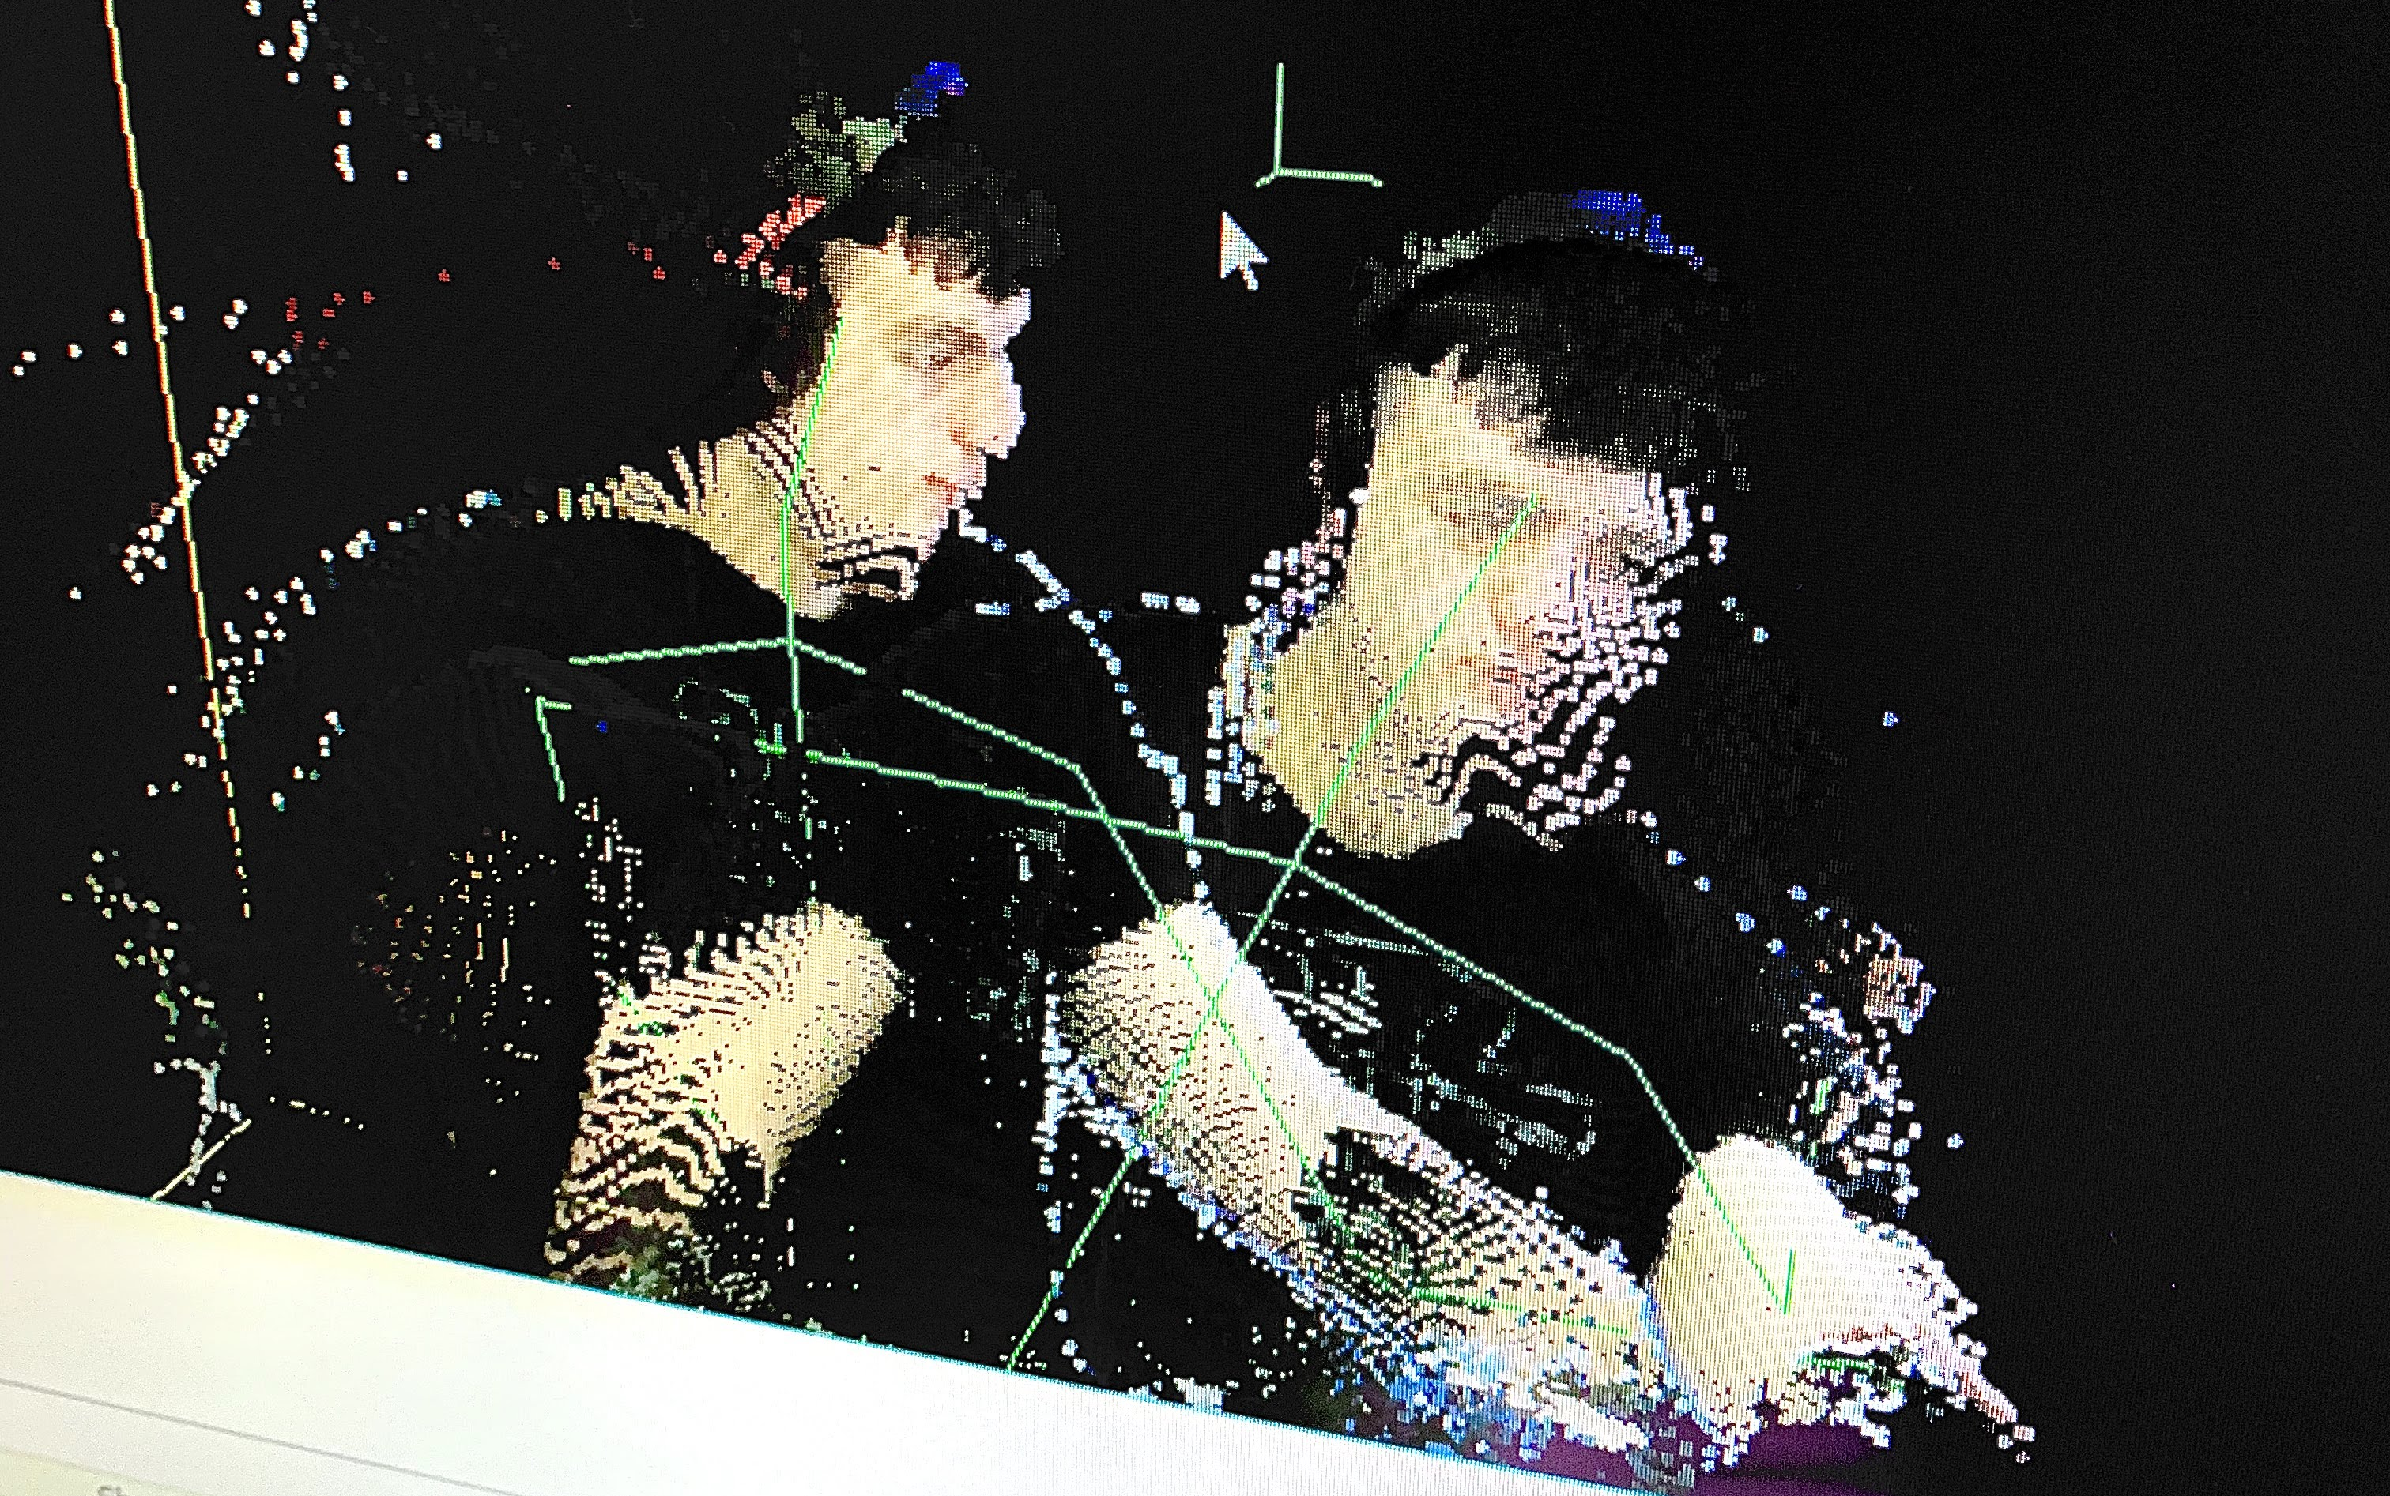
MainWindowForm
OpenGLWindow
lAllVertices
LallColors
lAllCameraPoses
lAllBodies
vertices
colors
cameraPoses
bodies
Local
Storage
Display
KinectServer
KinectClient

Slide 5
MainWindowForm
OpenGLWindow
lAllVertices
LallColors
lAllCameraPoses
lAllBodies
vertices
colors
cameraPoses
bodies
Local
Storage
Affine
Transform
Display
KinectServer
KinectClient

Slide 6
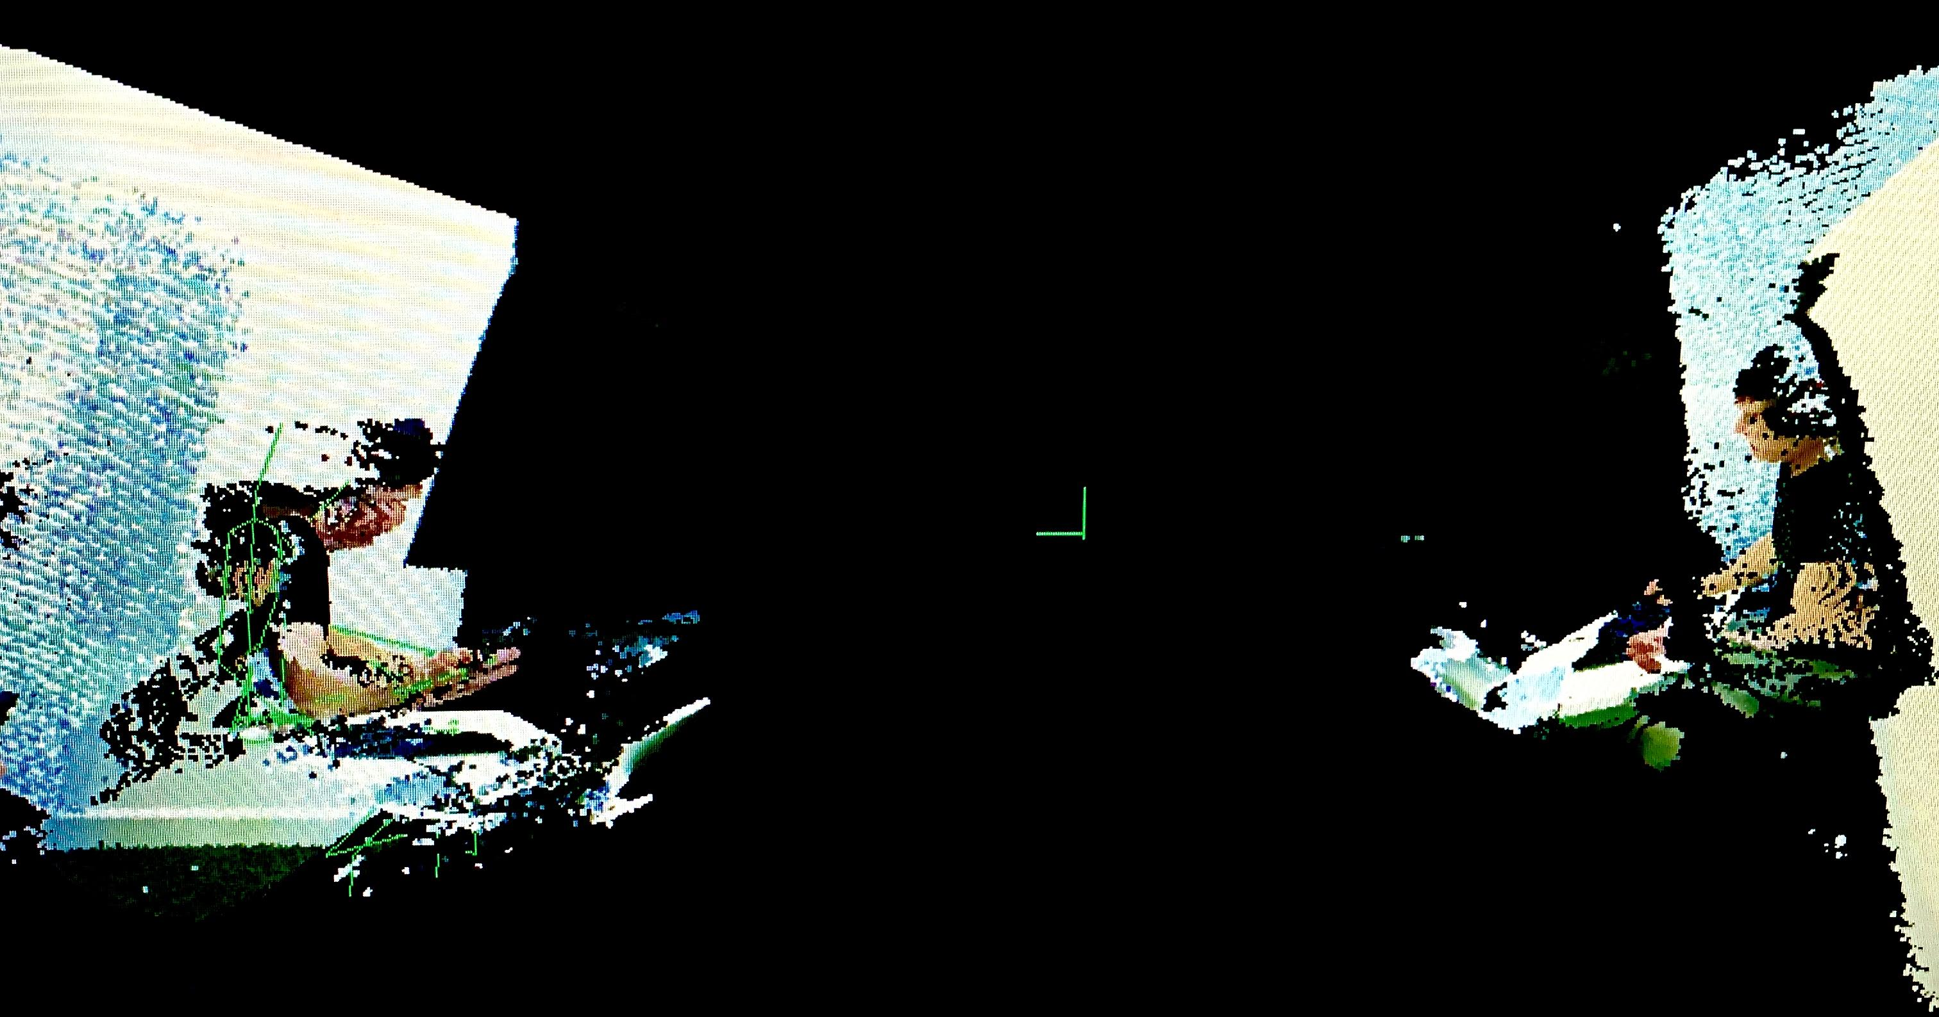

Slide 7
MainWindowForm
OpenGLWindow
Logical
Client
Frames
Logical
Client
Frames
Local
Storage
Affine
Transform
KinectServer
Display
lAllVertices
LallColors
lAllCameraPoses
lAllBodies
ClientID
KinectClient
Logical Client Frame =

Slide 8
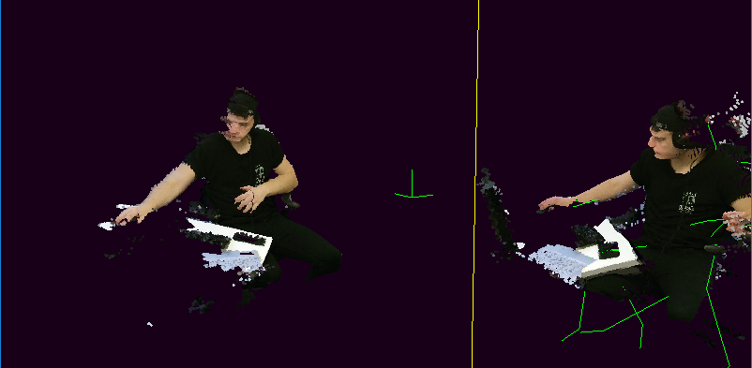
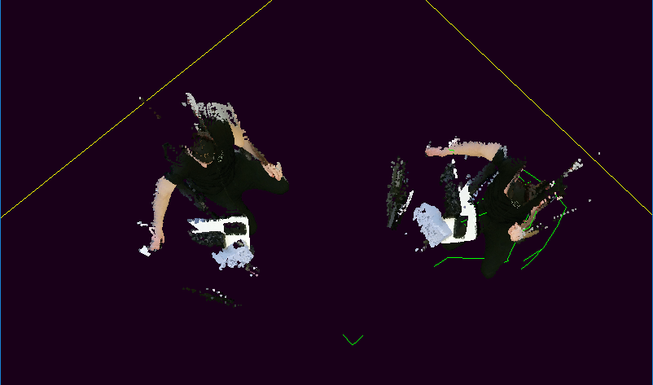

Slide 9
MainWindowForm
OpenGLWindow
Logical
Client
Frames
Logical
Client
Frames
Affine
Transform
KinectServer
Display
KinectLogicalClient
KinectClient

Slide 10
MainWindowForm
OpenGLWindow
Logical
Client
Frames
Logical
Client
Frames
Affine
Transform
KinectServer
Display
KinectLogicalClient
KinectLogicalClient
KinectClient
KinectClient
KinectClient

Slide 11
MainWindowForm
Generic
Display
Logical
Client
Frames
KinectServer
KinectLogicalClient
KinectLogicalClient
KinectClient
KinectClient
KinectClient

