Slide 1





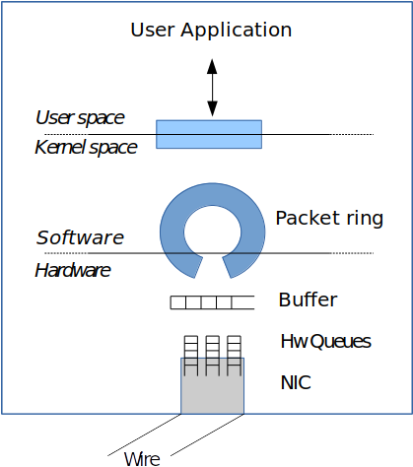
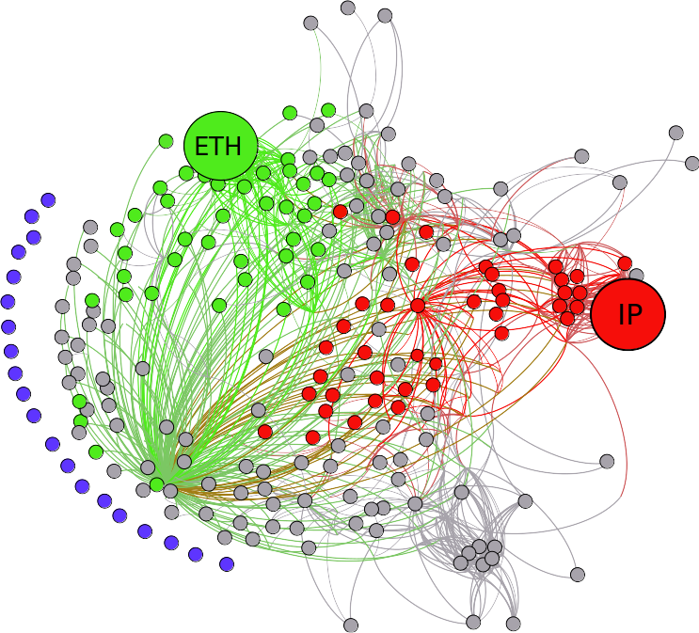
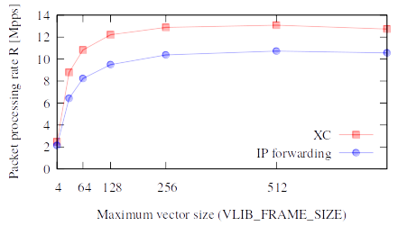
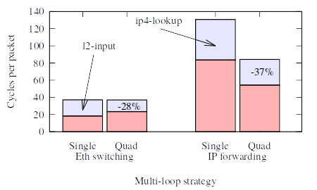
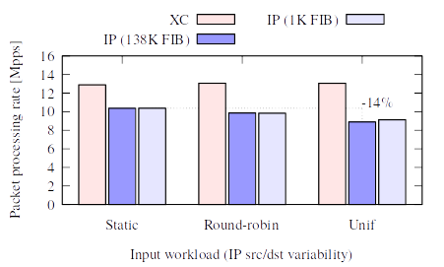
Long long long long title with
emphasis on last part
People participating, comma separated
Telecom ParisTech – {name.surname}@telecom-paristech.fr
Left column
Info and picture
Right column
Other info and logo
HW
Black
Box
pkt-in
pkt-out
Mid part of right
Another picture, remember few text
Figure 1: Caption of the figure
Bottom part, same col
List of things to do
A
B
C
D
What really matters
Figure 2: Do you really want to copypaste the caption from the paper?
Bottom part of right
Takeaways, prepare the reader for next
Experimental results

