Slide 1



Title of the talk
Leonardo Linguaglossa (Telecom ParisTech)
Acknowledgments: all people I work with

Slide 2
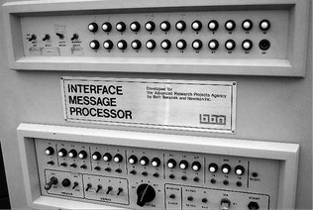
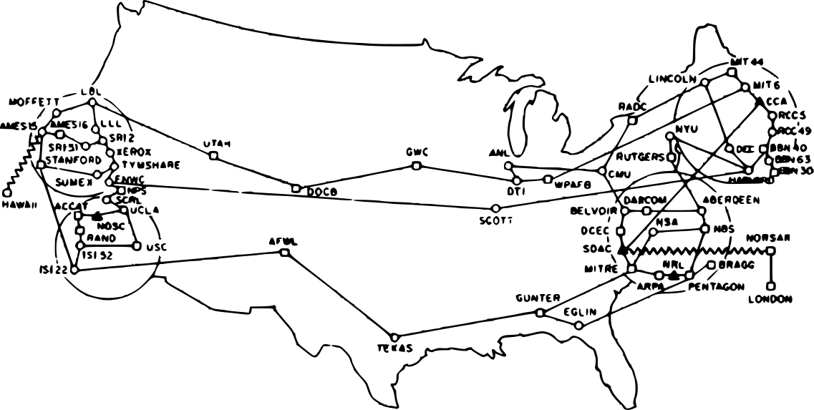
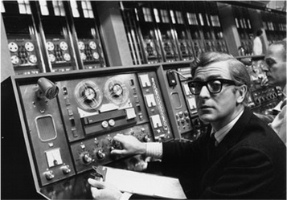
Motivation
Fancy picture
A picture
Yet another picture

Slide 3
Separation of parts
1) Part done
2) Part current
3) TBD
4) TBD
5) TBD
Key points
A
B
C

Slide 4
Main content
Subsection subtitle
Category 1
A
B
C
Category 2
A
B
Flows
NIC
Packet processing
λ₁
λ₂
λ₃
NIC +
Hw queues
Parallel processing
Flows
λ₁
λ₂
λ₃

Slide 5
Color style
Subsection subtitle
Cat 1
Light green
Light red
Cat 2
Big lines
Short lines for connections
Payload
Pkt struct
MAC src/dst
IP src/dst
Payload

Slide 6
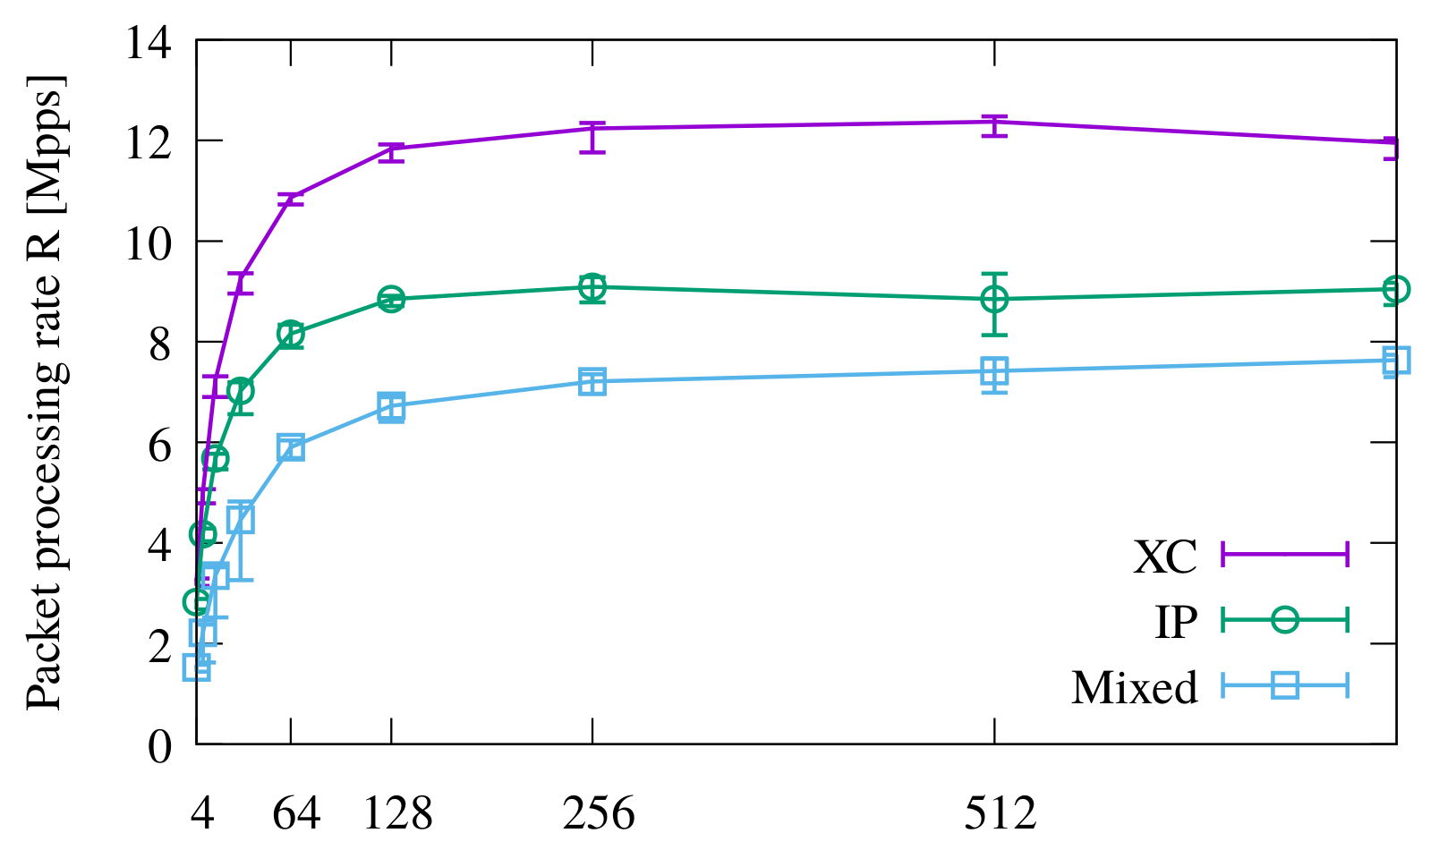
Plots
Animation with some additional
description of the data
Maximum vector size

Slide 7

Summary
1) Done
2) Done
3) Done
4) Done
5) Conclusion with exclamation!

Slide 8

Thanks.
Questions
perso.telecom-paristech.fr/~linguaglossa
linguaglossa [at] telecom-paristech.fr

