Slide 1




Vectorized Packet Processing
High-speed software data plane via
Leonardo Linguaglossa & Dario Rossi, Télécom ParisTech
David Barach & Damjan Marion & Pierre Pfister, Cisco Systems

Slide 2
Outline
Background
Vector Packet Processor
Experimental results
Conclusion

Slide 3
Background
Vector Packet Processor
Experimental results
Conclusion

Slide 4
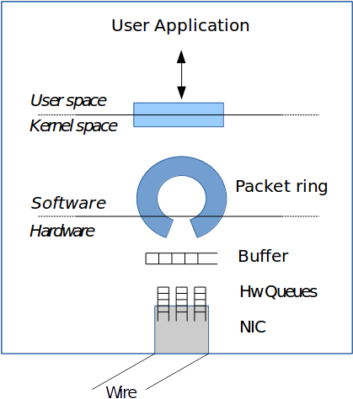
Software-based networking
Background
Flexibility of SW
vs
Performance of HW

Slide 5
Thanks.

