Slide 2
DROIDGROUND
A flexible playground for Android CTF challenges

Slide 3

Angelo Delicato
Penetration Tester, SECFORCE

Slide 4


BIO
Yes, my name means “delicate angel”
Yes, it was a difficult childhood
Yes, I use it as an icebreaker now
Mainly focused on web hacking
thelicato
Always been interested in the Android ecosystem:
Dockerized Android: a container-based platform to build mobile Android scenarios for Cyber Ranges (paper & source code, 2022)
Robodroid: manage Android machines with pre-defined behaviors for Cyber Range environments. (source code, 2024)
DroidGround’s ancestor

Slide 5
AGENDA
Android & Security
Purpose
Architecture & Features
🌟 Demo 🌟
Technical Deep Dive
What’s Next

Slide 6
ANDROID & SECURITY
Context & Stats

Slide 7



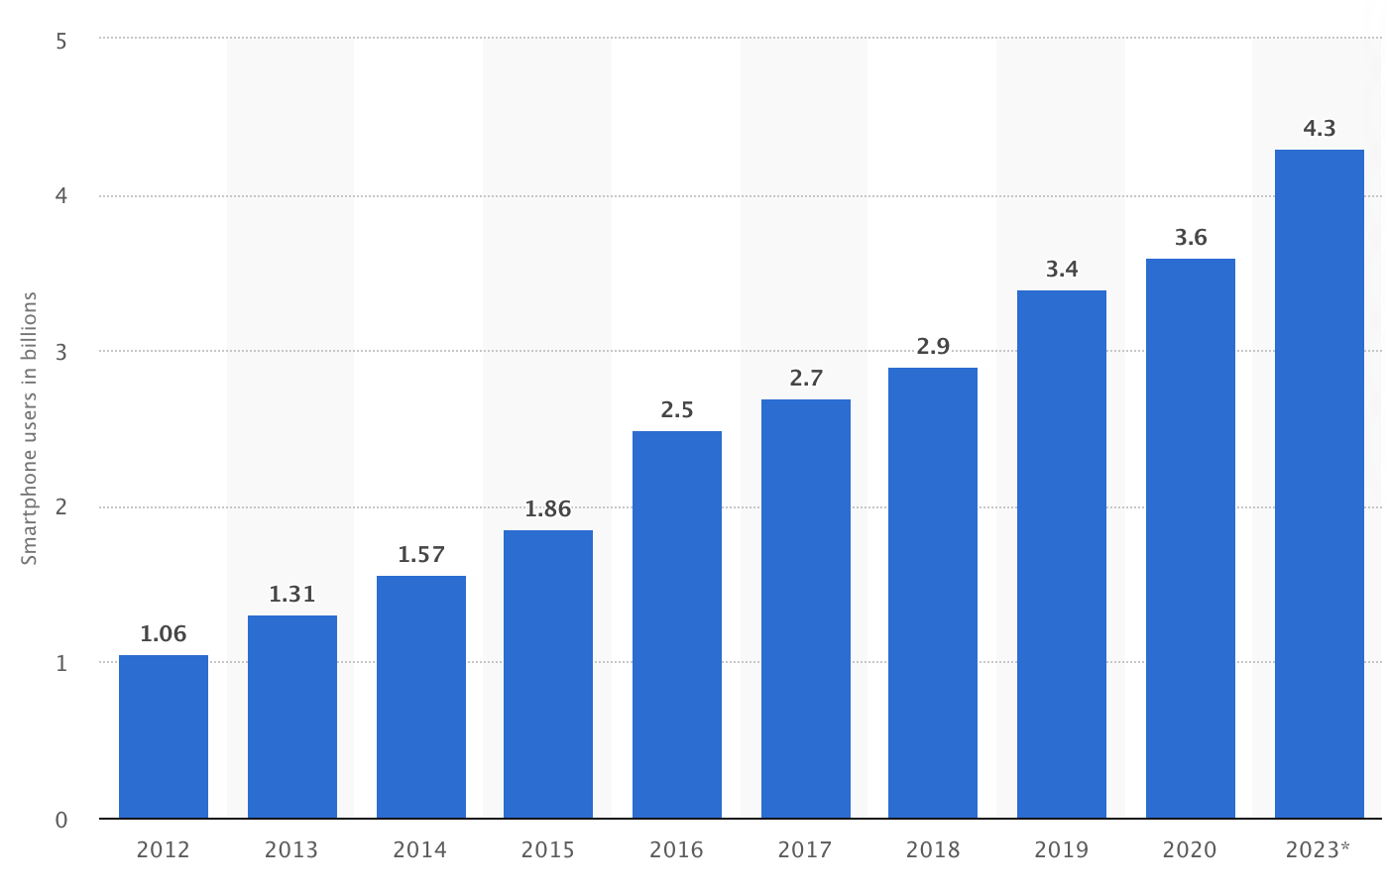

CONTEXT: MOBILE DEVICES TODAY & CYBER SECURITY
~4.88 Billion smartphone users in the world as of 2024
About 70% of them are Android devices (~3.41 billion)
One of the biggest threats to security

Slide 8
SOME STATS
6.3% of smartphones had a malicious app installed (2024)
70% of online fraud is accomplished through mobile platforms (2024)
83% of phishing sites specifically targeted mobile devices (2024)
31% of devices had out-of-date operating systems in Q3 2024
Mobile malware jumping by 151% since start of year
Google increasing bug bounty rewards for Android
Pwn2Own’s recent results (Samsung Galaxy S25 RCE + withdrawn WhatsApp 0-click RCE)

Slide 9
TOTALLY DIFFERENT KIND OF VULNERABILITIES
Pending Intents
Binder
Services
Permissions
WebViews
Sandbox bypass
TWAs
Intents
Broadcast Receivers
Content Providers
Activities

Slide 10
PURPOSE
Why DroidGround exists and what problem it solves

Slide 11
WHY DROIDGROUND?
Classic CTF Android challenges are mostly static reverse engineering of an APK.
Real runtime exploitation (RCE, IPC abuse, intent abuse, etc.) is hard to host.
Organizers also want control and be able to force the intended path to get the flag.
DroidGround solves this by providing a flexible and controlled access to an Android target

Slide 12
WHAT DROIDGROUND IS
DroidGround is an enabler that makes it practical to host live, runtime Android exploitation challenges, letting organizers present bugs that only manifest on a running device instead of static APK puzzles.
The benefits?
Teaches realistic exploitation workflows
It’s more fun! (aka don’t underestimate the power of gamification)

Slide 13
ARCHITECTURE & FEATURES
An overview into the structure of the tool

Slide 14
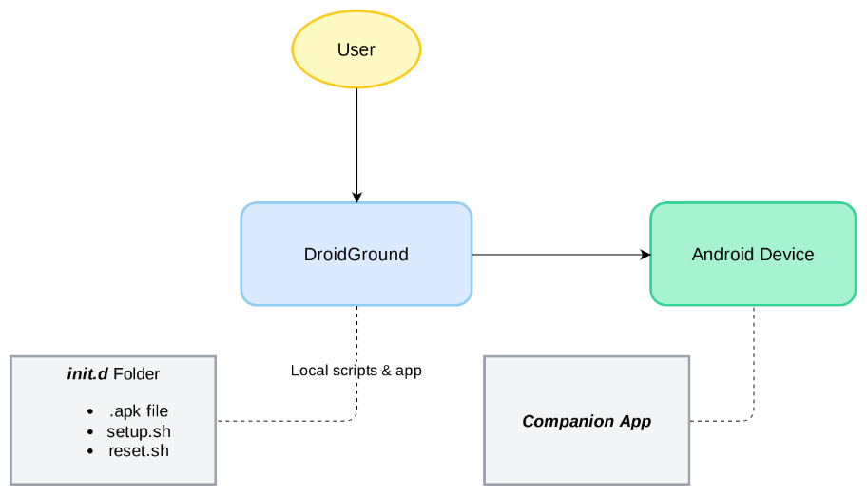

DROIDGROUND: OVERALL ARCHITECTURE
This can be a real device, an AVD, a Docker container

Slide 15

DROIDGROUND: FEATURES
Real-Time Device Screenshare (via scrcpy)
Reset Challenge State
Restart App
Start Activity
Start Service
Send Broadcast Intent
Shutdown Device
Reboot Device
Download Bugreport (via bugreportz)
Frida Scripting (either “jailed” or “full” mode)
File Browser
Terminal Access
Application Management (install and run exploit app)
Logcat Viewer
Toggable

Slide 16
GUARDRAILS
Provided by Android itself
Apps override
Provided by DroidGround
Apps override
Apps override
Apps override
Provided during deploy (by you)
Apps override

Slide 17

⭐ DEMO TIME ⭐

Slide 18
TECHNICAL DEEP-DIVE
Details about the Companion app

Slide 19
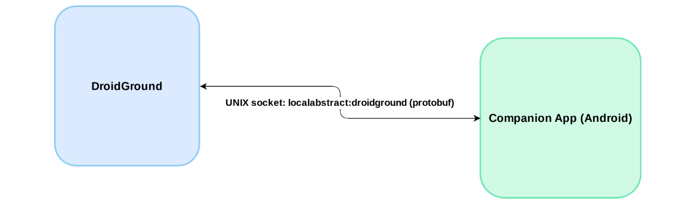
TECHNICAL DEEP-DIVE: THE COMPANION APP
The App Manager feature leverages a custom-made Companion App:

Slide 20
TECHNICAL DEEP-DIVE: THE COMPANION APP
The Companion App:
Is a dexed Java binary that runs outside the standard app sandbox via Android’s app_process (similar to scrcpy)
Leverages the localabstract:droidground UNIX socket
Communicates with the server via protobuf
Provides the following features:
getVersion: returns the current version of the installed apps
getPackageInfos: returns some metadata about the apps (e.g. the name and the icon)
getAttackSurface: returns the exported components for each app

Slide 21
LET’S TALK ABOUT THE ELEPHANT IN THE ROOM
Scaling it for real-world, multi-player CTF environments is not trivial:
Use separate instances for each team/player: provision costs are higher if compared with webapps. Even when using containers, disk and RAM requirements are slightly higher. A sample instancer is available on GitHub
Use a shared instance: a little bit of custom orchestration would be needed in this case (currently not envisioned as part of the project)
Different solutions are being explored as of now and feedback is highly welcomed!

Slide 22

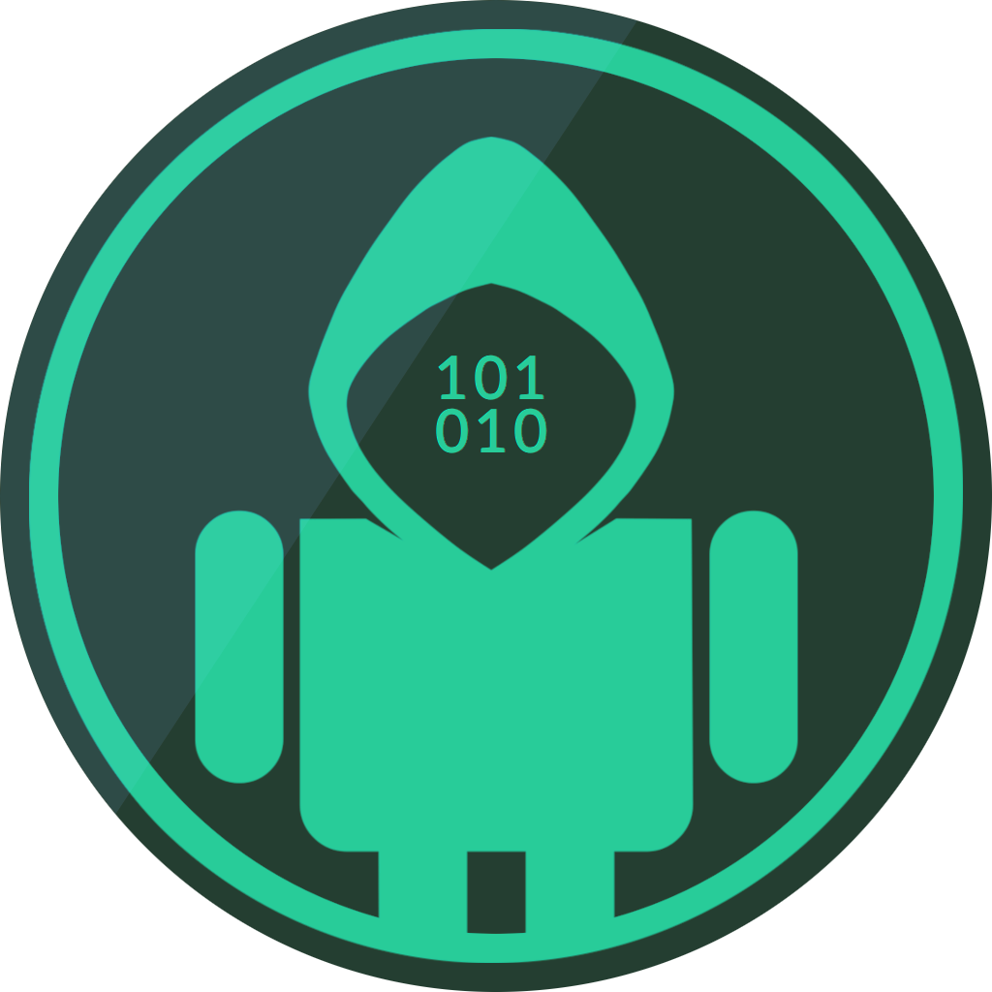
WHAT’S NEXT
Spread the word
Use it
Get feedback
Upcoming CTF by Napwnli
https://napwn.li
Improve it!
https://github.com/SECFORCE/droidground
Get involved!

Slide 23
THANKS FOR YOUR TIME!
Angelo Delicato

