Slide 1


Brampton Gavel Club Education
Revised October 2017
Content in this PowerPoint has been adapted from the Toastmasters International Education Program

Slide 2
Two Different Tracks
Communication
Leadership
Competent Communicator (CC)
Advanced Communicator Bronze (ACB)
Advanced Communicator Silver (ACS)
Advanced Communicator Gold (ACG)
Competent Leader (CL)
Advanced Leader Bronze (ALB)
Advanced Leader Silver (ALS)
Distinguished Gavelier (DG)

Slide 3
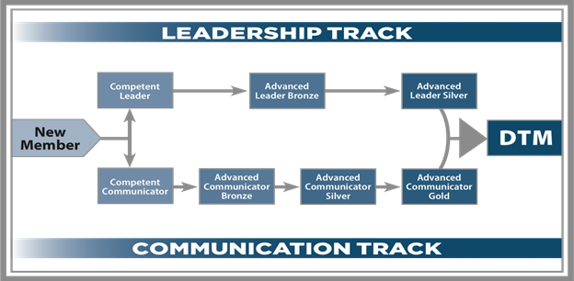
Communication and Leadership: Flow Chart
https://trafalgartoastmasters.wordpress.com/2012/10/22/toastmaster-education-program/

Slide 4
Communication

Slide 5
Communication Track
Competent Communicator (CC)
Complete the Competent Communication manual
10 speeches

Slide 6
Communication Track
Advanced Communicator Bronze (ACB)
Complete Competent Communicator (CC) award
Complete two manuals from the Advanced Communication Series
Each manual has five speeches

Slide 7
Communication Track
Advanced Communicator Silver (ACS)
Complete Advanced Communicator Bronze (ACB) award
Complete two more manuals from the Advanced Communication Series
Each manual has five speeches
Conduct any two education presentations from The Better Speaker Series and/or The Successful Club Series

Slide 8
Communication Track
Advanced Communicator Gold (ACG)
Complete Advanced Communicator Silver (ACS) award
Complete two more manuals from the Advanced Communication Series
Each manual has five speeches
Conduct a presentation from the Success/Leadership Series, Success/Communication Series, or Youth Leadership
Conduct any two education presentations from The Better Speaker Series and/or The Successful Club Series
Coach a new member with their first three speech projects

Slide 9
Leadership

Slide 10
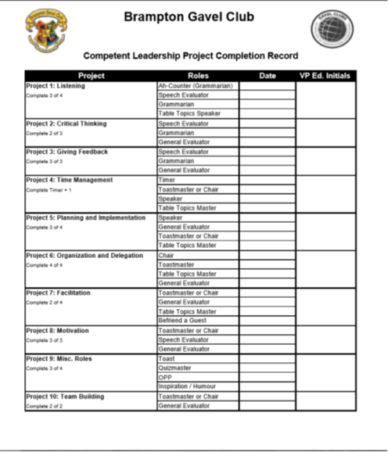
Leadership Track
Competent Leader (CL)
Complete the Competent Leadership manual / worksheet

Slide 11
Leadership Track
Advanced Leader Bronze (ALB)
Complete Competent Leader (CL) award
Complete Competent Communicator (CC) award
Serve at least six months as a club officer (president, vice president education, vice president membership, vice president public relations, secretary, treasurer, sergeant at arms) and participated in the preparation of a Club Success Plan while serving in this office
While serving in the above office, participated in a district-sponsored club officer training
Conduct any two presentations from The Successful Club Series and/or The Leadership Excellence Series

Slide 12
Leadership Track
Advanced Leader Silver (ALS)
Complete Advanced Leader Bronze (ALB) award
Served a complete term as a district officer (district director, program quality director, club growth director, public relations officer, administration manager, finance manager, division director, area director)
Complete the High Performance Leadership program
Served successfully as a club sponsor, mentor, or coach
Gavel Club requirements for this award are TBD

Slide 13
Communication / Leadership Track
Distinguished Toastmaster (DTM) Gavelier (DG)
Complete Advanced Communicator Gold (ACG) award
Complete Advanced Leader Silver (ALS) award
Distinguished Gavelier is the highest recognition a member may receive. No Gavelier has received this designation.

