Slide 1
Yi Camera USB GUIDE

Slide 2
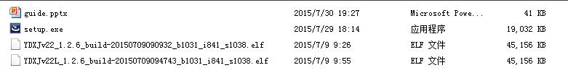
File list
1. setup.exe
update tool
2. YDXJ**.elf
firmware file
note:
Check your camera SN at the battery compartment
Z2215** matches YDXJV22_1.2.6**.elf
Z22L5** matches YDXJV22L_1.2.6**.elf

Slide 3

Installing and Updating
Double click on “setup.exe” and Install the USB tool
It’s named as “yiSportCamUSB”

Slide 4
Preparing the Hardware:
Dismantle the front panel of the camera
Connect the camera USB to PC with a micro USB cable
Use tweezers to short-circuit in two points
> One point above the Resistor
> One point at GND
Press the power button and turn on the camera

Slide 5
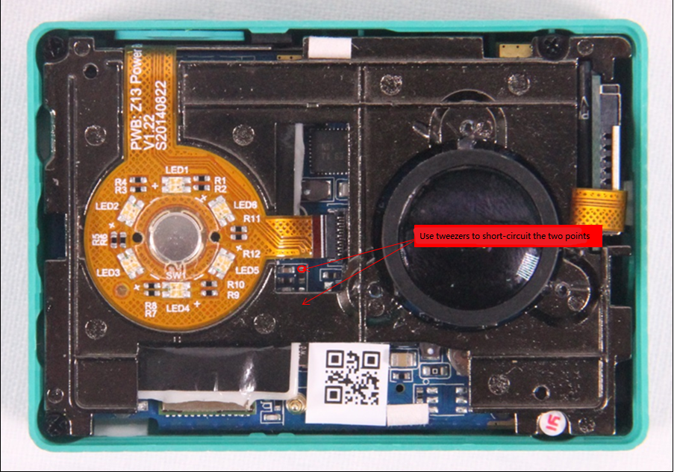
Preparing the Hardware: image

Slide 6
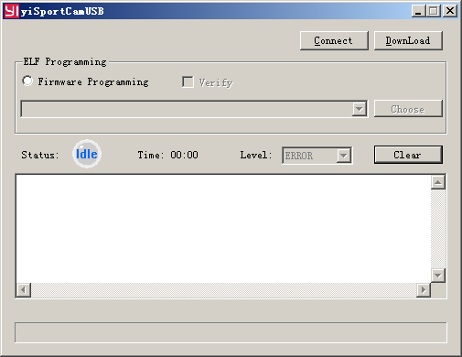
Updating the Firmware
Open yiSportCamUSB

Slide 7
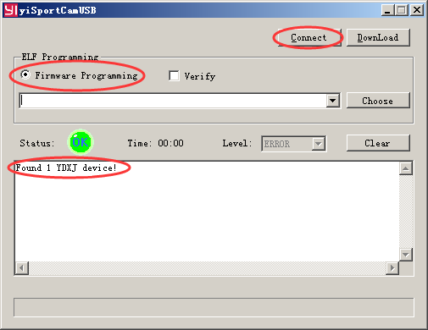
Updating the Firmware
Check “Firmware Programming” radio button
Click on “Connect” button
If the short-circuit is successful, yiSportCamUSB will prompt “Found 1 YDXJ device!”

Slide 8
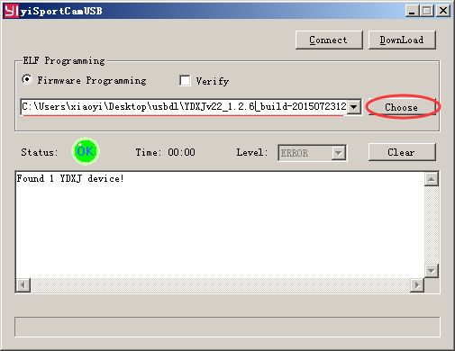
Updating the Firmware
4. Click on “Choose” button and choose the option YDXJV22_1.2.6**.elf

Slide 9
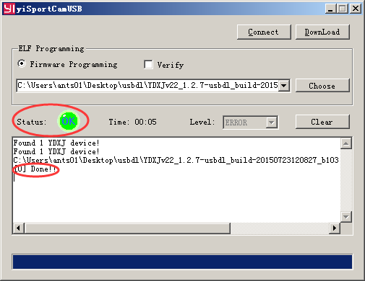
Updating the Firmware
5. Click on “Download” button and update the firmware
The status label will show “OK”, the text will show “Done!!” and
the camera will beep 3 times later.
Now, the upgrade is complete.

