Slide 1
GENAULY · PRODUCT STRATEGY
How We Organize & Filter Learning Content
A plain-language plan for sorting our words, phrases and exercises, now with a Work / Personal / Both mode that reshapes the whole experience around why each learner is here.
Research + recommendation + app mockups · v3 (adds Mode layer)
Written for a non-technical reader. No code knowledge needed.

Slide 2
BEFORE WE START
>
How to read this deck
This deck answers one question:
“As we add more words, phrases and exercises, how do we sort and label them so the app stays easy to use and easy to grow?”
Four plain-English ideas you'll see repeated
• Mode = who you are here as. A big switch: learning for Work, Personal life, or Both. It reshapes everything below it. (NEW in this version.)
• Topics = folders. A tree you browse: Working life → Meetings → Running a meeting.
• Tags = sticky labels. Properties you mix and match: “level B2” + “formal” + “still learning”.
• A filter = a saved search. “Formal B2 office-email phrases I haven't mastered” is just labels combined, not a new folder.
The supermarket analogy we'll use all deck
A good supermarket has aisles (folders) AND labels like “organic” or “under €5” (tags), so you can browse or zero in. Mode is like choosing which half of the store you came for today. Our app has aisles, only one of them, and no mode and no labels yet.

Slide 3
SLIDE 1
1
The big picture, in one minute
The problem:
Every part of the app sorts content by one thing only, a flat list of 11 topics on a single dropdown. No language level is shown anywhere, no sub-topics, no “what's left to learn,” and no sense of whether a learner is here for work or daily life. It works at 11 topics. It breaks at 100.
The fix:
Add a Work / Personal / Both mode on top. Under it, a shallow topic tree (3 levels) plus mix-and-match labels (level, formality, status). In Work mode, unlock richer labels: job sector, workplace situation, who you're speaking to. Show 2 simple filters by default; “Advanced” for the rest.
Today | After this plan
No sense of work vs. personal | A Work / Personal / Both mode set at sign-up
1 dropdown, 11 flat topics | Topics in a tidy tree + mix-and-match labels
No language level shown | Every item shows its level (B1.1 … B2.2)
Work = 10 generic topics | Work mode adds sector, situation & “who you talk to”
Why now
Far cheaper to set this up at 11 topics than to untangle it at 100. The longer we wait, the more items we relabel later.

Slide 4
SLIDE 2 · WHAT OTHER APPS DO (1 OF 3)
2
The big consumer apps
App | How it sorts content | What it teaches us
Duolingo | One fixed path; the app decides, you can't filter | Great momentum, useless if you need Behörde words THIS week
Babbel | Courses by goal; a whole corporate “work German” arm | Asks your goal at sign-up. The work-vs-life split is real and sells.
Busuu | Sorted by language level first, then topic | Level-first is how our learners think. Steal this.
Anki / Memrise | Sticky labels (tags); filter by any mix | Max flexibility, no teaching. Great engine, raw front.
The takeaway
Leaders run from “app decides everything” (Duolingo) to “you control everything” (Anki). Our motivated adults want the middle: smart defaults out of the box, real control when they want it. Babbel already proves asking “why are you here?” at sign-up works, which is exactly our Mode idea.

Slide 5
SLIDE 3 · WHAT OTHER APPS DO (2 OF 3)
3
The serious German + exam world
Source | How it sorts content | What we steal
Lingoda | Strict level grid (A1.1 … C1) | Level is a clear coordinate, not a vague feeling
telc “Beruf” exams | Fields of action + “who you talk to” (boss/colleague/customer) | Two work labels we're missing: situation AND counterpart
German state courses (DeuFöV) | Split by job SECTOR: care, technical, commercial | “Work sector” is how Germany itself organizes job German
The official CEFR scale | Level × situation × formality | The standard already uses several labels at once. So should we.
The takeaway (this is the research backbone for Mode)
Germany's own professional-language system splits work German by sector (care / technical / commercial) and by communication situation. We don't invent our taxonomy, we mirror the framework our learners already study toward. More detail on slide 9.

Slide 6
SLIDE 4 · WHAT OTHER APPS DO (3 OF 3)
4
5 rules of a great system
• Start from why the learner is here. Work, daily life, or both. Set it once, shape everything.
• Mix-and-match labels beat deep folders. An item is “care sector” AND “B2” AND “formal” at once.
• Show the language level. For a B1–B2 app, hiding level is a strategic hole.
• Keep folders shallow. Two or three levels. Deeper and people get lost.
• One system underneath, many views on top. Same labels power browsing, search and review.
Mistakes to avoid (some are in our app today)
• One flat list every part of the app is forced to share (us, today)
• No sense of the learner's goal, so everyone sees the same pile (us, today)
• Each module its own walled-off system (Babbel-style islands)
• Language level missing or an afterthought (us, today)

Slide 7
SLIDE 5 · THE CORE IDEA (1 OF 3)
5
Folders vs. labels
The single most important distinction in this whole deck:
• A folder answers “where does this live?” One home per item. Good for browsing. Bad when something belongs in several places.
• A label answers “what is this like?” Many per item. Good for filtering, search, personalization.
What the learner wants | How we give it
“I'm here for work / for life” | Mode (a lens over everything)
“Show me a map of everything” | Folders (Field → Topic → Sub-topic)
“Narrow to exactly what I want now” | Labels (level, formality, sector…)
“Just pick the next best thing for me” | Labels + what the app knows about you
Our rule
Mode and labels are lenses (properties). Topics are folders (places). Never make “level”, “formal” or “Work” a folder. We'll see on slide 11 why Mode must be a lens, not a wall.

Slide 8
SLIDE 6 · THE CORE IDEA (2 OF 3)
6
Keep each label clean & independent
Each label should be independent of the others.
You can set “level = B2” without it forcing “sector = care” or “formal.” When labels are independent, a handful of them combine into thousands of useful, specific views.
A simple test for whether a label earns its place:
• “Formality” passes. Two B2 care-sector words can differ only in how formal they are. Worth a label.
• “Difficulty” fails. Just another word for “level.” Don't store the same fact twice.
Fixed labels (a short, set list)
Mode, level, formality, word type, sector, exam tag. These power the filter buttons. Keep the list short and stable.
Free labels (open, can grow)
Fine-grained keywords and real-life “can-do” goals. These power search and future AI. Allowed to be messy.

Slide 9
SLIDE 7 · THE CORE IDEA (3 OF 3)
7
How deep should folders go?
Three levels, and stop. Show 5–9 choices at each step, never 30.
Mode sits ABOVE these three as a lens, it does not count as a fourth folder level (more on slide 11).
~5–7 Fields (broadest: “Working life”, “Everyday life”…)
└─ ~6–10 Topics each (our 11 current topics live here)
└─ ~3–6 Sub-topics each (NEW – the missing middle layer)
└─ the actual words, phrases and exercises
Why this shape works
Room for ~160 sub-topics and effectively unlimited items, while never showing a learner more than ~9 choices at once. One rule that saves pain later: never rename a topic's hidden ID, only its display name, so we can re-label freely without breaking the thousands of items pointing at it.

Slide 10
SLIDE 8 · THE MODE LAYER (1 OF 4)
8
The big new idea: Work / Personal / Both
Before a learner sees any topic, they pick a Mode, the single answer to “why am I here?”
It's set with one friendly question at sign-up, shown as a small switch in the header, and changeable anytime. It then reshapes what's emphasized everywhere: topics, goal cards, even which filters appear.
Mode | What it surfaces | Extra labels it unlocks
Beruf (Work) | Work topics + job-relevant daily life | Sector · Situation · Who you talk to · Task type
Privatleben (Personal) | Behörde, housing, health, banking, family | Life area · Life situation
Beides (Both) | Everything, blended | Mode labels become optional / advanced
Why this is powerful
It captures the one thing the app most needs to know and currently ignores: the learner's motivation. A nurse and a new resident sorting out their Anmeldung want very different German. Mode lets the same app serve both without either wading through the other's content.

Slide 11
SLIDE 9 · THE MODE LAYER (2 OF 4)
9
The research says this is how German works
The Mode idea isn't a hunch. It mirrors how Germany's official professional-language system is built.
Real-world source | What it shows | Maps to our…
telc / BAMF framework for work German | 12 “fields of action” PLUS separate “who you talk to” areas (boss, colleague, customer, HR) | Workplace Situation + Counterpart facets
German state courses (DeuFöV) | Funded job-German split by SECTOR: health/care, technical, commercial | Work “Sector” facet
telc has a dedicated “Deutsch Pflege” exam | Care work is its own certified language track | Sector matters enough to certify per-sector
Babbel / Duolingo onboarding | Ask goal upfront (career / travel / personal) | The Mode question itself
Bottom line
Sector, situation and counterpart aren't invented categories. They are the exact axes the German integration and exam system already uses. Mirroring them makes our content instantly recognizable to learners studying for those exams.

Slide 12
SLIDE 10 · THE MODE LAYER (3 OF 4)
10
What “Work mode” unlocks
WORK MODE (picked at sign-up, switchable anytime)
adds these extra labels, on top of the shared ones (level, formality…):
Sector / Branche Care · Trades · Office · IT · Retail · Hospitality
Workplace situation Meeting · Shift handover · Customer call · Conflict
Who you talk to Manager · Colleague · Customer · Your team
Task type E-mail · Phone call · Report · Giving instructions
(Department – advanced) HR · Sales · Production · Service
How the learner uses it (the mockup is on slide 19)
• A nurse picks Sector = Care. Now “handover”, “duty roster”, “medication” surface, not factory or sales words.
• Adds “Who you talk to = Manager.” The app leans formal (Sie), the way that conversation really works.
• Most of these already half-exist. Our 10 work topics ARE workplace situations; we're adding Sector and Counterpart as new cross-cutting labels.

Slide 13
SLIDE 11 · THE MODE LAYER (4 OF 4)
11
The key decision: a lens, not a wall
Should Mode be a hard top folder (everything lives under exactly one mode) or a lens (a setting that emphasizes, but never hides)? We strongly recommend a lens.
Reason: real life overlaps. A doctor's visit is personal; “workplace health” is work. “I see it differently, but…” is useful in both. A hard wall would force us to copy that content into two places. A lens lets one item count for whichever modes fit.
What a lens does
• Sets the default emphasis: topics, goal cards, and which filters show.
• Tags each topic as work / personal / both, and filters on it.
• Persists like your other settings and syncs across devices.
• Switchable in one tap from the header.
What a lens must NOT do
• Never lock content away. In Work mode you can still reach a doctor's-visit phrase.
• Search ignores Mode by default, so nothing is ever truly hidden.
• “Both” shows the union; no content is mode-only.
• It guides, it doesn't gatekeep.

Slide 14
SLIDE 12 · THE FULL DESIGN (1 OF 5)
12
The full set of labels
Label | Plain meaning | Used by
Mode | Work / Personal / Both lens | Everything (sets defaults)
Topic / Sub-topic | Where it lives in the tree | Words, phrases, writing
Level (A1–C2) | How advanced it is | Everything
Sector (work mode) | Care, trades, office, IT… | Vocabulary, phrases
Situation / Counterpart | Workplace scene + who you talk to | Phrases, dialogues
Formality | neutral / formal / diplomatic | All text
Word type · Usefulness · Exam tag | supporting labels | Words, all modules
Good news: this rolls out gradually
Mode, Topic and Level are the foundation; everything else layers on over months without breaking what works. We're mostly formalizing labels the content already half-has, plus the new Sector/Counterpart axes that Work mode introduces.

Slide 15
SLIDE 13 · THE FULL DESIGN (2 OF 5)
13
The “Field” layer under each mode
Inside a mode, topics group under ~6 Fields. As we add banking, doctor visits and housing, a flat list of 20+ topics gets unwieldy.
Field | Mostly shows in | Holds (today + planned)
Working life | Work | meetings, scheduling, customer, conflict, project
Work environment | Work | technology, sustainability, safety, business travel
Everyday life & errands | Personal | Behörde, + banking, housing, shopping (planned)
Health & social | Both | doctor (personal) + workplace health (work)
Exam training | Both | a curated VIEW, not a real folder (next slide)
Notice “Health” sits in Both
That's exactly why Mode is a lens, not a wall (slide 11). A doctor's visit and workplace health share vocabulary; the Field belongs to both modes and surfaces in whichever one you're in. Nothing moves, each topic just gains a parent + a mode tag.

Slide 16
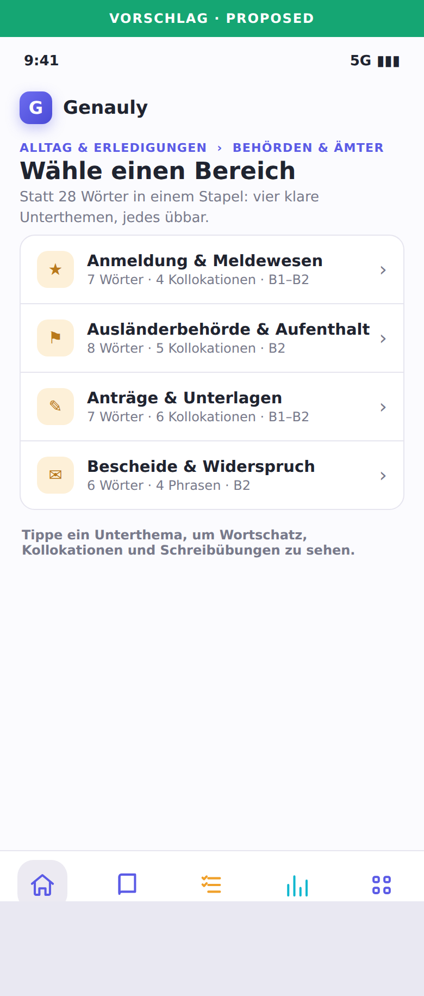
SLIDE 14 · THE FULL DESIGN (3 OF 5)
14
The missing middle: sub-topics
PROPOSED · Behörde sub-topics
Today, tapping “Behörde” dumps 28 words in one pile.
Instead, split each topic into a few clear sub-topics (left). The hints already exist: our “situations” list per topic becomes the sub-topics almost word-for-word.
Why it's the highest-value single change
• Navigable. “I need the appeal-letter words,” not “somewhere in these 28.”
• Smarter coaching. “You're weak on official letters,” not just “on Behörde.”
• Zero-risk rollout. Items with no sub-topic yet just roll up to the topic, like today.

Slide 17
SLIDE 15 · THE FULL DESIGN (4 OF 5)
15
“Exam prep” is a saved search, not a folder
Same principle as Mode: some things are searches, not places. An exam set borrows care-sector words + negotiation phrases + e-mail grammar; it doesn't own them.
The learner wants… | We build it as… | NOT as…
telc B2 Beruf prep | a saved search: exam tag = telc | a folder that copies content
Formal e-mail phrases | “formal” + “request/opinion” labels | a “Formal” topic
Everything at level B2.1 | “level = B2.1” across the app | a “B2” island
My weak spots | “still learning” (from review data) | —
Why it matters
Keeping these as searches (not folders) stops us copying the same word into ten places. That copying is exactly what makes Babbel-style course-islands so hard to maintain.

Slide 18
SLIDE 16 · THE FULL DESIGN (5 OF 5)
16
The whole picture on one screen
MODE ▸ Work | Personal | Both (a lens, set once, switchable)
│ scopes the tree below + turns mode-specific labels on/off
▼
FIELD Working life
├─ TOPIC Meetings & teamwork [B1–B2] ├─ Running a meeting · Making a point
└─ TOPIC Conflict resolution [B2]
FIELD Everyday life & errands
└─ TOPIC Authorities & bureaucracy ├─ Registration · Forms · Official letters
SHARED LABELS: level · formality · word type · usefulness · exam · “still learning”
WORK-ONLY LABELS: sector · workplace situation · who you talk to · task type
One lens on top, three folder levels you can see, and labels you switch on. No fourth folder level.

Slide 19
SEE IT IN ACTION
How the app would look
The next screens are mockups inside Genauly, including the new Mode picker and Work-mode browser. “Proposed” screens are design concepts, not the live app yet.

Slide 20
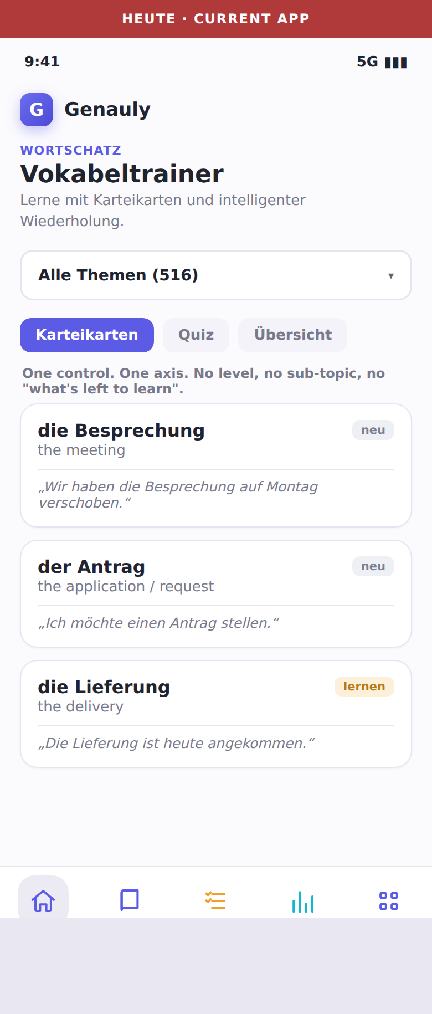
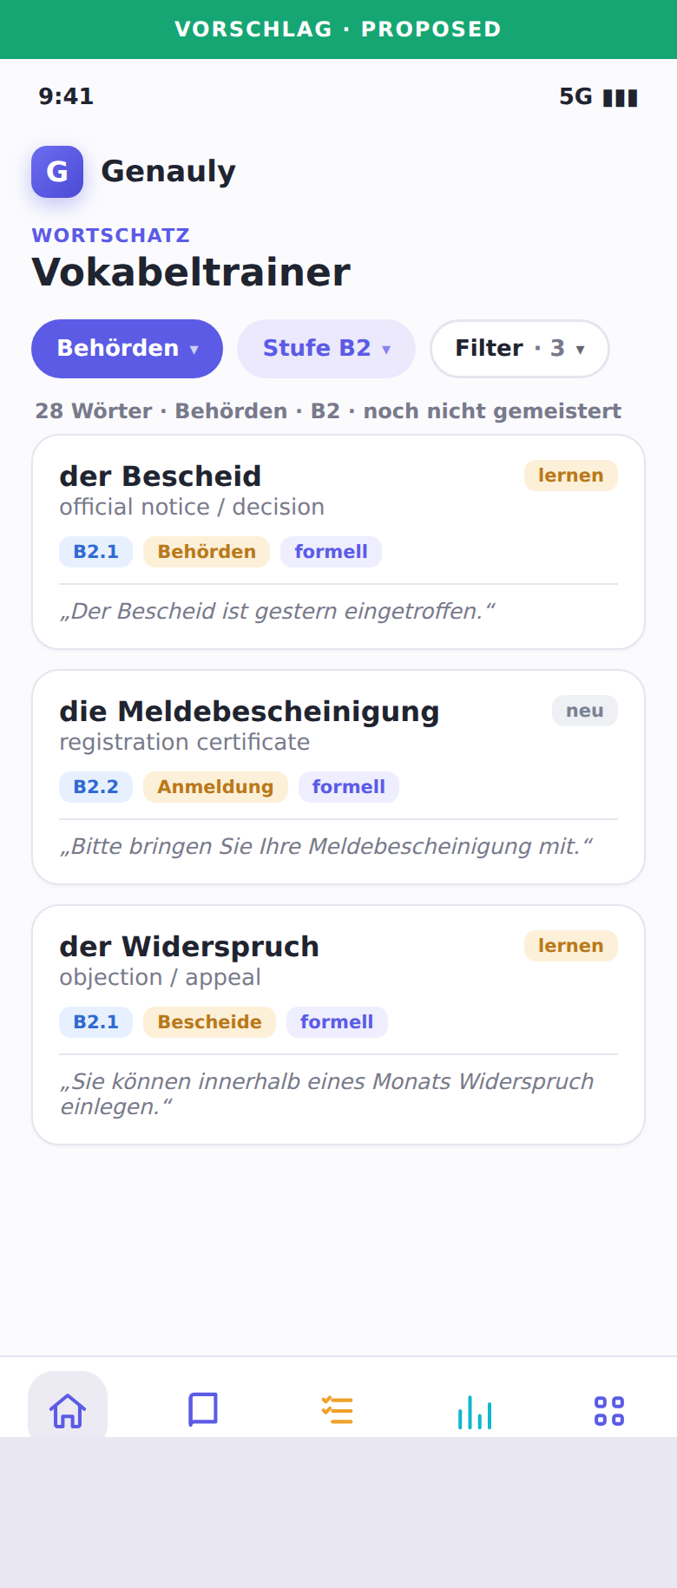
SEE IT IN ACTION (1 OF 8)
17
Before vs. after: the vocabulary screen
TODAY
PROPOSED
What changed
• A real filter bar (Topic · Level · Filter) replaces the dropdown.
• Every word shows its level and formality at a glance.
• A live count tells you what you're looking at.
• “Still learning” status gives practice a target.
Same data, friendlier surface
Nothing about the words changed. We added labels and let the learner filter on them.

Slide 21
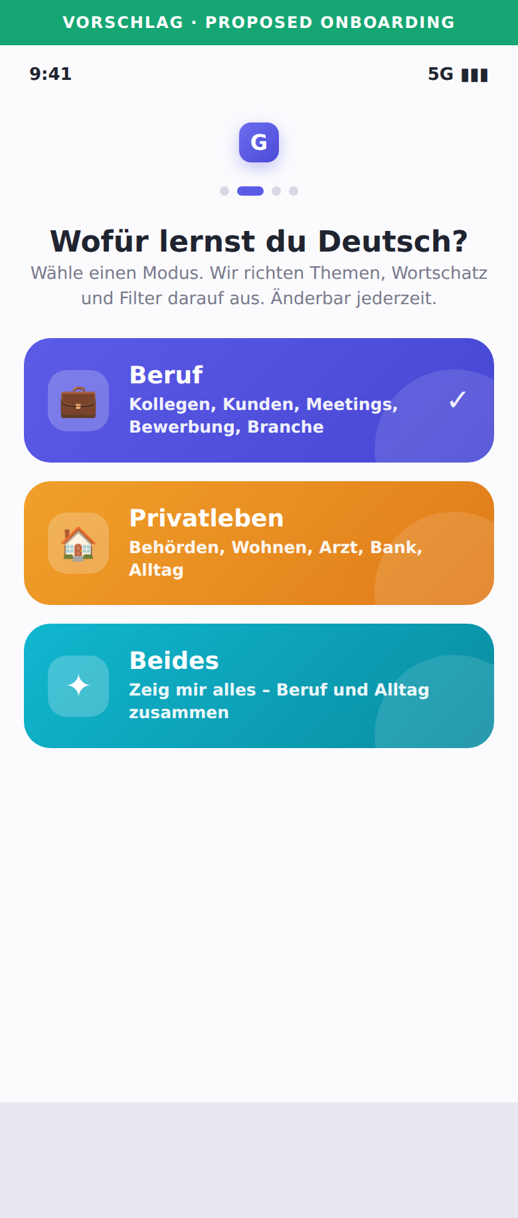
SEE IT IN ACTION (2 OF 8)
18
Sign-up: pick your Mode
PROPOSED · Onboarding
One friendly question sets the whole experience.
“What do you want German for?” Work, Personal life, or Both. That single choice quietly configures topics, goal cards and which filters appear, so the very first screen already feels made for this learner.
• It's one tap, not a long quiz. We refine over time, not all upfront.
• Changeable forever. A small mode switch lives in the header (see next slide).
Why open with this
It's the single most useful thing to know about a learner, and the thing the app ignores today. Babbel and Duolingo both open this way for the same reason.

Slide 22
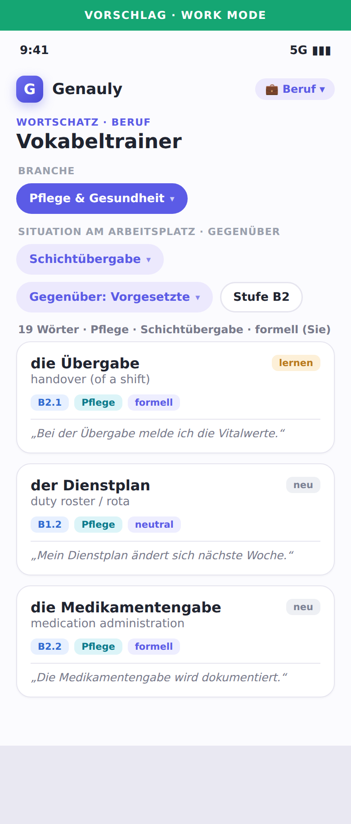
SEE IT IN ACTION (3 OF 8)
19
Work mode: sector, situation, counterpart
PROPOSED · Work mode
This is the payoff of the whole Mode idea.
A care worker has set Mode = Work and Sector = Care. The screen now offers job-specific labels no general app gives: the workplace situation (shift handover) and who they're speaking to (a manager), which sets the right formality automatically.
• The header pill (“Beruf”) is the always-there mode switch.
• Words are real care vocabulary: Übergabe, Dienstplan, Medikamentengabe, each tagged “Care”.
Directly mirrors the German system
“Care sector” + “talking to a supervisor” are exactly the axes telc and the state courses use. This screen is what makes us credible for job-German learners.

Slide 23
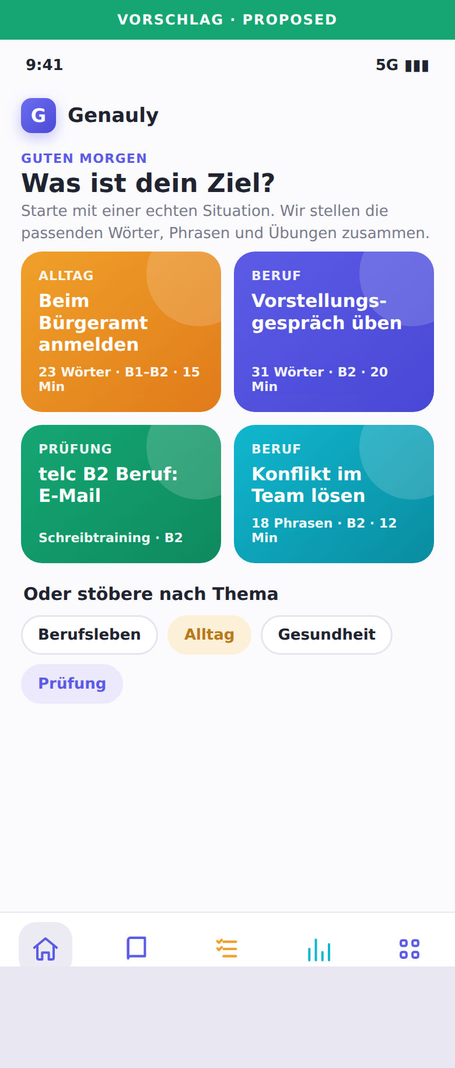
SEE IT IN ACTION (4 OF 8)
20
Start from a goal, not a word list
PROPOSED · Home screen
The home screen leads with real situations, tuned to your Mode.
Tapping a card sets the right labels behind the scenes and drops the learner straight into the matching words, phrases and exercises. Work mode shows work goals; Personal mode shows life goals.
• “Register at the Bürgeramt” → Behörde, B1–B2, 15-min set.
• “Practice a job interview” → work topics, B2, speaking.
Browsing by topic still exists, just below. This is the welcome mat, not the only door.

Slide 24
SEE IT IN ACTION (5 OF 8)
21
Drilling into a topic
PROPOSED · Sub-topic picker
Inside “Authorities & bureaucracy.”
Instead of 28 words in one list, the learner picks a clear sub-topic. Each row shows how much content sits inside and at what level, so there are no surprises.
The same pattern works for every topic, so the app feels consistent as it grows from 11 topics to 50.
Where the sub-topics come from
We already wrote a “situations” list for every topic. Those lines become these sub-topics almost directly, so this is mostly relabeling, not new writing.

Slide 25
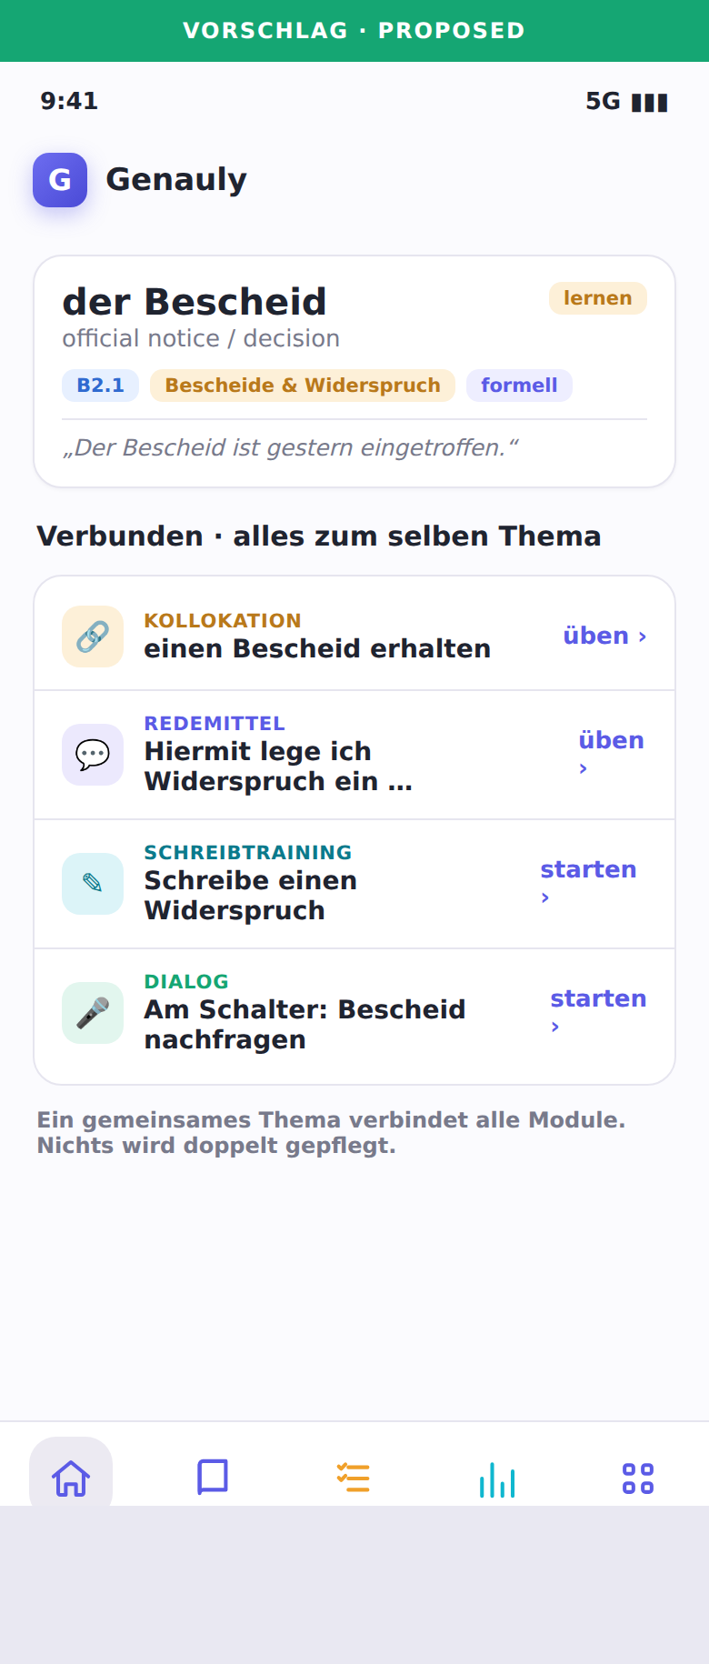
SEE IT IN ACTION (6 OF 8)
22
Everything about a word, in one place
PROPOSED · Word detail
Tap a word, see the whole web around it.
Because every module shares the same topic labels, one word can show its matching collocation, a ready phrase, a writing task and a role-play, all automatically.
• der Bescheid → “einen Bescheid erhalten” (collocation)
• → “Hiermit lege ich Widerspruch ein…” (phrase)
• → “Write an objection letter” (writing task)
The payoff competitors can't copy
Apps with walled-off courses can't link like this. Shared labels turn four modules into one connected learning web.

Slide 26
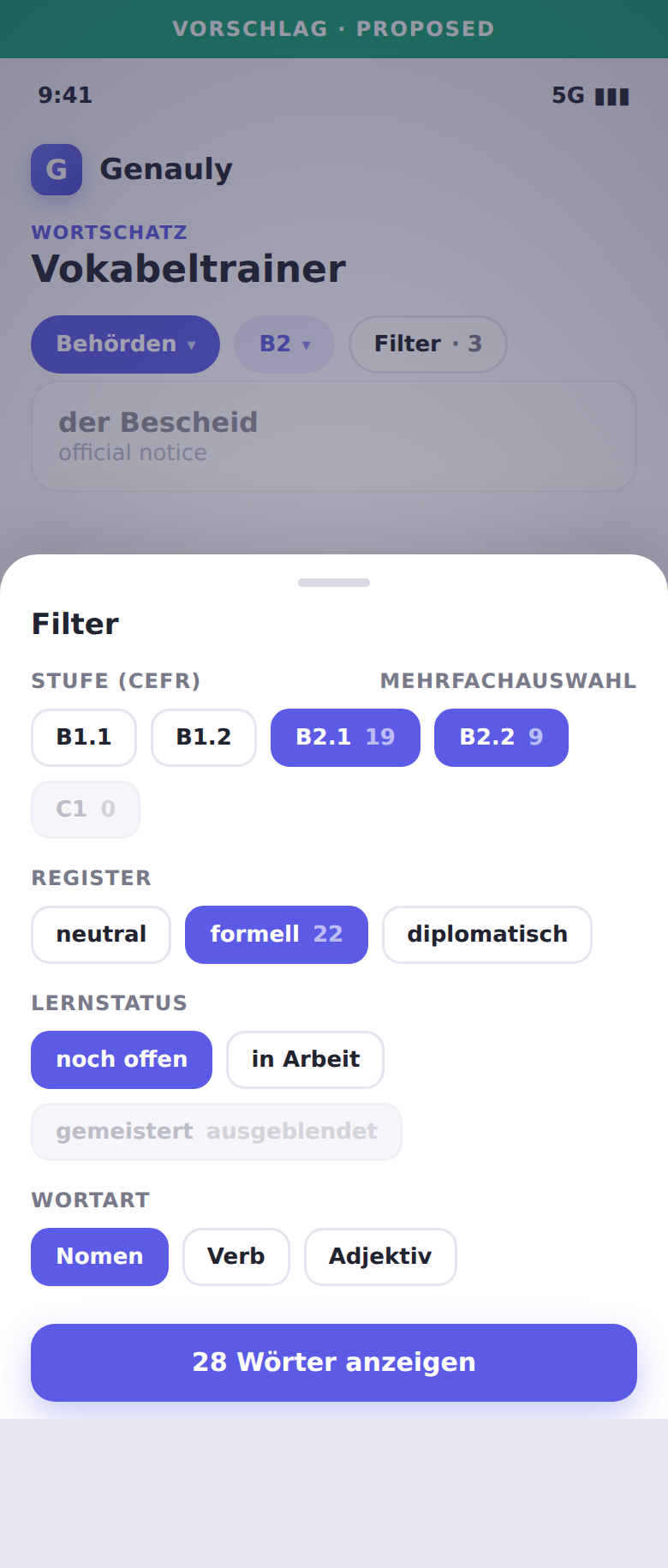
SEE IT IN ACTION (7 OF 8)
23
The “Advanced” filter (for power users)
PROPOSED · Filter sheet
Beginners never see this. Power users love it.
Tapping “Filter” slides up this sheet. Three details make it feel smart, not fiddly:
• Live counts on each option (“B2.1 (19)”).
• Dead ends greyed out (“C1 (0)”), so no empty screens.
• “Hide mastered” turns browsing into focused study.
The golden UX rule
The power must exist, but never in a beginner's face. Two simple filters by default; everything else one tap away.

Slide 27
SEE IT IN ACTION (8 OF 8)
24
The screens together
Pick a Mode
Work mode
Filter & browse
Sub-topics
Connected word
Advanced filter
One consistent design language from sign-up Mode through browsing, drilling, connecting and power-filtering.

Slide 28
SLIDE 25 · HOW FILTERING WORKS (1 OF 4)
25
Layers of filters
Layer | Filters | When shown
Mode (the lens) | Work / Personal / Both | Header switch, set at sign-up
Everyday (always there) | Topic / Sub-topic · Level | Right on the screen
Handy (one tap away) | Sector · Usefulness · Exam tag | Behind “Filter”
Power-user (advanced) | Formality · Word type · Situation · Counterpart · “still learning” | “Advanced” section
Build order, plainly
• First: Mode, Topic, Sub-topic, Level. These answer most of what people want.
• Second: Sector, Exam tag, Usefulness, Formality.
• Last (mostly automatic): Word type, Counterpart, and “still learning” (powers daily review).
The one to highlight
“Still learning” turns a word list into a study tool: hide what you've mastered, drill what's due. Most learners never toggle it by hand, but it drives the daily review under the hood.

Slide 29
SLIDE 26 · HOW FILTERING WORKS (2 OF 4)
26
What makes filtering feel smart
• Different labels narrow down. “Care” + “B2” + “formal” shows only items that are all three.
• Same label widens. Ticking both “B1” and “B2” shows either (a range).
• Always show counts. Every option says how many items it'll show, and impossible ones are greyed out. This one detail is the difference between guided and frustrating.
• Never a blank screen. If a combination has nothing, show “Nothing here yet. Nearest: 8 items at B2.2.”
A quiet bonus: shareable links
Each filtered view lives in its web address, so “formal B2 care-sector words” becomes a bookmarkable link, and the writing coach can deep-link straight to the right practice. Empty combinations also double as our content to-do list: they show exactly what to write next.

Slide 30
SLIDE 27 · HOW FILTERING WORKS (3 OF 4)
27
Same filters, sized to the screen
Where | What it looks like
On a phone | Mode switch in the header; filter chips below; “More” opens a slide-up sheet
On a desktop | A filter column down the left with checkboxes and counts
Search box | Type anything; searches keywords and goals; ignores Mode so nothing is hidden
Goal cards | Dashboard starting points that pre-set a bundle of filters, tuned to your Mode
The principle that ties it together: show complexity gradually
A first-timer sees their Mode, two filters and a goal card. A power user opens “Advanced” and slices by sector, counterpart and progress. Same underlying data, complexity revealed only as the learner asks for it.

Slide 31
SLIDE 28 · HOW FILTERING WORKS (4 OF 4)
28
The filters that know YOU
The most powerful filters aren't about the content, they're about your relationship to it. The app already tracks these; today it just doesn't let you filter on them.
Personal filter | Powers
Your Mode + sector | “Only show me care-sector work German”
Mastered / learning / new | “Hide what I know”, “drill my weak ones”
Due for review today | The daily review queue
Your weak grammar areas | “Practice your cases” shortcuts from the writing coach
This is where it pays off for AI
Once content wears clean labels (including Mode and sector), an adaptive engine can build a session as a simple search: “12 items due, care-sector, leaning on the supervisor-formal phrases you keep missing.” Without labels the engine is blind. With them, smart personalization is just filtering with good defaults.

Slide 32
SLIDE 29 · ACROSS THE 4 MODULES
29
One backbone, a few module-specific labels
Should all four modules share one system? Mostly yes, a shared backbone, plus the label each module uniquely needs. Mode and Level apply to all.
Label | Vocabulary | Collocations | Redemittel (phrases) | Writing
Mode / Topic / Level | yes | yes | yes | yes
Sector (work mode) | main hook | yes | secondary | yes
Formality | yes | yes (has it) | yes (has it) | yes (target)
Counterpart / Function | — | — | MAIN (has function) | yes
Word type | yes | — | — | —
Exam tag | yes | yes | yes | MAIN (task type)
The key insight
Phrases (Redemittel) are best sorted by what they're FOR (agree, negotiate) and who they're for (boss vs. peer), not by topic, and our code already does the “function” half. Don't force them under topics; add Mode, topic and counterpart as extra labels. Respect each module's natural primary label; share everything else.

Slide 33
SLIDE 30 · ACROSS THE 4 MODULES
30
What to lock down vs. let vary
Lock down (one shared definition)
• Mode – one Work/Personal/Both lens every module honors.
• The topic tree – one master list every module points at. This links words to phrases to writing.
• The level scale – one A1–C2 ladder used everywhere. (Today the quiz uses a private 1-2-3; fold it in.)
• Formality & Sector – one shared list each, so a “formal care-sector” filter means the same everywhere.
Let vary (each module's own)
• Each module's MAIN sorting label – topic for words, function/counterpart for phrases, task type for writing.
• Labels only that module needs – word type for vocabulary, task type for writing.
Rule of thumb: lock it down the moment a learner might filter across modules on it (Mode, level, topic, formality, sector, exam). Keep it private only if meaningless elsewhere.
Highest-leverage cleanup
“Level” is invisible today and the quiz secretly uses its own 1-2-3 scale. Merging onto one real level scale, and adding Mode, are the two foundational moves the whole plan rests on.

Slide 34
SLIDE 31 · HONEST TRADEOFFS
31
What could go wrong, and the answer
Risk | How real | Our answer
Mode could wall content off / annoy “Both” users | High | Mode is a lens, never a wall (slide 11); search ignores it; one-tap switch
“Sector” has almost no content yet | High (fair) | Ship 2–3 real sectors (e.g. care, office) we'll actually build; don't show empty ones
Re-labeling ~660 items is work | Medium | Every label optional + rolls up; back-fill topic-by-topic; AI drafts, human checks
Deciding a word's level / sector is subjective | Medium | Draft → verify workflow we already use; lean on telc / DeuFöV word lists
Too many filters overwhelm beginners | High | Mode + 2 filters by default; rest behind “Advanced”; counts + no empty screens
The honest summary
Mode adds real value but also the biggest risk: walling people in, or shipping empty sector filters. Both are avoided by treating Mode as guidance, not gatekeeping, and by only exposing sectors we have content for.

Slide 35
SLIDE 32 · THE RECOMMENDATION
32
Decisions to make + roadmap
Quick decisions (my defaults in bold; all reversible)
• Add a Work / Personal / Both Mode at sign-up — YES
• Mode is a lens, not a hard folder — YES
• First sectors to support → Care + Office (where content will go)
• Level detail → sub-levels B1.1…B2.2
• Sub-topics → optional, roll up by default
• Phrases stay sorted by function/counterpart, not topic
Rollout in 5 phases
0 · Set up the tree + level field + Mode tag (mostly invisible)
1 · Mode picker at sign-up + Level filter ← first visible win
2 · Sub-topics for the busiest topics
3 · Work-mode facets (sector, situation, counterpart) + goal cards
4 · Cross-module links + smart, mode-aware review
What success looks like
A care worker picks Work + Care and sees only relevant German; a new resident picks Personal and gets Behörde, housing and banking. Anyone can ask for “formal B2 care-sector phrases I haven't mastered” in a few taps and get a correct, non-empty result. Adding a new sector or life area becomes filling a template, not redesigning the app.
Bottom line
Mode answers “why am I here?”; the shallow tree answers “where is it?”; the labels answer “what is it like?”. Together they keep the app simple for a beginner and powerful enough for a nurse prepping a sector exam, while staying cheap to grow. Build the Mode + backbone now, while it's small.

Slide 36
REFERENCES
33
Sources & research
PRIMARY — German professional-language framework & exams
1 telc Deutsch B1·B2 Beruf — exam overview
https://www.telc.net/en/language-examinations/certificate-exams/german/telc-german-b1b2-business/
2 telc Deutsch-Test für den Beruf B2
https://www.telc.net/en/language-examinations/certificate-exams/german/german-for-business/german-for-business-b2/
3 telc Rahmencurriculum & Handbuch Deutsch Pflege B1·B2 (PDF)
https://shop.telc.net/media/catalog/product/file/5036B01010201bib.pdf
4 BAMF — Berufssprachkurse / DeuFöV (overview)
https://www.bamf.de/DE/Themen/Integration/ZugewanderteTeilnehmende/DeutschBeruf/deutsch-beruf.html
PRIMARY (cont.) — sector & curriculum detail
5 BAMF — Berufssprachkurse Anerkennung Gesundheitswesen (Pflege)
https://www.bamf.de/DE/Themen/Integration/ZugewanderteTeilnehmende/AnerkennungsBSK/anerkennungsbsk-node.html
6 BAMF — Konzept „Gesundheitsfachberufe“ (PDF)
https://www.bamf.de/SharedDocs/Anlagen/DE/Integration/Berufsbezsprachf-ESF-BAMF/BSK-Konzepte/konzept-nichtakademische-gesundheitsberufe.pdf
7 BAMF — Lernzielkatalog Spezial-/Basisberufssprachkurse (PDF)
https://www.bamf.de/SharedDocs/Anlagen/DE/Integration/Berufsbezsprachf-ESF-BAMF/BSK-Konzepte/lernzielkatalog-spezial-und-basisberufssprachkurse.pdf
8 Council of Europe — CEFR (official framework)
https://www.coe.int/en/web/common-european-framework-reference-languages

Slide 37
REFERENCES
34
App benchmarks & a note on sourcing
SECONDARY — language-app benchmarks (goal/use-case segmentation)
9 Babbel — comparison of best language-learning apps (goal-based)
https://www.babbel.com/compare-best-language-learning-apps
10 Babbel — apps for travelers / digital nomads (use-case framing)
https://www.babbel.com/best-language-learning-apps-for-digital-nomads
Honesty note on sourcing (so you can weigh the claims)
• The German-framework and exam claims (Mode, sector, situation, counterpart) are grounded in the primary sources 1–8 above. These are the load-bearing research claims and they hold.
• The structural descriptions of Duolingo, Busuu, Lingoda and Anki / Memrise (slides 2–3) come from general, current product familiarity, not a single cited page each. They are accurate at a high level but are not citation-grade; treat them as informed characterization.
• Everything about Genauly's current state is verified directly against the codebase, not the web.

