Slide 1

PROJECT TITLE
Smart Attendance System Using Face Recognition
SHRI RAMDEOBABA COLLEGE OF ENGINEERING AND MANAGEMENT
Team Members: Om Wankhede, Tanmay
Mundada
Guide: Prof. Poonam Meghare
Department of Computer Science and
Engineering, Shri Ramdeobaba College of
Engineering and Management, Nagpur
Academic Year: 2026-27
MINOR PROJECT
COURSE
CODE

Slide 2
PROBLEM STATEMENT
Manual attendance systems are time-consuming, prone to human error, and difficult to manage efficiently in classrooms and institutions.
Key Problems
Time-consuming process: Calling out names or signing registers consumes valuable class time.
Human errors: Manual records may contain incorrect entries, duplicate records, or missing attendance.
Proxy attendance: It is difficult to verify whether the actual student is present.
Difficult record management: Maintaining, searching, and updating attendance records manually is cumbersome.
Limited security: Repeated failed recognition attempts need a warning mechanism to discourage unauthorized access.
Need: A smart, face-recognition-based attendance system that automates attendance recording, provides security warnings, and enables centralized record management through an admin panel.

Slide 3
EXISTING SOLUTION / LITERATURE REVIEW
1. Traditional Manual Attendance
Attendance is recorded using registers or roll calls.
Simple to implement but time-consuming and prone to human error.
2. RFID / Smart Card-Based Systems
Students mark attendance using ID cards.
Faster than manual methods, but cards can be shared or misplaced.
3. Fingerprint-Based Attendance
Uses biometric verification to identify students.
Requires physical contact and dedicated scanning hardware.
Research Gap / Motivation
A simple, low-cost desktop solution is needed to combine face recognition, automatic attendance recording, failed-attempt warnings, and an admin panel for managing records.

Slide 4
PROPOSED SOLUTION
Develop a smart attendance system that identifies students through facial recognition
Capture live video through a webcam and detect human faces using OpenCV
Compare detected facial features with the stored student dataset
When a match is found, automatically record the student's name, roll number,
date and time
Store attendance in a database and provide daily/monthly reports
Innovation: contactless, automated and real-time attendance with reduced manual effort

Slide 5
OBJECTIVES
Automate attendance marking — mark
attendance without manual intervention
Eliminate proxy attendance — identify students through facial recognition
Maintain accurate records — store
attendance with date and time
Generate reports — provide attendance
percentage and daily/monthly reports

Slide 6
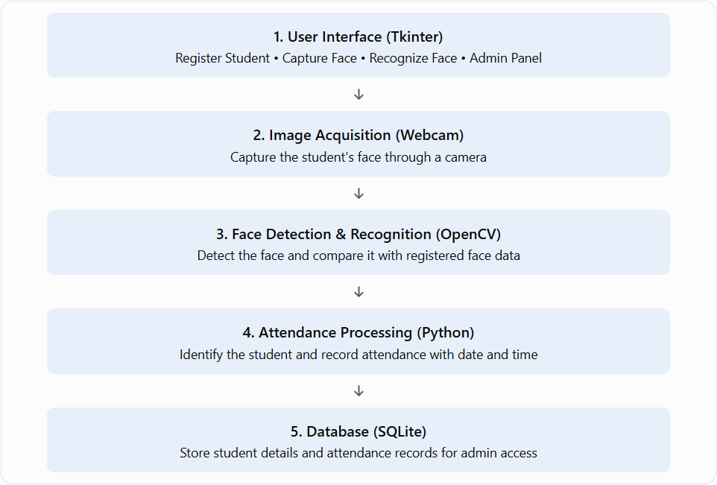
SYSTEM ARCHITECTURE / METHODOLOGY

Slide 7
IMPLEMENTATION
1. Development Environment
Programming language: Python
IDE: Visual Studio Code
Libraries: OpenCV, NumPy, Tkinter
Database: SQLite
2. Module Implementation
Student Registration: Enter and store student details.
Face Capture: Capture facial images using a webcam.
Face Detection: Detect faces using the Haar Cascade classifier.
Face Recognition: Identify registered students using the implemented recognition logic.
Attendance Management: Store attendance records with date and time in the SQLite database.
Admin Panel: Access student and attendance records through a password-protected interface.

Slide 8
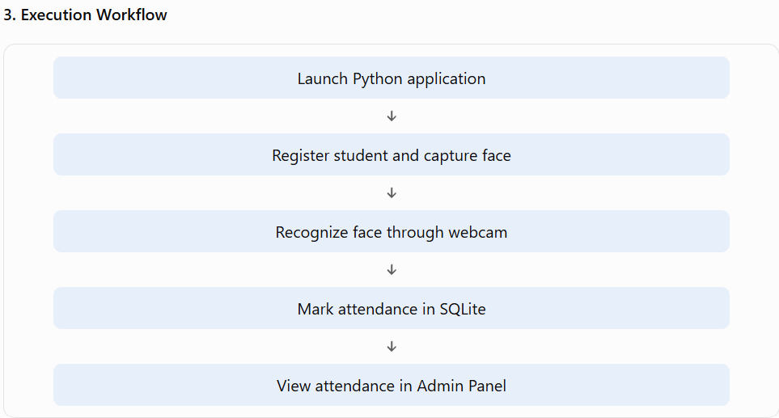
IMPLEMENTATION
4. Testing
Verified application startup and GUI navigation.
Tested student registration and face capture.
Checked face recognition and attendance recording.

Slide 9

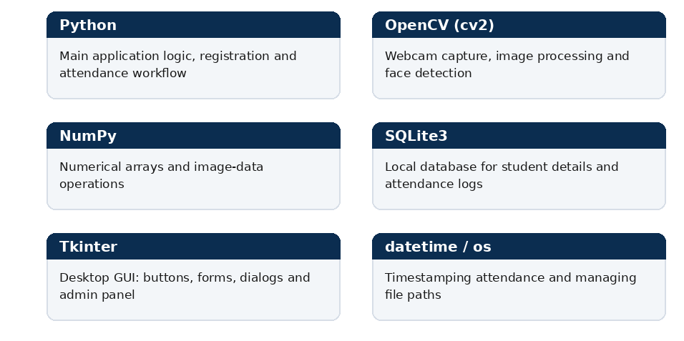

Slide 10

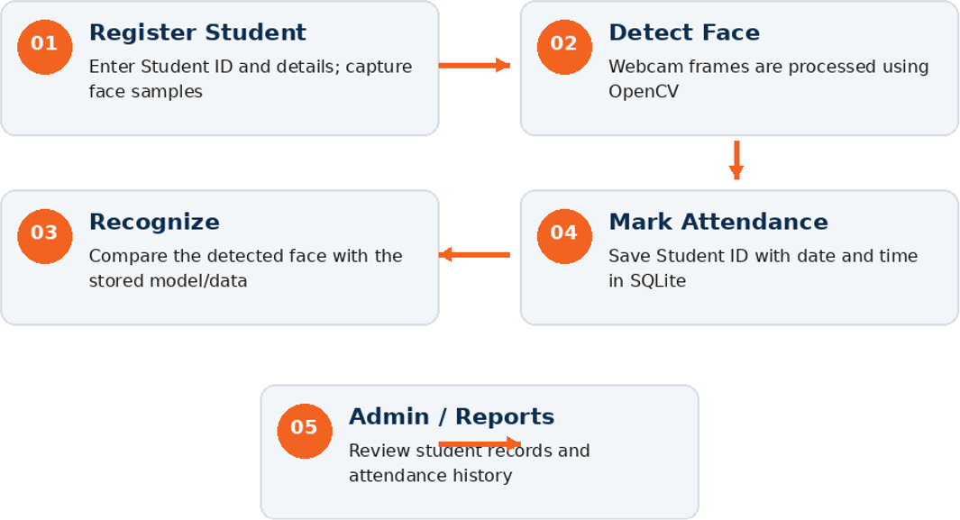

Slide 11

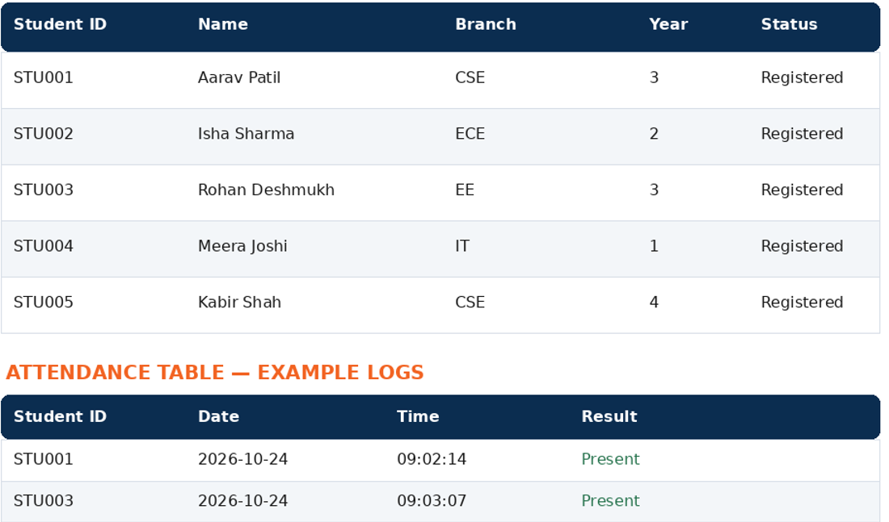

Slide 12
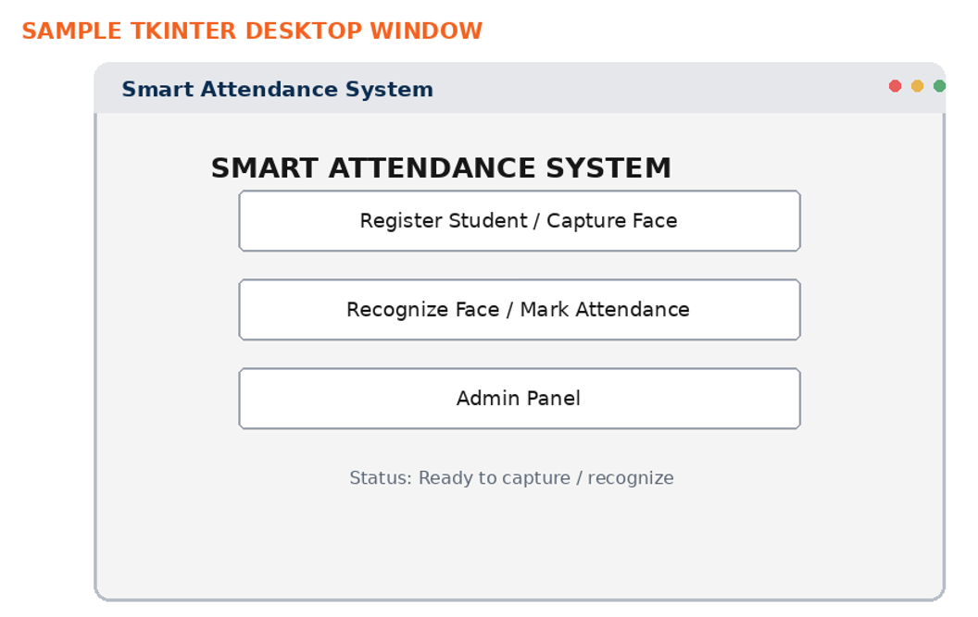

Slide 13
RESULTS / PROTOTYPE
1. Prototype Overview
Developed a desktop-based Smart Attendance System using Python.
Created a graphical user interface using Tkinter.
Integrated webcam-based face detection using OpenCV.
Connected an SQLite database to store student and attendance records.
2. Key Results
Student registration and face capture interface.
Face recognition interface for identifying registered students.
Attendance records stored with date and time.
Admin panel for managing and viewing attendance records.
Reduced the need for manual attendance entry.

Slide 14
INNOVATION, IMPACT, DELIVERABLES & FUTURE SCOPE
Innovation: combines computer vision, face recognition and database-based attendance in one automated workflow
Impact: reduces manual work, paperwork and attendance errors while improving classroom management
Deliverables: face dataset, trained model/encodings, attendance database, GUI
and automated reports
Applications: colleges, universities, corporate offices, government institutions, hospitals and training centers
Future scope: cloud-based attendance, mobile application, RFID + face recognition,
real-time dashboard and ERP integration

Slide 15
CONCLUSION & REFERENCES
Conclusion: The Smart Attendance System provides an efficient, secure and
automated approach to attendance management
Facial recognition minimizes manual effort and helps prevent proxy attendance
The system maintains accurate records and supports automatic attendance reporting
Technologies: Python, OpenCV, Face Recognition, NumPy, Pandas, SQLite/MySQL
and Tkinter
References: Project Synopsis — Smart Attendance System Using Face Recognition;
OpenCV and face-recognition technology documentation; Python ecosystem
documentation

