Slide 1
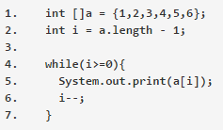
What is the result?
123456
An exception could be thrown at runtime
654321
Nothing
65432
12345

Slide 2
What is the result?
123456
An exception could be thrown at runtime
654321
Nothing
65432
12345

Slide 3
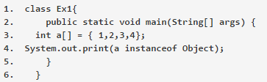
What is the output?
false
true

Slide 4
What is the output?
false
true

Slide 5
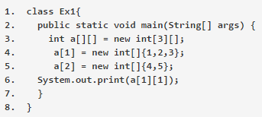
What is the output?
2
3
5

Slide 6
What is the output?
2
3
5

Slide 7
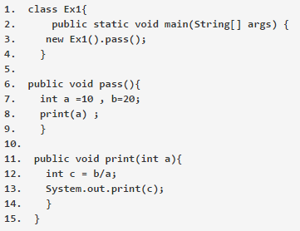
What is the result?
2
0
Compilation fails due to an error on line 12

Slide 8
What is the result?
2
0
Compilation fails due to an error on line 12

Slide 9
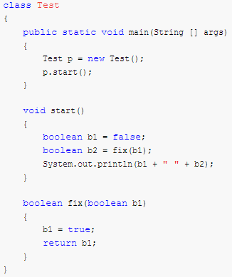
What is the output?
true true
false true
true false
false false

Slide 10
What is the output?
true true
false true
true false
false false

Slide 11
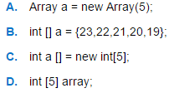
Which of the following will declare an array and initialize it with five numbers?

Slide 12
Which of the following will declare an array and initialize it with five numbers?

Slide 13
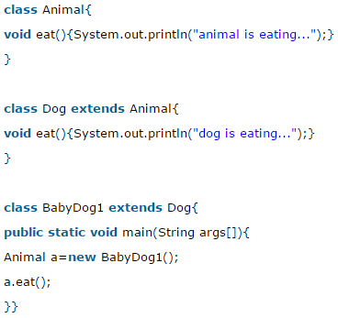
What is the output?
animal is eating…
dog is eating…
Nothing because BabyDog1 does not have an eat() method

Slide 14
What is the output?
animal is eating…
dog is eating…
Nothing because BabyDog1 does not have an eat() method

Slide 15
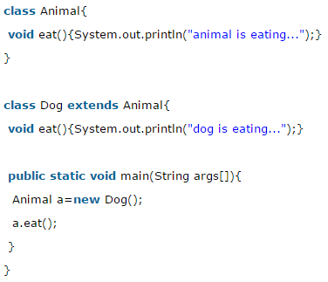
What is the output?
animal is eating…
dog is eating…
Nothing because reference Animal can’t store a Dog object

Slide 16
What is the output?
animal is eating…
dog is eating…
Nothing because reference Animal can’t store a Dog object

Slide 17
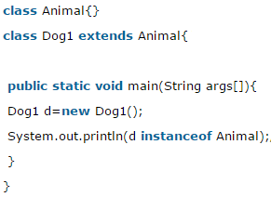
What is the output?
true
false

Slide 18
What is the output?
true
false

Slide 19
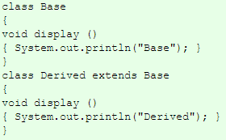


What is the output?
Base Derived Base
Derived Derived Derived
Base Derived Derived
Base Base Derived

Slide 20
What is the output?
Base Derived Base
Derived Derived Derived
Base Derived Derived
Base Base Derived

Slide 21


What is the output?
TRICKY!
10 20 20
20 20 10
20 10 10
10 20 10

Slide 22
What is the output?
TRICKY!
10 20 20
20 20 10
20 10 10
10 20 10
In Java, data members are not polymorphic, therefore you cannot override instance variables. When an instance variable in a subclass has the same name as an instance variable in a super class, then the instance variable is chosen in the class that is the reference type.
bd has a reference type of Base but an object of Derived

