Slide 1
A QUESTION ABOUT TEENAGERS & TECHNOLOGY
Can everyday habits reveal
how much an adolescent uses
their phone?
An investigation of 3,000 adolescents
PRACTICUM PRESENTATION
Notes:
Imagine two teenagers. You know how much they sleep, how often they check their phones, and how they are doing in school. Could you tell which one spends more time on their phone? That is the question I set out to investigate. I expected to find some useful patterns. What I discovered was more complicated.

Slide 2
WHY IT MATTERS
We often make assumptions about screen time
Parents and educators see habits—but not always the full picture.
Sleep
School
Daily habits
Does a different sleep schedule suggest heavier use?
Can academic performance tell us anything?
Do phone checks and activities reveal usage levels?
ADOLESCENT SMARTPHONE USE • PRACTICUM
02 / 09
Notes:
Screen time comes up in conversations among families, schools, and people who work with teenagers. We may assume that a teen who checks their phone constantly, sleeps less, or struggles in school is also a heavy phone user. But are those assumptions supported by the information we have? Understanding that matters before we make decisions or give advice.

Slide 3
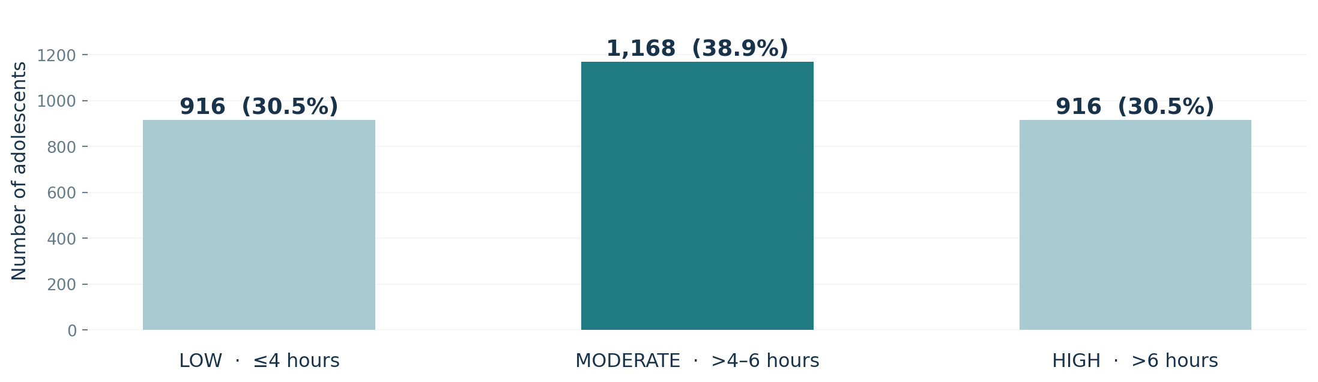
THE INVESTIGATION
3,000 teens. Three usage groups.
Daily smartphone hours were used only to define the groups—not to predict them.
Groups created for this study; these are not health recommendations.
ADOLESCENT SMARTPHONE USE • PRACTICUM
03 / 09
Notes:
I worked with a dataset of 3,000 adolescent records. To compare usage patterns, I divided them into three groups: four hours or less, more than four through six hours, and more than six hours a day. The groups were fairly balanced. These boundaries are choices made for this study, not official recommendations for healthy screen time.

Slide 4
HOW I APPROACHED IT
Can a Computer Learn to Recognize Smart-phone Patterns
Could other information help us recognize each group?
PHONE HABITS
LIFESTYLE
Checking frequency, apps, activities
Sleep, exercise, social interactions
SCHOOL & FAMILY
BACKGROUND
Performance, communication, parental controls
Age, gender, school grade
I compared three approaches and tested them on teenagers not used to develop them.
ADOLESCENT SMARTPHONE USE • PRACTICUM
04 / 09
Notes:
Instead of using daily screen time to predict itself, I set that measure aside and examined other information: phone-checking frequency, time spent on activities, sleep, exercise, school performance, family relationships, and demographics. I tried three different ways of looking for patterns. I developed each approach using most of the records and then checked how well it worked on 600 records set aside for testing.

Slide 5
THE SURPRISE
The best approach was right only 37% of the time
It did not beat a very simple alternative.
BEST APPROACH
SIMPLE GUESS
37%
39%
Correctly identified usage group
Always choose the largest group
ADOLESCENT SMARTPHONE USE • PRACTICUM
05 / 09
Notes:
Here was the surprising result. The best of the three approaches correctly identified a teenager’s usage group about 37 percent of the time. To put that into perspective, simply calling everyone a moderate user would be correct about 39 percent of the time, because moderate users were the largest group. So the more complicated approach did not even improve on that simple guess in overall accuracy. That is an important result, not something to hide.

Slide 6
WHERE IT STRUGGLED
The middle group was easier to recognize
Low and high users were usually mistaken for moderate users.
LOW
19%
MODERATE
64%
HIGH
19%
Percent of each group correctly identified
ADOLESCENT SMARTPHONE USE • PRACTICUM
06 / 09
Notes:
When I looked at the errors, a clear pattern emerged. About 65 percent of moderate users were identified correctly, but only about 19 percent of low users and 19 percent of high users. The approach tended to label teenagers as moderate users even when they belonged in the low or high group. That means it was especially poor at distinguishing the extremes the groups we might most want to understand.

Slide 7
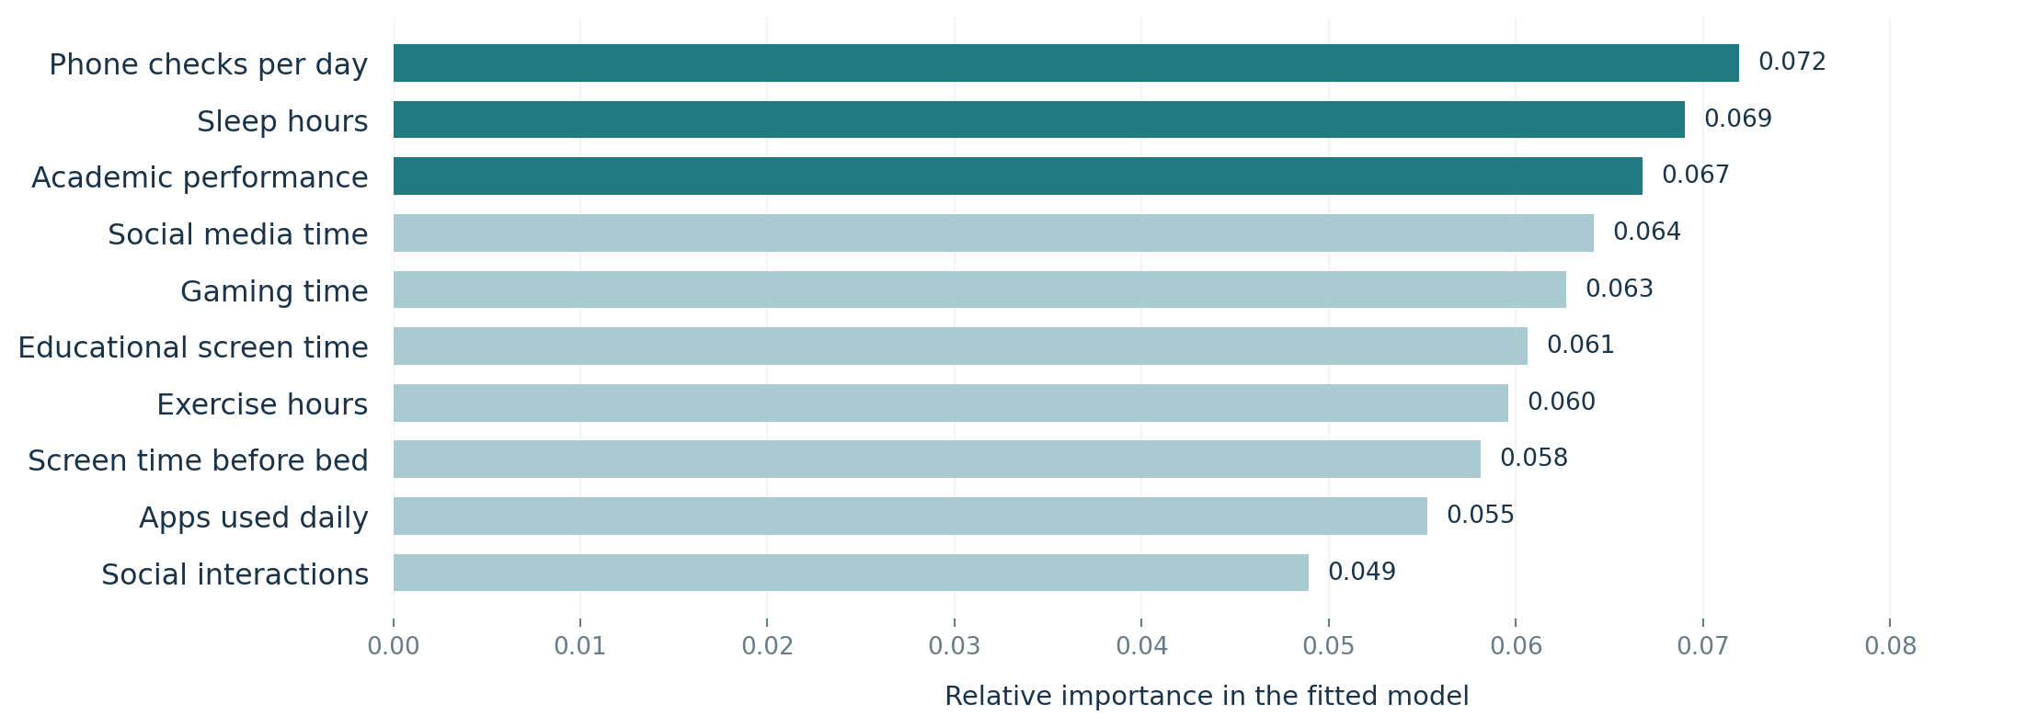
WHAT STOOD OUT
Which everyday characteristics stood out?
But none was a dependable way to identify usage levels.
Rankings describe what the approach relied on—not reliable predictions or causes.
ADOLESCENT SMARTPHONE USE • PRACTICUM
07 / 09
Notes:
I also examined which characteristics the best approach relied on most. Phone-checking frequency ranked first, followed closely by sleep hours and academic performance. Time spent on social media and gaming also appeared near the top. But the differences between these rankings were small, and the overall predictions were weak. So these are clues about what the approach. Not proof that these habits cause heavy phone use or reliably reveal it.

Slide 8
WHAT WE SHOULD DO
Ask better questions—not make faster assumptions
The findings point toward more careful measurement and interpretation.
1
2
3
Avoid labels
Measure consistently
Explore context
Do not infer a teen’s usage level from one habit.
Clarify how daily use and specific activities are recorded.
Ask when, why, and how devices are used.
Limitations: one dataset, study-defined groups, and unclear relationships between some usage measures.
ADOLESCENT SMARTPHONE USE • PRACTICUM
08 / 09
Notes:
What does this mean for parents, educators, or youth-serving professionals? First, we should avoid judging how much a teen uses their phone based on a single behavior, such as sleep or grades. Second, we need consistent definitions and measures: in this dataset, the reported time spent on three specific activities was almost unrelated to reported daily phone hours. That raises a question about measurement, although it does not tell us the cause. Third, future work should consider what teens do on their phones, when they use them, and why. This study has limitations, including its particular dataset and the group boundaries I chose.

Slide 9
THE TAKEAWAY
A teenager’s habits
don’t tell the whole story.
In this dataset, everyday characteristics could not reliably distinguish low, moderate, and high smartphone use.
Thank you
Notes:
So let me return to the question I began with: if you knew a teenager’s everyday habits, could you tell how much they use their phone? Based on these data, not reliably. The bigger lesson is that assumptions about screen time need to be tested and sometimes the most useful result is learning what the available information cannot tell us. Thank you.

