Slide 1
Netflix Dataset — Matplotlib Visualizations
By: Logan Martin

Slide 2
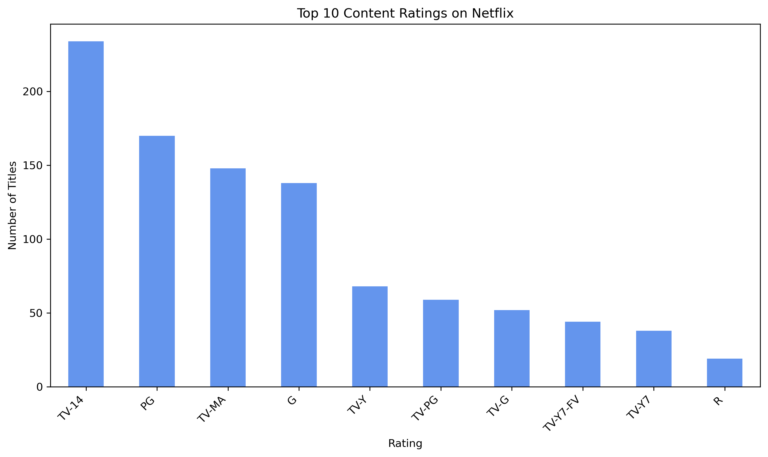
The dominate number of TV ratings are TV-14 / PG
Skew suggests broad, general-audience programming.
Useful for targeting content strategy and marketing.
Notes:
This bar chart ranks the most common content ratings in the sample. The concentration in a few TV categories indicates Netflix’s catalog is oriented toward broad audience appeal rather than niche extremes. The long tail shows diversity, but in smaller volumes. This matters for programming decisions. If most inventory is TV-14/TV-PG, recommendations and promotions should meet those audience expectations. It’s important to note that “rating” reflects guidelines for suitability, not quality. Also, this sample includes 1,000 titles, and ratings are present for all rows, so the distribution reflects the dataset without missing data in this field.

Slide 3
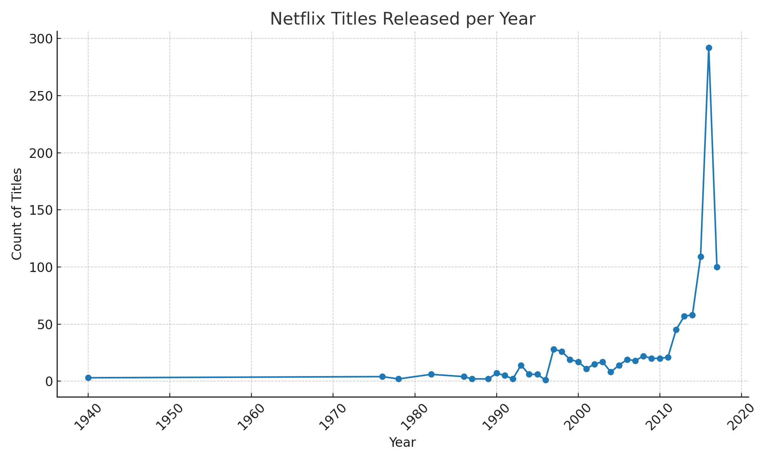
Clear year-to-year variability in volume
Visible peak periods of releases
Catalog growth is not linear over time
“Release year” ≠ “date added to Netflix.”
Notes:
This line chart counts titles by their original release year, not when they appeared on Netflix. We see distinct peaks, which suggests waves of content acquisition and production tied to strategy, licensing windows, or industry cycles. The trend helps explain catalog age and more recent peaks imply a younger library in some segments. Because this is “release year,” a dip may reflect fewer titles released industry-wide or gaps in what Netflix acquired for this sample. Practical takeaway: timing matters. Volume alone doesn’t describe user experience unless paired with when content actually hits the platform.

Slide 4
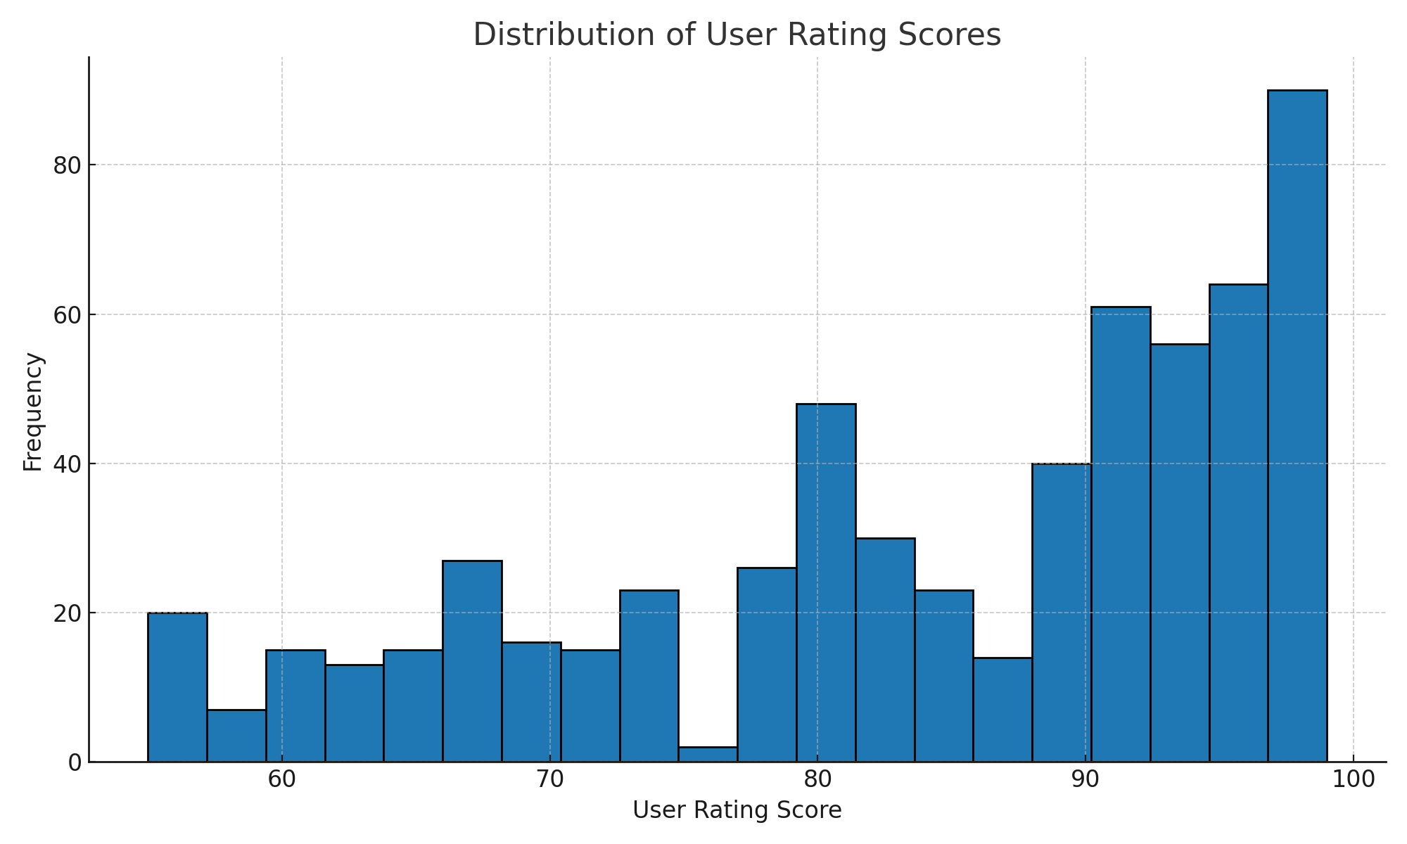
Scores cluster toward the higher end
Mid-to-high central tendency; limited
low-score density
Some variability remains (spread/outliers)
Scores available for ~60% of titles
Notes:
This histogram shows the distribution of user rating scores on a 0–100 scale. Most titles land in the mid-to-high range, indicating generally favorable audience sentiment. There’s still spread, implying meaningful differentiation across titles. A key concern is coverage here. Only about 60% of titles in this dataset have a user rating score, so the distribution reflects that subset. Missing scores can bias the picture. Popular or newer titles may collect ratings faster. Overall, the pattern supports a story of broadly positive reception with room for standout hits and underperformers.

Slide 5
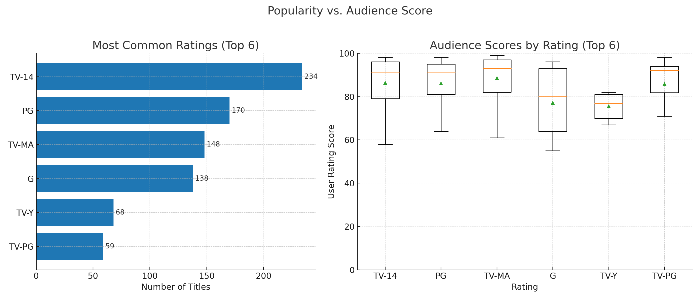
Popularity vs. Audience Score (Top Ratings)
Notes:
This two-panel figure pairs volume (left) with quality perception (right) for the top 6 rating categories. The horizontal bars show which categories dominate by count, while the boxplots summarize audience scores (median and spread). The key insight is decoupling. A category can be common, but not deliver the highest typical scores, and vice versa. Wider boxes indicate inconsistent audience reception within a category. This helps guide programming and promotion, while volume tells us what we have. Score distributions tell us where perceived quality concentrates and where variability suggests risk.

Slide 6
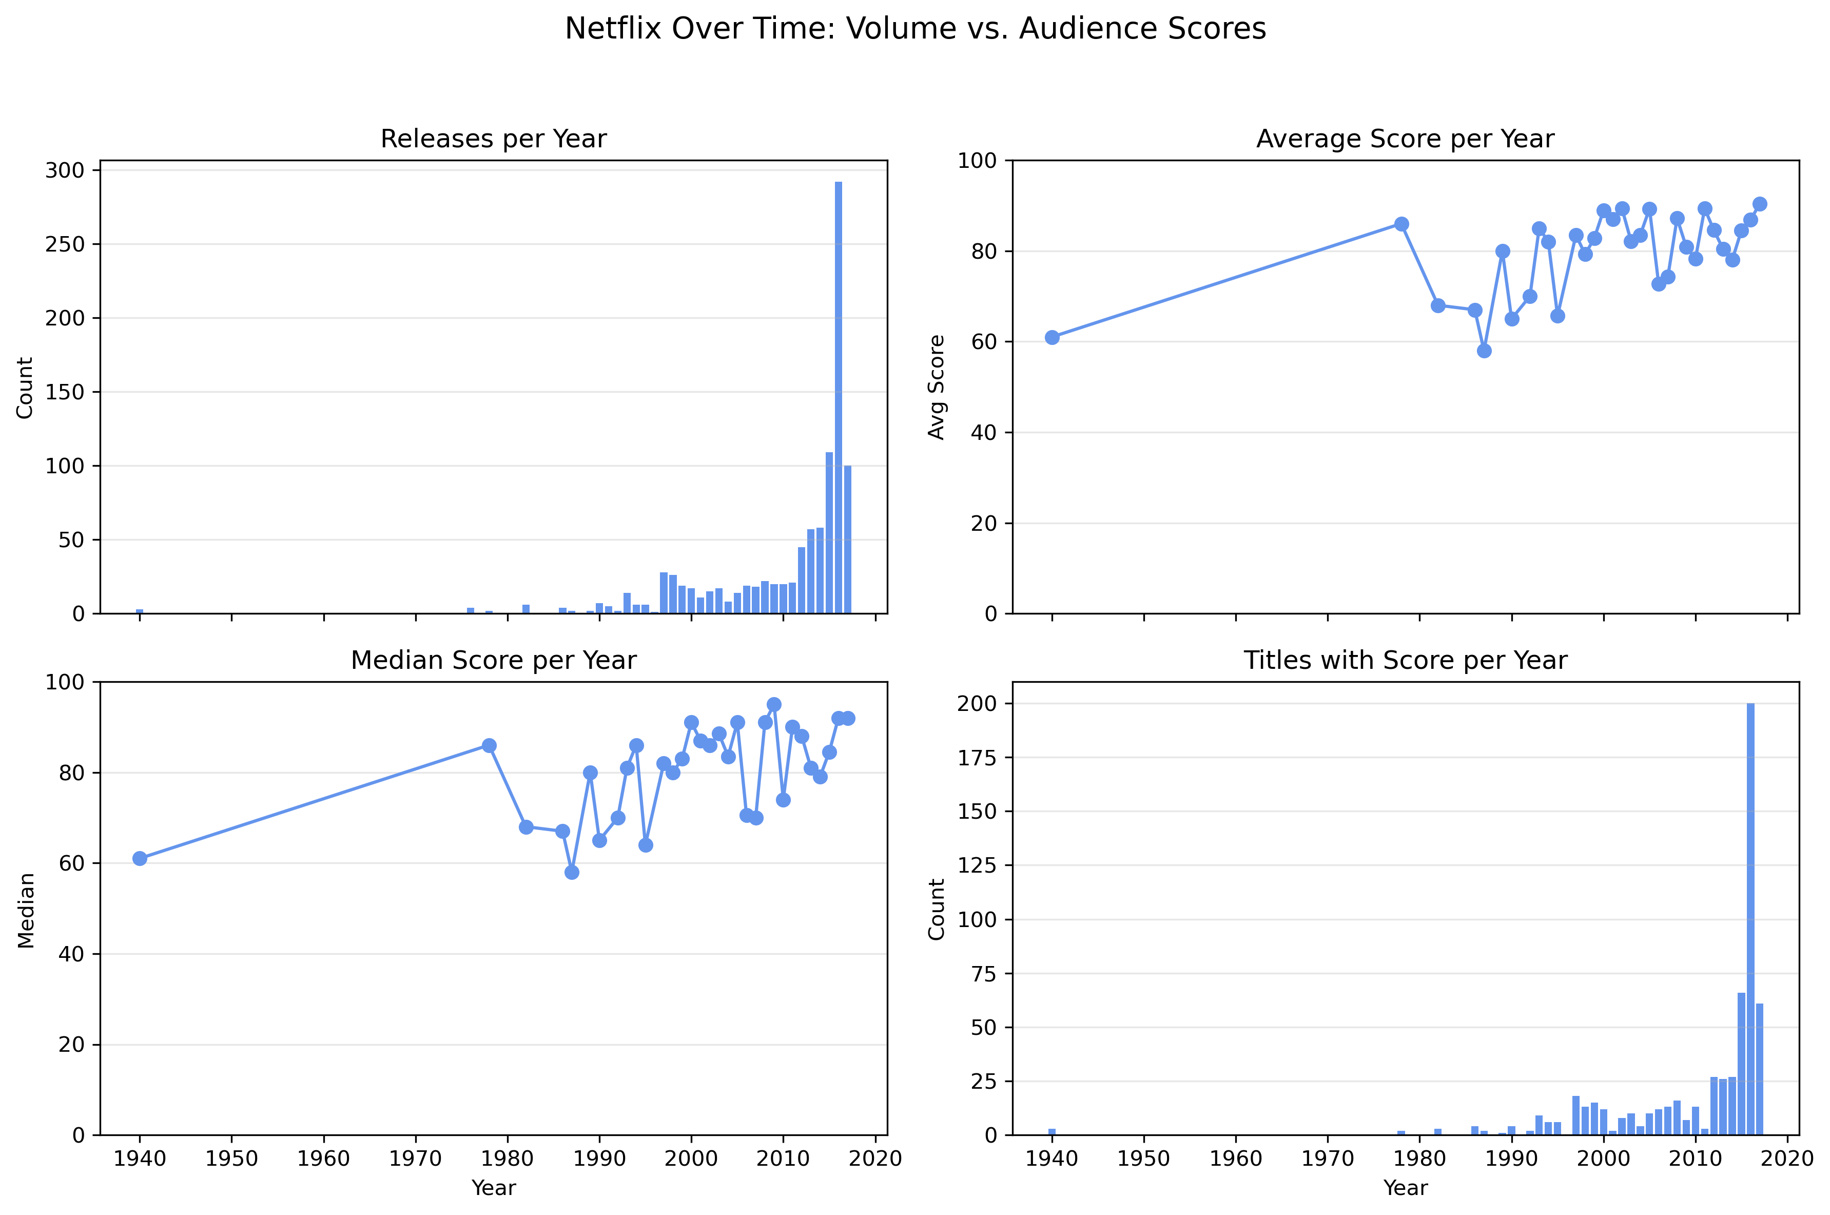
Volume spikes in late 2000s–2010s; clear peak years of releases
Scores stay high (avg/median 70–90) despite growth in volume
No tight coupling: more titles ≠ higher audience scores
Coverage bias: far more titles have scores in recent years
The Implication is that growth needs curation; quality doesn’t scale automatically
Notes:
This 2×2 view links what we release with how audiences feel. Top-left shows releases by release year (not date added to Netflix). We can see acceleration in the late 2000s and a sharp peak in the mid-to-late 2010s, indicating expansion waves. Top-right and bottom-left track average and median user scores by year; they generally sit in the 70–90 range and don’t rise simply because we shipped more titles. That decoupling is the key message: volume and sentiment move somewhat independently. Bottom-right counts how many titles actually have a user score each year; coverage grows substantially in recent years, so early-year averages are based on very small samples and should be read with caution. Overall: the catalog grew rapidly, but quality perception remained stable. Future strategy should emphasize curation and mix, not just volume. This could lift audience scores.

Slide 7
Conclusions
Catalog composition skews toward a few dominant TV ratings, shaping audience reach.
Release volume varies by year; peaks likely reflect strategic content pushes.
Audience sentiment is generally positive, but volume and scores don’t always move together—quality and curation matter.

