Slide 1
Cultural Evolution
Evolving a language
ESSLLI 2022 – Fausto Carcassi & Jakub Szymanik

Slide 2
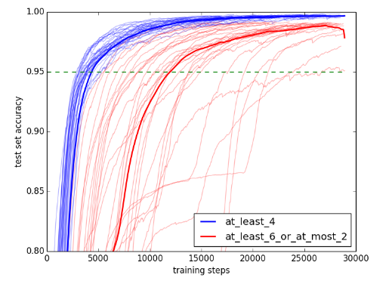
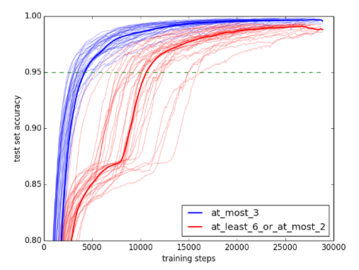
A neural network can learn monotone quantifiers faster
than non-monotone quantifiers.

Slide 3
Monotone quantifiers
are more learnable
Quantifiers
are monotone
?
Problem of Linkage
(Kirby 1999)
Notes:
Natural language quantifiers are monotone

Slide 4
Iterated Learning: The idea

Slide 5
Cultural evolution
Culture is hard to define
One sense just includes music, art, and films.
Our sense wider: roughly includes everything humans learn in virtue of belonging to a certain community.
This includes: how to sit, eat, play, who Joanna Newsom is, and language
Cultural evolution
What are the rules that govern the way culture changes?
“The structure of a language is under intense selection because in its reproduction from generation to generation, it must pass through a narrow bottleneck: children’s minds”
- Deacon (1997: 110)

Slide 6


The iterated learning model
We can model cultural evolution by an iterated process of change
Language 1
Linguistic data

Slide 7
The iterated learning model
We can model cultural evolution by an iterated process of change
Language 2
Language 1
Linguistic data

Slide 8

The iterated learning model
We can model cultural evolution by an iterated process of change
Language 2

Slide 9
The iterated learning model
We can model cultural evolution by an iterated process of change
Language 2
Language 3
Linguistic data

Slide 10
The iterated learning model
We can model cultural evolution by an iterated process of change
Language 2
Language 3

Slide 11
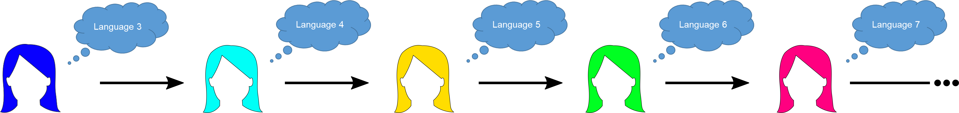
The iterated learning model
We can model cultural evolution by an iterated process of change
Iterated Learning shows the effects of cognitive structure on language structure
Language 3

Slide 12
The iterated learning model
Iterated Learning shows the effects of cognitive structure on language structure.
Monotone quantifiers are more learnable
Quantifiers
are monotone
IL
?

Slide 13
The iterated learning model
Some simplifications:
Only one cultural parent for each cultural child
No horizontal transmission
Iterated learning reveals learning biases!
Iterated learning is a mechanism for learnability to influence language.
We can explain some universals as the result of IL + certain learning biases.
We can look at IL through the lens of the theory of Markov Chains

Slide 14
Iterated Learning & Markov Chains

Slide 15
Markov chains: An example
Suppose there are three rooms connected by corridors, as follows:
You start in room A, and then move (facing the center) :
left with probability 0.3
right with probability 0.4
stay where you are with prob 0.3
A Markov Chain is (roughly) a (discrete-time) process that
Changes state stochastically and
Whose state at time t only depends on the state at time t-1 (Markov condition)
0.3
0.4
B
0.3
0.3
0.4
C
A
0.4
0.3
0.3
0.3

Slide 16
Markov chains: An example
Question: how do we calculate the probability that you will be in B in three steps?
We can represent the process with a transition matrix:
We start with a one-hot vector that indicates we are in B: [0, 1, 0]
And then do matrix multiplication three times
0.3
 | A | B | C
A | 0.3 | 0.4 | 0.3
B | 0.3 | 0.3 | 0.4
C | 0.4 | 0.3 | 0.3
0.4
B
0.3
0.3
0.4
C
A
0.4
0.3
0.3
0.3

Slide 17
Markov chains: An example
 | A | B | C
A | 0.3 | 0.4 | 0.3
B | 0.3 | 0.3 | 0.4
C | 0.4 | 0.3 | 0.3
0 | 1 | 0
 | A | B | C
A | 0.3 | 0.4 | 0.3
B | 0.3 | 0.3 | 0.4
C | 0.4 | 0.3 | 0.3
0.3 | 0.3 | 0.4
 | A | B | C
A | 0.3 | 0.4 | 0.3
B | 0.3 | 0.3 | 0.4
C | 0.4 | 0.3 | 0.3
0.3
0.4
B
0.3
0.34 | 0.33 | 0.33
0.3
0.4
C
A
0.4
0.3
0.3
0.3
0.333 | 0.334 | 0.333

Slide 18
Markov chains: An example
Initial position washed out pretty fast!
We are going towards a uniform distribution.
The differences are all relative to where one is.
Rather than ‘pointing’ to a specific place.
Suppose instead that you have a preference to stay in room A, whenever you end up there:
0.2
0.4
 | A | B | C
A | 0.8 | 0.1 | 0.1
B | 0.4 | 0.2 | 0.4
C | 0.4 | 0.4 | 0.2
B
0.4
0.4
0.1
C
A
0.4
0.1
0.2
0.8

Slide 19
Markov chains: An example
 | A | B | C
A | 0.8 | 0.1 | 0.1
B | 0.4 | 0.2 | 0.4
C | 0.4 | 0.4 | 0.2
0 | 1 | 0
 | A | B | C
A | 0.8 | 0.1 | 0.1
B | 0.4 | 0.2 | 0.4
C | 0.4 | 0.4 | 0.2
0.4 | 0.2 | 0.4
 | A | B | C
A | 0.8 | 0.1 | 0.1
B | 0.4 | 0.2 | 0.4
C | 0.4 | 0.4 | 0.2
0.2
0.4
B
0.4
0.56 | 0.24 | 0.2
0.4
0.1
C
A
0.4
0.1
0.624 | 0.184 | 0.192
0.2
0.8

Slide 20
Stationary distribution
When the situation is not symmetric across rooms, you might always tend to end up in a certain room over time
Two possible reasons:
When we get to A, we stick to it
When we are in a different room, we tend to go to A
We can see time evolution at https://www.mathematik.tu-clausthal.de/en/mathematics-interactive/simulation/markov-chain-discrete/
Over time, it does not matter where one starts, one reaches a certain probability of being in each room
(Note: condition of ergodicity)
This distribution that we tend towards over time is called stationary
Important insight: time average == space average

Slide 21
Where the hell am I going with this?

Slide 22
Iterated learning is a Markov chain
Now imagine:
Instead of rooms we have all the possible languages (or lang fragments)
Instead of ‘timesteps’ we have generations of cultural transmission
Instead of ‘moving’ we have ‘acquiring from parent’
Conditional distribution over learner’s language given teacher’s
Iterated Learning as a Markov Chain
At each new generation, the learner acquires a language from the teacher
How could the amount of data seen by the learner affect the process?
Language spoken at each generation only depends on previous one
Iterated learning can be thought of as a Markov Chain
…and therefore it has a stationary distribution!
(With some weak assumptions)

Slide 23
The stationary distribution of IL
Deep insight:
Under IL, it doesn’t matter where we start!
(Assuming ergodicity)
IL isn’t (necessarily) a diachronic model
How do we find the stationary distribution?
Model iterated learning
Pick a model of the domain (set of possible languages)
Pick a model of learning
Run simulation (or find first eigenvalue of transition matrix)
Let’s look at two models of learning: Bayesian learning and neural learning

Slide 24
Summary of the situation
We started with the linkage problem: how does learnability influence language?
This can be answered by iterated learning as a model of cultural evolution
We saw that iterated learning can be interpreted as a Markov chain
We need two ingredients for implementing IL as a Markov chain:
The space of possible states (langs)
A model of transition (learning)
Bayesian inference is a model of language acquisition to combine with IL!

Slide 25
Bayesian Iterated Learning

Slide 26
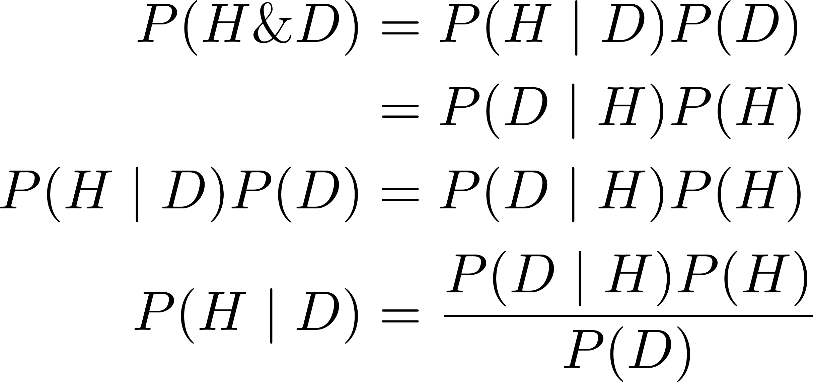
Bayes’ theorem
Bayes’ theorem is easy to prove:
And hard to understand!
Four components: prior, likelihood, posterior, evidence
Notes:
First just show the derivation of Bayes theorem
Then say it’s easy to derive but difficult to interpret
Go through the terms one by one and explain what they mean
Give an example of Bayesian update

Slide 27
Bayesian learning
Usually, we apply Bayes theorem to calculate P(H | D), where:
H is unobservable
D is observable
You can think of an application of Bayes theorem as a way of updating one’s model of the world when new data comes in.
A prior and a posterior then are relative to one update
So we can think of one application of Bayes’ theorem as an update in the state of knowledge given some data
This gives a very natural way of thinking about the way humans could update their picture of unknown quantities given a stream of new evidence.

Slide 28
Language learning in Bayesian agents
In language acquisition
The hypotheses are possible languages / semantic objects
The data is linguistic data produced by the hypotheses
Ex1
H: section of conceptual space (nominal meaning)
D: set of objects to which the noun applies
Ex2
H: section of a scale (adjectival meaning)
D: set of tuples (degree, truth value)

Slide 29
Language Learning in Bayesian agents
In Bayesian language acquisition:
Prior
Encodes the cognitive biases towards some languages over others
NOTE: This need not be language specific!
E.g. simplicity bias is not linguistic
Likelihood
Encodes the probability that a language user with a specific language would produce each possible utterance in each possible situation
Posterior
The probability of each possible language given the observed utterance/situation
Let’s see a simple example of Bayesian language acquisition

Slide 30
A simple example
Two objects, two words
Each word refers to some of the objects
Possible languages (at least one obj per word and one word per obj):
Suppose that there is a bias against ambiguity, e.g. this prior:
L1 | o1 | o2
w1 | 1 | 1
w2 | 1 | 1
L2 | o1 | o2
w1 | 1 | 0
w2 | 1 | 1
L3 | o1 | o2
w1 | 1 | 1
w2 | 1 | 0
L4 | o1 | o2
w1 | 1 | 1
w2 | 0 | 1
L5 | o1 | o2
w1 | 0 | 1
w2 | 1 | 1
L6 | o1 | o2
w1 | 0 | 1
w2 | 1 | 0
L7 | o1 | o2
w1 | 1 | 0
w2 | 0 | 1
L1 | L2 | L3 | L4 | L5 | L6 | L7
0.1 | 0.1 | 0.1 | 0.1 | 0.1 | 0.25 | 0.25

Slide 31
A simple example
Suppose the data is generated as follows:
The speaker sees one object sampled at random
Then they sample among the utterances compatible with the objects
If we observed one datapoint from L2, (o1, w1), the likelihood would be:
We then apply Bayes theorem and get the (unnormalized) posterior:
0.5 | 1. | 0.5 | 0.5 | 0. | 0. | 1.
L1 | o1 | o2
w1 | 1 | 1
w2 | 1 | 1
L2 | o1 | o2
w1 | 1 | 0
w2 | 1 | 1
L3 | o1 | o2
w1 | 1 | 1
w2 | 1 | 0
L4 | o1 | o2
w1 | 1 | 1
w2 | 0 | 1
L5 | o1 | o2
w1 | 0 | 1
w2 | 1 | 1
L6 | o1 | o2
w1 | 0 | 1
w2 | 1 | 0
L7 | o1 | o2
w1 | 1 | 0
w2 | 0 | 1
L1 | L2 | L3 | L4 | L5 | L6 | L7
0.1 * 0.5 | 0.1 * 1 | 0.1 * 0.5 | 0.1 * 0.5 | 0.1 * 0. | 0.25 * 0 | 0.25 * 1.

Slide 32
A simple example
We get posterior:
Even though the likelihood of (o1, w1) is the same for L2 and L7, because of the prior L7 has higher posterior probability.
Last step: select a language based on the posterior. Two options:
They can sample a language from the posterior
Or select the language with the highest posterior probability (MAP)
In this case, they might sample e.g., L2 or take the MAP L7
L1 | L2 | L3 | L4 | L5 | L6 | L7
0.1 | 0.2 | 0.1 | 0.1 | 0. | 0. | 0.5

Slide 33
Bayesian IL & stationary distribution
What if we iterate this process?
This can be thought of as running a Markov chain on the space of 7 languages
Where the transition probability x → y is the prob of a learner learning y from a certain number of datapoints produced by true language x
Question: What is the stationary distribution of this chain?
I.e. what will be the distribution over languages eventually?
Surprising answer (assuming sample agents):
It doesn’t depend on the number of datapoints
It doesn’t depend on starting language
It’s just the prior! (Griffiths & Kalish 2007)

Slide 34
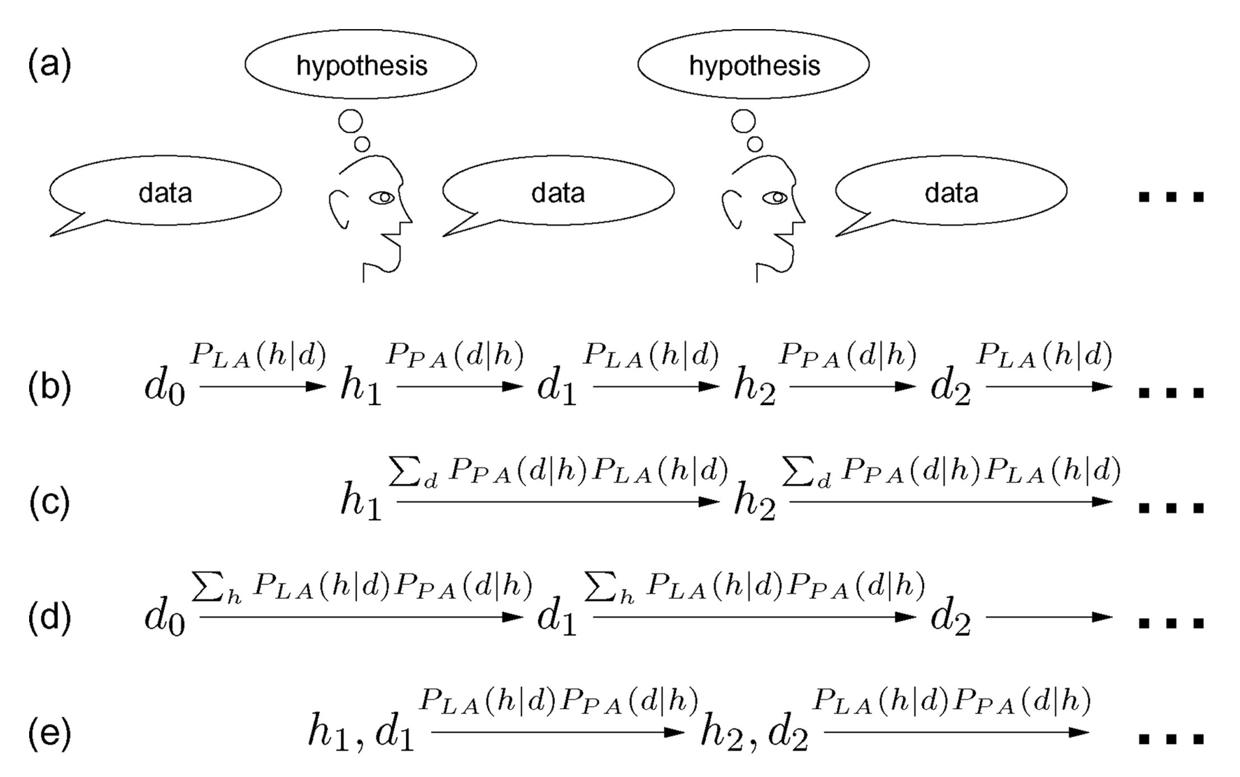
Convergence to the prior
Intuition:
IL
+ Bayesian agents
+ Sampling agents
Is a type of Gibbs sampling

Slide 35
Bayesian IL: A temporary conclusion
Temporary conclusion:
IL+Bayesian learners alone is somewhat boring
…always prior = stationary distribution.
Two ways to make it interesting:
Use not-sampling agents, e.g., MAP or maximum-likelihood agents
Hard to study mathematically
Combine with other pressures, e.g., communicative accuracy
Last lecture!
Point: IL reveals cognitive biases, but Bayesian inference builds them in
But we don’t know the prior biases of ANNs!

Slide 36
Neural Iterated Learning

Slide 37
The evolution of monotonicity
In the first lecture, we looked at monotonicity as a universal of the meaning of simple determiners.
Yesterday, we saw that ANNs can learn some monotonic quantifiers faster than non-monotonic quantifiers.
However, some non-monotonic quantifiers might still be easier than some monotonic ones.
In Carcassi, Steinert-Threlkeld, & Szymanik (2021), we look at an IL model.
We implicitly search a much larger space of quantifiers.
We show the evolution of quantifier meaning

Slide 38
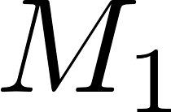
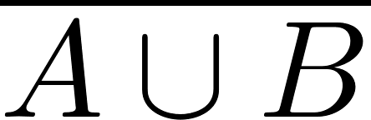
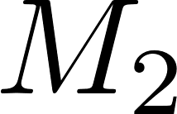
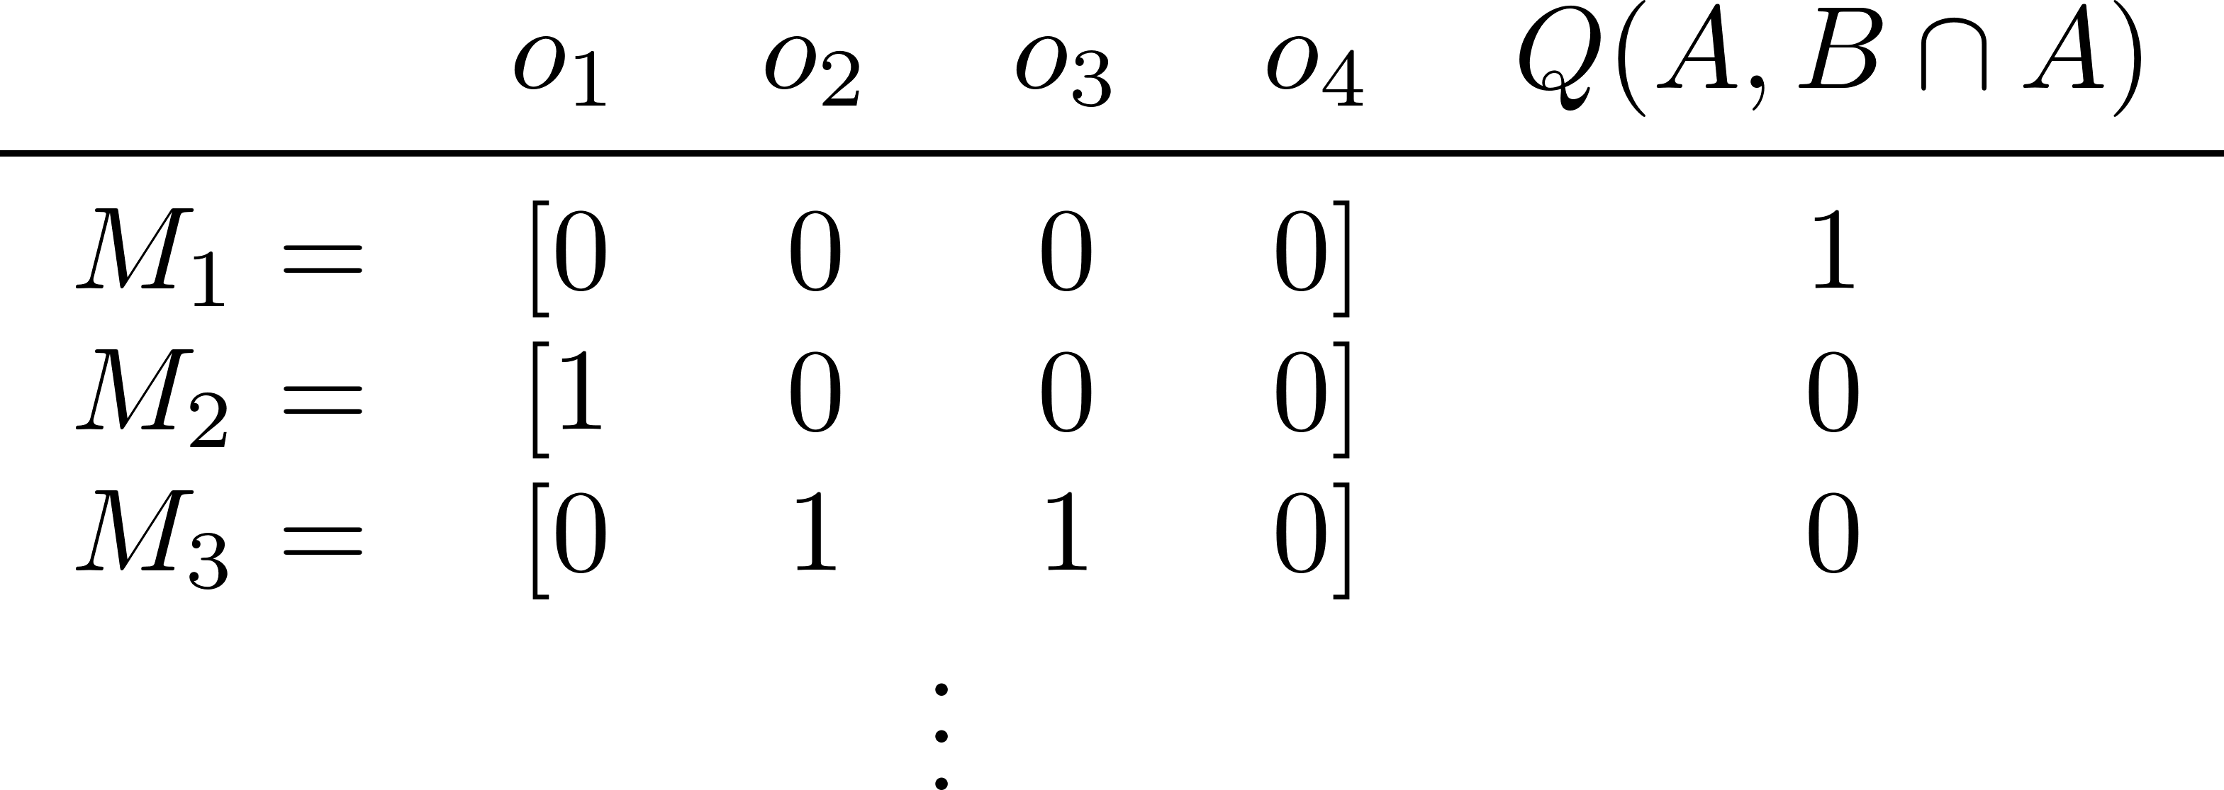


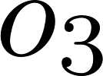

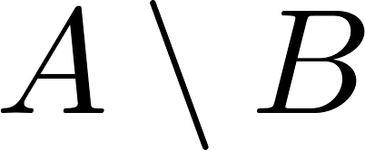

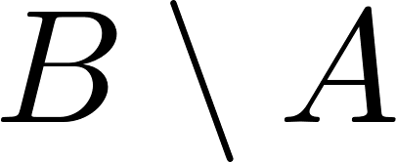
The evolution of monotonicity
Input
Output

Slide 39
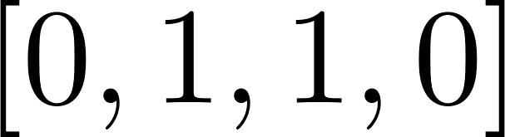
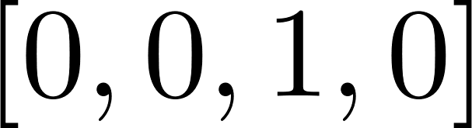

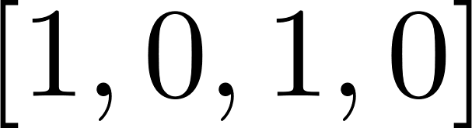

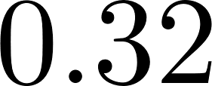
The evolution of monotonicity
Cultural parent
Data
Cultural child
Bottleneck size
Notes:
How the agents use the neural network to produce and learn quantifiers

Slide 40
The evolution of monotonicity
Cultural parent
Data
Cultural child
Notes:
How the agents use the neural network to produce and learn quantifiers

Slide 41
The evolution of monotonicity
Burn-in
Chain #
1
GEN 1
GEN 2
GEN h
GEN n-1
GEN n
2
GEN 1
GEN 2
GEN h
GEN n-1
GEN n
k
GEN 1
GEN 2
GEN h
GEN n-1
GEN n
Frequency of languages spoken

Slide 42
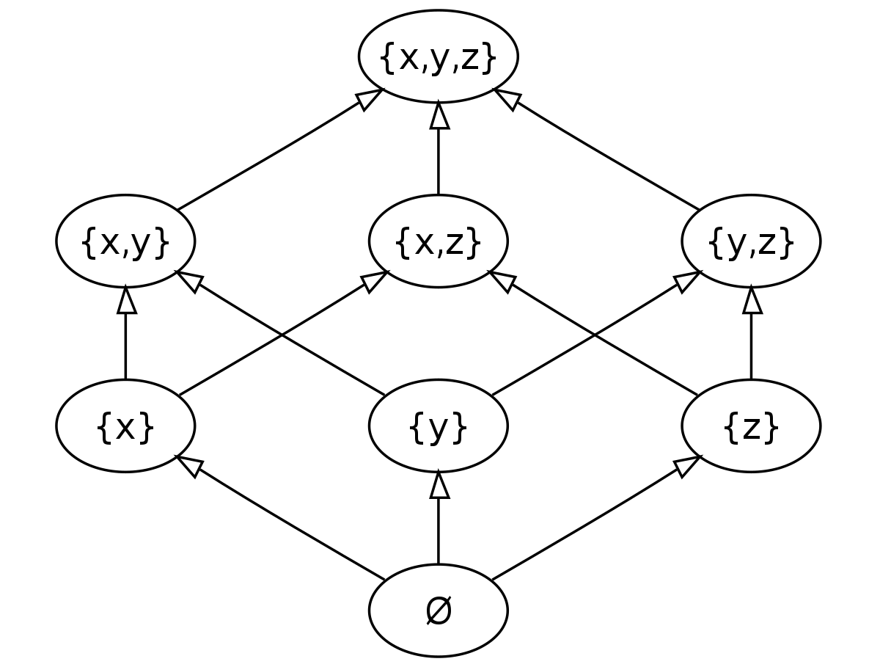
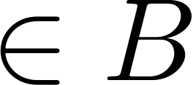
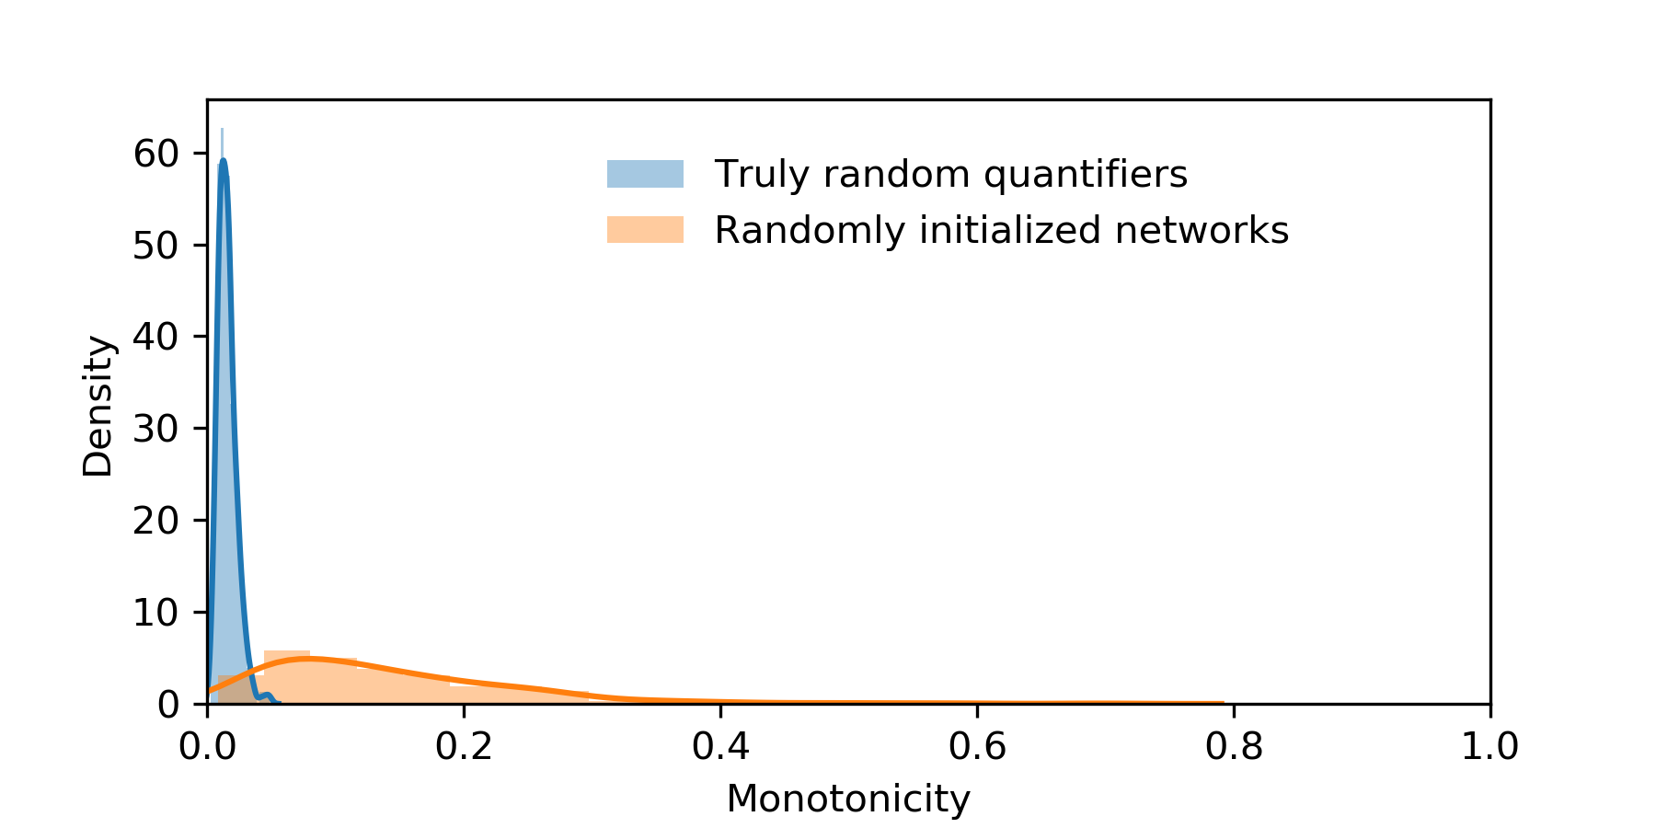
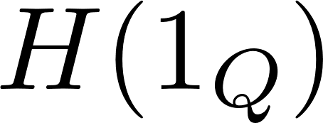
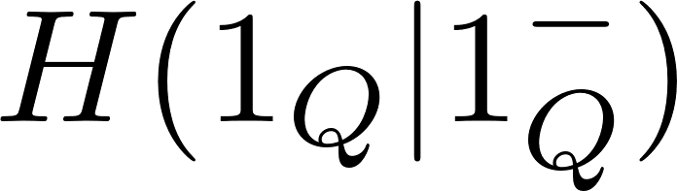
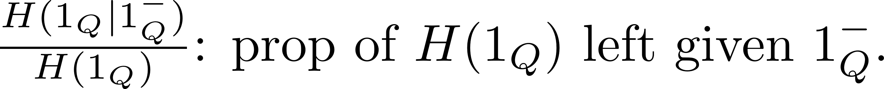
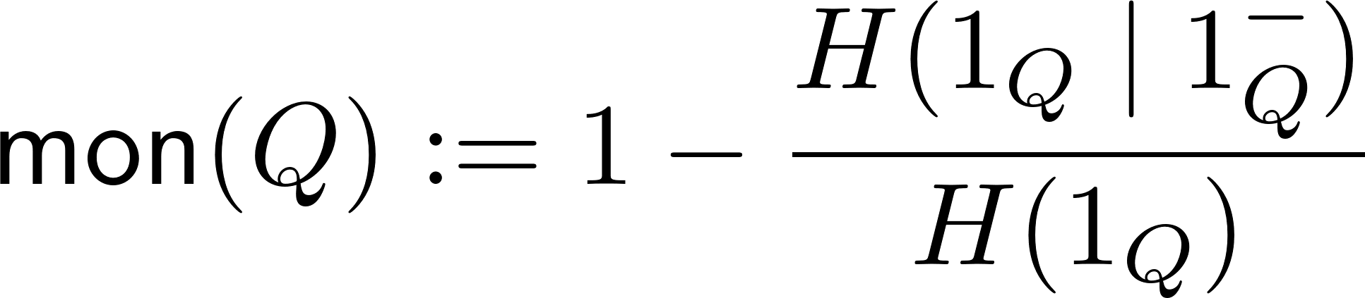
The evolution of monotonicity
supermodel
Notes:
How to measure monotonicity?

Slide 43
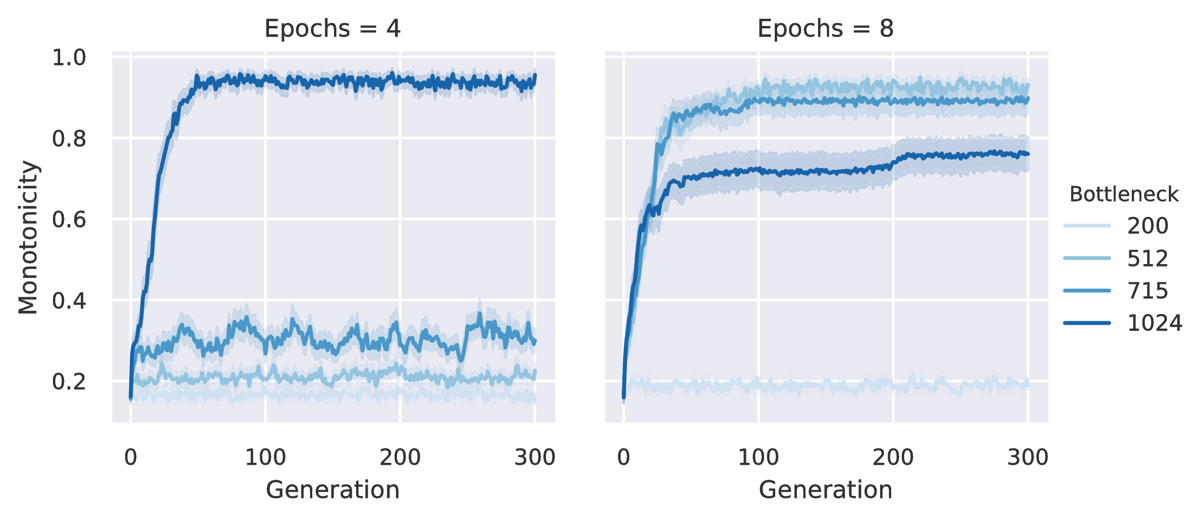
The evolution of monotonicity

Slide 44
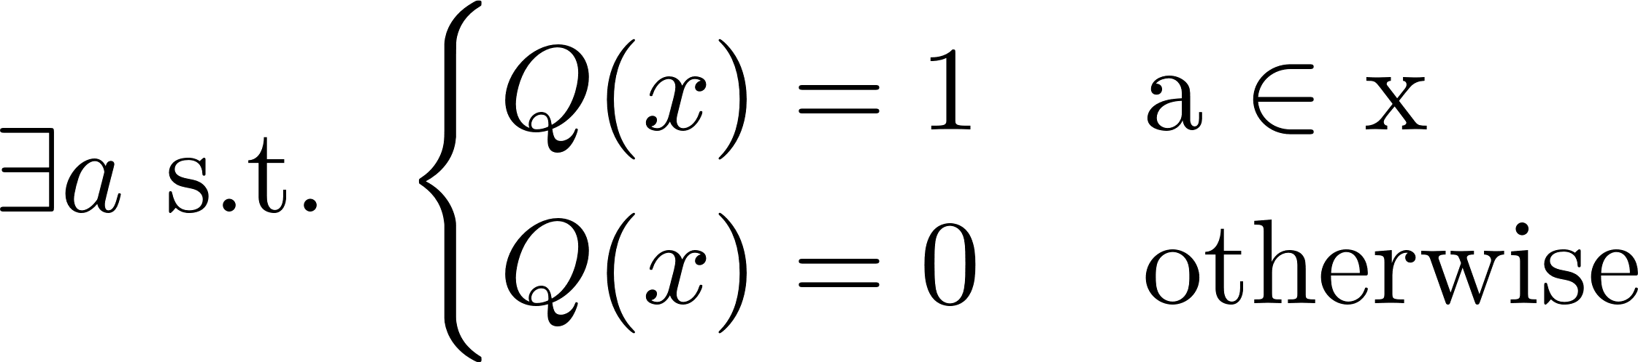
The evolution of monotonicity
Proper-noun-like quantifiers evolve in the first model because neural networks find it easy to exploit the identity of individual objects.
Notes:
Explain ultrafilters
Explain why the first model was somewhat unsatisfying

Slide 45
The evolution of monotonicity
Cultural parent
Data
Cultural child
Notes:
How the agents use the neural network to produce and learn quantifiers

Slide 46
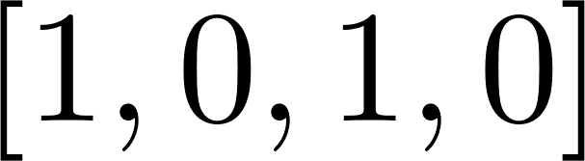
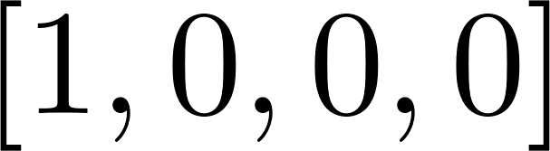
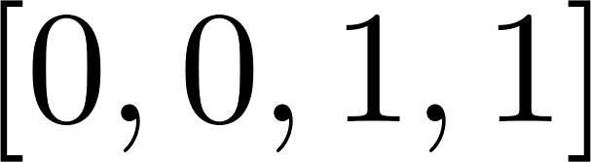
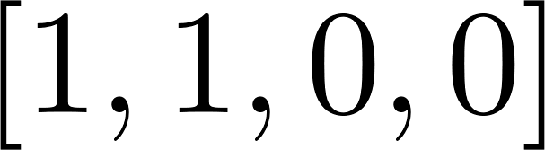
The evolution of monotonicity
Cultural parent
Data
Cultural child
Notes:
How the agents use the neural network to produce and learn quantifiers

Slide 47
The evolution of monotonicity
Cultural parent
Data
Cultural child
Notes:
How the agents use the neural network to produce and learn quantifiers

Slide 48
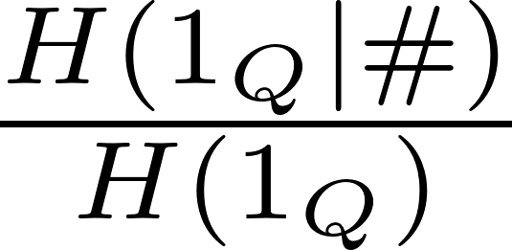
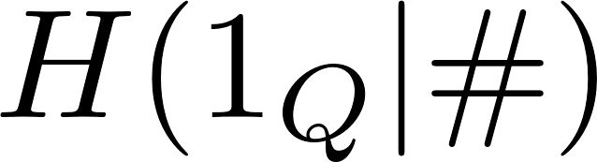
The evolution of monotonicity
The only quantifiers that are robust across the permutations of the string are the quantitative quantifiers.
Notes:
How to measure monotonicity?

Slide 49
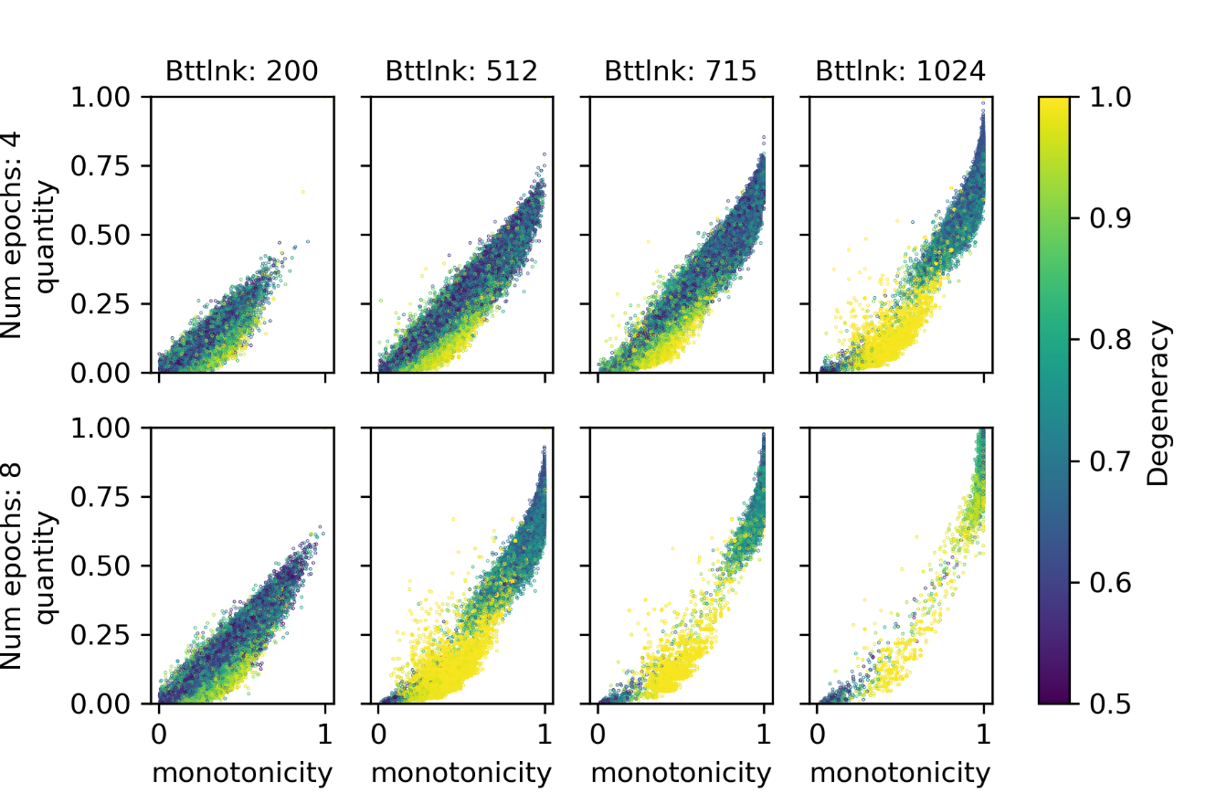
The evolution of monotonicity
Vague threshold
quantifiers
Nearly degenerate quantifiers
Notes:
Show plot of results with two blobs
Explain what the two blobs correspond to

Slide 50
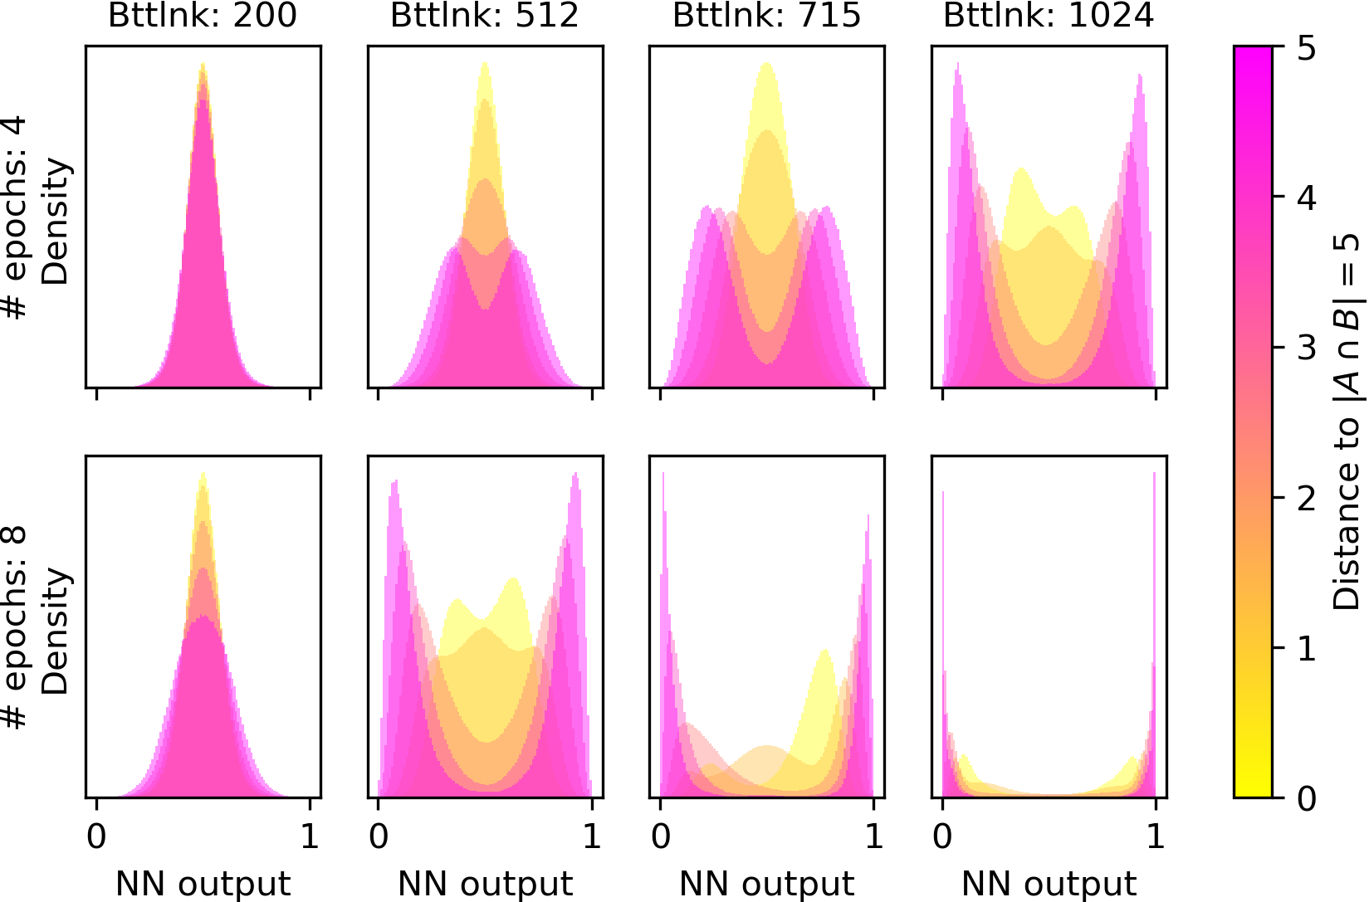
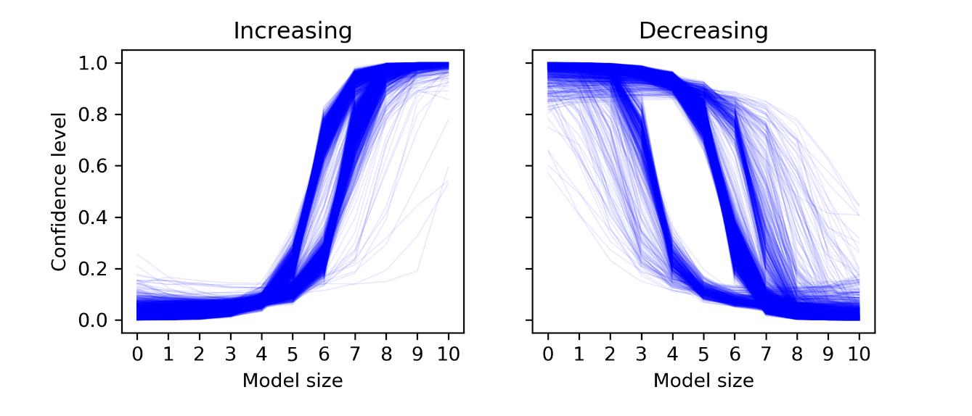
The evolution of monotonicity
By “threshold quantifier” we mean that the average confidence in its truth is a monotonic function of the model size.
This is not simply a side effect of the fact that there are more models with middle number of ones.
Notes:
Talk about nearly degenerate quantifiers
Talk about vague threshold quantifiers & the fact that vagueness decreases with larger bottleneck

Slide 51
Summary
Iterated Learning model as a way of solving the linkage problem
IL requires a model of learning, two natural options: Bayes & ANNs
With sampling Bayesian learners, IL converges to the prior
We’ll come back to IL on Friday
With neural learners, we can use IL to reveal biases
We used this to reveal the IL preference for monotonicity
And for quantity!
Questions?

