Slide 1
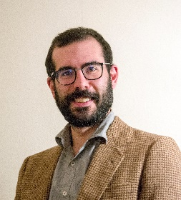
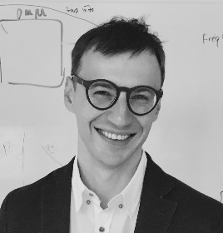
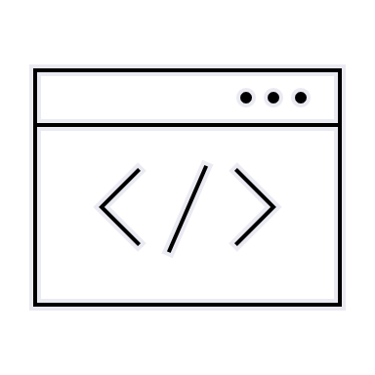
Computational approaches
to the explanation
of universal properties of meaning
Fausto Carcassi & Jakub Szymanik
https://thelogicalgrammar.github.io/ESSLLI22_langevo

Slide 2
Goals
Overview of the thriving research area of semantic universals.
Examples of concrete universals in content and logical vocabularies of Ls
Different theoretical explanations
Different computational modelling paradigms
Notes:
Structure

Slide 3
Course Outline
Introduction to linguistic universals
Learnability explanations
Cultural evolution explanations
Complexity explanations
Communicative efficiency explanations
Notes:
Structure

Slide 4
Today’s Outline
What are meaning universals?
Examples:
Quantifier universals
Convexity
Boolean universals
Gradable adjectives
Modals
Responsive verbs
Notes:
Structure

Slide 5
Introduction

Slide 6
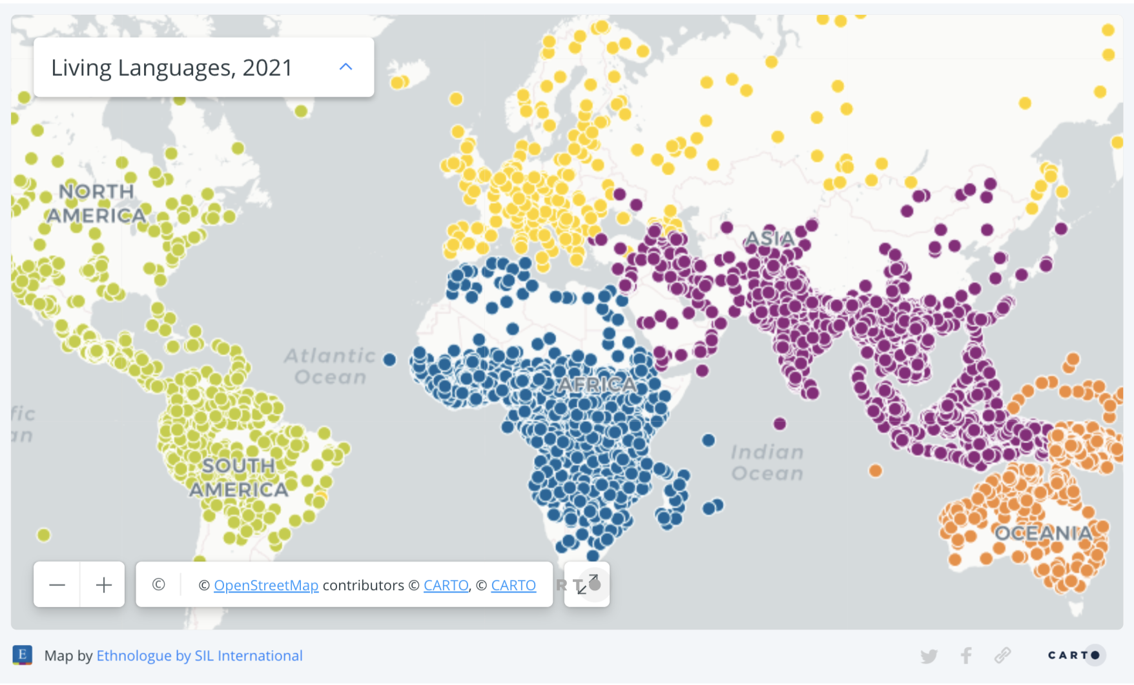

Slide 7
Language variation and universals
Enormous variation but common properties across (almost) all Ls
Called language universals
Provide us with a window into our cognition
What are the limits of variation?
What are the cognitive sources of such limits?
Notes:
Structure

Slide 8
Examples of linguistic universals
Phonology: All spoken languages have consonants and vowels. All spoken languages have at least one unrounded and one back vowel (Hyman 2008).
Morphology: All languages have pronominal categories involving at least three persons and two numbers (Greenberg 1966; Bauer 2010).
Grammar (syntax): All languages have verbs and nouns (Croft 1990). Grammatical rules are structure-dependent (Chomsky 1965)
Semantics: …
Notes:
Structure

Slide 9

Quantifiers

Slide 10
Double click to open pdf document:

Slide 11
Convexity

Slide 12
Convexity (Connectedness)
Extending the notion of monotonicity
No noun in English means ‘bottle or eagle’.
No quantifier means ‘less than 5 or more than 10’.
Informally, if two objects are blickets then, any object in between those two must also be a blicket.
Notes:
Structure

Slide 13
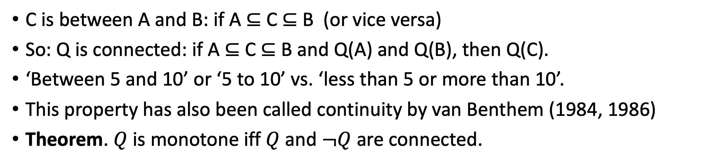
Convex Quantifiers
C is between A and B: if A ⊆ C ⊆ B￼ (or vice versa)
So: Q is connected: if A ⊆ C ⊆ B and Q(A) and Q(B), then Q(C).
‘Between 5 and 10’ or ‘5 to 10’ vs. ‘less than 5 or more than 10’. ￼
This property has also been called continuity by van Benthem (1984, 1986)
Theorem. $Q$ is monotone iff $Q$and $¬Q$ are connected.
Notes:
Structure

Slide 14
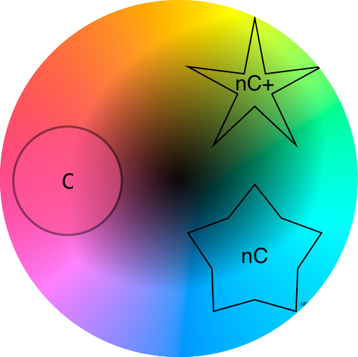
Convex Color Terms
Color terms across languages denote convex regions (Jaeger, 2010)
Notes:
Structure

Slide 15
Convexity Universal
All lexical categories satisfy convexity (Gardenfors 2014)
Notes:
Structure

Slide 16
Boolean Connectives

Slide 17
Boolean semantics
Certain words in natural language can express Boolean functions
Functions from some n-product of {true, false} to {true, false}
‘Maria is in Galway and Maria is a linguist’
We can reconstruct the input/output relations:
P | Q | Not P | P and Q
True | True | False | True
True | False | False | False
False | True | True | False
False | False | True | False

Slide 18
Boolean universals
Suppose we restrict ourselves to Binary connectives
Then, there are 16 possible operators
All the way of diving the 4 lines of a truth table with P and Q into true and false
English has ‘and’, ‘or’, ‘nor’
But they can in principle all be lexicalized!
What about other languages?
{and} | Wari (Chapacuran)
{or} | Maricopa (Yuman)
{and, or} | Iraqw (Chusitic)
{and, or, nor} | English (Indo-European)

Slide 19
Boolean semantics
Two distinct questions:
Why do we only see some operators and not others, e.g., ‘and’ but not ‘nand’?
Why do they come in certain combinations, e.g. never ‘nor’ alone?
For some operators, there are some intuitively plausible answers
E.g., ‘left projection’ operator, which returns value of left argument
However, others have received much discussion in the literature
E.g., why is there no ‘nand’?

Slide 20
Gradable Adjectives

Slide 21
Adjectival semantics
Adjectives: Italian, red, tall, square
Gradable adjectives:
*Very Italian, *very square
Very red, very tall
Two big types of gradable adjectives:
Relative-standard: tall, short, cold, warm
Absolute standard: empty, full, straight, bent
Notes:
- Gradable adjectives are words used to

Slide 22
Uses of gradable adjectives
Gradable adjectives occur in two main contexts:
Measure uses: Roberta is 180 centimeters tall
Bare uses: Roberta is tall
Relative-standard adjectives have some peculiarities:
Sorites paradox
If Chiara is tall, then someone 1mm shorter than Chiara is also tall.
Context sensitivity:
Chiara is tall (context: Italians) while Chiara is not tall (context: basketball players)
The universal we consider applies to bare uses of gradable adjectives in a fixed context.

Slide 23
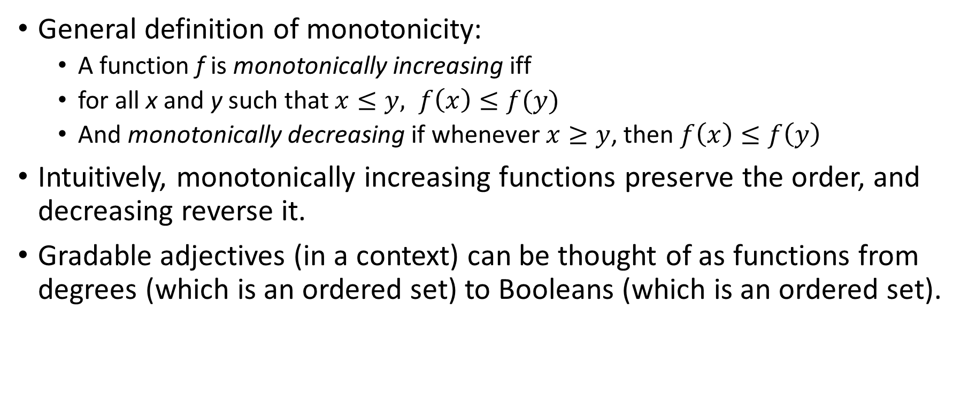
Monotonicity for gradable adjectives
General definition of monotonicity:
A function f is monotonically increasing iff
for all x and y such that $x≤y, f\left(x\right)≤f(y)$
And monotonically decreasing if whenever $x≥y$, then $f\left(x\right)≤f\left(y\right)$
Intuitively, monotonically increasing functions preserve the order, and decreasing reverse it.
Gradable adjectives (in a context) can be thought of as functions from degrees (which is an ordered set) to Booleans (which is an ordered set).
Big

Slide 24

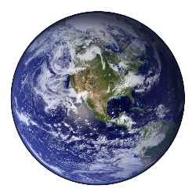
Monotonicity for gradable adjectives
Conceptual spaces? No, because:
Overlaps between categories
Space is not completely covered
Monotonicity, not just convexity
Huge
Big
(Monotonic)
Small
a
c
b
*Pictures not to scale
Notes:
So, the claim is that gradable adjectives refer to portions of ordered domains.
The next natural question is whether the convexity generalization also applies to gradable adjectives.
So let’s consider some typical gradable adjectives.
“Warm”, “cold”, “hot”
They are indeed convex.
However, notice that as a whole they show a different patterns from nouns.
Namely, there are overlaps
And also, there are parts of the spaces that are not covered by any adjective in the system. Both of these things would not be possible with a Voronoi tessellation.
Moreover, the categories are not only convex, but also monotone. This means, simply, said, that they are single bounded. In other words, there is a direction such that for any point more extreme in the direction than a point that belongs to the category also belongs to the category.
So there are three points to explain.

Slide 25
Modality

Slide 26
Modal semantics
Modals are expressions such as ‘might’, ‘must’, ‘could’, ‘should’, ‘can’
Attempting an exact definition is very hard, but roughly they can be used to talk about non-actual situations
Since Kratzer (1981), we distinguish two axes of variation in modal meaning: force and flavour. Examples:
 | Strong (universal) force | Weak (possibility) force
Epistemic flavour | The keys must be on the table | It may be raining
Deontic flavour | You must do your homework | You may park here

Slide 27
Modal semantics
There’s other flavours:
Bouletic (desire)
Teleological (goals)
And so on
There’s other forces
Arguably, ‘should’ is a necessity, but weaker than ‘must’
In English, modal verbs come with a fixed force and variable flavour
In other languages, modals vary wrt force and not flavour
St’át’icmets (Rullmann, Matthewson & Davis 2008), Nez Perce (Deal 2011), Old English (Yanovich 2016), and Pintupi-Luritja (Gray 2021).

Slide 28
Universals of modal meaning
The single axis of variability universal (Nauze 2008):
If a modal can express more than one flavor, it can only express one force (and mutatis mutandis for force and flavor).
Second proposal (Vander Klok 2013):
A modal system as a whole only has lexically encoded force or flavour
However, two counterexamples:
Washo (Bochnak 2015): A verb can vary both wrt to force and flavour
Koryak (Mocnik & Abramovitz 2019): A verb that can be used both to mean ‘believe’ (strong force) and ‘allow for the possibility that’ (weak force), and multiple flavours (doxastic and assertive)

Slide 29
Universals of modal meaning
Independence of force and flavour universal (Steinert-Threlkeld 2022)
All modals in natural language satisfy the independence of force and flavor property: if a modal can express the pairs (fo1;fl1) and (fo2;fl2), then it can also express (fo1;fl2) and (fo2;fl1).
This universal includes the cases that contradicted previous proposals
And it excludes some meanings:
A modal mighst which behaves like a mix of:
Might: it can be used in epistemic possibility contexts
Must: in that it can be used in deontic necessity contexts.

Slide 30
Responsive Verbs

Slide 31
Responsive verbs
Types of verbs:
Jakub believes that he is in Ireland
# Jakub believes where Ireland is
# Jakub wonders that he is in Ireland
Jakub wonders where Ireland is
Jakub knows that he is in Ireland
Jakub knows where Ireland is
 | Declarative | Interrogative | Example
Rogative | No | Yes | Wonder
Anti-rogative | Yes | No | Believe
Responsive | Yes | Yes | Know Forget
Lahiri 2002; Theiler, Roelofsen, and Aloni 2018; Uegaki 2018

Slide 32
Veridicality
‘Know’ is veridical wrt declarative complements:
Jakub knows ESSLLI is in Ireland
→ ESSLLI is in Ireland
‘Know’ is veridical wrt interrogative complements:
Jakub knows where ESSLLI is
& ESSLLI is in Ireland
→ Jakub knows that ESSLLI is in Ireland
‘Know’ is veridically uniform!
‘Be certain’ is not veridical wrt declarative complements:
Jakub is certain that ESSLLI is in Ireland
-\-> ESSLLI is in Ireland
‘Be certain’ is not veridical wrt interrogative complements:
Jakub is certain about where ESSLLI is
& ESSLLI is in Ireland
-\-> Jakub is certain that ESSLLI is in Ireland
‘Is certain’ is veridically uniform!

Slide 33
Veridical uniformity
Based on these observations, we can formulate a universal:
All responsive verbs are veridically uniform
(Spector and Egre 2015; Theiler, Roelofsen, and Aloni 2018)
Why is this a substantial universal?
Because it’s easy to think of meanings for responsive verbs that do not satisfy it!
E.g. knopinion:
‘John knopinions that it will rain’
→ John knows that it will rain
Veridical!
‘John knopinions whether it will rain’
→ John has an opinion about whether it will rain
Non veridical!

Slide 34
Some concluding remarks
General strategy:
Pick a semantic domain
Quantifiers, Boolean operators, nouns, modal verbs, responsive verbs
Define the space of possible meanings
By semantic type (quantifiers, adjectives)
or cognitive model (conceptual spaces)
Define a restriction that…
Includes attested meanings
Excludes non-attested meanings
This restriction is a universal to be explained!
In the rest of the course we’ll see strategies to explain these universals

Slide 35
Questions time!

