Slide 1




Thomas Representation aka the cultural evolution of the mindreading capability given domain-general cognitive primitives
Fausto Carcassi, Soren Schlassa, Charlie Pilgrim, Danaja Rutar
DISI 2024

Slide 2
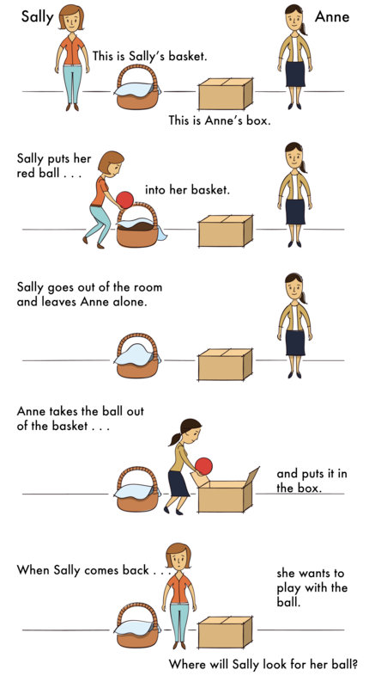
Mindreading
The ability to predict, explain and regulate the behaviour of others (Heyes, 2018)
Related to a richer cognitive ability, theory of mind (e.g., Baron-Cohen et al., 1985)

Slide 3
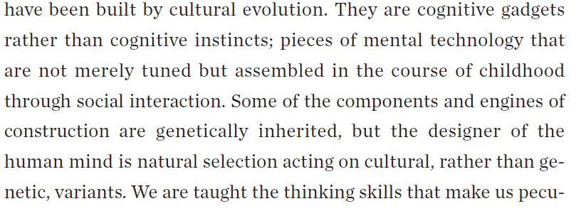
The origins of mindreading
How does the mindreading capability emerge?
Mindreading as a cognitive instinct (Baron-Cohen, 1997)
Simulation theory (Goldman, 2006)
Theory-theory (Gopnik and Wellman, 2012)
Mindreading as a cognitive gadget (Heyes, 2019)
CG is a distinctively human cognitive mechanism that acquires its characteristic features through social interaction in the course of development.
Notes:
Humans genetically inherit a specific predisposition to develop cognitive mechanisms representing mental states, and these mechanisms mature to much the same terminal state in a very broad range of developmental environments (Baillargeon, Scott, and He, 2010; Baron-Cohen, 1997; Leslie, 1987).
Simulation theory: the child works out what others are thinking and feeling through introspection, imagining herself in the same situation as another agent.
Theory-theory: mindreading is learned via a quasi-scientific process (Gopnik and Wellman, 2012). The developing child generates, through her own efforts, hypotheses about the mind and uses the behavior of others as a database for testing these hypotheses.
It is a cognitive capability that acquires its characteristic features through social interaction in the course of development.

Slide 4

Mindreading as a cognitive gadget
BUT!
Explicit mindreading
(allows us deliberate and verbalise mental states)
CULTURAL EVOLUTION
Epistemic engineering
Social scaffolding
Language based teaching
Explicit instruction
Social learning
Implicit mindreading
(tracking the behaviour of other agents)
Involuntary attentional orienting
Cue retrieval
Object-centered coding of stimulus locations
Spatial coding of response locations
BIOLOGICAL EVOLUTION
Submentalising
Domain general cognitive mechanisms (genetically inherited mechanisms that did not evolve for mentalising)
Notes:
Children are taught about the mind by members of their social group, and the information that is culturally inherited in this way forms a conceptual structure enabling the ascription of mental
states to the self and others. So, children are taught to read minds, and, once developed, mindreading contributes to teaching.
The cognitive gadget view suggests that children are taught how to read minds in much the same way as they are taught how to read print: through scaffolding or “epistemic engineering”
(Sterelny, 2012) and explicit instruction.

Slide 5

Domain general mechanisms
Cognitive processes that are genetically inherited but did not evolve to track and predict others' behaviour or represent their mental states (Heyes, 2019, 2014):
Attention
Memory
(Reinforcement) learning
Bayesian inference
Retroactive interference
Notes:
No need to represent what other see, believe or intend
Spatial coding of response locations: coding the location of our own actions relative to objects, our own bodies and to the locations of other agents’ actions for the purposes of action coordination when agents are attending to the same targets and have same action priorities

Slide 6
Empirical support for the domain generality hypothesis
FASTER JUDGMENTS: effect is due to the domain-general mechanisms that mediate automatic attentional orienting
(Samson, Apperly, Braithwaite, Andrews, and Bodley Scott, 2010)
Notes:
Dot perspective task: people are presented with images like those on the left of Figure 7.2 and asked to make quick judgments about the number of dots that they, the experimental participant, can see. Providing evidence of implicit mindreading, participants typically make faster judgments when all dots are in front of the central figure, the “avatar” (Figure 7.2A), than when some dots are behind the avatar (Figure 7.2B).
Using an inanimate control procedure, Santiesteban and colleagues found that this effect also occurs when the central object is an arrow—an inanimate object rather than a human figure
(Figures 7.2C and 7.2D)—suggesting that the effect is due to the domain-general mechanisms that mediate automatic attentional orienting (Tipples, 2008).

Slide 7
From statistical regularities to categories
Parsing based on low level features (colour, shape, movement)
Detection of statistical regularities intrinsic in body movement
Building of higher-order categories and sequences to predict where a movement will end and how movements follow each other
ACTION VOCABULARY: provides an initial set of referents for mental state terms and for instructions about how mental states relate to behaviour (Skerry et al., 2013).
Notes:
Resulting action vocabulary

Slide 8
Mindreading as a cognitive gadget
Explicit mindreading
CULTURAL EVOLUTION
Social learning
Labels for higher-level features regarding action vocabulary
New way of thinking about action: as a product of internal states that represent the world and each other
Submentalising
Implicit mindreading
BIOLOGICAL EVOLUTION
Action vocabulary
Domain general cognitive mechanisms
Notes:
Through conversation about the mind, children do not just learn labels for the high-level features of behavior they have discovered by associative learning.
In addition, through the operation of System 2 processes, rather than associative learning, they discover yet more abstract features of behavior and develop a whole, new way of thinking about action—as the product of internal states that represent the world and each other, that is, explicit mindreading.
But the substrate, or scaffold, for this linguistically mediated learning is the action vocabulary established by submentalizing. The submentalizing hypothesis, and the cognitive gadget theory of mindreading more generally, assumes that “language comes

Slide 9
Research goals
Heyes’ theory of cognitive gadgets is based on wide ranging empirical evidence
However, not clear:
1) if the domain general principles are actually enough,
2) which domain general mechanisms would be needed for the emergence of the mindreading capability,
3) and under which cultural pressures.
Research goal: to model trajectories by which mindreading cognition could have culturally evolved, assuming domain-general cognitive primitives.

Slide 10




The simulation setup

Slide 11

The simulation setup

Slide 12

The simulation setup

Slide 13
The simulation setup

Slide 14
The simulation setup
Library learning:
“goes_to”
“prefers”
Library learning:
“wants”?
“believes”?
GAME 1
GAME 1
GAME 1
GAME 2
GAME 2
GAME 2
GAME 3
GAME 3
GAME 3

Slide 15
What can the agents do, primitively
Recognize individual agents and objects
Make predictions about the behavior of the other agents
Understand how good different outcomes are for themselves
Assign hidden variables to objects and agents, initially uninterpreted
What do we have?
We have working code (but not time to run it)!

Slide 16
Now that we have this simulation…
Is there a plausible trajectory to complex mentalising? If not with these games, then with others?
Are there clear, qualitative stages? How robust are they?
Are there interesting evolutionary dynamics? For example, does increasingly sophisticated gameplay generate pressure to develop to further stages?
What primitives are needed to get things off the ground? How domain-specific must they be?

