Slide 1
Bayes I
Or: How to be precise with uncertainty
The Language of Thought: computational cognitive science approaches to category learning
Who: Fausto Carcassi
When: Sommer semester 2022

Slide 2
Where are we now?
We have now learned about how to:
Write a formal grammar for a specific cognitive domain, e.g. music
Write an interpretation function for it that gives each sentence in the grammar a meaning, compositionally.
This is cool as it allows us to generate objects from the domain randomly.
However, we can’t really do anything useful with this.
What we want to do is go the other way:
Start from some object(s) in the domain
Infer what sentence(s) in the LoT generated it / what grammar
For this, we are going to need how to go from a generative process and some observations to the probability of hidden causes: Bayesian inference!

Slide 3
Interpretations of probability
It is tempting to say: probability is anything satisfying the probability axioms.
Kolmogorov axioms:
(Non-negativity) P(A) ≥ 0, for all A∈F.
(Normalization) P(Ω)=1.
(Additivity) P(A∪B)=P(A)+P(B) for all A,B∈F such that A∩B=∅
However, this is not very satisfying: we can give a semantics to the Kolmogorov axioms with things that are clearly not probabilities, e.g. normalized weight.
And there are other axiomatizations of probability.
It seems like we need to first decide on some notion of probability to then formalize it.

Slide 4
Three main interpretations (SEP)
Classical / logical / evidential: An epistemological concept, which is meant to measure objective evidential support relations. For example, “in light of the relevant seismological and geological data, California will probably experience a major earthquake this decade”.
Frequentist: A physical concept that applies to various systems in the world, independently of what anyone thinks. For example, “a particular radium atom will probably decay within 10,000 years”.
Subjective: The concept of an agent’s degree of confidence, a graded belief. For example, “I am not sure that it will rain in Canberra this week, but it probably will.”
Typically, Bayesian probability is associated with the subjective view!

Slide 5
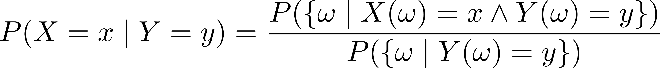
From joint to conditional
a
1
b
0
c
3
d
4

Slide 6
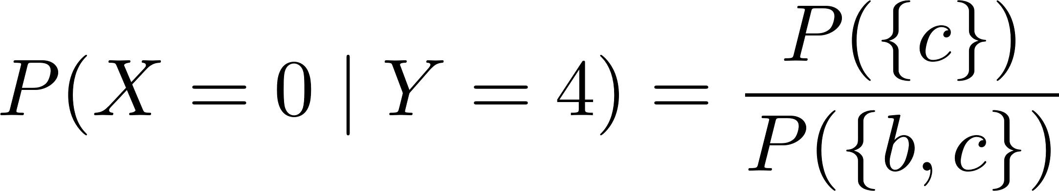
From joint to conditional
a
1
b
0
c
3
d
4

Slide 7
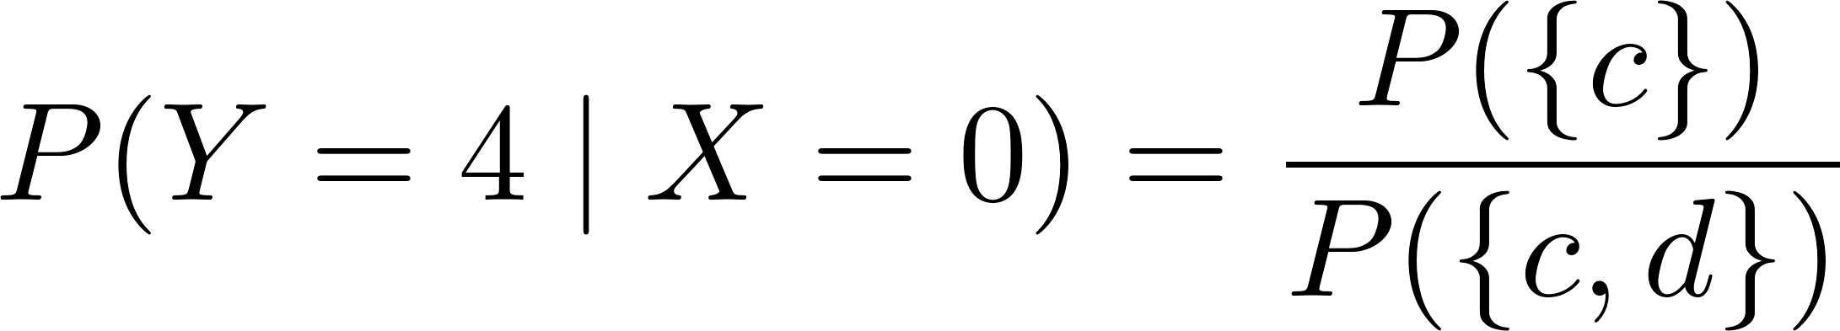
From joint to conditional
a
1
b
0
c
3
d
4

Slide 8
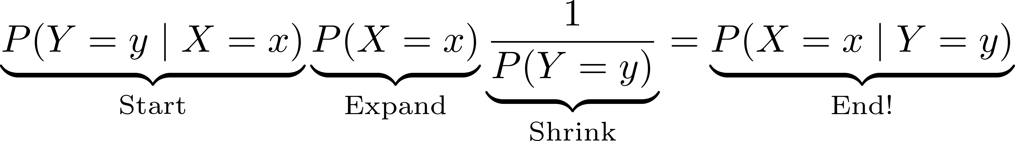
Conditional probability to Bayes theorem
We can see that the numerator in the calculations for P(X=x|Y=y) and P(Y=y|X=x) is the same, namely: the set of events that satisfy both!
But the denumerator changes in the two expressions:
P(X=x|Y=y) it’s the probability of the set of events that are y
P(Y=y|X=x) it’s the probability of the set of events that are x
Going from one to the other gives us Bayes theorem:

Slide 9
A motivating example
Suppose that we have a bag with an infinite number of marbles.
n% of the marbles are blue, 1-n% are red.
Suppose we take 20 marbles out of the bag.
We know from a couple weeks ago how to calculate the probability of getting exactly m blue marbles as a function of n.
But suppose we don’t know n. Rather, we get a number m of blue marbles and we want a posterior over possible proportions n.
Can we write this with conditional probability notation?
Conceptually, what we need to do is go from one conditional probability, namely P(m blue marbles | n) to another, namely P(n | m blue marbles)

Slide 10
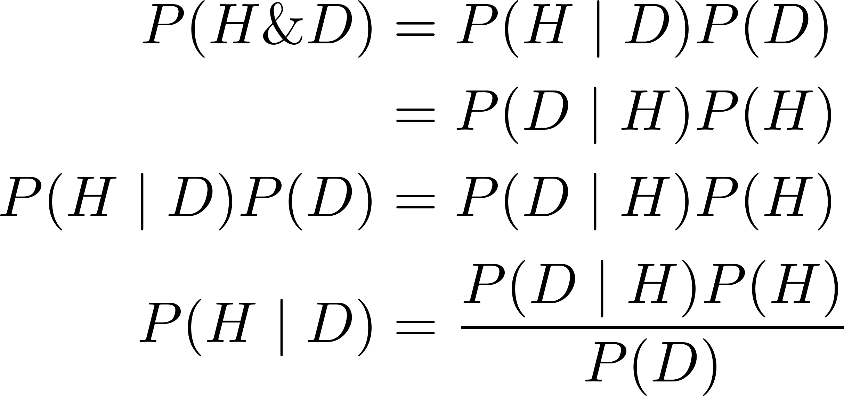
Bayes’ theorem, a simple derivation
To do this, we can use Bayes theorem
There is also a simple derivation of Bayes theorem you can keep in mind.
First, note that from the definition of conditional probability we can write the joint in two different ways:

Slide 11
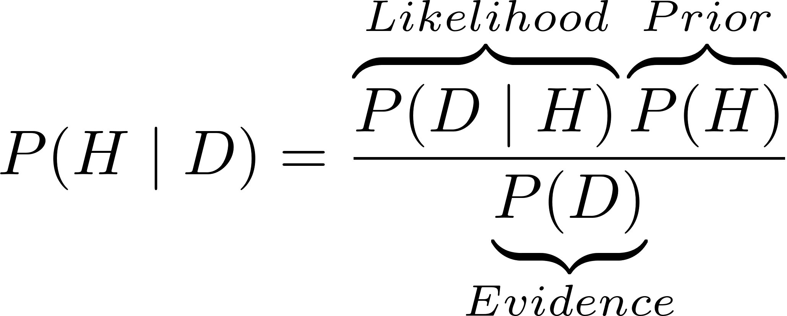
The components of Bayes theorem
Three ingredients in Bayes theorem:
The likelihood is the probability of the data given the hypothesis (as a function of the hypothesis though!)
How to interpret it?
The prior is the probability of the hypothesis NOT conditioned on the data
How to interpret it?
The evidence is the probability of the data NOT condition on an H.
How to interpret it?

Slide 12
The components of Bayes theorem
Three ingredients in Bayes theorem:
Let’s think what happens when we change the components individually.
Note that you can rewrite the evidence as a sum! Which one?
This means that if we calculate the numerators for all hypotheses and put them in a vector, and then we normalize the vector (divide it by its sum), we don’t need to explicitly calculate the evidence.
If the space of hypotheses is infinite, it’s often easy to calculate the numerator and hard or impossible to calculate the denominator!
Is this all clear?

Slide 13
Bayes’ theorem vs Bayesian update
Usually, we apply Bayes theorem to calculate P(H | D), where:
The hypothesis is something about the world we can’t observe directly
The data is something we can observe directly
You can think of an application of Bayes theorem as a way of updating one’s model of the world when new data comes in.
A prior and a posterior then are relative to one update
So we can think of one application of Bayes’ theorem as an update in the state of knowledge given some data
This gives a very natural way of thinking about the way humans could update their picture of unknown quantities given a stream of new evidence.

Slide 14
Applying Bayes’ theorem to example
Example 1:
Suppose we got the following sample from the bag above:
4 blue marbles, 6 red marbles
Let’s calculate the posterior of n
Example 2:
Now I observe one more red marble.
What happens?
A person tells good jokes 30% of the time, alright jokes 30% of the time and bad jokes 40% of the time. Their friend laughs 10% of the time when it’s a good joke; 3% of the time when it’s okay; and 7% of the time when it’s bad.
What is the probability it was a bad joke if their friend laughs?
What is the probability it was an okay joke if their friend doesn’t laugh?

Slide 15
Causal graphs
Imagine we have a bunch of random variables X, Y, Z
This induces a joint distribution P(X, Y, Z)
We can factor this in various equivalent ways, e.g.
P(X, Y | Z) P(Z)
P(Y | X, Z) P(X | Z) P(Z)
Etc.
We know that least some of these conditional probs will depend on the way the variables causally influence each other.
In a causal graph, we have a node for each variable, and we draw an arrow from A to B iff A causally influences B.
E.g. P(X, Y, Z) = P(Z|Y)P(X|Y)P(Z|X)
We can distinguish between seen and unseen variables!
Y
X
Z
Y
X
Z

Slide 16
Thinking in generative terms
The Bayesian approach is generative. This means that we imagine the data as being generated by some (unseen) mechanism.
In practice, we start with a joint over data and hypotheses:
P(data, hypothesis)
The hypothesis is a combination of values for all the unseen variables
Which then factorizes into prior and likelihood
P(data|hypothesis)P(hypothesis)
The prior is the distribution we give to the unconditional random variables in the generative mechanism, the likelihood is defined by all the conditional probabilities.
We can also give a value to all the unconditional variables in the generative model and do a ‘forward pass’ through the model, i.e. calculate P(D|H)

Slide 17
Bayesian inference in formal grammars
How do you think we could use Bayesian inference to learn a sentence in a grammar (the LoT) given some observations?
What’s the prior, likelihood, evidence, and posterior?
What is going to be the practical problem with this?
Next week we’re going to see how we can partially solve this problem!

Slide 18
Summary
This week we have seen a little bit about Bayesian inference.
In particular, starting from the concept of a conditional distribution, we have seen how to go from one conditional P(D|H) and a prior P(H) to a posterior P(H|D)
This is basically the fundamental idea of Bayesian inference. Everything else is an elaboration on this.
A big problem with Bayesian inference is computational: we need clever algorithms to actually find the posterior.
Next week we are going to see one such algorithm, the Metropolis-Hastings algorithm.
We’ll also see how to apply it to some basic cognitive examples.

