Slide 1
The Logical Primitives of Thought
Or: Logical LoT for categorization
The Language of Thought: computational cognitive science approaches to category learning
Who: Fausto Carcassi
When: Sommer semester 2022

Slide 2
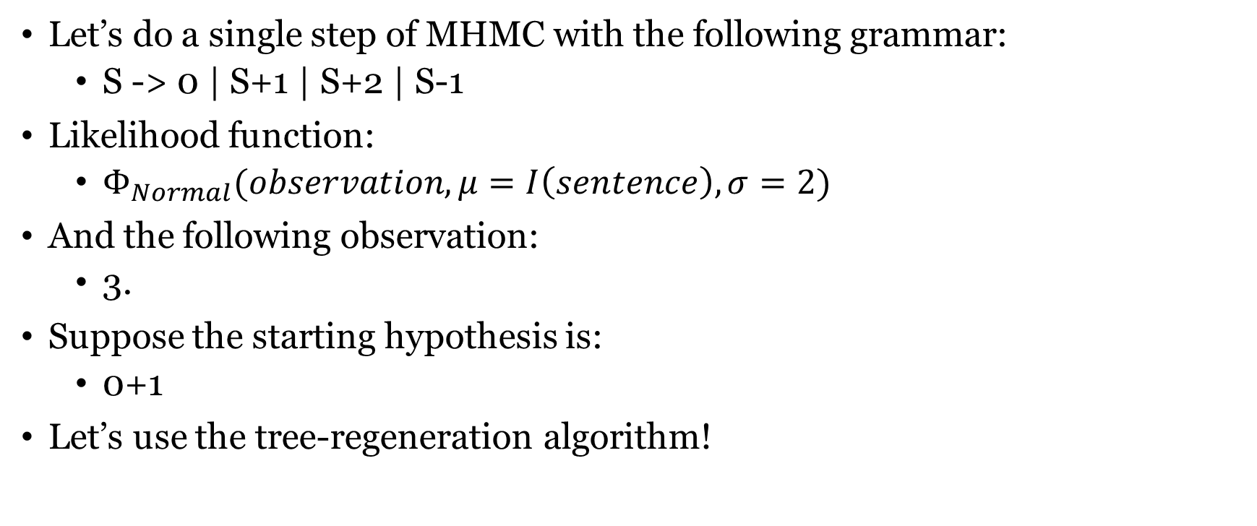
Bayesian update
Let’s do a single step of MHMC with the following grammar:
S -> 0 | S+1 | S+2 | S-1
Likelihood function:
$Φ_{Normal}(observation, μ=I\left(sentence\right), σ=2)$
And the following observation:
3.
Suppose the starting hypothesis is:
0+1
Let’s use the tree-regeneration algorithm!

Slide 3
Where we are
Let week, we have seen some arguments supporting the pLoT approach to cognitive science, and we have started to see how to use Piantadosi’s LOTlib3 library.
Today, we’ll look at the first application of all the technical machinery we have covered so far, namely the acquisition of logically structured categories
Paper: Piantadosi et al (2016) The Logical Primitives of Thought: Empirical Foundations for Compositional Cognitive Models

Slide 4
The problem: Concept learning
Boolean concepts
Concepts that use Boolean operators to connect properties
E.g. “object is blue and not square”
Shefferstrich (negated conjunction) is enough in principle
But more operators allow us to express concepts more compactly
And different sets of operators can imply different complexity levels for the same category
Quantificational concepts
Concepts that use
E.g. “There is another object with the same shape”
E.g. “Every other object with the same shape is blue”

Slide 5
Some background: Feldman (2000)
Feldman (2000) is a very foundational paper for the LoT field, but didn’t age very well.
Feldman showed participants a bunch of ‘amoebas’ with simple binary features (shape of the nuclei, size of the nuclei, shading of the nuclei and number of nuclei)
Participants saw a bunch of them and had to learn to identify a ‘new species of amoeba’.
First a random Boolean concept was generated, and then participants saw all positive and negative examples on the screen for a fixed duration.
Finally, the participants saw each object and had to say whether it belongs to the new species or not.

Slide 6
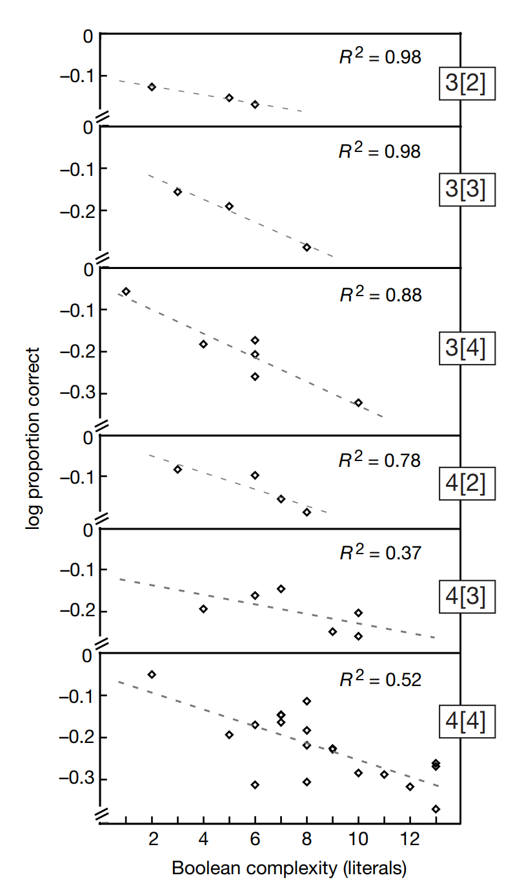
Some background: Feldman (2000)
What interested Feldman is whether people would struggle categorizing correctly the species that were encoded by more complex concepts in Boolean logic.
And that’s what we see in fact!
This particular result was disputed in successive literature, but the general approach became very successful.
Namely: learning manifests something about the complexity of the encoding of different concepts.
A lot of pLoT literature is an improvement of this!
In this background, Piantadosi (2016) studies a similar categorization problem.

Slide 7
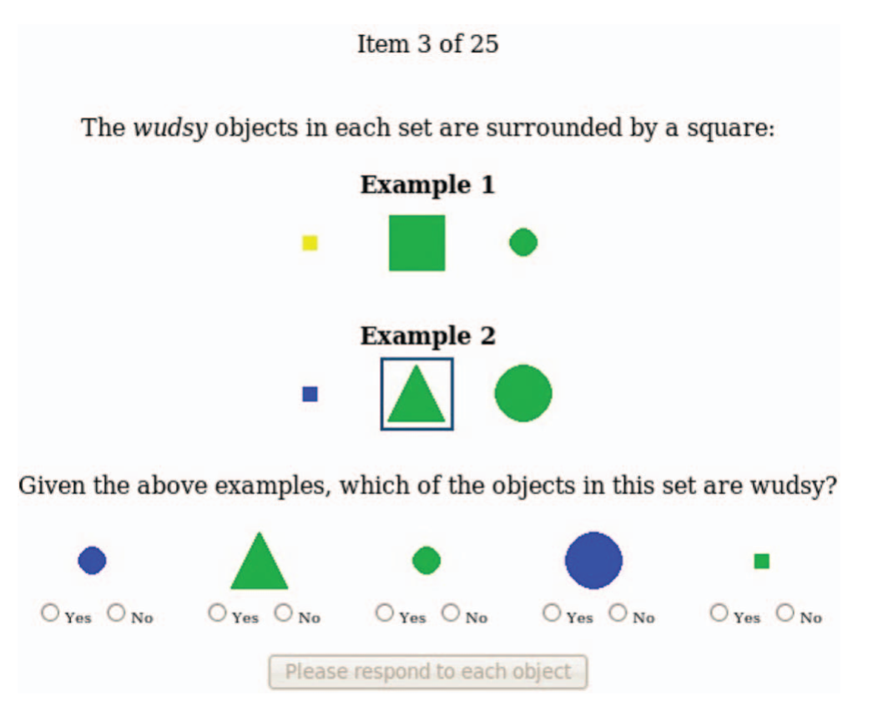
Experiment (Piantadosi et al 2016)
Participants were told that they had to discover the meaning of wudsy, a word in an alien language.
They were told that this word applied to some objects in a set, and that whether or not an object was wudsy might depend on what other objects were in the set.
Participants were shown a set and asked whether each item was wudsy.
After responding, they were shown the right answers.
The correctly labeled sets stayed visible on the screen, and participants moved on to the next set.

Slide 8
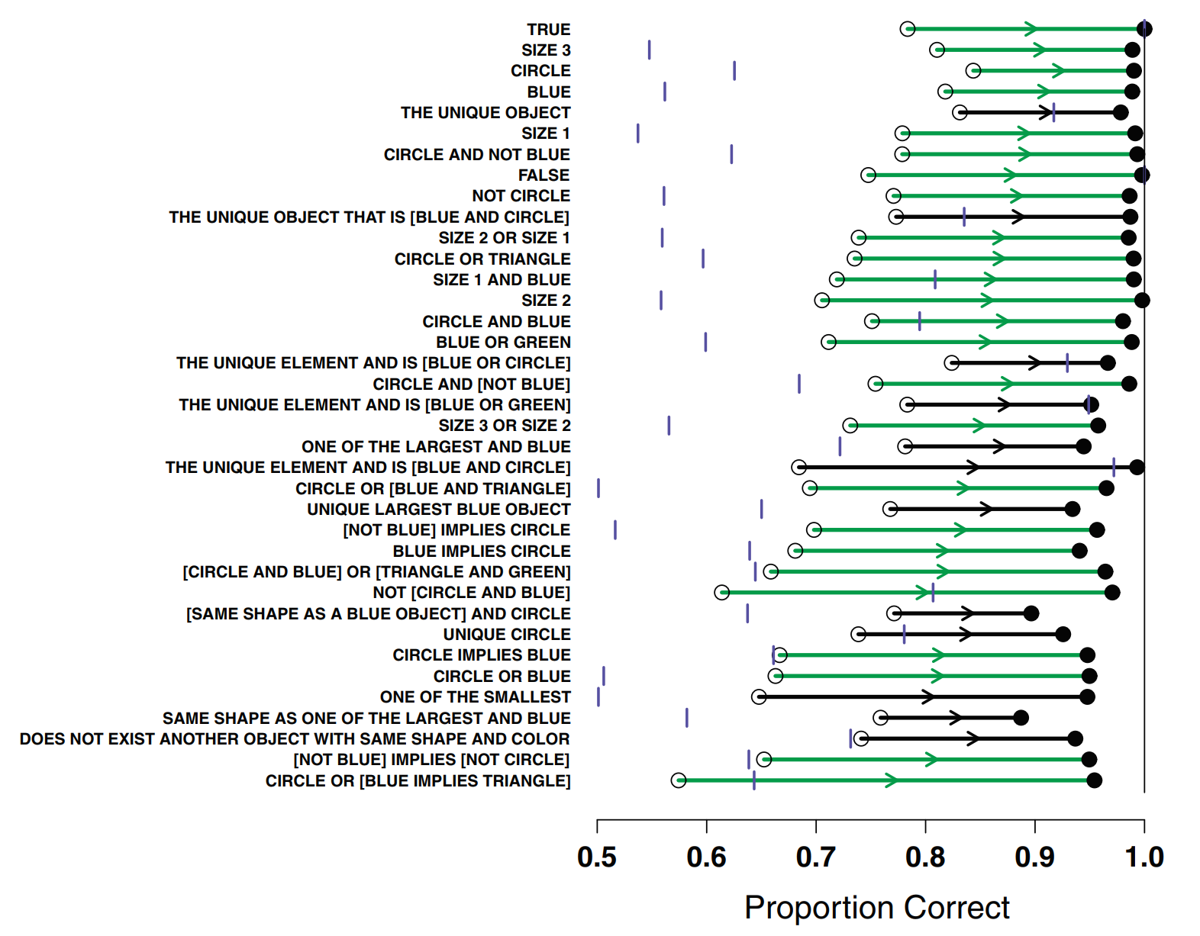
Experiment
Objects were:
Squares, circles, triangles
Green, blue, yellow
Three sizes
1596 participants, 108 concepts!
Model-free results:
Top third most easily learned
White circle: accuracy on first 25%
Black circle: accuracy on last 25%

Slide 9
Need for a model-based analysis
Three problems with analyzing this data just looking at accuracy levels:
Different concepts have different baseline accuracy which makes it difficult to compare them directly
Participants can get high accuracy by learning not the right concept, but a wrong one that agrees with the right one in most cases
Data observed by different participants might give different amount of information about the true concept.
The Bayesian pLoT model allows us to calculate learning curves for specific observed sets and the probability of including each object in the category given learning state!
Do you see how we could use a Bayesian model to analyse the data?

Slide 10
Bayesian data analysis
We have looked at how we can do Bayesian analysis when learning about some unknown aspect of the world
However, note that when we analyse data from cognitive science experiments, what we are interested in is something about participants we can’t see directly.
This is perfect for a model of Bayesian inference!
Suppose we have some model of participants with an unknown free parameter, which tell us the probability that the participant will behave in a certain way: P(behaviour | values of hidden parameters, cognitive model)
Then, we can use Bayes theorem to find a distribution over the hidden parameter given the experimental data! This is Bayesian data analysis.
This is exactly what they do in the Piantadosi model.
So let’s see what model they develop for participants’ behaviour!

Slide 11
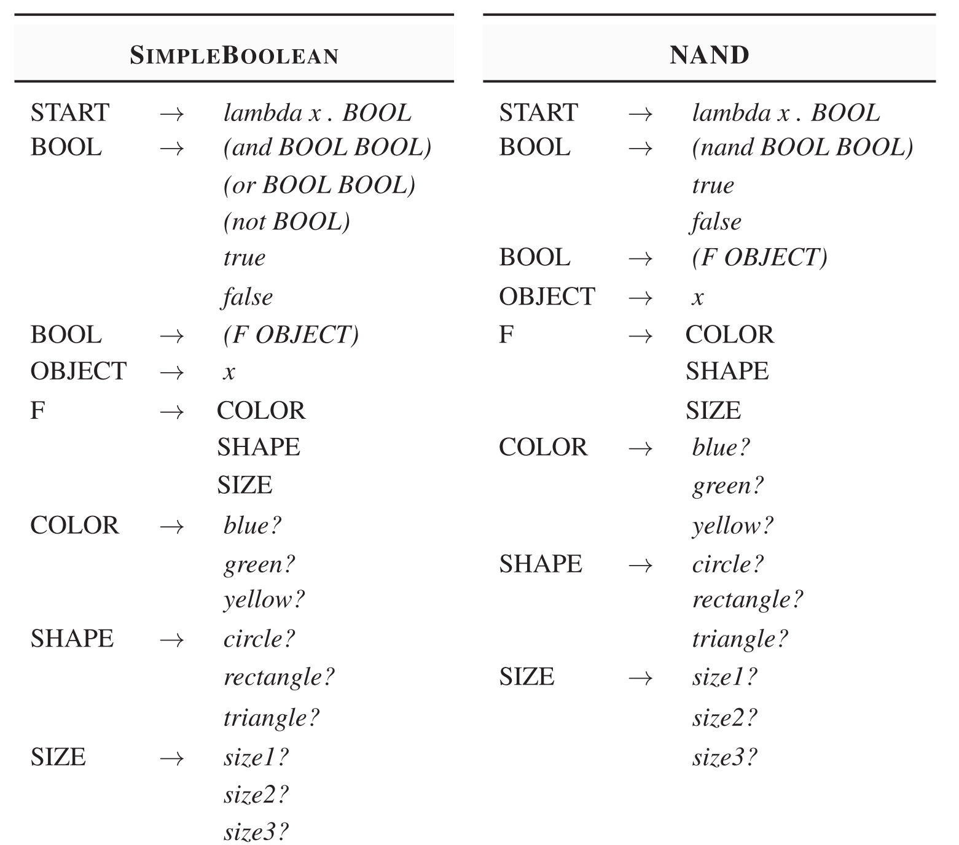
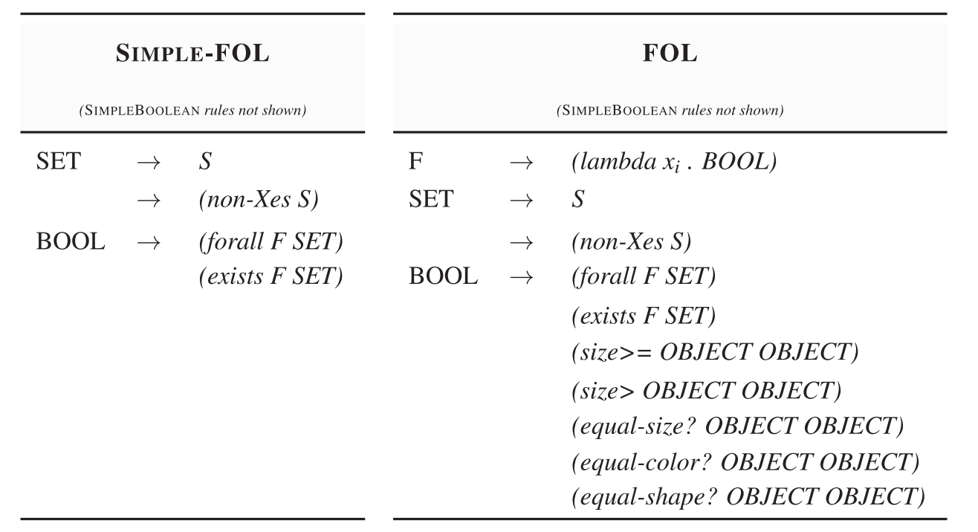
Boolean LoTs
Instead of using just one LoT, Piantadosi et al consider a set of possible LoTs that participants might be using the infer the data, e.g.:

Slide 12
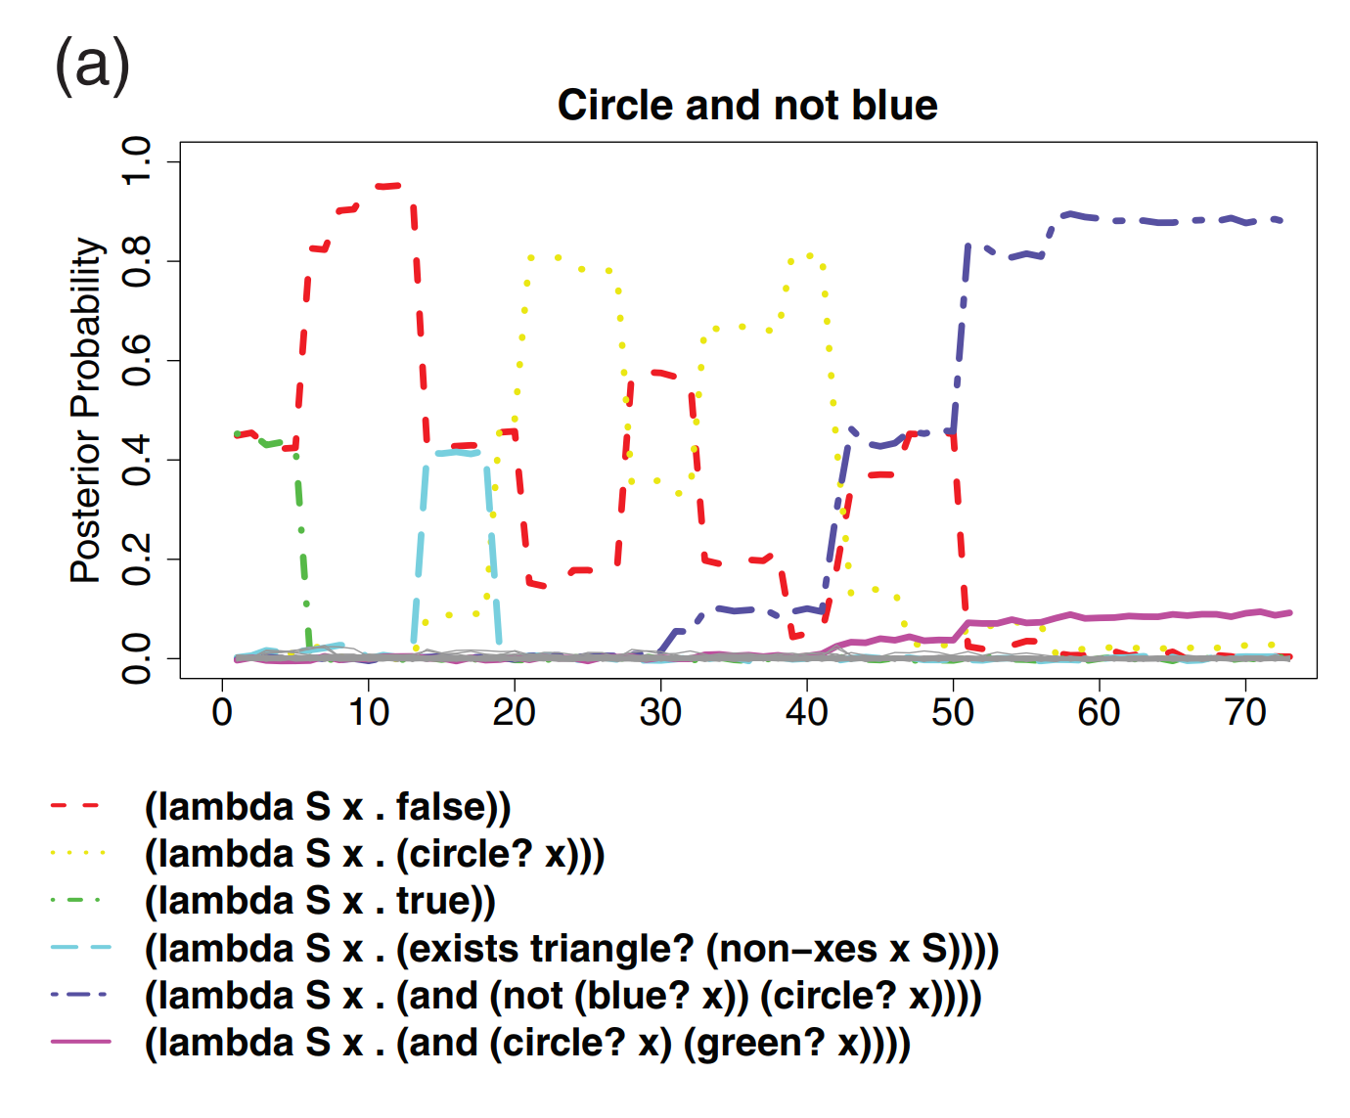
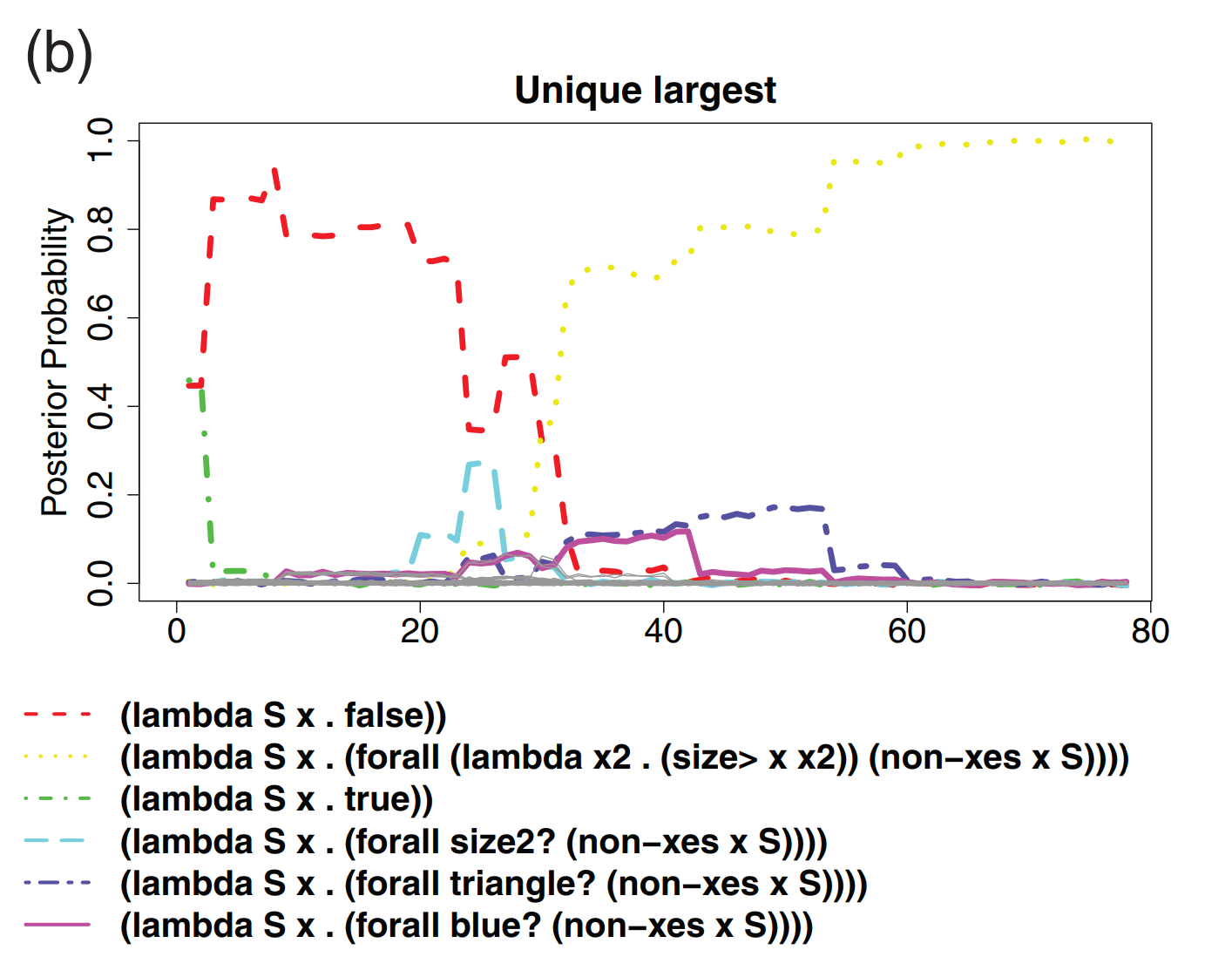
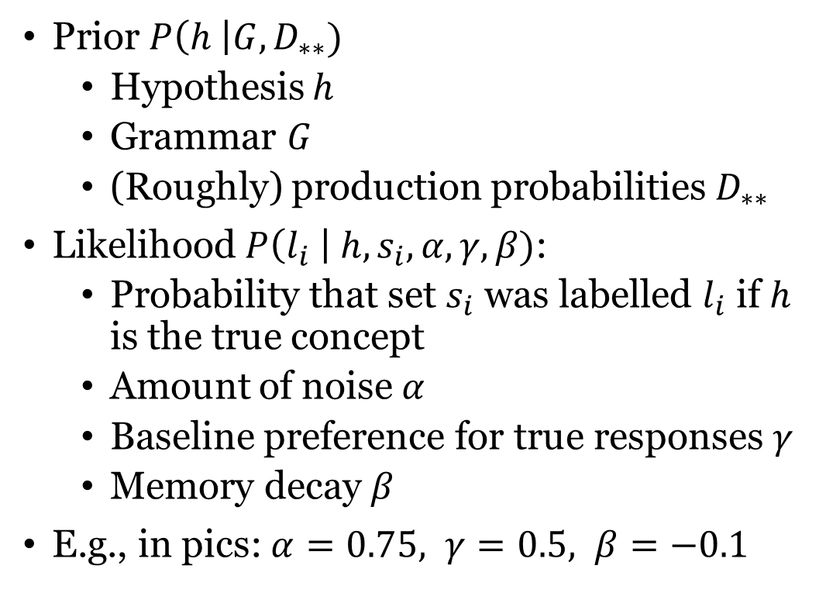
Bayesian model
Prior $P\left(h \right|G, D_{∗∗})$
Hypothesis $h$
Grammar $G$
(Roughly) production probabilities $D_{∗∗}$
Likelihood $P\left(l_{i} \right| h, s_{i}, α, γ, β)$:
Probability that set $s_{i}$ was labelled $l_{i}$ if $h$ is the true concept
Amount of noise $α$
Baseline preference for true responses $γ$
Memory decay $β$
E.g., in pics: $α=0.75, γ=0.5, β=−0.1$

Slide 13
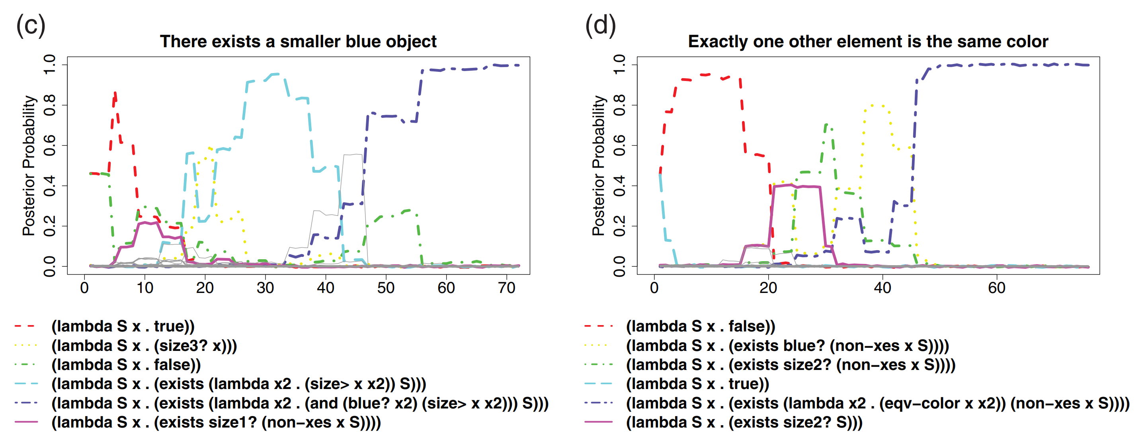
Bayesian model
Prior $P\left(h \right|G, D_{∗∗})$
Hypothesis $h$
Grammar $G$
(Roughly) production probabilities $D_{∗∗}$
Likelihood $P\left(l_{i} \right| h, s_{i}, α, γ, β)$:
Probability that set $s_{i}$ was labelled $l_{i}$ if $h$ is the true concept
Amount of noise $α$
Baseline preference for true responses $γ$
Memory decay $β$
E.g., in pics: $α=0.75, γ=0.5, β=−0.1$

Slide 14
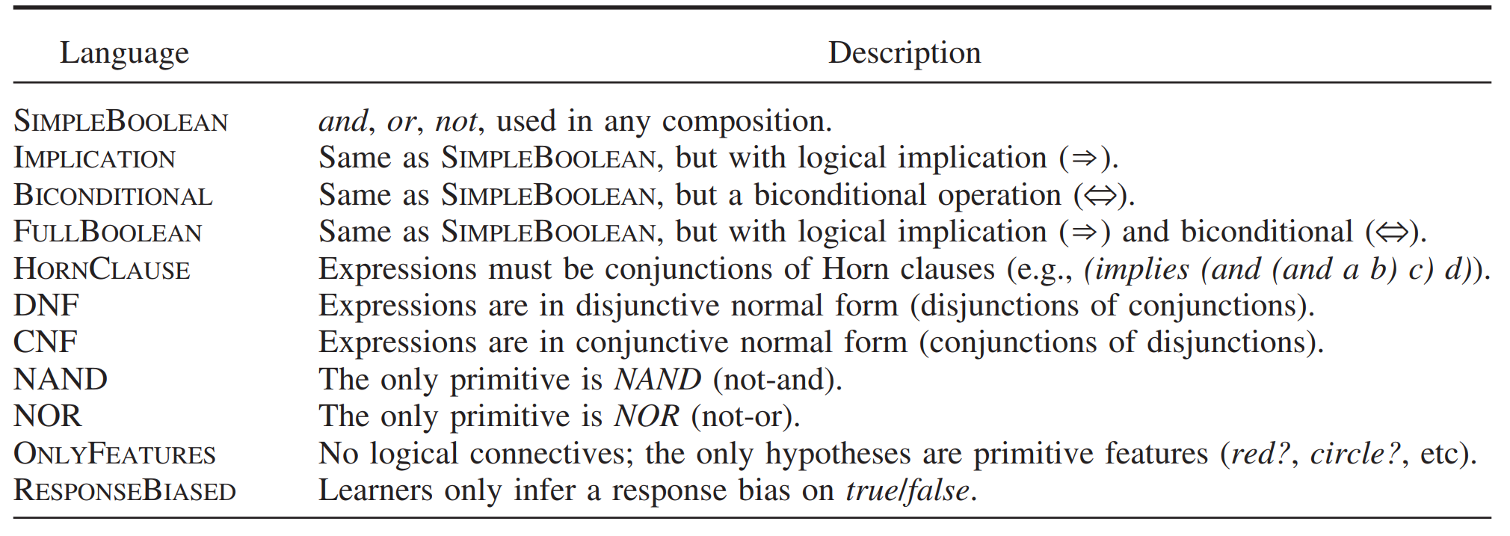
Bayesian model
Now we have a model of participants’ behaviour
So we can do Bayesian inference on the experimental data and calculate a posterior for the unobserved parameters that control participants’ categorization behaviour.
The posterior depends on the grammar that we assume participants are using.
Piantadosi fits the data with various grammars, e.g. for the purely Boolean:

Slide 15
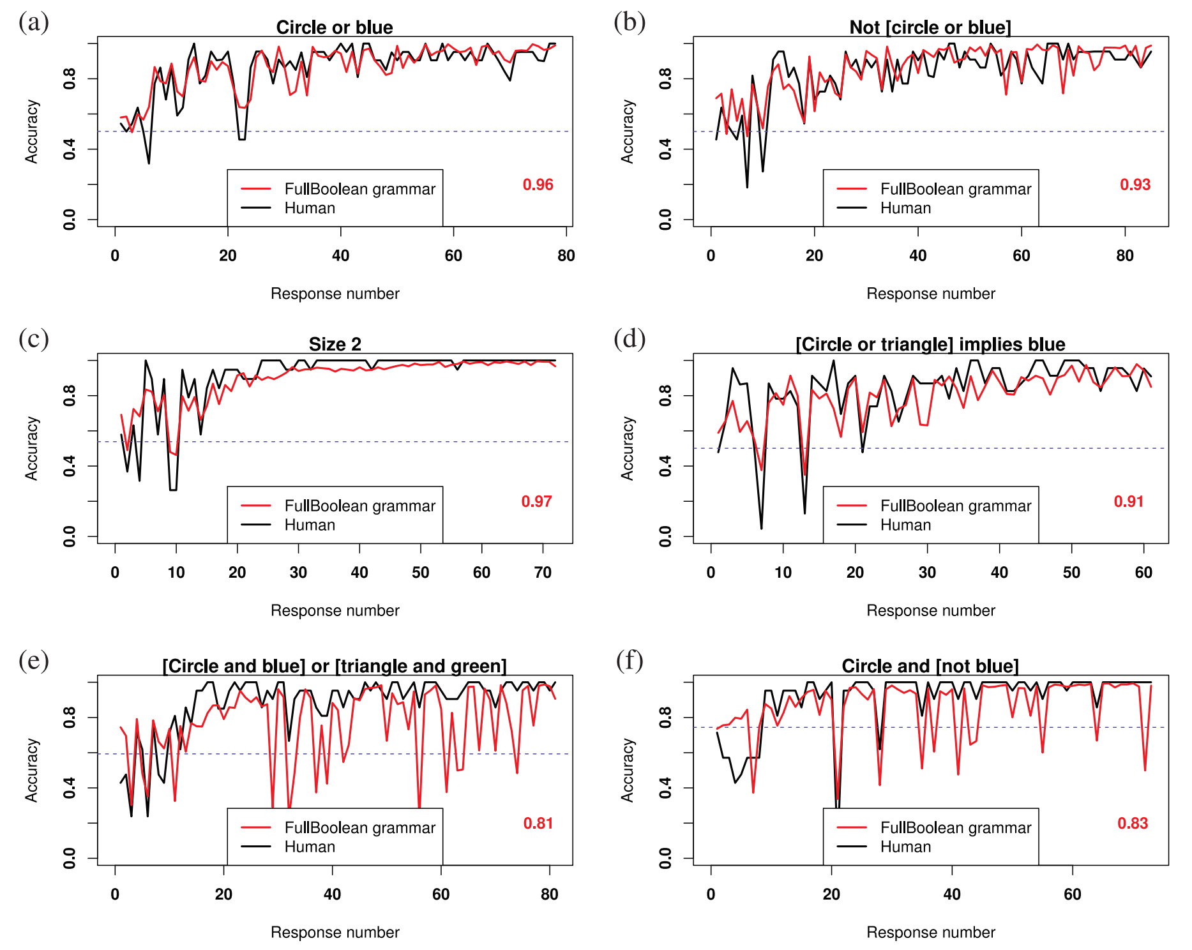
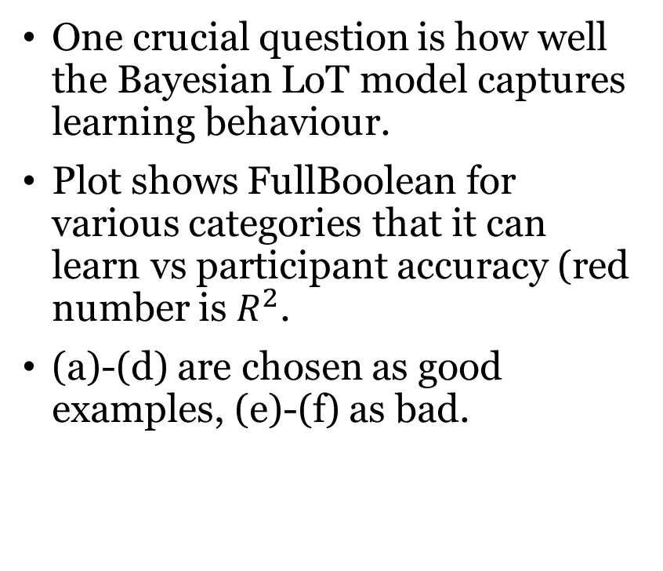
Results
One crucial question is how well the Bayesian LoT model captures learning behaviour.
Plot shows FullBoolean for various categories that it can learn vs participant accuracy (red number is $R^{2}$.
(a)-(d) are chosen as good examples, (e)-(f) as bad.

Slide 16
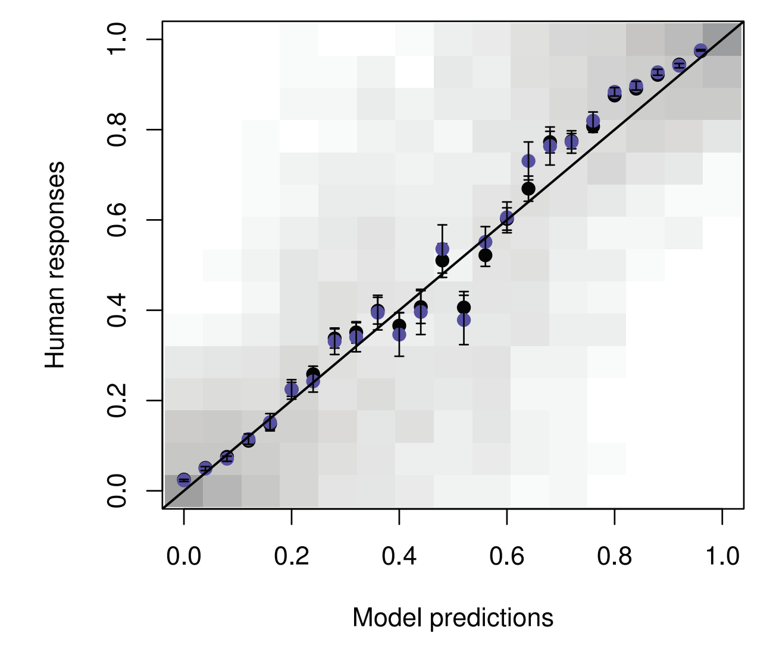
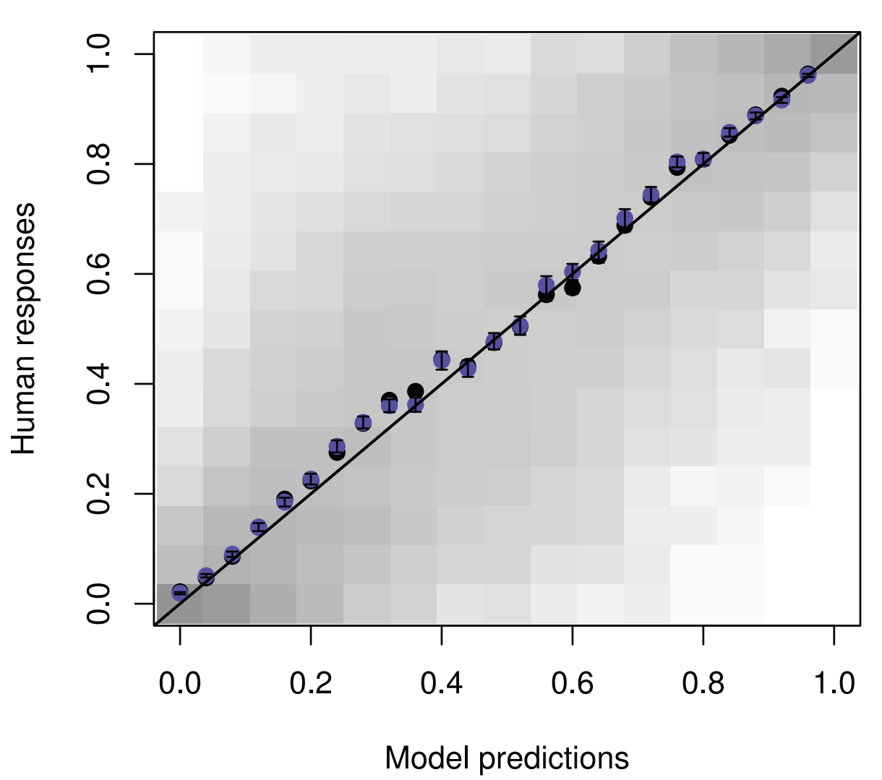
Results
Really good correlation between model’s predictions and participant’s categorization probabilities in the Boolean case (top fig)
Even better with quantificational LoTs! (bottom fig)

Slide 17
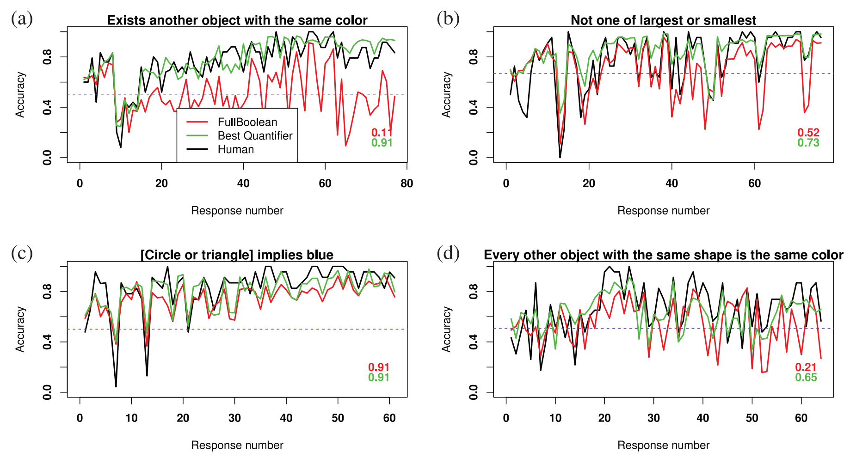
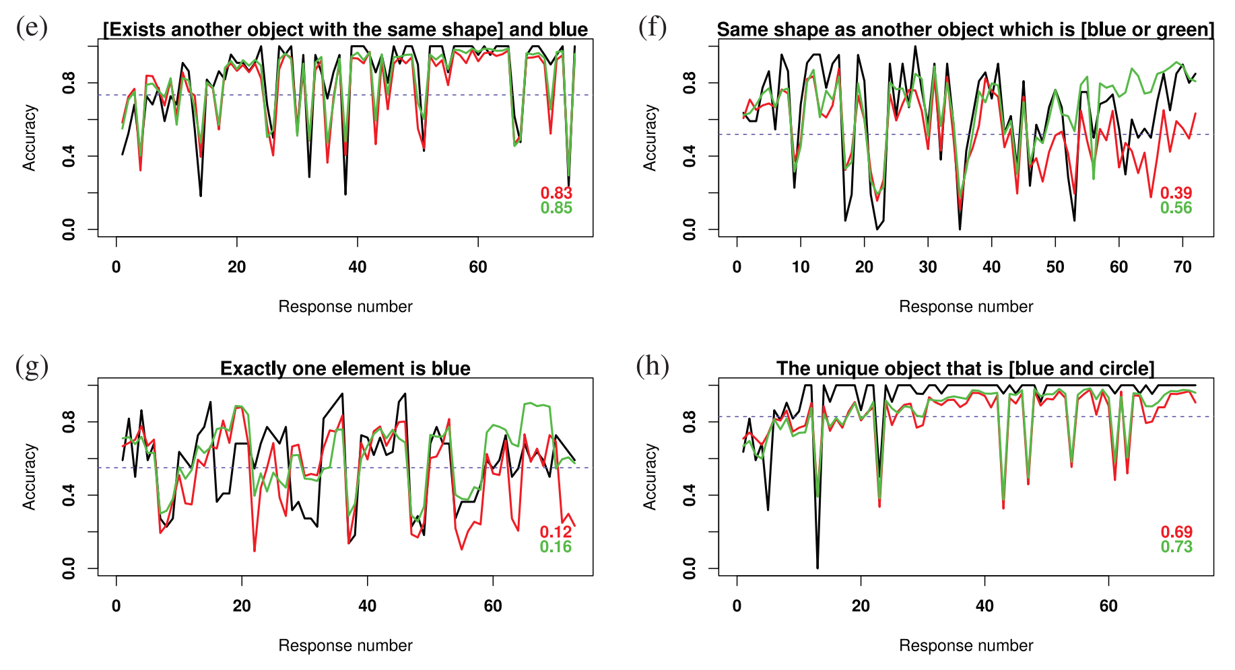
Results
A second question is which grammar best captures the data.
It seems clear that LoTs with quantification capture learning patterns much better.
This indicates the participants are using quantificational means of representing categories!

Slide 18
Where are we now?
This week we have seen that a LoT model can accurately model human learning of feature-based categories.
Categorization is a fundamental domain for cognitive science, so this model is quite an impressive achievement.
In the lab this week we’ll finish looking at the introduction to LOTlib3, and if there is time look at an implementation of category learning in LOTlib3.
Next week we have a choice!
We can either look at:
A paper from last year that concerns the acquisition of kinship systems which also looks at kinship systems in different languages.
A paper from 2015 on inferring hand-written digits with an LoT

