Slide 1
The probabilistic Language of Thought
Or: The pLoT thickens…
The Language of Thought: computational cognitive science approaches to category learning
Who: Fausto Carcassi
When: Sommer semester 2022

Slide 2
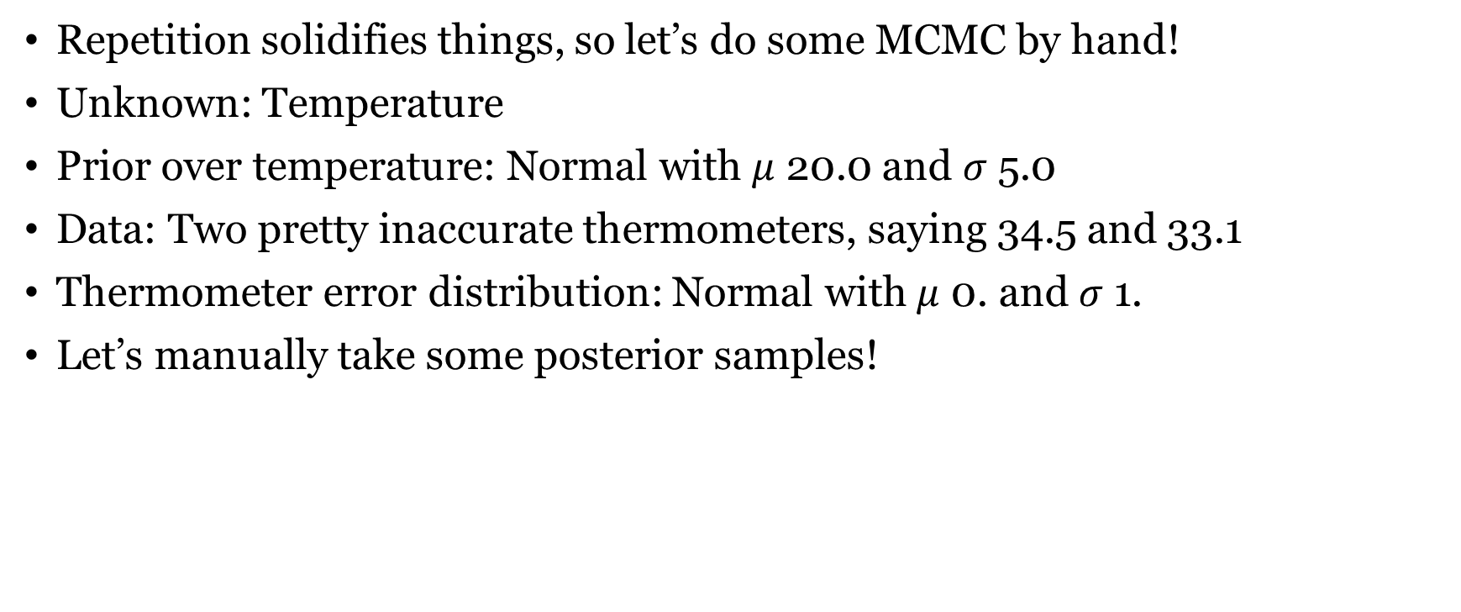
Refresher: Bayesian update, MCMC
Repetition solidifies things, so let’s do some MCMC by hand!
Unknown: Temperature
Prior over temperature: Normal with $μ$ 20.0 and $σ$ 5.0
Data: Two pretty inaccurate thermometers, saying 34.5 and 33.1
Thermometer error distribution: Normal with $μ$ 0. and $σ$ 1.
Let’s manually take some posterior samples!

Slide 3
Refresher: Lambda calculus
Let’s write a lambda expression that
Characterizes the set of objects that are red and square (in first order logic, with RED and SQUARE as predicates)
Takes an object and returns the set of properties of the object
Characterizes the set of objects with exactly two properties

Slide 4
Where we are
Last week, we have seen how to practically perform Bayesian inference for any given context
Namely, approximately and with the MHMC algorithm
In practice, this algorithm sometimes doesn’t work so well. But it will be fine for our purposes.
Piantadosi’s other library, fleet, implements a better and much faster algorithm (reversible-jump MCMC)
What we are particularly interested in is doing Bayesian inference on the hypothesis space induced by a PCFG.
From the exercise you had two weeks ago, you should have a sense of how expressive PCFGs can be. In principle, they can express anything.

Slide 5
Where we are
The homework from last week’s lab is the last one.
The other assessment is the final project!
So please start thinking about what you might want to do for that (some ideas are in the website) and let’s discuss it!

Slide 6
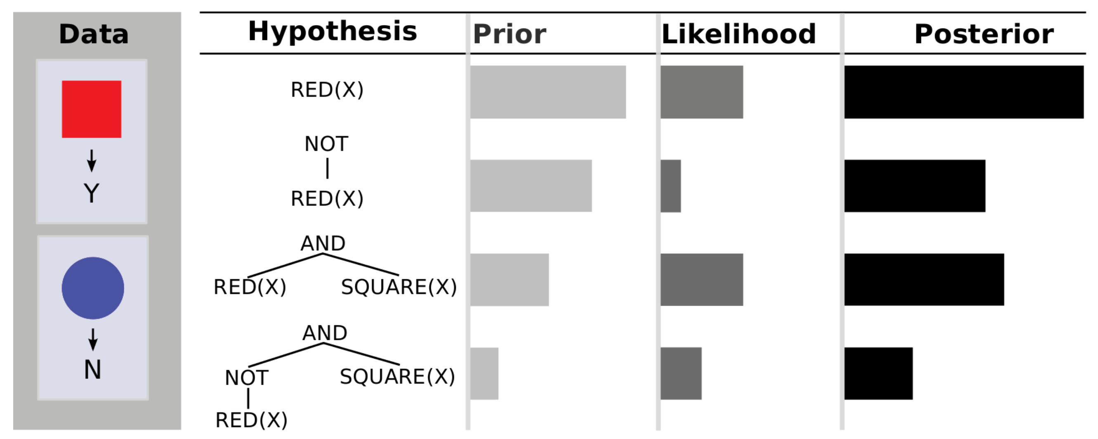
The main idea of the pLoT

Slide 7
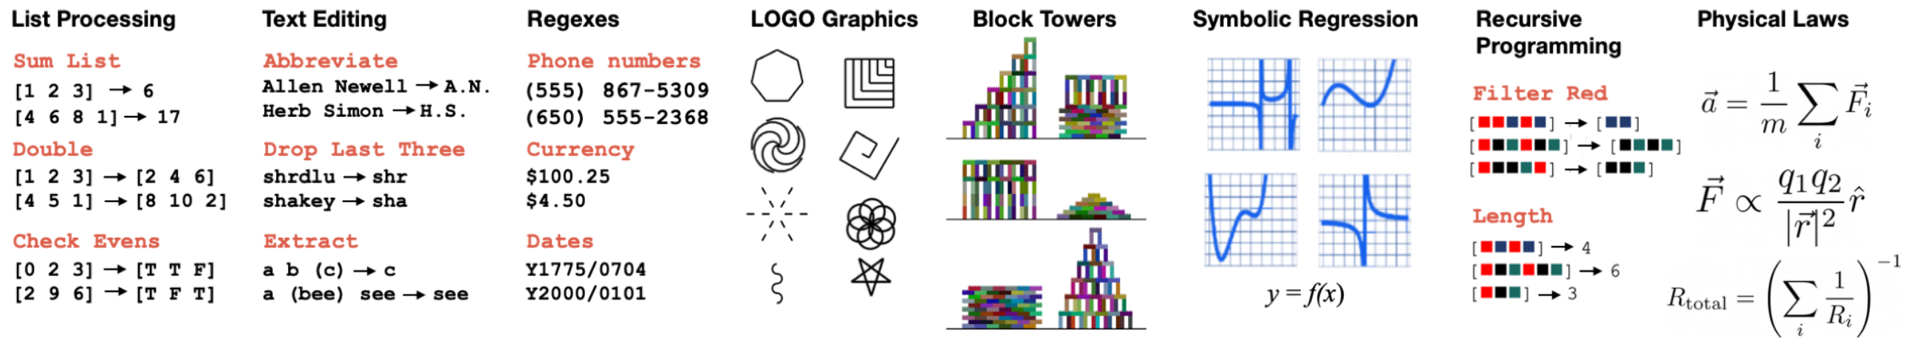
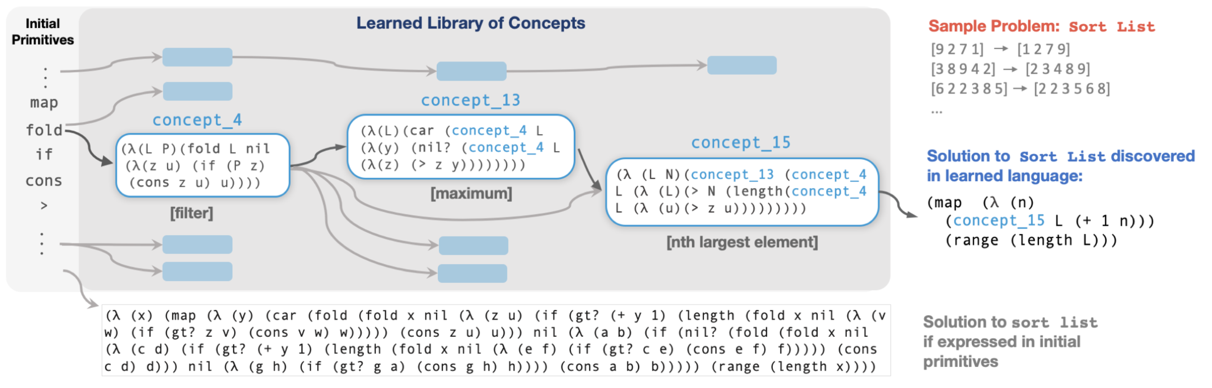
Application (DreamCoder)

Slide 8
Two approaches to AI
Historically, there have been two main approaches to AI
First, a symbolic / logic approach, based on symbol manipulation
What are the big advantages and disadvantages of this?
Pro: Can model compositionality, deduction, very structured things
Contra: Brittle, not robust to noise, can’t easily model
Second, statistical approach
Pro: Flexible to noise
Contra: Need a lot of hand-specification
PLoT approach combines these two approaches
Representations are modelled symbolically (as opposed to neural nets)
But learning happens probabilistically

Slide 9
Nativism and empiricism
Nativism: Some mental structures / knowledge is innate
Pro: Makes little assumptions at the cognitive level
Con: Machine learning shows that a lot can be learned from data
Empiricism: Everything is learned from data
Pro: Can make sense of ‘poverty of the stimulus’ arguments
Con: Assumes stuff we can’t yet verify
PLoT finds a balance between the two
Most is learned, but the pLoT defines a so-called structural prior
Specific innate LoT can be studied empirically

Slide 10
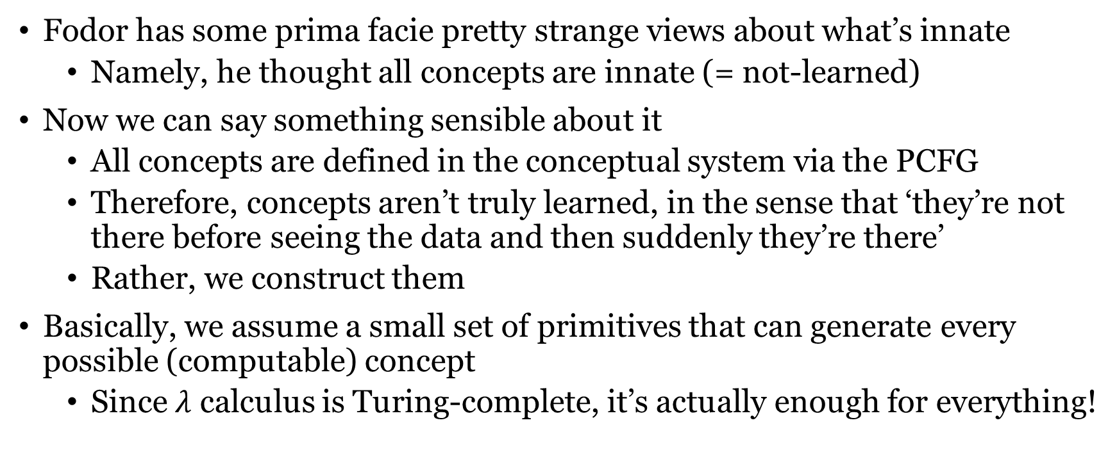
Novelty in learning
Fodor has some prima facie pretty strange views about what’s innate
Namely, he thought all concepts are innate (= not-learned)
Now we can say something sensible about it
All concepts are defined in the conceptual system via the PCFG
Therefore, concepts aren’t truly learned, in the sense that ‘they’re not there before seeing the data and then suddenly they’re there’
Rather, we construct them
Basically, we assume a small set of primitives that can generate every possible (computable) concept
Since $λ$ calculus is Turing-complete, it’s actually enough for everything!

Slide 11
Sensations to concepts
pLoT inference can infer modality-independent hierarchically-structured representations straight from sensory data
“it can specify how local patches combine to form surfaces, how surfaces combine to form parts, how parts combine to form objects, and how objects combine to form scenes”
Do you see roughly how we could do that?

Slide 12
What can we do with these models?
Now we have a bunch of techniques. What can we do with them?
Main: Make some observations, update posterior over sentences in a PCFG
This gives us a generative model of some part of the world
If the PCFG defines functions, it can define higher-order concepts
Observations can be input-output pairs ran on the function
If the input is e.g. a situation and the output is e.g. a sentence, this can be e.g. a model of language learning
We can imagine a system that learns a ‘library’ of concepts
Since the PCFG is totally unspecified, and PCFGs can encode anything that’s computable, we can learn anything with it.
Importantly, after we’ve learned a posterior, we can inspect the learned sentence and see what it says in all other cases.

Slide 13
What can we do with these models?
Once we have a generative model, we can do:
Prediction: predict future world states given the generative model. Predictions can be probabilistic, we can answer counterfactual questions, and we know why they are being made
Inference: Having a generative model can help us in inferring other aspects of the world. E.g. knowing what color an object is + sensory input can inform us about the lighting conditions.
Generalization: If we have a generative model, we can transfer the knowledge to new scenarios. E.g. if we learn the weight of a pool ball from seeing some plays, it can help us play future games

Slide 14
Next time: First order logic
The paper for next time is concerned with inferring categories via inference of expressions in a logical fragment of the pLoT.
Can you already see how it would go intuitively?
Do you remember first order logic?

Slide 15
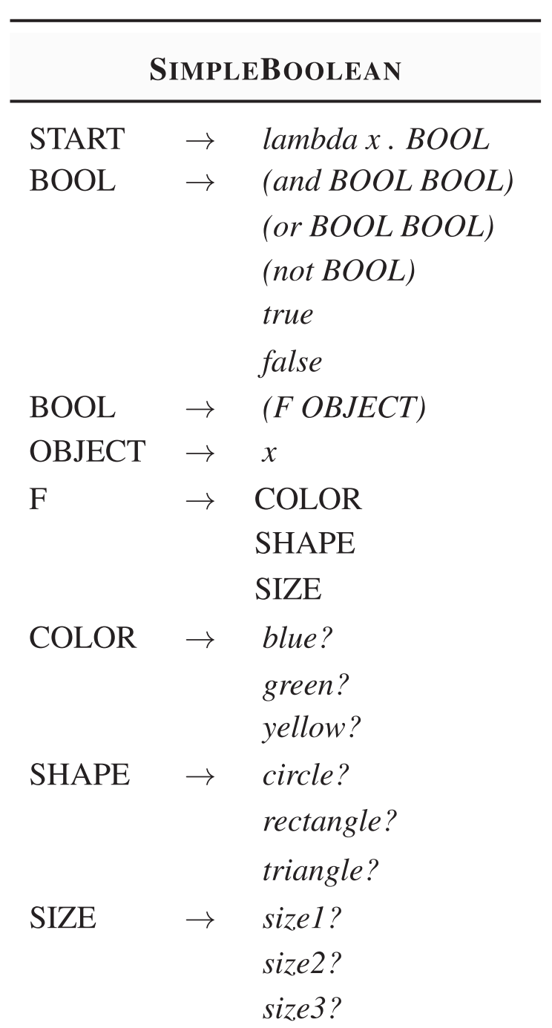
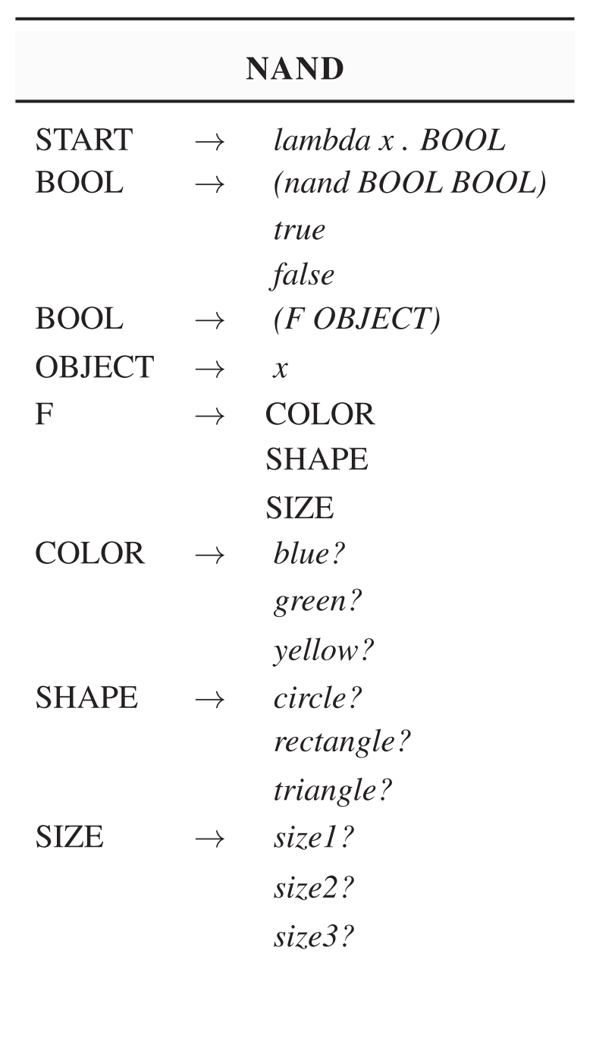
LoT for next time
Aim: define categories
Based on properties
Different LoTs give us different inductive biases
Therefore, based on people’s learning patterns, we might be able to infer which LoT they have

Slide 16
Where we’re going
In the lab this week we will finally learn Piantadosi’s LOTlib3 library
This will allow us to simply define an arbitrary PCFG, some observations, and run MCMC on it to define a posterior over hypotheses.
From next week we will then start going through specific case studies to see how the pLoT project has been applied in cognitive science.
We will alternative reading a paper that implements a pLoT model and trying to implement it in LOTlib3 (or at least a simplified version)
We have 4 weeks to do this, so 4 models!
Topics I have picked (but we can change them if you’d rather do something else): Categories, kinship terms, numerals, sequences

Slide 17
Anything unclear this far?

