Slide 1
Conclusions
Or: DreamCoder and conclusive remarks
The Language of Thought: computational cognitive science approaches to category learning
Who: Fausto Carcassi
When: Sommer semester 2022

Slide 2
Where are we?
We have finally reached the last week!
We have covered quite a lot of stuff:
The philosophical background on the Language of Thought (Fodor)
Some technical background
Formal grammars
Compositional semantics with lambda calculus
Bayesian inference and MCMC for approximating a posterior
The probabilistic Language of Thought
The LOTlib3 library
Some applications to various conceptual domains

Slide 3
Where are we?
Today let’s have a look at two things:
What the state of the art is (DreamCoder)
Where the people in the field see it going (The Child as a Hacker)
In the lab this week we will again write together a little inference script for a conceptual domain
I was thinking we could do a little model to fit a function with some simple operations
So we might get some input-output combos ( [0, 0.3], [0.4, -0.1], … ) and we have to infer an expression that encodes them (e.g., y = log(x)-2)

Slide 4
DreamCoder: The general idea
The problem: Program Induction / pLoT is not scalable compared to neural network systems!
Why do you think that is?
Program Induction systems need to start with a domain specific language.
This is partially because if we start with domain general primitives the programs we need to solve practical problems become so long that they can’t be inferred
Combinatorial /discrete nature of the search space
The space of programs isn’t continuous, so we can’t use our best algorithms (e.g., gradient descent or Hamiltonian monte carlo)
DreamCoder attempts to solve both of these problems!

Slide 5
DreamCoder: The general idea
Two related ideas:
Instead of a fixed list of primitives, grow new concepts, so that the inferred programs are shorter!
This library of new learned concepts will depend on the specific domain, so that DreamCoder grows a domain-specific language.
Learn implicit procedural knowledge
This means that observing the object to be inferred gives us some ideas about which concepts we are going to need and how
This is what we do when we actual program, and it relies on intuition, and so the most natural way is to use a neural networks that goes from the data to the probability of each substitution rule!

Slide 6
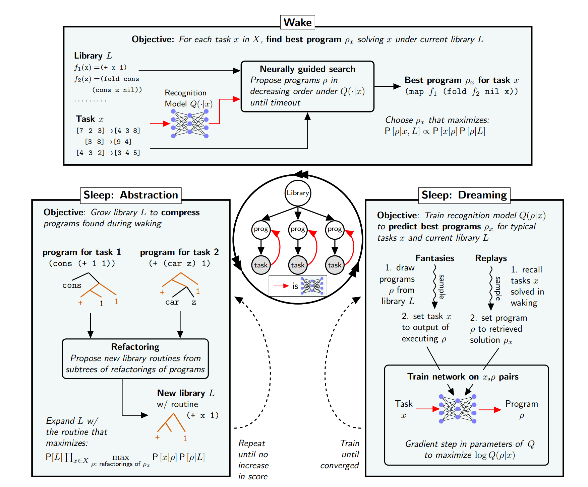
DreamCoder: Learning
Various things need to be done:
How do we grow new concepts?
How and when is the ANN trained?
Solution: Wake/Sleep Program Learning

Slide 7
DreamCoder: Results
First test. Two classic domains: List processing and text editing (218 problems)
In both domains, the program defines a function
DreamCoder starts with a domain-general functional basis
Each round of abstraction built on concepts discovered in earlier sleep cycles
E.g., first learns filter, then uses it to learn to take the maximum element of a list, then uses that routine to learn a new library routine for extracting the nth largest element of a list, which it finally uses to sort lists of numbers
DreamCoder solves 84.3% of the problems with 1 hour & 8 CPUs per problem.
The best-performing synthesizer in this competition (CVC4) solved 82.4% of the problems.
CVC4 had a different hand-engineered library of primitives for each text editing problem!

Slide 8
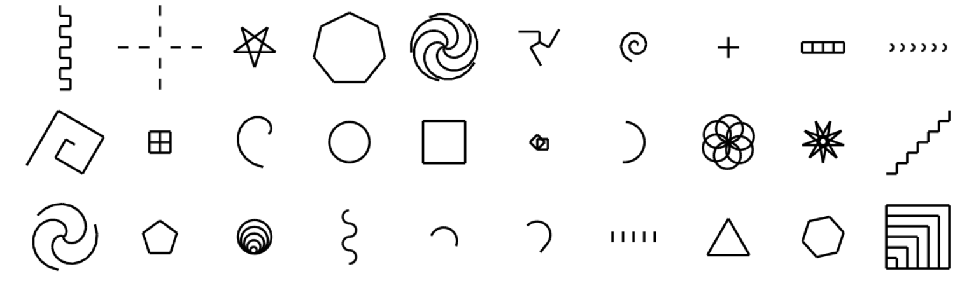
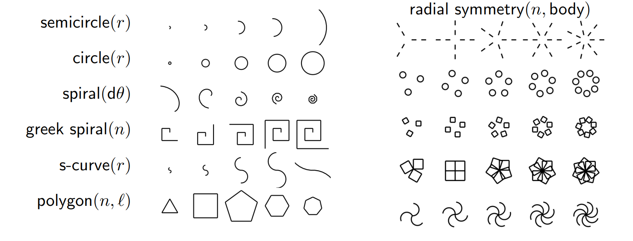
DreamCoder: Results
Second test. More creative domains: generating images, plans, and text.
Programs to learn (30 out of 160) for LOGO shapes task:
Some learned parametric ‘shape concepts’ and higher order function:

Slide 9
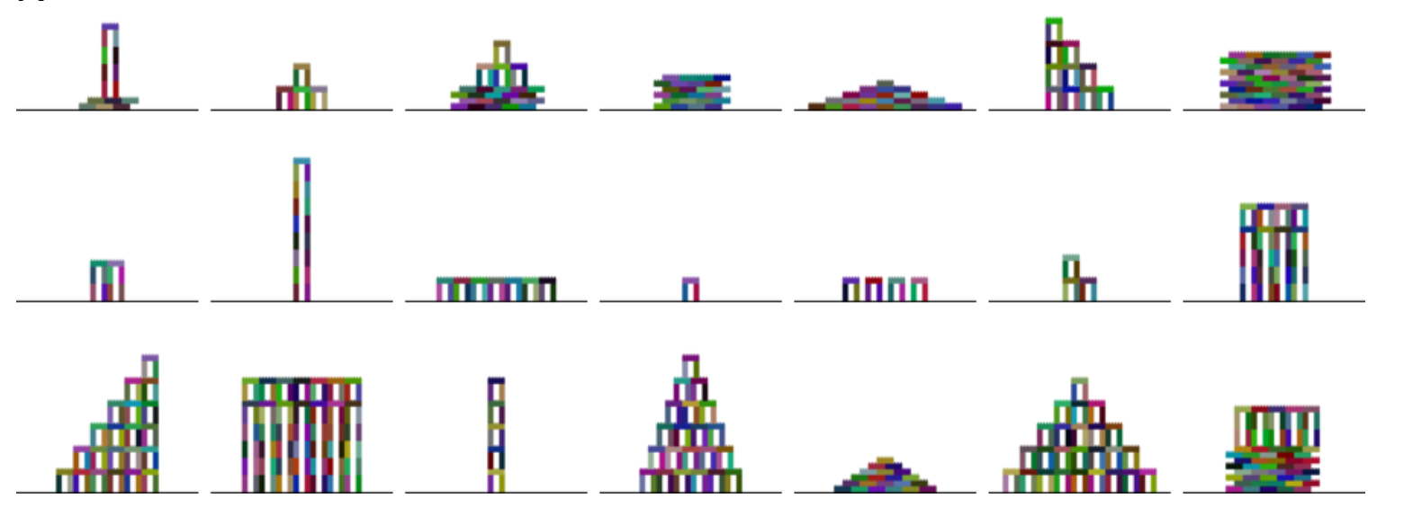
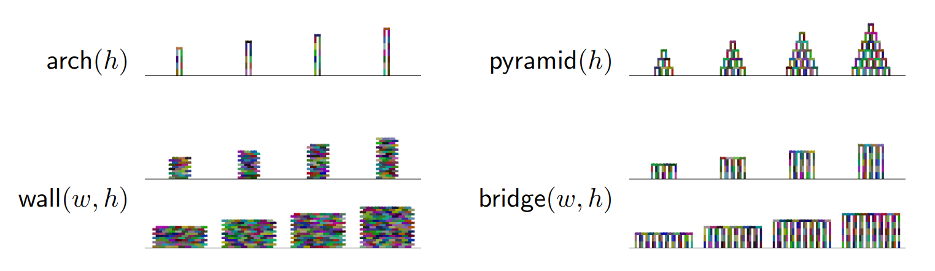
DreamCoder: Results
Second test. More creative domains: generating images, plans, and text.
Programs to learn for towers building:
Some learned parametric ‘shape concepts’ and higher order function:

Slide 10
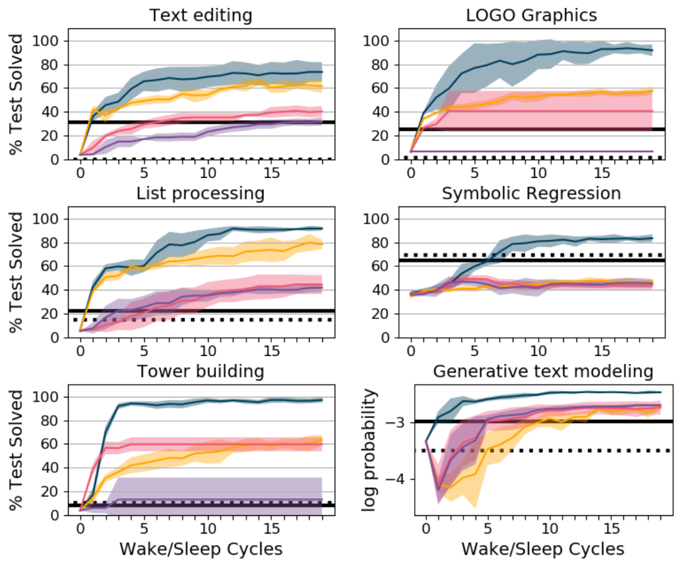
DreamCoder: Results

Slide 11
DreamCoder: Results
Third set of tasks: Learning whole languages!
Question: Can DreamCoder solve complex problems starting just with super general operations and progressively building complex concepts?
Task: Learn a set of 60 physical laws and mathematical identities from quantitative measurements
E.g. mechanics, electromagnetism
After 8 cycles of wake/sleep, DreamCoder learns 93% of the rules
First learning conceps like inner product, vector sum, and norm
Then learns complex like the inverse square law
Finally uses these to formulate the actual laws like Newton’s laws of gravitation and Coulomb’s law of electrostatic force

Slide 12
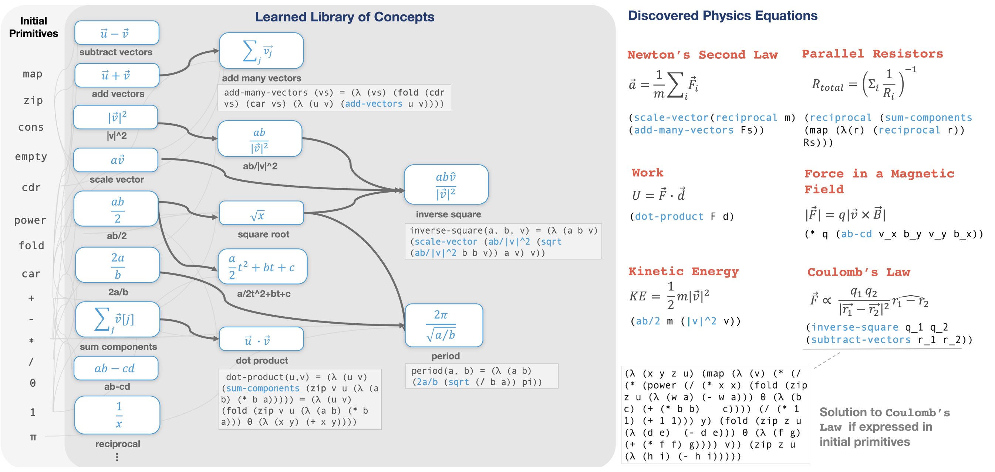
DreamCoder: Results

Slide 13
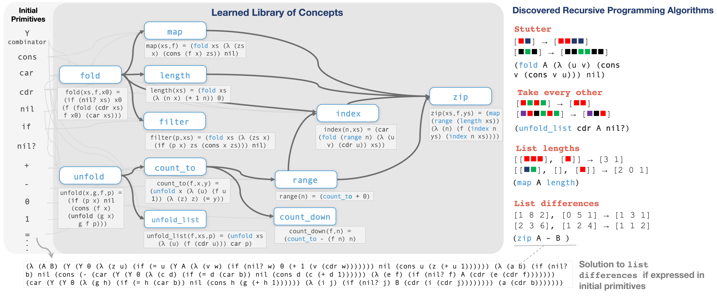
DreamCoder: Results
They also did it with recursive algorithms:

Slide 14
DreamCoder: Results
Overall, I find DreamCoder pretty mindblowing
All the code is available online and you can get it running on your machine in about half a day
There is much more to explore in this direction!

Slide 15
Future directions: The Child as a Hacker
Rule et al. 2020, The Child as a Hacker.
Citing the paper:
Programs provide our best general-purpose representations for human knowledge, inference, and planning; human learning is thus increasingly modeled as program induction, learning programs from data.
Many formal models of learning as program induction reduce to a stochastic search for concise descriptions of data. Actual human programmers and learners are significantly more complex, using many processes to optimize complex and frequently changing objectives.
The goals and activities of hacking, making code better along many dimensions through an open-ended and internally motivated set of goals and activities, are helping to inspire better models of human learning and cognitive development

Slide 16
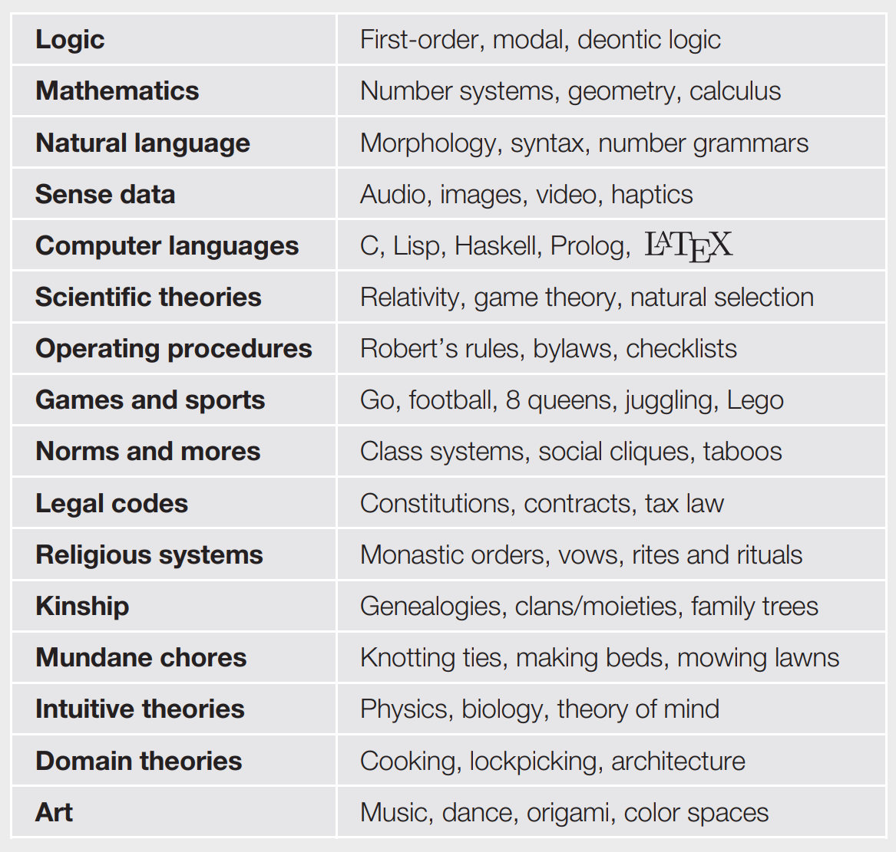
Future directions: The Child as a Hacker
The main point is that we use algorithmic knowledge in all sorts of domains.
All of these could be modelled in an LoT framework.

Slide 17
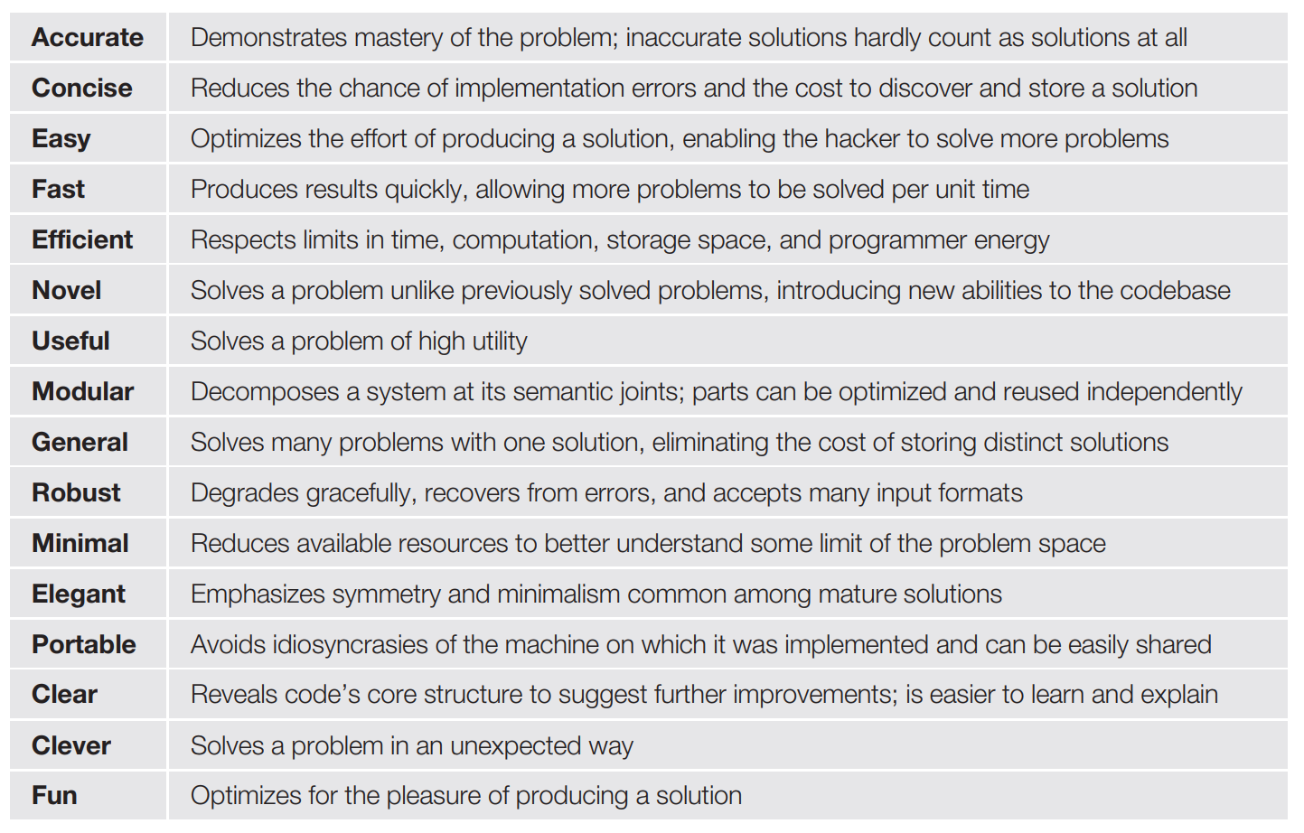
Future directions: The Child as a Hacker
The main conceptual move in this paper is that the kind of pLoT theory we have looked at in this course focused on just one dimension
But actual program development considers many dimensions to optimize!
Some examples:

Slide 18
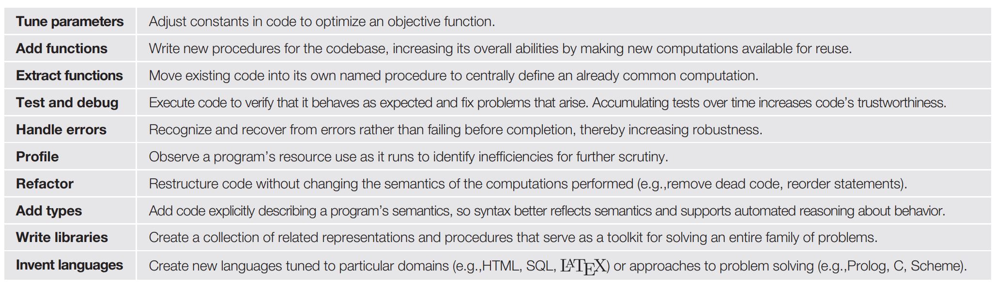
Future directions: The Child as a Hacker
Moreover, there’s many strategies to building the program, which weren’t captured by our inference algorithm.
Some examples:

Slide 19
Future directions: The Child as a Hacker
How might traditional accounts of cognitive development be usefully reinterpreted through the lens of hacking? How can core knowledge be mapped to an initial codebase? How can domain-specific knowledge be modeled as code libraries? What chains of revisions develop these libraries? How do libraries interact with each other? Which hacking techniques are attested in children and when do they appear? Which values? How can individual learning episodes be interpreted as improving code?
What are children’s algorithmic abilities? How do they learn in the absence of new data? What aspects of learning are data-insensitive? How do they extract information from richly structured data? What kinds of nonlocal transformations do we see? Do children ever find more complex theories before finding simpler ones? How do children move around the immense space of computationally expressive hypotheses?
How do humans program? What techniques do they use? What do they value in good code? How do they search the space of programs? Does the use of many techniques make search more effective?
How can the discoveries of computer science best inform models of human cognition? For example, what remains to be learned about human cognition from the study of compilers, type systems, or databases? How can we use the vocabulary of programming and programming languages to more precisely characterize the representational resources supporting human cognition? Are things like variable binding, symbolic pattern matching, or continuations cognitively primitive? If so, are they generally available or used only for specific domains? How does the mind integrate symbolic/discrete and statistical/continuous information during learning? What kinds of goals do children have in learning? What improvements do they inspire? How do they move around the space of goals? What data structures does this movement suggest for goal management?

Slide 20
The end!
And that’s it for the lectures this course folks!
Let me know when you want to discuss topics for the final project.
I’ll be out of Tubingen until the end of August
I’ll still see you on Wednesday
We’ll implement another model from scratch
Any questions?
I was asked to let you write evaluations during class time

