Slide 1
Bayes II
Or: How to actually use Bayes theorem
The Language of Thought: computational cognitive science approaches to category learning
Who: Fausto Carcassi
When: Sommer semester 2022

Slide 2
Where are we?
Since the course started, we have been developing a series of concepts and techniques centering around the idea of a language of thought.
We started with the philosophical idea of an LoT
Then, we looked at how to model a fragment of the LoT for various conceptual domains, using PCFGs.
Last time we started looking at Bayesian inference, with the aim of understanding how to learn sentences in the LoT from observations.
Today we are going to keep looking at how to deal with an LoT probabilistically!

Slide 3
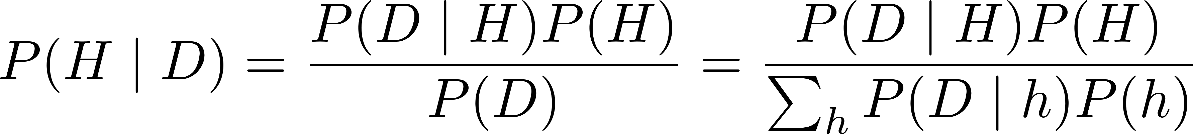
The problem: Bayesian evidence
Last time we talked about Bayesian inference, but we didn’t talk about how to do it in practice.
Good old Bayes theorem:
To calculate the denominator, we need to sum (or integrate) across all hypotheses. This is not possible except for the very simplest cases!
E.g., consider: P(positive test | sick) = 0.9, P(positive test | not sick) = 0.1, P(sick) = 0.1. We can calculate P(sick | positive test).
But in general, we need an alternative approach.

Slide 4
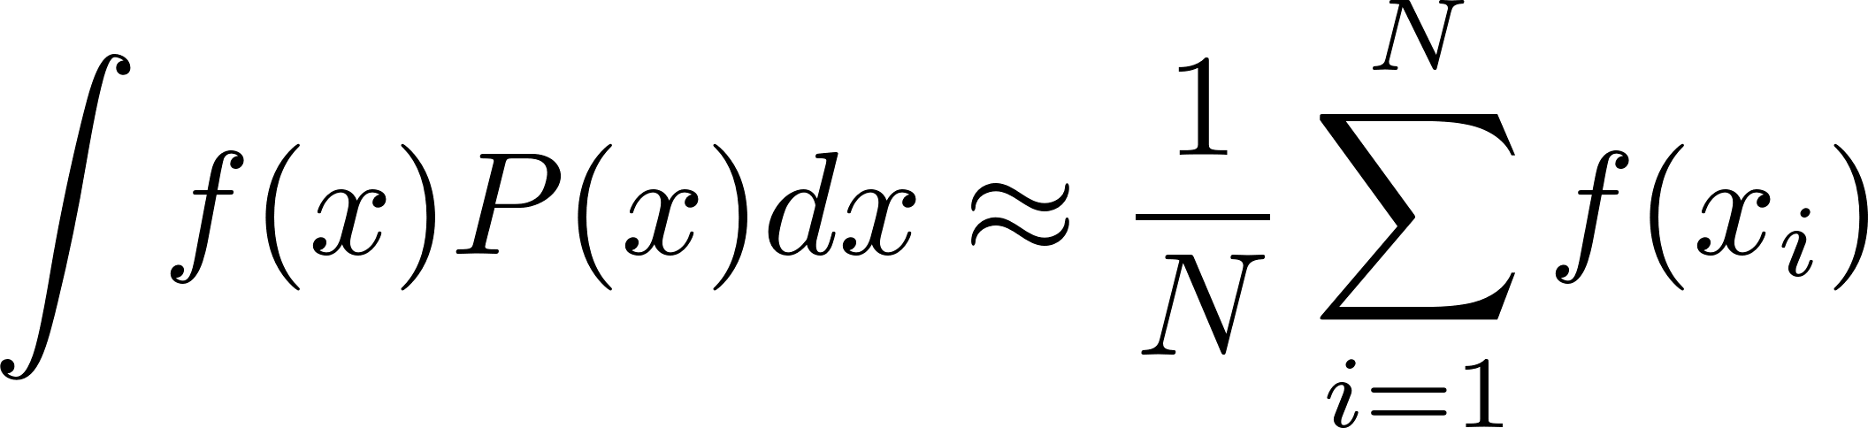
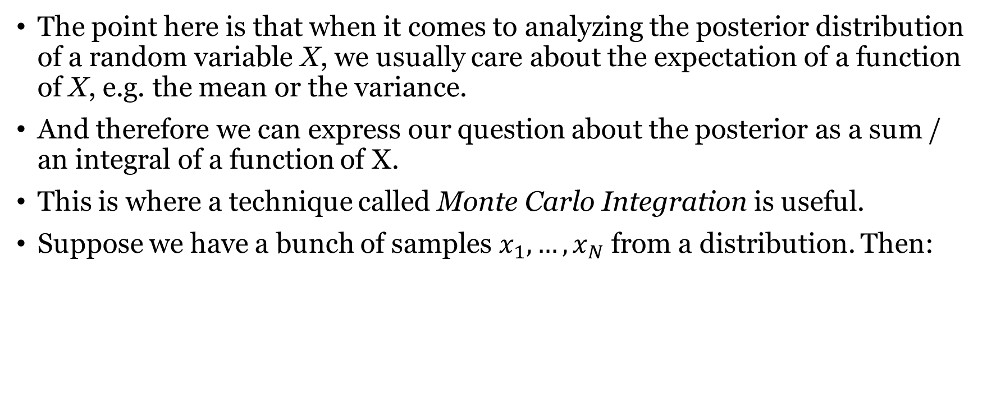
Note: We care about expectations
The point here is that when it comes to analyzing the posterior distribution of a random variable X, we usually care about the expectation of a function of X, e.g. the mean or the variance.
And therefore we can express our question about the posterior as a sum / an integral of a function of X.
This is where a technique called Monte Carlo Integration is useful.
Suppose we have a bunch of samples $x_{1},…, x_{N}$ from a distribution. Then:

Slide 5
Monte Carlo integration
Monte Carlo Integration means that to get any information we want from the posterior (e.g. mean, variance, histograms, etc.), all we need is samples from the posterior.
Therefore, if we can get posterior samples, that’s enough even if we can’t calculate the full posterior probability.
And it turns out that there’s a (family of) really convenient algorithms to get samples from a probability even if all we have is a function that is just proportional to the distribution density function.
The simplest algorithm of this type (which is used in Piantadosi’s LOTlib3 library) is called Metropolis-Hastings algorithm.

Slide 6
Metropolis-Hastings algorithm
Imagine you are on a ship on a lake
You have a stick with which you can poke the bottom of the lake and determine its depth.
Some parts of the lake are deeper than others and some more shallow.
Problem: write down a list of points on the lake with a probability proportional to their depth.
How would you go about doing this?
Do you see why this is equivalent to the problem we have?

Slide 7
Metropolis-Hastings algorithm
One solution:
Start at any point P_{current} at random
Then for i=1; i < N; i++:
Move to a different point P_{proposed} following a certain (symmetric) probability distribution centered at P_{current}
If depth(P_{proposed}) > depth(P_{current}):
Move to P_{proposed}, i.e. set P_{current} = P_{proposed}
Else:
Move to P_{proposed} with probability depth(P_{proposed}) / P(P_{current})
If they’re almost the same, move with high probability, etc.
Metropolis-Hastings is just this, but instead of depth we have probability!

Slide 8
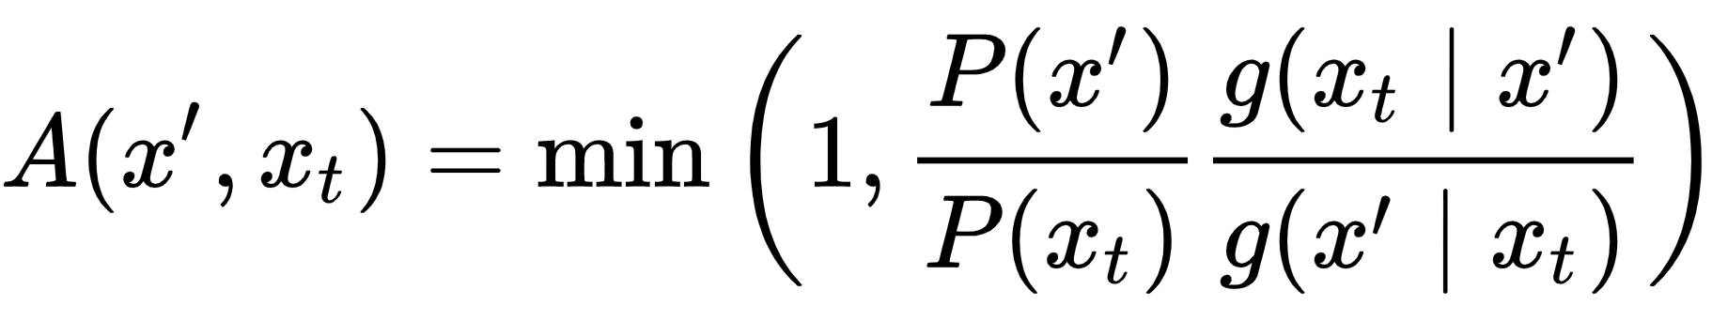
Asymmetric proposal distribution

Slide 9
Summary: Markov-chain Monte Carlo
If some pretty weak conditions are satisfied, in the limit of infinite samples the distribution of samples converges to the true posterior distribution.
We can think of MCMC as a way of getting samples from the posterior without knowing the normalization constant for the posterior, i.e. the Bayesian evidence.
If we get enough samples, we can calculate an expectation of a function of the posterior with high accuracy, and therefore any ‘summary’ we are interested in.
Now we have all the ingredients we need to apply Bayesian inference to cognitive models!

Slide 10
Case study: Simple category learning
Suppose that we are trying to learn a category from examples.
For simplicity, suppose that
The space is simply the integers from 1 to 50
The examples are numbers from the category
The category is convex, meaning we just need to set two borders
We get examples from the category. There are two options:
Weak sampling: Both positive and negative evidence can be seen
Strong sampling: Only positive evidence can be seen

Slide 11
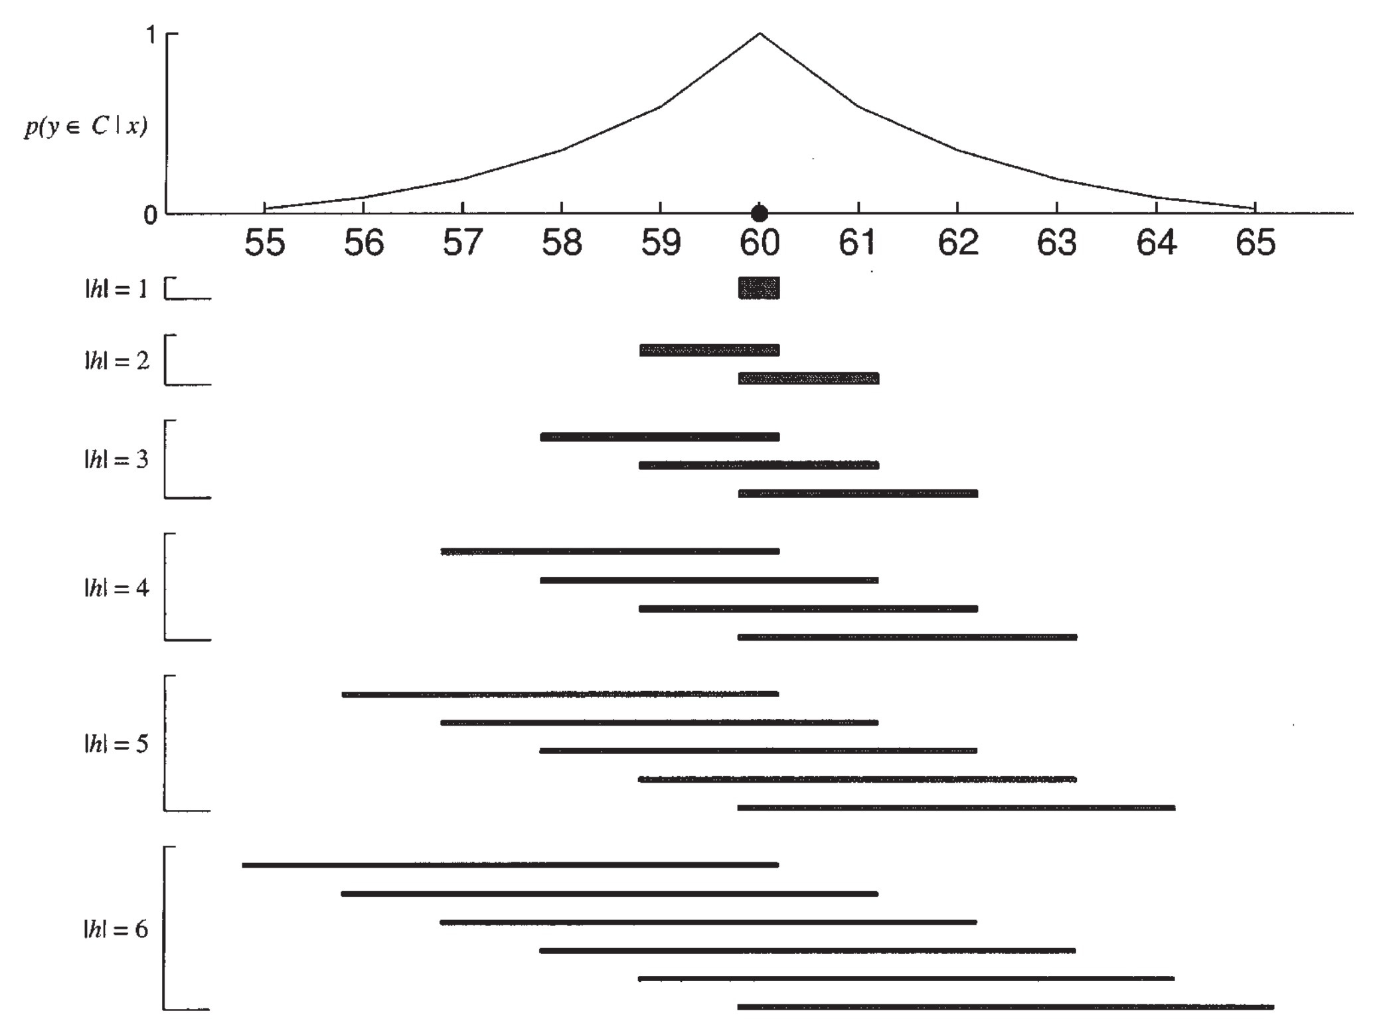
Simple category learning
Let’s go over this case of inference, assuming we got one observation!
What’s the space of hypotheses?
What’s the posterior, likelihood, and prior?
What happens if we get more observations?

Slide 12
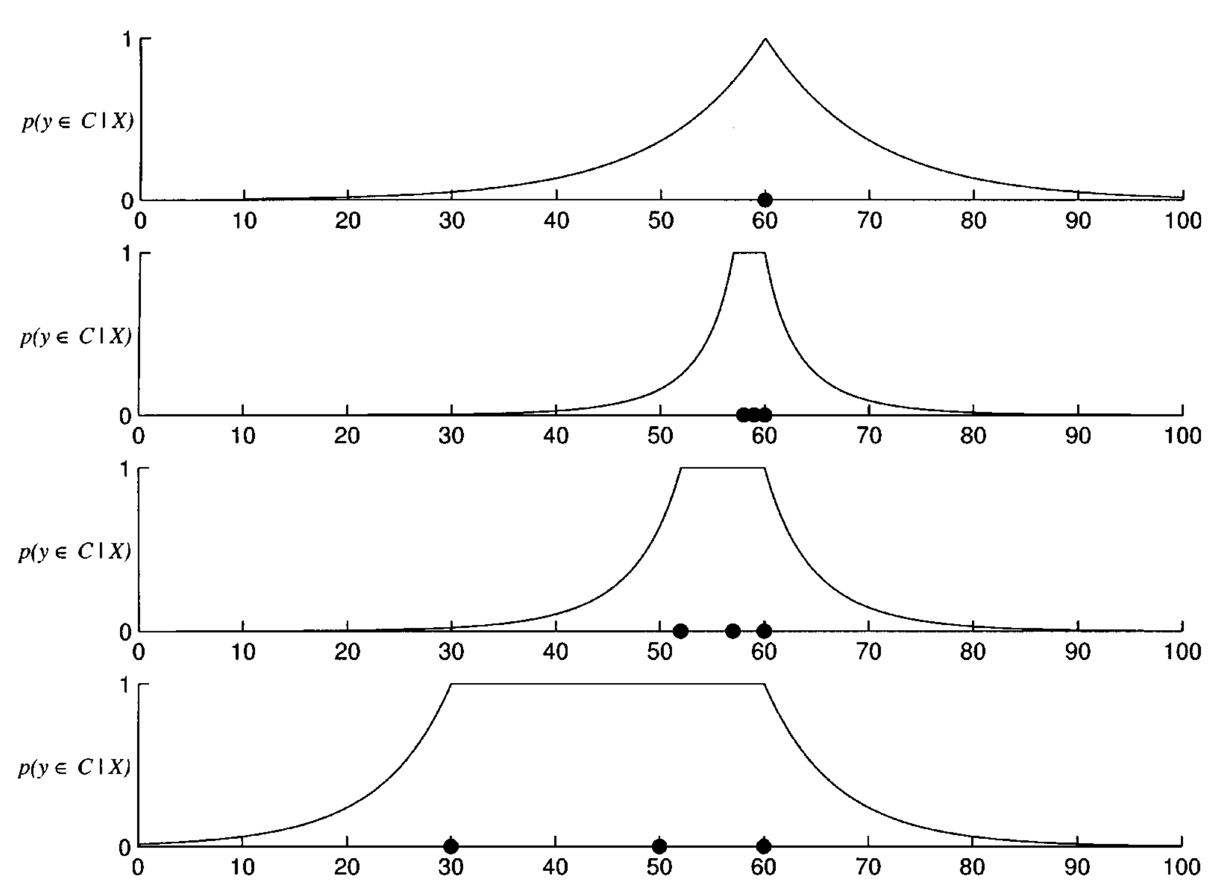
Simple category learning
One important phenomenon here is the size effect
More observations within a range makes the probability of the borders decrease faster.
Can you see why formally?
Can you see why intuitively?

Slide 13
PCFGs and probabilities
We have seen how to add probabilities to the production rules of a grammar, and we called those probabilistic context-free grammars.
Basically, they give us the conditional probability of applying each rule given a certain nonterminal.
This was the only point where probabilities enter the CFGs. However, we can also have probabilities at the level of the interpretation function.
In this case, the interpretation of a sentence is not deterministic: evaluating a certain sentence multiple times can return different object.
A sentence then returns a distribution over objects (in the relevant domain).

Slide 14
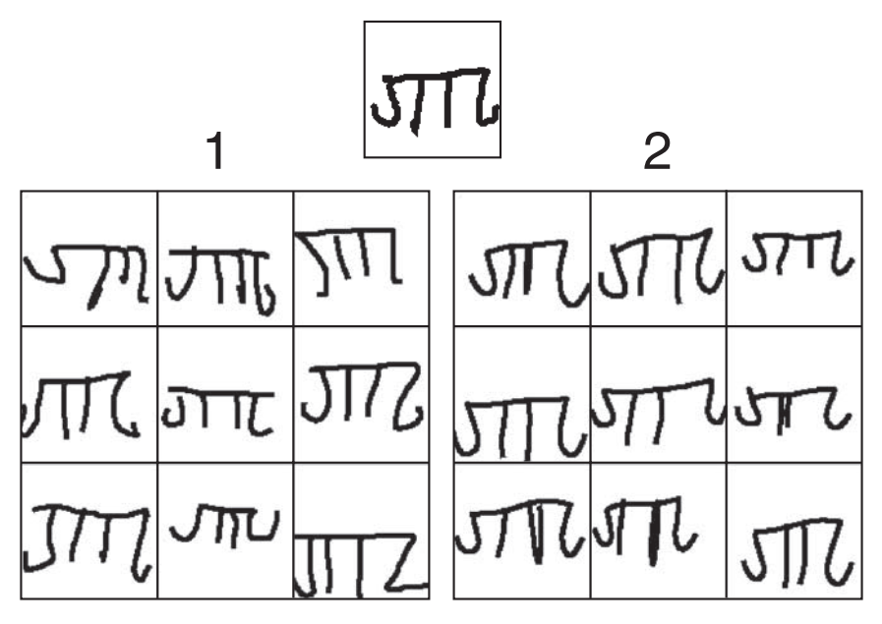
PCFGs and probabilities
For instance, consider a fragment of the LoT that encodes handwritten characters. In a way, we can recognize the following as being ‘the same character’:
The most natural way to make sense of this is to say that the same pLoT sentence can be realized in different ways, in virtue of it having a probabilistic component.
In the context of learning an LoT expression from data, this gives us a likelihood P(data | LoT sentence).

Slide 15
Learning in a grammar
Putting everything together, can we think of a way of sampling from the posterior distribution over sentences in an LoT given some observations?
Prior, likelihood, proposal distribution

