Slide 1

Part II Technical background
Fausto Carcassi

Slide 2
Plan
Formal grammars
Semantics for formal grammars
Bayesian inference
Part I | Introduction: On the very idea of an LoT
Part II | Technical background
Part III | Bayesian program induction (LOTlib3)
Part IV | Case studies
Part V | Summary & Future prospects

Slide 3
Formal grammars

Slide 4
What’s a grammar
Start with a language (Typically, a natural language)
A notion of well-formedness independent of meaning
E.g., ‘3 is more curious than the past table’
We call this grammatical well-formedness.
We can build an abstract device to encode grammaticality
Two types of such devices are popular: automata and formal grammars.
There is a correspondence between automata and grammars!
In the rest of the course we’ll just use grammars.

Slide 5
Formal grammars
Grammars: Infinite use of finite means
Four ingredients:
A finite set N of nonterminal symbols
A finite set Σ of terminal symbols
A finite set P of production rules
A symbol S in N: the start symbol

Slide 6
Formal grammars
N (nonterminal symbols)
Σ (terminal symbols)
P (production rules)
S (start symbol)
{S, x, y}
{a, b}
1. S → x
2. x → xy
3. y → a
4. x → b
Let’s derive a sentence in this grammar!

Slide 7
Formal grammars
N (nonterminal symbols)
Σ (terminal symbols)
P (production rules)
S (start symbol)
{S, x, y}
{a, b}
1. S → x
2. x → xy
3. by → ba
4. x → b
Let’s derive a sentence in this grammar!

Slide 8
Formal grammars
N (nonterminal symbols)
Σ (terminal symbols)
P (production rules)
S (start symbol)
{S, x, y}
{a, b}
1. S → x
2. x → xy
3. by → ba
4. x → b
5. b → a WRONG! Why?
Let’s derive a sentence in this grammar!

Slide 9
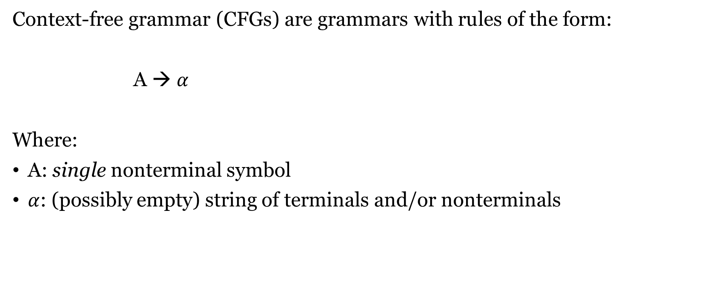
CFG - Context Free Grammars
Context-free grammar (CFGs) are grammars with rules of the form:
A → $α$
Where:
A: single nonterminal symbol
$α$: (possibly empty) string of terminals and/or nonterminals

Slide 10
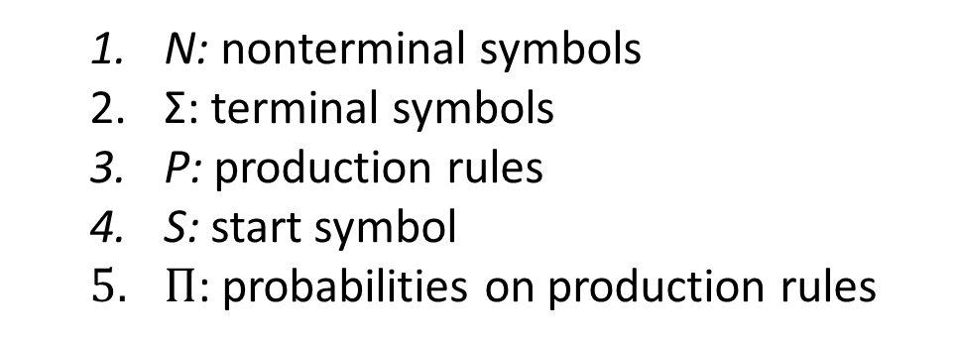
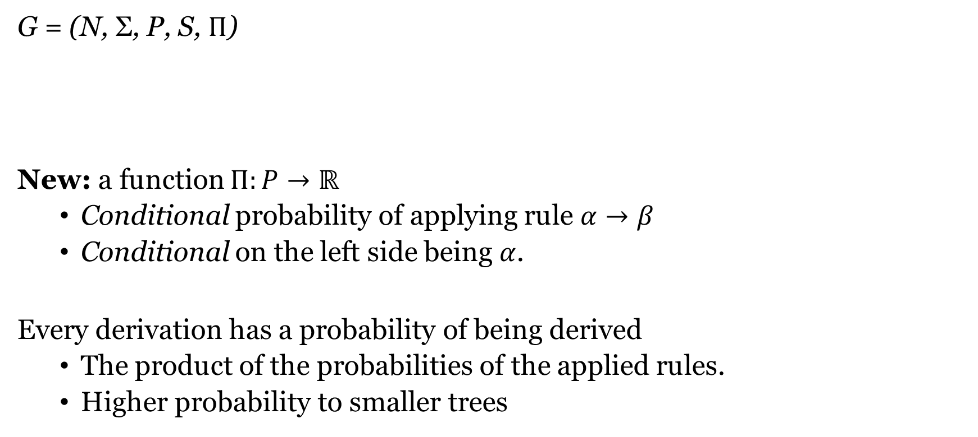
PCFG - Probabilistic CFG
N: nonterminal symbols
Σ: terminal symbols
P: production rules
S: start symbol
$Π$: probabilities on production rules
G = (N, Σ, P, S, $Π$)
New: a function $Π:P→ℝ$
Conditional probability of applying rule $α→β$
Conditional on the left side being $α$.
Every derivation has a probability of being derived
The product of the probabilities of the applied rules.
Higher probability to smaller trees

Slide 11
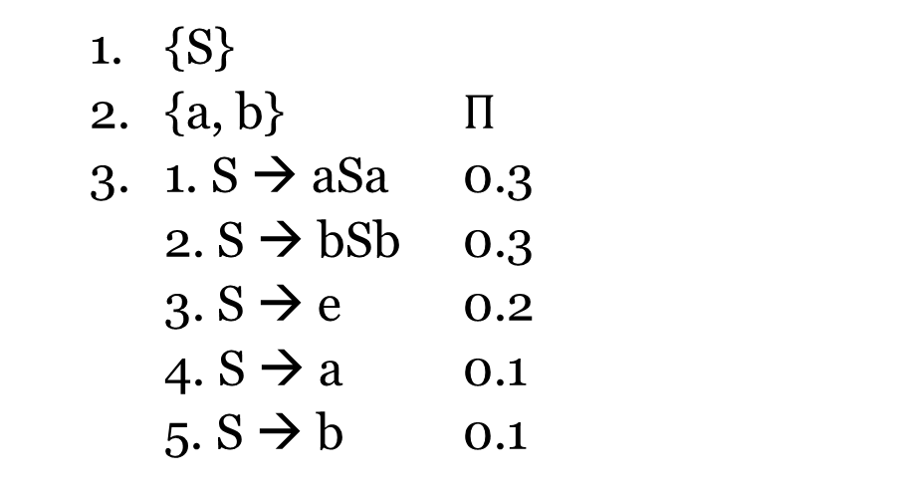
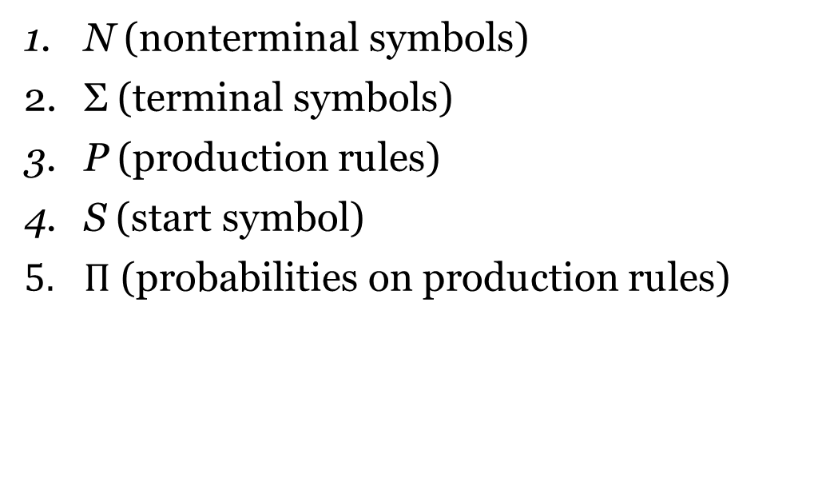
PCFG - Probabilistic CFG
N (nonterminal symbols)
Σ (terminal symbols)
P (production rules)
S (start symbol)
$Π$ (probabilities on production rules)
{S}
{a, b} $Π$
1. S → aSa 0.3
2. S → bSb 0.3
3. S → e 0.2
4. S → a 0.1
5. S → b 0.1

Slide 12
Interpreting a grammar

Slide 13
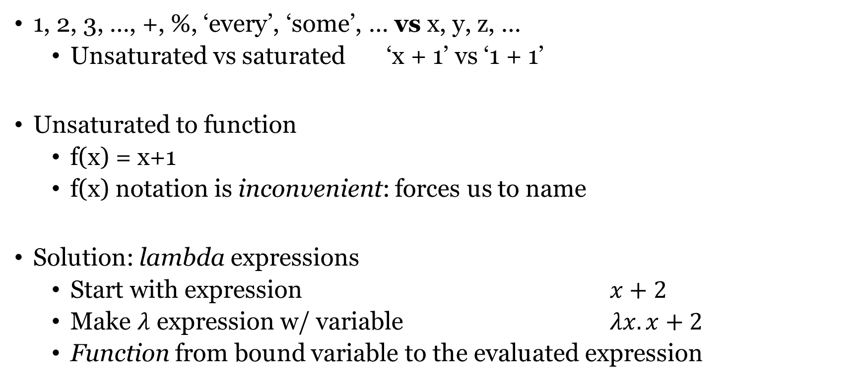
Writing down functions
1, 2, 3, …, +, %, ‘every’, ‘some’, … vs x, y, z, …
Unsaturated vs saturated ‘x + 1’ vs ‘1 + 1’
Unsaturated to function
f(x) = x+1
f(x) notation is inconvenient: forces us to name
Solution: lambda expressions
Start with expression $x+2$
Make $λ$ expression w/ variable $λx. x+2$
Function from bound variable to the evaluated expression

Slide 14
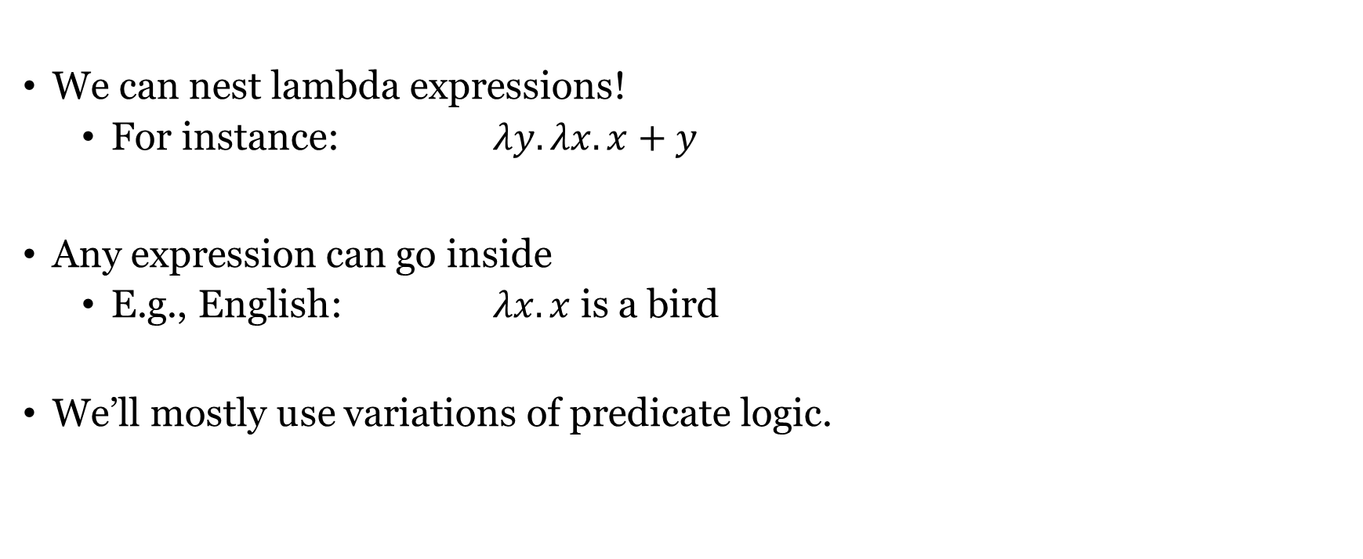
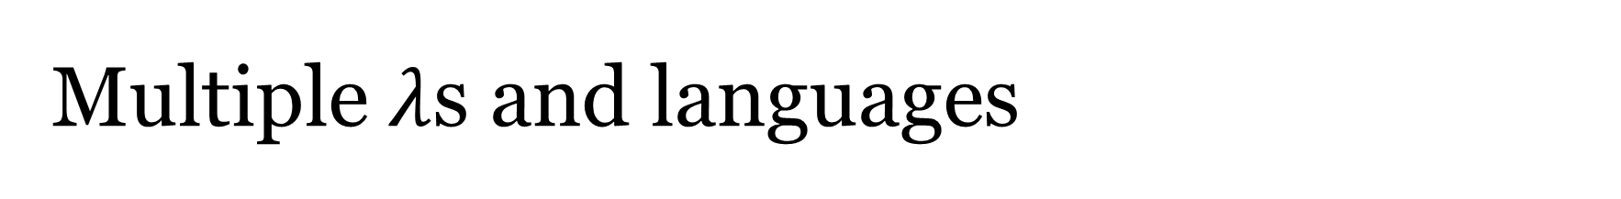
Multiple $λ$s and languages
We can nest lambda expressions!
For instance: $λy.λx. x+y$
Any expression can go inside
E.g., English: $λx.x$ is a bird
We’ll mostly use variations of predicate logic.

Slide 15
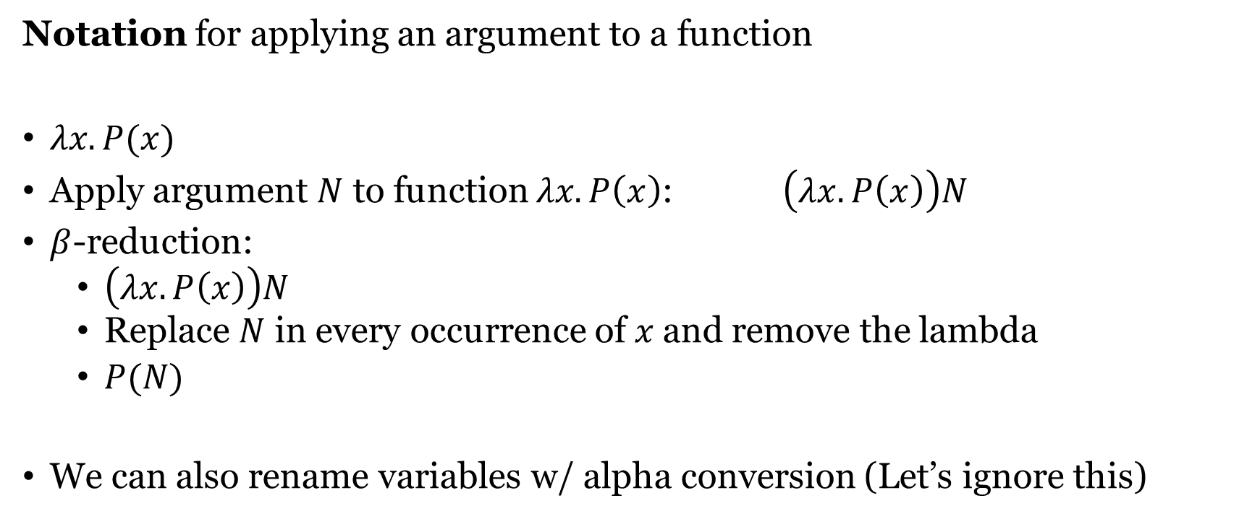

The notation of $λ$-calculus
Notation for applying an argument to a function
$λx.P(x)$
Apply argument $N$ to function $λx.P\left(x\right)$: $\left(λx.P\left(x\right)\right)N$
$β$-reduction:
$\left(λx.P\left(x\right)\right)N$
Replace $N$ in every occurrence of $x$and remove the lambda
$P(N)$
We can also rename variables w/ alpha conversion (Let’s ignore this)

Slide 16
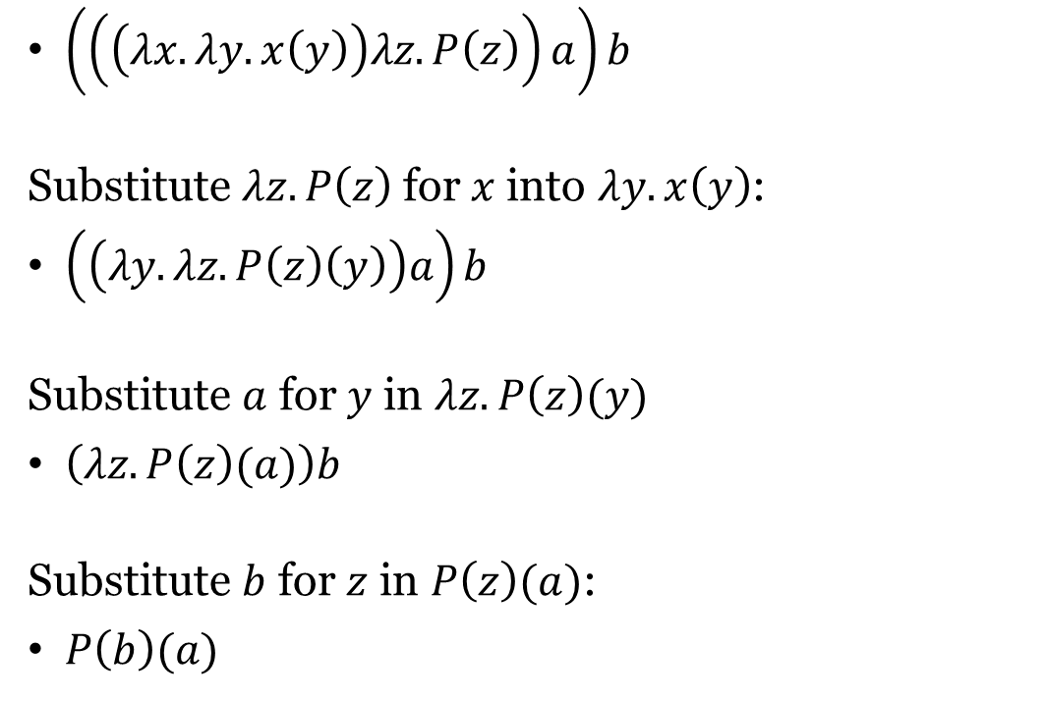
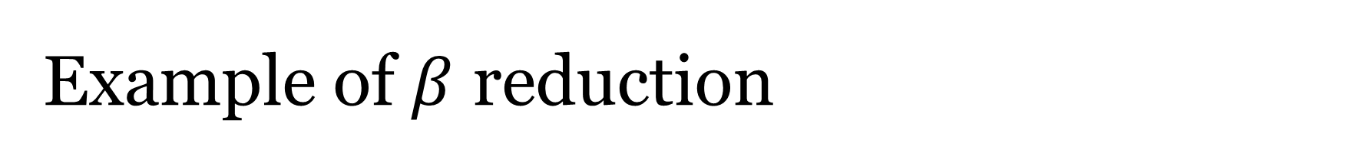
Example of $β$ reduction
$\left(\left(\left(λx. λy. x\left(y\right)\right)λz.P\left(z\right)\right)a\right)b$
Substitute $λz.P\left(z\right)$for $x$into $λy. x\left(y\right)$:
$\left(\left(λy.λz.P\left(z\right)\left(y\right)\right)a\right)b$
Substitute $a$ for $y$ in $λz.P\left(z\right)(y)$
$\left(λz.P\left(z\right)(a)\right)b$
Substitute $b$ for $z$ in $P\left(z\right)(a)$:
$P\left(b\right)(a)$

Slide 17
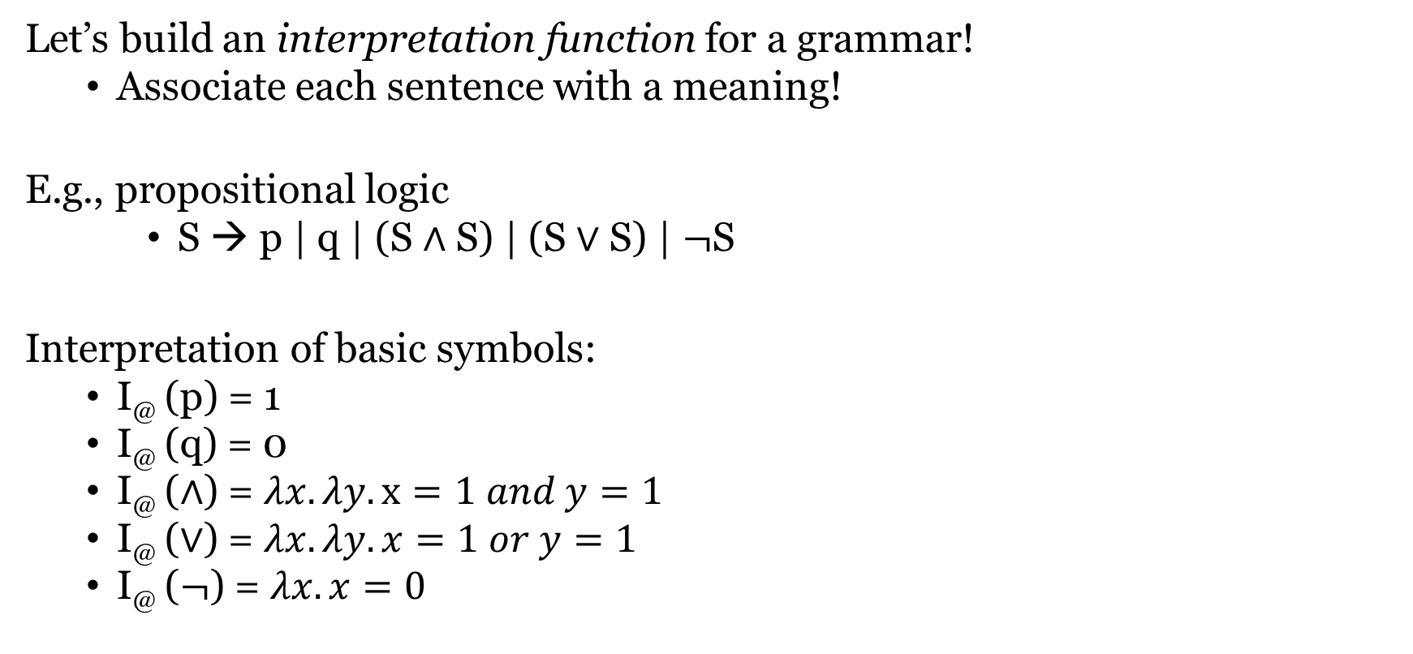
Compositional interpretation
Let’s build an interpretation function for a grammar!
Associate each sentence with a meaning!
E.g., propositional logic
S → p | q | (S $∧$ S) | (S $∨$ S) | $¬$S
Interpretation of basic symbols:
I@ (p) = 1
I@ (q) = 0
I@ ($∧$) = $λx. λy. x=1 and y=1$
I@ ($∨$) = $λx.λy. x=1 or y=1$
I@ ($¬$) = $λx.x=0$

Slide 18



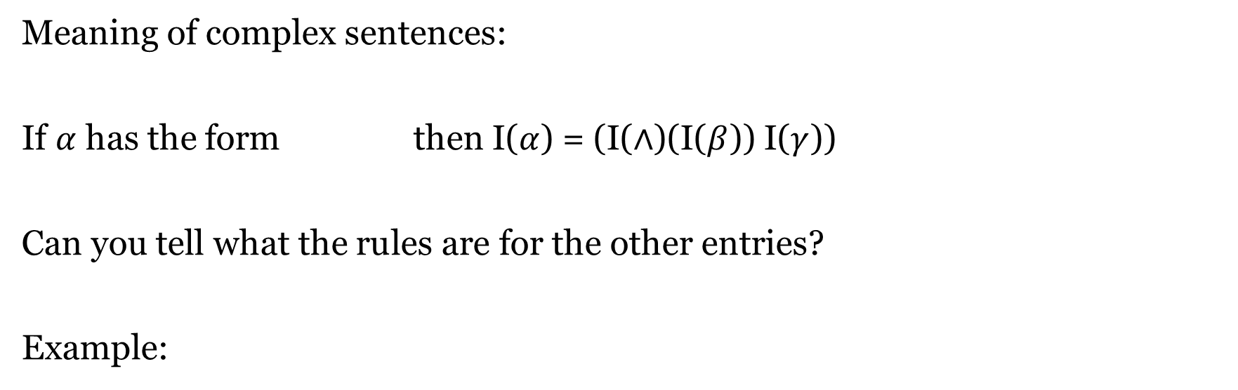



Compositional interpretation
Meaning of complex sentences:
If $α$ has the form then I($α$) = (I($∧$)(I($β$)) I($γ$))
Can you tell what the rules are for the other entries?
Example:
$$S$$
$$β$$
$$∧$$
$$γ$$
S
S
$$∨$$
p
S
$$∧$$
S
p
q

Slide 19
Bayesian inference

Slide 20

Probability & conditional probability
What is probability?
Feature of system in the world
Dice behaviour over many rolls
Degree of support btw propositions
“Given that it’s raining, we’ll probably get wet”
Strength or degree of a belief, or credence
“I think George is probably at the party”
We write
P(A) for “credence of A”
P(A | B) for “credence of A given B”
In general, P(A | B) ≠ P(B | A)
P(X flies | X is a Kakapo) is high, P(X is a Kakapo | X flies) is low

Slide 21
A motivating example
Question: “Is my new haircut better than the old one?”
You are completely unsure: 50/50
Mother of a friend says “Yes” –> new belief?
Your worst enemy says “Yes” –> new belief?
You are pretty sure it’s worse than it was: 90/10
Mother of a friend says “Yes” –> new belief?
Your worst enemy says “Yes” –> new belief?
What is at play?
Prior
Likelihood

Slide 22
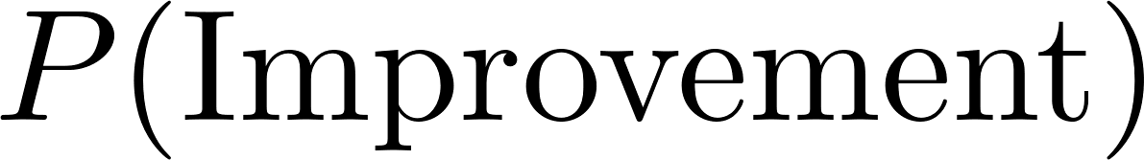
A motivating example
Why product and not addition?
What if a component is zero?
Why divide by P(‘Yes’ from mum)?
P(improvement | ‘Yes’ from mum) + P(not improvement | ‘Yes’ from mum)
Posterior has to sum to 1

Slide 23
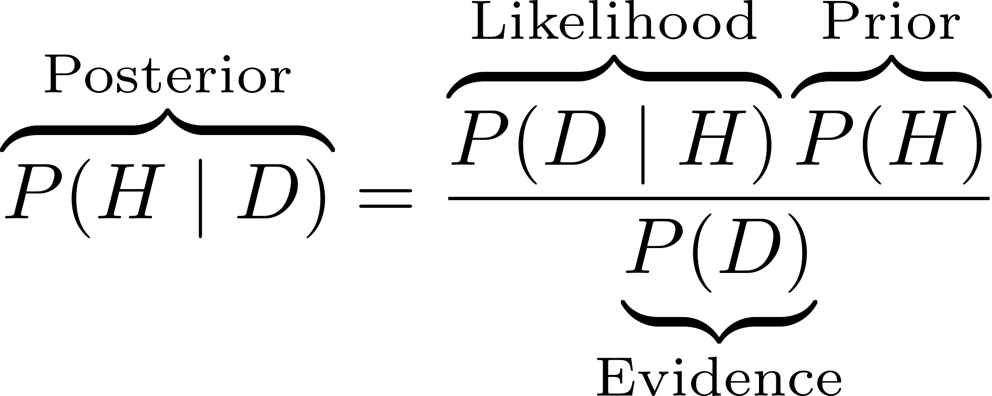
The components of Bayes theorem
Four ingredients in Bayes theorem:
Posterior Probability of hypothesis given data
Likelihood Probability of the data given the hypothesis
Prior Probability of the hypothesis, NOT conditioned on data
Evidence Probability of the data, NOT conditioned on H

Slide 24
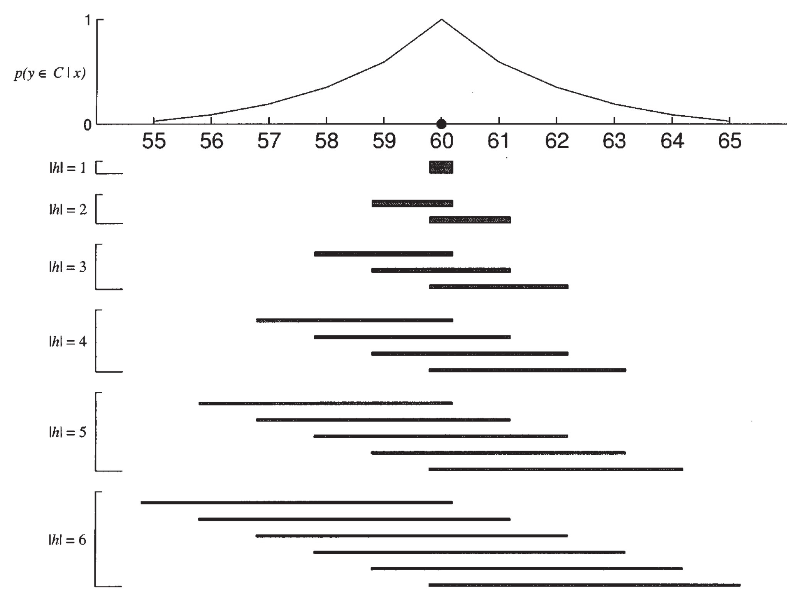
Case study: Simple category learning
Task: learn a category from examples.
The space is simply the integers from 1 to 50
The examples are numbers from the category
The category is a convex region
We get examples from inside the category
Bayesian category learning
What’s the space of hypotheses?
What’s the posterior, likelihood, and prior?
What happens if we get more observations?
Tenenbaum & Griffiths (2001)

Slide 25
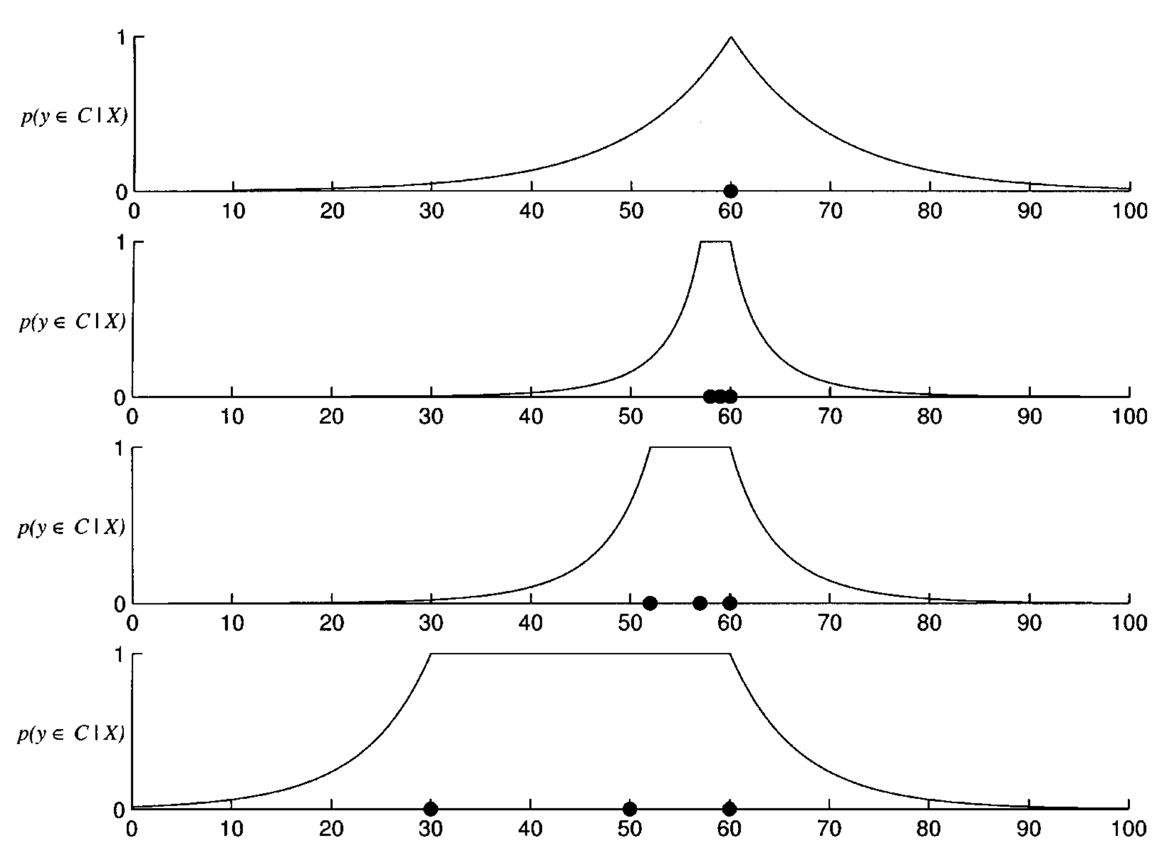
Case study: Simple category learning
Strong sampling –> size effect
Can you see why intuitively?
Can you see why formally?
Tenenbaum & Griffiths (2001)

Slide 26
Approximate Bayesian inference

Slide 27
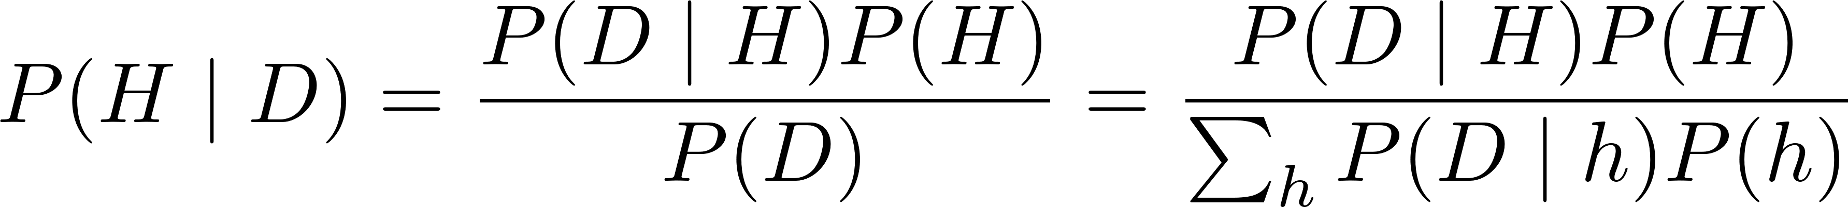
The problem: Bayesian evidence
Bayes theorem again:
E.g., consider:
P(positive test | sick) = 0.9,
P(positive test | not sick) = 0.1, P(sick) = 0.1.
We can calculate P(sick | positive test)
Sum/integrate across all hypotheses is not possible except simplest cases!
But in general, we need an alternative approach.

Slide 28
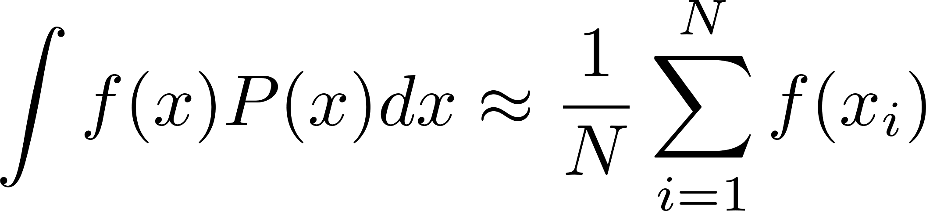
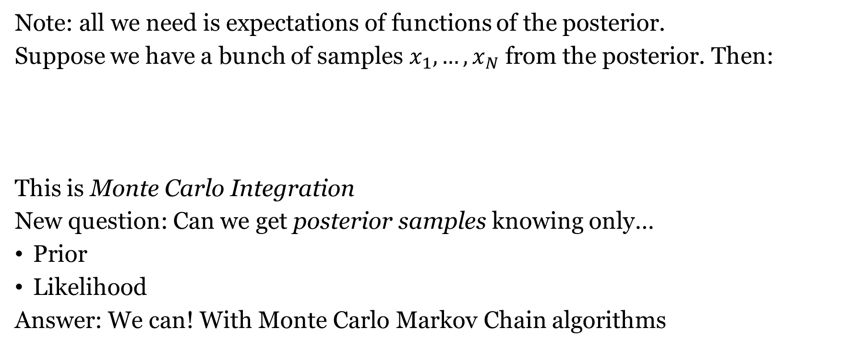
Note: We care about expectations
Note: all we need is expectations of functions of the posterior.
Suppose we have a bunch of samples $x_{1},…, x_{N}$ from the posterior. Then:
This is Monte Carlo Integration
New question: Can we get posterior samples knowing only…
Prior
Likelihood
Answer: We can! With Monte Carlo Markov Chain algorithms

Slide 29

Metropolis-Hastings algorithm
You are on a ship on a lake. You can
poke the bottom of the lake with a stick
determine its depth.
Problem:
Write down a list of points on the lake
With a frequency proportional to their depth
How would you go about doing this?
Do you see why this is equivalent to the problem we have?

Slide 30
Metropolis-Hastings algorithm
Start at (any) P_{current}
Then for i=1; i < N; i++:
Try a different point P_{proposed} following a proposal distribution
Proposal can depend on P_{current}
If depth(P_{proposed}) > depth(P_{current}):
Move to P_{proposed}, i.e., set P_{current} = P_{proposed}
Else:
Move to P_{proposed} with probability depth(P_{proposed}) / depth(P_{current})
If they’re almost the same, move with higher probability, etc.
Metropolis-Hastings is just this, but instead of depth we have probability!

Slide 31
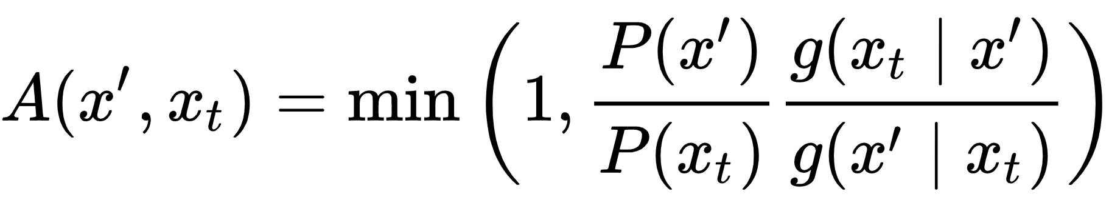
Asymmetric proposal distribution
Proposal distribution
Candidate state
Current state

Slide 32
Markov Chain Monte Carlo
If some pretty weak conditions are satisfied, in the limit of infinite samples the distribution of samples converges to the true posterior distribution.
MCMC: a way of getting samples from the posterior
without knowing the normalization constant
i.e., the Bayesian evidence.
With enough samples, we can accurately approximate the posterior.

Slide 33
Putting it all together

Slide 34
Our grand plan for the pLoT
Much of cognition consists in manipulating world models
But the models have to be encoded somehow
Claim: Our world models are encoded in the LoT
World model
pLoT (PCFG)
Bayesian update
data
Linking assumptions
P(data | h)
behaviour
P(h | data)
P(h)

Slide 35
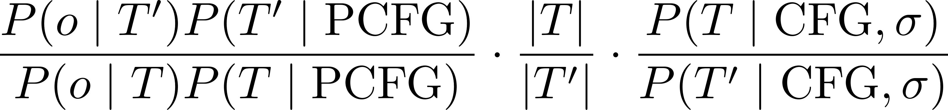
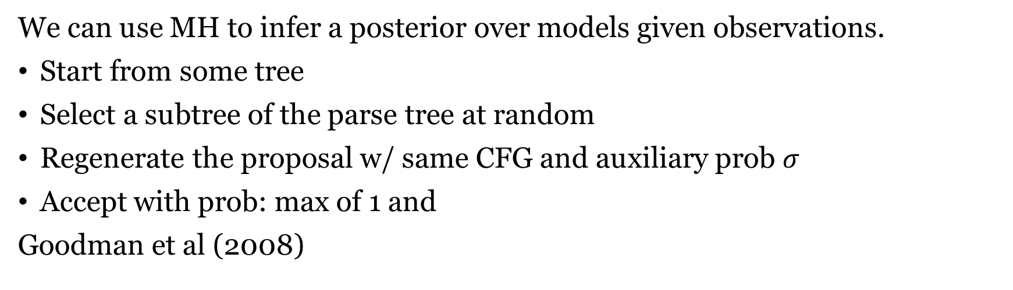
Proposals for learning w/ a grammar
We can use MH to infer a posterior over models given observations.
Start from some tree
Select a subtree of the parse tree at random
Regenerate the proposal w/ same CFG and auxiliary prob $σ$
Accept with prob: max of 1 and
Goodman et al (2008)

Slide 36
Conclusions
We’ve learned about
PCFGs
their interpretation
Bayesian category learning
We can use this as a model of the pLoT
Next session:
Combine into computational model!
Part I | Introduction: On the very idea of an LoT
Part II | Technical background
Part III | Bayesian program induction (LOTlib3)
Part IV | Case studies
Part V | Summary & Future prospects

Slide 37
If there’s time left…

Slide 38
The grand plan of the pLoT
Interpreted PCFG
Defines hypotheses H
Defines prior over H
Observations O
Generated by unknown H
Likelihood P(O | H)
Bayesian inference
Gets P(H | O)
<- Models the Language of Thought
<- Sentences in the LoT
<- Prior probability of LoT sentences
<- Data for learning
<- To be represented in the LoT
<- From a world model
<- Gives us a distribution over LoT sentences
Our best guess for the representation content!

Slide 39
Type theory
(This part might be confusing!)

Slide 40
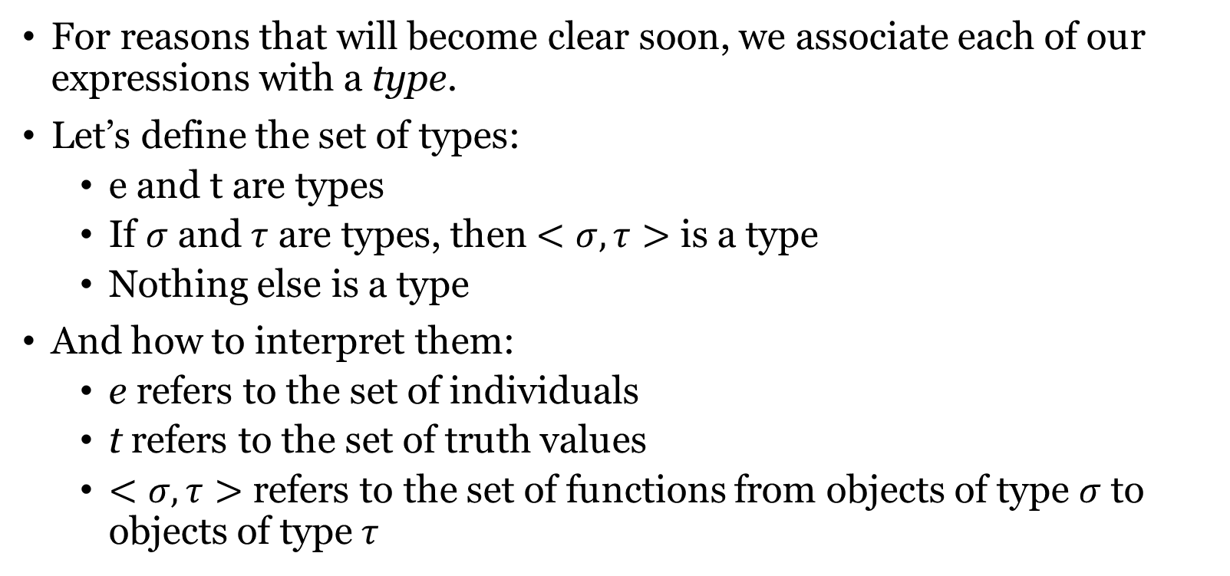
Type theory
For reasons that will become clear soon, we associate each of our expressions with a type.
Let’s define the set of types:
e and t are types
If $σ$ and $τ$ are types, then $<σ, τ>$ is a type
Nothing else is a type
And how to interpret them:
e refers to the set of individuals
t refers to the set of truth values
$<σ, τ>$ refers to the set of functions from objects of type $σ$ to objects of type $τ$

Slide 41
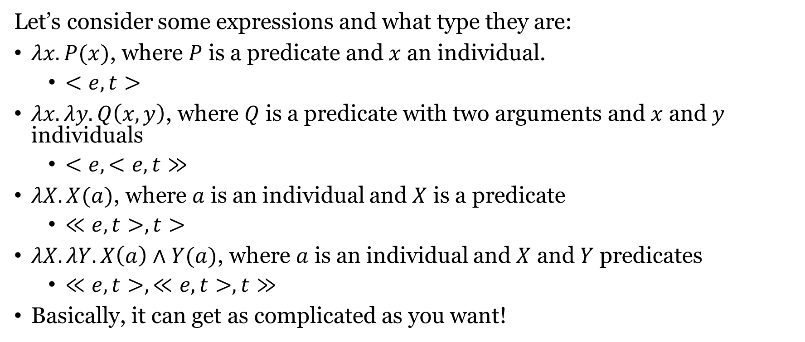
Type theory
Let’s consider some expressions and what type they are:
$λx.P(x)$, where $P$ is a predicate and $x$ an individual.
$<e,t>$
$λx.λy.Q\left(x, y\right)$, where $Q$ is a predicate with two arguments and $x$ and $y$ individuals
$<e,<e,t≫$
$λX.X(a)$, where $a$ is an individual and $X$ is a predicate
$≪e,t>, t>$
$λX.λY.X\left(a\right)∧Y(a)$, where $a$ is an individual and $X$ and $Y$ predicates
$≪e,t>, ≪e,t>, t≫$
Basically, it can get as complicated as you want!

Slide 42
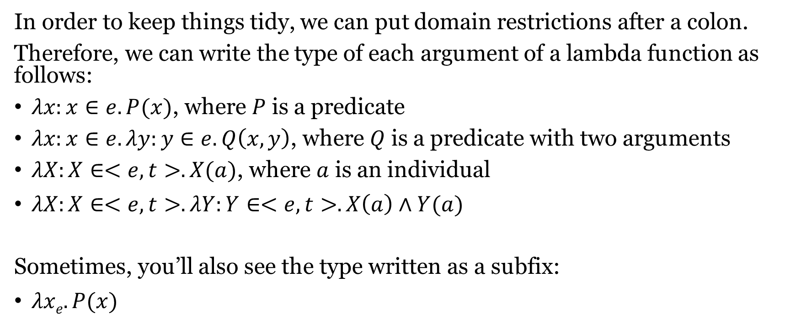
Type theory
In order to keep things tidy, we can put domain restrictions after a colon.
Therefore, we can write the type of each argument of a lambda function as follows:
$λx:x∈e.P(x)$, where $P$ is a predicate
$λx:x∈e.λy:y∈e.Q\left(x, y\right)$, where $Q$ is a predicate with two arguments
$λX:X∈<e,t>.X(a)$, where $a$ is an individual
$λX:X∈<e,t>.λY:Y∈<e,t>.X\left(a\right)∧Y(a)$
Sometimes, you’ll also see the type written as a subfix:
$λxe.P(x)$

Slide 43
Language to grammar
We’ve seen grammar –> language
We can also go language –> grammar
Let’s try to write a grammar that produces all the palindromes in {a, b}*
N (nonterminal symbols)
Σ (terminal symbols)
P (production rules)
S (start symbol)
{S}
{a, b}
1. S → aSa
2. S → bSb
3. S → e
4. S → a
5. S → b

Slide 44
Language to grammar
All strings with the form: a^{n}b^{n}
N (nonterminal symbols)
Σ (terminal symbols)
P (production rules)
S (start symbol)
{S}
{a, b}
1. S → aSb
2. S → e

