Slide 1
Part I On the very idea of an LoT
Fausto Carcassi

Slide 2

Introduction & disclaimers
Me: Fausto Carcassi
Various practicalities
For content / slides: https://github.com/thelogicalgrammar/pLoT_workshop
You can run labs on Google Colab
You can give me feedback on the website.
Disclaimers
This is a mostly informal/imprecise introduction
I’ll be mostly Fodorian – but other options exist
I’ll assume little and explain a lot

Slide 3
Introduction & disclaimers
Who has heard about…
Probabilistic context-free grammars
Lambda calculus
Bayesian inference

Slide 4
The overall plan
Part I | Introduction: On the very idea of an LoT
Part II | Technical background
Part III | Bayesian program induction (LOTlib3)
Part IV | Case studies
Part V | Summary & Future prospects

Slide 5
The plan for the session
Some observations about the mind
The Language of Thought (LoT)
How the LoT makes sense of the observations
The probabilistic LoT (pLoT)

Slide 6
Learning a rule
Robert Feldman → Dr Feldman
Ruth Millican → Dr Millikan
Joanna Newsom → ??
Dj Newsom
“Dr <last name>” or “D<first letter of first name> <last name>”?
6 @ 2 = 12
3 @ 4 = 12
10 @ 2 = ??
12
@ = multiplication or return 12?

Slide 7
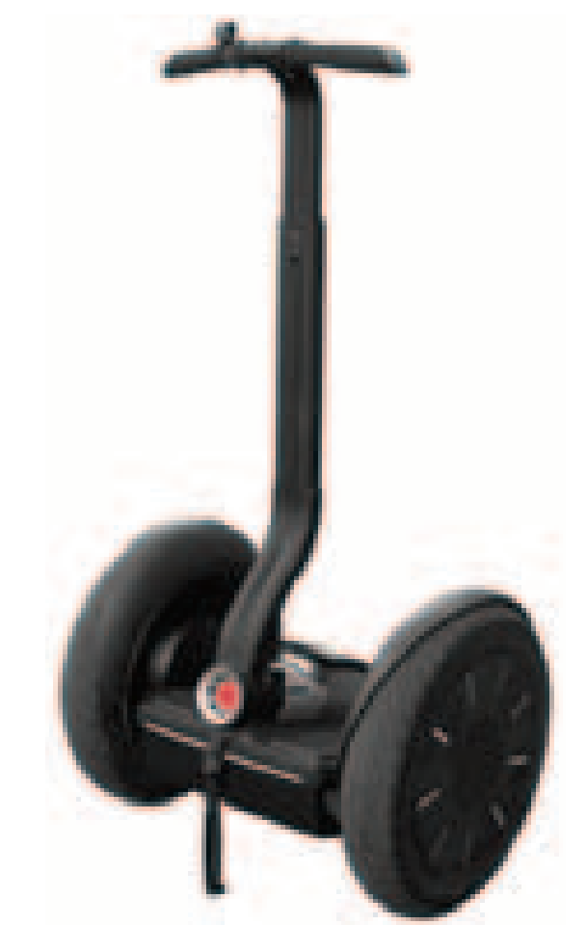
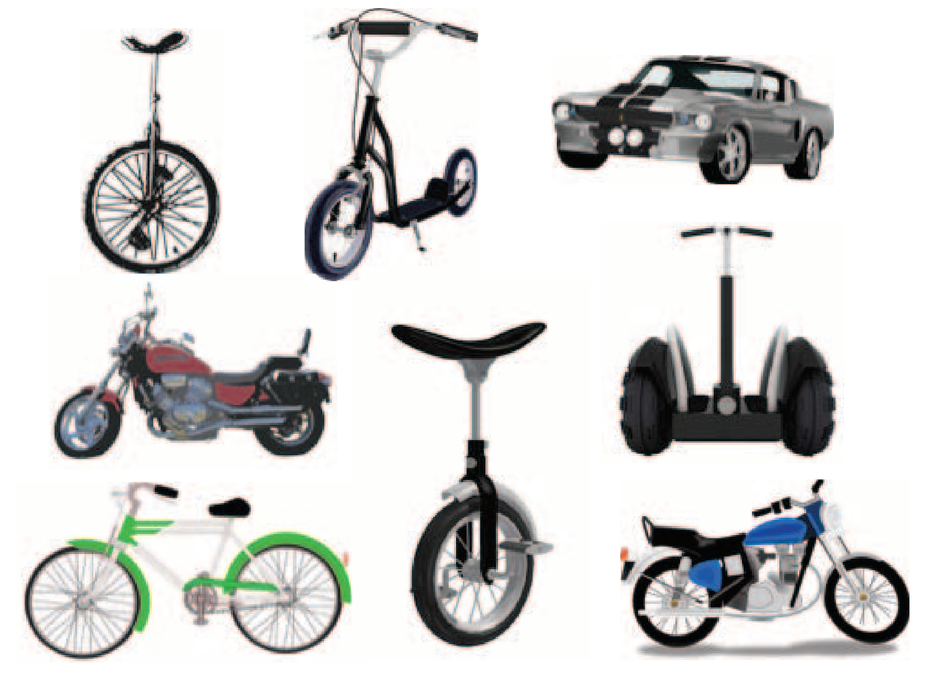
Learning a rule
Humans can learn a huge amount from a single instance.
Based on just this one instance, we can do loads.
E.g., classify new examples:
Lake et al (2015)

Slide 8
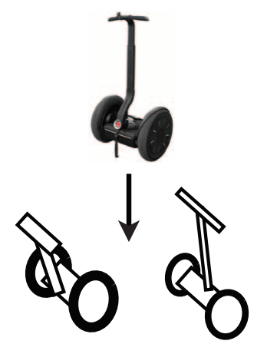
Learning a rule
Humans can learn a huge amount from a single instance.
Based on just this one instance, we can do loads.
E.g., generate new examples:
Lake et al (2015)

Slide 9
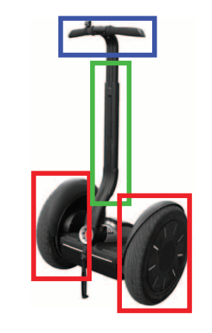
Learning a rule
Humans can learn a huge amount from a single instance.
Based on just this one instance, we can do loads.
E.g., parse the object into parts:
Lake et al (2015)

Slide 10
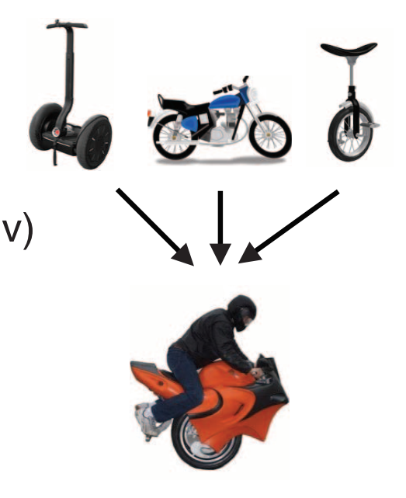
Learning a rule
Humans can learn a huge amount from a single instance.
Based on just this one instance, we can do loads.
E.g., generate new concepts:
Lake et al (2015)

Slide 11
Learning a rule
Humans can learn a huge amount from a single instance.
Based on just this one instance, we can do loads.
What allows us to do this?
Lake et al (2015)

Slide 12
Pills of Fodorianism

Slide 13
Productivity
We can think indefinitely many thoughts
E.g., for every natural number n, “My favorite number is n”
“But we are finite beings – we can’t think infinitely many thoughts!”
Finite performance, but competence for unboundedly many representations
Cf English: Finitely many sentences in a lifetime, but not in principle
“Mary thinks that John are the apple”
“John thinks that Mary thinks that John ate the apple”
Etc.

Slide 14
Systematicity
The ability to represent (a) and (b) are related:
(a) ‘John is close to the fish’
(b) ‘The fish is close to John’
We say thoughts are systematically related:
They differ in arrangement
Same building blocks
(a’) ‘It rains and Mary sleeps’
(b’) ‘Mary sleeps and it rains’

Slide 15
Inferential coherence
If we can draw inference (a), we can draw inference (b)
It rains and it is wet –> It rains
John sleeps and the cat purrs –> The cat purrs
And any inference with a similar structure!
(c) If blorgs zorg and bixes bon –> Blorgs zorg

Slide 16
Questions?

Slide 17
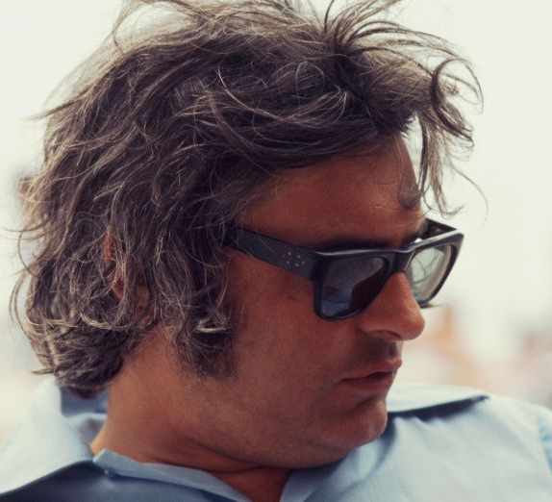
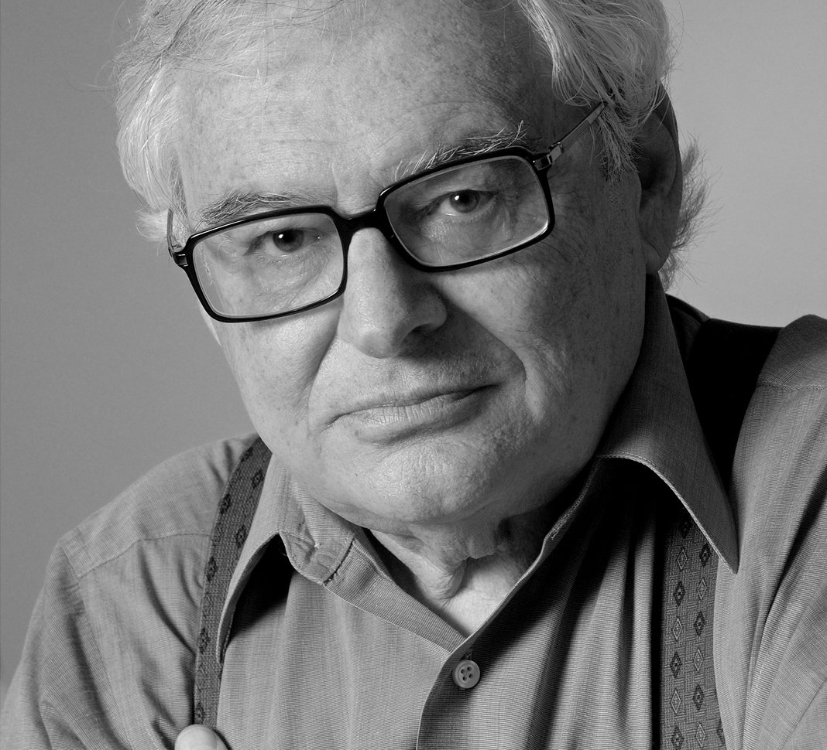
The LoT

Slide 18
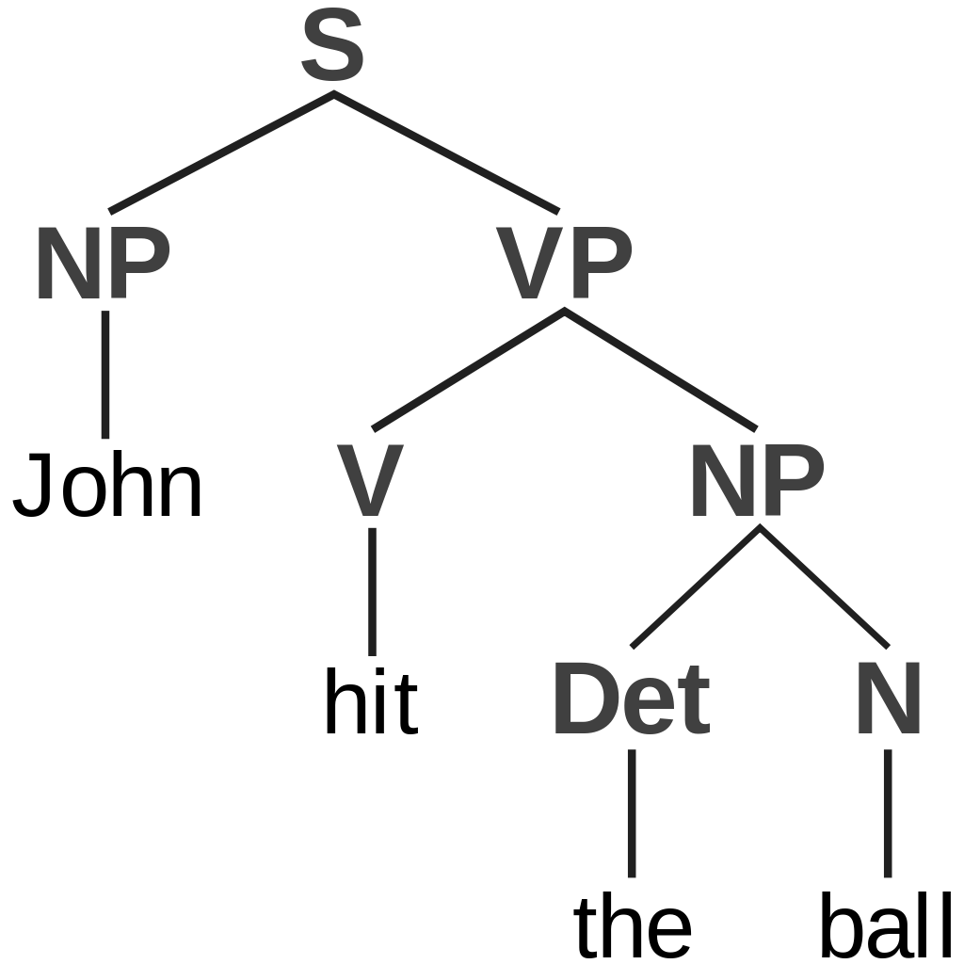
The main idea
Main claim: Thinking happens in a language.
“In what sense is it like English?”
Combinatorial grammar
Basic building blocks (“atoms of thought”)…
…combined into hierarchical structures (sentences)…
…with a grammar: only some combinations allowed!
Compositional semantics
Sentences have a meaning, which depends on…
…the meaning of the building blocks and…
…the way they are combined.

Slide 19
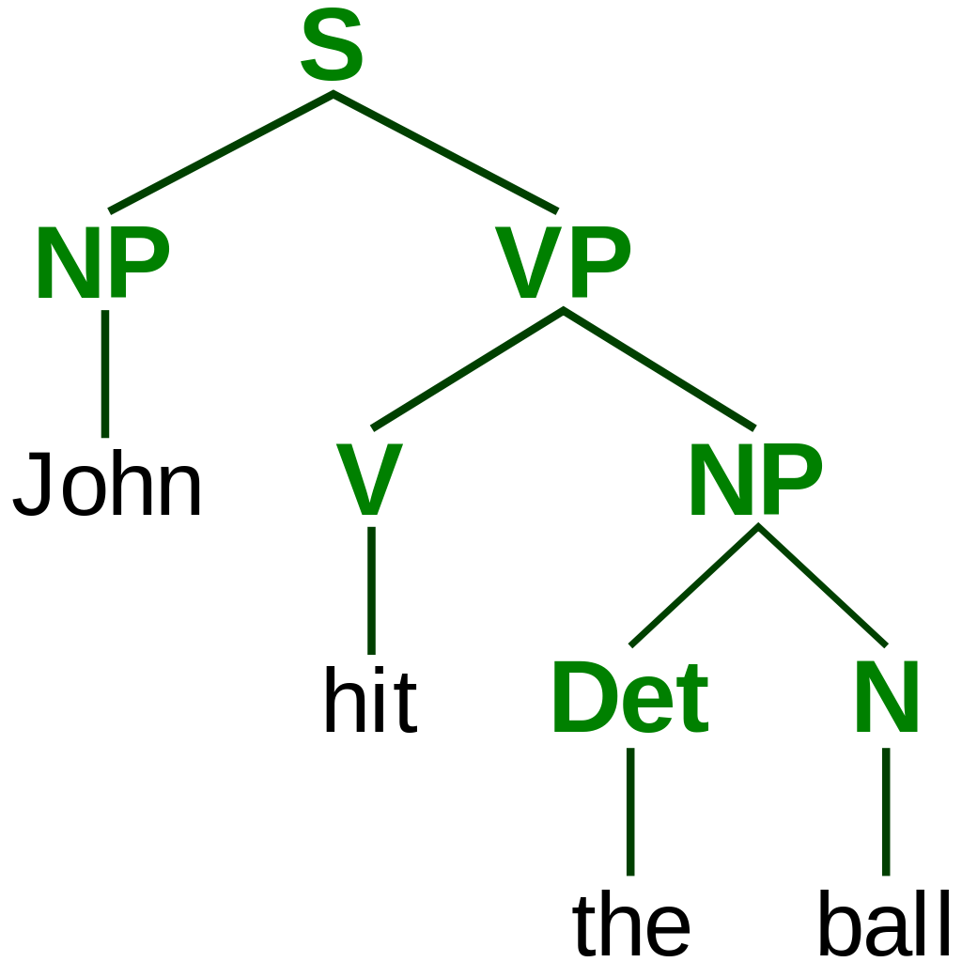
The main idea
Main claim: Thinking happens in a language.
“In what sense is it not like English?”
No phonetics or writing system
Not usable for communication with others
Though maybe within the mind?
Meanings are not represented (Fodorian point!)
Thinking happens in a language
Cf machine language vs interpreted language

Slide 20
The main idea – example
LoT representation
 | LoT representation
 | circle(x) AND red(x)
 | circle(x) AND green(x)
 | circle(x) AND blue(x)
 | square(x) AND red(x)
 | square(x) AND green(x)
 | square(x) AND blue(x)

Slide 21
Properties - Quilty-Dunn, Porot, & Mandelbaum (2022)
Discrete constituents
circle, AND, square, etc.
Role-filler independence
AND means the same across objects
Predicate-argument structure
circle, red, etc.: attributes of objects
LoT representation
 | LoT representation
 | circle(x) AND red(x)
 | circle(x) AND green(x)
 | circle(x) AND blue(x)
 | square(x) AND red(x)
 | square(x) AND green(x)
 | square(x) AND blue(x)

Slide 22
Properties - Quilty-Dunn, Porot, & Mandelbaum (2022)
Logical operators
LoT contains word for AND etc.
Inferential promiscuity
Inference proceeds automatically & is sensitive only to form.
circle(x) AND red(x) –> red(x)
circle(x) AND blue(x) –> blue(x)
Abstract content
‘square’ does not specify a color
LoT representation
 | LoT representation
 | circle(x) AND red(x)
 | circle(x) AND green(x)
 | circle(x) AND blue(x)
 | square(x) AND red(x)
 | square(x) AND green(x)
 | square(x) AND blue(x)

Slide 23
Alternative representational formats
Disentangled bit encoding
 | n1 | n2 | n3 | n4
 | 1 | 1 | 0 | 0
 | 1 | 0 | 1 | 0
 | 1 | 0 | 0 | 1
 | 0 | 1 | 0 | 0
 | 0 | 0 | 1 | 0
 | 0 | 0 | 0 | 1

Slide 24
Alternative representational formats
Holistic bit encoding
 | n1 | n2 | n3 | n4
 | 0 | 1 | 0 | 0
 | 0 | 1 | 0 | 1
 | 0 | 0 | 1 | 0
 | 0 | 0 | 1 | 1
 | 1 | 0 | 0 | 1
 | 1 | 0 | 0 | 0

Slide 25
Alternative representational formats
Reals intervals
 | LB | UB
 | 12 | 18
 | 18 | 19
 | - ∞ | 0
 | 0 | 6
 | 6 | 12
 | 19 | ∞

Slide 26
Alternative representational formats
Embeddings
 | n1 | n2 | n3
 | -19 | 0.3 | 54.4
 | 3 | -10.2 | 23
 | -54.3 | 0 | 81
 | -7.3 | 4 | 34
 | -776 | 9.7 | 34.6
 | 13 | 0.01 | 123

Slide 27
Alternative representational formats
Icons
 | icon

Slide 28

A rough sketch of failures
 | Discrete constituents | Role-filler independence | Pred-arg structure | Logical ops | Inferential promiscuity | Abstract concepts
Disentangled bits
Holistic bits
Intervals of reals
Embeddings
Icons / maps

Slide 29
The Fodorian challenges
Productivity
Primitive symbols + combination rules which we can apply iteratively
Systematicity
John is close to the fish is a sentence in the LoT w/ expressions for John, being-close-to, etc.
W/ some plausible assumptions, you can reshuffle to get systematically connected thoughts.
Question: How can we exclude ill-formed thoughts like ‘Is close John’?
Inferential coherence
Reasoning consists of…
computations over mental representations (which are expressions in the LoT)
that only depends on form

Slide 30
Block (1995) The Mind as the Software of the Brain
(A simplified version of) Daniel Dennett
We have infinitely many beliefs!
For instance, ‘2 is smaller than 3’, ‘2 is smaller than 4’, etc.
Implausible that we store infinitely many LoT expressions
Ned Block
Distinguish ordinary and scientific notions of belief.
In ordinary sense, we have infinitely many beliefs.
In scientific sense, we only have finitely many beliefs.
Causally active beliefs: they cause behaviour or other mental states, or they are caused by perception or other mental states.

Slide 31
Block (1995) The Mind as the Software of the Brain
Dennett
We ascribe beliefs that are not explicitly represented.
E.g., guitarist: “I have to switch to an A-”
Despite lacking any such explicit representation!
Pre-theoretical notion of belief ≠ LoT notion.
Block
Again: LoT concerns scientific, cognitive notion of belief

Slide 32
Block (1995) The Mind as the Software of the Brain
Dennett’s thought experiment:
Surgeon inserts LoT expression “I have a pet turtle” as a belief in your brain.
You wake up & are asked whether you have pets
You say “Indeed, I have a pet turtle”
But! When asked how old it is and what its name is, you can’t answer, etc.
Intuitively: You don’t really believe it!
Block
The functional role for belief includes integration with other beliefs, other mental states, and behavior. An isolated belief isn’t a belief.

Slide 33
The pLoT

Slide 34




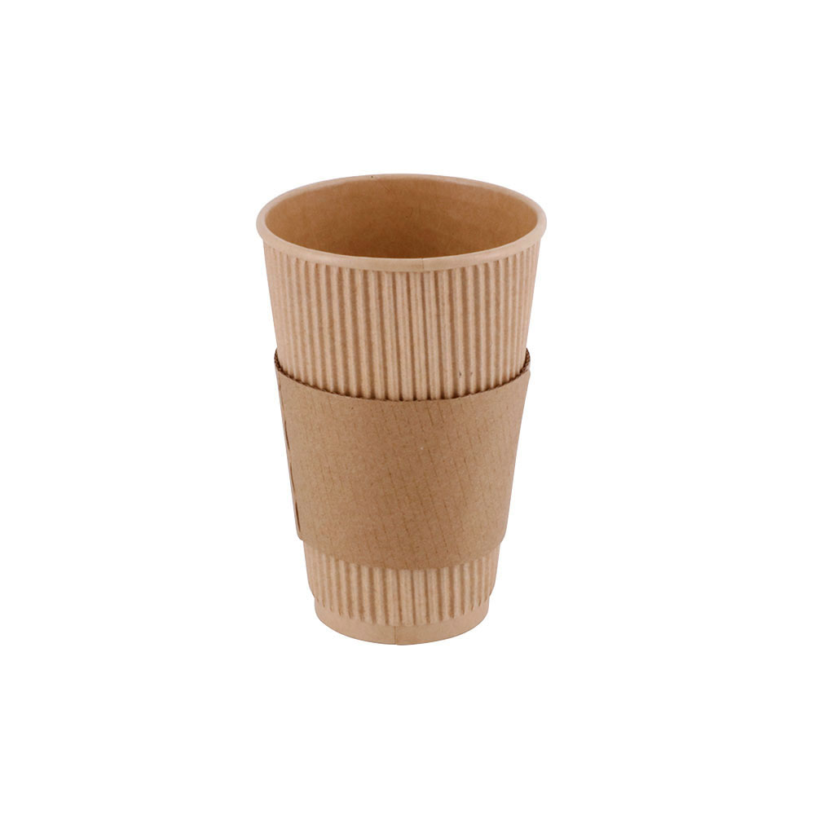

The “p” in “pLoT”
‘pLoT’ stands for ‘probabilistic LoT’
Recent (~20 years) extension: LoT enriched w/ probabilistic inference
Much more in the rest of the course!
Examples of category
In category?

Slide 35

Taking stock – a family of claims
What the LoT is like:
Compositional language w/ words
Some logical operators and predicates
What the LoT can do:
Content of beliefs/desires/intentions/… are LoT expressions
Reasoning -> manipulation of LoT expressions
Learning -> finding LoT expressions that match requirements

Slide 36
Conclusions
We saw a conceptual picture of the mind
It relates to various empirical claims
We want to make it more formal / quantitative
Computational modelling!
Next session: Formal tools
Part I | Introduction: On the very idea of an LoT
Part II | Technical background
Part III | Bayesian program induction (LOTlib3)
Part IV | Case studies
Part V | Summary & Future prospects

Slide 37
Questions?

Slide 38
If there’s time left…

Slide 39
Action - Fodor’s LoT (p.28-31)
Claim: Organisms have a representational system
The agent finds themselves in situation S
The agent believes that (in S) they can only do B₁, B₂, …, B_{n}
The probable consequence of performing each are predicted
i.e., agent computes a set of hypotheticals of roughly the form:
“If B_{i} is performed in S, then, with a certain probability, C_{i}”
A preference ordering is assigned to the consequences.
Action is determined based on preferences and probabilities assigned.
‘The notion that the agent can represent to himself salient aspects of the situations in which he finds himself presupposes that such familiar semantic properties as truth and reference are exhibited by formulae in the representational system’ (p.32)

Slide 40
Learning
Claim: Organisms have a representational system
Experiences of x which are F cause the conclusion that ‘all xs are F’
Rather than some other property G!
E.g., why do observations of white swans (rather than brown ducks) lead to the conclusion that ‘All swans are white’?
Fodor thinks there’s only one story:
The organism represents the relevant experiences as being of xs which are F.
One of the hypotheses that the organism entertains is that “all xs are F”.
The organism employs a rule that says that observations of xs that are F is ground for the belief that all xs are F.

Slide 41
Perception
Claim: Organisms have a representational system
The organism somehow infers a task-relevant environment description from a physical description
E.g., sensorial input –> ‘it’s time for tea’
Perception typically involves hypothesis formation and confirmation
Inference to the best explanation
There is typically no intrinsic conceptual connection between sensorial input and description
The only plausible solution to appeals to the computational capacities of the organism

Slide 42
The big argument in the LoT (p.27)
The only psychological models of cognitive processes that seem even remotely plausible represent such processes as computation.
Computation presupposes a medium of computation: a representational system.
Remotely plausible theories are better than no theories at all.
We are thus provisionally committed to attributing a representational system to organisms. ‘Provisionally committed’ means: committed insofar as we attribute cognitive processes to organisms and insofar as we take seriously such theories of these processes as are currently available.
It is a reasonable research goal to try to characterize the representational system to which we thus find ourselves provisionally committed.
It is a reasonable research strategy to try to infer this characterization from the details of such psychological theories as seem likely to prove true.
This strategy may actually work: It is possible to exhibit specimen inferences along the lines of item 6 which, if not precisely apodictic, have at least an air of prima facie plausibility.
Today’s topic!
Self evident!
Follows from 1-3
To justify in practice

