Slide 1
Aims for this session
A little bit of probability (probably redundant)
Bayes’ theorem from scratch (probably redundant)
Usual linear regression (maybe redundant)
Bayesian linear regression

Slide 2
The language to talk about probabilities
A probability distribution is a function that associates numbers to events and satisfies certain axioms.
If the domain is discrete, it tells the probability of each event. If it is continuous, it tells the probability density (each event has prob 0, and p of event in an interval is the integral of the function in the interval)
A conditional probability, written p(A|B), is the probability of event A occurring given that event B occurs.
p(A|B) can be different from p(B|A). For instance, p(called “Fausto” | Italian) = LOW, while p(Italian | called “Fausto”) = HIGH.

Slide 3
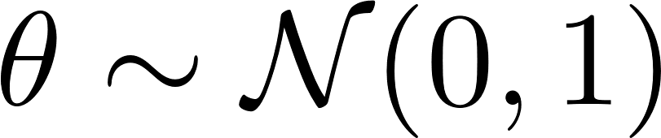
The language to talk about probabilities
A random variable is an useful abstract notion to talk about probability. It is basically a measurement that hasn’t taken a specific value but whose value is realized according to a distribution.
A random variate is a specific realization of a random variable, i.e. value that a random variable took.
For instance, the height of a person is a random variable. My height is a variate of that random variable.
We use the symbol “~” to express how a random variable is distributed. For instance:

Slide 4
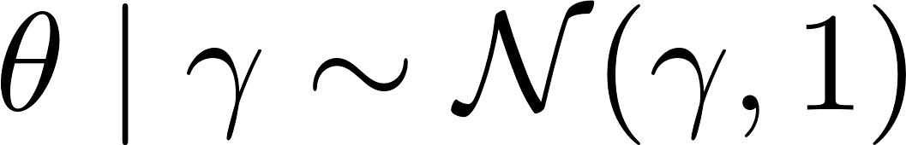
The language to talk about probabilities
Random variables can also be conditionally distributed:
This notation is used to express how the distribution of a random variable depends on some other values.
For instance, imagine that every day I bring my umbrella with a 0.9 probability if it rains and 0.3 probability otherwise. This can be written as:

Slide 5
Is everything clear up to this point?
What are other examples of random variables and variates?
How are they distributed?
What does the following mean?

Slide 6
Bayes’ theorem
It’s a-bayes-ing

Slide 7
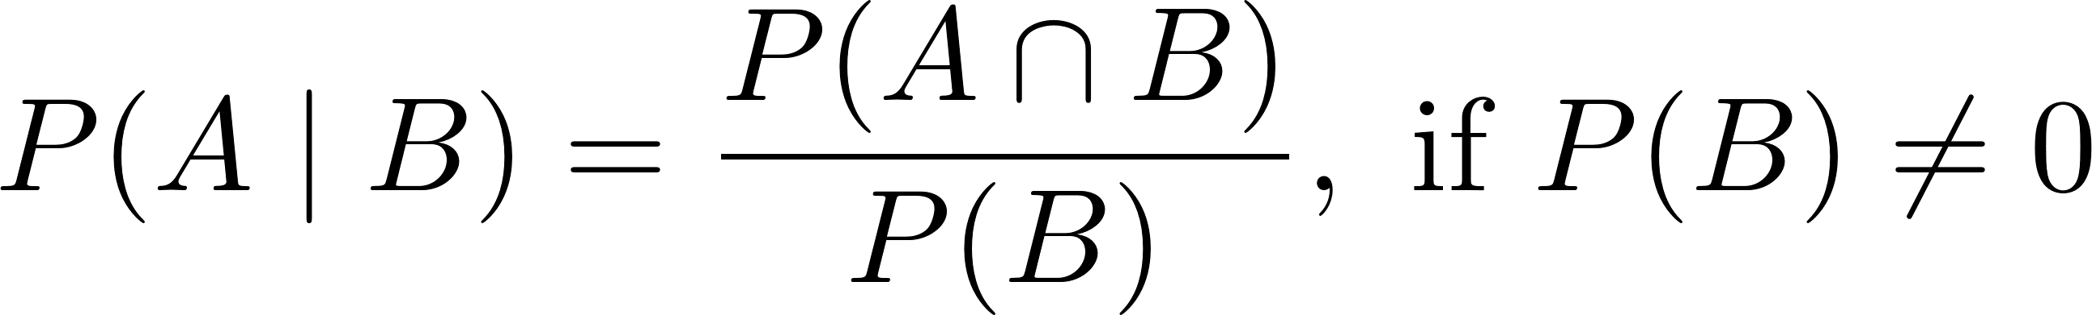
Conditional probability
Definition of conditional probability:
Conditional probability formalizes the probability of something (A) given that we know something else (B).
It is a function of two things: the probability of what we assume, P(B), and the probability of (what we assume and what we are interested in).
Apparent problem: Given that we are assuming B, why does P(B) in the denominator give us any information?
It’s because B also appears in the numerator!
Assume that B is certain. Then, conditioning on B gives no information. Formally: P(A and B) = P(A) and P(B) = 1. Therefore, P(A|B) = P(A).

Slide 8
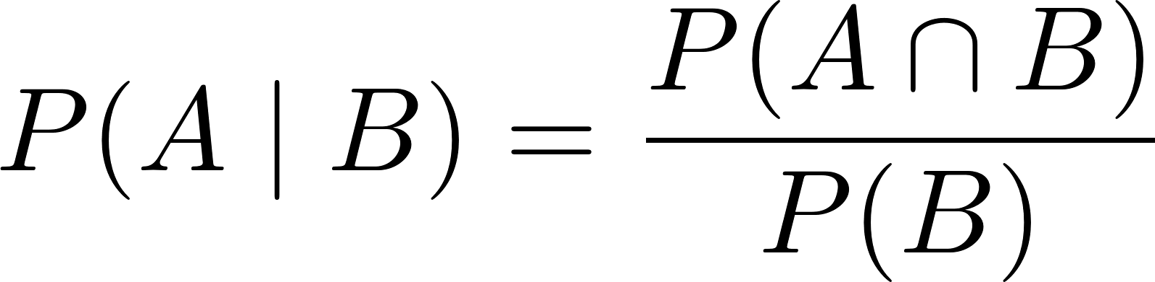
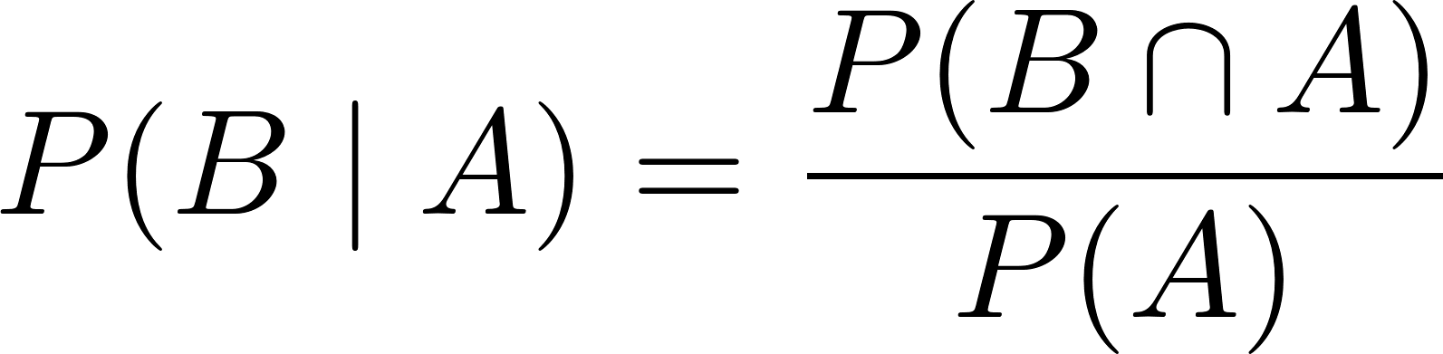
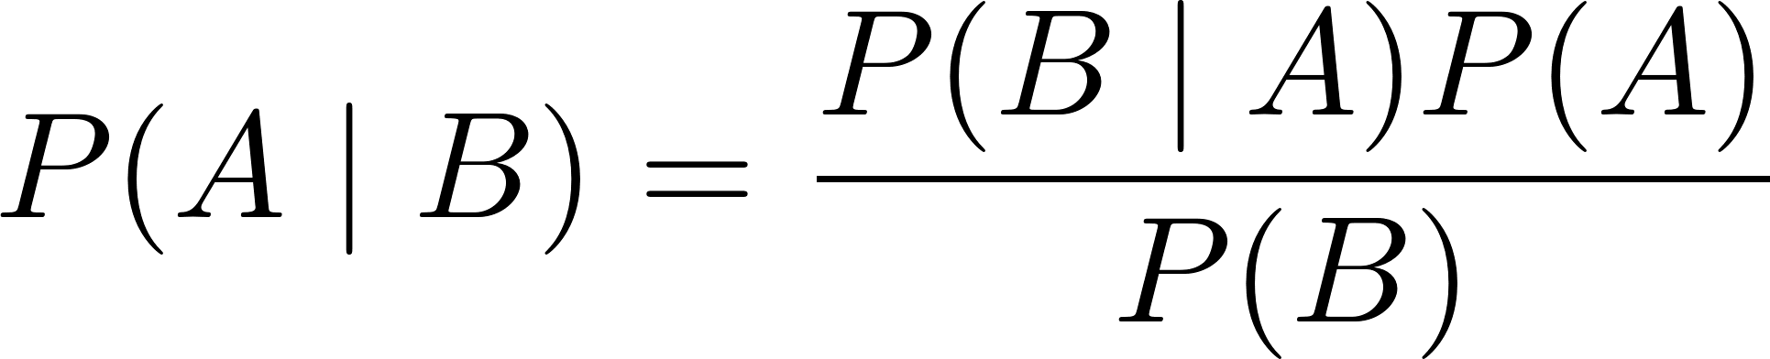
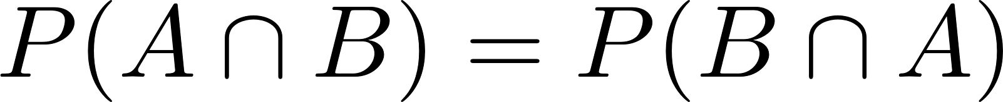
How do derive Bayes’ theorem

Slide 9
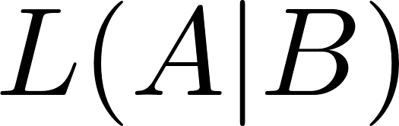
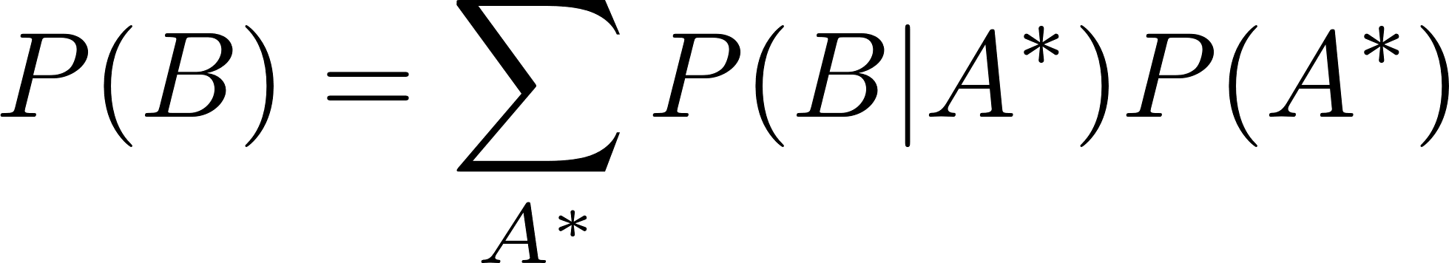
Bayes’ theorem
Likelihood
Prior
Posterior
Hypothesis
Data
Evidence

Slide 10
The intuition behind Bayes’ theorem
If we observe some data, the probability that it was produced by a world-state depends on two things:
the probability of that world-state producing the observed data
the probability of the world-state (independently of the data).
The more probable (1) or (2) are, the more probably is the world state.
The probability of the data across all world-states (i.e. the “evidence”, the denominator) is just for normalizing and doesn’t mean too much.

Slide 11
Linear regression

Slide 12
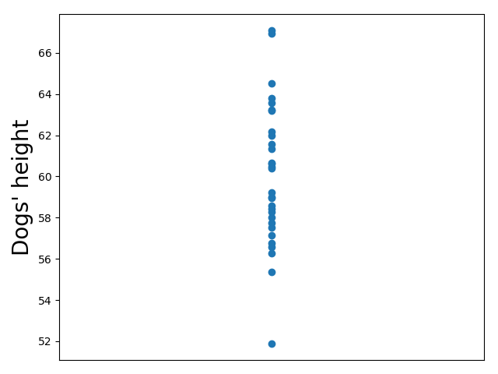
A bunch of measurements
Imagine you have a bunch of measurements of a quantity in a population
Let’s say, you measured the height of a bunch of dogs
Presumably, they are going to be distributed normally around a value, something like this:

Slide 13
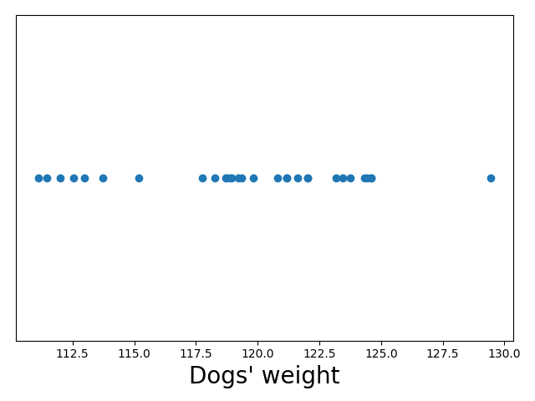
A bunch of measurements
Each of the dots corresponds not to a height, but to a dog.
That makes sense: you can have more than one point on the same height.
Therefore, each of those points (i.e. dogs) can be given a value wrt to other dimensions too – depending on the properties of the dog corresponding to the point.
For instance, for each point there is a corresponding weight, colour, age, average walking speed. E.g. :

Slide 14
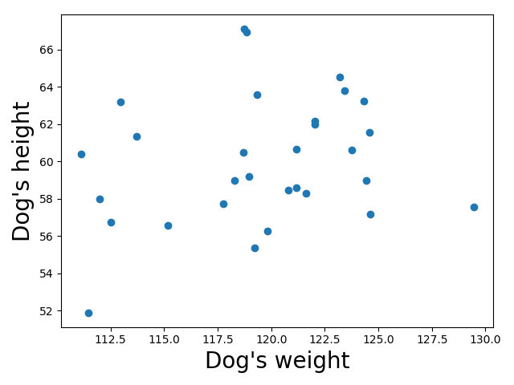
A bunch of measurements
Across plots, the points refer to the very same dogs.
But it is hard to recognize which points refer to the same dog across one-dimensional plots, so if we want to do that we can plot in more dimensions, each dimension corresponding to one property.
E.g. the relation between height and weights:
This becomes harder for >2 dimensions.

Slide 15
A bunch of measurements
Why would we want to consider more than one property at a time?
Because we can be interested in the relations between different properties. We might investigate the relations between them.
In particular, the value of one property can affect the way another property is distributed.
IMPORTANT: this is the central intuition!
Each observation is a realization of a random variable with a certain distribution. We can look at the conditional distribution of the random variable. In particular, we can condition the distribution on the value of another property.
We are then interested in the conditional distribution.

Slide 16
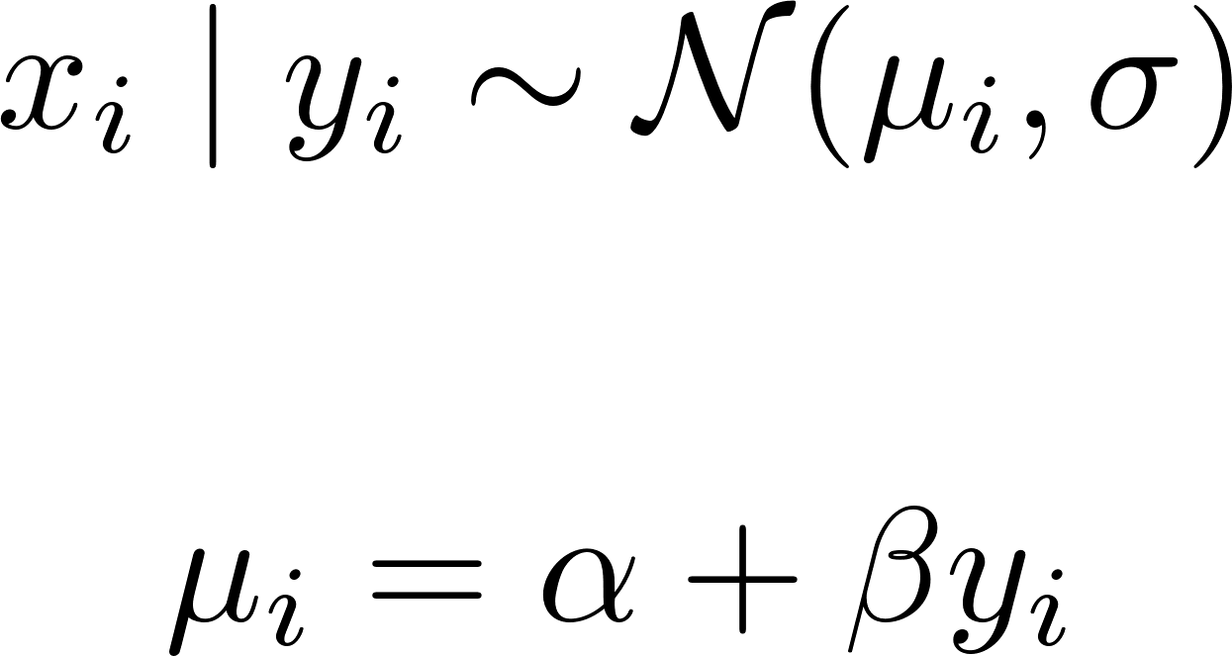
A bunch of measurements
In principle, we can condition the distribution of one variable on the values of other variables however we want – imagination is the only limit!
(that is hierarchical Bayesian models <3!)
In simple linear regression however, we use a fixed schema.
We assume that one variable (the dependent variable) is distributed normally with a fixed variance and a mean that depends linearly on the value of another variable (the independent variable)
This is clearly expressed as an equation:

Slide 17
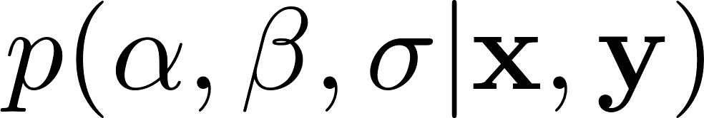
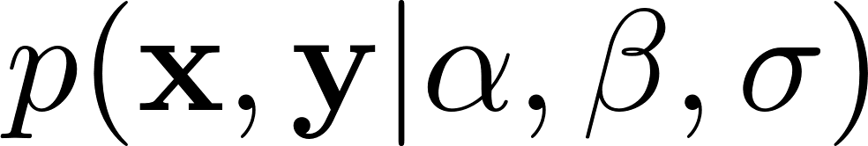
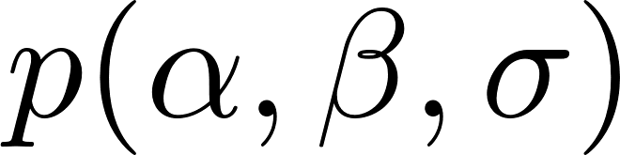
A bunch of measurements
Basically, we have three free parameters in the model that we want to estimate: the variance (one value), the intercept (one value) and the slope (one value).
These three values describe how the distribution of one (set of) variable depend on another (set of) variable, assuming the model is correct up to the values of the model parameters.
So we are interested in:
Bayes tells us how to calculate this in terms of and

Slide 18
A bunch of measurements
Before we get to Bayes, there is one thing to notice.
If you are happy with uniform priors for all parameters and only getting the parameters with the highest posterior probability rather than a full posterior distribution, then all you need to do is to minimize the sum of the squared residuals.
This is what classical non-Bayesian regression does.

Slide 19
Bayesian linear regression
: )

Slide 20
How it works…
General Bayesian approach:
We think informally about a model that we assume generates the data, up to the value of some well-defined free variables. This encodes our assumptions about the world. In our case, linear model.
We define a prior over the values of the free model parameters.
We define the formula to calculate the likelihood (i.e. the probability of the data we observed given every value of the free parameters)
We can use the general purpose language I presented earlier!
We put the formula in a machine and let it deal with the calculations.
Finally, we get a posterior over the free variables!

Slide 21
How to specify the prior in general?
The prior are supposed to encode the prior uncertainty (but also information) about the state of the world.
For each free parameter, we should specify a prior distribution.
There is an important intuition here. The likelihood encodes the probability of getting the data given a state of the world. The prior encodes the probability of the world state.

Slide 22
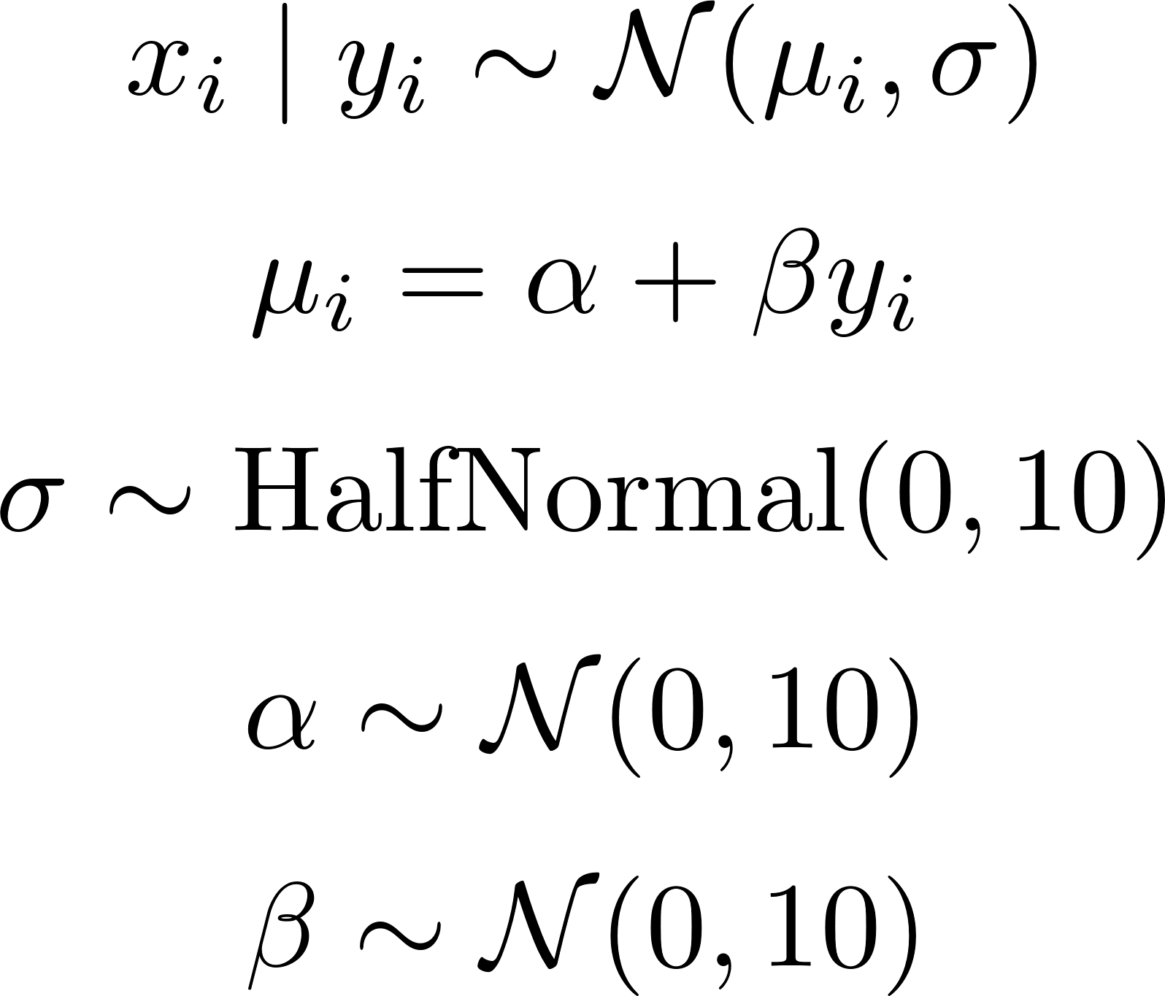
How to specify the prior in a linear model?
We write the generative model like this:
Likelihood
Deterministic function
Prior
Prior
Prior

Slide 23
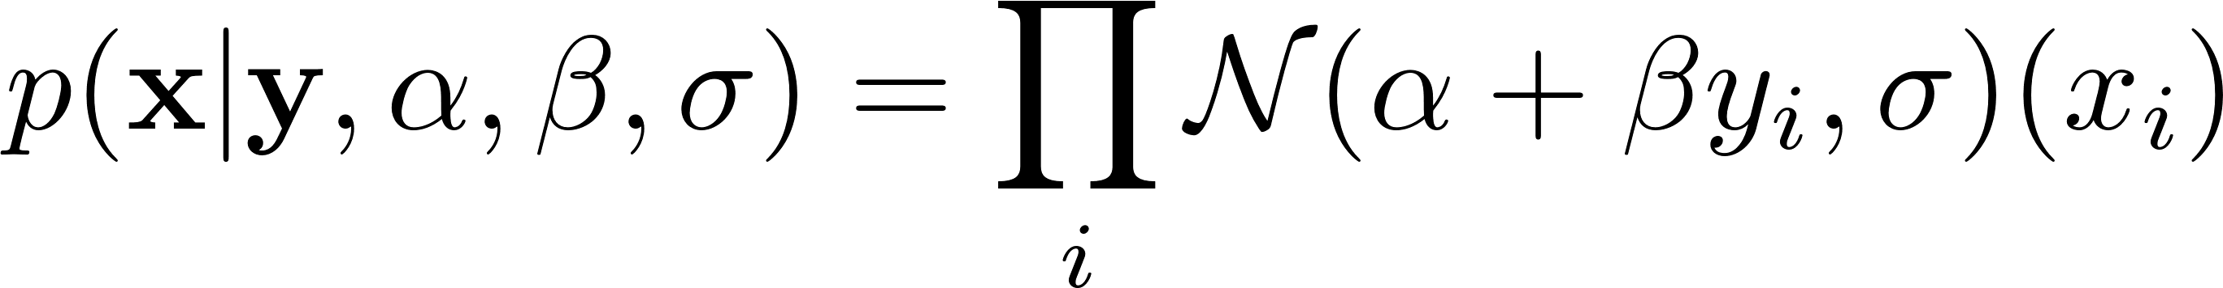
How to calculate the likelihood?
How do we calculate the likelihood in practice?
Good news: you only need the language to express models what I talked about earlier!
In a linear model, the likelihood is quite simple:
We assume that the realizations of the dependent variables are independent from each other, so we just need to multiply the probabilities of the model producing each observation.

Slide 24
Okay, how do I get the posterior in general?
Okay, now we have the prior and we specified the formula for the likelihood. How do we get the posterior?
The problem is that, except for simple cases, calculating the evidence (the denominator of Bayes’ formula) requires solving integrals that cannot be solved analytically.
Good news! There is a family of general purpose algorithms that estimate the posterior given just likelihood and prior: Markov Chain Monte Carlo (MCMC) techniques.
We can do this because the evidence is not that important: it’s basically just a normalization factor.
I can say a bit about MCMC later

Slide 25
How to interpret the posterior in general?
The posterior is a probability density function (since our parameters are continuous), namely the distribution describing the probability of the true value of the parameters being in any given interval.
From the posterior we can get the highest posterior density interval, namely the narrowest interval that contains e.g. 98% of the probability mass.

Slide 26
…and in linear regression?
In the linear regression, the posterior is going to be a joint distribution over the free parameters that tells us the probability density of each combination of values of the parameters.

Slide 27
Wrapping up

Slide 28
So what’s good about good ol’ Bayes?
We get a full posterior distribution over the free parameters instead of point estimates – this is a lot more informative!
We get A LOT more freedom in how we specify the models – it’s easy to specify complicated models with hundreds or even thousands of parameters (this happens when you do hierarchical models)
We get a simple, common language to specify all of our models in – there’s no need anymore for single-purpose statistical tests. Therefore, it becomes much easier to see what is happening.

Slide 29
What’s bad about Bayes?
It takes some time to learn (I don’t really know it)
A lot of people don’t know how to interpret results in Bayesian terms
Journals want p-values (although maybe Bayes factor could be a substitute)
Overall: definitely go Bayes!

Slide 30
Exercises if there is time left
The real power of Bayesian stats is that one can easily specify a model structure, which would require an ad-hoc test in a frequentist approach.
E.g. What if we don’t want the variance to be fixed?
For instance, imagine that we are modelling the temperature of a room as a function of the number of animals in the room.
In general, if there are no animals then the temperature is gonna be distributed normally.
If there are animals, then they might make the room warmer (if they are e.g. people) or not (e.g. lizards). But the more there are, the more they can affect the room’s temperature.

