Slide 1
Aims for this session
Understanding some central concepts in formal semantics (truth-condition, possible world)
Understanding the basis of lambda calculus and how to model simple sentences
One great result: determiners and generalized quantification
Warning: what follows might be a bit confusing and I might be massively overambitious.

Slide 2
Part I
Conceptual foundations

Slide 3
Formal semantics
General picture:
We talk about an object language (here, English) with a formal language we call the metalanguage.
If we use the metalanguage to talk about the meaning of the original sentence, then what we are doing is formal semantics.
The metalanguage is a language in its own right, and has a syntax and semantics of its own. Many metalanguages have been used.
We want a metalanguage that is good for encoding meanings.
We should be able to talk not just about whole sentences, but also sub-sentential components since those also have meaning.

Slide 4
What is it for?
Basically, formal semantics takes expressions in a language we care about (English) and talks about them with expressions in a language we do not care about (e.g. first-order logic with set theory and lambda calculus).
But why would we want that?
The metalanguage is (ideally) unambiguous.
We can do computation on the metalanguage more easily.
The relation between different sentences become clearer.
The metalanguage is designed to encode meanings clearly.
Models meaning independently of any specific natural language.
Metalanguage reveals deep logical form of sentences
In three words: we do it for clarity, computability and understanding!

Slide 5
“But English is so much more expressive!”
Of course, the metalanguage we’ll use does not describe everything about the original sentence. For instance, it doesn’t model irony or mood.
But then again, we don’t want it to insofar as those things are more part of a specific utterance than a sentence, and more part of how it’s meant than what is means – although this distinction is not always clear.
E.g. what about words “me” / “you” / “this etc.?
(There is a great theory for those but it’s more complicated than we can get into here)
For now, put these issues on the side and focus on simple cases.

Slide 6
Desiderata on our formal model
We want the formalism to represent formally the logical relations between sentences: if sentence B follows from sentence A in virtue of the meanings of A and B alone, the metalinguistic analysis of B should follow formally (in some well-define sense) from that of A.
We want to keep things compositional: the metalinguistic analysis of a complex expression should be a function of the metalinguistic analyses of the parts of the complex expression.
We’ll put this in the back of our minds and take a different path.

Slide 7
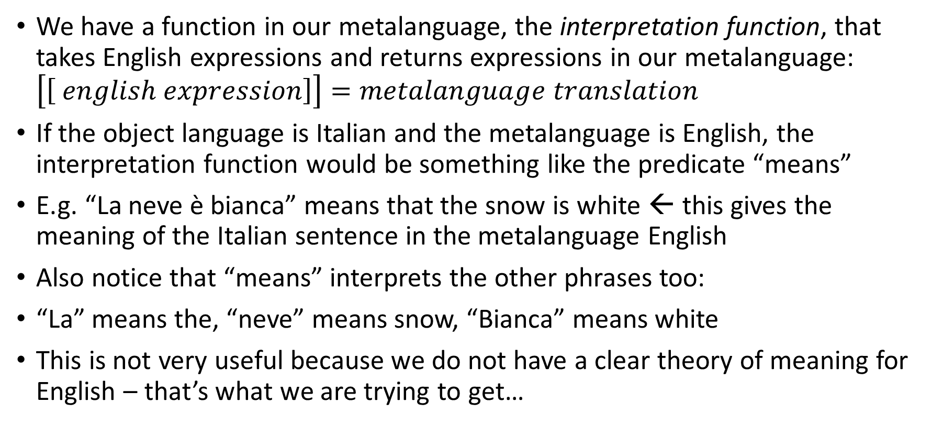
More specific strategy
We have a function in our metalanguage, the interpretation function, that takes English expressions and returns expressions in our metalanguage: $\left[\left[ english expression\right]\right]=metalanguage translation$
If the object language is Italian and the metalanguage is English, the interpretation function would be something like the predicate “means”
E.g. “La neve è bianca” means that the snow is white ← this gives the meaning of the Italian sentence in the metalanguage English
Also notice that “means” interprets the other phrases too:
“La” means the, “neve” means snow, “Bianca” means white
This is not very useful because we do not have a clear theory of meaning for English – that’s what we are trying to get…

Slide 8
A small detour – possible worlds
Consider the set of all the ways the world could have been:
Each of us could have been in Germany
Earth could have been a bit bigger or a bit smaller
Elephants could have been pink
(Maybe) the number 4 could have been odd
Each of these sentences is compatible with many ways the world could have been.
For instance, saying “elephants could have been pink” leaves unspecified whether Germany exists –the sentence could be true and Germany exist or not.
A way that reality as a whole could have been is a possible world.
The set of possible worlds is the set of all the ways the world could have been.

Slide 9
What should our metalanguage do?
Sentences
A sentence says something about how the world is.
To grasp the meaning of a sentence is to grasp what it would take for that sentence to be true.
Therefore: We can model the meaning of a sentence by specifying whether it is true or false for every possible situation, i.e. its truth-conditions.
The truth-condition for a sentence is a function from possible worlds to truth values, i.e. True is the sentence is true at that world and False otherwise.
In sum: When the interpretation function is applied to an English sentence, it should return a metalinguistic expression which refers to a function from possible worlds to truth values.

Slide 10
What should our metalanguage do?
Truth conditions visually

Slide 11
What should our metalanguage do?
Proper nouns
Proper nouns refer to individuals
e.g. “Tamar” refers to Tamar
Much of the meaning of a proper noun can be modelled by a function from possible worlds to an individual in that world if the individual exists in that world or else nothing.
E.g. “Tamar” means a function from possible worlds to Tamar in those world (or nothing if Tamar doesn’t exist in those worlds)
So we should make sure we have expressions referring to individuals in our metalanguage.

Slide 12
What should our metalanguage do?
Verbs
Verbs combine with proper nouns and create sentences
Since proper nouns refer to individuals and sentences are true or false, we can take verbs to refer to functions from individuals to truth values.
E.g. “runs” refers to a function that takes individuals and returns true if that individual is running and false if it is not running.
The meaning of a verb is a function from possible worlds to (for each world) a function from individuals to truth values.
For instance, “laughs” is a function that for every possible world specifies a function from individuals to whether they laugh or not.

Slide 13
What should our metalanguage do?
Common nouns
Common nouns refer to sets of individuals
e.g. “Penguin” refers to the (individuals in the) set of penguins
Much of the meaning of a common noun can be captured as a function from possible worlds to (possibly empty) sets.
So we make sure we have words in our metalanguage that refers to sets.

Slide 14
“Isn’t there a pattern?”
There is a pattern to these analyses
First we consider what an expression generally refers to, its so-called extension, and then we relativize it to possible worlds.
The function from possible worlds to extensions is called intension.
Think about it the other way around: the extension is the intension applied to the actual world.
The intuition is something like this:
The meaning of an expression can be captured by describing what it says about the world, in every possible world. Once we know that, it feels like there’s not much more to know about the meaning.

Slide 15
Important distinction
It’s important to distinguish between how we talk about a possible world and how the speakers in that possible world (if there are any) speak.
For instance, a possible world where people call feet “heels” is not necessarily a possible world where people have heels instead of feet.
(Although there is a possible world where people call feet “heels” and also people have heels instead of feet. Maybe in that possible world horses have feet instead of heels, and so a person in that world might say “Horses have heels” and mean that horses have feet)
Similarly, it’s not enough to consider a possible world where people call even “odd” to have a possible world where the number 4 is odd.
General lesson: we describe possible world in our English, not possible English.

Slide 16
Summary of concepts
Extension
Intension
Possible world
Meaning
Truth values
Truth conditions

Slide 17
Part II
The formalism

Slide 18
Fine and dandy but show us the formulas
Four things cover much of what people use in formal semantics:
Lambda calculus
(simple) First-order predicate logic
(simple) Set theory
(simple) Type theory

Slide 19
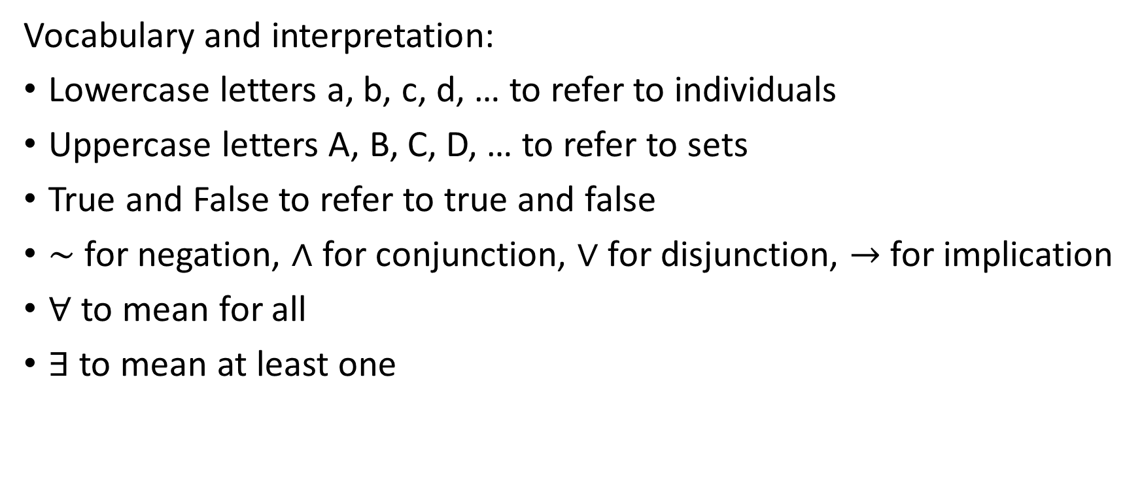
First-order logic: an informal presentation
Vocabulary and interpretation:
Lowercase letters a, b, c, d, … to refer to individuals
Uppercase letters A, B, C, D, … to refer to sets
True and False to refer to true and false
$\sim$ for negation, $∧$ for conjunction, $∨$ for disjunction, $→$ for implication
$∀$ to mean for all
$∃$ to mean at least one

Slide 20
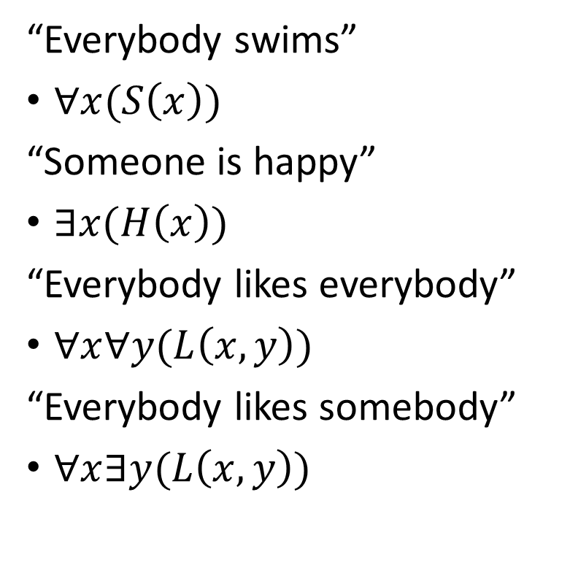
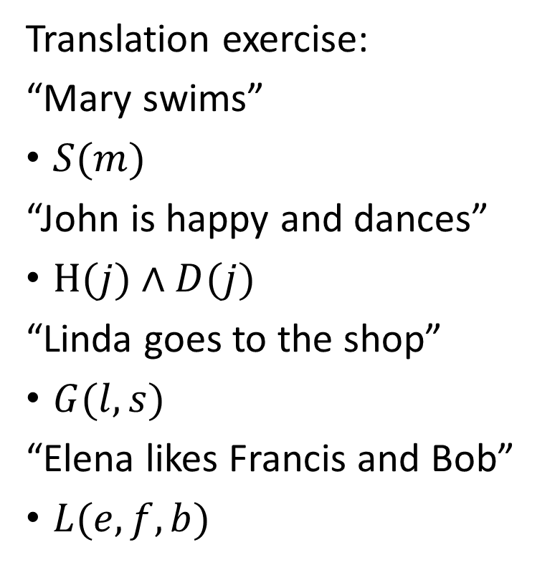
First-order logic: an informal presentation
Translation exercise:
“Mary swims”
$S(m)$
“John is happy and dances”
$H(j)∧D(j)$
“Linda goes to the shop”
$G(l, s)$
“Elena likes Francis and Bob”
$L(e, f, b)$
“Everybody swims”
$∀x(S\left(x\right))$
“Someone is happy”
$∃x(H\left(x\right))$
“Everybody likes everybody”
$∀x∀y(L\left(x, y\right))$
“Everybody likes somebody”
$∀x∃y(L\left(x, y\right))$

Slide 21
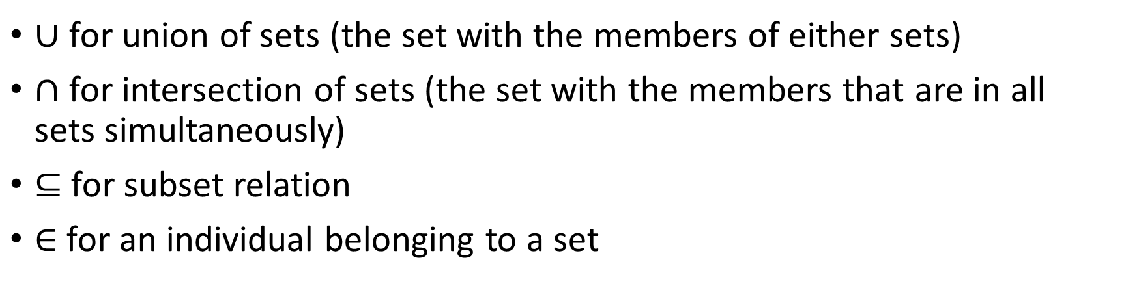
Set theory
$∪$ for union of sets (the set with the members of either sets)
$∩$ for intersection of sets (the set with the members that are in all sets simultaneously)
$⊆$ for subset relation
$∈$ for an individual belonging to a set

Slide 22
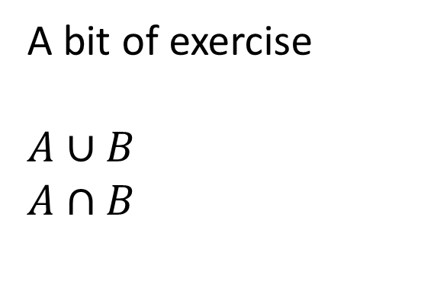
Set theory
A bit of exercise
$$A∪B$$
$$A∩B$$
A
B
C

Slide 23
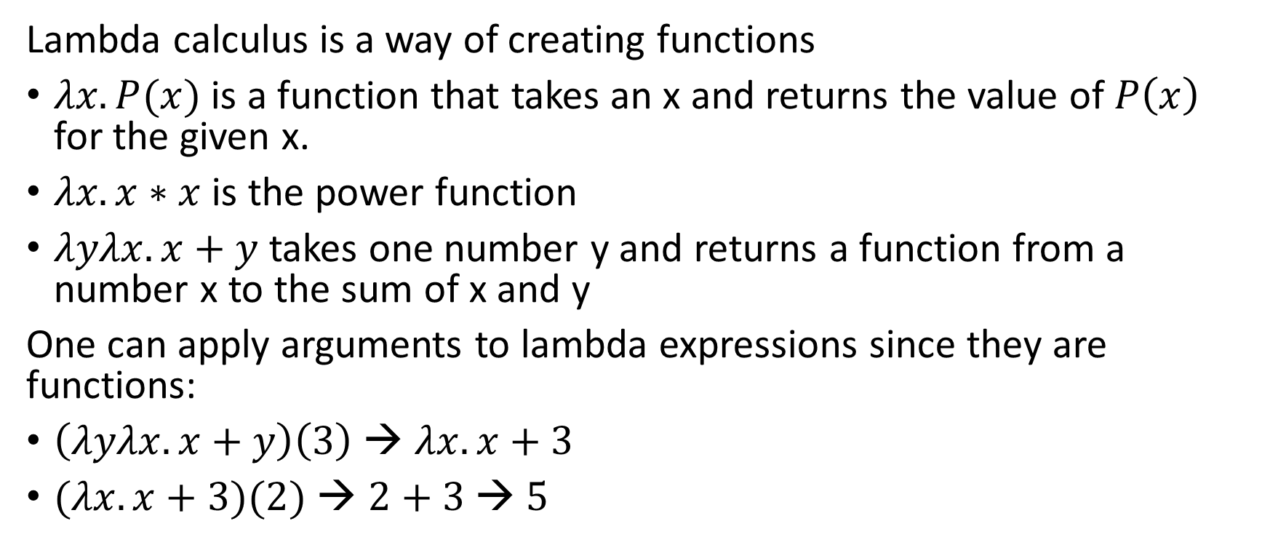
Lambda calculus
Lambda calculus is a way of creating functions
$λx.P(x)$ is a function that takes an x and returns the value of $P\left(x\right)$ for the given x.
$λx.x∗x$ is the power function
$λyλx.x+y$ takes one number y and returns a function from a number x to the sum of x and y
One can apply arguments to lambda expressions since they are functions:
$\left(λyλx.x+y\right)\left(3\right)$ → $λx.x+3$
$(λx.x+3)(2)$ → $2+3$ → $5$

Slide 24
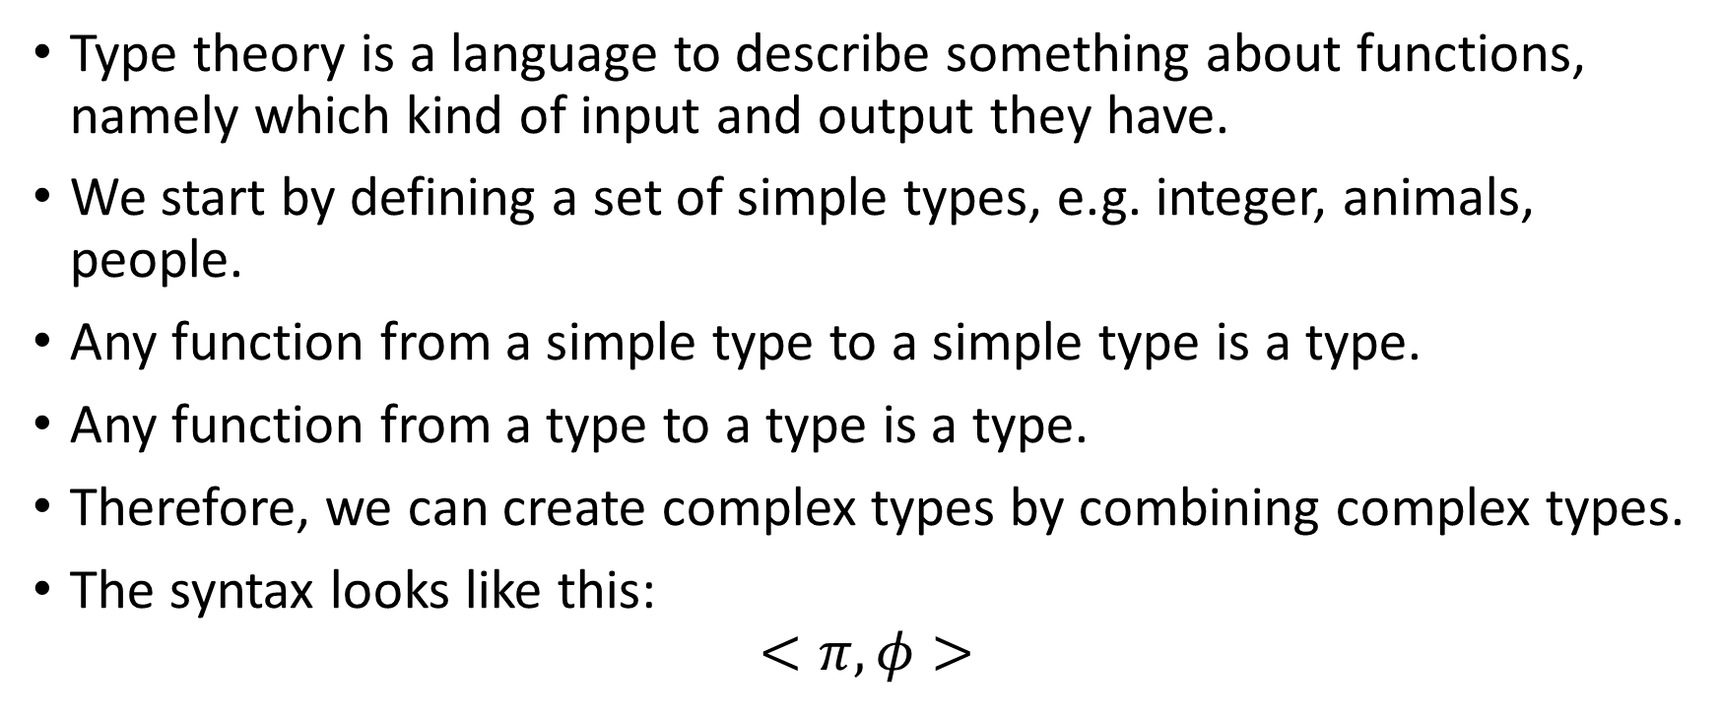
Type theory
Type theory is a language to describe something about functions, namely which kind of input and output they have.
We start by defining a set of simple types, e.g. integer, animals, people.
Any function from a simple type to a simple type is a type.
Any function from a type to a type is a type.
Therefore, we can create complex types by combining complex types.
The syntax looks like this:
$$<π,φ>$$
Input type
Output type

Slide 25
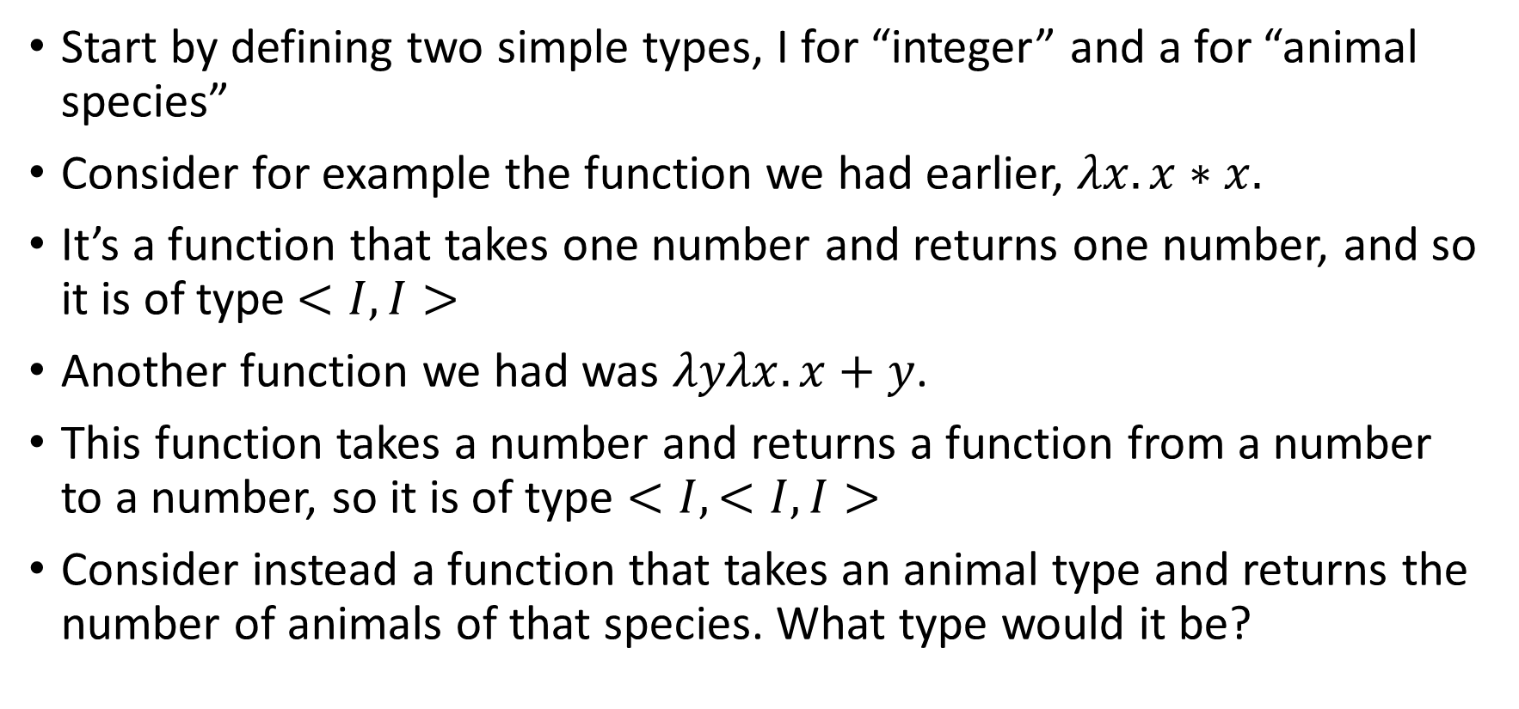
Type theory
Start by defining two simple types, I for “integer” and a for “animal species”
Consider for example the function we had earlier, $λx.x∗x.$
It’s a function that takes one number and returns one number, and so it is of type$<I,I>$
Another function we had was $λyλx.x+y$.
This function takes a number and returns a function from a number to a number, so it is of type $<I,<I, I>$
Consider instead a function that takes an animal type and returns the number of animals of that species. What type would it be?

Slide 26
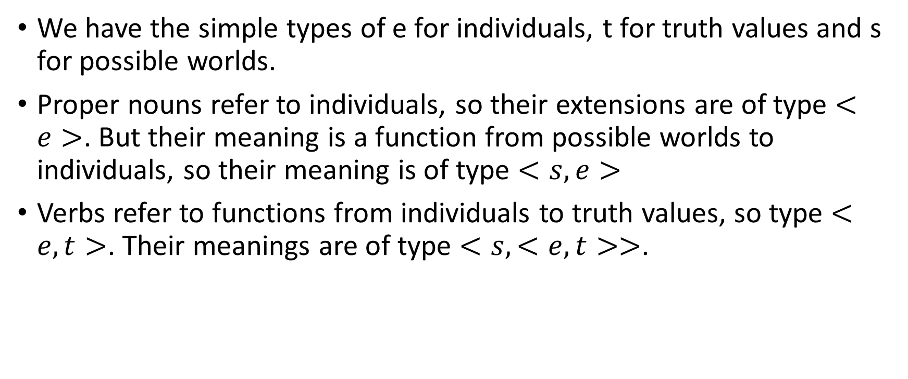
Putting everything together
We have the simple types of e for individuals, t for truth values and s for possible worlds.
Proper nouns refer to individuals, so their extensions are of type $<e>$. But their meaning is a function from possible worlds to individuals, so their meaning is of type $<s,e>$
Verbs refer to functions from individuals to truth values, so type $<e,t>$. Their meanings are of type $<s,<e, t>>$.

Slide 27
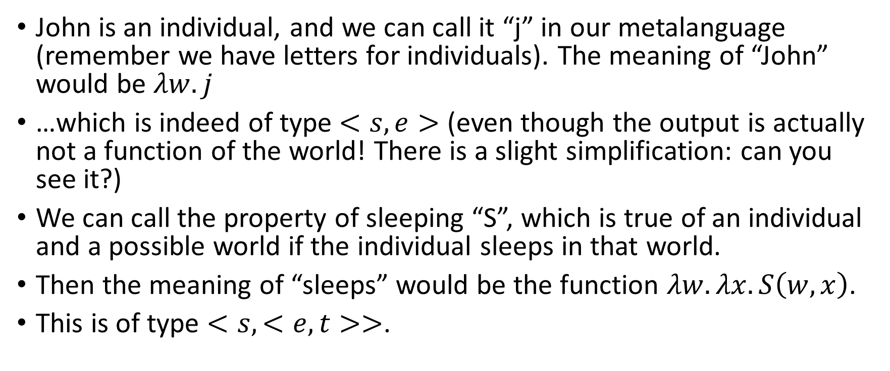
Putting everything together
John is an individual, and we can call it “j” in our metalanguage (remember we have letters for individuals). The meaning of “John” would be $λw.j$
…which is indeed of type $<s,e>$ (even though the output is actually not a function of the world! There is a slight simplification: can you see it?)
We can call the property of sleeping “S”, which is true of an individual and a possible world if the individual sleeps in that world.
Then the meaning of “sleeps” would be the function $λw.λx. S\left(w, x\right)$.
This is of type $<s,<e, t>>$.

Slide 28
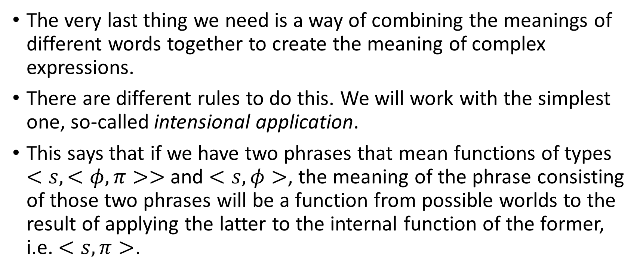
Putting everything together
The very last thing we need is a way of combining the meanings of different words together to create the meaning of complex expressions.
There are different rules to do this. We will work with the simplest one, so-called intensional application.
This says that if we have two phrases that mean functions of types $<s,<φ, π>>$ and $<s,φ>$, the meaning of the phrase consisting of those two phrases will be a function from possible worlds to the result of applying the latter to the internal function of the former, i.e. $<s,π>$.

Slide 29
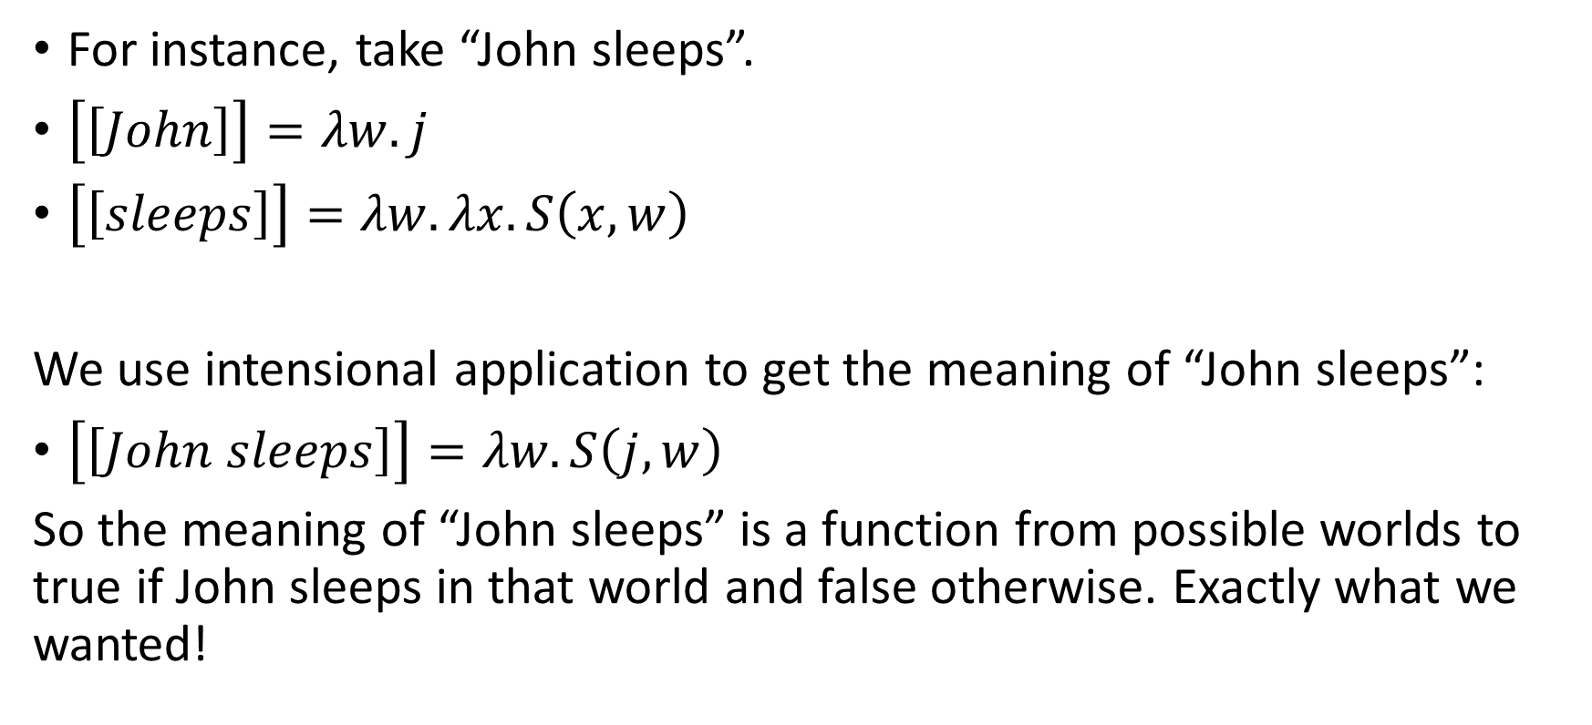
Putting everything together
For instance, take “John sleeps”.
$\left[\left[John\right]\right]=λw.j$
$\left[\left[sleeps\right]\right]=λw.λx.S\left(x, w\right)$
We use intensional application to get the meaning of “John sleeps”:
$\left[\left[John sleeps\right]\right]=λw.S\left(j, w\right)$
So the meaning of “John sleeps” is a function from possible worlds to true if John sleeps in that world and false otherwise. Exactly what we wanted!

Slide 30
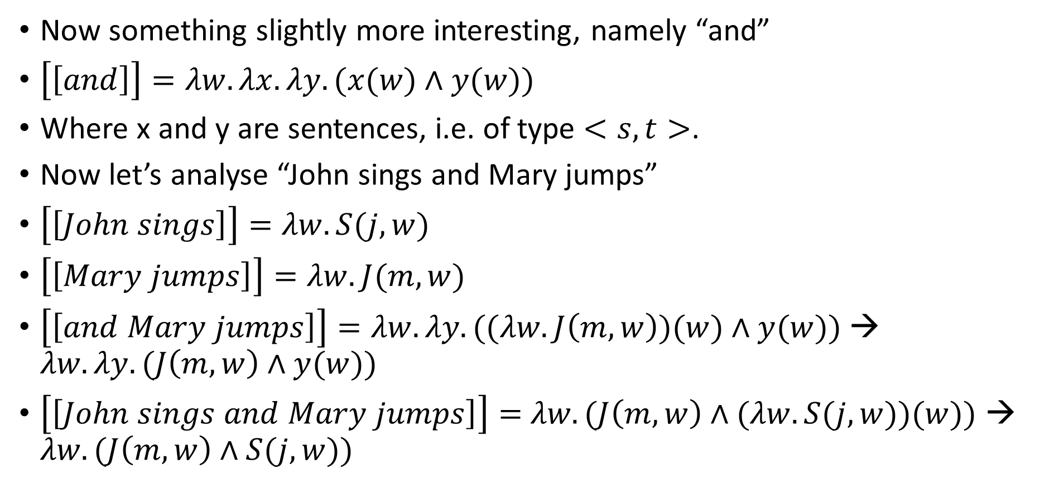
Putting everything together
Now something slightly more interesting, namely “and”
$\left[\left[and\right]\right]=λw.λx.λy.(x(w)∧y(w))$
Where x and y are sentences, i.e. of type $<s,t>$.
Now let’s analyse “John sings and Mary jumps”
$\left[\left[John sings\right]\right]=λw.S(j, w)$
$\left[\left[Mary jumps\right]\right]=λw.J(m, w)$
$\left[\left[and Mary jumps\right]\right]=λw.λy.((λw.J\left(m, w\right))(w)∧y(w))$ → $λw.λy.(J\left(m, w\right)∧y(w))$
$\left[\left[John sings and Mary jumps\right]\right]=$ $λw.(J\left(m, w\right)∧(λw.S(j, w))(w))$ → $λw.(J\left(m, w\right)∧S(j, w))$

Slide 31
If there’s any time left
How could we analyse common nouns, e.g. “potatoes”? What about “potatoes grow”?
How could quantifiers work?
E.g. “Some people likes potatoes”

