Slide 1
Disclaimer
Many of you know this stuff better than I do (you know who you are)
I’ll give it my best shot
Don’t know how long it’s going to take but we can discuss…

Slide 2
Overview
Three ways of thinking about entropy
Guessing game
Axiomatic
Coding length
A few important information-theoretical measures
Conditional entropy
Mutual information
Kullbach-Leibler divergence

Slide 3
First path to information theory
Imagine we are playing the following game:
You think of a person, I ask yes/no questions until I know who it is
You pick from a certain set and I start asking questions:
Me: Do they have long hair?
Superman
Fiona
Marieke
Jonas
Jon

Slide 4
First path to information theory
Imagine we are playing the following game:
You think of a person, I ask yes/no questions until I know who it is
You pick from a certain set and I start asking questions:
Me: Do they have long hair?
You: No
Superman
Fiona
Marieke
Jonas
Jon

Slide 5
First path to information theory
Imagine we are playing the following game:
You think of a person, I ask yes/no questions until I know who it is
You pick from a certain set and I start asking questions:
Me: Do they have long hair?
You: No
Superman
Fiona
Marieke
Jonas
Jon

Slide 6
First path to information theory
Imagine we are playing the following game:
You think of a person, I ask yes/no questions until I know who it is
You pick from a certain set and I start asking questions:
Me: Are they a superhero?
Superman
Fiona
Marieke
Jonas
Jon

Slide 7
First path to information theory
Imagine we are playing the following game:
You think of a person, I ask yes/no questions until I know who it is
You pick from a certain set and I start asking questions:
Me: Are they a superhero?
You: No
Superman
Fiona
Marieke
Jonas
Jon

Slide 8
First path to information theory
Imagine we are playing the following game:
You think of a person, I ask yes/no questions until I know who it is
You pick from a certain set and I start asking questions:
Me: Are they a superhero?
You: No
Superman
Fiona
Marieke
Jonas
Jon

Slide 9
First path to information theory
Imagine we are playing the following game:
You think of a person, I ask yes/no questions until I know who it is
You pick from a certain set and I start asking questions:
Me: It is Jon!
It took 3 questions
Superman
Fiona
Marieke
Jonas
Jon

Slide 10
First path to information theory
I try to find the answer by asking a series of questions. Which questions I ask depends on what you answer at each round.
Call the description of which questions I ask for every possible answer you give my “script”.
Depending on the script I use, it’s going to take fewer or more questions to get to the answer.

Slide 11
First path to information theory
Your behaviour can modelled as sampling from a distribution over people.
Imagine that we play this game many times and for some reason you always pick Jon (i.e. you pick Jon with probability 1.).
After a while, I am going to change my first question to “Is it Jon?”
The intuition is that the probability with which you pick each object influences which script is optimal.
This raises the question: how well can I do with the best possible script? What does peak performance look like?

Slide 12
First path to information theory
You can visualize a script as a tree
Question: how good is a given script s?
Is it a bird?
YES
NO
Bird
Is it a plane?
YES
NO
Plane
Superman

Slide 13

First path to information theory
You can visualize a script as a tree
Question: how good is a given script s?
We can quantify script goodness as the expected number of questions needed to guess correctly when following the script:
Is it a bird?
YES
NO
Bird
Is it a plane?
YES
NO
Plane
Superman
Probability of i being right guess
# questions needed to guess i with script s

Slide 14
First path to information theory
So, the best script is the script that minimizes this quantity:
Probability of i being right guess
# questions needed to guess i with script s

Slide 15
First path to information theory
Now we come to the cool result from information theory that should blow your mind…

Slide 16
First path to information theory
Now we come to the cool result from information theory that should blow your mind…
We can calculate how good the optimal script is without knowing the optimal script, just based on the probabilities that you will pick each object!
In other words, given any distribution we can calculate how many questions are needed on average to “zoom in” the unknown result of a sample from the distribution, given that we are asking the best questions for that distribution.
This value is (a way of seeing) the Shannon entropy of the distribution!

Slide 17

Entropy
So, here we come to the formula for entropy:
Again, entropy tells you how many questions on average I need to ask before I know what you thought of, if I use the best script for the distribution E in your head.
Reciprocal of probability
(Bigger than or equal to 1)
Bigger than or equal to 0

Slide 18
Back to the initial example…
Person | Probability 1 | Probability 2
Superman | .2 | 0.96
Fiona | .2 | 0.01
Jonas | .2 | 0.01
Marieke | .2 | 0.01
Jon | .2 | 0.01
Entropy: | ≈ 2.32 | ≈ 0.32

Slide 19
Second path to information theory
Imagine you observe an event e with a certain probability p(e).
Observing e makes you more of less surprised.
For instance, knowing that it’s cold in Edinburgh is not very surprising, but knowing that it’s cold in Nicaragua is very surprising.
How do we make the intuition formal? How should the information measure behave?
The measure of information is some function I from events to real numbers.
A way to find I is to first ask which properties it should satisfy

Slide 20

Nice properties for a measure of surprise
First of all, necessary events don’t surprise at all and improbable events are very surprising (the surprisal measure tends to infinity as the event’s probability goes to 0):
So the measure of surprisal is a function of the events’ probability

Slide 21

Nice properties for a measure of surprise
Second, you never get less surprised by observing an event, i.e. there’s always something to learn. Observing something cannot leave me knowing less. So, for any event e,

Slide 22
Nice properties for a measure of surprise
Third, the surprise from observing two events that happen with independent probabilities should be just the sum of the surprises from observing the individual events, i.e.

Slide 23
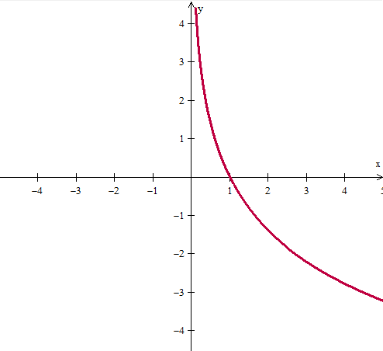
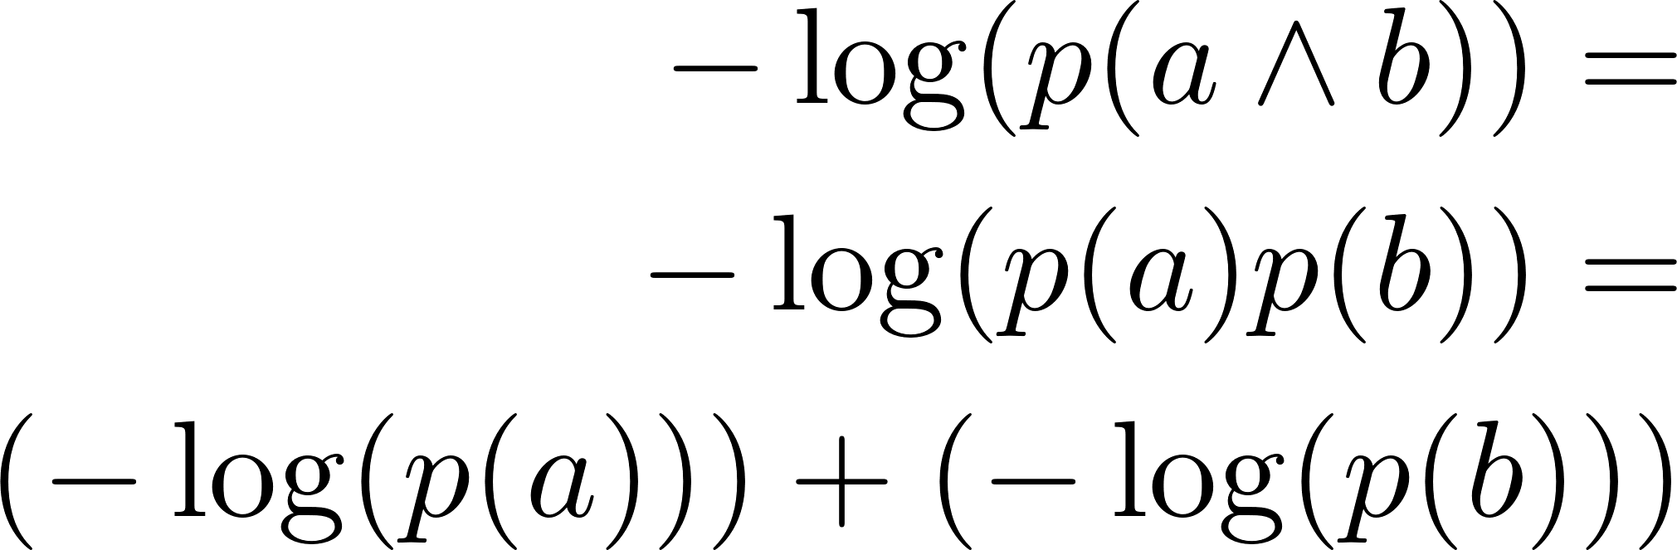
Nice properties for a measure of surprise
Well, as it happens the negative logarithm of the event’s probability (is the only function that) has all these nice properties!
Neat!
Goes to infinity!
Positive in the interval ]0,1[
-log(1) = 0

Slide 24

Nice properties for a measure of surprise
Finally, the entropy of a distribution is the expected surprisal from sampling:
Over all events
Probability of event e
Information from event e

Slide 25
A third path to information theory
Imagine you see the result of sampling from a distribution over the alphabet.
You have to encode the letters you see with binary strings and send them to me. You want to send as few bits as possible.
You do the encoding based on a translation from the letters to the binary strings, e.g.:
Letter | String
a | 0100
b | 1101
… | …

Slide 26
A third path to information theory
The question is: what is the best encoding, i.e. the encoding with the shortest expected number of bits, given the distribution?
By now you can probably guess what entropy tell us:
Not which encoding is best, but rather what is the expected number of bits we need to send, given that we are using the best encoding.

Slide 27
Where we are
Various ways to see the concept of informational entropy of a distribution:
Encoding length: Number of bits needed on average to describe, in the best encoding, the result of sampling the distribution.
Amount of information: Amount of information you get on average by sampling from the distribution.
Number of questions: Average number of yes-no questions you have to ask before you know the answer if you use the best script.

Slide 28
So what is information in general? My take…
Information can be seen under (at least) two equivalent lights:
The work that’s left to do to describe the result of sampling once you have perfected your language.
The surprise that you feel after observing the result of sampling once you have perfectly fine-tuned your expectations.

Slide 29
So what is information in general? My take…
Information can be seen under (at least) two equivalent lights:
The work that’s left to do to describe the result of sampling once you have perfected your language.
The surprise that you feel after observing the result of sampling once you have perfectly fine-tuned your expectations.
Initial idea: there are better and worse ways of dealing with the uncertainty in a given source of uncertainty (modelled as a distribution).
Information is the uncertainty that one is left to deal with in a source of uncertainty once one’s subjective behaviour is as good as it can get.
In this sense, information does not depend on the subject. It’s in the distribution itself.

Slide 30
Multiple distributions
One can think about entropy as the amount of uncertainty in a distribution, which depends on how the probability is distributed across the possible events.
But probability distributions can be related to each other!
For instance, imagine we don’t know where we are in the world and we don’t know how the weather is like out of the window. Knowing one fact gives us information about the other.
A bunch of measures can be defined to talk about the relation between the information in different distributions.
I will present a couple of these measures.

Slide 31

Conditional entropy
Imagine that two distributions X and Y are correlated.
Then, observing the value of Y reduces the uncertainty about the value that X takes. So it changes how much information I have about X.
The entropy of X given Y=y is:
Prob of seeing x given that y
Surprise from seeing x given that we have seen y

Slide 32
Conditional entropy
For instance, imagine we get to know that we are in Sardinia.
This reduces the uncertainty about the type of weather we can expect to see out of window.
The entropy of X given Y=y is intuitively how much uncertainty in the value of X is left after observing that the value of Y is y.

Slide 33
Conditional entropy
But there is a more general question of how much uncertainty we should expect to be left in X when we observe the value of Y. What is the expected uncertainty left in X after we observed Y?
This is the conditional entropy H(X|Y).
Intuitive facts about the conditional entropy H(X|Y):
If the value of X is completely determined by Y, then H(X|Y) should be 0
If X and Y are uncorrelated, H(X|Y) should be equal to the entropy of X (all the uncertainty of X is left)
H(X|Y) is bigger or equal to H(X)

Slide 34
Mutual information
The conditional entropy told us how much uncertainty is left in X after observing Y.
Mutual information I(X; Y) tells us something related: by how much the uncertainty in X is reduced when Y is observed.
Visual help:
H(X)
Entropy in X
H(Y)
Entropy in Y
I(X;Y)
Redundant information between X and Y
H(X|Y)
Novel information in X
H(Y|X)
Novel information in Y

Slide 35
Other measures
In the guessing game, imagine that you are guessing based on a certain distribution X, but I think you are guessing based on a different distribution Y, so I optimize my script for distribution Y.
Two questions spring in mind immediately:
How many questions do I need to ask on average?
This is answered by cross-entropy!
How many more questions do I need to ask than if I had known the true distribution you are using?
This is answered by the Kullback-Leibler divergence from the true distribution X to the wrong distribution Y I think you are using.

Slide 36
My footnote to this: semantics & entropy
How is this connected to semantics? (simplifying a lot)
Imagine the actual world as the result of sampling from the set of all possible worlds, W, over which I have an expected distribution.
An assertoric sentence generally says in which subset of the set of possible world the actual world is.
By making a sentence longer we can make it refer to a smaller subset of W, i.e. encode more specific things.
The fact that longer sentences describe more specific situations (smaller sets of world) indicates that language is somewhat optimized.
W
The set of all possible worlds
w2
@
w3
w4
w5

Slide 37
Discussion
How do CLE people think about information? Is there a specifically CLE interpretation of it?

