Slide 1
Fake news DETECTION
By UMESH SARASWAT AND VICKY KUMAR PRASAD ,
Bachelor OF TECHNOLOGY (iNFORMATION TECHNOLOGY), Delhi TECHNOLOGICAL uNIVERSITY
DECEMBER 12 2019

Slide 2
Outline
Section 1
Spread of fake news through social media and its implications on society
Why fake news identification is so hot now?.
Section 2
Data set/Corpus exploration
Deep learning approaches to combat fake news
Convolutional Neural Networks in image and LSTM for text classification, Network Architecture
Section 3
Results summary
Questions

Slide 3
What , why and it’s implications
A short definition of fake news is a news article or content created with false information to mislead readers and spread false claims. Fake news is created by different people for various reasons including financial and political gain.
Is social media to be blamed for the spread of fake news?
Users in social media trust, like and share articles shared by their friend
Humans can’t fact check each and every article or blog read on internet
Implications
https://www.snopes.com/fact-check/morgan-freeman-death-hoax/
Morgan freeman was declared dead in 2010 by CNN news channel according to some tweets. Later
CNN reported that it’ not true
Implications
https://www.snopes.com/fact-check/morgan-freeman-death-hoax/

Slide 4
Data SET/Corpus Exploration
Challenging problem to collect the available datasets.
Authenticated fact checked data sources
Datasets published for research purposes
Kaggle, GitHub – how much can we trust?
Dataset cleaning and preparation for learning algorithm
NLP techniques, stop words removal, padding documents to be of same length,
drop missing columns

Slide 5
DEEP Learning APPROACHES
Binary classification problem F : E -> { 0, 1} such that,
F(a) = {
1, if a is a piece of fake news,
0, otherwise }
Baseline classifiers - Naive bayes and Support vector machines
Bag-of-words model and Tf-Idf weighting scheme, Dimensionality reduction and feature extraction
Need for deep learning approaches? – Traditional models does not capture semantics in text. ”Words with similar meaning appear together in similar concept and must have same representation”
Word embeddings and n-gram models to the rescue
n-gram(bigram, trigram), skip-gram models – probabilistic language model
Vectorization - Word2vec, Fast text, Glove vectors

Slide 6
Convolutional Neural Networks IN image Classification
Convolutional neural networks
State-of-art in computer vision models,
Convoluted layers, pooling layers and fully connected layers
How does CNN fit for image ?
Whole model is compiled with the stochastic gradient descent algorithm and cross entropy loss function.
Training is improved by using k-fold cross validation.
Bias be decreased by hyperparameter tuning using
GridSearch() method from keras library.

Slide 7
Network ARCHITECURE
P(article = fake | new input document)
Document vector
Word Embedding Layer(Pre trained embeddings)
Conv 1D Layer(Windows and filters)
Max Pooling layer
Conv 1D Layer(Windows and filters)
Softmax Probabilistic Output layer(log-likelihood)
Global Max Pooling layer

Slide 8
RESULTS SUMMARY
Model was trained using Keras with Tensorflow backend
Data size trained 1.5GB
Epochs - 15, batch size – 4 ,opimizer-Adam ,trained on CPU
Comparison of results with baseline classifiers

Slide 9
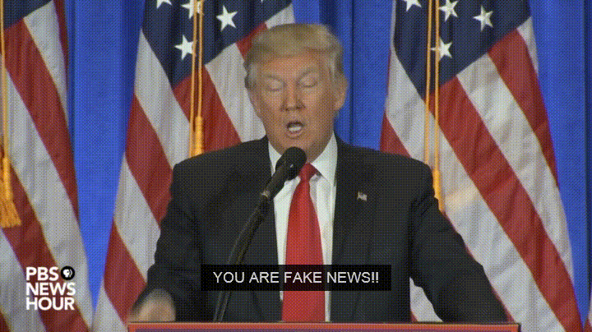
Questions?
Reach me on twitter @venar82 Linkedin: Venkatraman Jeyaraman
Blogs https://dzone.com/articles/demystifying-ai-and-machine-learning-part-2

