Slide 1
Multilevel Graph Partitioning and Fiduccia-Mattheyses
Wasim Mohiuddin

Slide 2
Papers
A Fast and High Quality Multilevel Scheme for Partitioning Irregular Graphs, 1995
A Coarse-Grain Parallel Formulation of Multilevel k-way Graph Partitioning Algorithm, 1997
Authors: George Karypis and Vipin Kumar
Link: www.cs.umn.edu/~metis

Slide 3
Applications
Graph partitioning is an important problem that has extensive applications in many areas:
  Scientific Computing
  VLSI Design
  Task Scheduling

Slide 4
Parallel Algorithms and Graphs
The implementation of many parallel algorithms require solutions graph partitioning problems
  Vertices represent computational tasks
  Edges represent data exchanges
  Vertices and Edges can be assigned weights proportional to the amount of work involved

Slide 5
Vertices are assigned a weight proportional to their task
Edges are assigned weights that reflect the amount of data that needs to be exchanged

Slide 6
Graph Partitioning
NP-complete
Many algorithms have been developed that find reasonably good partitions:
  Spectral Partitioning
  Geometric Partitioning
  Multilevel Graph Partitioning

Slide 7
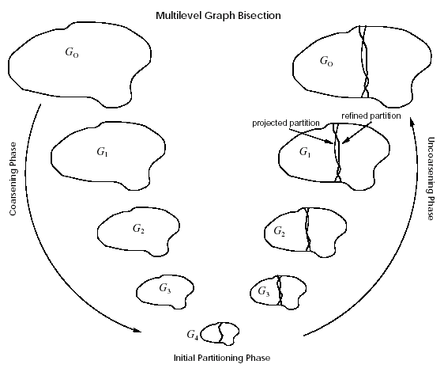
Multilevel Graph Partitioning
3 Phases
  Coarsen
  Partition
  Uncoarsen

Slide 8
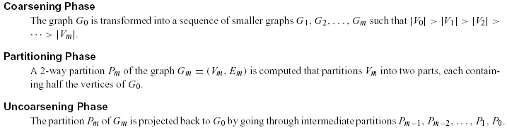
Formally Speaking…

Slide 9
Multilevel Graph Partitioning
Phase 1
  Coarsen
  Partition
  Uncoarsen

Slide 10
Coarsening Phase
A coarser graph can be obtained by collapsing adjacent vertices
  Matching, Maximal Matching
Different Ways to Coarsen
  Random Matching (RM)
  Heavy Edge Matching (HEM)
  Light Edge Matching (LEM)
  Heavy Clique Matching (HCM)

Slide 11
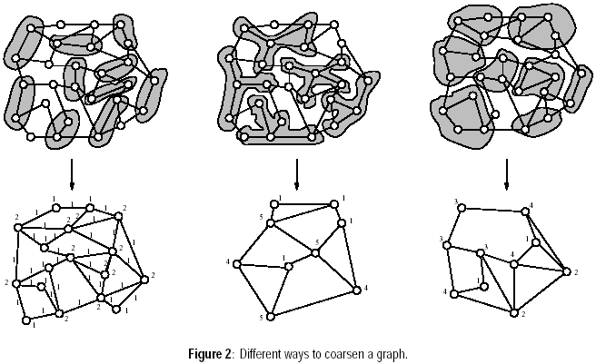
Different Ways to Coarsen

Slide 12
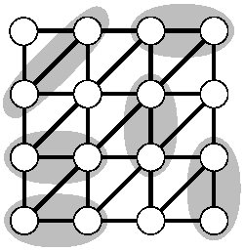
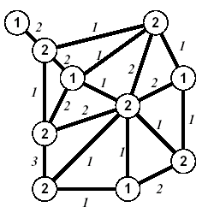
Coarsening

Slide 13
Multilevel Graph Partitioning
Phase 2
  Coarsen
  Partition
  Uncoarsen

Slide 14
Partitioning Phase
The second phase of a multilevel algorithm computes a high-quality (i.e., small edge-cut) P_{m} of the coarse graph G_{m} = (V_{m}, E_{m}) such that each part contains roughly half of the vertex weight of the original graph.

Slide 15
Partitioning Algorithms
Spectral Bisection (SB)
Kernighan-Lin (KL)
  Fiduccia-Mattheyses (FM)
Graph Growing Algorithm (GGP)
Greedy Graph Growing Algorithm (GGGP)

Slide 16
Kernighan-Lin Algorithm
Iterative in nature
Starts with an intial bipartition of the graph
  In each iteration, it searches for a subset of vertices from each part of the graph such that swapping them leads to a partition with a smaller edge-cut
  Each iteration takes O(E log E)

Slide 17
Fiduccia-Mattheyses Algorithm
An improvement on the original KL algorithm
  Reduces complexity to O(E) by using appropriate data structures

Slide 18
Simplified Fiduccia-Mattheyses: Example (1)
1
0
a
b
Grey nodes are in Part1; Black nodes are in Part2.
The initial partition into two parts is arbitrary. In this case it cuts 8 edges.
The initial node gains are shown in Grey.
-1
1
0
c
2
d
e
f
g
h
3
0
Nodes tentatively moved (and cut size after each pair):
none (8);

Slide 19
Simplified Fiduccia-Mattheyses: Example (2)
1
0
The node in Part1 with largest gain is g. We tentatively move it to Part2 and recompute the gains of its neighbors.
Tentatively moved nodes are hollow circles. After a node is tentatively moved its gain doesn’t matter any more.
a
b
-3
1
-2
c
2
d
e
f
g
h
-2
Nodes tentatively moved (and cut size after each pair):
none (8); g,

Slide 20
Simplified Fiduccia-Mattheyses: Example (3)
-1
-2
The node in Part2 with largest gain is d. We tentatively move it to Part1 and recompute the gains of its neighbors.
After this first tentative swap, the cut size is 4.
a
b
-1
-2
c
0
d
e
f
g
h
0
Nodes tentatively moved (and cut size after each pair):
none (8); g, d (4);

Slide 21
Simplified Fiduccia-Mattheyses: Example (4)
-1
-2
The unmoved node in Part1 with largest gain is f. We tentatively move it to Part2 and recompute the gains of its neighbors.
a
b
-1
-2
c
d
e
f
g
h
-2
Nodes tentatively moved (and cut size after each pair):
none (8); g, d (4); f

Slide 22
Simplified Fiduccia-Mattheyses: Example (5)
-3
-2
The unmoved node in Part2 with largest gain is c. We tentatively move it to Part1 and recompute the gains of its neighbors.
After this tentative swap, the cut size is 5.
a
b
0
c
d
e
f
g
h
0
Nodes tentatively moved (and cut size after each pair):
none (8); g, d (4); f, c (5);

Slide 23
Simplified Fiduccia-Mattheyses: Example (6)
-1
The unmoved node in Part1 with largest gain is b. We tentatively move it to Part2 and recompute the gains of its neighbors.
a
b
0
c
d
e
f
g
h
0
Nodes tentatively moved (and cut size after each pair):
none (8); g, d (4); f, c (5); b

Slide 24
Simplified Fiduccia-Mattheyses: Example (7)
-1
There is a tie for largest gain between the two unmoved nodes in Part2. We choose one (say e) and tentatively move it to Part1. It has no unmoved neighbors so no gains are recomputed.
After this tentative swap the cut size is 7.
a
b
c
d
e
f
g
h
0
Nodes tentatively moved (and cut size after each pair):
none (8); g, d (4); f, c (5); b, e (7);

Slide 25
Simplified Fiduccia-Mattheyses: Example (8)
The unmoved node in Part1 with the largest gain (the only one) is a. We tentatively move it to Part2. It has no unmoved neighbors so no gains are recomputed.
a
b
c
d
e
f
g
h
0
Nodes tentatively moved (and cut size after each pair):
none (8); g, d (4); f, c (5); b, e (7); a

Slide 26
Simplified Fiduccia-Mattheyses: Example (9)
The unmoved node in Part2 with the largest gain (the only one) is h. We tentatively move it to Part1.
The cut size after the final tentative swap is 8, the same as it was before any tentative moves.
a
b
c
d
e
f
g
h
Nodes tentatively moved (and cut size after each pair):
none (8); g, d (4); f, c (5); b, e (7); a, h (8)

Slide 27
Simplified Fiduccia-Mattheyses: Example (10)
After every node has been tentatively moved, we look back at the sequence and see that the smallest cut was 4, after swapping g and d. We make that swap permanent and undo all the later tentative swaps.
This is the end of the first improvement step.
a
b
c
d
e
f
g
h
Nodes tentatively moved (and cut size after each pair):
none (8); g, d (4); f, c (5); b, e (7); a, h (8)

Slide 28
Simplified Fiduccia-Mattheyses: Example (11)
Now we recompute the gains and do another improvement step starting from the new size-4 cut. The details are not shown.
The second improvement step doesn’t change the cut size, so the algorithm ends with a cut of size 4.
In general, we keep doing improvement steps as long as the cut size keeps getting smaller.
a
b
c
d
e
f
g
h

Slide 29
Multilevel Graph Partitioning
Phase 3
  Coarsen
  Partition
  Uncoarsen

Slide 30
Uncoarsening Phase
During the uncoarsening phase, the partitioning of the coarser graph G_{m} is projected back to the original graph by going through the graphs G_{m-1}, G_{m-2},…, G₁.
Since each vertex u in V_{i+1} contains a distinct subset U of vertices of V_{i} , the projection of the partition from G_{i+1} to G_{i} is constructed by simply assigning the vertices in U to the same partition in G_{i} that vertex u belongs in G_{i+1}.

Slide 31
Uncoarsening Phase

Slide 32
Multilevel Graph Partitioning and Fiduccia-Mattheyses
Questions?
Thank You

