Slide 1
15-853:Algorithms in the Real World
Graph Separators
  Introduction
  Applications

Slide 2
When I was a boy of 14 my father was so ignorant I could hardly stand to have the old man around. But when I got to be 21, I was astonished at how much he had learned in 7 years.
- Mark Twain

Slide 3
Edge Separators
An edge separator :
a set of edges E’ ⊆ E which partitions V into V₁ and V₂
Criteria:
  |V₁|, |V₂| balanced
  |E’| is small
2
0
1
3
V₁
6
4
5
V₂
7
8
E’
Notes:
Mention edge separators

Slide 4
Vertex Separators
An vertex separator :
a set of vertices V’ ⊆ V which partitions V into V₁ and V₂
Criteria:
  |V₁|, |V₂| balanced
  |V’| is small
2
0
1
V₂
V₁
3
6
4
7
5
8
Notes:
Mention edge separators

Slide 5
Compared with Min-cut
Min-cut: as in the min-cut, max-flow theorem.
Min-cut has no balance criteria.
Min-cut typically has a source (s) and sink (t).
Will tend to find unbalanced cuts.
t
V₂
V₁
s
E’
Notes:
Mention edge separators

Slide 6
Other names
Sometimes referred to as
  graph partitioning (probably more common than “graph separators”)
  graph bisectors
  graph bifurcators
  balanced or normalized graph cuts

Slide 7
Recursive Separation
0
2
1
3
6
2
0
4
5
1
7
3
8
6
4
1
7
5
8
2
0
4
5
7
5
3
8
8
6
3
0
7
4
1
8
5
2
6

Slide 8
What graphs have small separators
Planar graphs: O(n^{1/2}) vertex separators
2d meshes, constant genus, excluded minors
Almost planar graphs:
the internet, power networks, road networks
Circuits
need to be laid out without too many crossings
Social network graphs:
phone-call graphs, link structure of the web, citation graphs, “friends graphs”
3d-grids and meshes: O(n^{2/3})
Notes:
Also linked-lists….

Slide 9
What graphs don’t have small separatos
Hypercubes:
O(n) edge separators
O(n/(log n)^{1/2}) vertex separators
Butterfly networks:
O(n/log n) separators
Expander graphs:
Graphs such that for any U ⊆ V, s.t. |U| ≤ α |V|,
|neighbors(U)| ≥ β |U|. (α < 1, β > 0)
random graphs are expanders, with high probability
It is exactly the fact that they don’t have small separators that make them useful.

Slide 10
Applications of Separators
Circuit Layout (dates back to the 60s)
VLSI layout
Solving linear systems (nested dissection)
n^{3/2} time for planar graphs
Partitioning for parallel algorithms
Approximations to certain NP hard problems
TSP, maximum-independent-set
Clustering and machine learning
Machine vision

Slide 11
More Applications of Separators
Out of core algorithms
Register allocation
Shortest Paths
Graph compression
Graph embeddings

Slide 12
Available Software
METIS: U. Minnessota
PARTY: University of Paderborn
CHACO: Sandia national labs
JOSTLE: U. Greenwich
SCOTCH: U. Bordeaux
GNU: Popinet
Benchmarks:
Graph Partitioning Archive

Slide 13
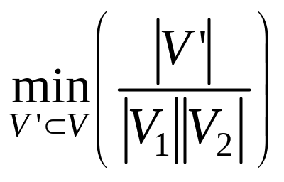
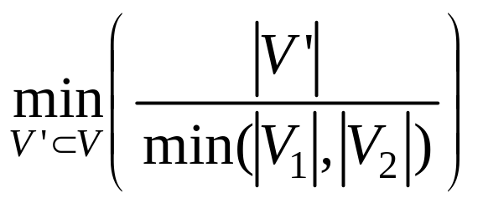
Different Balance Criteria
Bisectors: 50/50
Constant fraction cuts: e.g. 1/3, 2/3
Trading off cut size for balance (vertex separators):
min cut criteria:
min quotient separator:
All versions are NP-hard
|E’|
flux
isoperimetric
number
|E’|

Slide 14
Other Variants of Separators
k-Partitioning:
Might be done with recursive partitioning, but direct solution can give better answers.
Weighted:
Weights on edges (cut size), vertices (balance)
Hypergraphs:
Each edge can have more than 2 end points
common in VLSI circuits
Multiconstraint:
Trying to balance different values at the same time.

Slide 15
Asymptotics
If S is a class of graphs closed under the subgraph relation, then
Definition: S satisfies a f(n) vertex-separator theorem if there are constants α < 1 and β > 0 so that for every G ⊆ S there exists a cut set V’ ⊆ V, with
  |V’| ≤ β f(|G|) cut size
  |V₁| ≤ α |G|, |V₂| ≤ α |G| balance
Similar definition for edge separators.

Slide 16
Edge vs. Vertex separators
If a class of graphs satisfies an f(n) edge-separator theorem then it satisfies an f(n) vertex-separator.
The other way is not true (unless degree is bounded)
|E’| = n/2

Slide 17
Separator Trees
0
2
1
3
6
2
0
4
5
1
7
3
8
6
4
1
7
5
8
2
0
4
5
7
5
3
8
8
6
3
0
7
4
1
8
5
2
6

Slide 18
Separator Trees
Theorem: For S satisfying an (α,β) n^{1-ε} edge separator theorem, we can generate a perfectly balanced separator tree with separator size
|C| ≤ k β f(|G|).
Proof: by picture |C| = β n^{1-ε}(1 + α + α² + …) = β n^{1-ε}(1/1-α)

Slide 19
Algorithms
All are either heuristics or approximations
  Kernighan-Lin (heuristic)
  Planar graph separators
  (finds O(n^{1/2}) separators)
  Geometric separators
  (finds O(n^{(d-1)/d}) separators)
  Spectral (finds O(n^{(d-1)/d}) separators)
  Flow techniques (give log(n) approximations)
  Multilevel recursive bisection
  (heuristic, currently most practical)

Slide 20
Kernighan-Lin Heuristic
Local heuristic for edge-separators based on “hill climbing”. Will most likely end in a local-minima.
Two versions:
Original: takes n² times per step
Fiduccia-Mattheyses: takes n times per step

Slide 21
High-level description for both
Start with an initial cut that partitions the vertices into two equal size sets V₁ and V₂
Want to swap two equal sized sets
X ⊂ A and Y ⊂ B to reduce the cut size.
C
A
B
X
Y
Note that finding the optimal subsets X and Y solves the optimal separator problem, so it is NP hard.
We want some heuristic that might help.

Slide 22
Some Terminology
C(A,B) : the weighted cut between A and B
I(v) : the number of edges incident on v that stay within the partition
E(v) : the number of edges incident on v that go to the other partition
D(v) : E(v) - I(v)
D(u,v) : D(u) + D(v) - 2 w(u,v)
the gain for swapping u and v
A
v
C
B
u

Slide 23
Kernighan-Lin improvement step
KL(G,A₀,B₀)
∀ u ∈ A₀, v ∈ B₀
put (u,v) in a PQ based on D(u,v)
for k = 1 to |V|/2
  (u,v) = max(PQ)
  (A_{k},B_{k}) = (A_{k-1},B_{k-1}) swap (u,v)
  delete u and v entries from PQ
  update D on neighbors (and PQ)
select A_{k},B_{k} with best C_{k}
Note that can take backward steps (D(u,v) can be negative).
A
v
C
B
u
Notes:
Note that if swapping u to same side as neighbor w then w’s gain goes down by 2w(u,v), but if swapping to opposite side, then it goes up by 2w(u,v)

Slide 24
Fiduccia-Mattheyses improvement step
FM(G,A₀,B₀)
∀ u ∈ A₀ put u in PQ_{A} based on D(u)
∀ v ∈ B₀ put v in PQ_{B} based on D(v)
for k = 1 to |V|/2
u = max(PQ_{A})
put u on B side and update D
v = max(PQ_{b})
put v on A side and update D
select A_{k},B_{k} with best C_{k}
A
v
C
B
u
Notes:
Note that if swapping u to same side as neighbor w then w’s gain goes down by 2w(u,v), but if swapping to opposite side, then it goes up by 2w(u,v)

Slide 25
Two examples of KL or FM
Consider following graphs with initial cut given in red.

Slide 26
A Bad Example for KL or FM
Consider following graph with initial cut given in red.
2
2
2
2
1
1
1
KL (or FM) will start on one side of the grid (e.g. the blue pair) and flip pairs over moving across the grid until the whole thing is flipped.
After one round the graph will look identical?

Slide 27
Boundary Kernighan-Lin (or FM)
Instead of putting all pairs (u,v) in Q (or all u and v in Q for FM), just consider the boundary vertices (i.e. vertices adjacent to a vertex in the other partition).
Note that vertices might not originally be boundaries but become boundaries.
In practice for reasonable initial cuts this can speed up KL by a large factor, but won’t necessarily find the same solution as KL.

Slide 28
Performance in Practice
In general the algorithms do very well at smoothing a cut that is approximately correct.
Works best for graphs with reasonably high degree.
Used by most separator packages either
  to smooth final results
  to smooth partial results during the algorithm

Slide 29
Separators Outline
Introduction:
Algorithms:
  Kernighan Lin
  BFS and PFS
  Multilevel
  Spectral
  Lipton Tarjan
Applications:
  Graph Compression
  Nested Dissection (solving linear systems)

Slide 30
Breadth-First Search Separators
Run BFS and as soon as you have included half the vertices return that as the partition.
Won’t necessarily be 50/50, but can arbitrarily split vertices in middle level.
Used as substep in Lipton-Tarjan planar separators.
In practiced does not work well on its own.
6
1
2
5
3
4

Slide 31
Picking the Start Vertex
Try a few random starts and select best partition found
Start at an “extreme” point. Do an initial DFS starting at any point and select a vertex from the last level to start with.
If multiple extreme points, try a few of them.

Slide 32
Priority-First Search Separators
Prioritize the vertices based on their gain (as defined in KL) with the current set.
Search until you have half the vertices.
10
9
2
3
11
4
6
1
5
7
8

Slide 33
Multilevel Graph Partitioning
Suggested by many researchers around the same time (early 1990s).
Packages that use it:
  METIS
  Jostle
  TSL (GNU)
  Chaco
Best packages in practice (for now), but not yet properly analyzed in terms of theory.
Mostly applied to edge separators.

Slide 34
High-Level Algorithm Outline
MultilevelPartition(G)
If G is small, do something brute force
Else
Coarsen the graph into G’ (Coarsen)
A’,B’ = MultilevelPartition(G’)
Expand graph back to G and project the
partitions A’ and B’ onto A and B
Refine the partition A,B and return result
Many choices on how to do underlined parts

Slide 35
MGP as Bubble Diagram
G
Coarsen
Expand, Project
and Refine
“Brute Force”

Slide 36
How to Coarsen
Goal is to pick a sample G’ such that when we find its partition it will help us find the partition of G.
Possibilities?

Slide 37
Random Sampling
Pick a random subset of the vertices.
Remove the unchosen vertices and their incident edges

Slide 38
Random Sampling
Pick a random subset of the vertices.
Remove the unchosen vertices and their incident edges
Graph falls apart if it is not dense enough.

Slide 39
Maximal Matchings
A maximal matching is a pairing of neighbors so that no unpaired vertex can be paired with an unpaired neighbor.
The idea is to contract pairs into a single vertex.

Slide 40
A Maximal Matching
Can be found in linear time greedily.

Slide 41
A side note
Compared to a maximum matching: a pairing such that the number of covered nodes is maximum
Notes:
can be solved in O(n^{1/2} m) time???

Slide 42
Coarsening

Slide 43
Collapsing and Weights
New vertices become weighted by sum of weights of their pair.
New edges (u,v) become weighted by sum of weights of multiple edges (u,v)
We therefore have to solve the weighted problem.
2
1
2
1
Why care about weights?

Slide 44
Heuristics for finding the Matching
Random : randomly select edges.
Prioritized: the edges are prioritized by weight.
Visit vertices in random order, but pick highest priority edge first.
  Heaviest first: Why might this be a good heuristic?
  Lightest first: Why might this be a good heuristic?
Highly connected components: (or heavy clique matching). Looks not only at two vertices but the connectivity of their own structure.
Notes:
Don’t what to have to cut heavy edges at next level.
Kernighan-Lin works better with high degree vertices

Slide 45
Finding the Cut on the
Coarsened Graph

Slide 46
Exanding and “Projecting”

Slide 47
Refining
e.g. by using Kernighan-Lin

Slide 48
After Refinement

Slide 49
METIS
Coarsening: “Heavy Edge” maximal matching.
Base case: Priority-first search based on gain. Randomly select 4 starting points and pick best cut.
Smoothing: Boundary Kernighan-Lin
Has many other options. e.g., Multiway separators.

Slide 50
Separators Outline
Introduction:
Algorithms:
  Kernighan Lin
  BFS and PFS
  Multilevel
  Spectral
  Lipton Tarjan
Applications:
  Graph Compression
  Nested Disection (solving linear systems)

Slide 51
Spectral Separators
Based on the second eigenvector of the “Laplacian” matrix for the graph.
Let A be the adjacency matrix for G.
Let D be a diagonal matrix with degree of each vertex.
The Laplacian matrix is defined as L = D-A

Slide 52
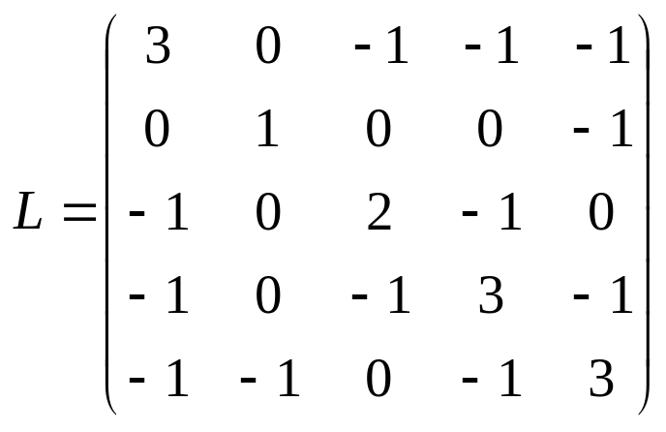
Laplacian Matrix: Example
1
2
5
3
4
Note that each row sums to 0.

Slide 53
Fiedler Vectors
Eigenvalues λ₁≤ λ₂ ≤ λ₃ ≤ ... ≤ λ_{n}, real, non-negative.
Find eigenvector corresponding to the second smallest eigenvalue: L x₂ = λ₂ x₂
This is called the Fiedler vector.
What is true about the first eigenvector?

Slide 54
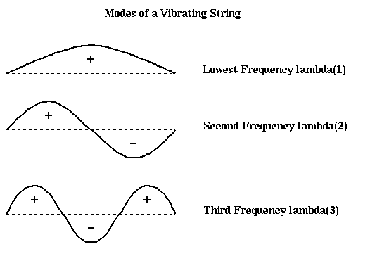
Modes of Vibration
x₂
(Picture from Jim Demmel’s CS267 course at Berkeley.)

Slide 55
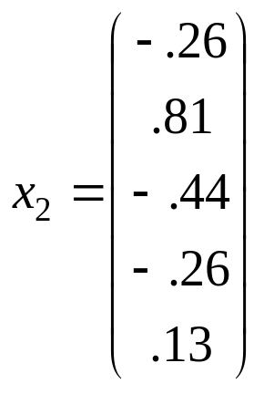
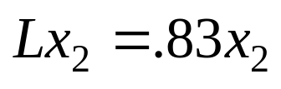
Fiedler Vector: Example
1
2
5
3
4
Note that each row sums to 0.
If graph is not connected, what is the second eigenvalue?

Slide 56
Finding the Separator
Sort Fiedler vector by value, and split in half.
1
2
5
3
4
sorted vertices: [3, 1, 4, 5, 2]

Slide 57
Power Method
Iterative method for finding first few eigenvectors.
Every vector is a linear combination of its eigenvectors e₁, e₂, …
Consider: p₀ = a₁ e₁ + a₂ e₂ + …
Iterating p_{i+1} = Ap_{i} until it settles will give the principal eigenvector (largest magnitude eigenvalue) since
p_{i} = λ₁^{i} a₁ e₁ + λ₂^{i} a₂ e₂ + …
(Assuming all a_{i} are about the same magnitude)
The more spread in first two eigenvalues, the faster it will settle (related to the rapid mixing of expander graphs)

Slide 58
The second eigenvector
Assuming we have the principal eigenvector, after each iteration remove the component that is aligned with the principal eigenvector.
n_{i} = A p_{i-1}
p_{i} = n_{i} – (e₁ • n_{i})e₁ (assuming e₁ is normalized)
Now
p_{i} = λ₂^{i} a₂ e₂ + λ₃^{i} a₃ e₃ + …
Can use random vector for initial p₀

Slide 59
Power method for Laplacian
To apply the power method we have to shift the eigenvalues, since we are interested in eigenvector with eigenvalue closest to zero.
How do we shift eigenvalues by a constant amount?
Lancoz algorithm is faster in practice if starting from scratch, but if you have an approximate solution, the power method works very well.

Slide 60
Multilevel Spectral
MultilevelFiedler(G)
If G is small, do something brute force
Else
Coarsen the graph into G’
e’₂ = MultilevelFiedler(G’)
Expand graph back to G and project e’₂ onto e₂
Refine e₂ using power method and return
To project, you can just copy the values in location i of e’₂ into both vertices i expands into.
This idea is used by Chaco.

