Slide 1


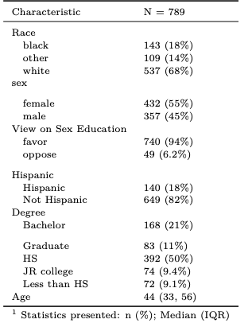
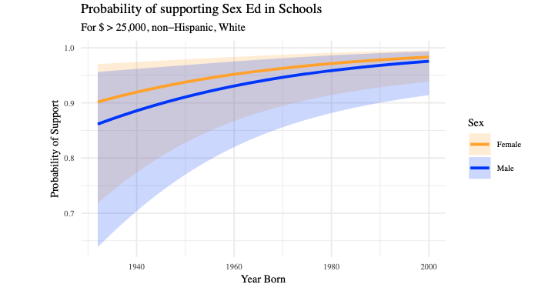
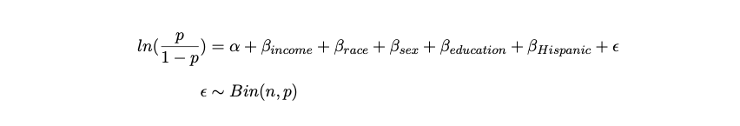
Exploring attitudes toward Sex ED in the US
Thelonious Goerz, Department of Sociology, University of Washington | SOC 506
Background
Researchers are often interested how opinion on canonically controversial social issues like sexual education in public schools is associated with different demographic characteristics.
In this analysis, I take this question and explore how opinions and acceptance about sex education vary across the income distribution. Particularly central to this analysis is an understanding of how high income individuals favor or do not favor different policies regarding better health education.
I hypothesize that income and age will be significantly associated with approval.
Summary Statistics
Visualization
Methods
I estimate two logistic regression models. First, a restricted model evaluating the link between income and sex education approval, the second, investigates the same relationship with controls.
Methods
Data: GSS
Logistic regression
Restricted and full models
Validated with
AIC,
BIC,
Log-lik ratios
Confusion Matrix
Results
References
Approving of sex ed in public schools is significantly positively associated with having an income > $ 25k.
As year born increases, there is a significant increase in the log-odds of approval.
Overall, it seems that people who have more access and resources, who are also generally older, support sexual education.
Bearman, Peter S, James Moody, and Katherine Stovel. 2004. “Chains of Affection: The Structure of Adolescent Romantic and Sexual Networks.” American Journal of Sociology 110 (1). The University of Chicago Press: 44–91.
Fentahun, Netsanet, Tsion Assefa, Fessahaye Alemseged, and Fentie Ambaw. 2012. “Parents’ Perception, Students’ and Teachers’ Attitude Towards School Sex Education.” Ethiopian Journal of Health Sciences 22 (2).
All code needed to generate this report is available on Github: https://github.com/theloniousgoerz

