Slide 1
5G SMART FACTORY · AI-BASED QUALITY INSPECTION
End-to-End Performance
Modelling and Analysis
Communication Networks • Continuous Assessment 1
2026–2027
Sun Jiangeng | 202612491511
Qian Tu | 202612491508
Lu Zipeng | 202612491522
A reproducible model, with explicit assumptions and measured uncertainty.
Communication Networks | Sun Jiangeng | 25s
01
Notes:
Sun Jiangeng — 25 seconds
Good morning. We are Sun Jiangeng, Qian Tu and Lu Zipeng. Our project investigates how images travel from industrial cameras to an edge server for AI-based quality inspection. We combine network routing, wireless polling and queueing theory. Our central question is whether a fast processing server is enough to guarantee timely delivery of every image.

Slide 2
PROJECT SCOPE
Three tasks, one image journey
01
02
03
Graph model
Link attributes and route
selection
Wireless access
Shannon rate and polling delay
Queueing model
M/M/1 and the arrival-rate limit
The integrated simulation checks whether the assumptions remain valid when the stages
are connected.
Communication Networks | Sun Jiangeng | 35s
02
Notes:
Sun Jiangeng — 35 seconds
The assessment has three connected tasks. First, we model cameras, base stations and the edge server as a graph and select a route. Second, we use Shannon's formula and a clearly specified polling schedule to derive wireless delay. Third, we analyse an M/M/1 server using Little's law. We then compare theory with Python simulations and examine the complete chain. Our results concern communication and processing delays; the AI classifier itself is outside the model.

Slide 3
INPUTS AND ASSUMPTIONS
An illustrative, fully declared baseline
4 cameras
1 Mbit
20 MHz
Independent Poisson image
arrivals
Fixed image size in baseline
Scheduled bandwidth; SNR =
10 dB
50 images/s
100 ms
0.20 ms
MEC mean service rate
Chosen mean-delay target
Grant / guard overhead per visit
Communication Networks | Sun Jiangeng | 40s
03
Notes:
Sun Jiangeng — 40 seconds
The brief does not specify numerical inputs, so these are declared design assumptions. We use four cameras, one-megabit images, twenty megahertz of bandwidth and a ten-decibel signal-to-noise ratio. The edge server processes fifty images per second on average. We choose one hundred milliseconds as an illustrative mean-time target. Camera arrivals are independent Poisson streams. Baseline images have fixed size, while edge processing times are exponential. These are distinct assumptions about two different stages of the system.

Slide 4
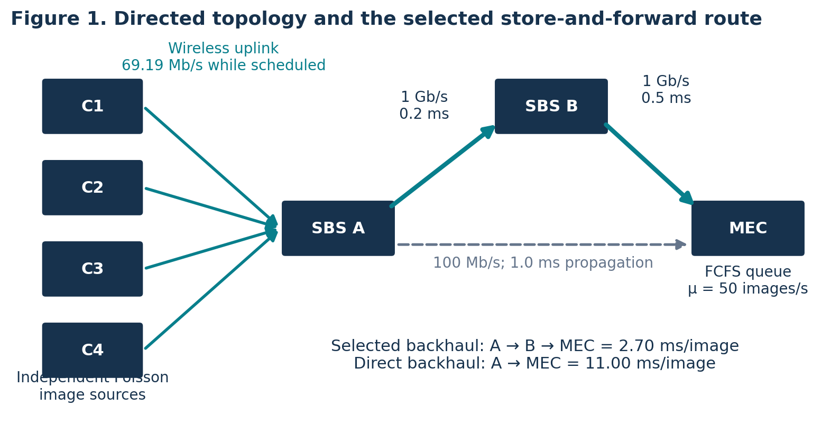
TASK 1 · GRAPH THEORY
A graph makes the routing decision explicit
Link weight = image serialization time + propagation delay. Source: report Section 3.
Communication Networks | Sun Jiangeng | 55s
04
Notes:
Sun Jiangeng — 55 seconds
Each camera, base station and server is a graph vertex. Directed edges represent possible uplink and backhaul links. Camera nodes carry an arrival rate and image size. The edge server carries its processing rate and queue discipline. Link attributes include capacity and propagation delay. Base station A can reach the server directly, or cooperate with base station B. Our example has one active camera cell, so the faster backhaul links do not develop queues. The wireless capacity shown here is available only while a camera is scheduled. It is not simultaneously available to all four cameras.

Slide 5
TASK 1 · DIJKSTRA RESULT
The extra hop is faster in this graph
11.00 ms
2.70 ms
Direct wired backhaul: A → MEC
Selected wired backhaul: A → B → MEC
Selected path: C1 → A → B → MEC
Total route weight: 17.15 ms; saving: 8.30 ms
Communication Networks | Sun Jiangeng | 45s
05
Notes:
Sun Jiangeng — 45 seconds
We assign each link a nonnegative weight equal to image size divided by link capacity, plus propagation delay. Dijkstra's algorithm selects the smallest sum. The direct wired backhaul takes eleven milliseconds per image. The two-hop path takes only two point seven milliseconds because its links have higher capacity. Including the common wireless transmission, the selected route takes seventeen point one five milliseconds before polling and processing are added. It saves eight point three milliseconds. This is the shortest unloaded transmission route for this graph, rather than a guarantee about every possible congestion condition.

Slide 6
TASK 2 · TRANSMISSION TIME
Shannon gives the scheduled radio rate
R = W log₂(1 + SNRlinear)
69.19 Mbit/s
14.45 ms
Ideal payload rate while scheduled
Transmission time τ = S / R
OFDMA resources are assigned in time; bandwidth is never counted four times.
Communication Networks | Qian Tu | 45s
06
Notes:
Qian Tu — 45 seconds
I will explain the wireless model. Shannon's capacity formula is bandwidth multiplied by the base-two logarithm of one plus the linear signal-to-noise ratio. Ten decibels corresponds to a linear value of ten. With twenty megahertz, the result is sixty-nine point one nine megabits per second. A one-megabit image therefore takes fourteen point four five milliseconds to transmit. This is an ideal capacity calculation. Actual throughput can be lower because of coding, interference and retransmissions. Our model grants all resource blocks to one camera at a time, which is a simple OFDMA scheduling case.

Slide 7
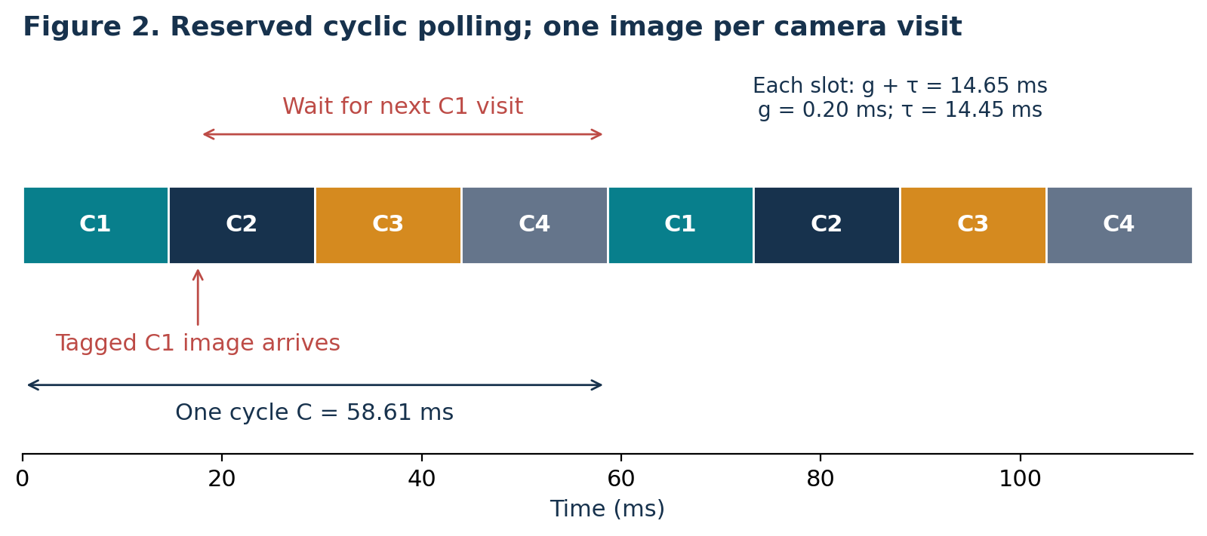
TASK 2 · POLLING TIMING
A visit is not immediately available
C = N(g + τ) = 58.61 ms
Tagged mean wireless time = C/2 + g + τ = 43.96 ms
Communication Networks | Qian Tu | 55s
07
Notes:
Qian Tu — 55 seconds
The base station visits cameras one to four cyclically. Each visit includes a grant interval and transmission of at most one image. An unused reservation remains idle. One visit lasts fourteen point six five milliseconds, and a full cycle lasts fifty-eight point six one milliseconds. Consider an isolated tagged image arriving at a random phase, with no older image waiting. Its mean residual wait is half a cycle. Adding the grant and transmission gives forty-three point nine six milliseconds. This particular formula assumes random arrival phase. A simultaneous batch at the start of a cycle would have a different average waiting time.

Slide 8
TASK 2 · QUEUED POLLING
Camera backlog adds another load effect
Mean polling wait = C / [2(1 − r)]
r = (λ / N)C = λ(g + τ)
Radio stability: λ < 68.24 images/s
46.25 ms
70.81 ms
Mean polling wait at λ = 25/s
Mean polling wait at λ = 40/s
Communication Networks | Qian Tu | 55s
08
Notes:
Qian Tu — 55 seconds
At higher traffic loads, there may already be older images at the same camera. A new image can then miss more than one visit. For our reserved one-image polling rule, the exact mean wait is the cycle length divided by twice one minus the camera's visit utilisation. The report derives this using the queue observed after each visit and Little's law. At twenty-five images per second, the mean polling wait is forty-six point two five milliseconds. At forty images per second it is seventy point eight one milliseconds. The simulation agrees with this formula to within about zero point one four percent across the tested rates.

Slide 9
REPRODUCIBLE SIMULATION
Test each model, then connect the stages
30
100,000
20,000
Independent replications per
rate
Measured images per
replication
Warm-up images discarded
11 arrival rates • Fixed published seed • 95% confidence intervals
10 deterministic tests passed; raw replication results included.
Communication Networks | Qian Tu | 45s
09
Notes:
Qian Tu — 45 seconds
We use three experiments: the isolated M/M/1 server, the exact polling system and the actual connected chain. Each tested arrival rate has thirty independent replications. Each replication retains one hundred thousand images after a twenty-thousand-image warm-up. Confidence intervals are calculated from replication means, because delays within a run are correlated. Ten deterministic tests check the scheduling, queue recursion, route selection and lecture example. We also check that end-to-end delay equals the sum of its measured components. Lu will now explain the server analysis and the final results.

Slide 10
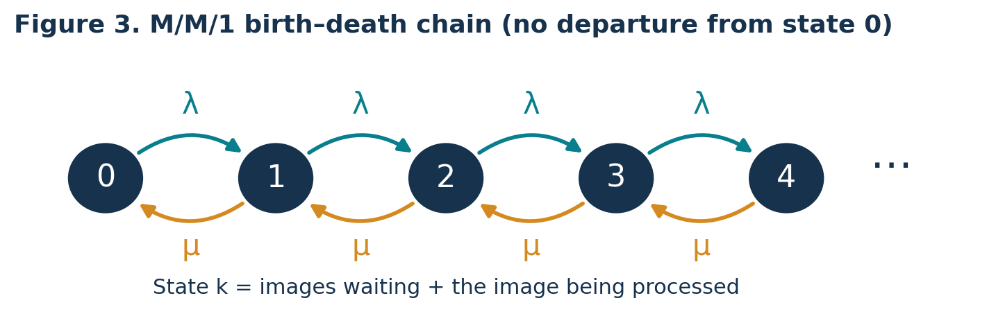
TASK 3 · QUEUEING THEORY
The required M/M/1 mean-delay bound
T = Ws = Wq + 1/μ = 1/(μ − λ)
λmax = μ − 1/Tmax = 40 images/s
Feasibility: Tmax > 1/μ; stability: λ < μ.
Communication Networks | Lu Zipeng | 50s
10
Notes:
Lu Zipeng — 50 seconds
The server state counts waiting images plus the image being processed. Arrivals increase the state at rate lambda; completions reduce it at rate mu when the server is occupied. Stability requires lambda smaller than mu. Using the geometric stationary probabilities and Little's law gives mean system time one divided by mu minus lambda. This includes both waiting and processing. Setting that mean to at most one hundred milliseconds, with a service rate of fifty images per second, gives a maximum arrival rate of forty images per second. This bound applies to the isolated Poisson-input server, not automatically to the complete image journey.

Slide 11
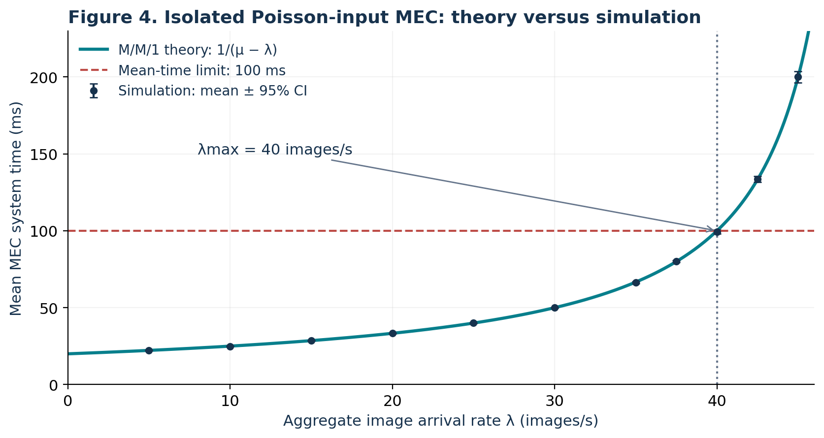
TASK 3 · NUMERICAL VALIDATION
Theory and simulation agree at the server
0.62%
Maximum relative
difference in the
mean
10 of 11 pointwise
intervals cover theory.
Communication Networks | Lu Zipeng | 40s
11
Notes:
Lu Zipeng — 40 seconds
The curve shows the rapid increase in queueing delay as the arrival rate approaches the processing rate. Simulated means closely follow the theoretical values, with a maximum relative difference of zero point six two percent. At forty images per second, theory gives one hundred milliseconds and simulation gives ninety-nine point three eight milliseconds. Error bars represent pointwise ninety-five-percent confidence intervals. Ten of eleven intervals cover the theoretical mean. We report that outcome explicitly rather than adjusting random seeds to force all points to match.

Slide 12
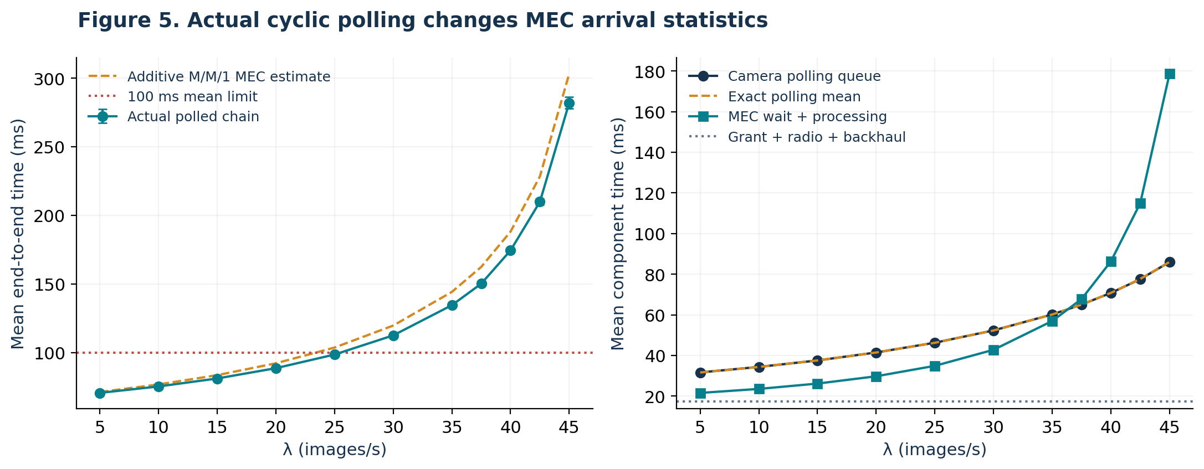
INTEGRATED-CHAIN RESULT
The complete chain has a lower latency capacity
25 images/s: 98.52 ms | 30 images/s: 112.48 ms
Communication Networks | Lu Zipeng | 45s
12
Notes:
Lu Zipeng — 45 seconds
Connecting the stages changes the answer. At twenty-five images per second, mean end-to-end delay is ninety-eight point five two milliseconds. At thirty images per second, it rises to one hundred twelve point four eight milliseconds. Therefore twenty-five is the highest tested rate meeting the mean target, not a proven exact threshold. Polling changes the server's arrival statistics, so simply adding an M/M/1 server time is only an approximation. The component plot shows both camera waiting and server processing. Twenty images per second provides more operating margin in the baseline.

Slide 13
OPTIMISATION AT Λ = 40 IMAGES/S
Upgrade radio and processing together
Baseline
174.18 ms
Faster MEC
110.29 ms
More bandwidth
127.64 ms
Both upgrades
57.31 ms
Combined upgrade: 40 MHz + 75 images/s MEC; deadline misses remain 9.51%.
Communication Networks | Lu Zipeng | 40s
13
Notes:
Lu Zipeng — 40 seconds
We also compare four designs at the same offered load. The baseline mean is about one hundred seventy-four milliseconds. A faster server alone gives one hundred ten milliseconds, and more bandwidth alone gives one hundred twenty-eight milliseconds. Combining both upgrades gives fifty-seven point three one milliseconds, a reduction of about sixty-seven percent. However, about nine point five percent of images still exceed one hundred milliseconds. The combined upgrade meets the chosen mean target, while a strict reliability requirement would need further design work.

Slide 14
CONCLUSIONS AND QUESTIONS
Design for the whole journey
01 Choose routes using capacity and delay.
02 Include both polling backlog and MEC queueing.
03 Check mean delay and deadline reliability separately.
Questions
Sources: assessment brief; course Chapter 2; Shannon (1948); Dijkstra (1959); Little (1961). Full references and derivations are in the report.
Communication Networks | Lu Zipeng | 25s
14
Notes:
Lu Zipeng — 25 seconds
Our conclusions are threefold. Route capacity matters as well as hop count. Polling delay increases with camera backlog. And an isolated server delay bound is not an end-to-end guarantee. Our code, diagrams and data make these findings reproducible. The next engineering step would be to measure real traffic and processing times, then specify a numerical reliability target. Thank you. We welcome your questions.

