Slide 1
Contents
1. Basic Concepts of Machine Learning
2. Computational Learning Theory
3. Generative Methods
3. Support vector machine
4. Support vector machine
4. Ada Boost*
5. Ada Boost*
5. Generative Methods*
6. Principal Component Analysis*
7. Expectation maximization*
[1] Zhi-Hua Zhou, Machine Learning, 2016, Tsinghua University Press. Ch. 6
[2] Hang Li, Statistical Learning Methods (2nd ed.), 2019, Tsinghua University Press. Ch. 7
[3] Fei Wu, Introduction to Artificial Intelligence: Models and Algorithms, 2020, Higher Education Press.
[4] Zhi-Hua Zhou et al., An Introduction to Machine Learning Theory, 2020, China Machine Press. Chs. 1.3, 1.4

Slide 2
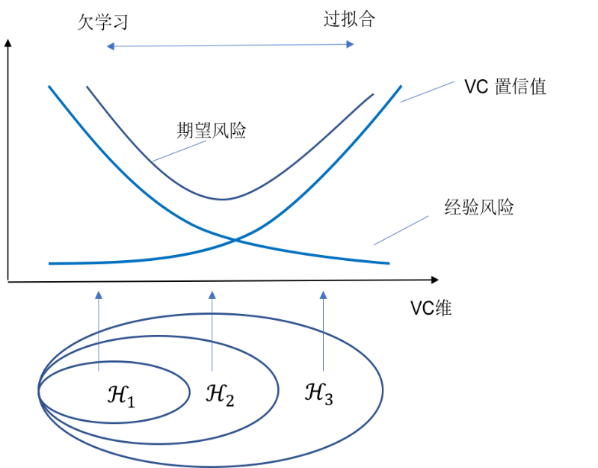
Support Vector Machines
Structural Risk Minimization
Structural risk minimization. VC theory distinguishes expected (true) risk $ℜ$ from empirical risk $ℜ_{emp}$. Their difference, the confidence risk, depends on sample size and model complexity. Fitting a complex model to a small sample often causes overfitting. Add a penalty or regularization term to empirical risk $ℜ_{emp}$ to account for both risks: this is structural risk minimization. It can improve small-sample performance. Maintaining low empirical risk while reducing the model's VC dimension helps control expected risk over the population. For a fixed training set, a larger classification margin corresponds to a smaller VC dimension of the associated class of separating hyperplanes.
Underfitting
Overfitting
VC
confidence
Expected risk
Empirical risk
VC dimension
Fig. 4.11. Empirical risk, expected risk, VC confidence, VC dimension, overfitting and underfitting

Slide 3
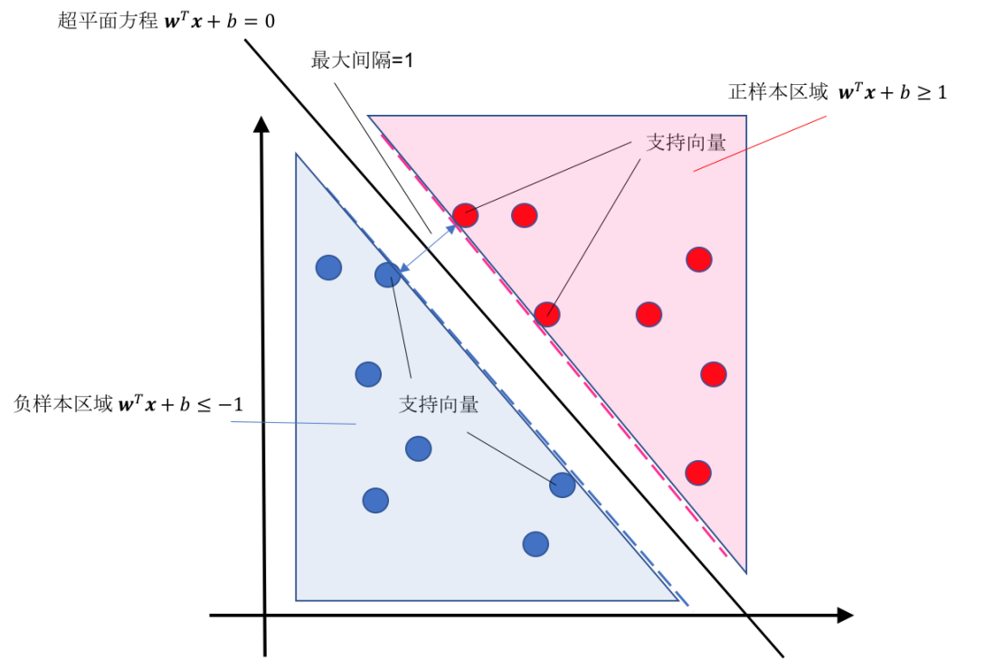
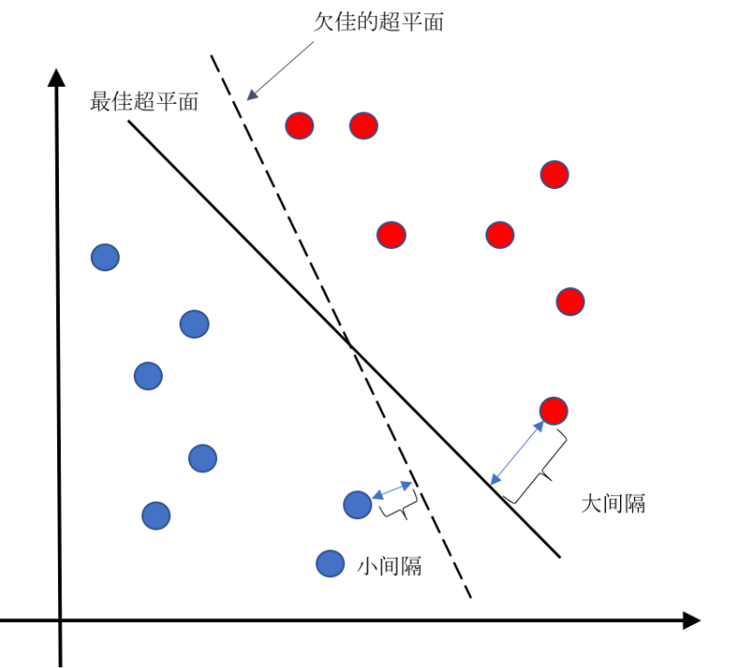
Support Vector Machines
Linearly Separable SVM
Hyperplane
Suboptimal hyperplane
Max. margin = 1
Positive
class
Optimal hyperplane
Support
vectors
Negative
class
Support
vectors
Large margin
Small margin
Find an optimal hyperplane with equation $w^{T}x+b=0$. Here, $w=(w_{1},w_{2},…,w_{d})$ is its normal vector, which determines its orientation; $b$ is a scalar bias that determines its offset from the origin.

Slide 4
Support Vector Machines
Linearly Separable SVM
The distance from any sample $x$ to the hyperplane is:
$r=d(w,b,x)=\frac{\left|w^{T}x+b\right|}{{|\left|w\right||}_{2}}$ （${|\left|w\right||}_{2}=\sqrt{w^{T}w}$）
Geometric margin
Hyperplane
Max. margin = 1
Scaling the normal vector $w$ preserves its direction, so the hyperplane representation is not unique. Impose the following normalization on $w$ and $b$:
$${\left|w^{T}x_{i}+b\right|}_{\underset{x_{i}}{argmin}{r} }=1$$
The nearest positive and negative samples give hyperplane-function values with absolute value 1.
Define the functional margin: ${\hat{r}}_{i}=y_{i}(w^{T}x_{i}+b)$
Positive
class
Support
vectors
Negative
class
Support
vectors
The hyperplane constraint becomes: $y_{i}(w^{T}x_{i}+b)≥1$.

Slide 5
Support Vector Machines
Linearly Separable SVM
The distance between the nearest samples of the two classes, measured across the separating hyperplane, is:
$$d\left(w,b\right)=\min_{\left(x_{k},y_{k}=1\right)}d\left(w,b,x_{k}\right)+\min_{\left(x_{m},y_{m}=−1\right)}d\left(w,b,x_{m}\right)$$
$$=\min_{\left(x_{k},y_{k}=1\right)}\frac{\left|w^{T}x_{k}+b\right|}{{\left|\left|w\right|\right|}_{2}}+\min_{\left(x_{m},y_{m}=−1\right)}\frac{\left|w^{T}x_{m}+b\right|}{{\left|\left|w\right|\right|}_{2}}$$
$$=\frac{1}{{\left|\left|w\right|\right|}_{2}}\left(\min_{\left(x_{k},y_{k}=1\right)}\left|w^{T}x_{k}+b\right|+\min_{\left(x_{m},y_{m}=−1\right)}\left|w^{T}x_{m}+b\right|\right)=\frac{2}{{\left|\left|w\right|\right|}_{2}}$$
Thus: $d\left(w,b\right)=\frac{2}{{\left|\left|w\right|\right|}_{2}}$
An SVM maximizes the classification margin: find $w$ and $b$ satisfying the constraints and maximizing $γ$. Equivalently:
$$\min_{w,b}{\frac{{||w||}^{2}}{2}}=\min_{w,b}{\frac{1}{2}w^{T}w}$$
$$s.t. y_{i}\left(w^{T}x_{i}+b\right)≥1,i=1,2,⋯,n$$
Convex quadratic programming

Slide 6
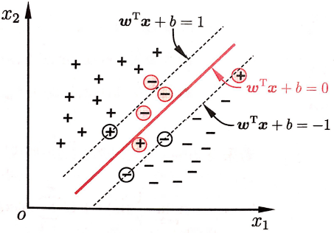
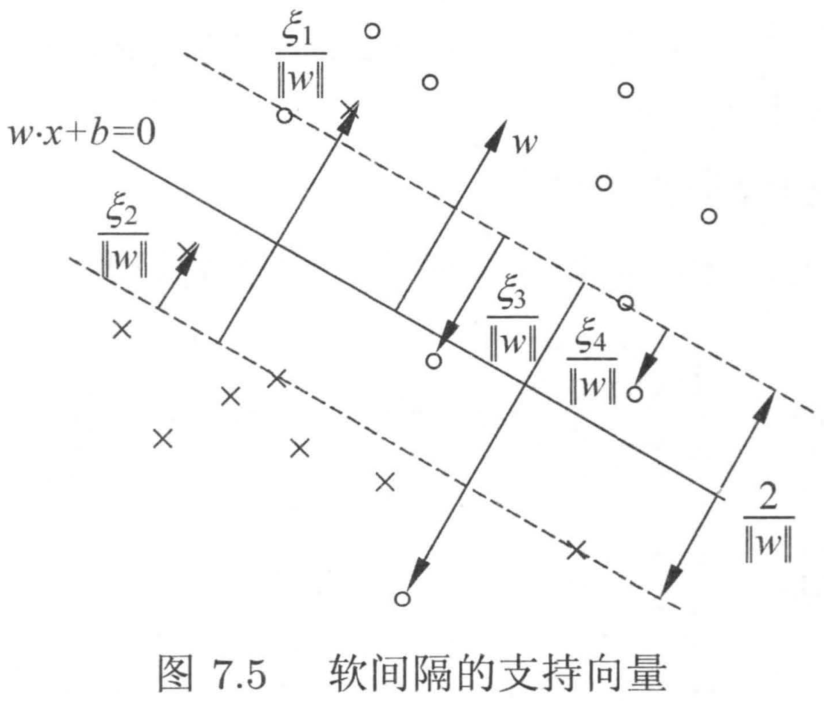
Support Vector Machines
So far, the training data were assumed linearly separable: a hyperplane completely separates the classes. This is the hard-margin setting. In contrast, a soft margin allows some training samples to be misclassified.
$$\min_{w,b}{\frac{1}{2}w^{T}w}+c×\sum_{i=1}^{n}{𝕀\left(y_{i}≠sign(w^{T}x_{i}+b)\right)}$$
$$s.t. y_{i}\left(w^{T}x_{i}+b\right)≥1 for correct x_{i}$$
$y_{i}\left(w^{T}x_{i}+b\right)≥−∞ for incorrect x_{i}$
$$\min_{w,b,ξ}{\frac{1}{2}w^{T}w}+c×\sum_{i=1}^{n}{ξ_{i}}$$
$$s.t. y_{i}\left(w^{T}x_{i}+b\right)≥1−ξ_{i}$$
$\text{ξ}\text{i} \text{≥} \text{0}\text{,} \text{i} \text{=} \text{1}\text{,}\text{2}\text{,} \text{…} \text{,} \text{n}$
Slack variables
Difficult to solve directly
Fig. 7.5. Soft-margin support vectors

Slide 7
Support Vector Machines
$$\min_{w,b}{\frac{1}{2}w^{T}w+c×\sum_{i=1}^{N}{ξ_{i}}}$$
$$s.t. y_{i}\left(w^{T}x_{i}+b\right)≥1−ξ_{i}$$
$\text{ξ}\text{i} \text{≥} \text{0}\text{,} \text{i} \text{=} \text{1}\text{,}\text{2,} \text{…} \text{,} \text{N}$
Let $ξ_{i}=max\left(0,1−y_{i}(w^{T}x_{i}+b) \right)$, where ξᵢ is the slack variable for sample i and ξᵢ ≥ 0. Each sample has one slack variable to represent its classification loss. The expression above becomes:
Objective with a hinge-loss term:
$$\min_{w,b}{\frac{1}{2}w^{T}w+c×}\sum_{i=1}^{n}{max⁡(0,1−y_{i}(w^{T}x_{i}+b))}$$
3
2
Hinge loss for correctly classified data:
$$\max\left(0,1−y_{i}(w^{T}x_{i}+b) \right)=0$$
1
-2
-1
0
1
2
Theorem 7.4. Primal optimization problem for a linear SVM:
Functional margin $y(w⋅x+b)$
Equivalent optimization problem: $\min_{w,b}{\sum_{i=1}^{N}{{\left[1−y_{i}(w⋅x_{i})\right]}_{+}}+c{\left\|w\right\|}^{2}}$

Slide 8
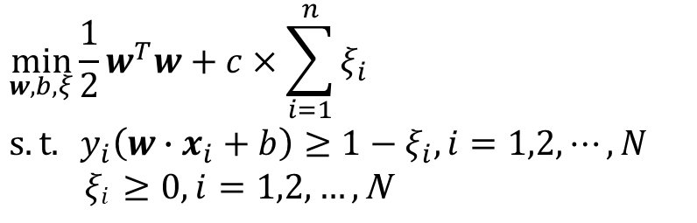

Support Vector Machines
Soft-margin SVM: primal problem (convex quadratic program)
$$\min_{w,b,ξ}{\frac{1}{2}w^{T}w}+c×\sum_{i=1}^{n}{ξ_{i}}$$
$s.t. y_{i}\left(w∙x_{i}+b\right)≥1−ξ_{i}, i=1,2,⋯,N$
$\text{ξ}\text{i} \text{≥} \text{0}\text{,} \text{i} \text{=} \text{1}\text{,}\text{2}\text{,} \text{…} \text{,} \text{N}$
Definition 7.5 (Linear SVM). For a linearly inseparable training set, solve the convex quadratic program, i.e., maximize the soft margin. The resulting separating hyperplane
$$w^{∗}∙x+b^{∗}=0$$
and the corresponding classification decision function
$$f\left(x\right)=sign(w^{∗}∙x+b^{∗})$$
define a linear support vector machine.

Slide 9
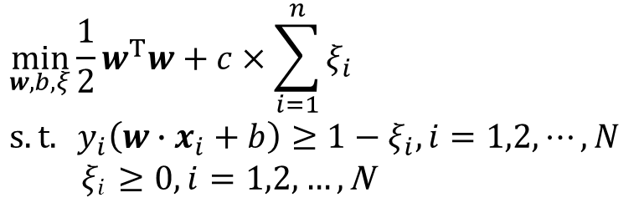
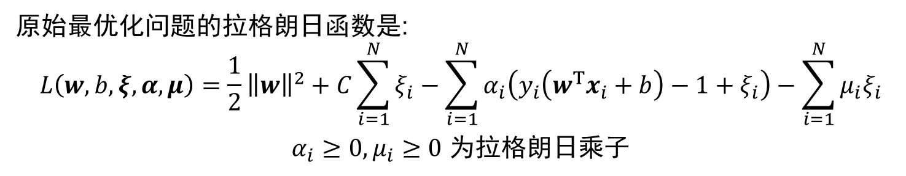
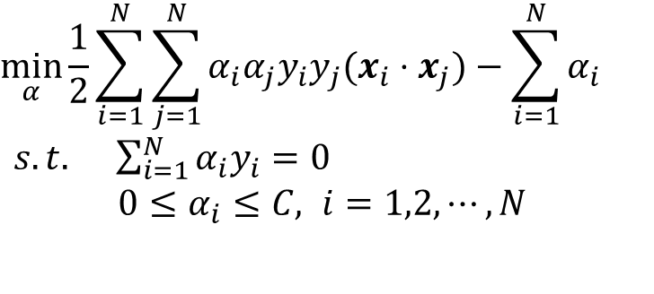
Support Vector Machines
Primal problem for a soft-margin SVM
(convex quadratic program):
$$\min_{w,b,ξ}{\frac{1}{2}w^{T}w}+c×\sum_{i=1}^{n}{ξ_{i}}$$
$s.t. y_{i}\left(w∙x_{i}+b\right)≥1−ξ_{i}, i=1,2,⋯,N$
$\text{ξ}\text{i} \text{≥} \text{0}\text{,} \text{i} \text{=} \text{1}\text{,}\text{2}\text{,} \text{…} \text{,} \text{N}$
$$\min_{α}{\frac{1}{2}\sum_{i=1}^{N}{\sum_{j=1}^{N}{α_{i}α_{j}y_{i}y_{j}(x_{i}⋅x_{j})}}−\sum_{i=1}^{N}{α_{i}}}$$
$s.t. \sum_{i=1}^{N}{α_{i}y_{i}}=0$
$0≤α_{i}≤C, i=1,2,⋯,N$
The dual of the primal problem is:
The Lagrangian of the primal problem is:
$$L\left(w,b,ξ,α,μ\right)=\frac{1}{2}{\left\|w\right\|}^{2}+C\sum_{i=1}^{N}{ξ_{i}}−\sum_{i=1}^{N}{α_{i}\left(y_{i}\left(w^{T}x_{i}+b\right)−1+ξ_{i}\right)}−\sum_{i=1}^{N}{μ_{i}ξ_{i}}$$
$α_{i}≥0,μ_{i}≥0$ are Lagrange multipliers.

Slide 10
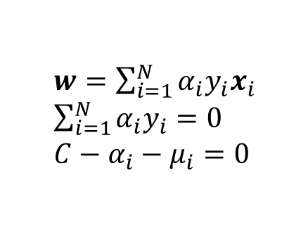
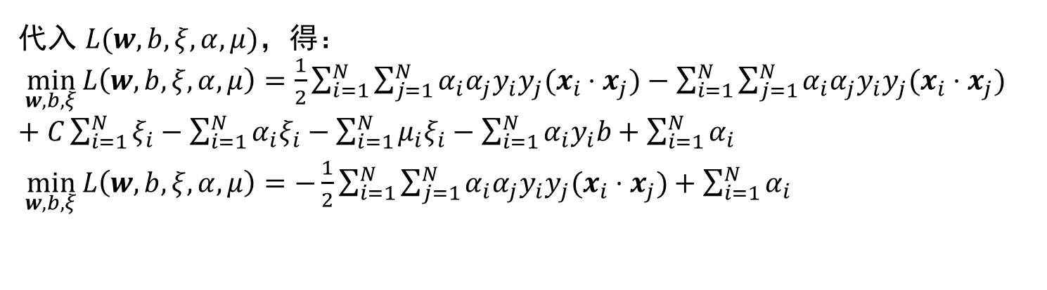
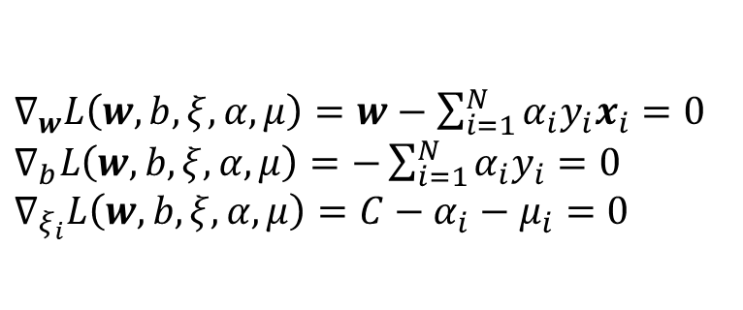
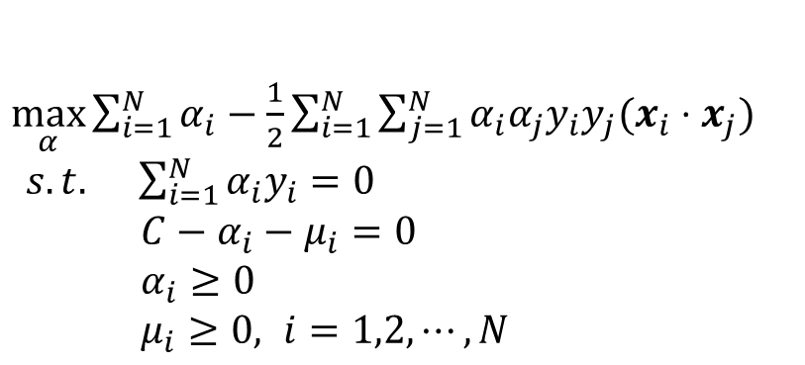
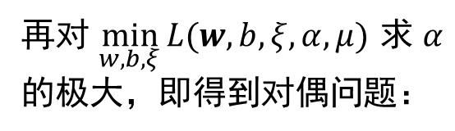
Support Vector Machines
The dual is a max–min problem for the Lagrangian:
$∇_{w}L\left(w,b,ξ,α,μ\right)=w−\sum_{i=1}^{N}{α_{i}y_{i}x_{i}}=0$
$∇_{b}L\left(w,b,ξ,α,μ\right)=−\sum_{i=1}^{N}{α_{i}y_{i}}=0$
$∇_{ξ_{i}}L\left(w,b,ξ,α,μ\right)=C−α_{i}−μ_{i}=0$
$w=\sum_{i=1}^{N}{α_{i}y_{i}x_{i}}$
$\sum_{i=1}^{N}{α_{i}y_{i}}=0$
$C−α_{i}−μ_{i}=0$
Substituting $L(w,b,ξ,α,μ)$ gives:
$\min_{w,b,ξ}{L\left(w,b,ξ,α,μ\right)}=\frac{1}{2}\sum_{i=1}^{N}{\sum_{j=1}^{N}{α_{i}α_{j}y_{i}y_{j}(x_{i}⋅x_{j})}}−\sum_{i=1}^{N}{\sum_{j=1}^{N}{α_{i}α_{j}y_{i}y_{j}(x_{i}⋅x_{j})}}+C\sum_{i=1}^{N}{ξ_{i}}−\sum_{i=1}^{N}{α_{i}ξ_{i}}−\sum_{i=1}^{N}{μ_{i}ξ_{i}}−\sum_{i=1}^{N}{α_{i}y_{i}b}+\sum_{i=1}^{N}{α_{i}}$
$\min_{w,b,ξ}{L\left(w,b,ξ,α,μ\right)}=−\frac{1}{2}\sum_{i=1}^{N}{\sum_{j=1}^{N}{α_{i}α_{j}y_{i}y_{j}(x_{i}⋅x_{j})}}+\sum_{i=1}^{N}{α_{i}}$
Next, maximize $α$ with respect to $\min_{w, b, ξ}{L(w,b,ξ,α,μ)}$ to obtain the dual problem:
$\max_{α}{\sum_{i=1}^{N}{α_{i}}−\frac{1}{2}\sum_{i=1}^{N}{\sum_{j=1}^{N}{α_{i}α_{j}y_{i}y_{j}(x_{i}⋅x_{j})}}}$
$s.t. \sum_{i=1}^{N}{α_{i}y_{i}}=0$
$C−α_{i}−μ_{i}=0$
$α_{i}≥0$
$μ_{i}≥0, i=1,2,⋯,N$
Reformulate the dual: use the equality constraint to eliminate $μ_{i}$, leaving only $α_{i}$. Rewrite constraints (7.46)–(7.48) as: $0≤α_{i}≤C$

Slide 11
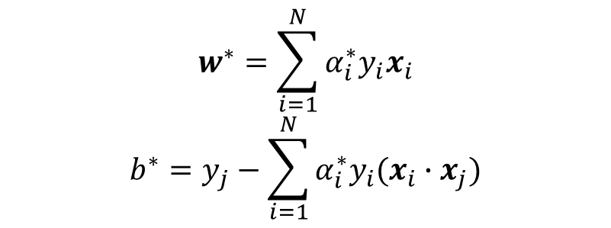
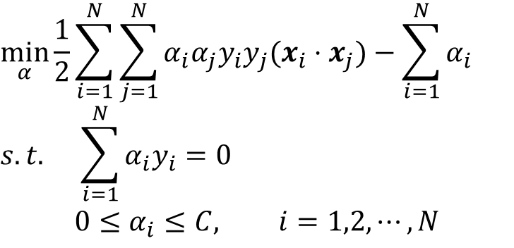
Support Vector Machines
Dual problem of the SVM:
$$\min_{α}{\frac{1}{2}\sum_{i=1}^{N}{\sum_{j=1}^{N}{α_{i}α_{j}y_{i}y_{j}(x_{i}⋅x_{j})}}−\sum_{i=1}^{N}{α_{i}}}$$
$$s.t. \sum_{i=1}^{N}{α_{i}y_{i}}=0$$
$$0≤α_{i}≤C, i=1,2,⋯,N$$
Theorem 7.3. Let $α^{∗}={(α_{1}^{∗},α_{2}^{∗},⋯,α_{N}^{∗})}^{T}$ solve the SVM dual problem. If a component $α_{j}^{∗}$ of $α^{∗}$ satisfies ${0<α}_{j}^{∗}<C$, the primal solution $w^{∗}, b^{∗}$ is given by:
$$w^{∗}=\sum_{i=1}^{N}{α_{i}^{∗}y_{i}x_{i}}$$
$$b^{∗}=y_{j}−\sum_{i=1}^{N}{α_{i}^{∗}y_{i}(x_{i}∙x_{j})}$$
Proof: KKT conditions

Slide 12
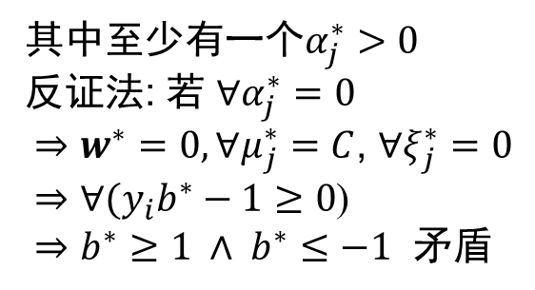
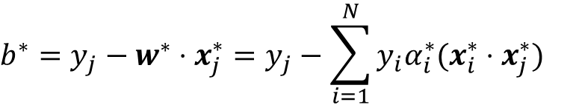
Support Vector Machines
From the KKT conditions:
$$y_{i}∈\{−1,+1\}$$
$∇_{w}L\left(w,b,ξ,α,μ\right)=w^{∗}−\sum_{i=1}^{N}{α_{i}^{∗}y_{i}x_{i}^{∗}}=0$
$∇_{b}L\left(w,b,ξ,α,μ\right)=−\sum_{i=1}^{N}{α_{i}^{∗}y_{i}}=0$
$∇_{ξ}L\left(w,b,ξ,α,μ\right)=C−α_{i}^{∗}−μ_{i}^{∗}$
$w^{∗}=\sum_{i=1}^{N}{y_{i}α_{i}^{∗}x_{i}^{∗}}$
At least one satisfies $α_{j}^{∗}>0$.
Proof by contradiction: suppose $∀α_{j}^{∗}=0$.
$⇒$ $w^{∗}=0, ∀μ_{j}^{∗}=C$, $∀ξ_{j}^{∗}=0$
$⇒∀(y_{i}b^{∗}−1≥0$)
$⇒b^{∗}≥1 ∧ b^{∗}≤−1$ — a contradiction.
$$α_{i}^{∗}\left(y_{i}\left(w^{∗}⋅x_{i}^{∗}+b^{∗}\right)−1+ξ_{i}^{∗}\right)=0$$
$$μ_{i}^{∗}ξ_{i}^{∗}=0$$
$$y_{i}\left(w^{∗}⋅x_{i}^{∗}+b^{∗}\right)−1+ξ_{i}^{∗}≥0$$
$$ξ_{i}^{∗}≥0$$
$$α_{i}^{∗}≥0$$
$$μ_{i}^{∗}≥0$$
When $0<α_{j}^{∗}<C$, $μ_{j}^{∗}>0,ξ_{j}^{∗}=0$,
and $y_{j}(w^{∗}⋅x_{j}^{∗}+b^{∗})−1+ξ_{j}^{∗}=0$.
The sample lies exactly on the margin: a support vector.
When $α_{j}^{∗}=0$, $μ_{j}^{∗}=C, ξ_{j}^{∗}=0$,
and $y_{j}(w^{∗}⋅x_{j}^{∗}+b^{∗})−1+ξ_{j}^{∗}≥0$.
The sample lies on or outside the margin boundary.
When $α_{j}^{∗}=C$, $μ_{j}^{∗}=0, ξ_{j}^{∗}≥0$,
and $y_{j}\left(w^{∗}⋅x_{j}^{∗}+b^{∗}\right)−1+ξ_{j}^{∗}=0$.
The sample lies inside the margin and may be misclassified.
0
$$b^{∗}=y_{j}−w^{∗}⋅x_{j}^{∗}=y_{j}−\sum_{i=1}^{N}{y_{i}α_{i}^{∗}(x_{i}^{∗}⋅x_{j}^{∗})}$$

Slide 13
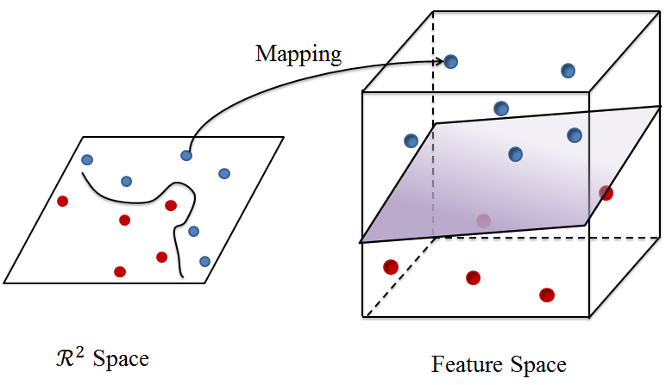
Support Vector Machines
Kernel SVM
Q: What if no hyperplane separates the two classes correctly (linear inseparability)?
A: Map the samples into a higher-dimensional feature space where they become linearly separable.
Map linearly inseparable samples to a higher-dimensional feature space, where they are likely to become linearly separable. If the original space is finite-dimensional, a higher-dimensional space in which the samples are separable exists [Shawe-Taylor, J., 2004].

Slide 14
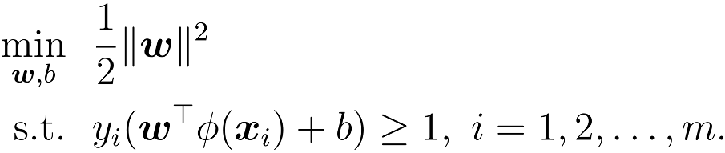
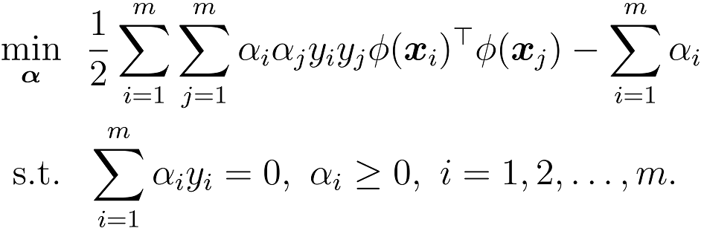
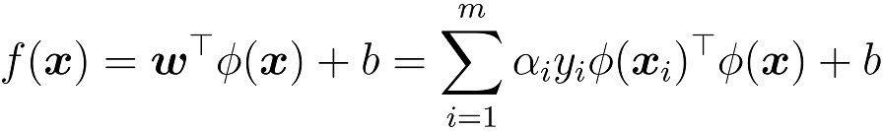
Support Vector Machines
Kernel SVM
Let the sample feature $x$ be mapped to $φ(x)$, with separating hyperplane $f\left(x\right)=w^{T}φ\left(x\right)+b$:
Primal problem
Dual problem
Prediction
Appears only through inner products

Slide 15
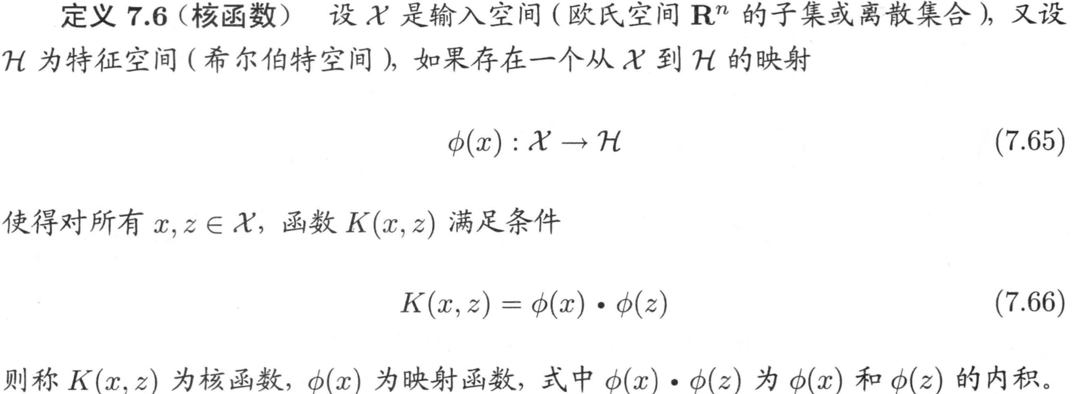
Support Vector Machines
Kernel Functions
Key idea: rather than explicitly constructing the feature map $φ(∙)$, design a kernel function:
$$κ\left(x_{i},x_{j}\right)={φ(x_{i})}^{T}φ(x_{j})$$
Definition 7.6 (Kernel function). Let X be the input space (a subset of ℝⁿ).
Let H be a feature space (a Hilbert space), with a mapping from X to H:
φ: X → H (7.65)
If, for all x, z ∈ X, K(x, z) satisfies
K(x, z) = φ(x) · φ(z) (7.66)
then K is a kernel function. Here φ is the feature map, and φ(x) · φ(z) is the inner product of φ(x) and φ(z).

Slide 16
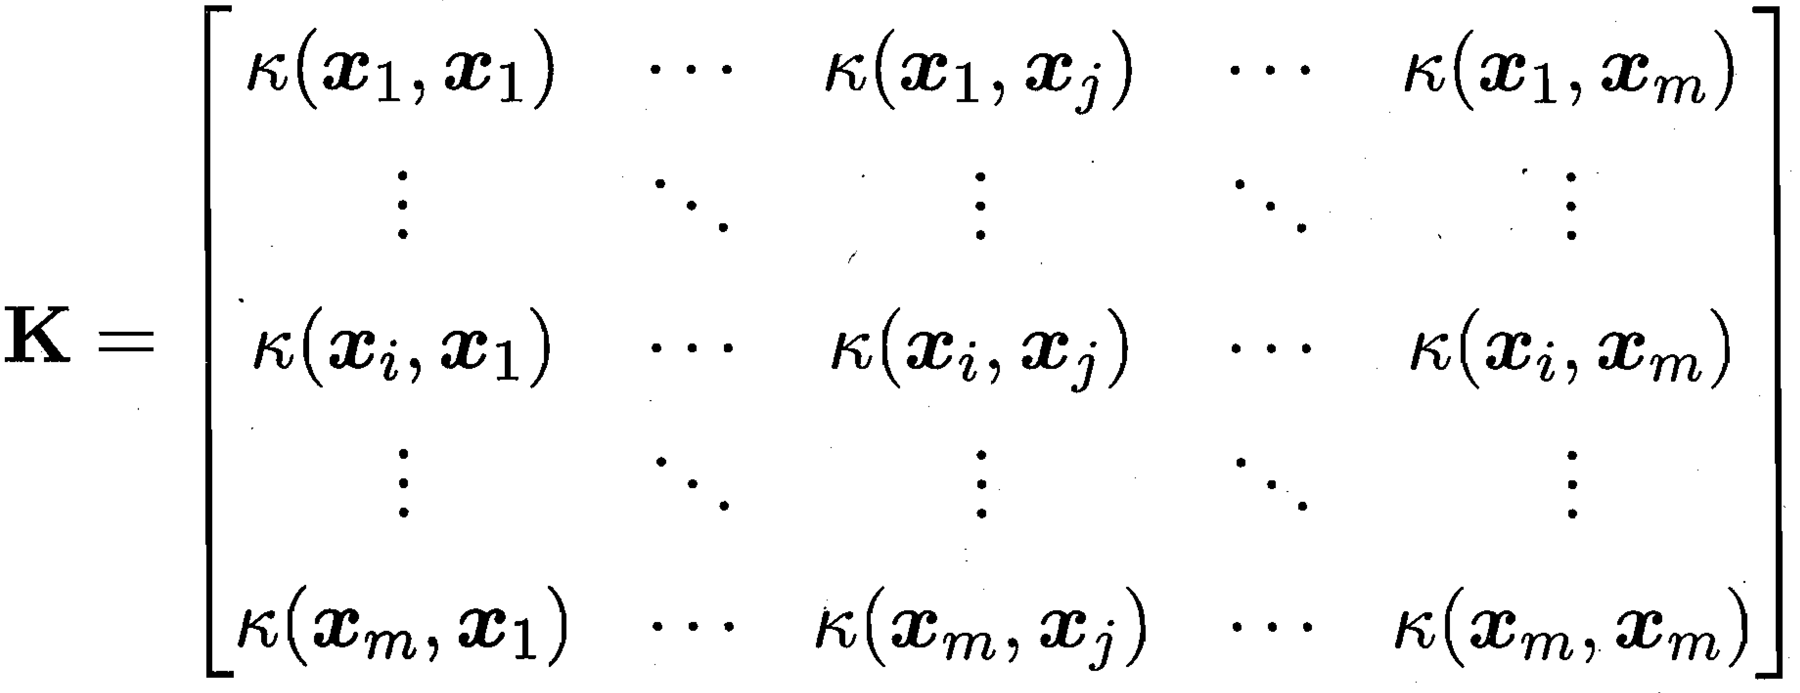
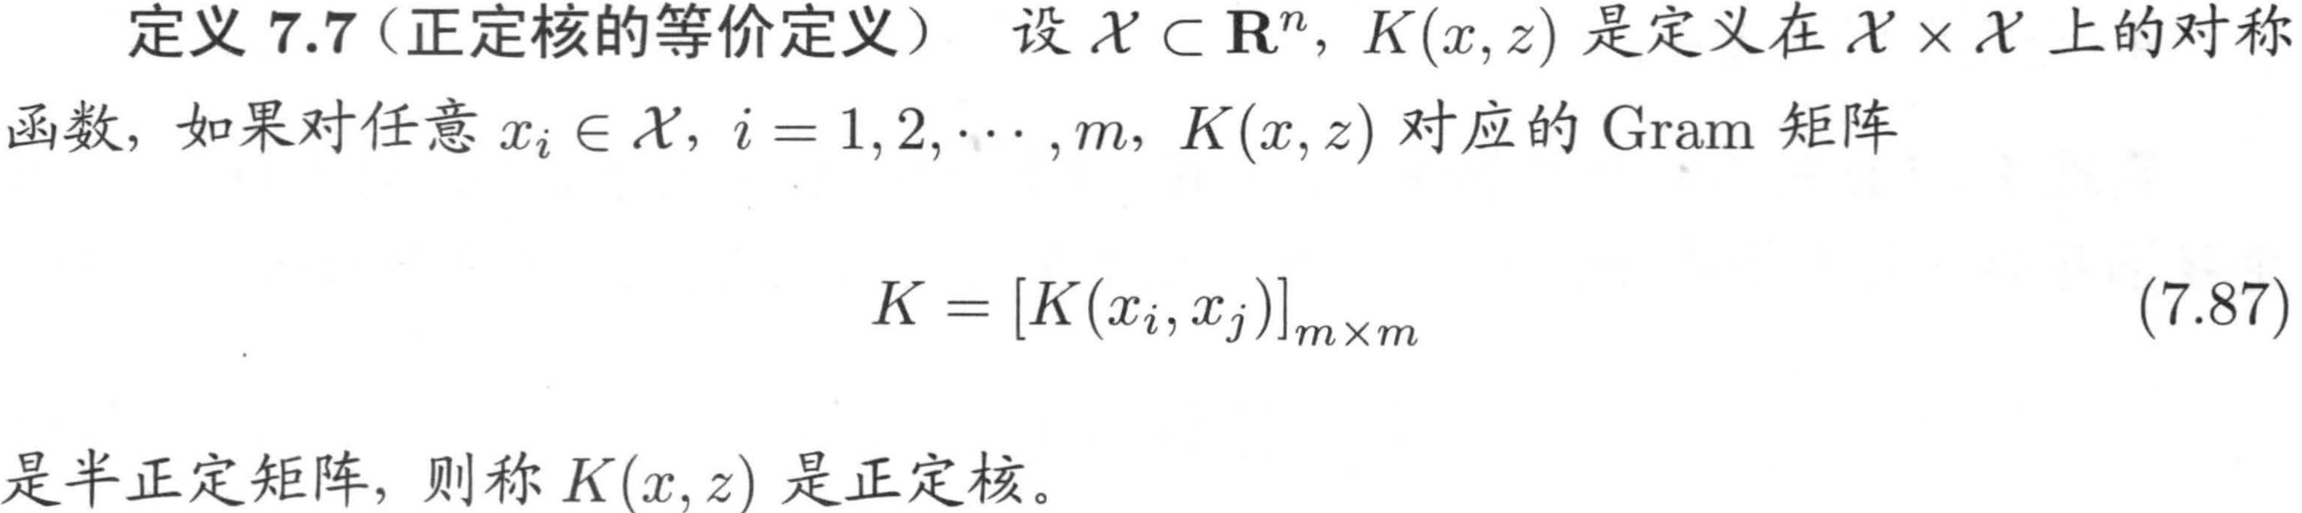
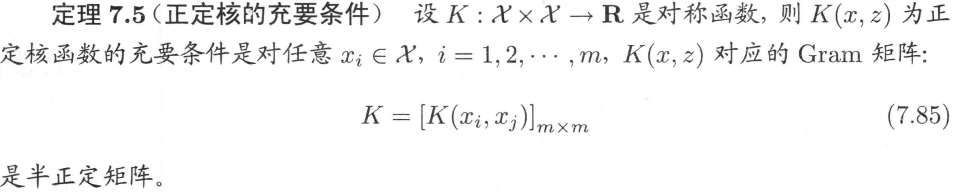
Support Vector Machines
Kernel Functions
Theorem 7.5 (Necessary and sufficient condition). Let K: X × X → ℝ be symmetric. K is a positive-definite kernel if and only if, for every finite set x₁, …, xₘ ∈ X, its Gram matrix is positive semidefinite:
K = [K(xᵢ, xⱼ)]ₘ×ₘ (7.85)
Definition 7.7 (Positive-definite kernel). A real-valued symmetric function K(x, z) on X × X, with X ⊆ ℝⁿ, is a positive-definite kernel if its Gram matrix is positive semidefinite for every finite set x₁, …, xₘ ∈ X.
K = [K(xᵢ, xⱼ)]ₘ×ₘ (7.87)

Slide 17
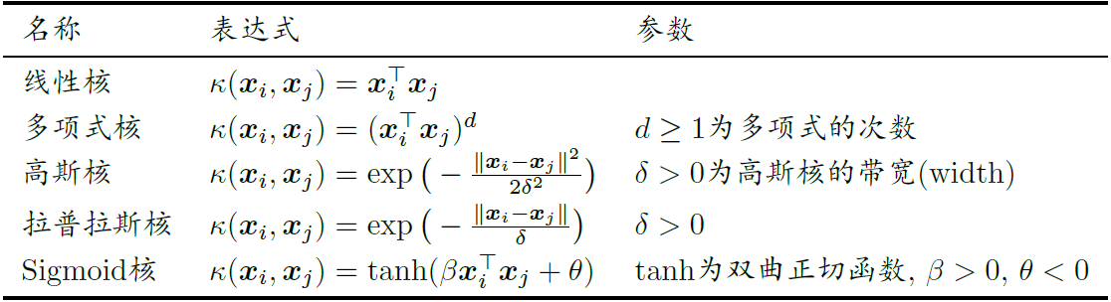
Support Vector Machines
Kernel Functions
Every kernel implicitly defines a feature space called a reproducing kernel Hilbert space (RKHS).
Positive-definite kernels (sufficient, not necessary): a symmetric function can serve as a kernel if its Gram matrix is positive semidefinite.
Common kernel functions:
Kernel | Expression | Parameters
Linear | κ(xᵢ, xⱼ) = xᵢᵀxⱼ | —
Polynomial | κ(xᵢ, xⱼ) = (xᵢᵀxⱼ)ᵈ | d ≥ 1: degree
Gaussian | κ(xᵢ, xⱼ) = exp(−‖xᵢ − xⱼ‖²/(2δ²)) | δ > 0: width
Laplacian | κ(xᵢ, xⱼ) = exp(−‖xᵢ − xⱼ‖/δ) | δ > 0
Sigmoid | κ(xᵢ, xⱼ) = tanh(βxᵢᵀxⱼ + θ) | β > 0, θ < 0; tanh: hyperbolic tangent

Slide 18
Support Vector Machines
Kernel Functions
Properties of kernel functions:
For any positive coefficients ${γ_{1},γ}_{2}$, the linear combination ${γ_{1}κ_{1}+γ}_{2}κ_{2}$ of kernels is also a kernel.
The direct product $κ_{1}⨂κ_{2}\left(x,z\right)=κ_{1}(x,z)κ_{2}(x,z)$ of kernels is also a kernel.
If $κ(x_{1},x_{2})$ is a kernel, then for any function $g$, $g\left(x_{1}\right)κ\left(x_{1},x_{2}\right)g\left(x_{2}\right) remains a kernel$ is also a kernel function.
Kernel choice is a major source of variation in SVMs.
Rule of thumb: use a linear kernel for text; use a Gaussian kernel when unsure.

Slide 19
Support Vector Machines
Kernel Methods
$$f\left(x\right)=w^{⊤}φ\left(x\right)+b=\sum_{i=1}^{m}{α_{i}y_{i}κ\left(x_{i},x\right)}+b$$
SVM
$$f\left(x\right)=w^{⊤}φ\left(x\right)+b=\sum_{i=1}^{m}{\left({\hat{α}}_{i}−α_{i}\right)κ\left(x_{i},x\right)}+b$$
SVR
Conclusion: in both support vector machines and support vector regression, the learned model can be expressed as a linear combination of kernel functions.
A more general result (representer theorem): let $ℍ$ be the RKHS associated with kernel $κ$. For any monotonically increasing function $Ω$ and nonnegative loss function $L$, the optimization problem $$\min_{h∈ℍ}{ F\left(h\right)=Ω\left({\left\|h\right\|}_{ℍ}\right)+L(h\left(x_{1}\right),⋯,h\left(x_{m}\right))}$$
always has a solution of the form $h^{∗}(x)=\sum_{i=1}^{m}{α_{i}κ(x,x_{i})}$.
$h(∙)$ maps the original feature space into the RKHS.

Slide 20
Support Vector Machines
SMO Algorithm
Dual problem of the soft-margin SVM:
Quadratic programming problem
$$\min_{α}{\frac{1}{2}\sum_{i=1}^{N}{\sum_{j=1}^{N}{α_{i}α_{j}y_{i}y_{j}K(x_{i}⋅x_{j})}}−\sum_{i=1}^{N}{α_{i}}}$$
$$s.t. \sum_{i=1}^{N}{α_{i}y_{i}}=0$$
$$0≤α_{i}≤C, i=1,2,⋯,N$$
Sequential minimal optimization (SMO): a heuristic algorithm
Basic idea:
If the solution satisfies the KKT conditions for all variables, optimization is complete.
Otherwise, select two variables and fix the rest. Solve the resulting two-variable quadratic subproblem analytically to speed up computation.
SMO has two components:
An analytical solution to the two-variable quadratic program
A heuristic for choosing the variables

Slide 21
Support Vector Machines
SMO Algorithm
Select two variables and fix the rest. The SMO subproblem is:
Here, $K_{ij}=κ(x_{i},x_{j})$, $i,j=1,2,⋯,N$, and $ς$ are constants. Constant terms independent of $α_{1},α_{2}$ are omitted from the objective in (7.101).
The two-variable quadratic program can be solved analytically.

Slide 22
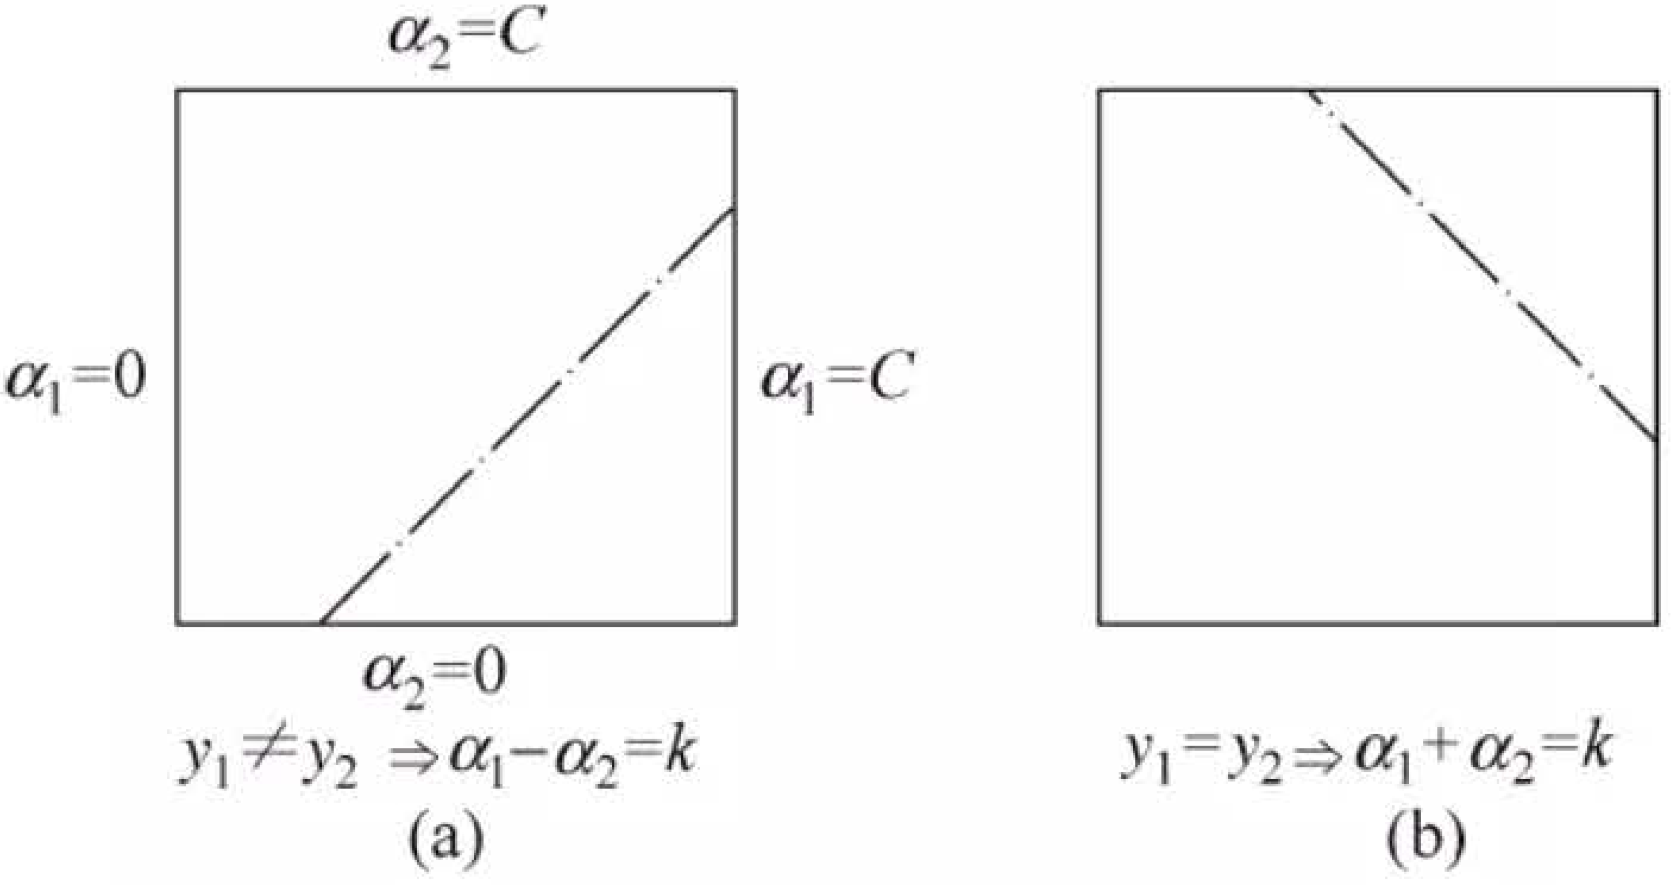
Support Vector Machines
SMO Algorithm
Constraint (7.103) restricts $(α_{1},α_{2})$ to the box $\left[0, C\right]×[0,C]$; equality (7.102) restricts $(α_{1},α_{2})$ to a line parallel to a diagonal of $\left[0, C\right]×[0,C]$. Optimize the objective along that line segment. Thus, the two-variable problem reduces to a one-variable problem in $α_{2}$.
Since $α_{2}$ must satisfy $0≤α_{i}≤C, i=1,2$ (7.103), the optimum $α_{2}^{new}$ must satisfy $L≤α_{2}^{new}≤H$. Here, $L$ and $H$ bound the endpoints of the diagonal segment containing $α_{2}^{new}$.
If $y_{1}≠y_{2}$, then $L=max⁡(0,α_{2}^{old}−α_{1}^{old})$, $H=min(C,C+α_{2}^{old}−α_{1}^{old})$.
If $y_{1}=y_{2}$, then $L=max⁡(0,α_{2}^{old}+α_{1}^{old}−C)$, $H=min(C,α_{2}^{old}+α_{1}^{old})$.

Slide 23
Support Vector Machines
SMO Algorithm
Write $g\left(x\right)=\sum_{i=1}^{N}{α_{i}y_{i}K\left(x_{i},x\right)+b}$.
Let $E_{i}=g\left(x_{i}\right)−y_{i}=\left(\sum_{i=1}^{N}{α_{j}y_{j}K\left(x_{j},x_{i}\right)+b}\right)−y_{i}$, $i=1,2$.
For $i=1,2$, $E_{i}$ is the difference between the prediction of $g(x)$ for input $x_{i}$ and the true output $y_{i}$.
Theorem 7.6. The unclipped solution of (7.101)–(7.103), along the feasible direction, is:
$$α_{2}^{new,unc}=α_{2}^{old}+\frac{y_{2}(E_{1}−E_{2})}{η}$$
$$η=K_{11}+K_{22}−2K_{12}={\left\|Φ\left(x_{1}\right)−Φ\left(x_{2}\right)\right\|}^{2}$$
(7.106)
(7.107)
$Φ(x)$ maps inputs to feature space; $E_{i},i=1,2$ is given by (7.105). After clipping, the solution for $α_{2}$ is:
(7.108)
$α_{1}^{new}=α_{1}^{old}+y_{1}y_{2}(α_{2}^{old}−α_{2}^{new})$ (7.109)

Slide 24
Support Vector Machines
SMO Algorithm
$\min_{α}{\frac{1}{2}\sum_{i=1}^{N}{\sum_{j=1}^{N}{α_{i}α_{j}y_{i}y_{j}K(x_{i}⋅x_{j})}}−\sum_{i=1}^{N}{α_{i}}}$
$s.t. \sum_{i=1}^{N}{α_{i}y_{i}}=0$
$0≤α_{i}≤C, i=1,2,⋯,N$
Dual problem of the soft-margin SVM:
Quadratic programming problem
Sequential minimal optimization (SMO)
Repeat until convergence:
① Select two variables $α_{i}$ and $α_{j}$ to update.
② Fix all parameters except $α_{i}$ and $α_{j}$; simplify the constraints to obtain:
$α_{i}y_{i}+α_{j}y_{j}=−\sum_{k≠i,j}^{N}{α_{k}y_{k}}$
$0≤α_{i},α_{j}≤C$
③ Compute and update $α_{i}$ and $α_{j}$ to minimize the objective.
If either $α_{i}$ or $α_{j}$ violates the KKT conditions, the objective increases after an iteration [Osuna et al., 1997]. First select the variable with the largest KKT violation. Choose the second for the fastest objective increase. Heuristic: maximize the separation between the samples associated with the two variables.

Slide 25
Contents
1. Basic Concepts of Machine Learning
2. Computational Learning Theory
3. Generative Methods
3. Support vector machine
4. Support vector machine
4. Ada Boost*
5. Ada Boost*
5. Generative Methods*
6. Principal Component Analysis*
7. Expectation Maximization*
[3] Fei Wu, Introduction to Artificial Intelligence: Models and Algorithms, 2020, Higher Education Press. Ch. 4.5
[1] Zhi-Hua Zhou, Machine Learning, 2016, Tsinghua University Press. Chs. 8.1, 8.2
[2] Hang Li, Machine Learning Methods, 2021, Tsinghua University Press. Ch. 8

Slide 26
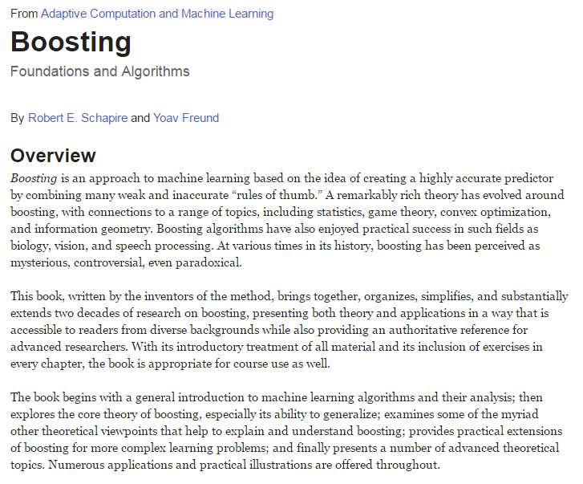
Boosting
A complex classification task can be split into subtasks. Combine their solutions to solve the original task.
Combine several weak classifiers to form a strong classifier.
“With the strength of many, one is invincible; with the wisdom of many, one need not fear even sages.” — Records of the Three Kingdoms, Book of Wu, Biography of Sun Quan
Freund, Yoav; Schapire, Robert E (1997), A decision-theoretic generalization of on-line learning and an application to boosting, Journal of Computer and System Sciences (original paper of Yoav Freund and Robert E.Schapire where AdaBoost is first introduced.)

Slide 27
Boosting
Hoeffding's Inequality
  Learning task: estimate the nationwide audience rating of a television program.
  Method: surveying everyone is infeasible. Sample part of the population and use the proportion of viewers in the sample to estimate the nationwide rating.
  Hoeffding's inequality: the population proportion of viewers ($x$) and the sample proportion ($y$) satisfy:
  $P(|x−y|≥ε)≤2e^{−2Nε^{2}}$ ($N$ is the sample size; $ε∈(0,1)$ is the allowed error.)
For sufficiently large $N$, the probability that the sample rating differs from the nationwide rating by more than $ε$ is very small.

Slide 28
Boosting
  For audience-rating estimation, different sampling methods (models) yield different errors.
  Question: can several weak models be combined into a strong model with very small error? This is a question addressed by probably approximately correct (PAC) learning.
In the PAC framework: strong and weak learnability
Strong learnability (strongly learnable) | A model classifies the vast majority of samples with high accuracy.
Weak learnability (weakly learnable) | A model classifies samples with accuracy slightly above random guessing. (Here, “unlearnable” means 50% accuracy, equivalent to random guessing.)
Strong and weak learnability are equivalent: a weak learning algorithm can be boosted into a strong one. AdaBoost does this by combining a sequence of weak classifiers into one strong classifier.

Slide 29
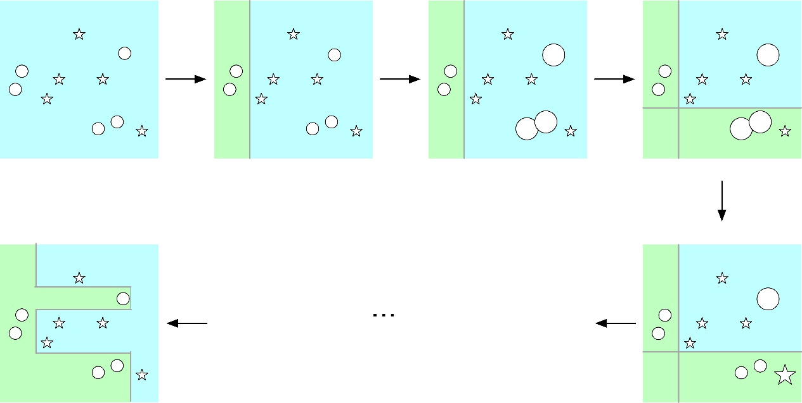
AdaBoost: Key Idea
Fig. 4.9.
Illustration of the AdaBoost learning process
  Two key questions in AdaBoost:
    How should training weights change for each weak learner? Increase the weights of samples misclassified in the previous round.
    How are weak classifiers combined? Use weighted majority voting: assign larger weights to classifiers with lower error so they contribute more, and smaller weights to those with higher error so they contribute less.

Slide 30
AdaBoost: Algorithm
  Given a training set of $N$ labeled samples $Γ=\left\{\left(x_{1},y_{1}\right),…,\left(x_{N},y_{N}\right)\right\}$,
  $x_{i}\left(1≤i≤N\right)∈X⊆R^{n}$, $y_{i}∈Y=\{−1,1\}$
  AdaBoost learns a sequence of weak classifiers from the labeled data and combines them linearly into a strong classifier.
    Initialize the weight of each training sample:
    $D_{1}=\left(w_{11},…,w_{1i},…,w_{1N}\right)$, where $w_{1i}=\frac{1}{N}(1$ $≤i≤N$).
    For $m=1,2,…,M$:
    Use training data with weights $D_{m}$ to learn the $m$-th weak classifier $G_{m}$: $G_{m}\left(x\right):X→\{−1,1\}$.
    Compute the training error of $G_{m}\left(x\right)$: ${err}_{m}=\sum_{i=1}^{N}{w_{mi}𝕀(G_{m}(x_{i})≠y_{i})}$, where $𝕀\left(∙\right)=1$ if $G_{m}(x_{i})≠y_{i}$, and 0 otherwise.
    Compute the weight of weak classifier $G_{m}\left(x\right)$: $α_{m}=\frac{1}{2}\ln{\frac{1−{err}_{m}}{{err}_{m}}}$.
    Update the training-sample weights: $D_{m+1}=$ $w_{m+1,i}=\frac{w_{m,i}}{Z_{m}}e^{−α_{m}y_{i}G_{m}(x_{i})}$, where $Z_{m}$ normalizes $D_{m+1}$ into a probability distribution, $Z_{m}=\sum_{i=1}^{N}{w_{m,i}}e^{−α_{m}y_{i}G_{m}(x_{i})}$.
    Combine weak classifiers by a weighted sum: $f\left(x\right)=\sum_{i=1}^{M}{α_{m}G_{m}(x)}$
    Obtain the strong classifier $G\left(x\right)=sign(f\left(x\right))=sign(\sum_{i=1}^{M}{α_{m}G_{m}(x))}$.

Slide 31
AdaBoost: Algorithm
    Training error of the $m$-th weak classifier $G_{m}\left(x\right)$:
    The error is the sum of the weights of misclassified samples.
    ${err}_{m}=\sum_{i=1}^{N}{w_{m,i}𝕀(G_{m}(x_{i})≠y_{i})}$, where $𝕀\left(∙\right)=1$ if $G_{m}(x_{i})≠y_{i}$, and 0 otherwise.
    Weight $α_{m}$ of the $m$-th weak classifier $G_{m}\left(x\right)$: $α_{m}=\frac{1}{2}\ln{\frac{1−{err}_{m}}{{err}_{m}}}$
    If the $m$-th weak classifier $G_{m}(x)$ has error 1, i.e., ${err}_{m}=\sum_{i=1}^{N}{w_{mi}𝕀(G_{m}(x_{i})≠y_{i})}=1$, every sample is misclassified. Then $α_{m}=\frac{1}{2}\ln{\frac{1−{err}_{m}}{{err}_{m}}}→−∞$, assigning the $m$-th weak classifier $G_{m}(x)$ a very low weight.
    If the $m$-th weak classifier $G_{m}(x)$ has error $\frac{1}{2}$, then $α_{m}=\frac{1}{2}\ln{\frac{1−{err}_{m}}{{err}_{m}}}=0$. If ${err}_{m}$ is below $\frac{1}{2}$, weight $α_{m}$ is positive (${err}_{m}<\frac{1}{2}、α_{m}>0$). Weight $α_{m}$ increases as ${err}_{m}$ decreases: lower-error classifiers receive larger weights.
    A weak classifier with error $\frac{1}{2}$ performs no better than random classification.

Slide 32
AdaBoost: Explanation
    Adjust the training-sample weights before training the $m+1$-th weak classifier $G_{m+1}\left(x\right)$.
    $$w_{m+1,i}=\left\{\begin{aligned}\frac{w_{m,i}}{Z_{m}}e^{−α_{m}}, { G}_{m}\left(x_{i}\right)=y_{i} \\ \frac{w_{m,i}}{Z_{m}}e^{α_{m}}{, G}_{m}\left(x_{i}\right)≠y_{i}\end{aligned}\right.$$
    If the $m$-th weak classifier $G_{m}\left(x\right)$ misclassifies a sample, increase its weight; otherwise decrease it. Misclassified samples receive more attention when training the $m+1$-th weak classifier $G_{m+1}\left(x\right)$.
    At each round, AdaBoost focuses on samples that are not yet correctly classified.
    Construct a strong classifier from weak classifiers: $G\left(x\right)=sign(f\left(x\right))=sign(\sum_{i=1}^{M}{α_{m}G_{m}(x))}$
    $f(x)$ is a weighted sum of $M$ weak classifiers. More accurate classifiers receive larger weights.
    The sum of $α_{m}$ does not equal 1.
    The sign of $f(x)$ determines whether sample $x$ is labeled 1 or −1. If $\sum_{i=1}^{M}{α_{m}G_{m}(x)}$ is positive, strong classifier $G\left(x\right)$ assigns sample $x$ to class 1; otherwise to class −1.

Slide 33
AdaBoost: Explanation
Revisiting Hoeffding's Inequality
    Suppose there are $M$ weak classifiers $G_{m}(1≤m≤M)$. The error of their $M$-classifier linear combination satisfies:
    $$P(\sum_{i=1}^{M}{G_{m}(x)≠ζ(x))≤e^{−\frac{1}{2}M{(1−2ε)}^{2}}}$$
    $ζ(x)$ is the true classification function, $ε∈(0,1)$. As more weak classifiers are combined, the training classification error decreases exponentially toward zero.
    The inequality assumes: (1) independent errors across weak classifiers; (2) each error rate below 50%. Since all classifiers use the same training set, (1) is difficult to satisfy. Accuracy of predictions and diversity among classifiers are hard to achieve simultaneously.
    AdaBoost uses sequential learning.

Slide 34
AdaBoost: Explanation
Optimization objective
    AdaBoost minimizes the following exponential loss:
    $$\sum_{i}{e^{−y_{i}f(x_{i})}=\sum_{i}{e^{−y_{i}\sum_{m=1}^{M}{α_{m}G_{m}(x_{i})}}}}$$
    The upper bound on AdaBoost's classification error is:
    $$\frac{1}{N}\sum_{i=1}^{N}{I\left(G\left(x_{i}\right)≠y_{i}\right)≤\frac{1}{N}\sum_{i}{e^{−y_{i}f\left(x_{i}\right)}}=\prod_{m}{Z_{m}}}$$
    At iteration $m$, AdaBoost tends to select the lowest-error model as the weak classifier $G_{m}$, rapidly reducing cumulative error.

Slide 35
Contents
1. Basic Concepts of Machine Learning
2. Computational Learning Theory
3. Support vector machine
4. Ada Boost*
5. Generative Methods*
6. Principal Component Analysis*
7. Expectation Maximization*
[2] Hang Li, Machine Learning Methods, 2021, Tsinghua University Press. Ch. 1.7
[3] Fei Wu, Introduction to Artificial Intelligence: Models and Algorithms, 2020, Higher Education Press.
[1] Zhi-Hua Zhou, Machine Learning, 2016, Tsinghua University Press.
[4] Zhi-Hua Zhou et al., An Introduction to Machine Learning Theory, 2020, China Machine Press.

Slide 36
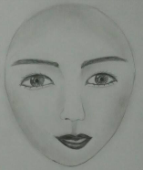
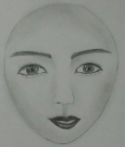
Generative vs. Discriminative Methods
Supervised learning includes generative and discriminative approaches, producing generative and discriminative models, respectively.
Discriminative methods directly learn a decision function $f(X)$ or a conditional probability distribution $P(Y|X)$ for prediction.
Given an input, a discriminative model predicts its output.
Examples include decision trees, SVMs, AdaBoost, and neural networks for classification and regression.
$$f( )$$
Face
$$P( Face | )$$
=0.99

Slide 37
Generative vs. Discriminative Methods
Generative methods learn the joint distribution $P(X,C)$, then derive the conditional distribution $P(C|X)$ for prediction: $P\left(c_{i} | x\right)=\frac{P(x,c_{i})}{P(x)}$.
P(x, c) = P(x | c) × P(c)
P(c | x) = P(x | c) × P(c) / P(x)
Joint = likelihood × prior
Posterior = likelihood × prior / evidence
For a given input $x$, its probability $P(x)$ is the same across classes and can be omitted.
The likelihood encodes how a class generates the input data.
Generative models learn the joint distribution $P(X,Y)$ from data, using the product of likelihood $P(X|Y)$ and class probability $P(Y)$: $P\left(Y | X\right)=\frac{P(X,Y)}{P(X)}$, or $P\left(Y | X\right)=\frac{P(X|Y)×P(Y)}{P(X)}$.
The joint distribution $P\left(X,Y\right)$ or likelihood $P(X|Y)$ can be difficult to compute.
Examples include Bayesian methods, hidden Markov models, and latent Dirichlet allocation (LDA).
Likelihood: evaluate model parameter values that could generate sample $X$.
$$P\left(Y | X\right)=\frac{P(X|Y)×P(Y)}{P(X)}$$

