Slide 1
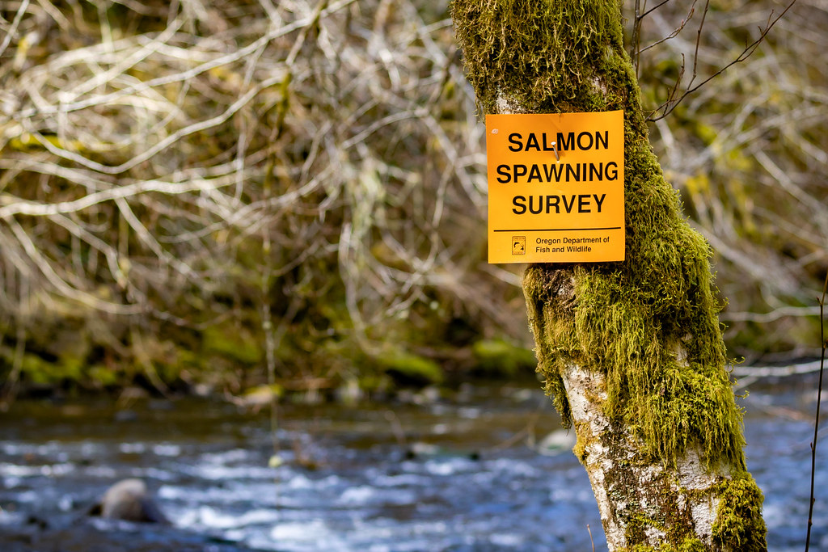
Investigating precision and accuracy of commonly used salmonid abundance survey methods

Slide 2







Investigating precision and accuracy of commonly used salmonid abundance survey methods
Brian McGreal bmcgreal@uw.edu

Slide 3
Background

Slide 4
What are salmon?

Slide 5
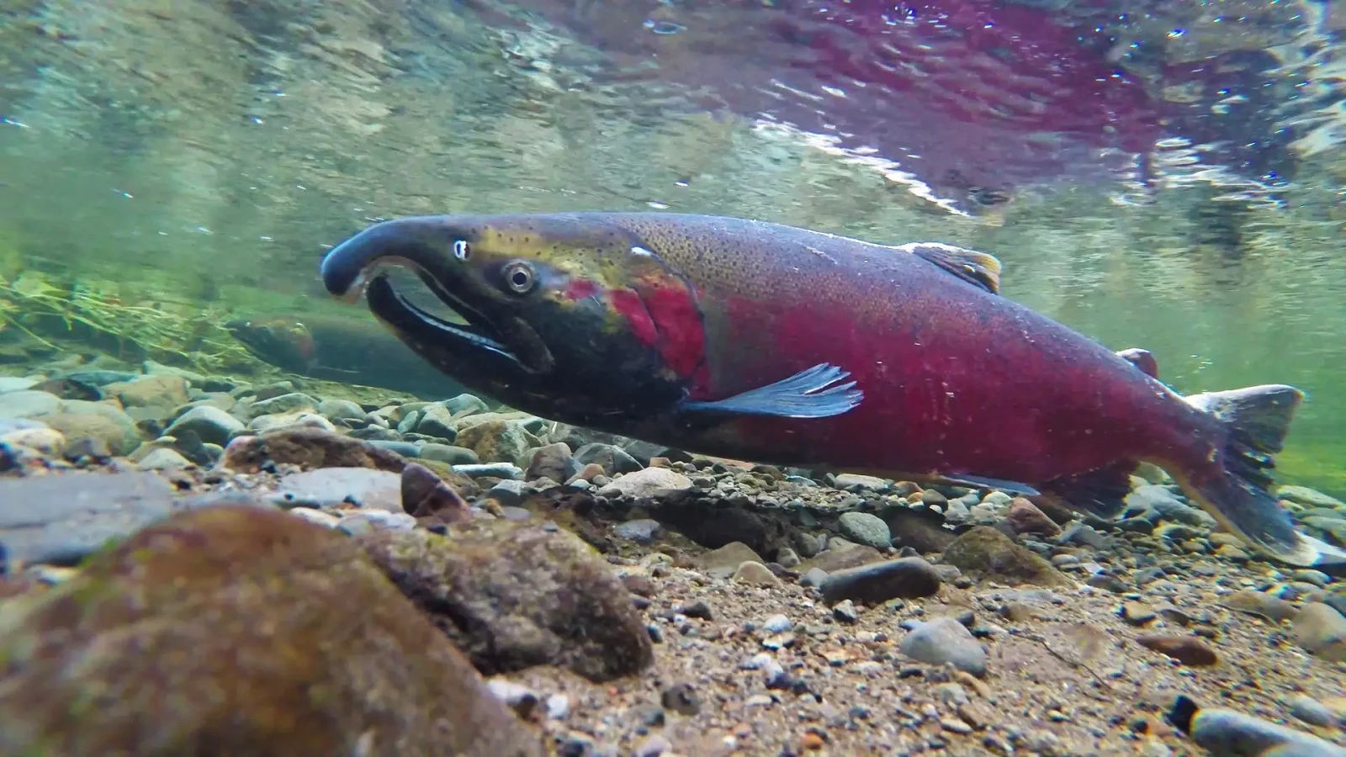
What are salmon?
Photo credit: Animalia

Slide 6
Why salmon are important?

Slide 7
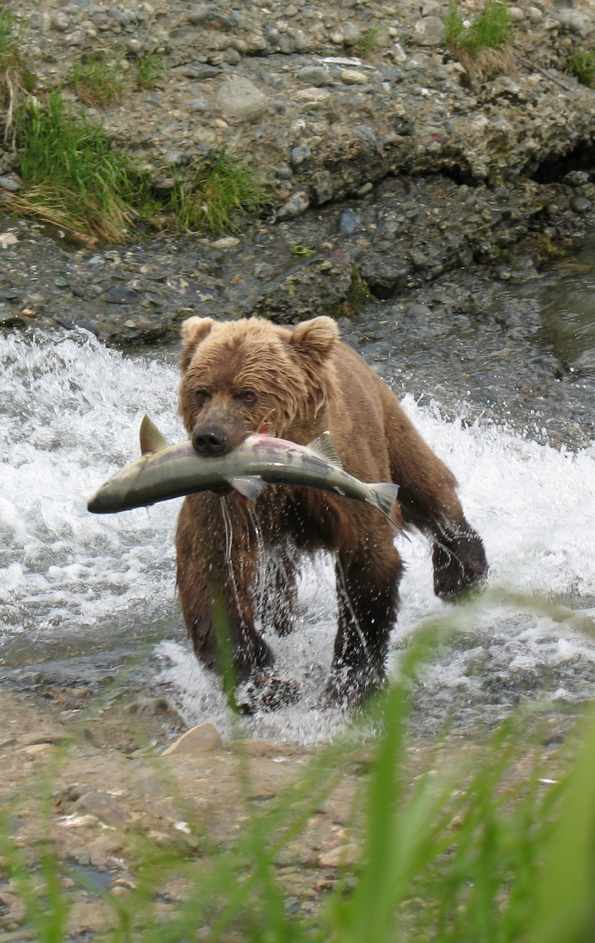
Why salmon are important?
Photo credit: Jean Beaufort
Notes:
Ecologically crucial species
Marine nutrients found in trees in central Idaho
Cultural significance
Central to Indigenous ways of life and cultural identity
Commercial significance
$7.2 million in OR in 2024 (landed value)
Not including sport fishing

Slide 8
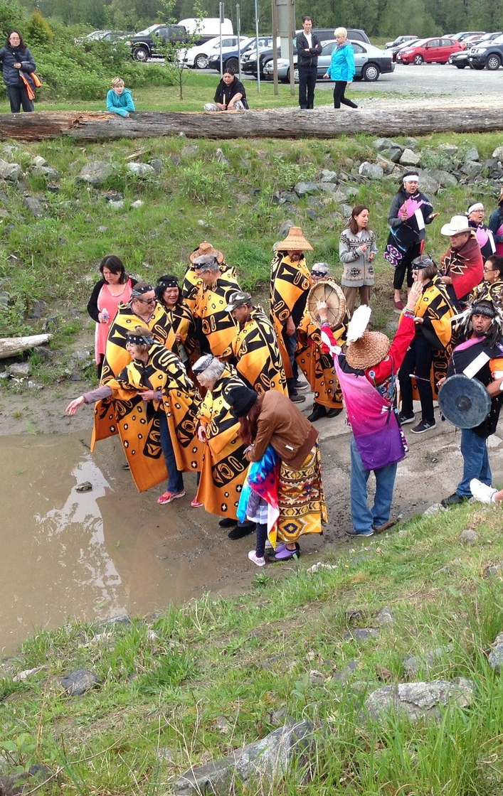
Why salmon are important?
Photo credit: Robert Jago
Notes:
Cultural significance - Kwantlen
Central to Indigenous ways of life and cultural identity
Commercial significance
$7.2 million in OR in 2024 (landed value)
Not including sport fishing

Slide 9
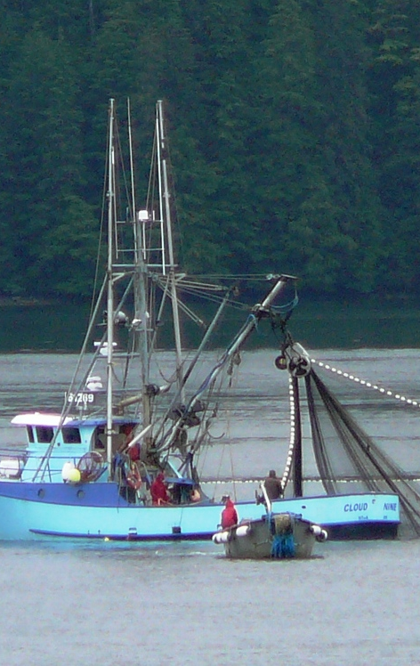
Why salmon are important?
Photo credit: CoastAlaska News
Notes:
Commercial significance
$7.2 million in OR in 2024 (landed value)
Not including sport fishing

Slide 10
How are salmon doing?

Slide 11
Not great

Slide 12
How are salmon doing?
Not great along the pacific coast
Notes:
Not great in the lower 48
28 population groups of salmon/trout listed as endangered or threatened under ESA
13 of these in Columbia Basin
Despite restoration efforts
$ 9 billion spent in Columbia Basin since 1990s

Slide 13
How are salmon doing?
Not great along the pacific coast
28 ESU/DPSs listed as endangered or threatened
Notes:
Not great in the lower 48
28 population groups of salmon/trout listed as endangered or threatened under ESA
13 of these in Columbia Basin
Despite restoration efforts
$ 9 billion spent in Columbia Basin since 1990s

Slide 14
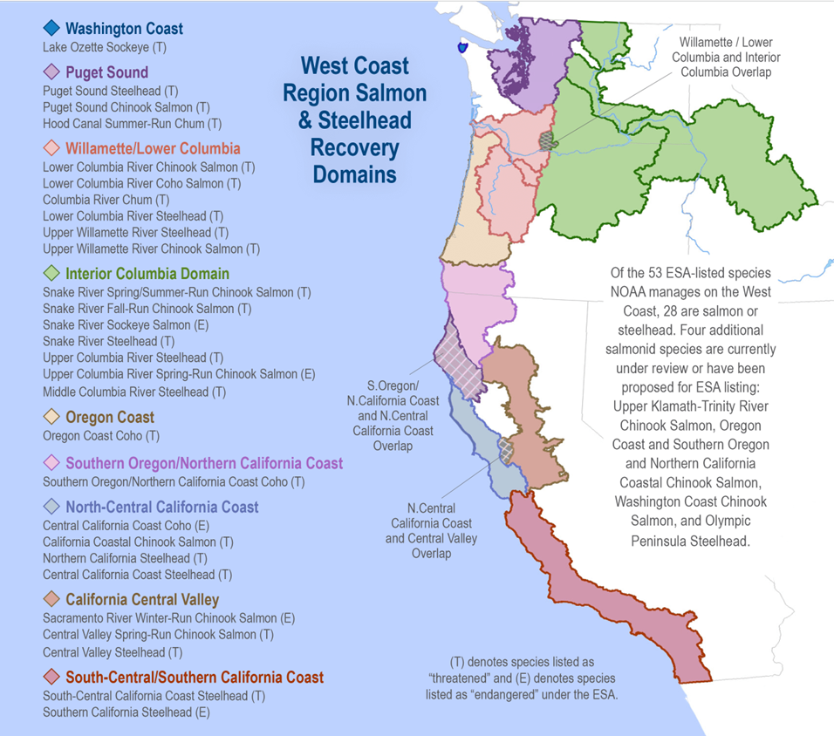
Photo credit: NOAA Fisheries

Slide 15
How are salmon doing?
Not great along the pacific coast
28 ESU/DPSs listed as endangered or threatened
13 in Columbia Basin
Notes:
Not great in the lower 48
28 population groups of salmon/trout listed as endangered or threatened under ESA
13 of these in Columbia Basin
Despite restoration efforts
$ 9 billion spent in Columbia Basin since 1990s

Slide 16
How are salmon doing?
Not great along the pacific coast
28 ESU/DPSs listed as endangered or threatened
13 in Columbia Basin
Despite restoration efforts
Notes:
Not great in the lower 48
28 population groups of salmon/trout listed as endangered or threatened under ESA
13 of these in Columbia Basin
Despite restoration efforts
$ 9 billion spent in Columbia Basin since 1990s

Slide 17
How are salmon doing?
Not great along the pacific coast
28 ESU/DPSs listed as endangered or threatened
13 in Columbia Basin
Despite restoration efforts
$ 9 billion spent in Columbia Basin since 1990s
Notes:
Not great in the lower 48
28 population groups of salmon/trout listed as endangered or threatened under ESA
13 of these in Columbia Basin
Despite restoration efforts
$ 9 billion spent in Columbia Basin since 1990s

Slide 18
How are salmon doing?
Not great along the pacific coast
28 ESU/DPSs listed as endangered or threatened
13 in Columbia Basin
Despite restoration efforts
$ 9 billion spent in Columbia Basin since 1990s
Ongoing
Notes:
Not great in the lower 48
28 population groups of salmon/trout listed as endangered or threatened under ESA
13 of these in Columbia Basin
Despite restoration efforts
$ 9 billion spent in Columbia Basin since 1990s

Slide 19
How do we know salmon aren’t doing great?

Slide 20
We count them!

Slide 21
We count them!
Well, we count some of them…

Slide 22
We count them!
Well, we count some of them…
…and make educated guesses
about the rest…

Slide 23
We count them!
Well, we count some of them…
…and make educated guesses
about the rest…
… using a variety of methods

Slide 24
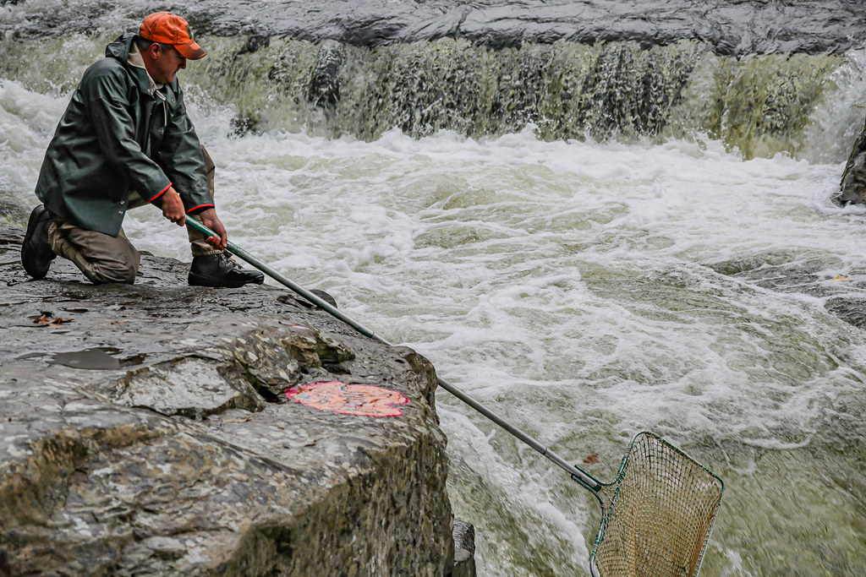
How do we know how salmon are doing?
Photo credit: US Bureau of Land Management
Notes:
Net survey

Slide 25
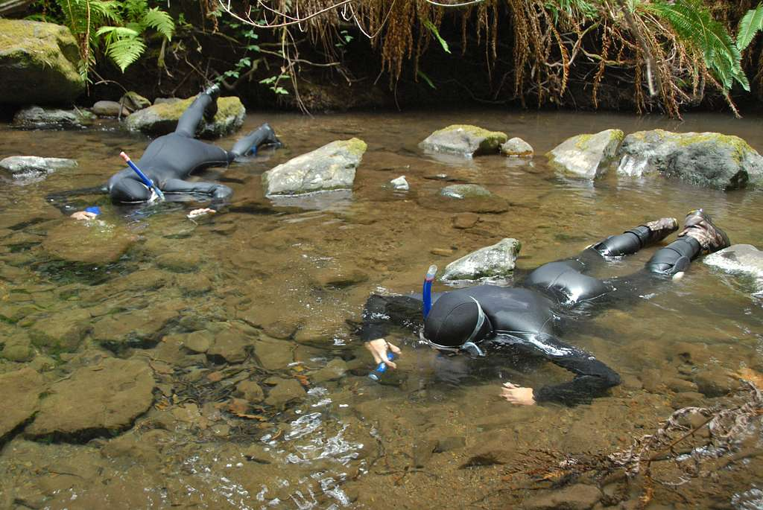
How do we know how salmon are doing?
Photo credit: National Parks Gallery
Notes:
Snorkel survey

Slide 26
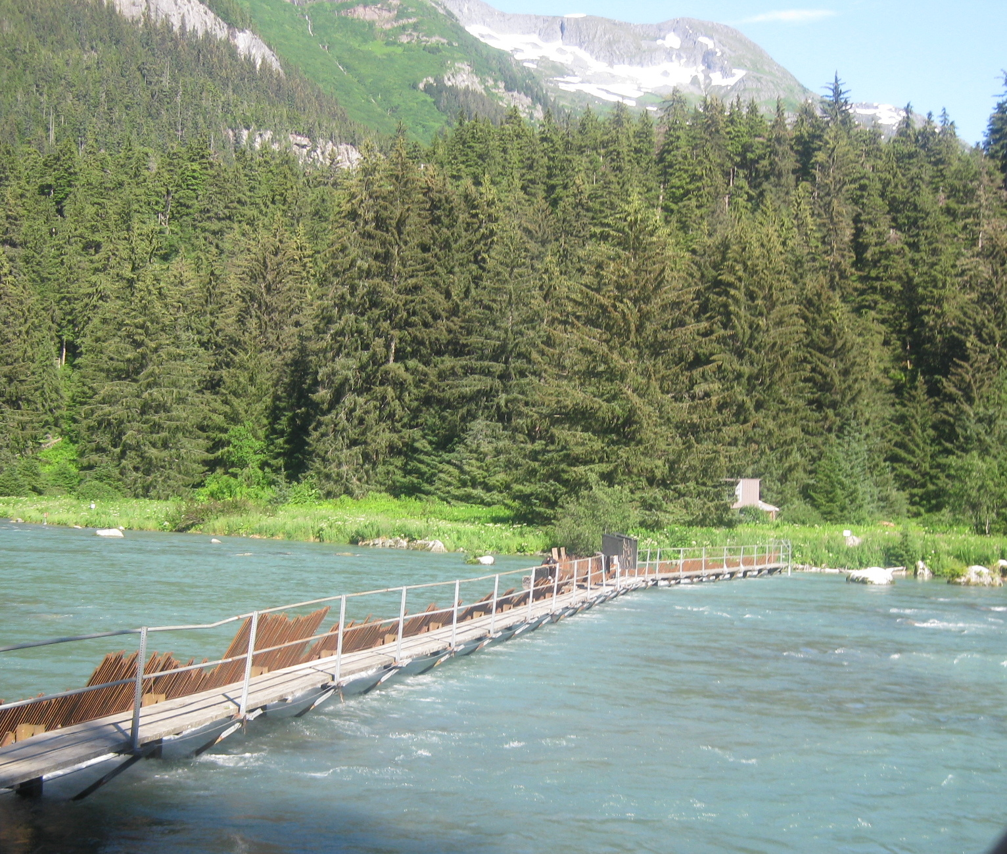
How do we know how salmon are doing?
Photo credit: Wikipedia Commons
Notes:
Weir

Slide 27
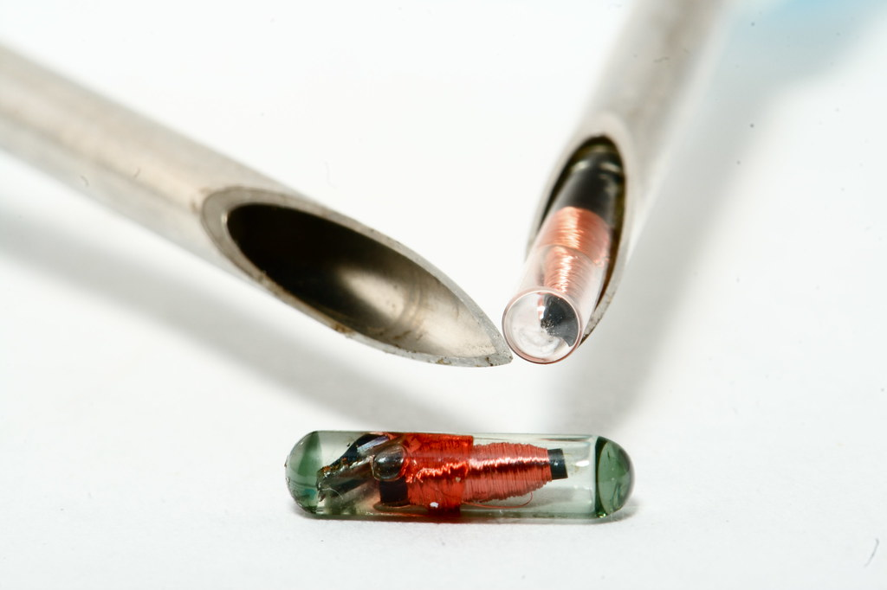
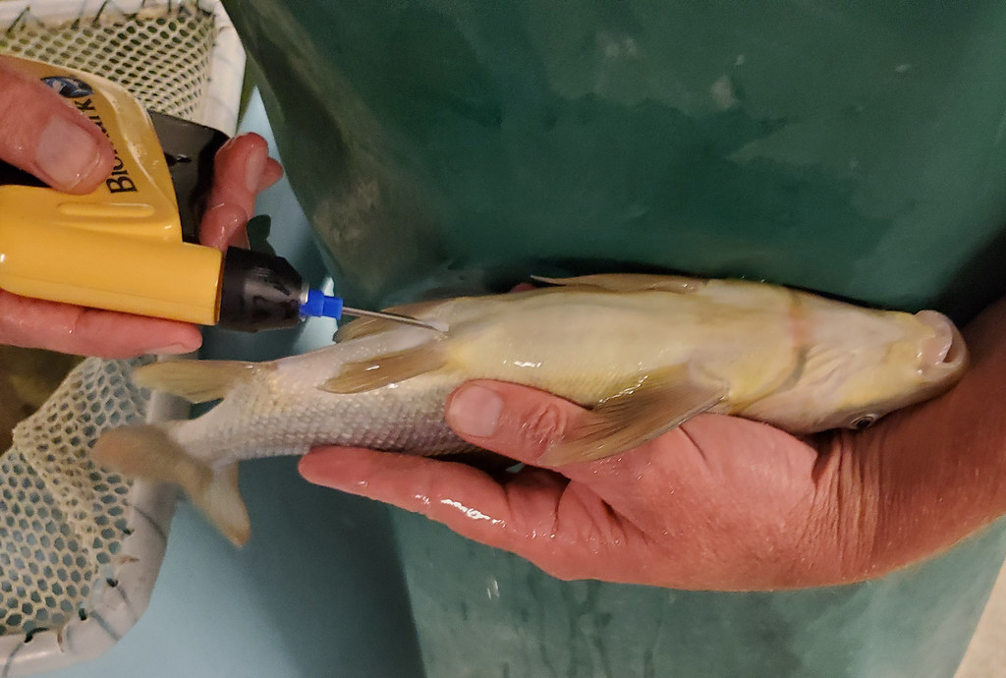
How do we know how salmon are doing?
Photo credit: US Fish and Wildlife Service
Notes:
PIT tag (passive integrated transponder)

Slide 28

How do we know how salmon are doing?
Photo credit: Nic McPhee
Notes:
Aerial Survey (AK)

Slide 29
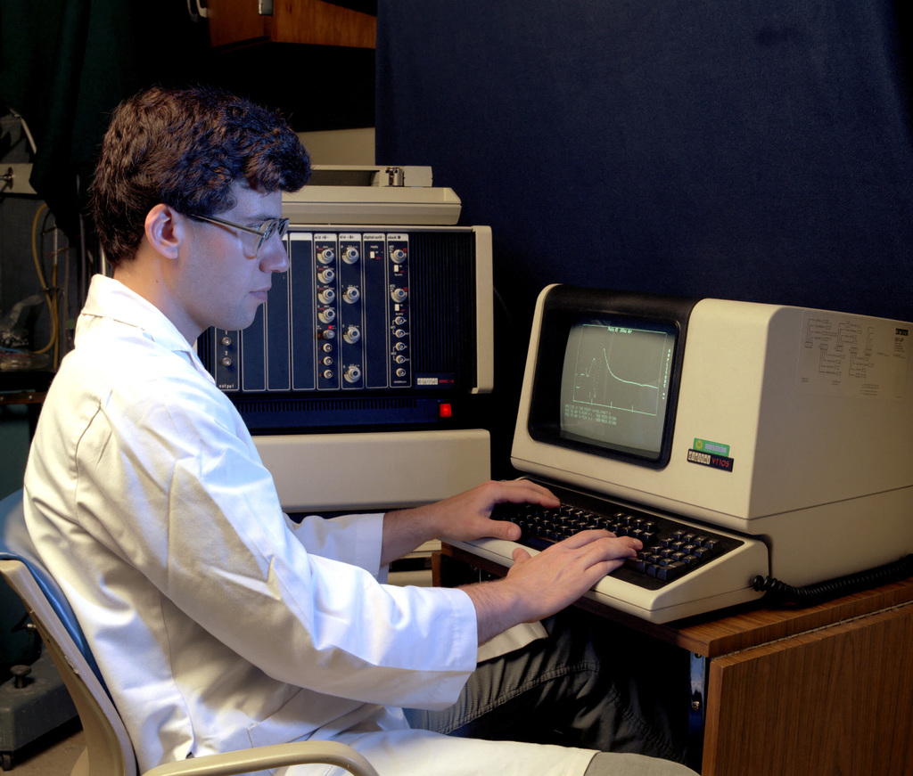
How do we know how salmon are doing?
Photo credit: U.S. National Archives
Notes:
Weir

Slide 30
How do we know how salmon are doing?

Slide 31
How comparable are these counts?

Slide 32
How comparable are these counts?
(specifically in terms of accuracy and precision)

Slide 33
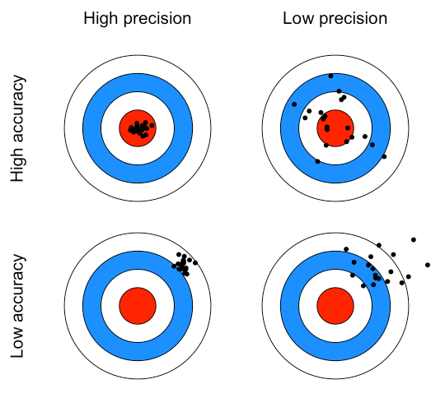
Accuracy and precision?

Slide 34
What is at issue?
Observations
Abundance
Time

Slide 35
What is at issue?
Observations
Decline
Abundance
Time

Slide 36
What is at issue?
Observations
Drop
Abundance
Time

Slide 37
What is at issue?
Observations
Drop
Abundance
Uncertainty
Time

Slide 38
What is at issue?
Observations
Drop
Abundance
New equilibrium?
Uncertainty
Time

Slide 39
Three survey methods
Observations
M1
M2
M3
Abundance
Time

Slide 40
What is at issue
Observations
M1
M2
M3
Abundance
Precise (but not accurate)
Time

Slide 41
What is at issue
Observations
M1
M2
M3
Abundance
Precise (but not accurate)
Accurate (but not precise)
Time

Slide 42
What is at issue
Observations
M1
M2
M3
Abundance
Precise (but not accurate)
Accurate (but not precise)
Accurate and precise
Time

Slide 43
What is at issue
Observations
True abundance
M1
M2
M3
Abundance
Precise (but not accurate)
Accurate (but not precise)
Accurate and precise
Time

Slide 44
Research goal: Evaluate salmon survey methods for precision and accuracy

Slide 45
Data

Slide 46
Data
Natural-origin spawning salmon estimates in Oregon

Slide 47
Data
Natural-origin spawning salmon
estimates in Oregon
68 salmonid populations

Slide 48
Data
Natural-origin spawning salmon
estimates in Oregon
68 salmonid populations
3 species: Chinook, coho, steelhead

Slide 49
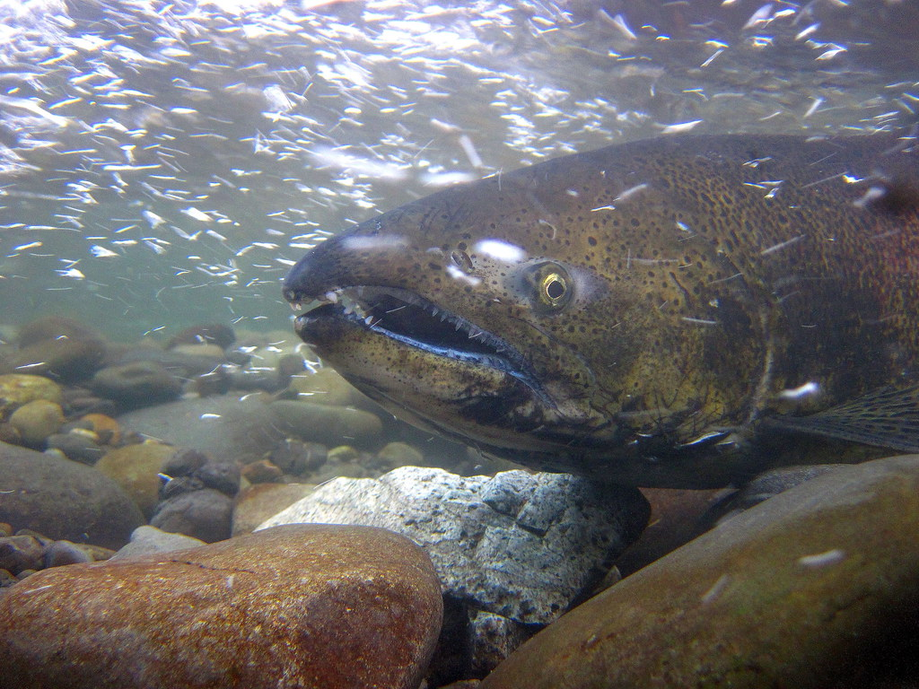
Data
Natural-origin spawning salmon
estimates in Oregon
68 salmonid populations
3 species: Chinook, coho, steelhead
Photo credit: Olympic Nat’l Park

Slide 50
Data
Natural-origin spawning salmon estimates in Oregon
68 salmonid populations
3 species: Chinook, coho, steelhead
Annual observations, 1980 to 2022

Slide 51
Data
Natural-origin spawning salmon
estimates in Oregon
68 salmonid populations
3 species: Chinook, coho, steelhead
Annual observations, 1980 to 2022
31 survey methods

Slide 52
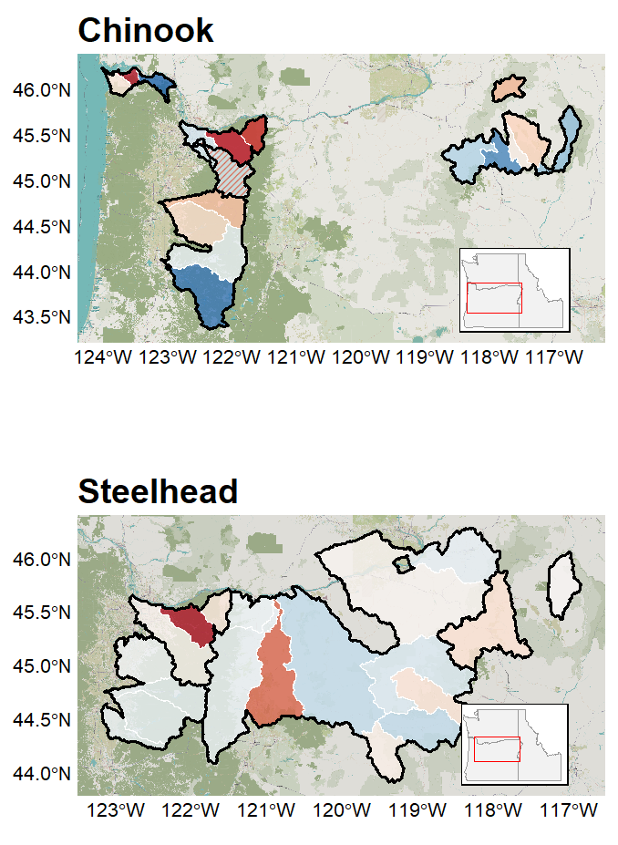
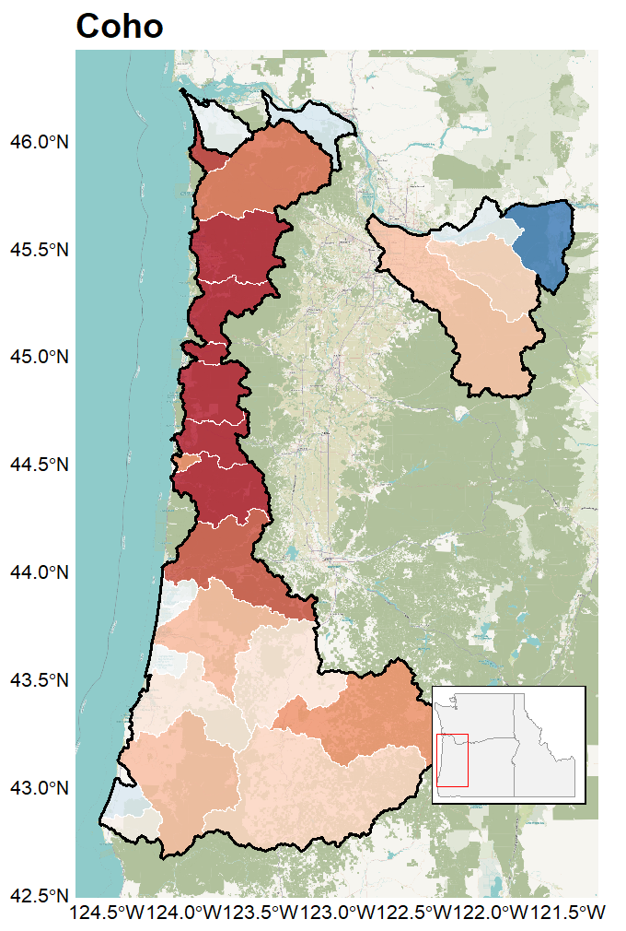
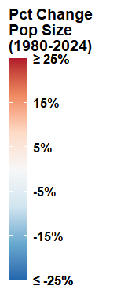

Slide 53
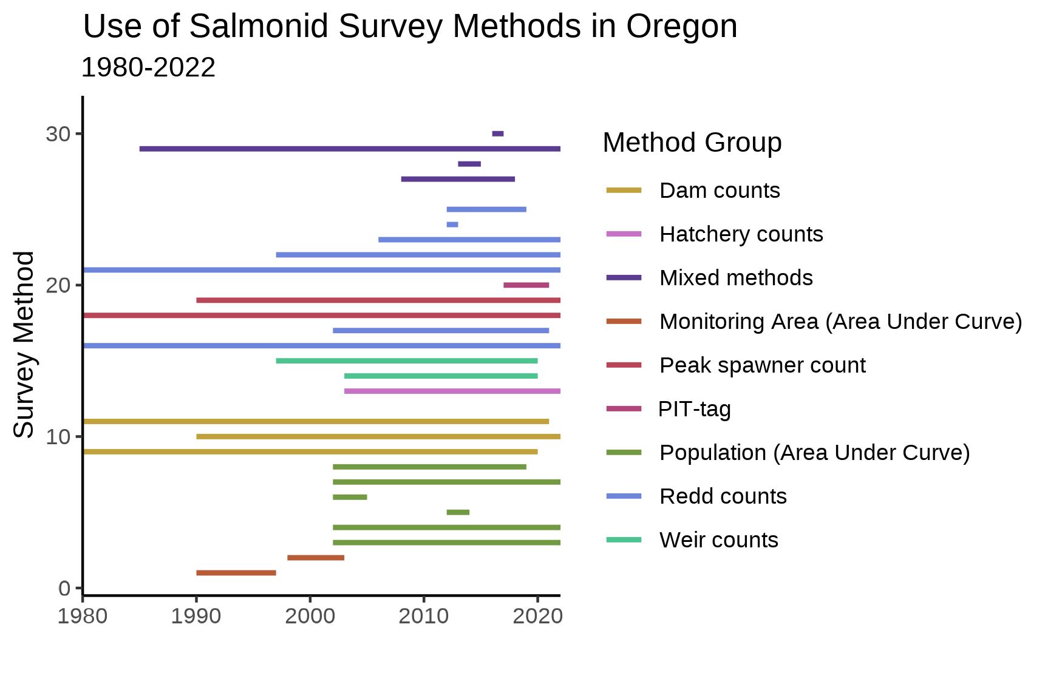
Survey methods -use

Slide 54
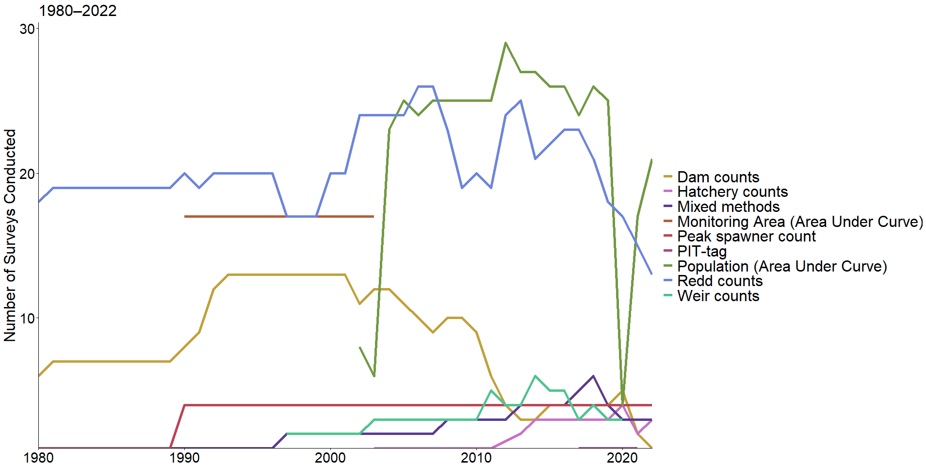
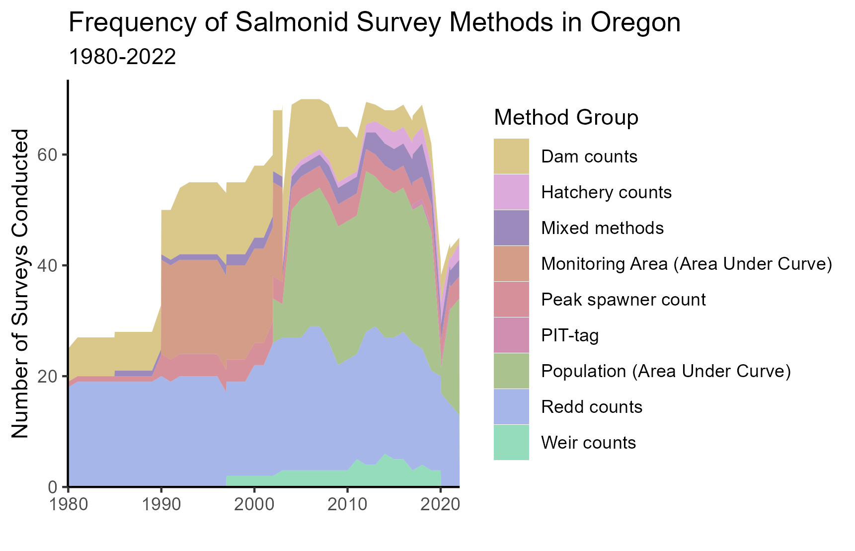
Survey methods - frequency

Slide 55
Analysis

Slide 56
Modeling approach
Multivariate Auto-Regressive State Space models
(MARSS)

Slide 57
Modeling approach
Multivariate Auto-Regressive State Space models
(MARSS)
In English?

Slide 58
Modeling approach
MARSS models
Observation equation
observation = abundance + offset + error

Slide 59
Modeling approach
MARSS models
Underlying state/process equation
abundance = prior year abundance + randomness
observation = abundance + offset + error

Slide 60
Modeling approach
MARSS models
abundance = prior year abundance + randomness
observation = abundance + offset + error
data

Slide 61
Modeling approach
MARSS models
abundance = prior year abundance + randomness
observation = abundance + offset + error

Slide 62
Modeling approach
MARSS models
What am I interested in?
abundance = prior year abundance + randomness
observation = abundance + offset + error

Slide 63
Modeling approach
MARSS models
I am interested in accuracy
abundance = prior year abundance + randomness
observation = abundance + offset + error

Slide 64
Modeling approach
MARSS models
I am interested in precision
abundance = prior year abundance + randomness
observation = abundance + offset + error

Slide 65
Modeling approach
MARSS models
abundance = prior year abundance + randomness
observation = abundance + offset + error
Estimates of accuracy (offset) and precision (error)

Slide 66
Modeling approach
MARSS models
abundance = prior year abundance + randomness
observation = abundance + offset + error
Estimates of accuracy (offset) and precision (error), as well as ‘true’ abundance

Slide 67
Results

Slide 68
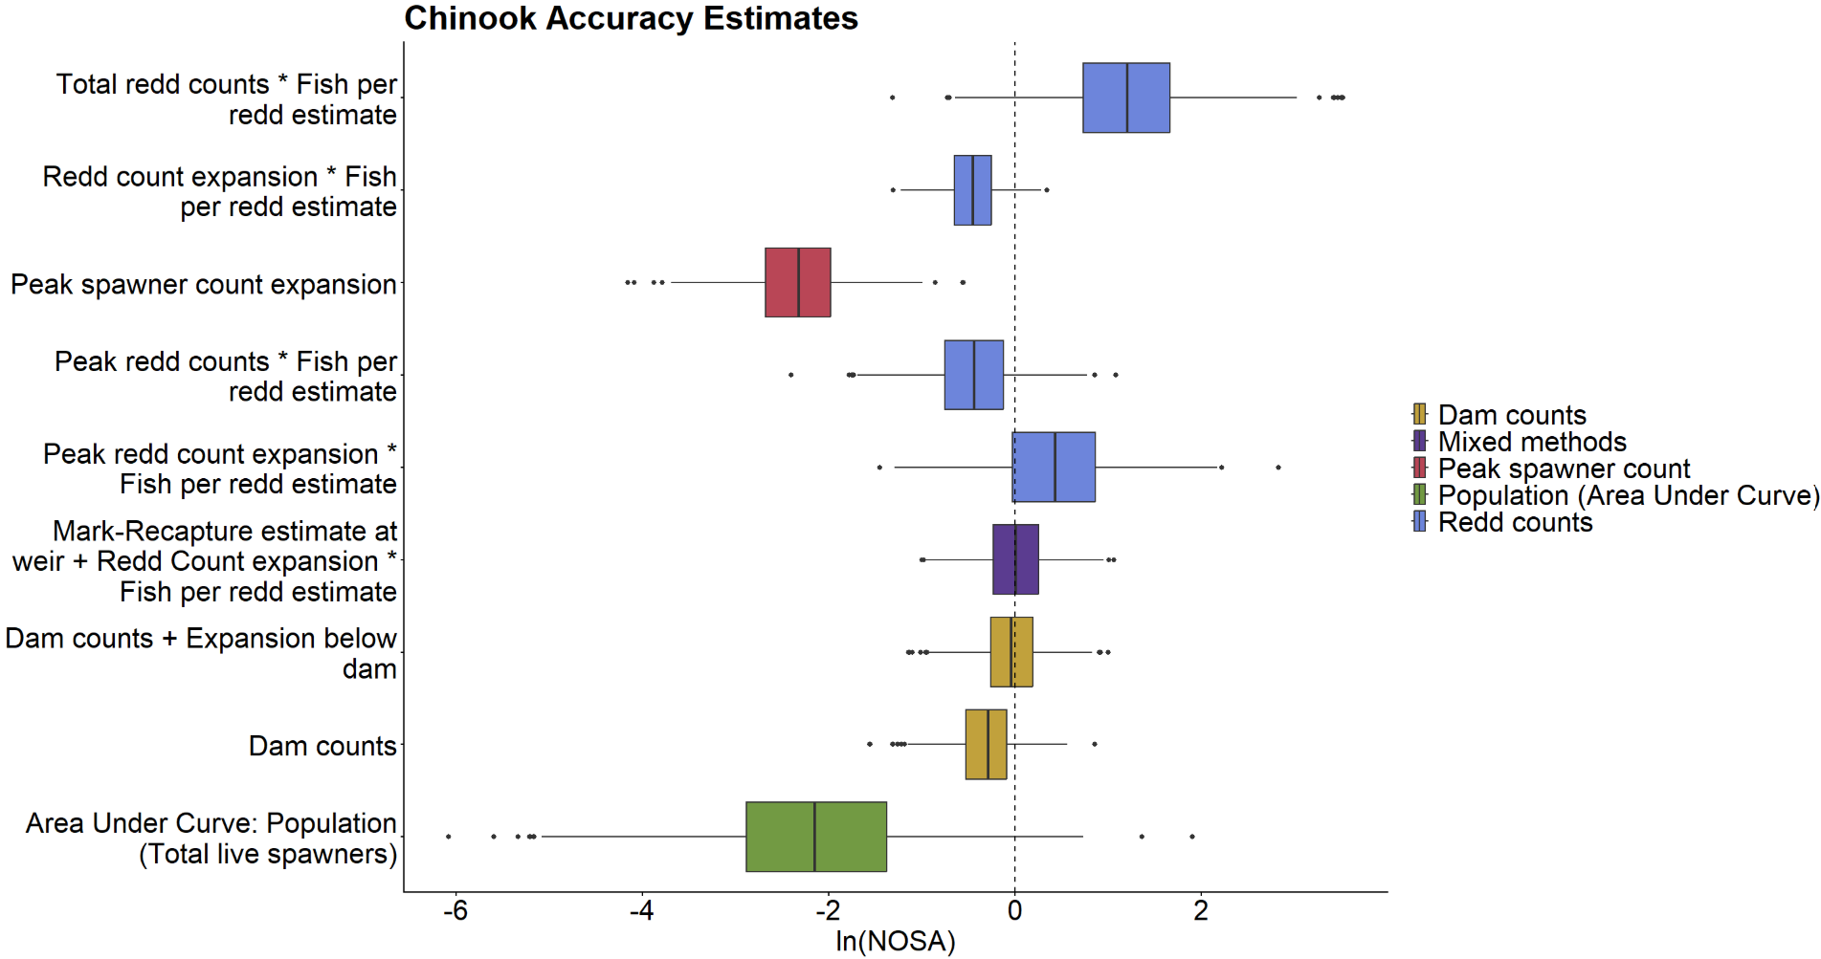

Slide 69
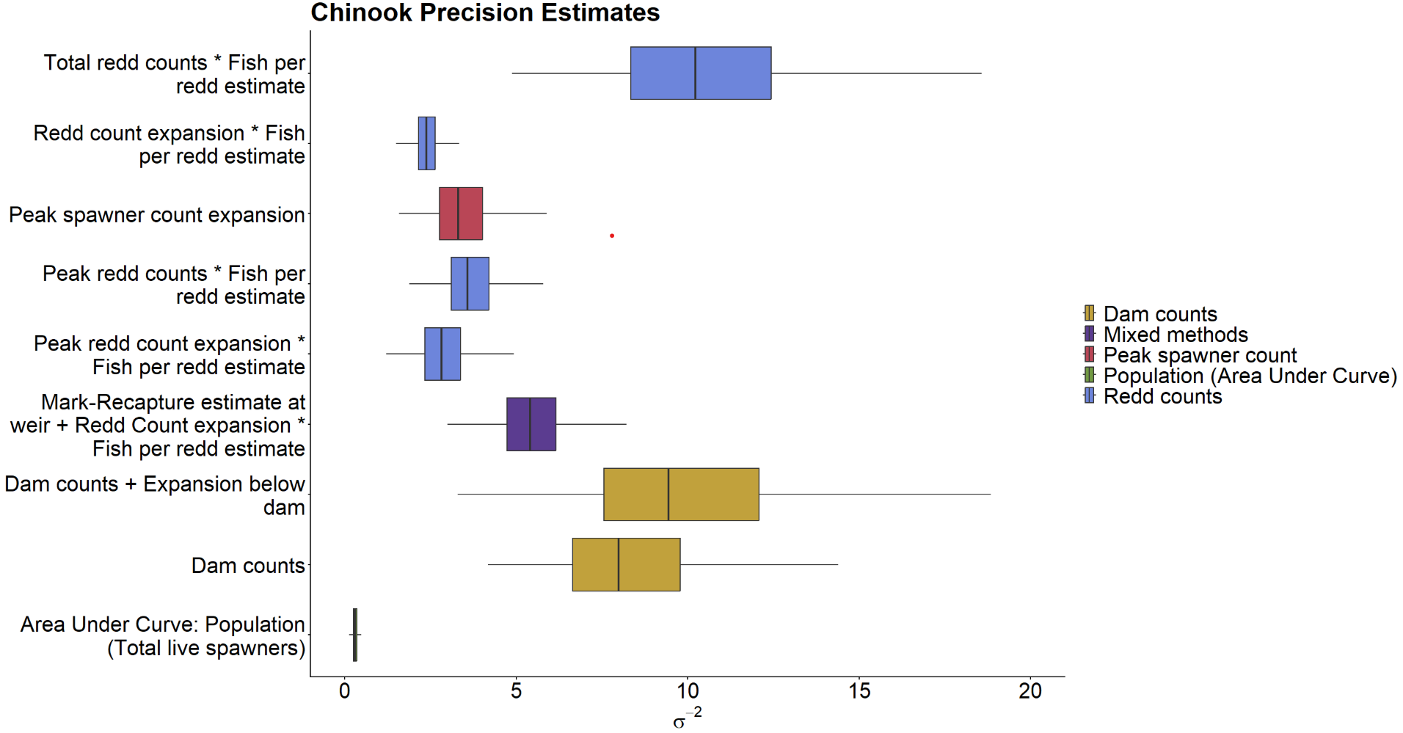

Slide 70
What can be done with this information?

Slide 71
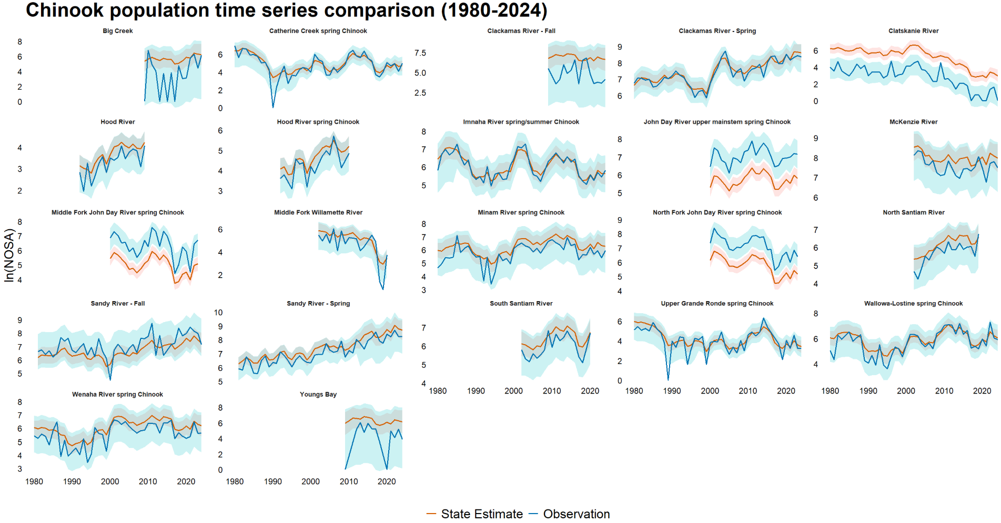

Slide 72
Case Studies

Slide 73
Accuracy and precision – four case studies

Slide 74
Case study 1: High precision, high accuracy

Slide 75
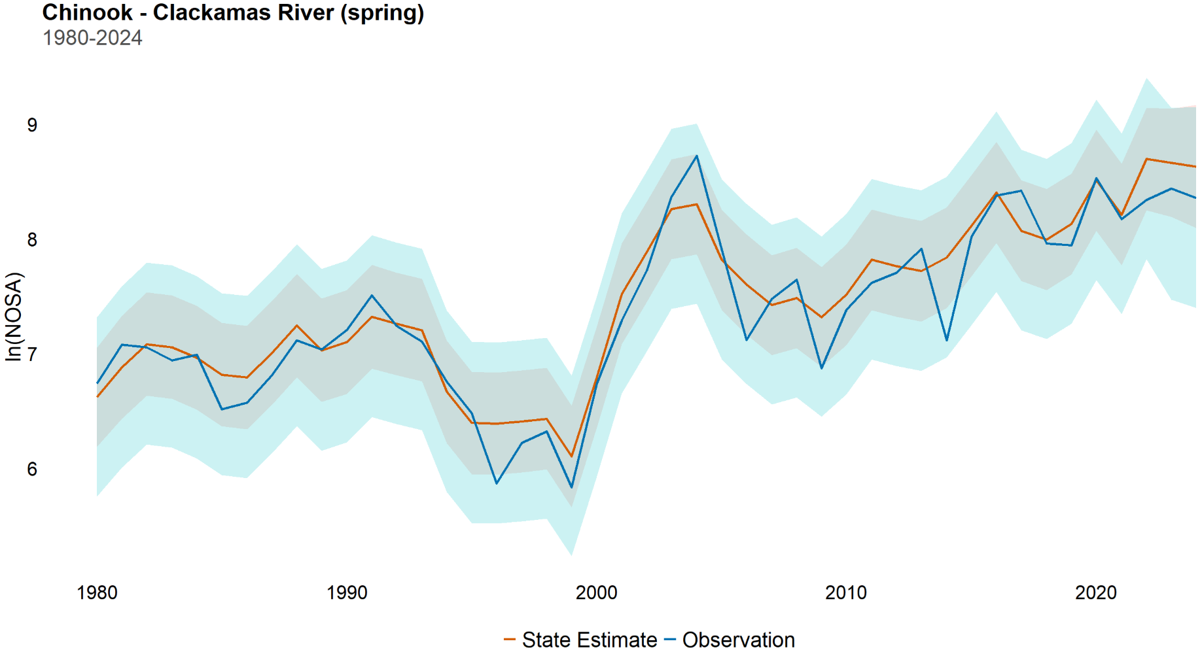
Case study 1: High precision, high accuracy

Slide 76
Case study 1: High precision, high accuracy
Surveyed with ‘Dam counts + Expansion below dam’

Slide 77
Case study 1: High precision, high accuracy
Surveyed with ‘Dam counts + Expansion below dam’
Ideal scenario

Slide 78
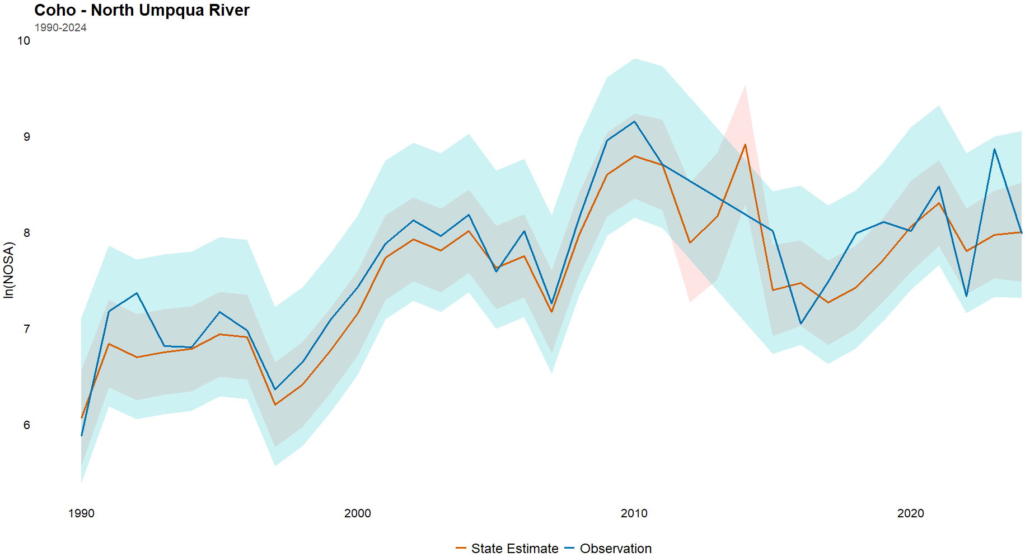
Case study 1: High precision, high accuracy
Surveyed with ‘Dam counts + Expansion below dam’
Ideal scenario
Many survey methods resemble this behavior

Slide 79
Case study: High precision, high accuracy
Surveyed with ‘Dam counts + Expansion below dam’
Ideal scenario
Many survey methods resemble this behavior
No major adjustments necessary

Slide 80
Case study 2: High precision, low accuracy

Slide 81
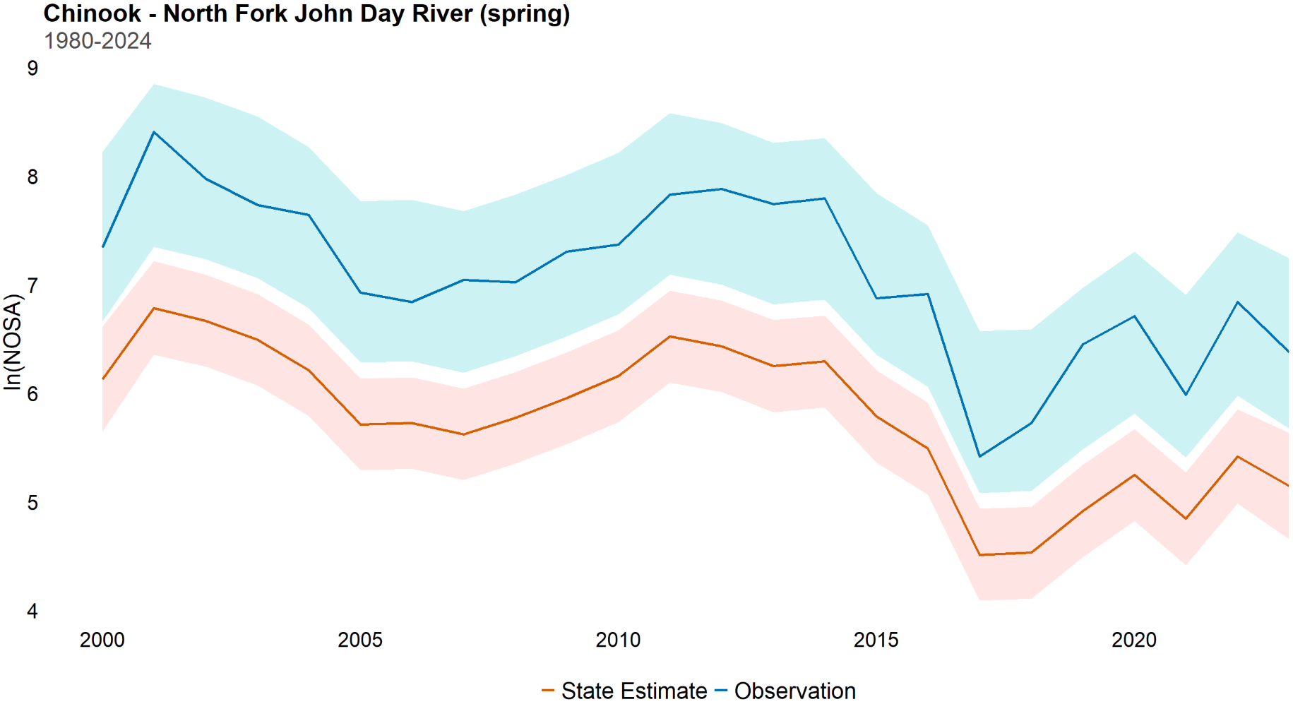
Case study 2: High precision, low accuracy

Slide 82
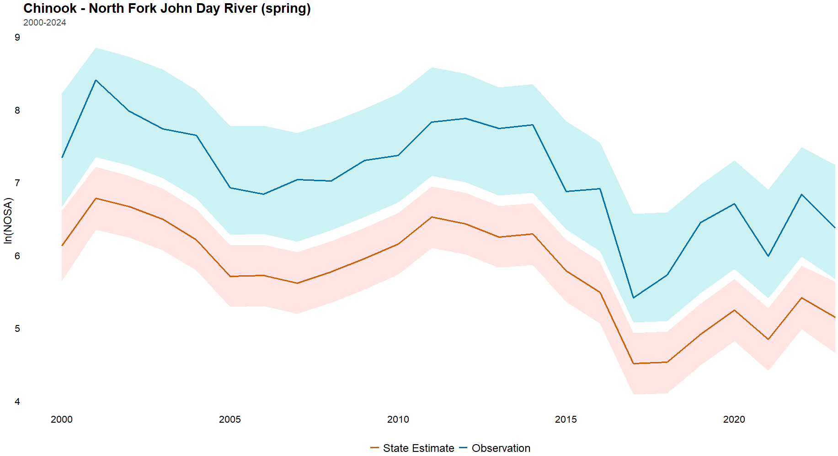
Case study 2: High precision, low accuracy
Surveyed with ‘Total redd counts * Fish per redd estimate’

Slide 83
Case study 2: High precision, low accuracy
Surveyed with ‘Total redd counts * Fish per redd estimate’
Can lead to unfavorable management outcomes

Slide 84
Case study 2: High precision, low accuracy
Surveyed with ‘Total redd counts * Fish per redd estimate’
Can lead to unfavorable management outcomes
Captures abundance shifts, despite over/under counting

Slide 85
Case study 2: High precision, low accuracy
Surveyed with ‘Total redd counts * Fish per redd estimate’
Can lead to unfavorable management outcomes
Captures abundance shifts, despite over/under counting
Easily adjustable if bias is known

Slide 86
Case study 3: Low precision, high accuracy

Slide 87
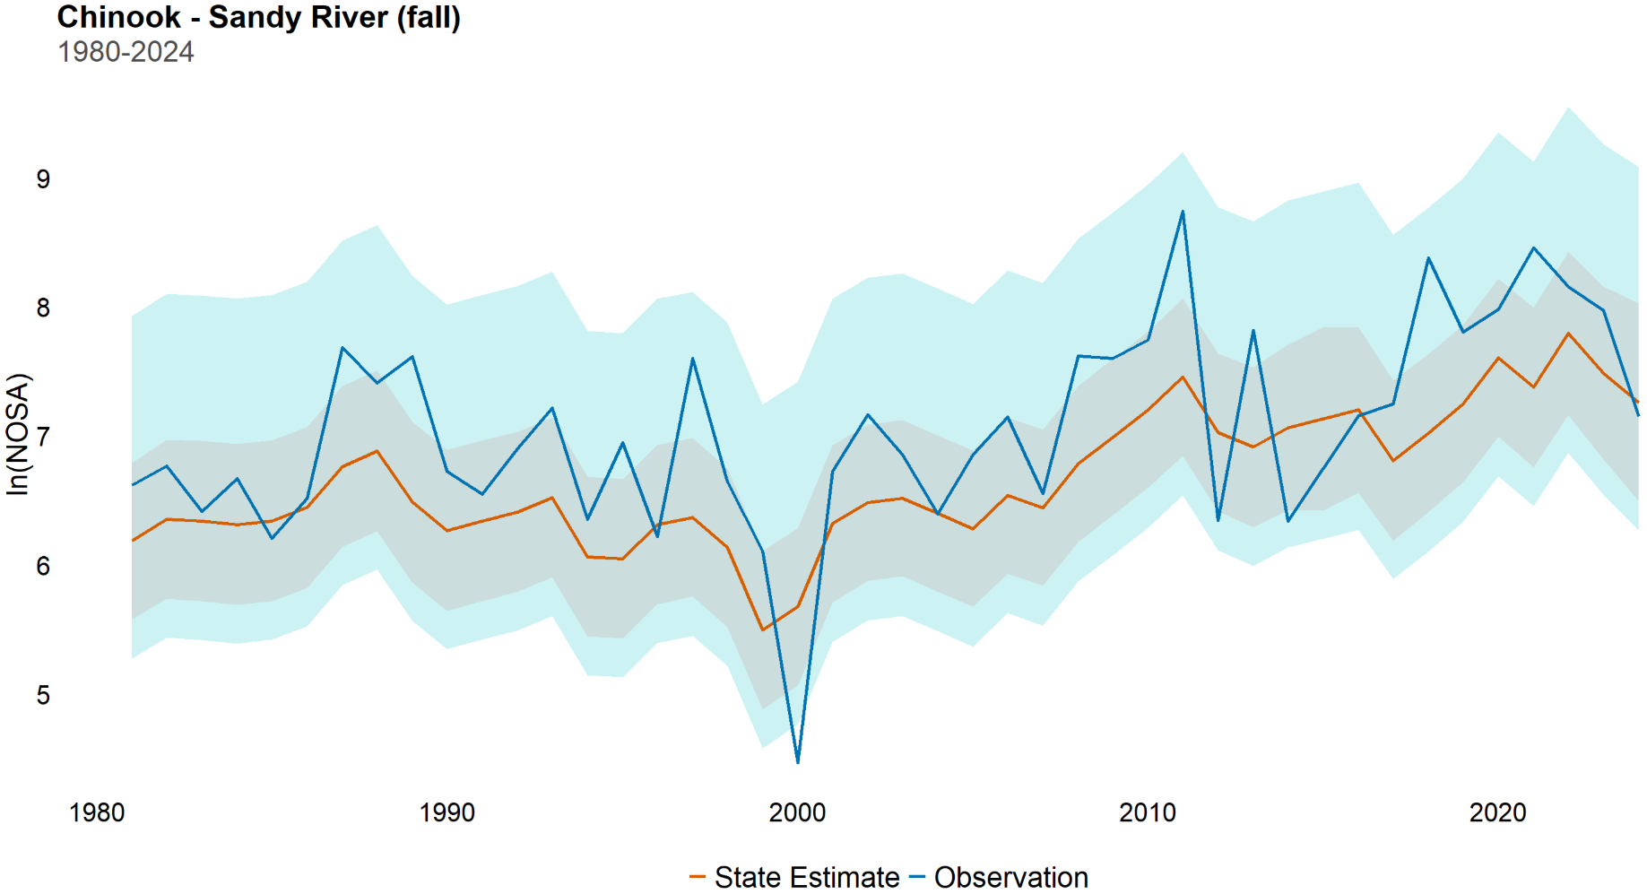
Case study 3: Low precision, high accuracy

Slide 88
Case study 3: Low precision, high accuracy
Surveyed with ‘Peak redd count expansion * Fish per redd estimate’

Slide 89
Case study 3: Low precision, high accuracy
Surveyed with ‘Peak redd count expansion * Fish per redd estimate’
Captures general trends over time

Slide 90
Case study 3: Low precision, high accuracy
Surveyed with ‘Peak redd count expansion * Fish per redd estimate’
Captures general trends over time
Obscures short term shifts - impacts of interventions

Slide 91
Case study 3: Low precision, high accuracy
Surveyed with ‘Peak redd count expansion * Fish per redd estimate’
Captures general trends over time
Obscures short term shifts - impacts of interventions
Difficult to adjust for low precision

Slide 92
Case study 4: Low precision, low accuracy

Slide 93
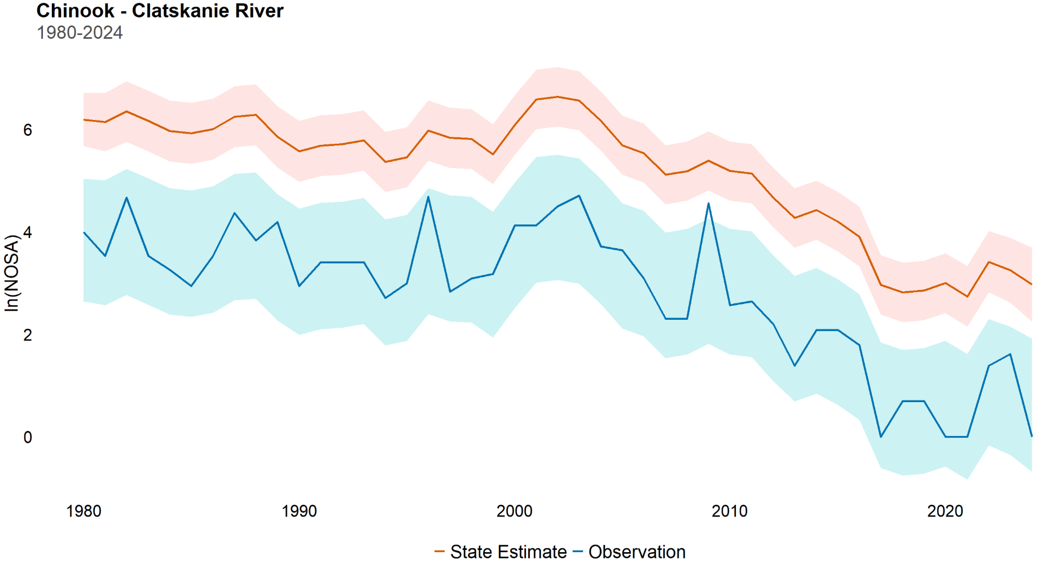
Case study 4: Low precision, low accuracy

Slide 94
Case study 4: Low precision, low accuracy
Surveyed with ‘Peak spawner count expansion’

Slide 95
Case study 4: Low precision, low accuracy
Surveyed with ‘Peak spawner count expansion’
Worst case scenario

Slide 96
Case study 4: Low precision, low accuracy
Surveyed with ‘Peak spawner count expansion’
Worst case scenario
Both true abundance and short-term trends are obscured

Slide 97
Case study 4: Low precision, low accuracy
Surveyed with ‘Peak spawner count expansion’
Worst case scenario
Both true abundance and short-term trends are obscured
Long-term trends are somewhat discernable

Slide 98
Discussion

Slide 99
Discussion
Wide variety of survey methods available to biologists

Slide 100
Discussion
Wide variety of survey methods available to biologists
Understanding accuracy and precision is crucial

Slide 101
Discussion
Wide variety of survey methods available to biologists
Understanding accuracy and precision is crucial
Interpreting impacts of conservation actions depends on fidelity of estimates

Slide 102
Discussion
Majority of survey methods analyzed are neither heavily inaccurate nor imprecise

Slide 103
Discussion
Majority of survey methods analyzed are neither heavily inaccurate nor imprecise
Low precision obscures abundances shifts in the near term

Slide 104
Discussion
Majority of survey methods analyzed are neither heavily inaccurate nor imprecise
Low precision obscures abundances shifts in the near term
Low accuracy creates false impression of abundance

Slide 105
Discussion
Patterns of survey method behavior occur at level of species

Slide 106
Discussion
Patterns of survey method behavior occur at level of species
The same survey method can exhibit differing levels of precision and accuracy across species

Slide 107
Discussion
Not all methods are universally applicable

Slide 108
Discussion
Not all methods are universally applicable
Often employment of method is driven by factors beyond the scope of this work

Slide 109
Discussion
Not all methods are universally applicable
Often employment of method is driven by factors beyond the scope of this work
The best method is the one that can be implemented

Slide 110
Investigating precision and accuracy of commonly used salmonid abundance survey methods
Brian McGreal bmcgreal@uw.edu

Slide 111
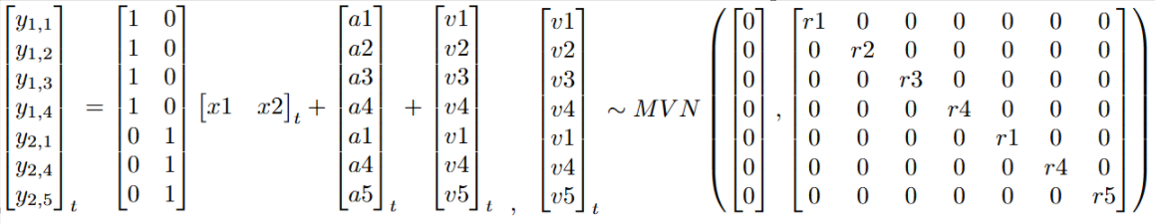
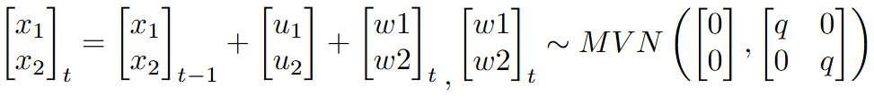
Modeling approach
Specifying matrices properly is crucial

Slide 112
Modeling approach
MARSS models
Observation equation
y_{t} = Zx_{t} + a + v_{t}, where v_{t}∼MVN(0,R)

Slide 113
Modeling approach
MARSS models
Underlying state/process equation
x_{t} = Bx_{t−1} + u + w_{t}, where w_{t}∼MVN(0,Q)
y_{t} = Zx_{t} + a + v_{t}, where v_{t}∼MVN(0,R)

Slide 114
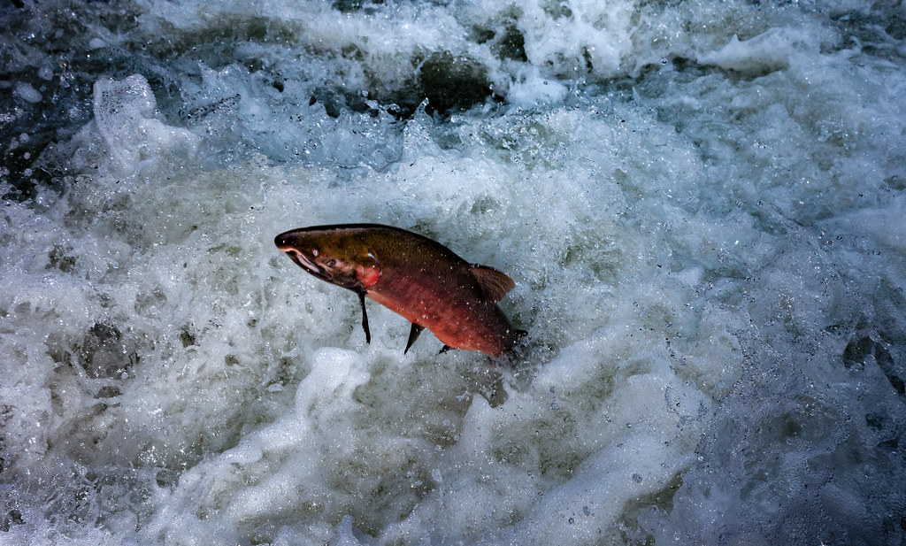
Coho
Photo credit: Bureau of Land Mgmt.

Slide 115
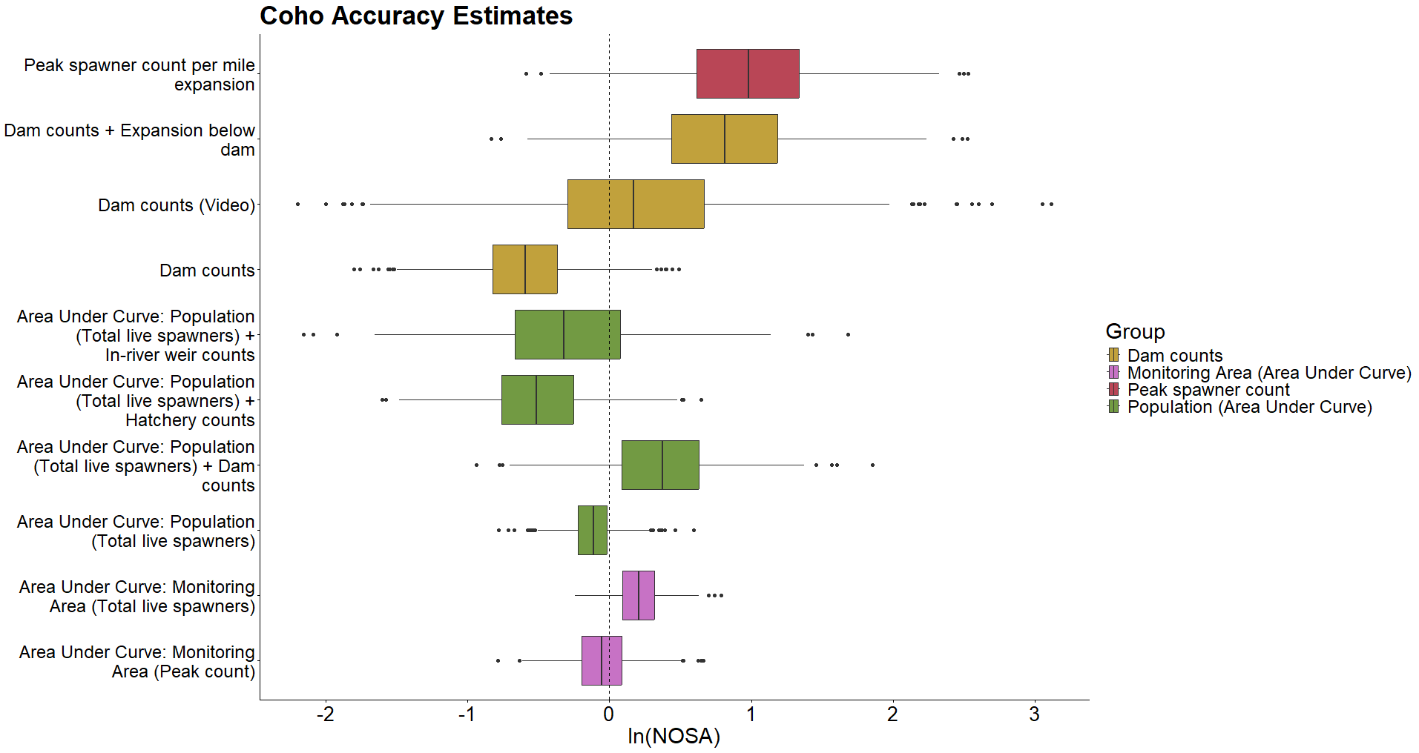

Slide 116
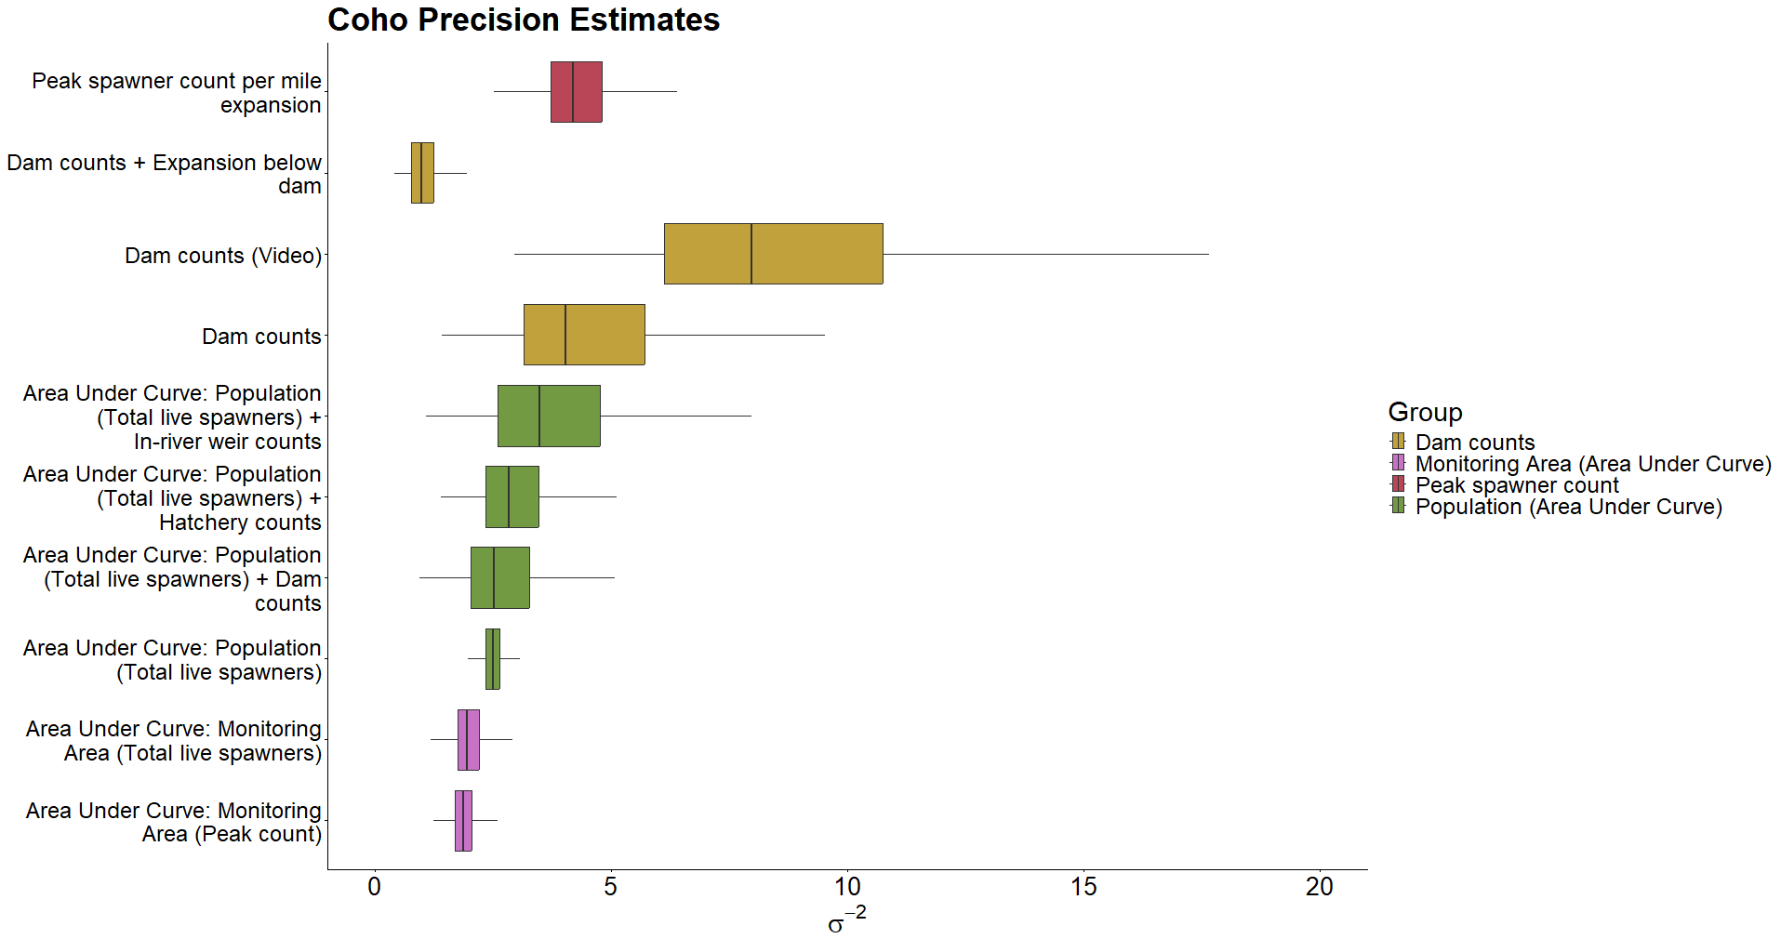

Slide 117
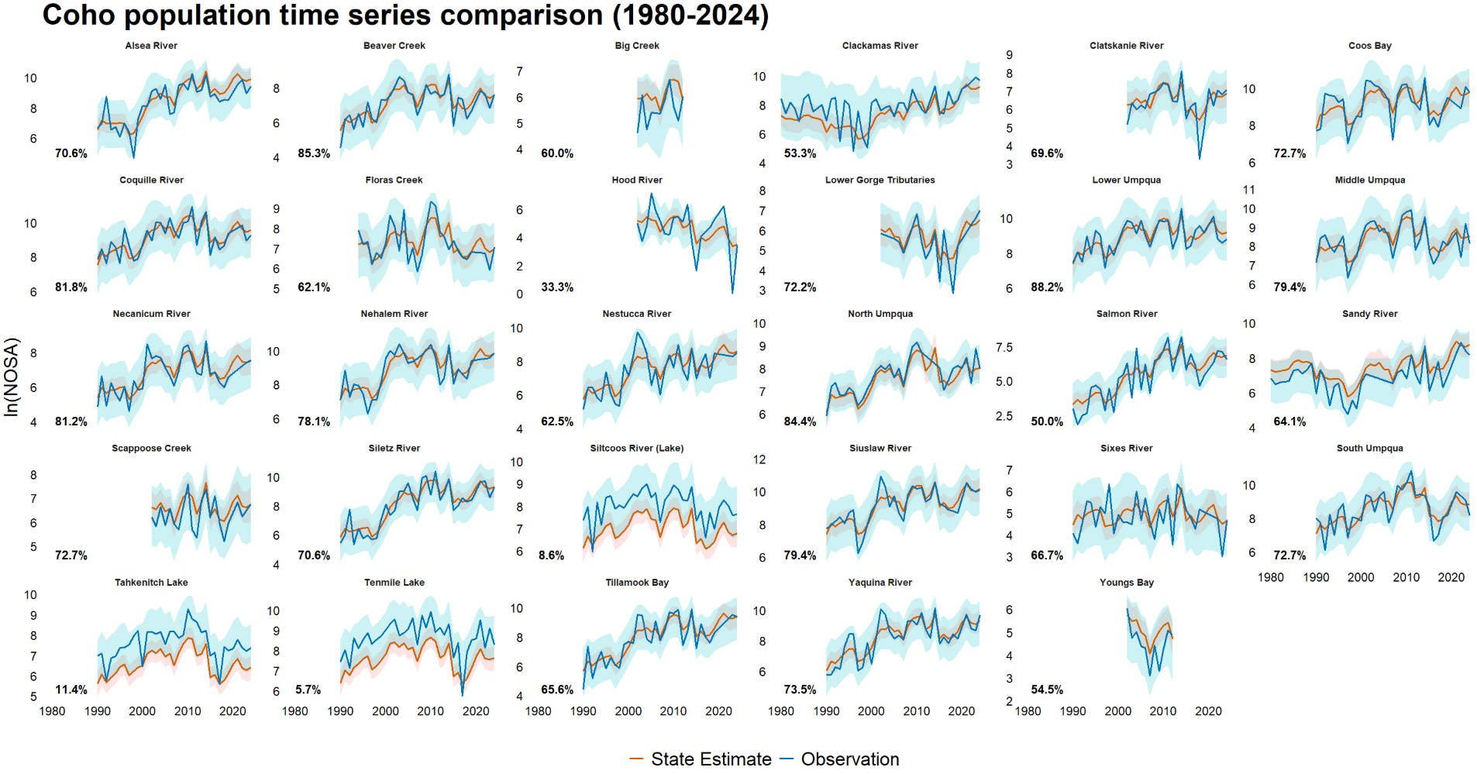

Slide 118
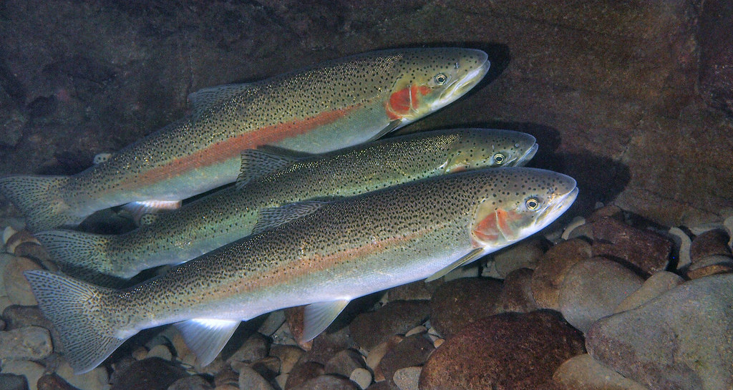
Steelhead
Photo credit: Oregon State University

Slide 119
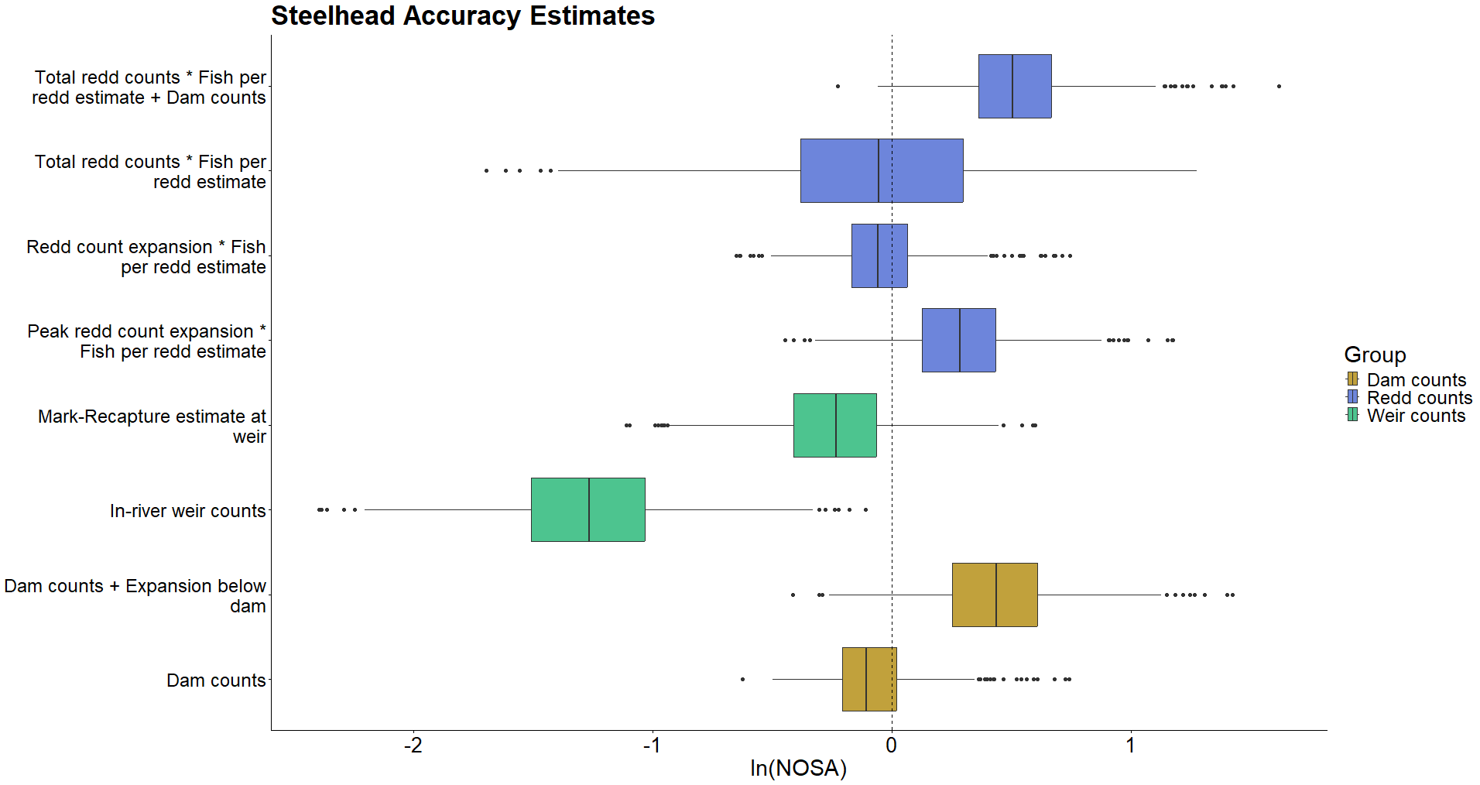

Slide 120
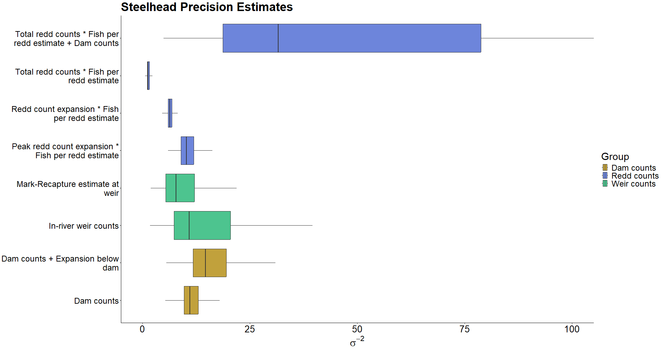

Slide 121
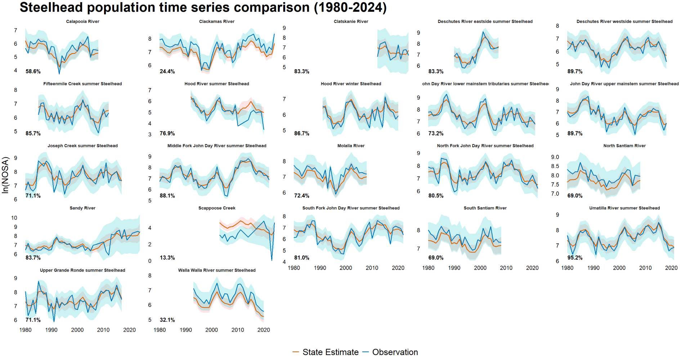

Slide 122
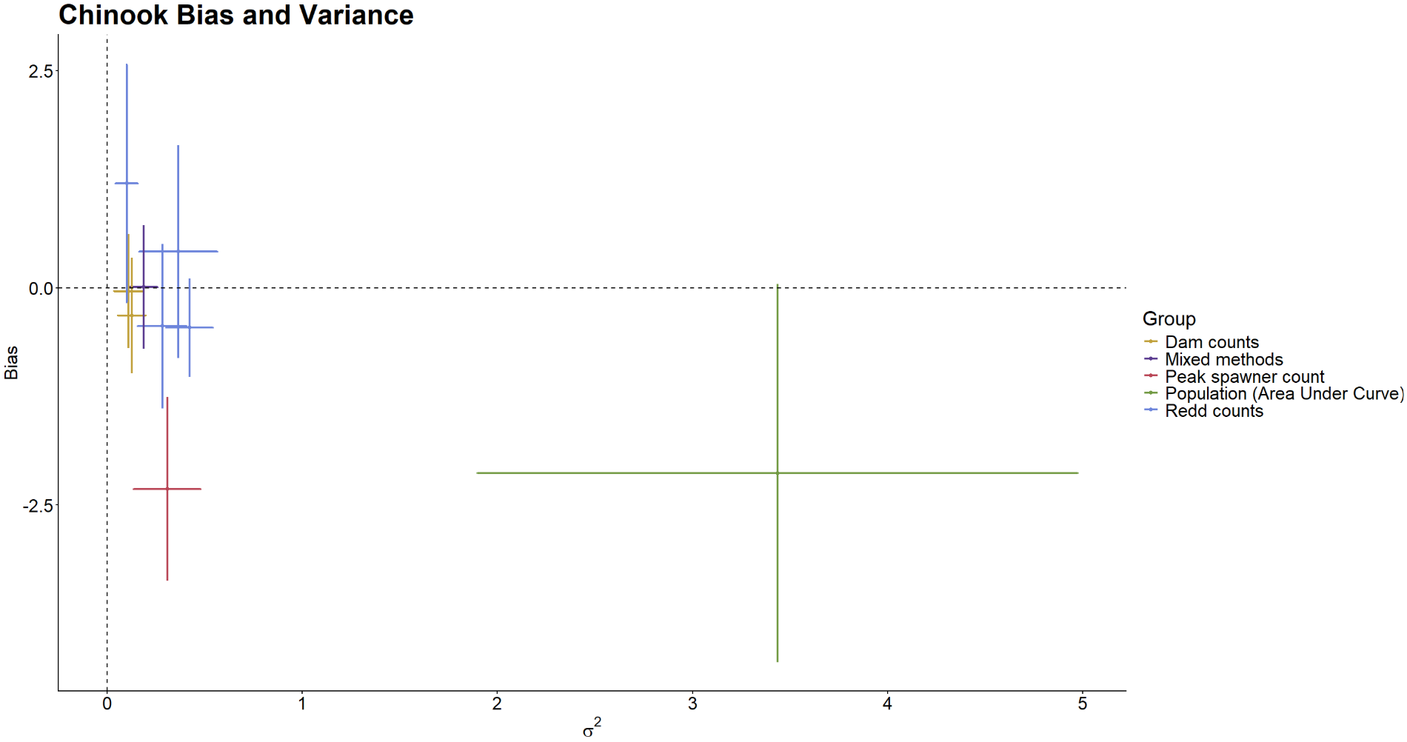

Slide 123
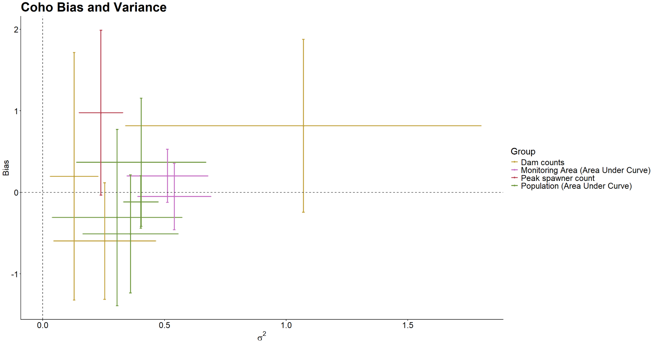

Slide 124
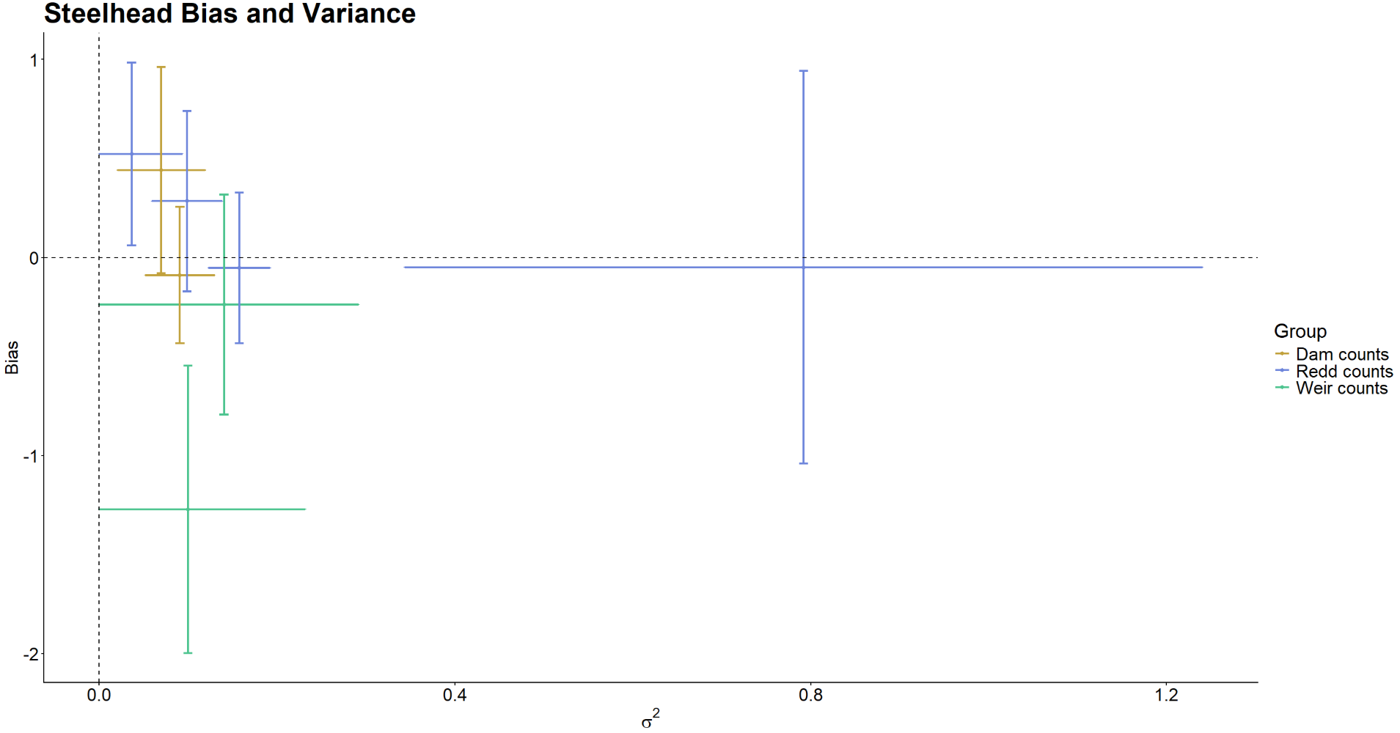

Slide 125
Chinook
Photo credit: Olympic Nat’l Park

