Slide 1


EMOTION DETECTION

Slide 2

CURRENT STATUS
Initial exploration of dataset (Done)
Data preprocessing (Done)
Text processing
Feature extraction
Baseline model selection (Done)
Initial phase of result analysis (Done)
Future works (In progress)
Model improvement
Other models
7446 rows

Slide 3
Dataset Description (ISEAR Dataset)
INDEX | EMOTION | DOCUMENT
1 | joy | 'On days when I feel close to my partner and other friends. \nWhen I feel at peace with myself and also experience a close \ncontact with people whom I regard greatly’
2 | fear | 'Every time I imagine that someone I love or I could contact a \nserious illness, even death.'
3 | anger | 'When I had been obviously unjustly treated and had no possibility \nof elucidating this.'
4 | sadness | 'When I think about the short time that we live and relate it to \nthe periods of my life when I think that I did not use this \nshort time.'
5 | disgust | 'At a gathering I found myself involuntarily sitting next to two \npeople who expressed opinions that I considered very low and \ndiscriminating.'
6 | shame | 'When I realized that I was directing the feelings of discontent \nwith myself at my partner and this way was trying to put the blame \non him instead of sorting out my own feeliings.'
7 | guilt | 'I feel guilty when when I realize that I consider material things \nmore important than caring for my relatives. I feel very \nself-centered.'

Slide 4
Dataset Description
7446 rows
Emotion labels
Documents
7 emotions labels
Joy, Sadness, Anger, Fear, Disgust, Shame, Guilt
7446 rows

Slide 5
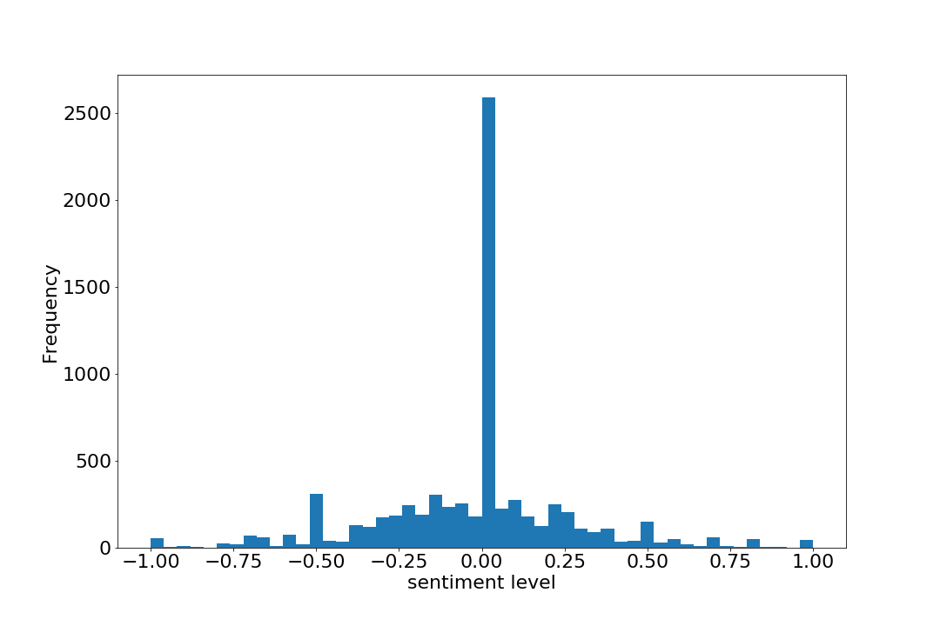
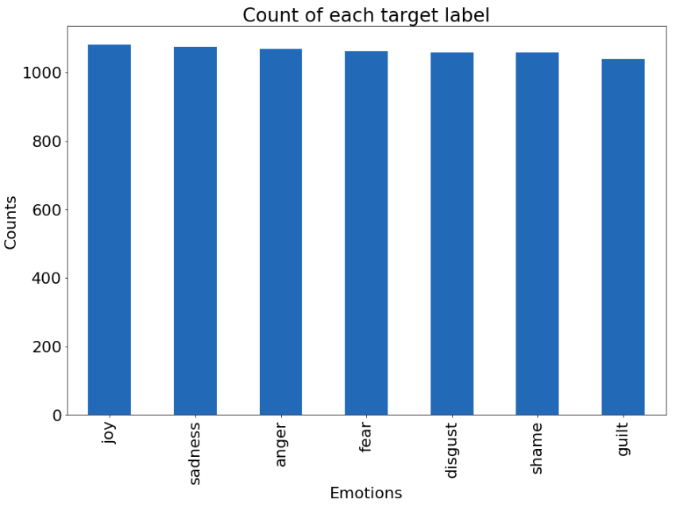
Dataset visualization
Bar plot of Emotions label vs count in samples
Histogram (sentiment vs frequency)

Slide 6
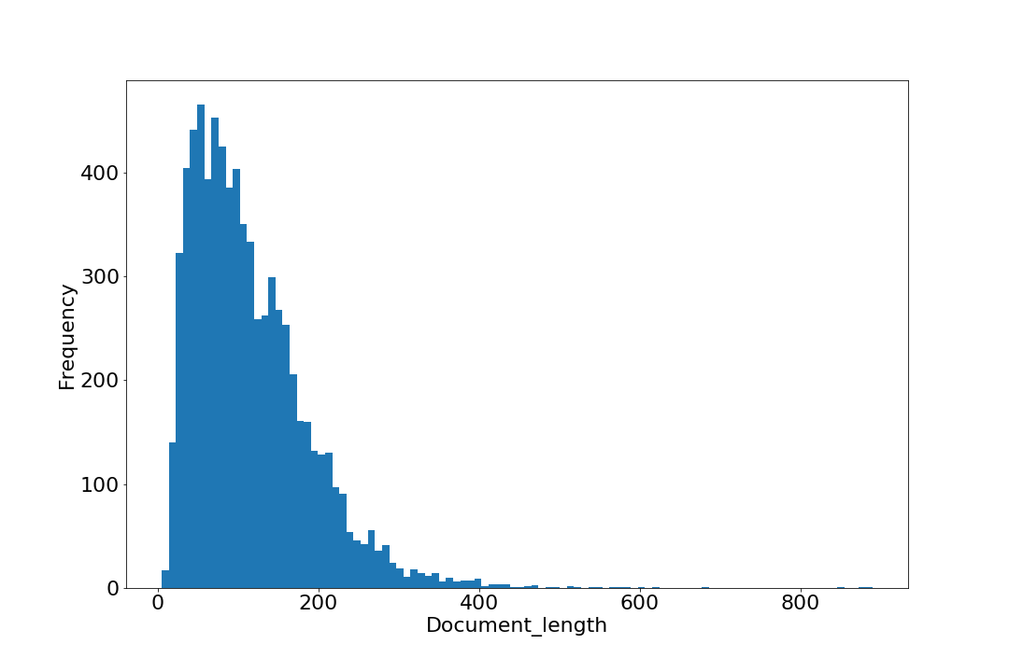
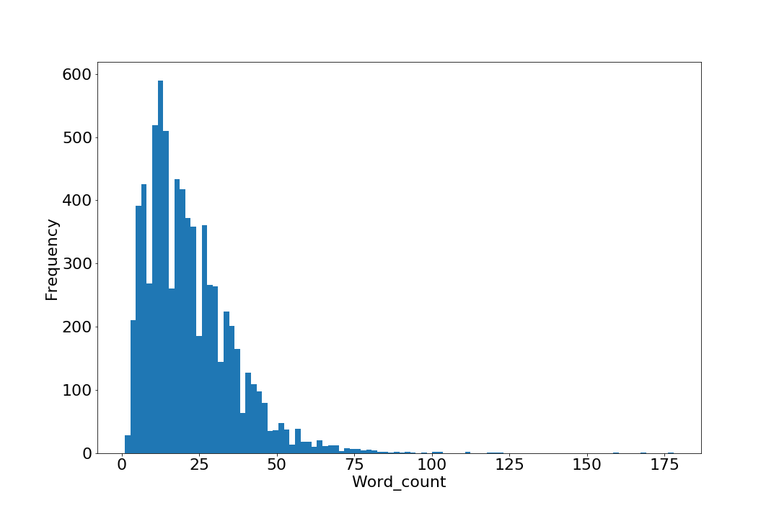
Dataset visualization
Histogram(Document_length vs frequency)
Histogram (word_count vs frequency)

Slide 7
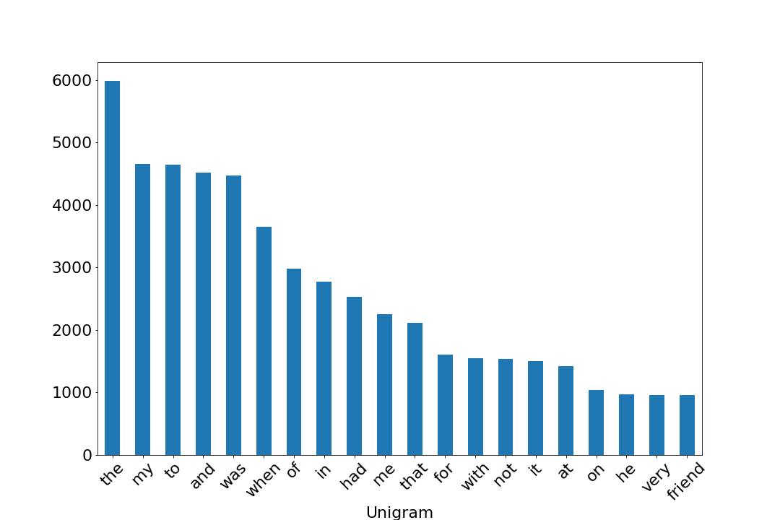
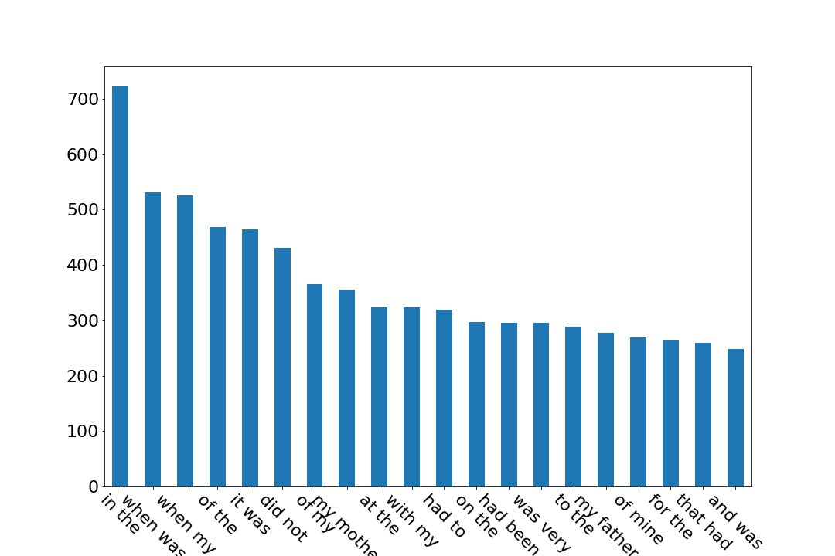
Dataset visualization
Word count for unigram before preprocessing
Word count for Bigram before preprocessing

Slide 8
Data preprocessing
Text Preprocessing
Original Sentence
'Every time I imagine that someone I love or I could contact a \nserious illness, even death.'
Conversion to lower case+ removal of non-alphanumeric character.
'every time i imagine that someone i love or i could contact a serious illness, even death'
Tokenization
'every’ ‘time’ ‘i’ ‘imagine’ ‘that’ ‘someone’ ‘i’ ‘love’ ‘or’ ‘i’ ‘could’ ‘contact’ ‘a’ ‘serious’ ‘illness’, ‘even’ ‘death'
Stop words removal
'every', 'time','imagine', 'someone','love', 'could', 'contact', 'serious','illness', 'even','death'
Lemmatization
'treats, treating, treated' → 'treat'

Slide 9
Data preprocessing
Feature Extraction
Bi-Gram Representation: (~60000 features)
“This is the first document” - ‘This is” ,“is the” ,“the first” ,“first document”
CountVectorizer
Convert a collection of text documents to a matrix of token counts
D1 : 'This is the first document.',
D2 :'This document is the second document.'
 | This | is | the | first | document | second
D1 | 1 | 1 | 1 | 1 | 1 | 0
D2 | 1 | 1 | 1 | 0 | 2 | 1

Slide 10
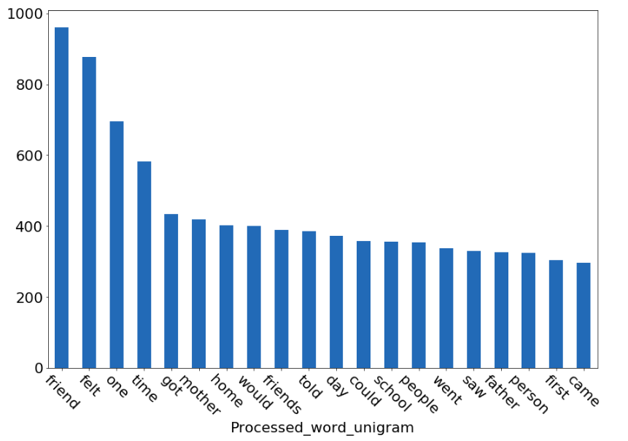
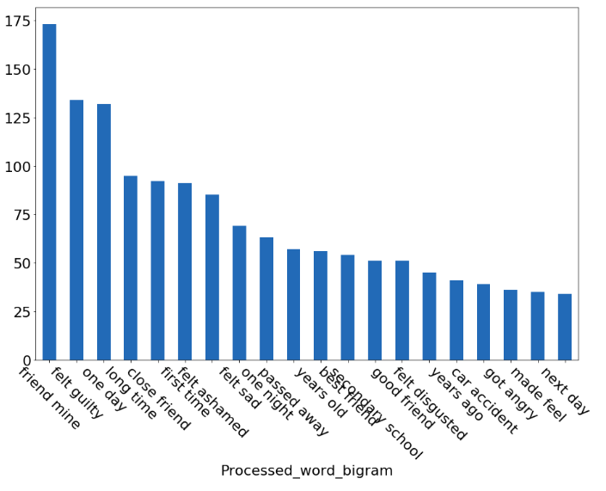
Dataset visualization
Word count for unigram
Word count for Bigram

Slide 11
BASELINE MODEL
Model Selection Machine Learning (SOTA)
Naive bayes classifier(alpha=1.0)
SVC (C=1.0, kernel=linear)
Softmax Regression(L1 and L2 regularization)
Train-Test split = 80-20

Slide 12
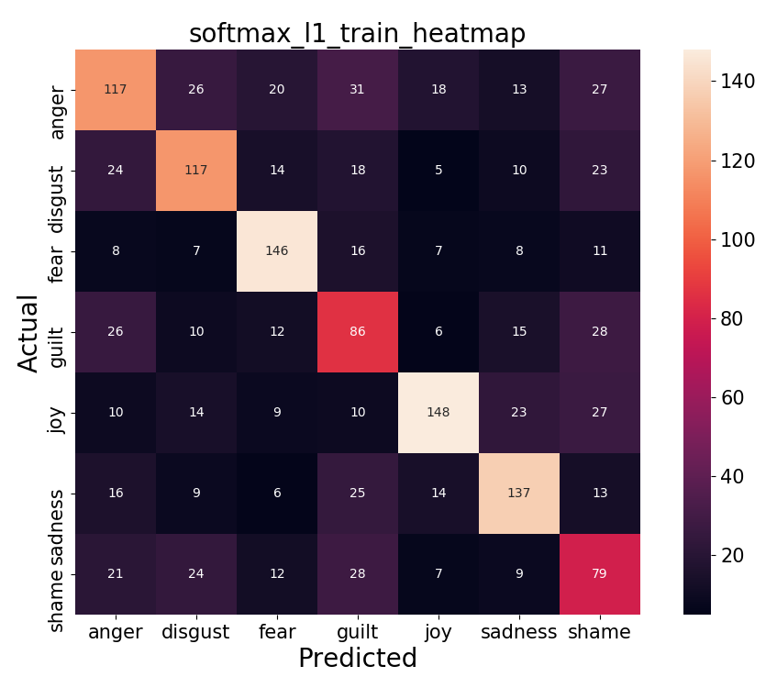
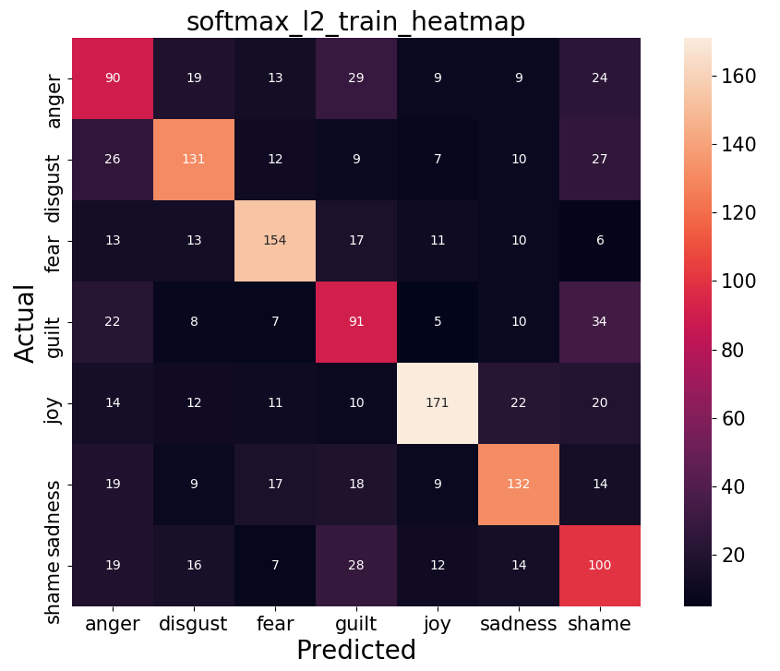
RESULTS AND COMPARISON

Slide 13
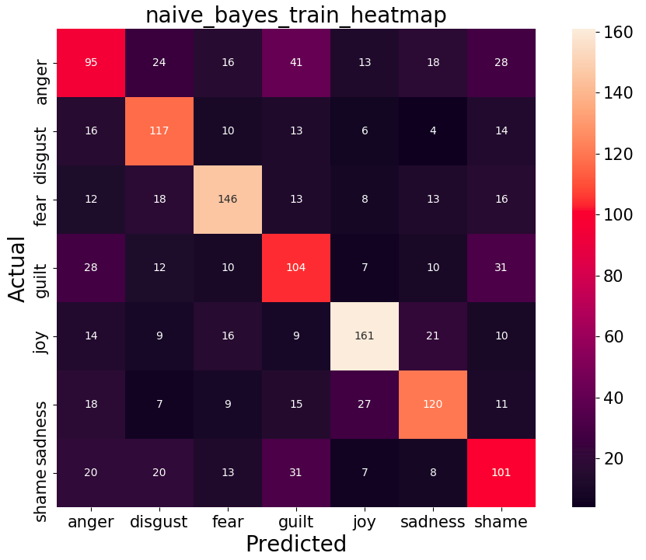
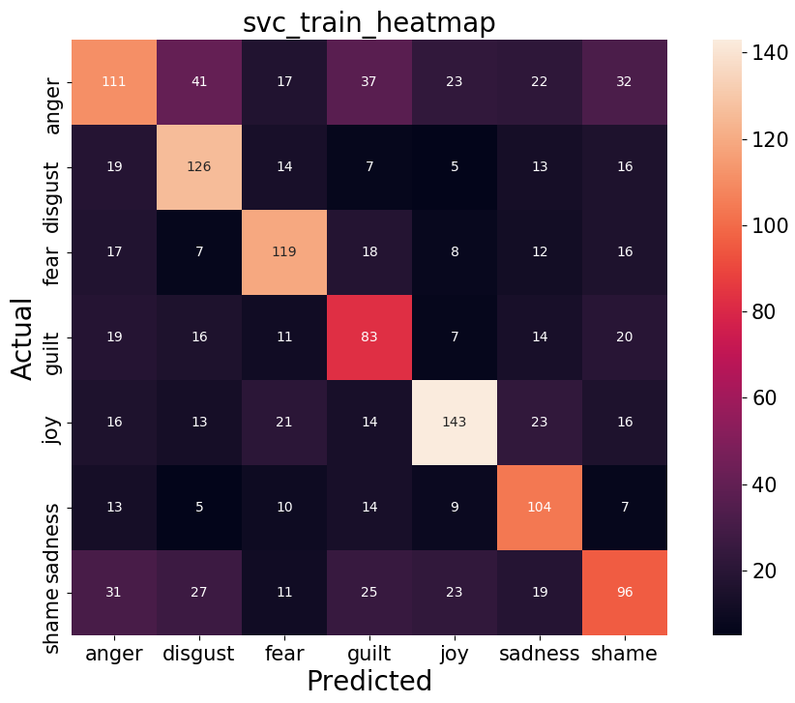
RESULTS AND COMPARISON

Slide 14
RESULTS AND COMPARISON
 | precision | recall | f1-score | support
anger | 0.942 | 0.962 | 0.952 | 866.000
disgust | 0.978 | 0.941 | 0.959 | 852.000
fear | 0.958 | 0.956 | 0.957 | 843.000
guilt | 0.974 | 0.948 | 0.961 | 814.000
joy | 0.953 | 0.966 | 0.959 | 853.000
sadness | 0.941 | 0.952 | 0.946 | 880.000
shame | 0.937 | 0.953 | 0.945 | 848.000
accuracy |  |  | 0.954
macro avg | 0.955 | 0.954 | 0.954 | 5956.000
weighted avg | 0.954 | 0.954 | 0.954 | 5956.000
Table 2: Naive Bayes Classification Report For Train Set

Slide 15
RESULTS AND COMPARISON
 | precision | recall | f1-score | support
anger | 0.404 | 0.467 | 0.433 | 203.0
disgust | 0.65 | 0.565 | 0.604 | 207.0
fear | 0.646 | 0.66 | 0.654 | 220.0
guilt | 0.514 | 0.460 | 0.485 | 226.0
joy | 0.670 | 0.703 | 0.686 | 229.0
sadness | 0.579 | 0.618 | 0.598 | 194.0
shame | 0.505 | 0.478 | 0.491 | 211.0
accuracy |  |  | 0.566
macro avg | 0.567 | 0.565 | 0.565 | 1490.0
weighted avg | 0.568 | 0.566 | 0.566 | 1490.0
Table 2: Naive Bayes Classification Report For Test Set

Slide 16
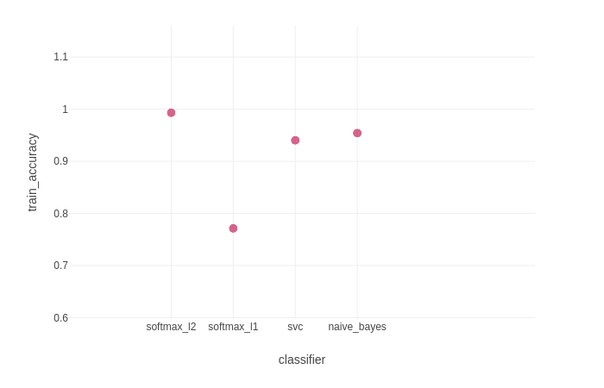
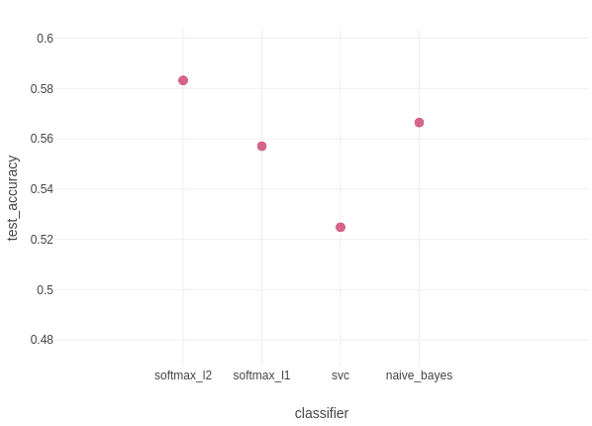
RESULTS AND COMPARISON

Slide 17
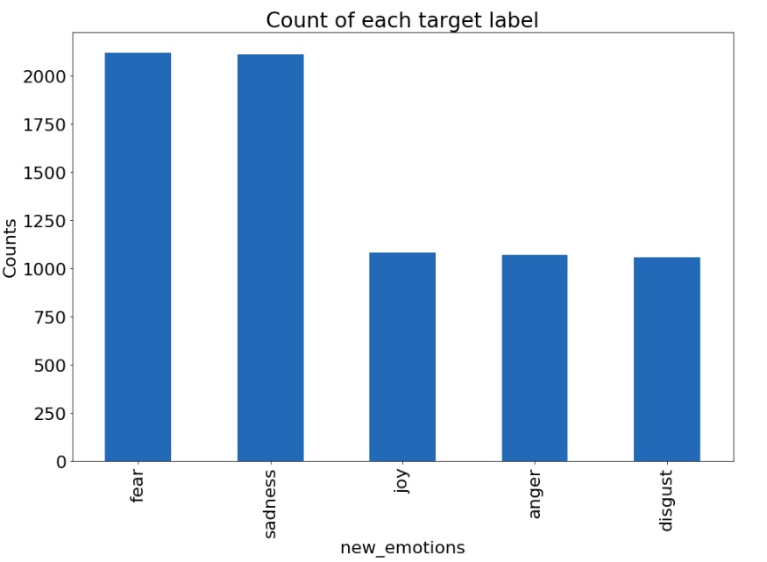
TRY OUT
Softmax Classifier with L1 penalty
Weighted_train_accuracy = 82.6%
Weighted_test_accuracy = 60.7%
Weighted_avg_test_precision=60.9%
Weighted_avg_test_recall=61.1%

Slide 18
FUTURE WORKS
Model Improvement
Hyperparameter tuning
Naive Bayes:
usekernel: allow kernel density estimate vs gaussian density estimate
adjust: allow bandwidth of kernel density
fL: allow laplace smoother
SVC:
kernel: linear, rbf, poly
gamma: vary values (increase introduce non-linearity)
C: penalty for error terms
degree: degree of polynomial for hyperplane
Metric Addition in mlflow : Precision and Recall

Slide 19
FUTURE WORKS
Model Improvement
Text processing
Careful on punctuation removal
Word2vec implementation
Further text processing
Word normalization
Deep Learning
Artificial Neural nets
RNN/LSTM

Slide 20
Thank You!!

