Slide 1
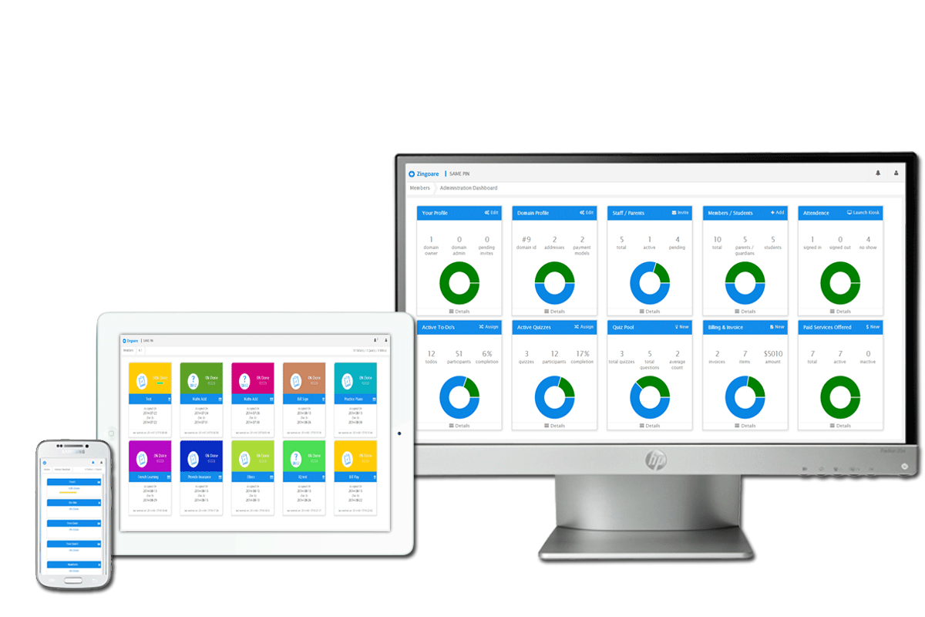

Cost Push - $0.99

Slide 2





What can $1 do?
Confidential and subject to change without notice.

Slide 3
Zingoare Pricing
One-time $29.^{99*}configuration fee
As low as 99¢per member/month
2 Months – Absolutely FREE
All the features discussed until Now and a lot more upcoming features Absolutely Free – No hidden fee – No fine Print gimmicks.
Confidential and subject to change without notice.

Slide 4
How is this modal a win-win?
$0.99
Pay for what you use
No hidden fees of fine prints
No maintenance costs
FREE first 2 months
One time set up fee
Upgrades to new features
Confidential and subject to change without notice.

Slide 5
Rough Estimates? – Org has 20-30 members
JAN - 30 Members
FEB - 35 Members
MAR - 30 Members
APR - 30 Members
$0
$0
$29.99 + $29.7
$29.7
MAY - 20 Members
JUN– 0 - Holidays
JUL– 0 Holidays
AUG - 20 Members
$19.8
$0
$0
$19.8
SEP - 25 Members
OCT - 30 Members
NOV - 20 Members
DEC - 0 - Holidays
$24.75
$29.7
$19.8
$0
Confidential and subject to change without notice.

Slide 6
How to charge* this $0.99?
1
You can even charge the member a dollar more, and with the new feature that should cause any issues
2
A part of cost savings on paper, man hours, resources etc.
3
And a lot more ways you can be creative. The best part is, you don’t need to worry when you product is so meaningful.
*These are just for illustrative purpose only.
Confidential and subject to change without notice.

Slide 7

Happy to help!!
Confidential and subject to change without notice.

