Slide 1
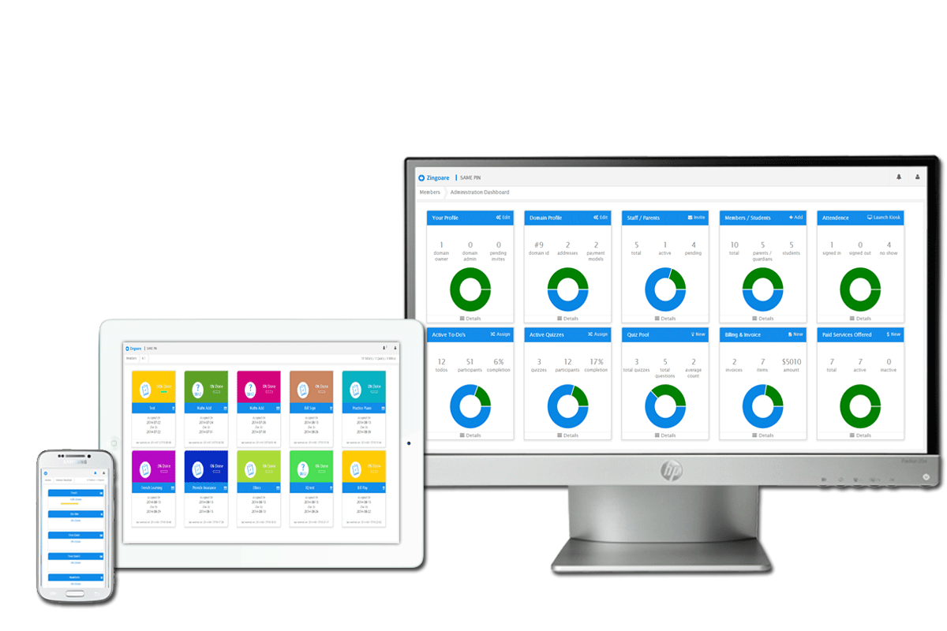

Rich Features

Slide 2

Admin services
Administration Dashboard
Manage Day-Day Operations
Manage Communications
Attendance Module
Manage Finances
Manage custom reports
Manage Access Levels
Confidential and subject to change without notice.

Slide 3
Finance services
Finance Module
Generate Monthly Invoices
Manage Late Fee’s
Manage Service plans and costs
Plan projections
Manage custom reports
Never miss a bill or charge
Confidential and subject to change without notice.

Slide 4
Enrichment services
Enrichment Services
Assign Tasks to members / parents / teachers
Create and assign Quizzes
One place for all the supporting resources
Individual Attention
Track progress
Set goals and generate competition
Confidential and subject to change without notice.

Slide 5
Collaboration services
Collaboration Modules
Unified Notifications for updates
Email communication when needed between members/ parents / teachers
Challenge Quizzes and tasks
Organize events
Accessible from any latest device browser – Mobile friendly
Info up to date from secure cloud sync
Confidential and subject to change without notice.

Slide 6
Other services
ZINGOARE
No Advertisements
Print invoices and reports from anywhere
Free upgrades to future release features
Payment Modules
Rich Quiz and knowledge pool
No infrastructure maintenance
Confidential and subject to change without notice.

Slide 7
Zingoare Pricing
One-time $29.^{99*}configuration fee
As low as 99¢per member/month
2 Months – Absolutely FREE
All the features discussed until Now and a lot more upcoming features Absolutely Free – No hidden fee – No fine Print gimmicks.
Confidential and subject to change without notice.

Slide 8

Happy to help!!
Confidential and subject to change without notice.

