Slide 1
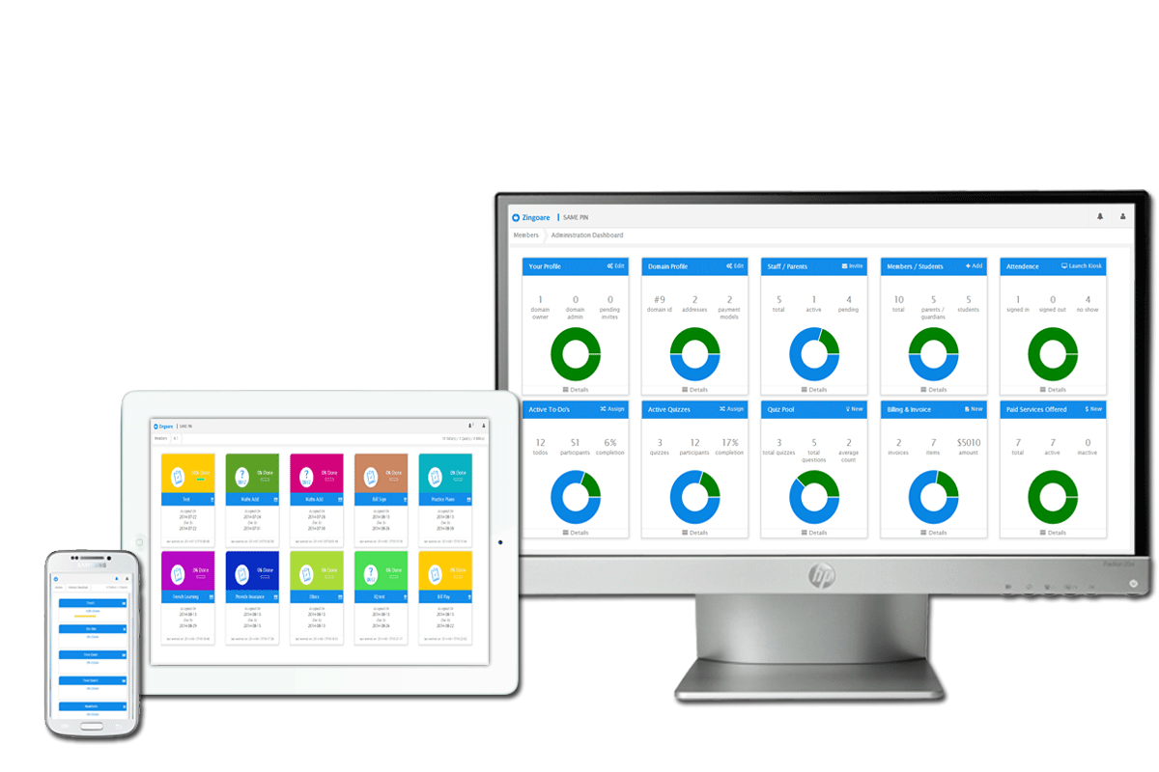

Technology Stack

Slide 2
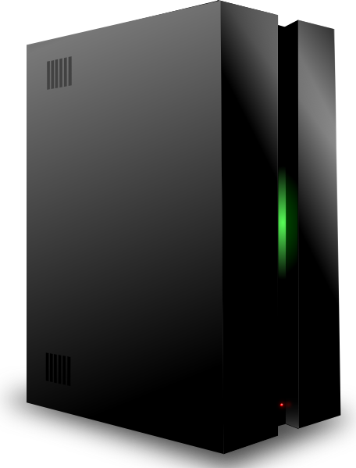

Infrastructure Details
Primary Server
13.6 GHz CPU
2GB RAM
SSD HDD
2TB Network
HA Server
2048L CPU
2GB RAM
SSD HDD
3000 GB Network
Back Up Server
4 Core CPU
16GB RAM
SDDHDD
HighSpeed Network
Confidential and subject to change without notice.

Slide 3







Front End/ UI Details
Confidential and subject to change without notice.

Slide 4








Backend/Core Details
Confidential and subject to change without notice.

Slide 5


Supported Browsers
Confidential and subject to change without notice.

Slide 6

Happy to help!!
Confidential and subject to change without notice.

