Slide 1
sorting
stable sorting

Slide 2
stable sorting
sorting
A sorting algorithm is stable if for any two entries x and y
of S such that
x.getKey() == y.getKey() and
x precedes y in S before sorting
x precedes y after S is sorted

Slide 3
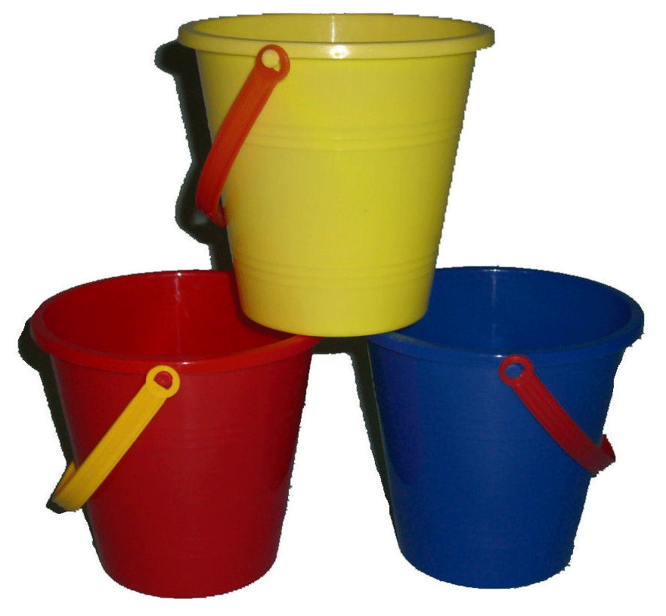
sorting
bucket sort
aka
pigeonhole sort

Slide 4
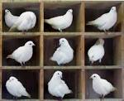
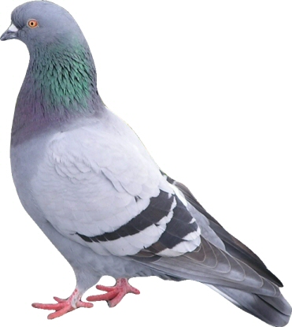
sorting
bucket sort
aka
pigeonhole sort
PIGEONHOLE SORT

Slide 5
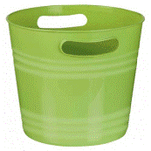
bucket sort (aka pigeonhole sort)
sorting
Use the sey of an object as an index into a bucket array
Assume we have n object to sort
Assume keys are in range [0,N-1]
insert object e into bucket[e.getKey()]
Complexity is O(n+N)

Slide 6
bucket sort (aka pigeonhole sort)
sorting
Use the sey of an object as an index into a bucket array
Assume we have n object to sort
Assume keys are in range [0,N-1]
insert object e into bucket[e.getKey()]
Complexity is O(n+N)
How might we do this in java?
What data structures would we use?
Is it stable?
What kind of data sets would be suitable?

Slide 7


