Slide 1
Welcome to THR 350 Play as Film
Online Course

Slide 2
This class is an examination of the terms “theatrical” and “cinematic”
Throughout this course you will be reading several plays and watching the movie adaptations of them.
It is hoped you will gain a deeper understanding of those terms

Slide 3
Course Description:
Comparisons of plays and musicals that are also films, with emphasis on structural changes from the play to film.
Course Objectives:
To gain a better understanding and appreciation of the transformation of plays to film.
To make students critically aware of the process of screen adaptation.
To gain insight into dramatic structure.
To gain a comparative eye of playwriting vs. screenwriting.
To decipher what makes a better cinematic choice vs. a compelling theatrical choice.
To gain a better understanding of theatrical filmmaking.
To become better critics when watching a film.

Slide 4
Cinematic vs. Theatrical

Slide 5
Common Synonyms for Cinematic:
accurate, detailed, faithful, filmic, graphic, lifelike, minute, natural, pictorial, picturesque, precise, realistic, visual, vivid
These terms describe positive attributes of cinema, but do not address any negative attributes.
There are many campy, over-the-top, dumbed-down, “Hollywood” films. This is because filmmakers have to make their films appeal to the broadest audience base possible to compete financially.
Think back to a recent film you have seen. What are some words you would use to describe the experience?

Slide 6
Common Synonyms for Theatrical:
affected, amateur, artificial, campy, ceremonious, comic, dramaturgic, exaggerated, ham, hammy, histrionic, legitimate, mannered, melodramatic, meretricious, operatic, ostentatious, pompous, schmaltzy, show, showy, staged, stilted, superficial, theatric, thespian, tragic, unnatural, unreal, vaudeville
Many of these terns have negative connotations. This is largely due the recent increase of popularity of cinema over theatre, which has led to a misunderstanding of humanity’s oldest performing art form: theatrical performance.
There are many plays and musicals that are moving, exciting, vivid, stimulating, and bold. Theatrical artists have more freedom in how they present their work as budget and audiences sizes are typically much smaller.
Think back to a play you might have seen. What are some of the words you would use to describe the experience?

Slide 7
Differences in Theatrical and Cinematic Storytelling:
Spontaneity - Theater is live whereas cinema is pre-recorded. Each performance of a theatrical work will differ from previous performances. In cinema, the presentation is fixed, captured in time. Time Structure - Theater is experienced in real time without the aid of editing. Not only is film edited, but the proper editing of the final piece is essential to the telling of the story.
Focus - In both film and theater, the goal of the storyteller is to grab the focus of the audience. In film, this is done irrevocably; the audience cannot view any part of the scene that the filmmaker does not include. In theatre, the storyteller must earn this attention since the audience has more control over where he or she looks. In short, with theater, the performance is experienced from the point of view of the audience whereas in film, it is from the point of view of the filmmaker. Interactivity - In theater, as opposed to film, the audience takes an active rather than passive role in the entertainment. The performance of a story within a theater is not just live, but it is also interactive. The audience is present to witness the performance, and audience reaction drives the actors.

Slide 8
Cinematic vs. Theatrical
Read the excellent article on theatrical elements from
David Ball’s book
Backwards and Forwards in the Lesson Module.

Slide 9
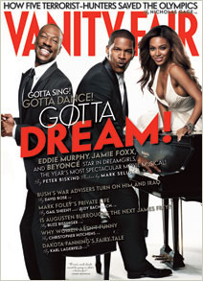
Bill Condon Interview
In the January 2007 issue of Vanity Fair, Peter Biskind interviewed Dreamgirls director and screenwriter Bill Condon who also wrote the screenplay for the movie Chicago which we will examine in an upcoming presentation.
“Movie directors, whenever they adapt a piece of theatre for screen, whether it is a musical or a drama, automatically “open” it up. Condon….learned to go the other way. ‘When you have something like Dreamgirls, it often becomes more cinematic if you stay closer to its theatrical roots. If you stay within the constraints of theatre and figure out how to shoot that stuff in a way that’s completely exciting– because the relationships between the lights and the set and the actors and the audience are more powerful in movies, it will work.” - Bill Condon

Slide 10
Read the following quotes about plays and films to help arrive at your definitions of cinematic and theatrical.
In turning a stage musical into a movie, there are critical choices involving casting (Broadway vs. Hollywood), style (theatrical vs. cinematic), rewriting the script, and cutting/adding numbers. For Guys and Dolls, movie actors were cast in three of the four lead roles, with Vivian Blaine repeating her classic performance as Adelaide, and the supporting cast was taken mostly from the stage production.
- Ultimate AV MAG
It is very hard to successfully translate a play into film. A play loses its heart most of the time. The actors tend to overact or the dialogue seems heavy and weighted on film. It is a very different medium switch to be sure. Othello is one of the first, besides O'Neill's Long Days Journey Into Night (1962), to capture the very personal pure emotions one experiences in a play's production on film. Othello is a dark solemn story and so, too, is Welles' cinematography, actors, set and wardrobe.
- Emily Blunt, BLUNT REVIEW

Slide 11
Read the following quotes about plays and films to help arrive at your definitions of cinematic and theatrical.
Adapting musical theatre to the screen is really, really difficult. In doing so, you risk alienating old fans, and fan bases, and as much as the cinematic medium opens up new possibilities for a project, there is going to be an equal number of things that it doesn't do very well. I suppose that's why we have theatres for theatre and cinemas for cinema.
- Hour CA. Film review Rent
Cinema has a rich tradition of attempts to translate theatrical texts into film. If at one level such attempts can be appreciated simply as productions of the plays in question, at another level such adaptations bring to the fore the specificity of theatre and film as distinct forms of representation working within differing conventions. The course thus covers a number of films adapted from plays not merely with the intention of gauging the fidelity of the adaptation to the original but more importantly in order to explore the complex dynamics of exchange between these two different forms of representation.
- UAN Play into Film

Slide 12
Look at the following movie titles. They are considered both cinematic and theatrical.
Of those you have seen can you define the cinematic or theatrical elements within?
Sin City
Chicago
Moulin Rouge
Titanic
League of Extraordinary Gentleman
Strictly Ballroom
Six Degrees of Separation
LA Confidential
The Wizard of Oz
King Kong

Slide 13
Cinematic or Theatrical Terminology
Throughout this course several terms from both the theatrical and cinematic worlds will be offered.
For theatre related terms an excellent glossary is:
Glossary of Dramatic Terms
For cinema related terms an excellent resource is:
Movie Terminology Glossary
Notes:
http://www.wwnorton.com/college/english/nadrama/content/review/glossary/welcome.aspx
http://www.imdb.com/glossary/

Slide 14
The class usually runs with this sort of structure.
You will need to read the play first. Most scripts may be ordered through a company like amazon.com or The Drama Book Shop
Once you have read the script an analysis review will be uploaded by you before you may view the presentation. The presentation describes some of the differences between the play and film.
You will need to also have the movie version of the play to watch along with the presentation. Some films may be harder to find than others, so a membership to an online movie delivery service like Netflix, Blockbuster On Demand, or purchasing the film on discount sites if your local rental house does not have the films necessary for the class.
The final step will be a required written posting outlined in the Lesson module.
Notes:
http://www.amazon.com/
http://www.dramabookshop.com/
https://www.netflix.com/us/

Slide 15
The class usually runs with this sort of structure.
In a few cases you may be asked to watch the movie before reading the play. Instructions for each new assignment appear at the end of the preceding presentation.
There are two self-designed projects in the class.
In the first, you must choose from an approved list of modern Shakespearean adaptations (e.g. R+J) and compare the movie to the original Shakespeare play.
In the second project you must find a play and its subsequent movie version that has not been covered in class and create a presentation similar (PowerPoint or Essay) that covers the cinematic and theatrical changes to the property.

Slide 16
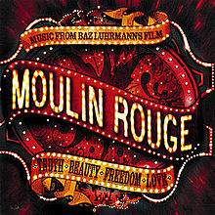
Cinematic or Theatrical?
Watch the first few minutes of the film before continuing.

Slide 17

Moulin Rouge Excerpt

Slide 18
Cinematic or Theatrical?
Note the following elements:
Director Baz Lurhmann has a history of mixing the best of theatrical and cinematic elements to create a unique world. He also does this in the film Shakespeare’s R+J.
From the very campy opening of the conductor leading the studio musical theme, he sets up a post-modern world (where he acknowledges that we are watching a movie – or more precisely a play in the way he has filmed it) that combines heightened characters (the conductors furious leaping around is very theatrical because of his strong choices) and a very theatrical setting (an actual theatre!)

Slide 19
Cinematic or Theatrical?
The movie then turns completely cinematic with that beautiful tracking shot (purely cinematic as it focuses the eye of the audience and covers a scope impossible onstage).
What is unique is that the design of Paris is purely theatrical (almost cartoon and scenic in representation).
He mixes this stylistic world of theatre and cinema having those extreme close-ups (cinematic) of these very heightened characters (theatrical).

Slide 20
Cinematic or Theatrical?
Some elements that make this scene theatrical:
One stagnant locale that is obviously a set once we arrive in the room… a salute to theatre’s on-stage limitations.
A heightened quality of the acting. It is clear that the actor is making a strong choice about the characterization.
A stylized design that acknowledges the theatrical underpinnings of the piece.
A piece with style and flair that showcases the best of what theatre can offer.

Slide 21
Cinematic or Theatrical?
Some elements that make this scene cinematic:
The dizzying camera work that focuses the viewer’s eye on only what the director wants you to see.
The editing that tells the story rather relying on the dialogue.
The playing around with the time and structure in the editing of the storytelling.

Slide 22
Premise and Dramatic Structure
Presentation 1: Part 2

Slide 23
READING A PLAY…
For some of you, this may be the first time you have really read and examined a play.
Two ways to assist you in the reading is to define the premise and the dramatic structure of the play.
Before most presentations (and viewing the movie) you will be asked to define the premise and dramatic structure for the play you have just read.
The following contains ways to make this search for premise and structure go smoothly.

Slide 24
PREMISE
Once you have completed reading the play write down a list of words, images, feelings, or metaphors that the play evoked. They may relate to the main character’s dilemma or overall conflict of the play.
Let’s say you have read a play version of The Wizard of Oz. Some examples of the words you might write down include:
Home
Adventure
Friendship
Family
Magic
Courage
Power
Journey

Slide 25
PREMISE
Once you have brainstormed these words, go back and try and figure out what the playwright was trying to say.
What is the main thrust of the play? Is the playwright saying that Dorothy (our main character) should have run away? Was he saying that Dorothy is better off in Oz?
Is it a comedy? Does Dorothy end up happy?
Is it a tragedy? Does Dorothy end up destroyed?
By defining the type of show, your premise will also have a similar ending. If it is a comedy, the premise should end positively; if a tragedy the premise ends negatively.

Slide 26
PREMISE
Start to formulate the brainstormed word into a sentence that describes the overall message of the show. This is your premise.
A few things to remember about a premise:
A premise:
consists of an active phrase followed by a result. For example doing something leads to something else.
must be true.
must also have the opposite true (sometimes reflected in other characters in the script).
must be succinct.

Slide 27
PREMISE
Some examples of premises:
Seeking adventure leads to a greater appreciation of home. (The Wizard of Oz)
Companionship in unexpected disaster leads to a deeper love. (Titanic)
Recognizing hard work leads to success. (Bring it On)
A premise is not an absolute. It is what YOU have decided the play is about. You must be able to support your premise with examples from the script.

Slide 28
PREMISE
For more help with premise read Chapter One of Lajos Egri’s excellent book The Art of Dramatic Writing in the Lesson module.

Slide 29
PREMISE
The premise may be informed by several elements of the play.
First, decide why the author chose that specific title. That is a pretty specific clue as to what the playwright thinks the play is about!
The CLIMAX of the play usually contains the biggest clue to the premise. To find the climax, you must fine the dramatic structure of the play.

Slide 30
Freytag's Analysis of Dramatic Structure
Freytag is known for his analysis of the structure of ancient Greek and Shakespearean drama. According to Freytag, a drama is divided into five parts, or acts:
exposition
inciting incident and rising action
climax (or turning point)
falling action
denouement or catastrophe (depending upon whether the drama is a comedy or a tragedy) either a denouement or a catastrophe.
(A comedy is a drama in which the protagonist, or main character, is better off at the end of the story than he or she was at the beginning; a tragedy is the opposite.)
Freytag's analysis of dramatic structure is sometimes represented by means of a visual aid known as Freytag's Pyramid.

Slide 31
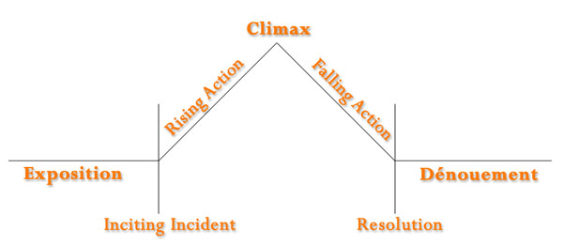
Freytag's Pyramid

Slide 32
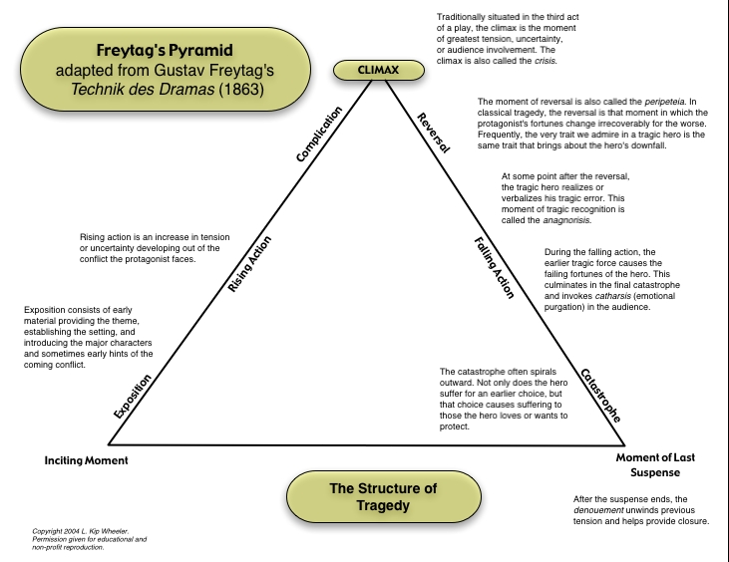

Slide 33
Exposition
In the exposition, the background information that is needed to understand the story properly is provided. Such information includes the protagonist, the antagonist, the basic conflict, the setting, and so forth.
The exposition ends with the inciting moment, which is the single incident in the story's action without which there would be no story. The inciting moment sets the remainder of the story in motion beginning with the second act, the rising action.

Slide 34
Inciting Incident
The inciting Incident marks the end of the exposition and the introduction of the first sign of conflict in the play. It is usually a moment that will introduce the main conflict of the story. At this point you can begin to feel tension in the script.

Slide 35
Rising Action
During the rising action, the basic conflict is complicated by the introduction of related secondary conflicts, including various obstacles that frustrate the protagonist's attempt to reach his or her goal. Secondary conflicts can include adversaries of lesser importance than the story's antagonist, who may work with the antagonist or separately, by and for themselves...

Slide 36
Climax (turning point)
The third act is that of the climax, or turning point, which marks a change, for the better or the worse, in the protagonist's affairs. If the story is a comedy, things will have gone badly for the protagonist up to this point; now, the tide, so to speak, will turn, and things will begin to go well for him or her. If the story is a tragedy, the opposite state of affairs will ensue, with things going from good to bad for the protagonist.

Slide 37
Falling Action
During the falling action, the conflict between the protagonist and the antagonist unravels, with the protagonist winning or losing against the antagonist. The falling action may contain a moment of final suspense, during which the final outcome of the conflict is in doubt.

Slide 38
Denouement or Catastrophe
The comedy ends with a denouement in which the protagonist is better off than he or she was at the story's outset. The tragedy ends with a catastrophe in which the protagonist is worse off than he or she was at the beginning of the narrative.

Slide 39
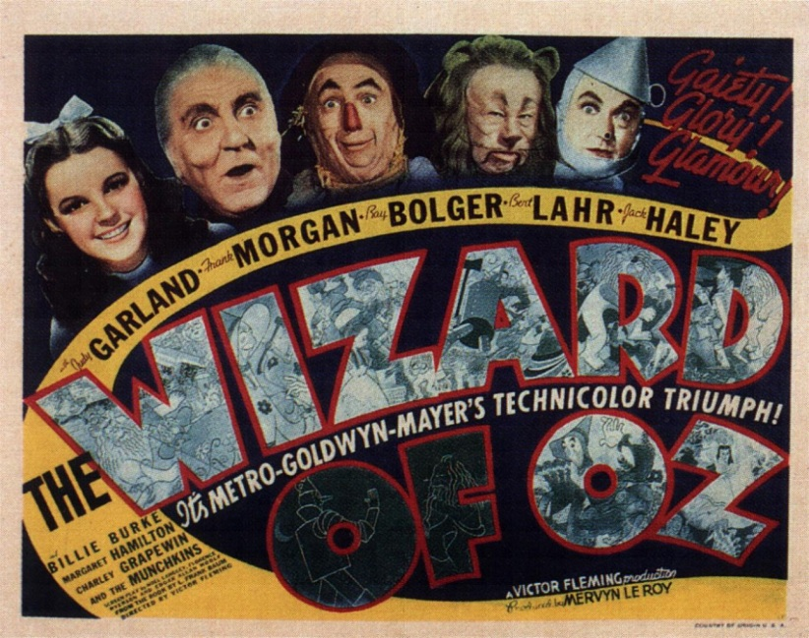
Example of Freytag's Analysis:
Here is the dramatic structure of the movie version of
The Wizard of Oz
Spoiler warning: Plot and/or ending details follow.

Slide 40
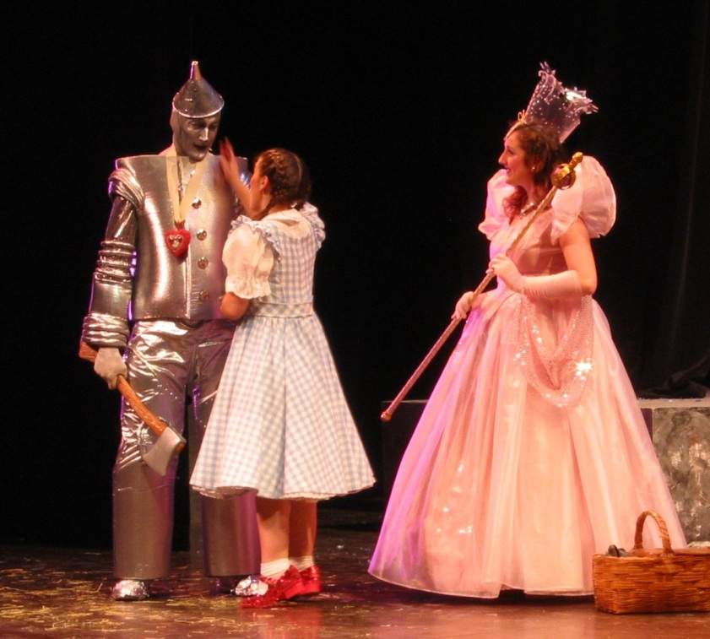
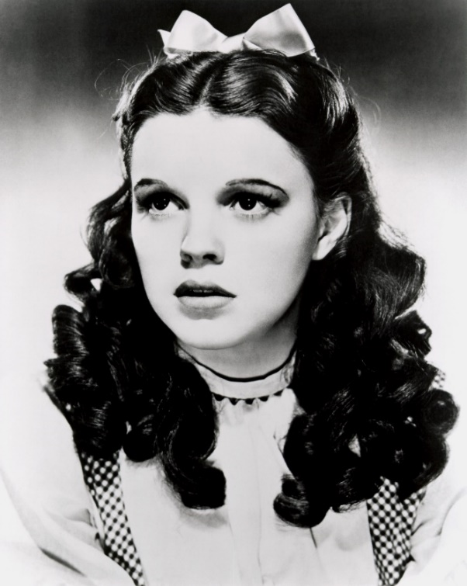
Exposition:
The protagonist, Dorothy Gale, is introduced, and the audience meets her Aunt Em, Uncle Henry, and their three farmhands. The antagonist, Mrs. Gulch, arrives to seize Dorothy's dog, Toto, to take him to the authorities to be euthanized.

Slide 41
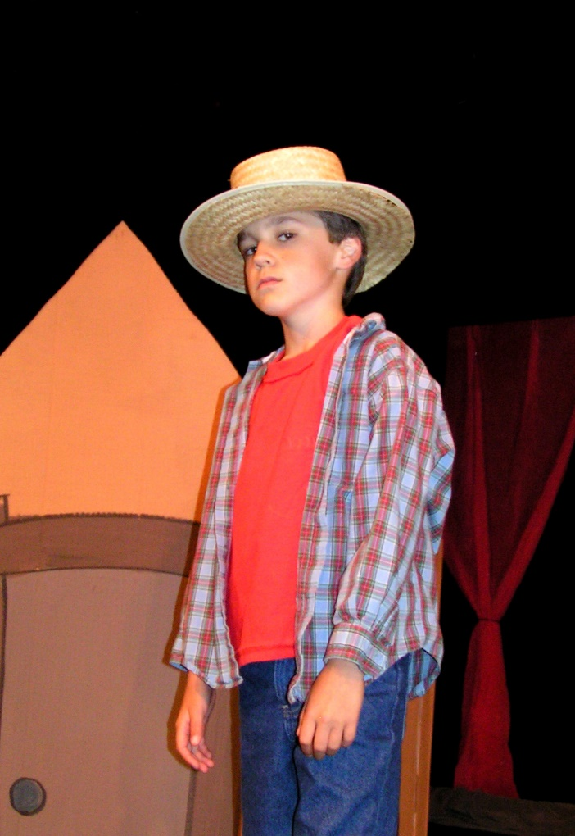
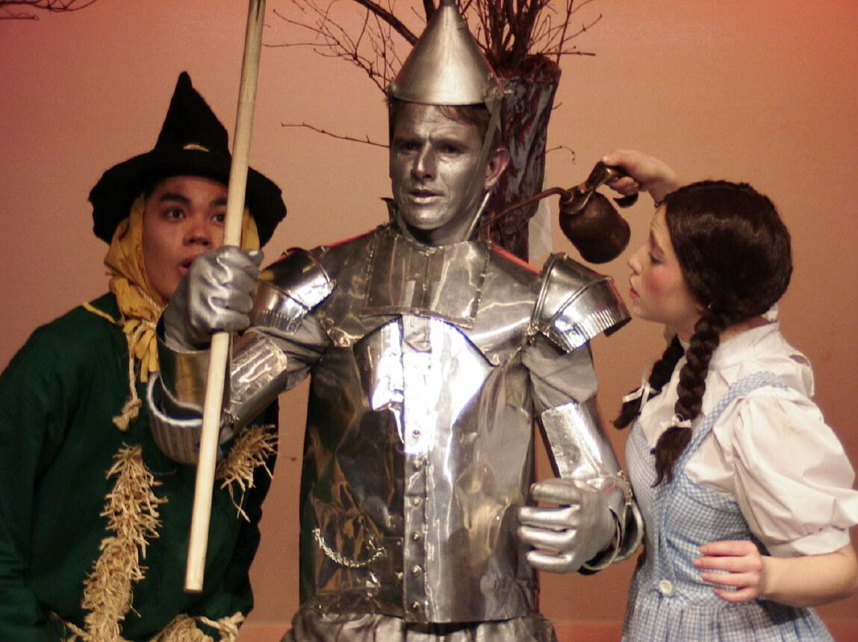
Inciting Incident:
Dorothy runs away from home, distraught.

Slide 42
Rising Action:
Dorothy encounters a circus performer, who encourages her to return home. As she nears her farm, she is joined by Toto, who has escaped from Mrs. Gulch, but they are too late to join Aunt Em, Uncle Henry, and the farmhands inside the storm cellar, where they have sought refuge from an approaching tornado. Dorothy carries Toto into the family's house, where she is struck in the head by a shutter that becomes detached from the house because of the tornado. The injured girl loses consciousness, to awaken in the Land of Oz.
Glinda, the Good Witch, recommends that she see the Wizard of Oz, in the Emerald City, who can help her return to her home in Kansas. She wears a pair of ruby slippers that belonged to the Wicked Witch of the East, upon whom her house landed when the tornado set it down in the land of the diminutive Munchkins.

Slide 43
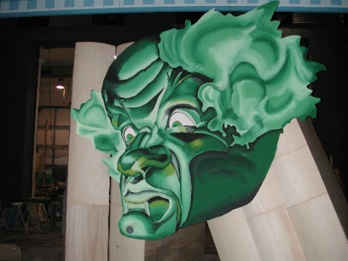
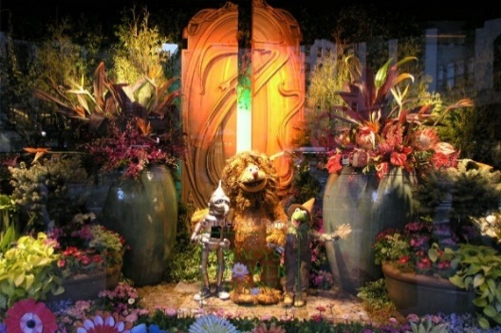
Rising Action:
Along the way, as she follows a yellow brick road, she encounters traveling companions in the form of a Scarecrow, a Tin Woodman, and a Cowardly Lion. Surviving attacks by the Wicked Witch of the West, the sister of the slain witch, who wants to recover the ruby slippers, Dorothy arrives in the Emerald City, with her companions. However, the Wizard refuses to help Dorothy or her friends unless she returns to the Emerald City with the broomstick of the Wicked Witch of the West. Dorothy and her companions are attacked by the Witch's army of winged monkeys, and Dorothy and Toto are borne to her castle. The Scarecrow, Tin Woodman, and Cowardly Lion follow, rescuing Dorothy.

Slide 44
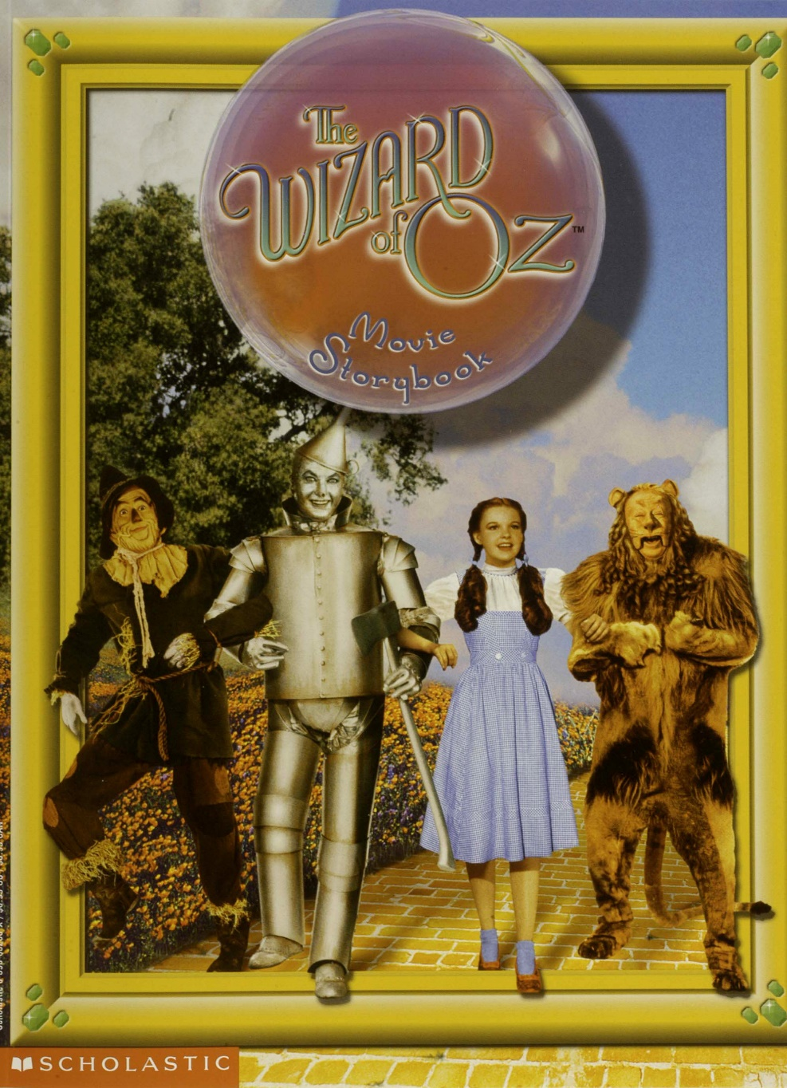
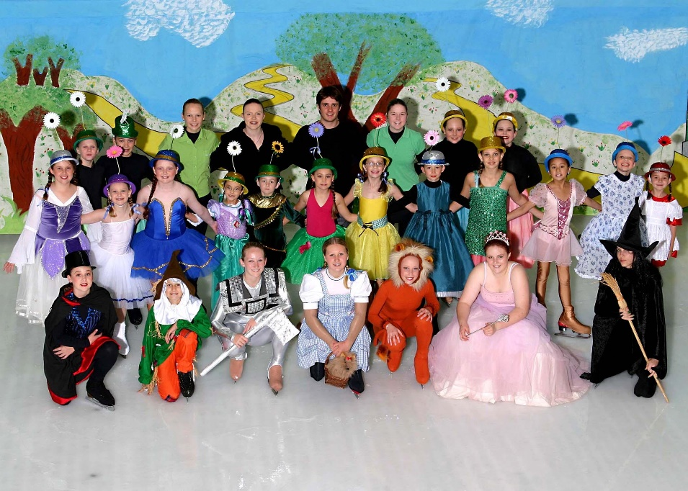
Climax (turning point):
As they seek to escape the Witch's castle, the antagonist confronts her fleeing prisoner and her friends, and Dorothy pitches a pail of water on the Witch, melting her.

Slide 45
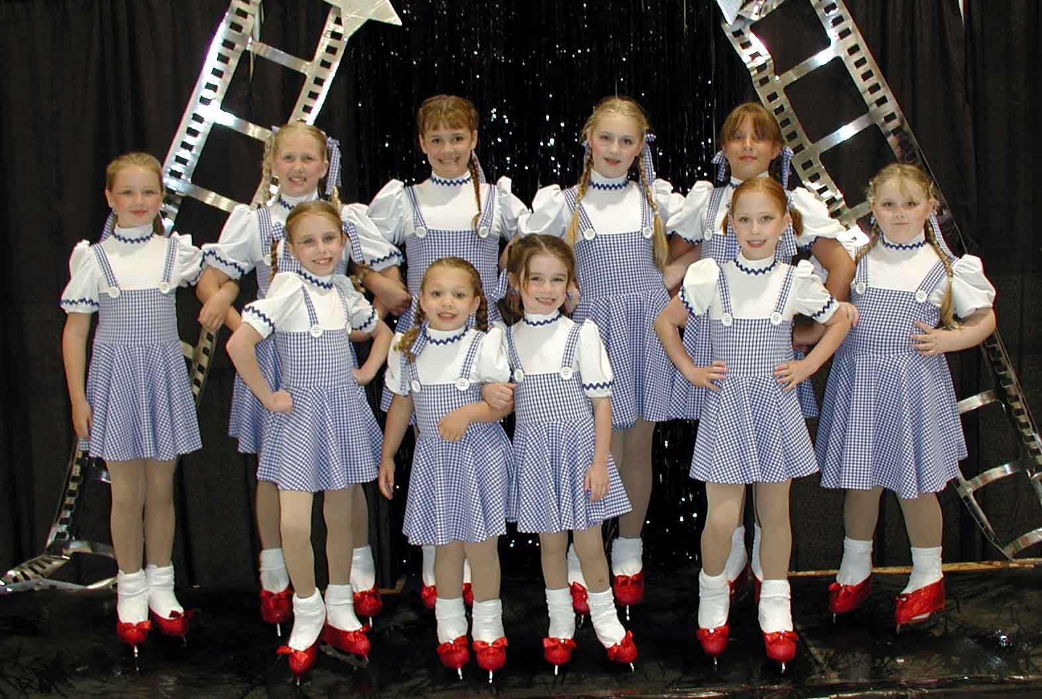
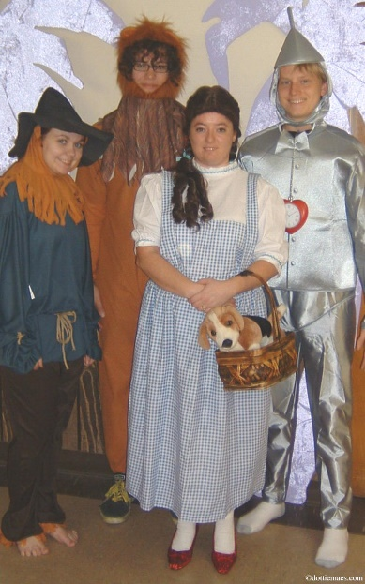
Falling Action:
Armed with the Witch's broomstick,
Dorothy returns to the Emerald City,
accompanied by her companions.
However, it is soon apparent that the Wizard is a fraud. He cannot work magic . However, he confers a diploma upon the Scarecrow, bestows a medal of courage upon the Cowardly Lion, and presents the Tin Woodman with a ticking clock, so that they each have that which they, respectively, have lacked: a brain, courage, and a heart. To transport Dorothy back home to Kansas, he inflates a balloon with hot air (the moment of final suspense), but the balloon leaves before Dorothy can join him in the basket, leaving her stranded in Oz.

Slide 46
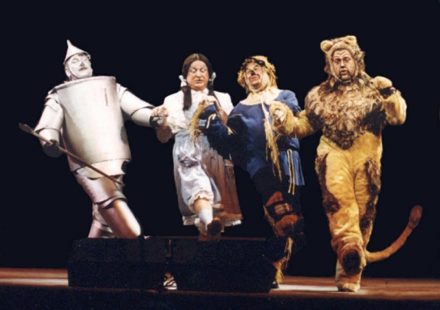
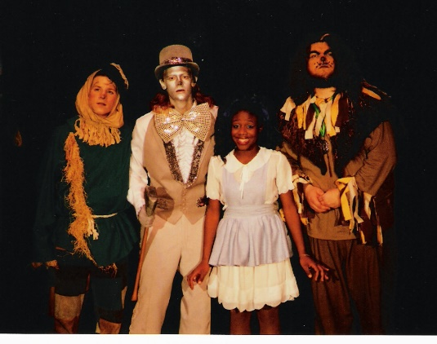
Denouement or Catastrophe:
A comedy, The Wizard of Oz ends with the appearance of Glinda, who advises Dorothy that she can return home simply by clicking the heels of her ruby slippers together three times and repeating "There's no place like home."
After bidding farewell to her friends, she does so, awakening in her own bed, surrounded by Aunt Em, Uncle Henry, the three farmhands, and the circus performer. Her adventures in Oz were nothing more than a dream that helped her to realize that "There's no place like home" and that, if happiness isn't in one's own backyard it is unlikely to be anywhere else, including "Somewhere Over the Rainbow."

Slide 47
There are several ways to analyze dramatic structure, Freytag’s being the easiest and the cleanest.
Of course, it has been argued the highest point of tension (the decision by Dorothy to throw water on the witch) is not the real turning point. That revelation that Dorothy had the power to go home all along is the real climax.
This choice related better to our premise.

Slide 48
Dramatic Structure
So, your decision on premise and dramatic structure for each play may have several acceptable answers IF you support your decisions with details from the script.
For example, you must write the exact line or event that causes the inciting incident and the exact line or event that is the climax along with textual support for your reasoning.
Textual support is also needed for your premise ideas.

Slide 49
FIRST ASSIGNMENT
Please choose any of the movies listed in the highest grossing top 50 movies of all time.
Watch the film you choose.
Go to the Discussion Posting in the Lesson module and discuss what elements from the film you considered theatrical and what elements were cinematic.
Notes:
http://en.wikipedia.org/wiki/List_of_highest-grossing_films

Slide 50
BEFORE THE NEXT LESSON
To prepare for the next presentation, you must have read the play
A Streetcar Named Desire by Tennessee Williams.
Complete the Dramatic Structure Worksheet.
The following presentation should be read while watching the film.
Notes:
http://en.wikipedia.org/wiki/List_of_highest-grossing_films

