Slide 1
Computational Techniques for Large-Scale Data Analysis
Lecture 1: Introduction

Slide 2
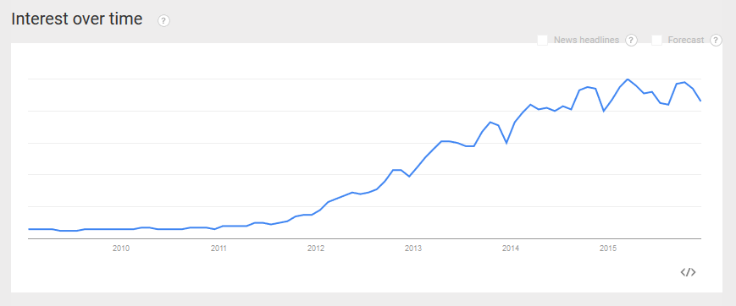
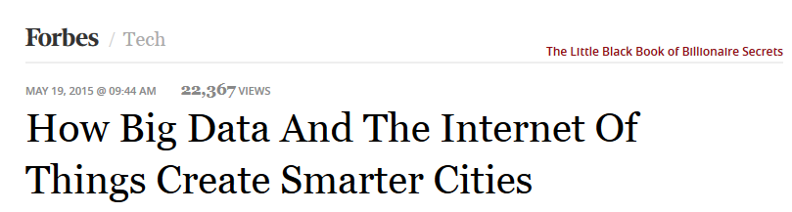
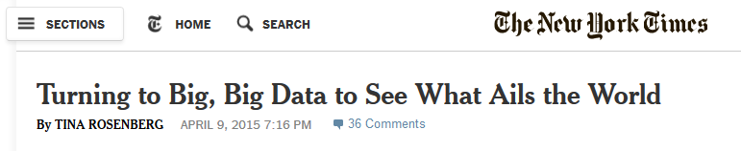
Big Data in the News
https://www.google.com/trends/explore#q=big%20data&date=1%2F2009%2084m&cmpt=q&tz=Etc%2FGMT%2B5

Slide 3
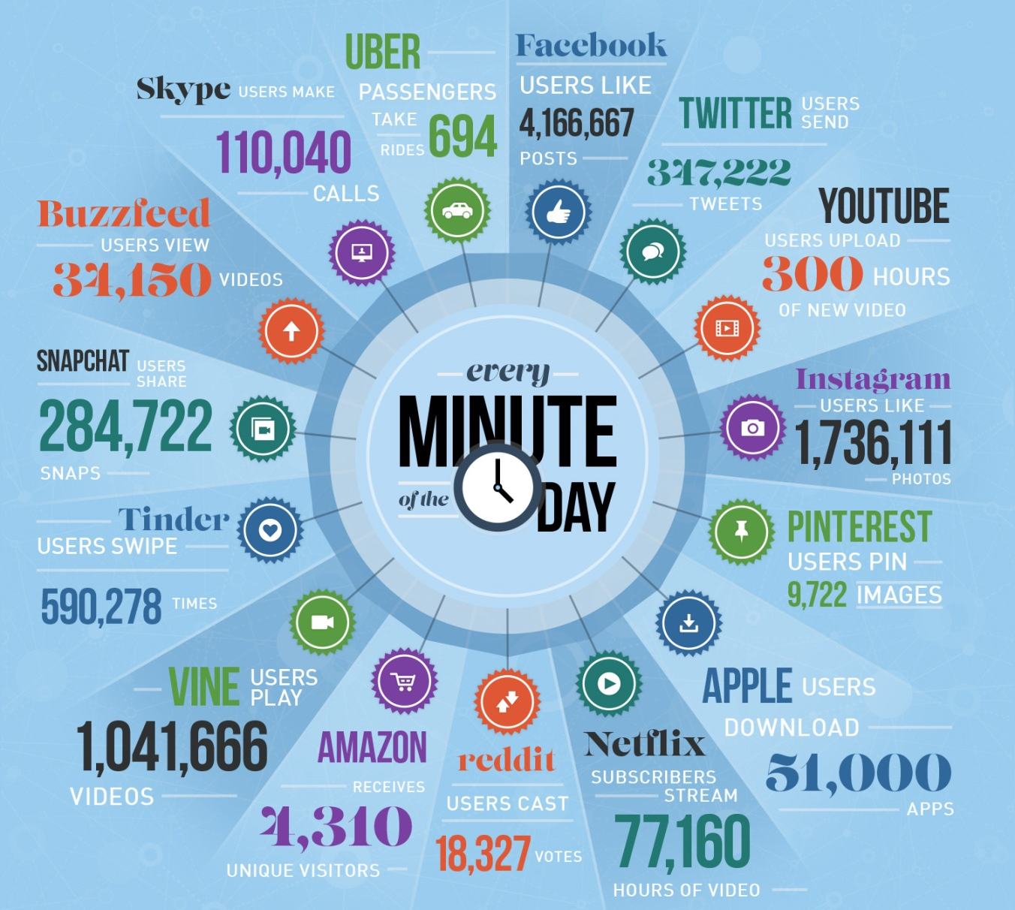
Growth of Big Data
Source: http://editorial.designtaxi.com/editorial-images/news-data14082015/big.jpg

Slide 4
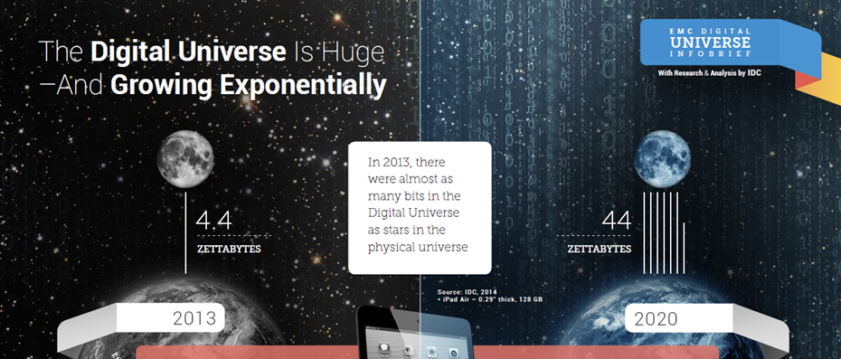
How Much Data is Out There?
Source: http://www.emc.com/leadership/digital-universe/index.htm

Slide 5
How much is a Zettabyte?
1 ZettaByte = 1000 ExaBytes = 10⁶ PetaBytes = 10⁹ TeraBytes = 10¹² GigaBytes
1 ZettaByte ~ 10²¹ / 5×10⁹ = 200 billion DVDs to store them
Each DVD stores about 5 GB data and its case is about 1cm thick
Distance from Earth to moon
= 384,000 km = 3.84 × 10¹⁰ cm
** If you stack together all the DVDs that contain 1 ZB of data, it is about 3 times the distance to the moon and back

Slide 6
Why Analyze Big Data?
Data is an asset/lifeblood for many organizations
Lots of data are being collected and warehoused
The data often contain useful information that can be harnessed to improve the organization
But their sheer size makes it difficult to effectively analyze them
In the meantime, computers have become cheaper and more powerful
This presents an opportunity to apply computational techniques to help businesses plan and optimize their operations

Slide 7
Applications of Big Data
Customer relationship management
Improve our ability to nurture and retain the most valuable customers
Customer acquisition and product promotion
Target new customers and identify cross- and up-selling opportunities
Brand management
Monitor brand health and track customers’ sentiments
Optimize business model and operations
Identify best practices, reduce fraud, waste and abuse

Slide 8
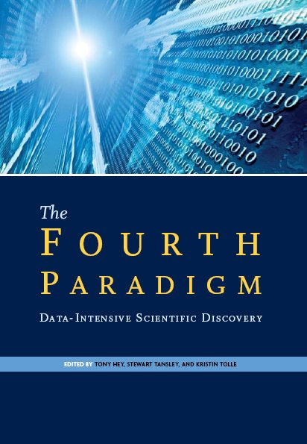
Big Data for Scientific Discovery
Big data is not just a problem for businesses
Lots of big data problems in scientific research
Examples: biomedical data, astronomy, high-energy physics, climatology/hydrology
Data-intensive computing as 4th paradigm for scientific discovery
Theory, experiments, simulations are the other 3 paradigms
Source: The Fourth Paradigm: Data-Intensive Scientific Discovery. http://research.microsoft.com/en-us/collaboration/fourthparadigm/

Slide 9
Characteristics (5 V’s) of Big Data
Volume: large amount of data that is continuously growing
Velocity: rapid streams of data that must be processed in real-time
Variety: structured and unstructured data obtained from (potentially) multiple data sources
Veracity: messiness or trustworthiness of the data
Value: usefulness of the data; needs a careful cost/benefit analysis before embarking on big data project

Slide 10

Creating Value from Big Data
Target Domain
Data acquisition and storage
Data preprocessing
Postprocessing
Modeling and analysis

Slide 11
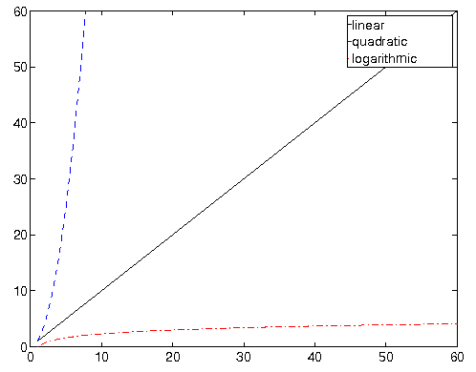
Challenges in Analyzing Big Data
Storage limitation
Traditional approaches assume entire data can fit into memory
Infeasible when applied to big data problems
Computation time
There are few sublinear time algorithms
How long does it take to sort 1 million floating point numbers? 10 million? 100 million?

Slide 12
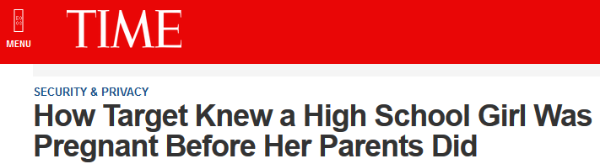
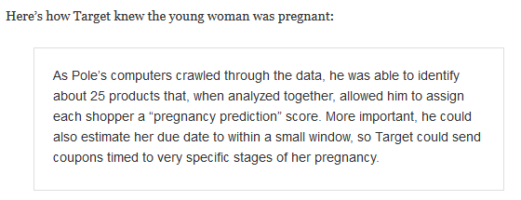
Other Challenges: Privacy
http://techland.time.com/2012/02/17/how-target-knew-a-high-school-girl-was-pregnant-before-her-parents/

Slide 13
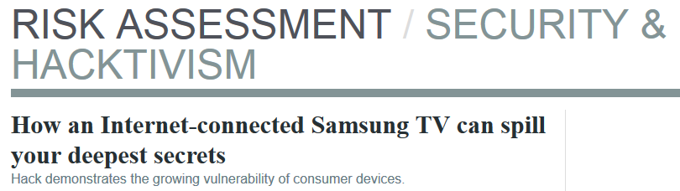
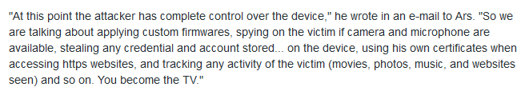
Other Challenges: Security
http://arstechnica.com/security/2012/12/how-an-internet-connected-samsung-tv-can-spill-your-deepest-secrets/

Slide 14
Types of Data Analysis
Predictive modeling
Cluster analysis
Queries
Outlier detection
Descriptive statistics
Collaborative Filtering
SImple
Complexity of analysis
Complex

Slide 15
(Simple) Descriptive Statistics
Mean (average)
Standard deviation
Median
Mode
Quartiles
Correlation
etc…

Slide 16
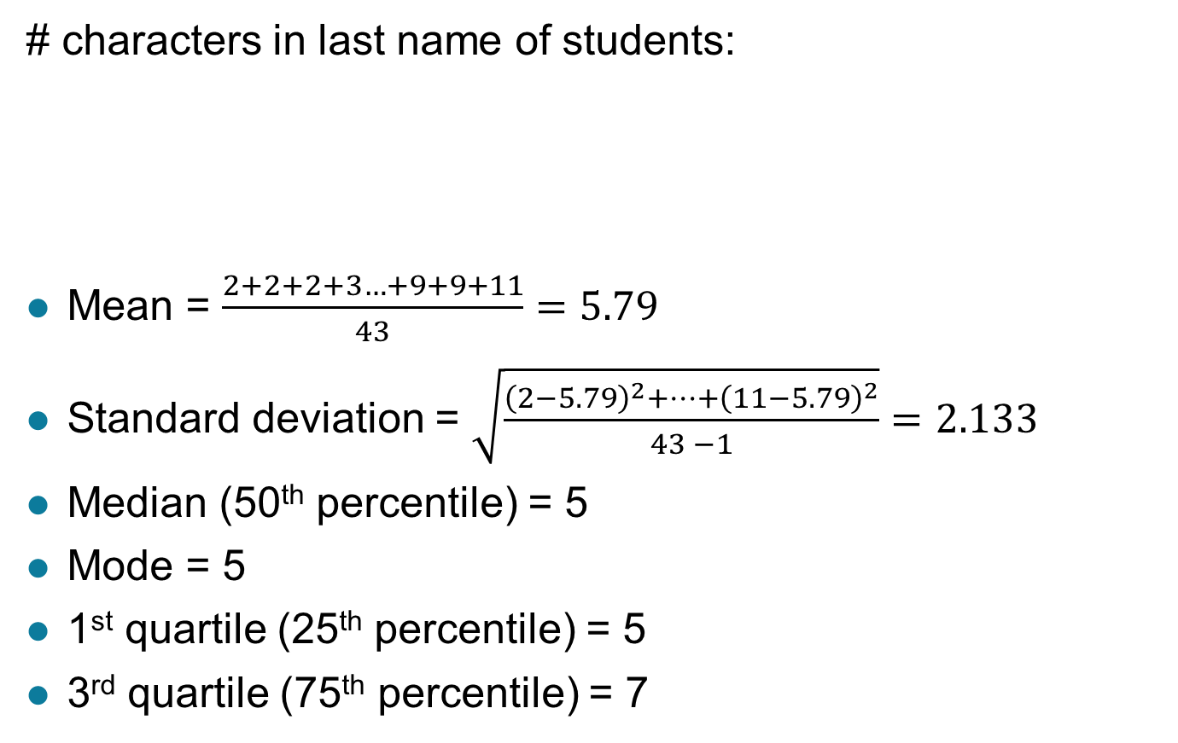
Example: Descriptive Statistics
# characters in last name of students:
Mean = $\frac{2+2+2+3…+9+9+11}{43}=5.79$
Standard deviation = $\sqrt{\frac{{\left(2−5.79\right)}^{2}+…+{\left(11−5.79\right)}^{2}}{43 −1}}=2.133$
Median (50th percentile) = 5
Mode = 5
1st quartile (25th percentile) = 5
3rd quartile (75th percentile) = 7
2 2 2 3 3 3 4 4 4 4 5 5 5 5 5 5 5 5 5 5 5 5 6 6 6 6 6 6 6 7 7 7 7 8 8 8 8 9 9 9 9 9 11

Slide 17
Querying
Find the top-10 most frequently purchased items at a given store in 2015
SQL:
SELECT item, count(*) as freq
FROM transactions
WHERE Year(Tdate) = 2015
GROUP BY item
ORDER BY freq DESC
LIMIT 10
TID | Tdate | Item | CustID | … | Price

Slide 18
Predictive Modeling
To predict the value of an unknown feature of the data
Examples
Predict the future price of a stock
Predict whether a customer will purchase an item at a store
Predict which product a customer is interested in buying when visiting an online store
Predict whether an existing customer will churn (move) to a competitor
Though the prediction tasks may be different, similar types of algorithms can be applied to solve the tasks

Slide 19



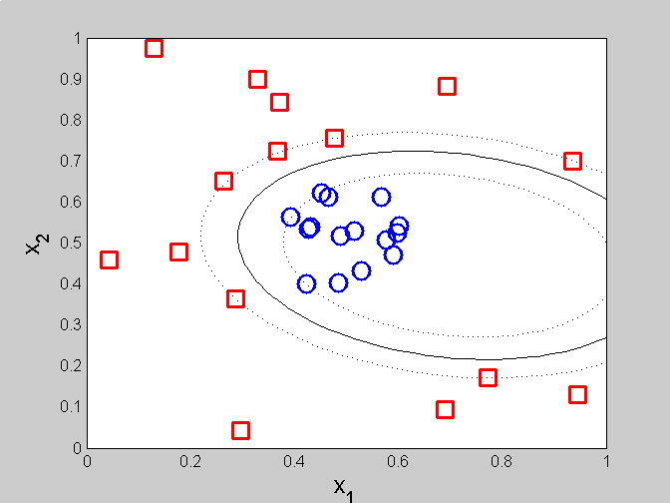

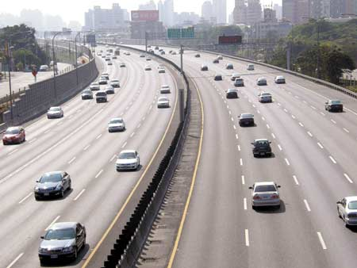
Framework for Predictive Modeling
Labeled examples
Unlabeled examples
congestion
No
congestion
Test
Set
Train
Model
Training
Set
Model

Slide 20
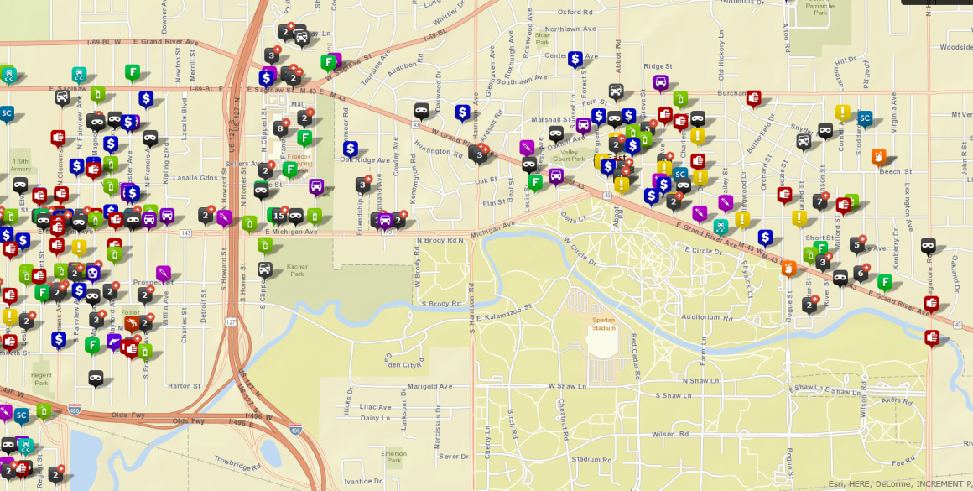
Cluster Analysis
To identify groups (clusters) of observations such that observations in the same group are more similar to each other than to those in other groups
Crime hotspot detection

Slide 21
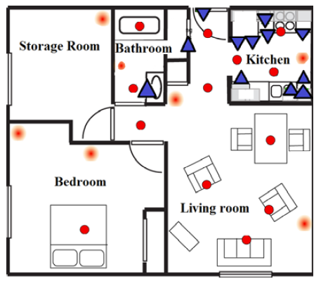
Association Analysis
Extract patterns of frequently co-occurring events
Time | Sensor ID | State
3/1/2015 07:48:05 | BR1 | OFF
3/1/2015 07:48:07 | LR1 | ON
3/1/2015 07:48:10 | LR6 | ON
3/1/2015 07:48:20 | BT1 | ON
3/1/2015 07:48:40 | LR6 | OFF
3/1/2015 07:49:30 | BT3 | ON
Weekday, 7 - 8am, BR2 = OFF, BR1 = OFF, LR6 = ON → LR1=ON
Weekday, 10-11pm, BR1 = ON, BR2 = ON, LR6 = OFF → LR1 = OFF

Slide 22
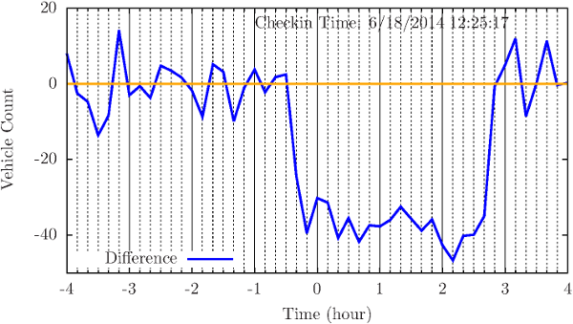
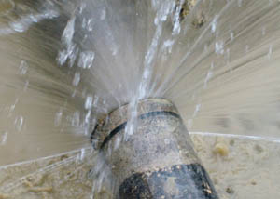
Anomaly Detection
Detect significant deviations from normal observations
Examples:
Smart Transportation
Congestion detection
Smart Home/Building
Pipe burst detection
Network intrusion detection

Slide 23
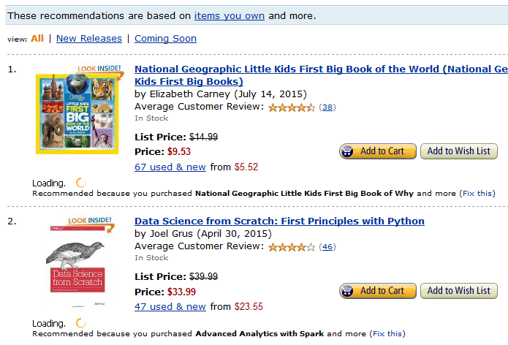
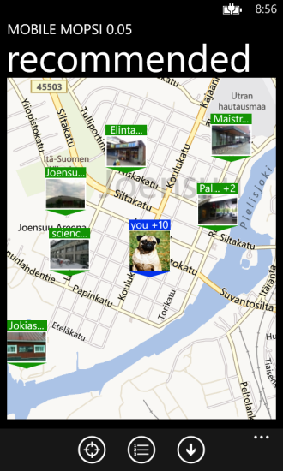
Ranking (Recommendation)
Given a query q, rank items in specific order based on their relevance to q
Examples:
Location-aware services
Recommender systems

Slide 24
Summary
Big data analytics plays a significant role in various sectors (businesses, homeland security, medicine, and various scientific and engineering disciplines)
This lecture presents a brief overview of:
The challenges in analyzing big data
The types of data analysis

Slide 25
Practice In-class Exercise 0

