Slide 1

INFORMATION
SMART FARMING AND HARVEST - AN APPROACH TOWARDS DIGITAL AND SMART FARMING is a
farming/agricultural application as developed as our Capstone project.
This web-based application helps our farmers to directly access to our farming services where farmers can inquire or query to our expert and provide them with relevant solution
This web-based application also provides a service where our farmer can upload the snapshot of their cultivating soil and through analysis of the snapshot of soil, ,information about MSP of crops, weather report ,farming related news and information about the farming product production

Slide 2
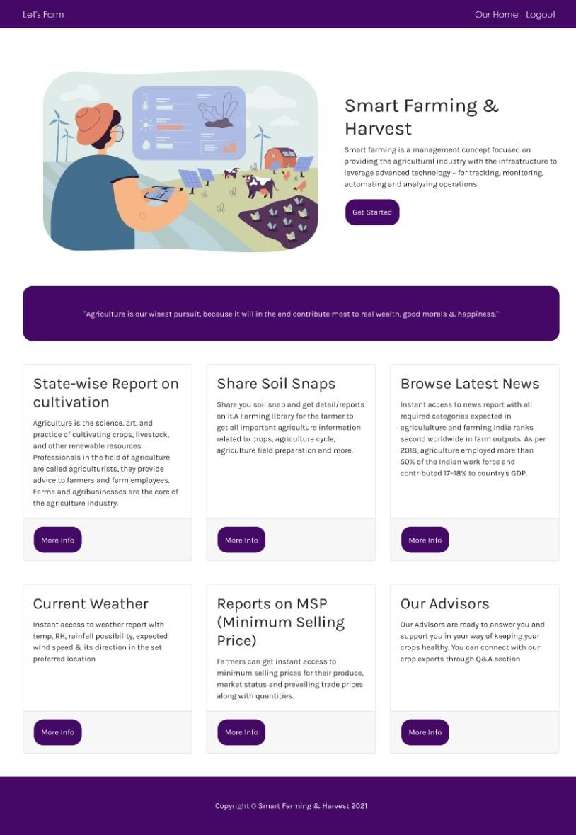
Homepage
User/expert/admin without login
visit
this
module
Card View
After login user/admin another module from this clicking on view more button
navigate to
module by
Our Services Section
View More
User can also view their profile by clicking on user name in navbar
Footer

Slide 3
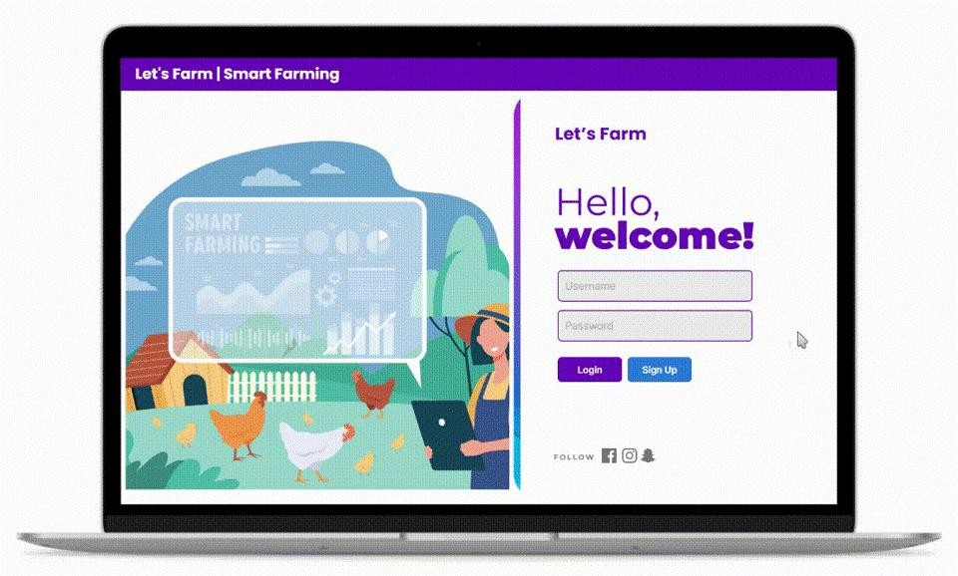
Sign-In Section
Nav-Bar
User can login using this module after
registration and get access to our services.
If user is not registered than they can move to register section by clicking on sign up button
Username Password Sign Up
Sign-In

Slide 4
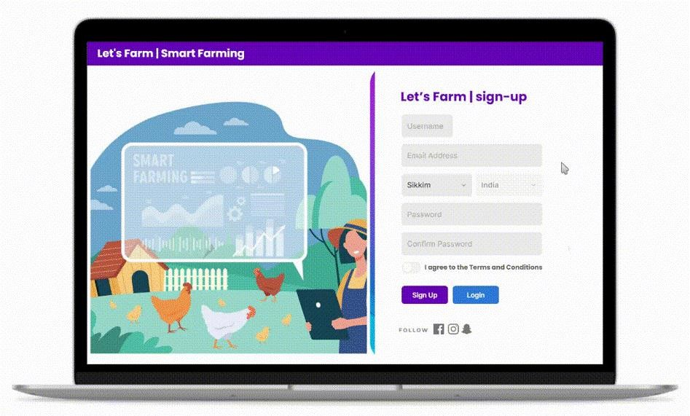
Sign-up-Section
Username Email-Address
User can Register through this module and proceed with logging in.
If user is already register than they can move to login section by clicking on sign in button.
Password
Login
Register

Slide 5
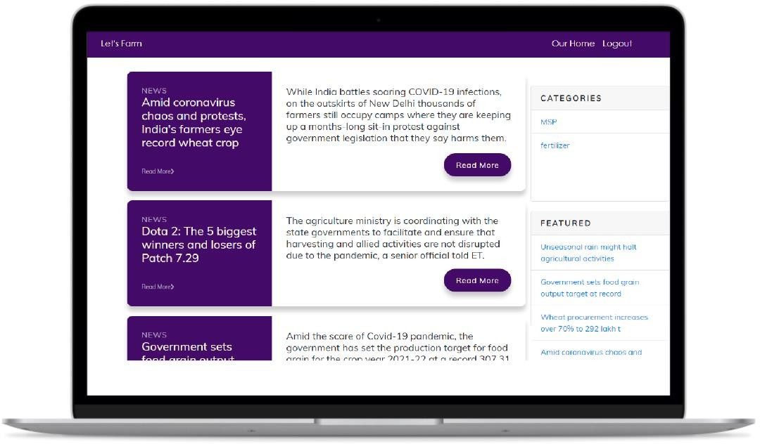
News-Feed-Section
In this section user view all the farming related news.
User can view news by categories.
By Clicking on the read more button user will be able to read full news.
Categories
Featured News
User also gets access to top 5 trending news through sidebar featured section.
News Section

Slide 6
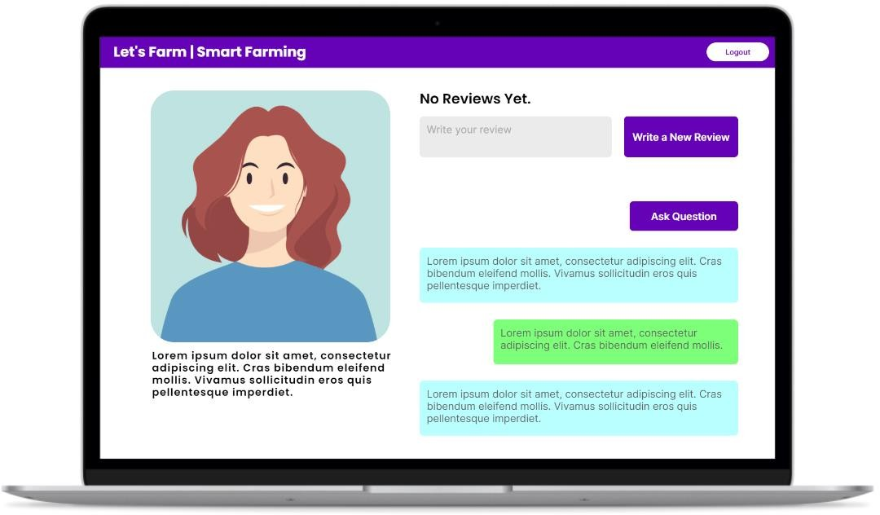
Expert Question Answer-Section (User)
In this section user can ask the question to expert related to farming and gets relevant report back.
User Review
Ask Question
User can also leave reviews and ratings to
expert according to their experience
User can also be able to delete and update their reviews and comments on expert.
Q&A Section
User can also view all the reviews and ratings
by clicking on see all review button.
Expert Section

Slide 7
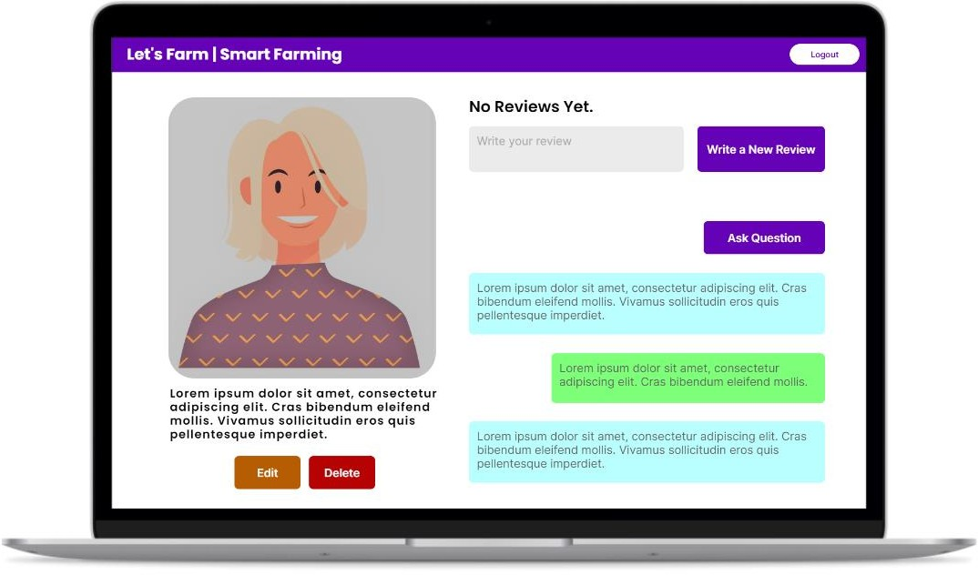
Admin-Expert-Details-Module-Section (Admin)
In this module Admin have access to update the expert section.
New Review
Also Admin have access to delete the expert
and can add new expert as required.
If admin deletes the expert than all pointing question and review of particular expert get automatically deleted.
Register Question
Expert
Profile
Q&A History
Expert Details
Edit Details
Delete Expert

Slide 8
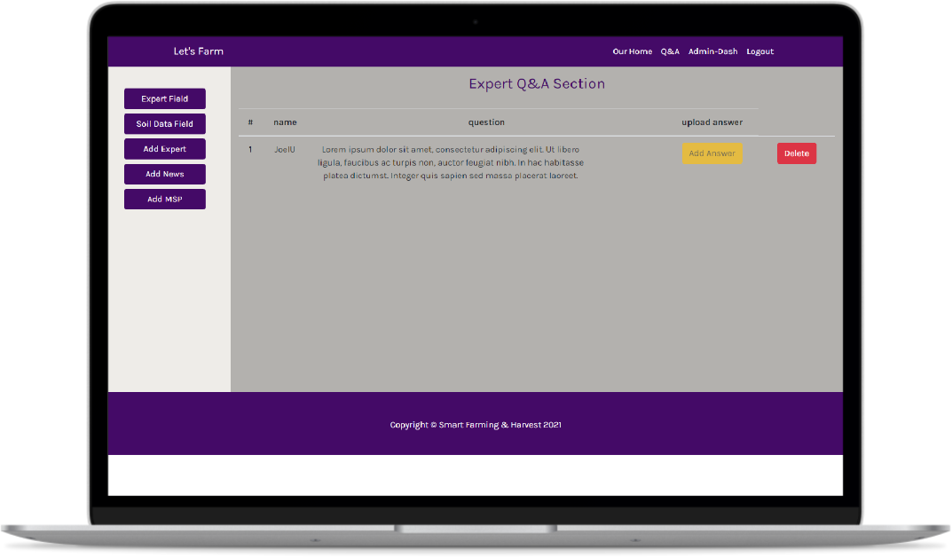
Admin-Q&A-Dashboard-Section (Admin)
In this section Admin/Expert can add an answer to questions as asked by user.
After an answer is uploaded/replied Admin/Expert can also update and delete their answers.
Admin can also add news, expert from this section .
Delete
Also from navigate to Dashboard
this section Admin/Expert can Soil Detail Dashboard and MSP
Dashboard Categories
Upload Answer
Asked Question
User Details

Slide 9
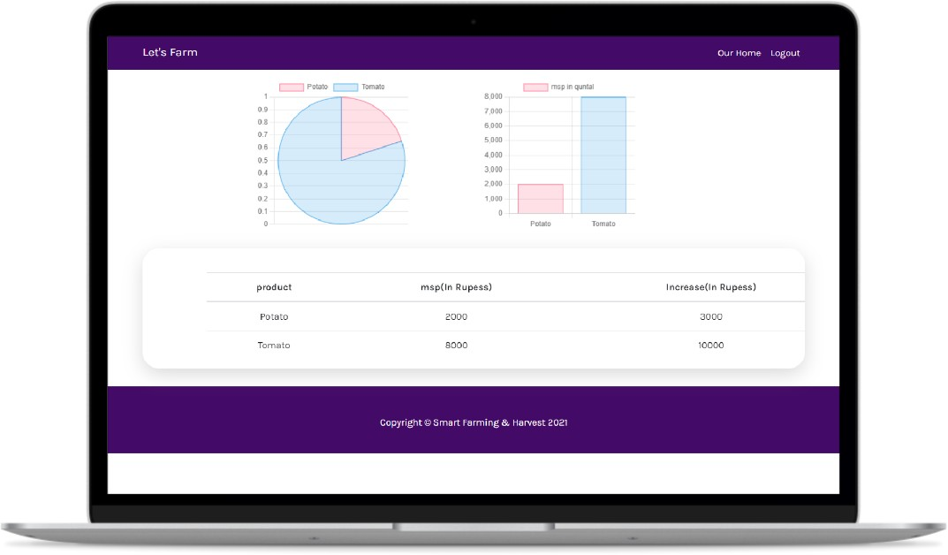
Minimum-Selling-Price-Module-Section (User)
Pie Chart Showing Individual MSP values
In this module user will get access to all the MSP of major farming product in tabular and chart form.
Details contain name of the farming product and MSP of the given product in Rupees and the increase in MSP(in rupees ) compared to recent changes in it.
List of MSP details

Slide 10
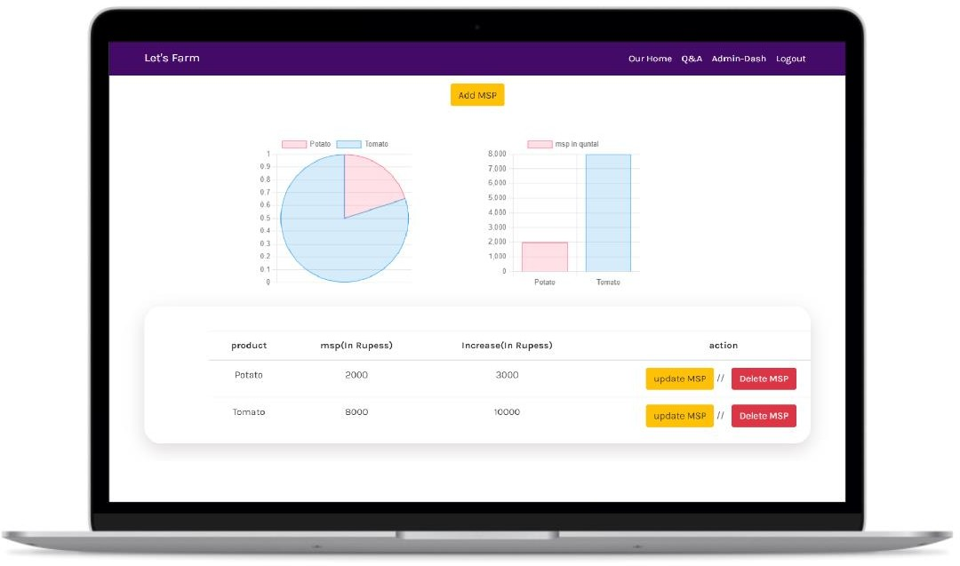
MSP-Data-Statistics-Module-Section (Admin)
In this module Admin/Expert have permission access to update, delete MSP’s of farming products.
Chart Statistics
When Admin deletes or updates the MSP details the given charts updates its data and updates it.
Delete MSP data
Product Details
Update MSP
Increase
Quantity

Slide 11
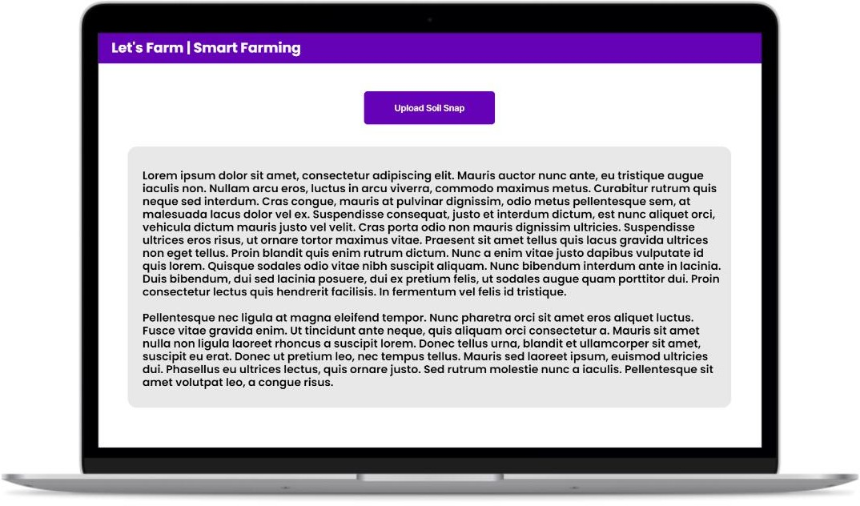
Soil-Snap-Report-Module (For User)
Upload snapshot of soil
After user signs in to portal they can upload soil snaps.
After the uploading snapshot user will receives a report on basis of their snaps.
Report of Snap
Also user can only upload one snaps, after uploading one snap upload buttons gets disabled

Slide 12
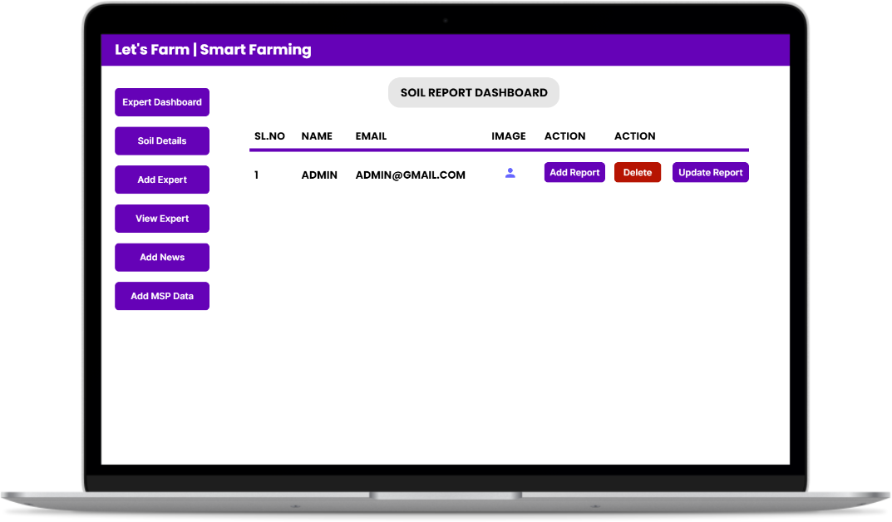
Admin-Soil-Report-Dashboard-Section (Admin)
From this module admin/expert have access to upload the report for soil after analyze the snapshot
Update Report
After upload the report admin/expert can also
update and the report
Admin/expert also have access to delete the snapshot
When expert clicking on image it became bigger so expert/admin have better view of snapshot
Dashboard Categories
Snap
Delete snapshot
User Email
New Report
User Name

Slide 13
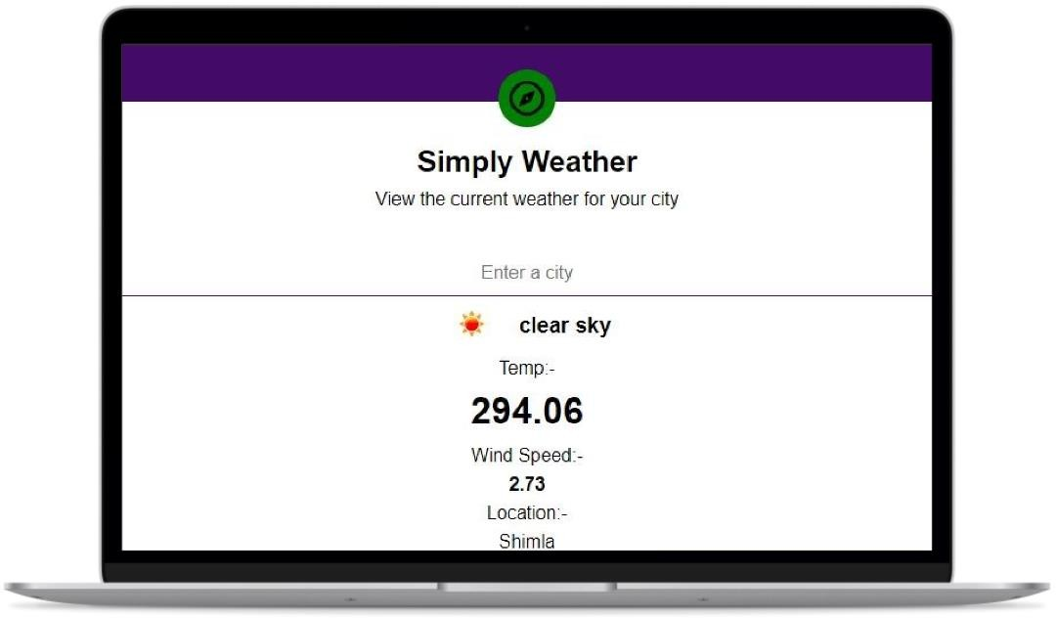
Weather-Report-Module (User View)
After a login when user visit this section this application automatically detect the current location of user and display weather report
Manual City
if user want search weather report of another location then they can simply search by providing location name
Temp. Report
Auto Location

Slide 14
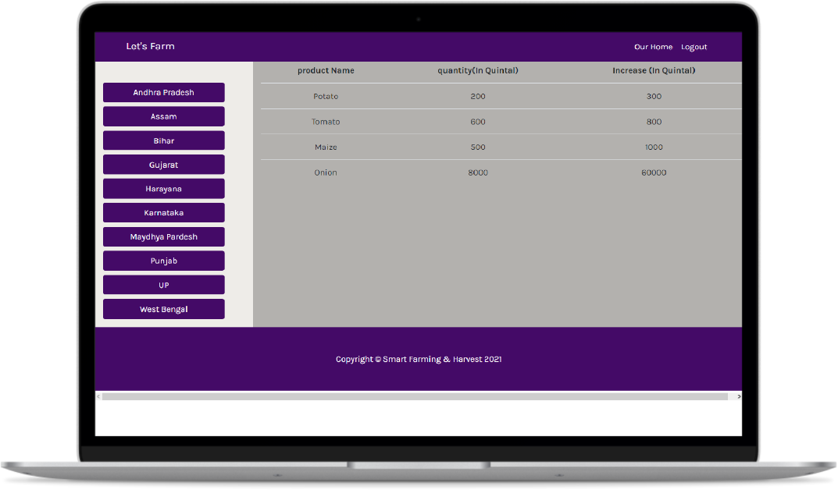
State-Wise-Product-Details (User)
After login When user will visit this module they will get the information about production of different farming product in different state (in quintal)
Product Details
Information contain product name quantity of product (in quintal) and increase in quantity (in quintal)
User also see farming product production detail by simply navigating different state by clicking on
State List

Slide 15
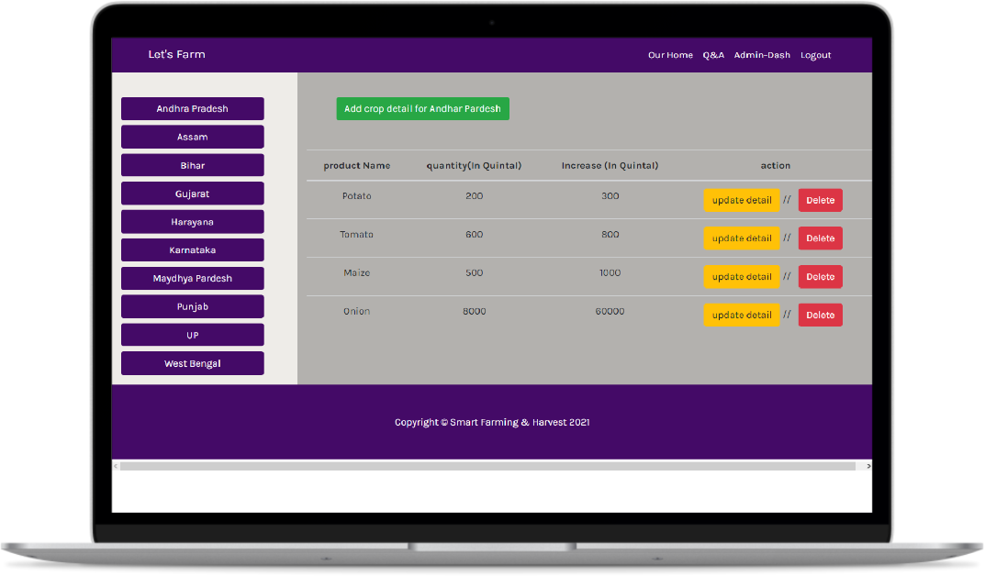
State-Wise-Product-Details (Admin)
After login as admin In this module admin
/expert have access to add the farming product
production detail in quintal
After adding the detail admin/expert have the access to update and delete the detail
Delete
Admin/Expert also navigate to different state
make the change by clicking on state name
Update Details
State List
Product Details

