Slide 1
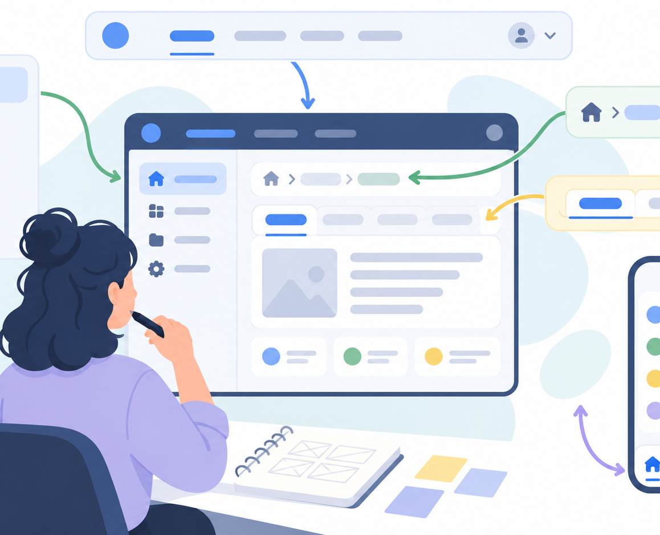
W4
Navigation, Windows
and Visual Design
User Interface Programming
From requirements to visible interface components
Mehmet Akif Cifci
User Interface Programming · Week 4
1
Notes:
Speaker notes:
Good morning everyone. Today we move from requirements to concrete interface decisions. Last week we discussed what users need and how to define GUI requirements. This week we discuss how those requirements appear on the screen through navigation, menus, windows, input controls, colours, and graphical elements.

Slide 2
W4
Today's learning outcomes
By the end of this session, students should be able to connect interface requirements with screen-level design choices.
1. Explain navigation structures
Describe how menus, sidebars, tabs, breadcrumbs and bottom navigation guide users.
2. Design program windows
Identify the role of main windows, dialogs, modals, panels and notifications.
3. Select input and control objects
Choose text fields, buttons, lists, check boxes, radio buttons, sliders and other controls.
4. Apply colour and visual principles
Use colour, contrast, spacing, hierarchy and graphic elements to support interaction.
5. Extend Project 1
Convert requirements into a first structured interface layout.
User Interface Programming · Week 4
2
Notes:
Speaker notes:
Before we start, these are the outcomes for today. I want you to leave this lecture able to explain navigation, windows, controls, colour, and visual hierarchy. More importantly, I want you to use these ideas in your own Project 1 design.

Slide 3
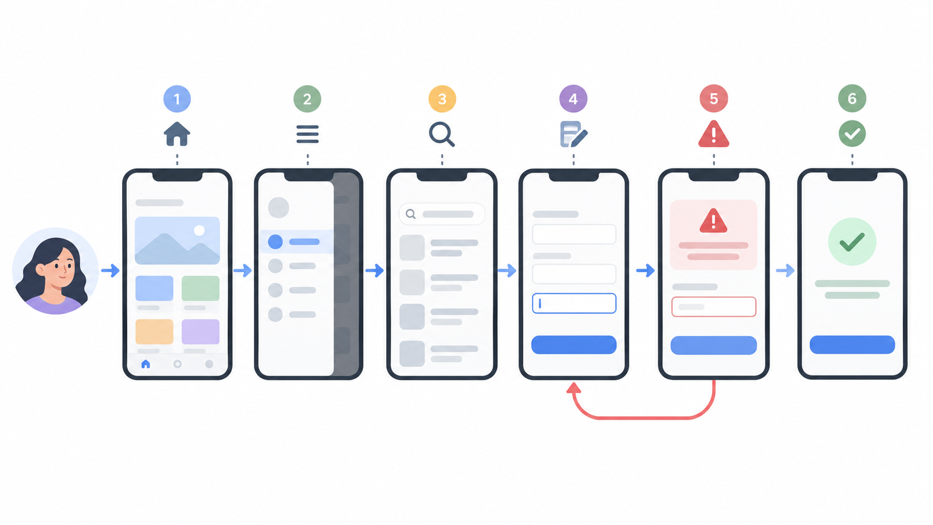
W4
From requirements to screen structure
A requirement becomes useful only when it is translated into a clear interface decision.
Requirement
A user needs to complete a task, such as submitting a form, finding a record, or checking status.
Interface decision
The design specifies where the task starts, what controls are used, and what feedback appears.
Visible structure
The final screen includes navigation, windows, input controls, colours, icons and messages.
Design rule: every screen element should answer a real user need.
User Interface Programming · Week 4
3
Notes:
Speaker notes:
Last week, we said that requirements describe what the user needs. Today we take the next step. We ask: if this is the requirement, what should the interface look like? Where does the user click first? Which window appears? Which control is appropriate? What feedback is given after the action?

Slide 4
W4
Four visible building blocks of GUI design
Most application interfaces combine navigation, windows, controls and visual presentation.
Navigation
Windows
Controls
Visual layer
Menus, sidebars, tabs, breadcrumbs, links, bottom navigation and search.
Main windows, dialogs, modal windows, panels, tool windows and notifications.
Buttons, fields, lists, check boxes, radio buttons, toggles, sliders and tables.
Colour, typography, spacing, icons, images, grouping and hierarchy.
Good interface design is not decoration. It is task structure made visible.
User Interface Programming · Week 4
4
Notes:
Speaker notes:
We can simplify today’s topic into four building blocks. Navigation tells users where they can go. Windows organize work and system states. Controls let users act. The visual layer makes the structure understandable. If one of these is weak, the whole interface becomes harder to use.

Slide 5
W4
Navigation: helping users know where they are
Navigation is not just movement between pages. It also communicates structure, priority and context.
• Where am I now?
• Where can I go next?
• How do I return or undo?
• Which action is primary?
• What has already been completed?
Navigation should reduce thinking, not increase it.
User Interface Programming · Week 4
5
Notes:
Speaker notes:
When students design navigation, they often think only about menus. But navigation is broader. It answers basic user questions. Where am I? Where can I go? How do I return? Which action matters most now? If the interface does not answer these questions, users will feel lost.

Slide 6
W4
Menu and navigation types
The correct navigation pattern depends on the task, device, information depth and user frequency.
Top navigation
Sidebar navigation
Tabs
Good for a small number of major sections. Common on websites and dashboards.
Useful when many sections exist or when users need stable access to tools.
Suitable for related views inside the same context.
Breadcrumbs
Bottom navigation
Context menus
Useful in deep structures where users move through hierarchy.
Common on mobile apps with a few frequent destinations.
Provide actions related to the selected object, but should not hide essential tasks.
Choose navigation by user task, not by fashion.
User Interface Programming · Week 4
6
Notes:
Speaker notes:
There is no single best menu type for every system. Top navigation is simple but limited. Sidebars support larger systems. Tabs work inside one context. Breadcrumbs show hierarchy. Bottom navigation works well on mobile. Context menus save space but can hide actions. The important question is: which pattern supports the task?

Slide 7
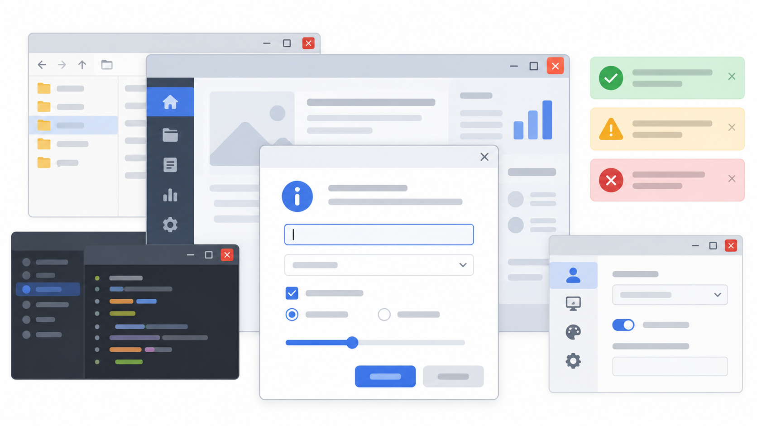
W4
Program windows: organizing attention and workflow
Windows and dialogs should structure work without interrupting users unnecessarily.
Main window
Dialog / modal
The stable workspace where users perform the primary task.
A temporary space for focused input, confirmation, or important decisions.
Panel / sidebar
Notification
A secondary area for navigation, filters, details or settings.
A short message about success, warning, error or system status.
Do not use a modal when the user can safely continue without interruption.
User Interface Programming · Week 4
7
Notes:
Speaker notes:
Now let us discuss windows. A main window gives the user a stable workspace. A dialog or modal interrupts the flow, so we should use it only when the user must make a decision or provide focused input. Side panels are useful for supporting information. Notifications should be short and clear.

Slide 8
W4
Input and control objects
A control should match the type of decision the user needs to make.
Text field
Dropdown / list
Checkbox
Radio buttons
Use when the value is open-ended or cannot be predicted easily.
Use when values are predefined and the user must choose one or more items.
Use when each option can be independently selected or deselected.
Use when the user must choose exactly one option from a small visible set.
Button
Toggle / switch
Slider
Use for actions. Button labels should start with verbs such as Save, Submit, Search, or Cancel.
Use for an immediate on/off state, especially settings that can be reversed.
Use for approximate values on a range, not for exact critical input.
Wrong control choice creates wrong mental model.
User Interface Programming · Week 4
8
Notes:
Speaker notes:
Controls are not interchangeable. If the user must type an unknown value, we use a text field. If the values are predefined, a list or dropdown is better. If multiple options can be selected independently, checkboxes are appropriate. If only one option can be selected, radio buttons are clearer.

Slide 9
W4
Feedback: every user action needs a visible response
Feedback tells users whether the system understood the action and what happened next.
Success
Confirm that the action was completed. Avoid vague messages.
Warning
Alert users before a risky or irreversible action.
Error
Explain the problem and tell the user how to correct it.
Progress
Show that the system is working when a task takes time.
User Interface Programming · Week 4
9
Notes:
Speaker notes:
Feedback is one of the most important parts of interaction. If a user clicks a button and nothing appears to happen, they may click again, cancel, or lose trust. Feedback can be success, warning, error, or progress. Good error messages are especially important. They should explain what happened and how to fix it.

Slide 10

W4
Colour: meaning, hierarchy and readability
Colour should support meaning and visual hierarchy. It should not be used only for decoration.
Meaning
Use colour consistently: green for success, red for errors, yellow/orange for warnings, blue for neutral actions.
Contrast
Text must be readable. Weak contrast makes even a good design difficult to use.
Moderation
Too many colours create noise. Use a small palette and clear emphasis.
User Interface Programming · Week 4
10
Notes:
Speaker notes:
Colour has meaning. Users often expect green to mean success, red to mean error, and yellow or orange to mean warning. But colour must also be readable. If contrast is weak, students may have a beautiful screen that is still difficult to use. Also, using too many colours makes the interface noisy.

Slide 11

W4
Graphic elements and visual hierarchy
Icons, images, spacing and grouping should make the interface easier to scan.
Icons
Images
Spacing
Hierarchy
Use icons that match common user expectations. Add labels when meaning may be unclear.
Use images only when they help users understand content or context.
Separate unrelated groups and keep related elements close together.
Size, position, contrast and order tell users what to notice first.
Ask: what should the user see first, second, and third?
• Primary action should be visible.
• Secondary actions should not dominate.
• Dangerous actions need separation and confirmation.
User Interface Programming · Week 4
11
Notes:
Speaker notes:
Graphic elements are not just decoration. Icons, images, spacing, and hierarchy help users scan the interface. A good question is: what should the user see first, second, and third? If everything is emphasized, then nothing is emphasized.

Slide 12
W4
Common mistakes in navigation and visual design
Most weak interfaces fail because they ask users to think about the system rather than their own task.
Hidden actions
Inconsistent labels
Overloaded windows
Important actions are available only through unclear menus or gestures.
The same action is described with different terms across screens.
Too much information is placed in one window without grouping.
Weak feedback
Poor colour use
Unclear controls
Users cannot tell whether the action succeeded, failed, or is still loading.
Colour is decorative, inconsistent, or has insufficient contrast.
A control does not match the required input or decision type.
A simple, predictable interface is usually better than a clever but confusing one.
User Interface Programming · Week 4
12
Notes:
Speaker notes:
These are common mistakes I want you to avoid in your project. Do not hide important actions. Do not use different words for the same action. Do not overload one window. Do not leave users without feedback. And do not use colours randomly.

Slide 13
W4
Project 1 continuation: from requirements to layout
This week students should revise the Project 1 wireframe using navigation, windows, controls and visual principles.
Update your project idea
Confirm the application domain, target users and main user tasks.
Define navigation
Decide how the user moves between screens and returns to previous states.
Choose controls
Match each input field and action button to the user requirement.
Add visual rules
Specify colours, icons, grouping and the primary action on each screen.
User Interface Programming · Week 4
13
Notes:
Speaker notes:
For Project 1, I do not want only a drawing of a screen. I want you to show design thinking. What is the user task? What navigation structure supports it? What controls are needed? Which action is primary? What colours and icons support meaning?

Slide 14
W4
In-class activity: critique and improve a screen
Work in pairs. Use the checklist to evaluate one Project 1 screen or rough wireframe.
Task
Choose one project screen. Identify the primary task, navigation pattern, window type, controls, feedback, and visual hierarchy.
Discussion questions
1. What is the user trying to do?
2. Is the primary action clear?
3. Are the controls appropriate?
4. Is feedback visible?
5. What should be simplified?
Deliverable: one improved wireframe decision and one reason for the improvement.
User Interface Programming · Week 4
14
Notes:
Speaker notes:
Now we will do a short activity. Work in pairs. Look at one screen from your Project 1 idea. Do not only say whether it looks good or bad. Use the checklist. What is the task? What is the navigation? Which control is used? What feedback is visible? Then improve one part and explain why.

Slide 15
W4
Summary and preparation for next week
Navigation, windows, input controls, colours and graphical elements turn requirements into usable screens.
Today's key ideas
Before next class
• Navigation should answer where the user is and where they can go.
• Windows and dialogs organize attention and workflow.
• Controls must match the decision or input type.
• Colour should communicate meaning and hierarchy.
• Visual elements should support scanning, not decoration.
• Revise your Project 1 wireframe.
• Add clear navigation and window structure.
• Mark the primary action on each screen.
• Check controls and feedback messages.
• Prepare to discuss your design decisions.
Next focus: interface layout, device characteristics and responsive decisions.
User Interface Programming · Week 4
15
Notes:
Speaker notes:
Before we finish, let me summarize today. Navigation helps users understand where they are and where they can go. Windows and dialogs structure attention. Controls allow users to act. Colour and graphic elements make the interface easier to understand. For next week, revise your Project 1 wireframe. Add clear navigation, window structure, suitable controls and feedback messages.

