Slide 1
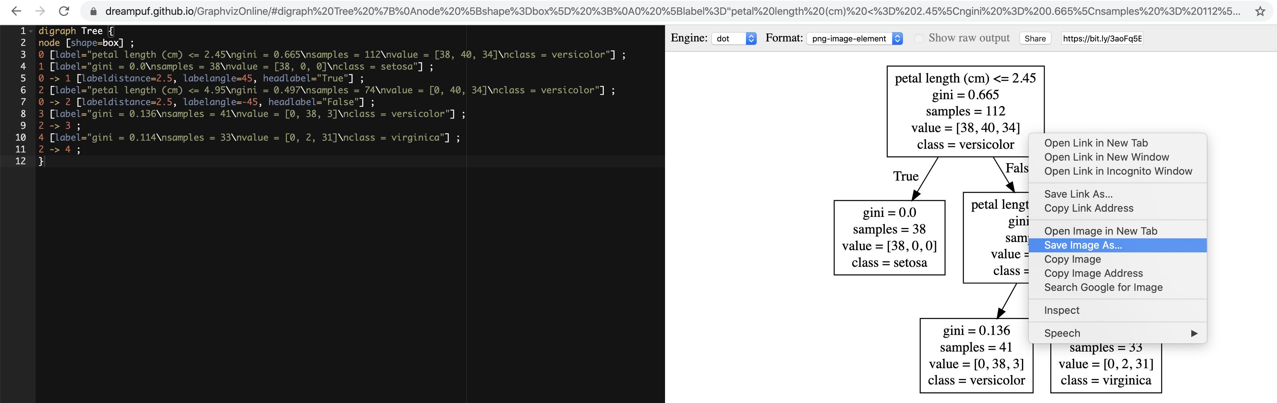
The area enclosed in the red rectangle is a place where the random forest algorithm differs from the bagged tree algorithm.

Slide 2
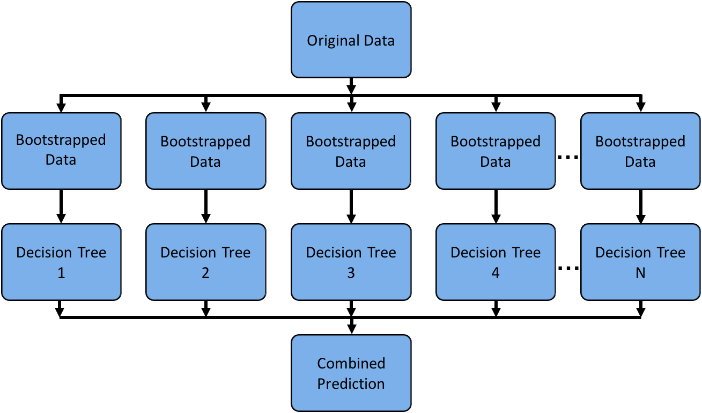
The area enclosed in the red rectangle is a place where the random forest algorithm differs from the bagged tree algorithm.

Slide 3
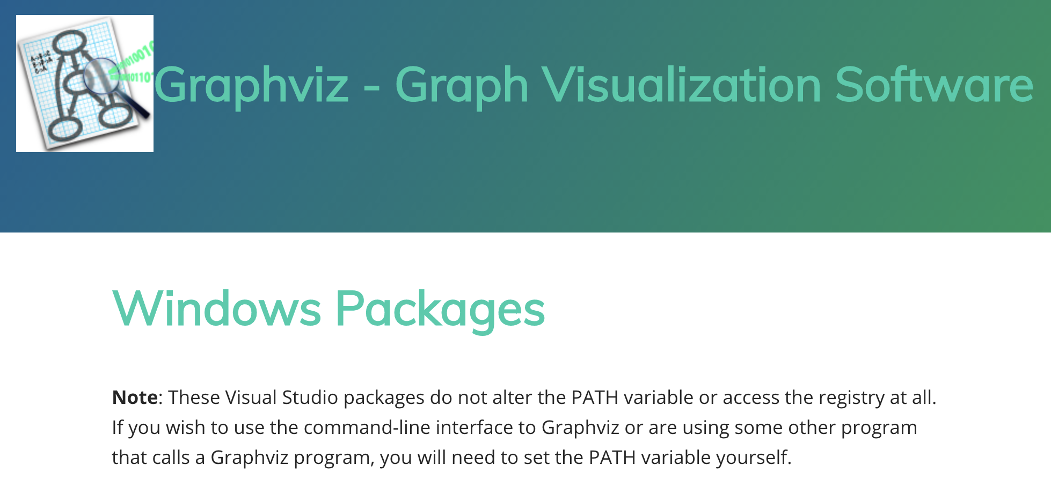

Slide 4
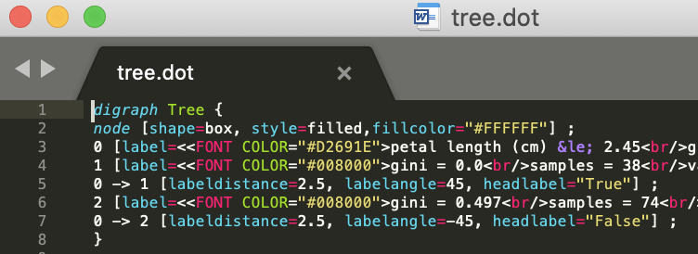
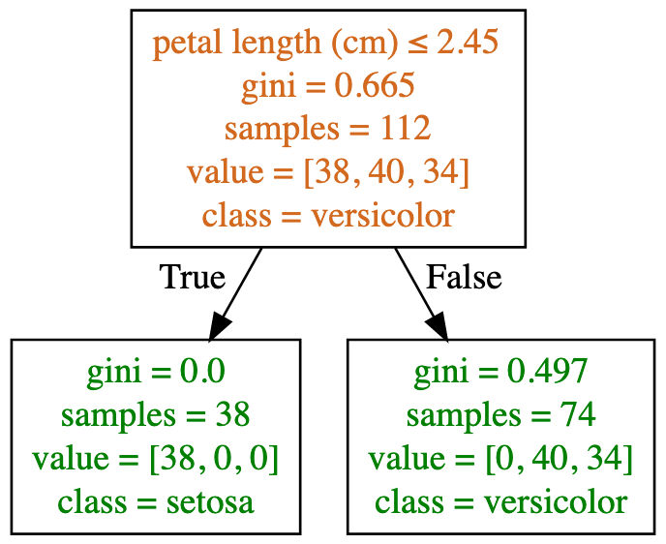
Dot File
(Graphviz representation of decision tree)
Image File
(png, jpg, etc)

