Slide 1
Random Forest
Notes:
The way this lecture works is we first will do some review and then work on an exercise.

Slide 2
Class Outline
Review Decision Trees
Understanding Bagged Trees
Understanding Random Forests
Build a Random Forest classification model using the scikit-learn library.
Review Decision Trees
Bagged Trees
Random Forests
Notes:
Random forests are built on decision trees, so it is important to review how they work.
Trees have one aspect that prevents prevents them from being the ideal tool for predictive learning, inaccuracy.
Random forests combine simplicity of decision trees with flexibility resulting in large improvement in accuracy.
Step one create bootstapped dataset: we randomly select samples from the original dataset. We can pick the same sample more than once.
Step 2: create a decision tree using the bootstrapped dataset, but only use a random subset of variables (or columns) at each step.
Step 3: Go back to step 1 and repeat: make a new bootstrapped dataset and build a new tree considering a subset of variables at each step. Depending on how many times you do this, you could land up with hundreds of trees. Using a bootstrapped sample and considering only a subset of variables at each step results in a wide variety of trees.
Step 4: Take data and run data down first tree and get a class or value. Then the second true and record its prediction
Using a

Slide 3

Where are we in the machine learning universe?
Notes:
Important to point out that you really do need more than 50 samples.
Check Jake Vanderplas

Slide 4
Where are we in the machine learning universe?
Notes:
Important to point out that you really do need more than 50 samples.
Check Jake Vanderplas

Slide 5
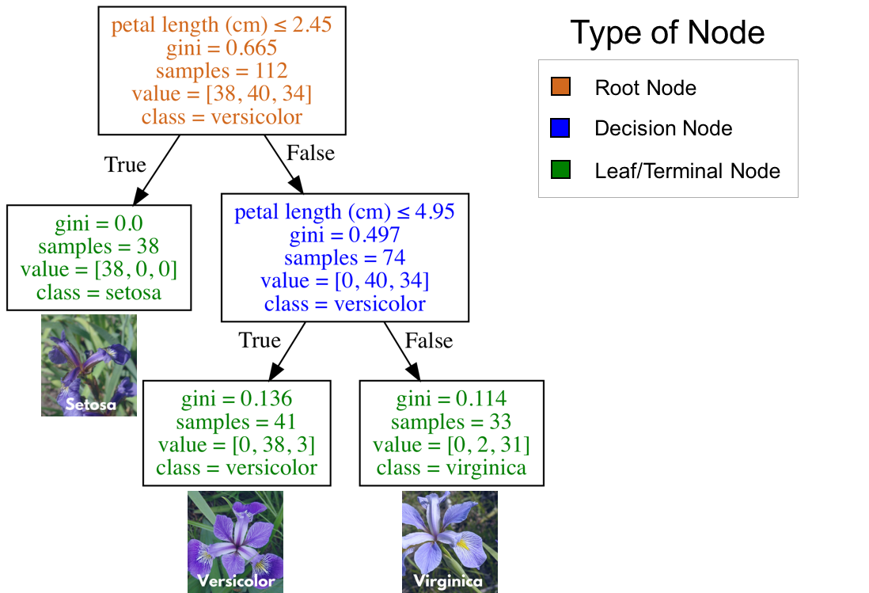
Review: What are Decision Trees?
An algorithm which is essentially a series of questions designed to assign a class or value
Decision trees used for classification are called classification trees
Decision trees used for regression are called regression trees.
Classification tree (decision tree) to classify one of three flower species (IRIS Dataset)

Slide 6
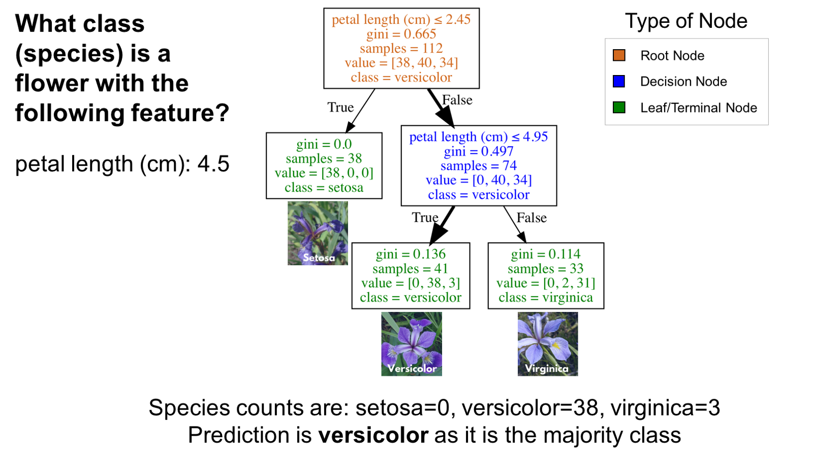
Review: How to use a Decision (classification) Tree
Start at the top of the classification tree (root node) and traverse the tree until you reach a leaf (terminal) node.
In the image to the right, imagine you had a flower with a petal length of 4.5cm and you wanted to classify It.
Classification tree (decision tree) to classify one of three flower species (IRIS Dataset)
Notes:
Common practice is to assign the negative class as the absence of something (ie absence of a tumor), but it doesn’t really matter what you assign what.
positive class typically is the presence of something we are looking for.
This example is just with two classes. Later on, with our digits example, we will talk about multiclass classification problems as well. in that case our variable y can take on multiple values {0, 1, 2, 3, 4, 5, 6, 7, 8, 9}

Slide 7
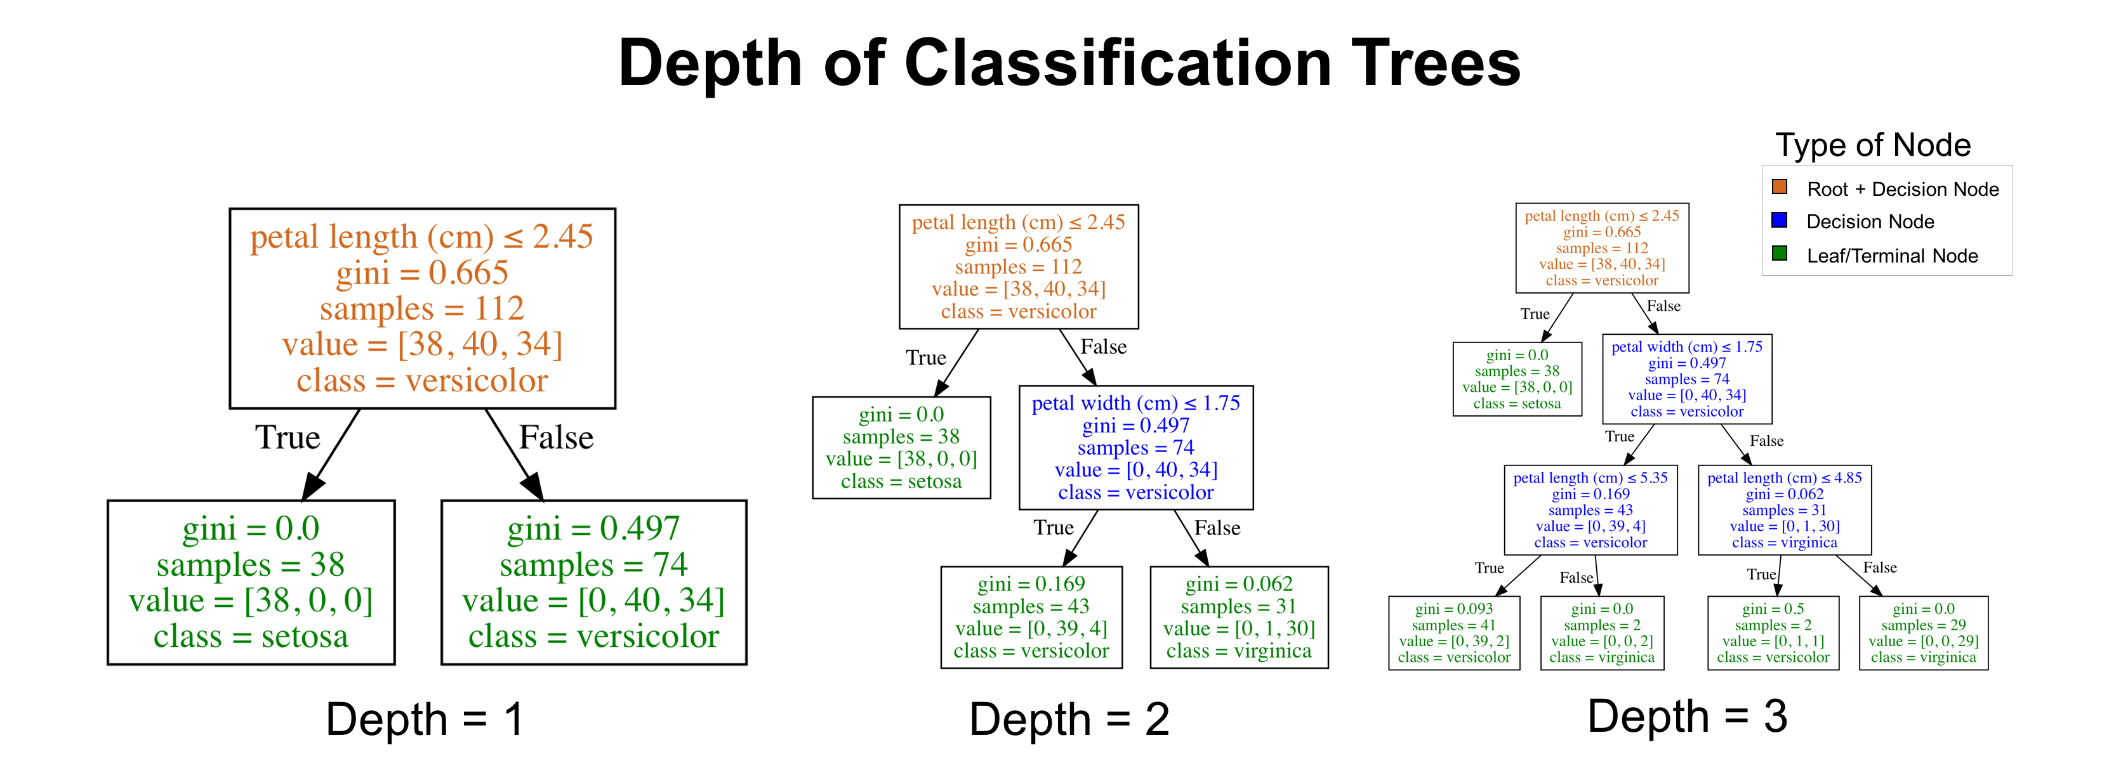
Review: Depth of a Decision Tree
Most classification tree implementations allow you to control for the maximum depth of a tree.
Notes:
Common practice is to assign the negative class as the absence of something (ie absence of a tumor), but it doesn’t really matter what you assign what.
positive class typically is the presence of something we are looking for.
This example is just with two classes. Later on, with our digits example, we will talk about multiclass classification problems as well. in that case our variable y can take on multiple values {0, 1, 2, 3, 4, 5, 6, 7, 8, 9}

Slide 8
Review: Benefits and Flaws of Decision Trees
Benefits
Highly interpretable
Prediction is fast
Can be used for classification or regression
Better performance in nonlinear settings (they use interactions between variables)
don’t require feature scaling
Flaws
Without pruning/cross-validation, they are prone to overfitting
Not the most performant model
Small variations in the data can result in a completely different tree (high variance algorithm). This is a problem we will try to mitigate with Bagged Trees and Random Forests.
Classification tree (decision tree) to classify one of three flower species (IRIS Dataset)
Notes:
Classification trees are essentially a series of questions designed to assign a classification

Slide 9
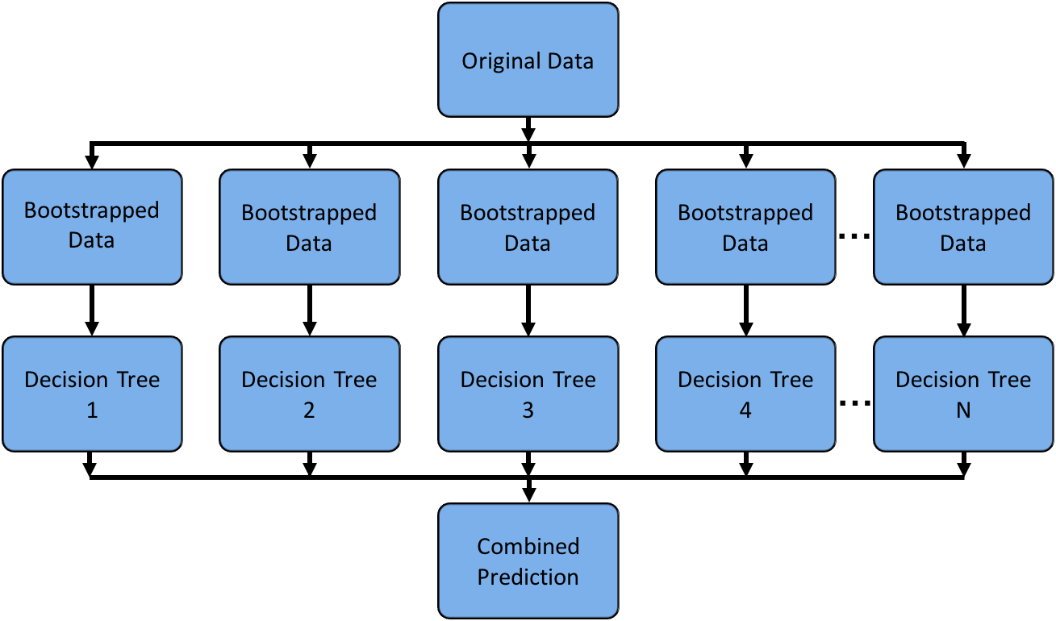
Bagged Trees
Bagged trees are an ensemble method which means using multiple learning algorithms to obtain a better predictive performance than could be obtained from any of the constituent learning algorithms alone (Many trees protect each other from their individual errors).
The name bagging is short for bootstrap aggregating. Bootstrapping is any test or metric that relies on random sampling with replacement.
Notes:
Bootstrapping the data plus using the aggregate to make a decision is called bagging
Classification trees are essentially a series of questions designed to assign a classification

Slide 10
How do Bagged Trees Work?
Grow N trees using N bootstrap samples from the training data
Make predictions
Combine the predictions
Average the predictions for regression trees
Majority vote for classification trees
Notes:
Each bootstrap sample is typically the same size as the original training set (it may contain repeated rows)
N should be a large enough value that the error seems to have stabilized
The trees are grown deep so that they have low bias/high variance.
Notes:
Classification trees are essentially a series of questions designed to assign a classification

Slide 11
Benefits and Flaws of Bagged Trees
Benefits
Typically better performance
More reliable estimate of feature importance (in theory).
Can be used for classification or regression
Don’t require feature scaling
Flaws
They are less interpretable than decision trees.
They are slower to train
They are slower to predict.
Individual models can be correlated with each other
Notes:
Classification trees are essentially a series of questions designed to assign a classification

Slide 12
Random Forests
Random Forests offer a slight variation on bagged trees.
The difference is that when building each tree, each time a split is considered, a random sample of m features is chosen as split candidates from the full set of p features. The split is only allowed to use one of those m features.
A new random sample of features is chosen for every single tree at every single split.
For classification, m is typically chosen to be the square root of p
For regression, m is typically chosen to be somewhere between p/3 and p.
The area enclosed in the red rectangle is a place where the random forest algorithm differs from the bagged tree algorithm.
Notes:
Classification trees are essentially a series of questions designed to assign a classification

Slide 13
Why Random Forests over Bagged Trees
Suppose there is one very strong feature in the data set. When using bagged trees, most of the trees will use that feature as the top split, resulting in an ensemble of similar trees that are highly correlated.
Averaging highly correlated quantities does not significantly reduce variance (which is the goal of bagged trees)
By randomly leaving out candidate features from each split, random forests “decorrelate” the trees to the extent that the averaging process can reduce the variance of the resulting model
Notes:
Classification trees are essentially a series of questions designed to assign a classification

