Slide 1

Computer Networking
Mehmet Akif CIFCI
Assistant Professor
@themanoftalent on all platforms

Slide 2
What is a “Network”
A network is a way to get “stuff” between 2 or more “things”
Examples: Mail, phone system, conversations, railroad system, highways and roads.

Slide 3
Course Content
Networks: Basic concepts
Uses of networks in sharing of resources, Backups
Common types of networks; LAN/WAN / Internet, Server based networks, client server model, P2P
Network media
Wireless networks.
Threats to networks
The internet world
Cloud and Cloud Computing

Slide 4
The Computer Network
A computer network is a group of computers/devices(Nodes) that use a set of common communication protocols over digital interconnections for the purpose of sharing resources located on or provided by the network nodes.
The nodes of a computer network may include personal computers, servers, networking hardware, or other specialised or general-purpose hosts.
The interconnections between nodes are formed from a broad spectrum of telecommunication network technologies, based on physically wired, optical, and wireless technologies.
A communication protocol is a set of rules for exchanging information over a network. physically wired, optical, and wireless

Slide 5
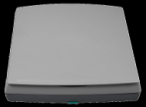


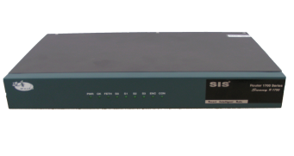
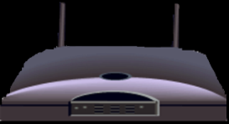
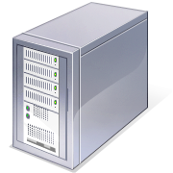
The Network Diagram
Wired Network
PC
Firewall
The Internet
Fiber Optic Network Cable
Router
Switch
Server
Other LANS
Wireless Network

Slide 6
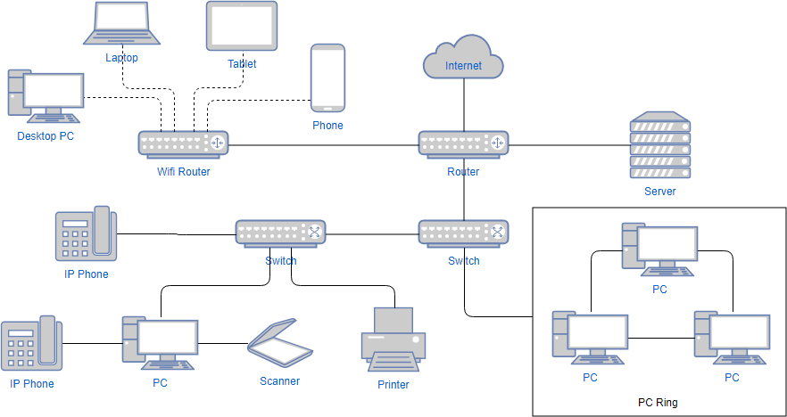
The Network Diagram

Slide 7
The Advantages/Uses of Network
Simultaneous Access
There are moments in any business when several workers may need to use the same data at the same time.
Shared Peripheral Devices
Personal Communications
Videoconferencing
Voice over Internet Protocol (VoIP):-VoIP transmits the sound of voice over a computer network using the Internet Protocol (IP ) rather than sending the signal over traditional phone wires
Easier Data Backup

Slide 8
The Networking Devices(Nodes)
NIC Card
Repeater
Hub
Switch
Bridge
Router
Gateway
Firewall

Slide 9

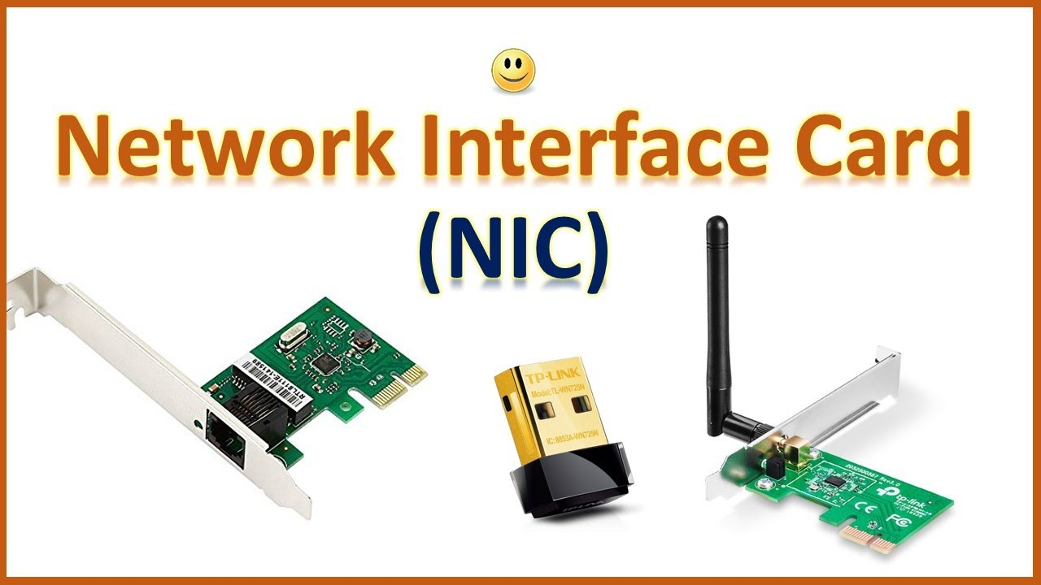
1. Network Interface Card
NIC is used to physically connect host devices to the network media.
A NIC is a printed circuit board that fits into the expansion slot of a bus on a computer motherboard.
It can also be a peripheral device. NICs are sometimes called network adapters.
Each NIC is identified by a unique code called a Media Access Control (MAC) address.
This address is used to control data communication for the host on the network.

Slide 10
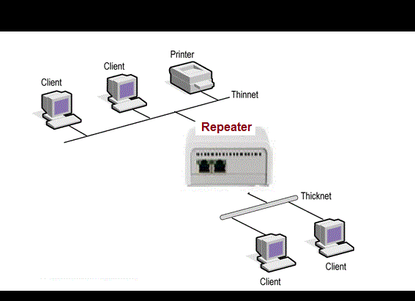
2. Repeaters
A repeater is a network device used to regenerate a signal.
Repeaters regenerate analog or digital signals that are distorted by transmission loss due to attenuation.
A repeater does not make an intelligent decision concerning forwarding packets

Slide 11
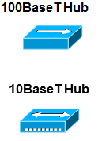
3. Hubs
Hubs concentrate on connections.
In other words, they take a group of hosts and allow the network to see them as a single unit. This is done passively, without any other effect on the data transmission.
Active hubs concentrate hosts and also regenerate signals.

Slide 12
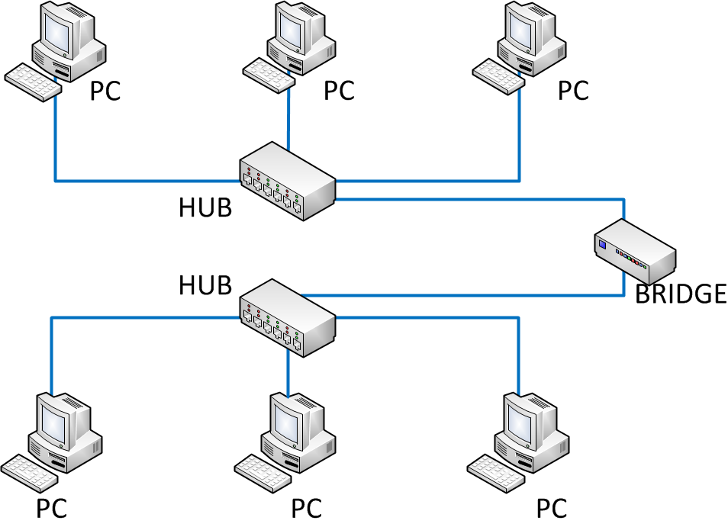
4. Bridges
Bridges convert network data formats and perform basic data transmission management.
Bridges provide connections between LANs.
They also check data to determine if it should cross the bridge. This makes each part of the network more efficient
Notes:
Once again, I tried to pull graphics from the original network diagram. I had to alter the wireless router graphic in Photoshop to make it look better. I darken the and removed a white background to make it look consistent in relation to the standard router.

Slide 13
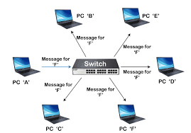
5. Switches
A network switch is a piece of hardware for connecting devices on a computer network. It does this by using packet switching to receive data and send it to the right device.
Switches add more intelligence to data transfer management.
They can determine if data should remain on a LAN and transfer data only to the connection that needs it.
Another difference between a bridge and switch is that a switch does not convert data transmission formats
Notes:
Once again, I tried to pull graphics from the original network diagram. I had to alter the wireless router graphic in Photoshop to make it look better. I darken the and removed a white background to make it look consistent in relation to the standard router.

Slide 14
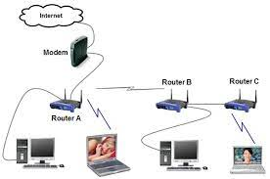
6. Routers
Routers have all the capabilities listed above.
Routers can regenerate signals, concentrate multiple connections, convert data transmission formats, and manage data transfers.
They can also connect to a WAN, which allows them to connect LANs that are separated by great distances.
Notes:
Once again, I tried to pull graphics from the original network diagram. I had to alter the wireless router graphic in Photoshop to make it look better. I darken the and removed a white background to make it look consistent in relation to the standard router.

Slide 15
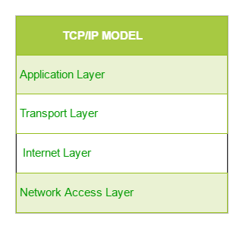
Transmission Control Protocol/Internet Protocol (TCP/IP)
TCP/IP Reference Model is a four-layered suite of communication protocols.
It was developed by the DoD (Department of Defence) in the 1960s.
Armadillos
Take
In
New Ants

Slide 16
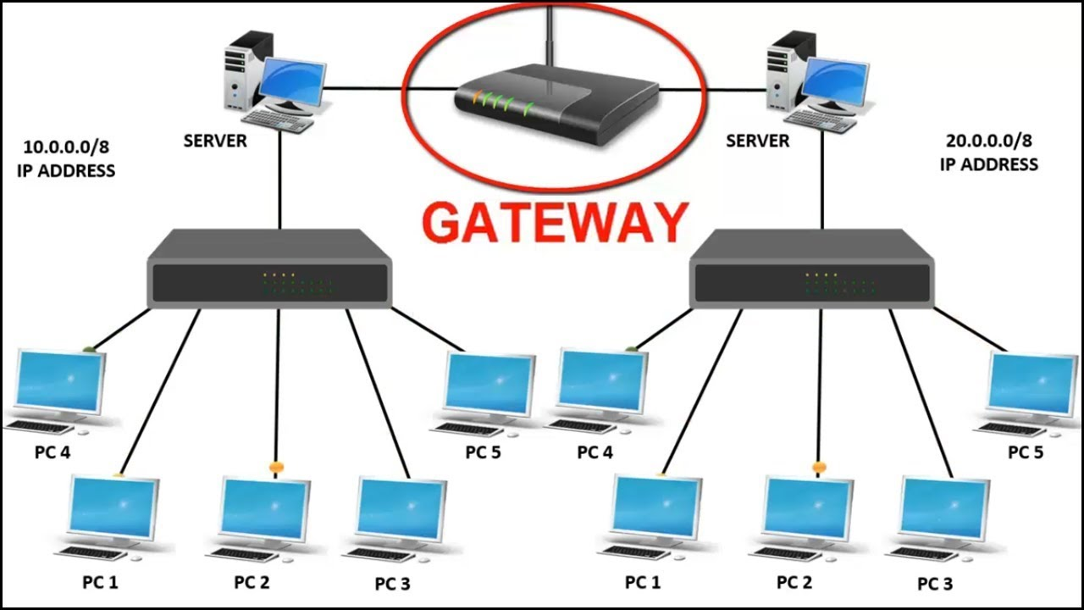
7. Gateway
A gateway is a piece of networking hardware used in telecommunications for telecommunications networks that allows data to flow from one discrete network to another.
Gateways are distinct from routers or switches in that they communicate using more than one protocol to connect a bunch of networks.
A computer that connects two or more networks or programs. The gateway changes the format or protocol of information, data, or other communications from one to another. A router may be able to do some of what a gateway does.
Notes:
Once again, I tried to pull graphics from the original network diagram. I had to alter the wireless router graphic in Photoshop to make it look better. I darken the and removed a white background to make it look consistent in relation to the standard router.

Slide 17
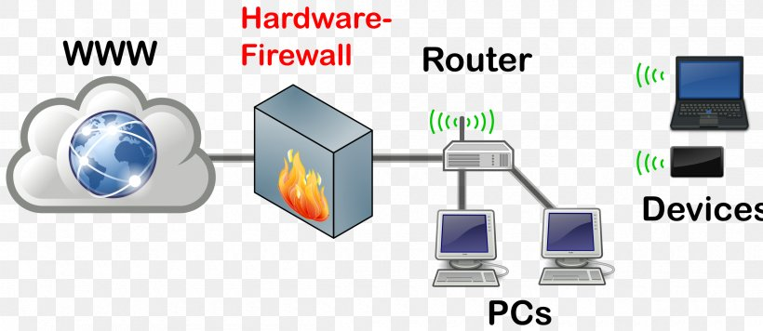
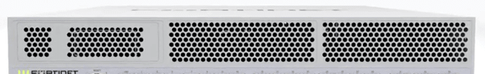
8. Firewall
A firewall is a network device or software for controlling network security and access rules.
Firewalls are inserted in connections between secure internal networks and potentially insecure external networks such as the Internet.
Firewalls are typically configured to reject access requests from unrecognized sources while allowing actions from recognized ones.
The vital role firewalls play in network security grows in parallel with the constant increase in cyber attacks.
Notes:
Once again, I tried to pull graphics from the original network diagram. I had to alter the wireless router graphic in Photoshop to make it look better. I darken the and removed a white background to make it look consistent in relation to the standard router.

Slide 18
8. Firewall
There are a few different ways security firewalls can watch and control network traffic. Some of these ways are:
Packet filtering. Packets are small groups of data. When a firewall uses packet filtering, the packets trying to get into the network are run through a set of filters. These filters take out the packets that match known threats and let the rest get to where they need to go.
Proxy service. These firewalls are very safe, but they also have some problems. They work more slowly than other types of firewalls and can often only support a limited number of applications.
Stateful inspection. Stateful inspection firewalls look at different parts of each data packet and compare them to a database of trusted information. Static filtering only looks at the packet headers. These elements are the source and destination IP addresses, ports, and applications.

Slide 19
Network Media
The function of the media is to carry a flow of information through a LAN.
Wired Media:- A widely adopted family that uses copper and fiber media in local area network (LAN) technology are collectively known as Ethernet
Copper Cable
Coaxial Cables
Shielded Twisted Pair(STP)
Unshielded Twisted Pair
Fibre Optic Cable
Wireless Media:- use the atmosphere, or space, as the medium.
Notes:
Once again, I tried to pull graphics from the original network diagram. I had to alter the wireless router graphic in Photoshop to make it look better. I darken the and removed a white background to make it look consistent in relation to the standard router.

Slide 20
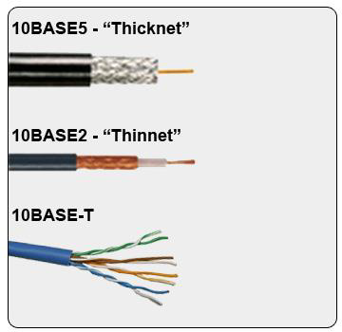
1. Copper Cable
The most common, easiest, quickest, and cheapest form of network media to install.
The disadvantage of sending data over copper wire is that the further the signal travels, the weaker it becomes.
Notes:
Once again, I tried to pull graphics from the original network diagram. I had to alter the wireless router graphic in Photoshop to make it look better. I darken the and removed a white background to make it look consistent in relation to the standard router.

Slide 21
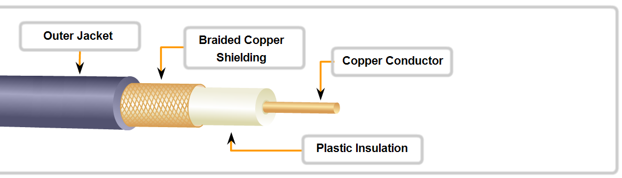
a. Coaxial Cable
It can be run longer distances than Twisted pair Cables.
Speed: 10-100Mbps
• Cost: Inexpensive
• Media and connector size: Medium
• Maximum cable length: 500m
Notes:
Once again, I tried to pull graphics from the original network diagram. I had to alter the wireless router graphic in Photoshop to make it look better. I darken the and removed a white background to make it look consistent in relation to the standard router.

Slide 22
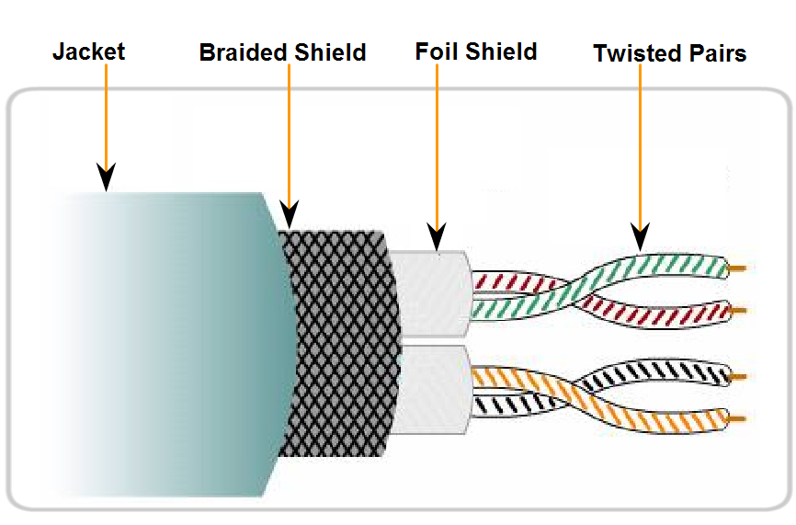
b. Shielded Twisted Pair(STP)
Speed: 0-100Mbps
Cost: Moderate
Media and connector size: Medium to large
Maximum cable length: 100m
Notes:
Once again, I tried to pull graphics from the original network diagram. I had to alter the wireless router graphic in Photoshop to make it look better. I darken the and removed a white background to make it look consistent in relation to the standard router.

Slide 23
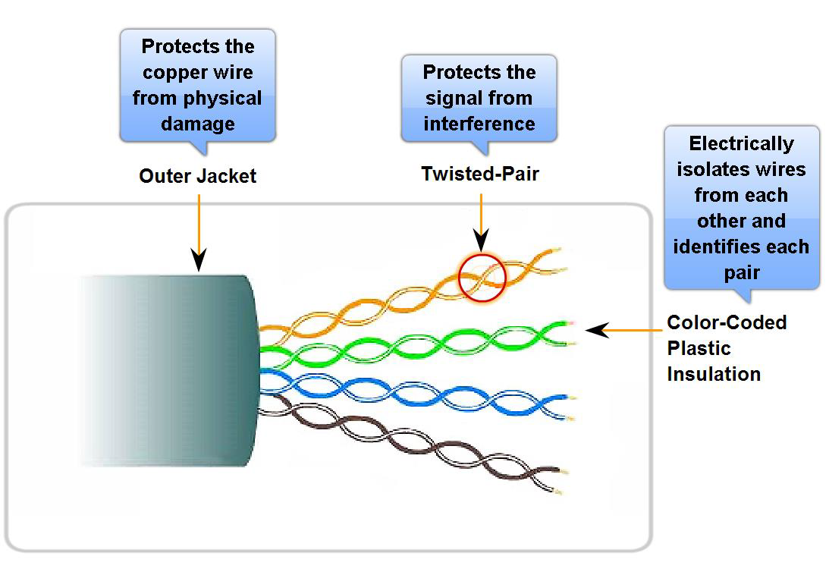
c. Unshielded Twisted Pair
UTP is a four-pair wire medium used in a variety of networks.
Each of the eight copper wires in the UTP cable is covered by insulating material
Speed: 10-100-1000 Mbps*
Cost: Least Expensive
Media and connector size: Small
Maximum cable length: 100m * (Depending on the quality/category of cable)
Notes:
Once again, I tried to pull graphics from the original network diagram. I had to alter the wireless router graphic in Photoshop to make it look better. I darken the and removed a white background to make it look consistent in relation to the standard router.

Slide 24
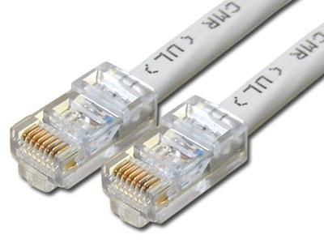
UTP Implementation
EIA/TIA specifies an RJ-45 connector for UTP cable.
(Telecommunications Industry Association (TIA) and
Electronic Industries Alliance (EIA).)
The letters RJ stand for registered jack.
The term RJ45 has also come to refer to a range of connectors for Ethernet jacks.

Slide 25
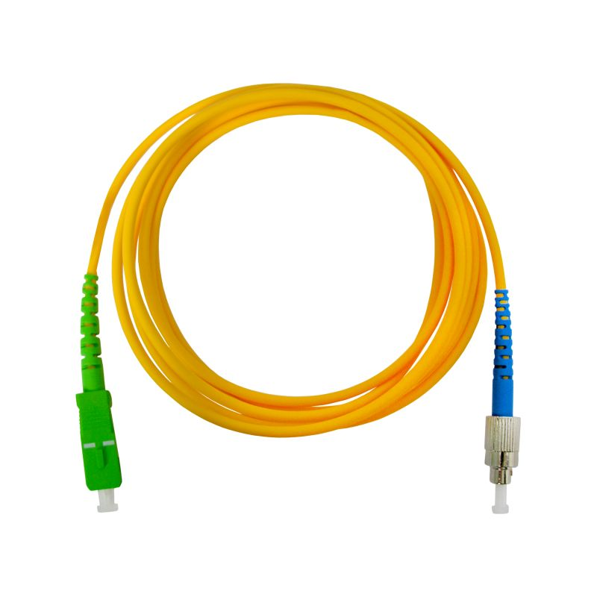
Fiber Optic Cable
Glass fiber carrying light pulses, each pulse a bit.
Based on the Total Internal Reflection of Light.
High-speed point-to-point transmission 10-100’s Gbps
low error rate:
repeaters spaced far apart
immune to electromagnetic noise

Slide 26
Communication Protocols
Internet Protocol Suite
Also called TCP/IP, is the foundation of all modern networking.
It defines the addressing, identification, and routing specifications for IPv4 and for IPv6.
It is the defining set of protocols for the Internet.
IEEE 802
It is a family of IEEE standards dealing with local area networks and metropolitan area networks.
They operate mostly at levels 1 and 2 of the OSI model.
Ethernet
It is a family of protocols used in wired LANs, described by a set of standards together called IEEE 802.3
Notes:
Once again, I tried to pull graphics from the original network diagram. I had to alter the wireless router graphic in Photoshop to make it look better. I darken the and removed a white background to make it look consistent in relation to the standard router.

Slide 27
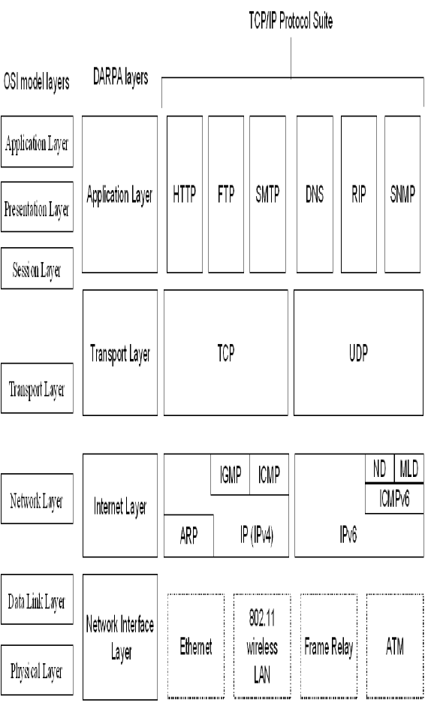
TCP/IP Protocol Suite

Slide 28
Communication Protocols
Wireless LAN
It is standardized by IEEE 802.11 and shares many properties with wired Ethernet.
SONET/SDH
Synchronous optical networking (SONET) and Synchronous Digital Hierarchy (SDH) are standardized multiplexing protocols that transfer multiple digital bit streams over optical Fibre using lasers.
Asynchronous Transfer Mode(ATM)
It uses asynchronous time-division multiplexing and encodes data into small, fixed-sized cells.
Good choice for a network that handle both traditional high-throughput data traffic, and real-time, low-latency content such as voice and video.
Notes:
Once again, I tried to pull graphics from the original network diagram. I had to alter the wireless router graphic in Photoshop to make it look better. I darken the and removed a white background to make it look consistent in relation to the standard router.

