Slide 1
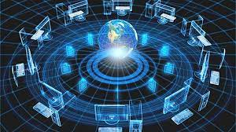
Computer Networking
Mehmet Akif CIFCI
Assistant Professor
@themanoftalent on all platforms
Week 2

Slide 2
Types of Networks
Personal Area Network (PAN)
Local Area Network (LAN)
Campus Area Network (CAN)
Metropolitan Area Network (MAN)
Wide Area Network (WAN)
Storage-Area Network (SAN)
Virtual Private Network (VPN)
Client Server Network
Peer to Peer Network (P2P)
Notes:
I used this slide as a Introduction to the different types of networks. I tried to let the graphics do the talking on this slide. I elaborated more on each network type on subsequent slides.

Slide 3
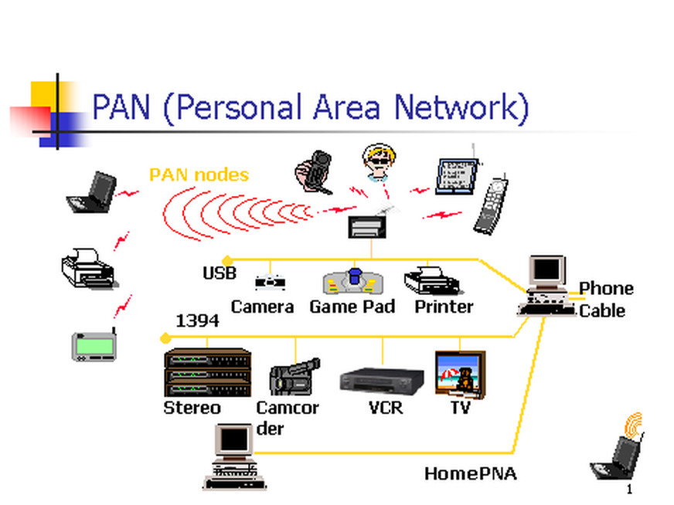
1. Personal Area Network
Personal Area Network (PAN) is a computer network used for data transmission amongst devices such as computers, telephones, tablets and personal digital assistants.
Also Known as HAN (Home Area Network)
PANs can be used for communication amongst the personal devices themselves (interpersonal communication), or for connecting to a higher level network and the Internet (an uplink) where one "master" device takes up the role as internet router.
Notes:
I kept the graphic the same as the previous graphic representing the Wide Area Network in hopes of creating a degree familiarity. I also include some basic facts about it.

Slide 4
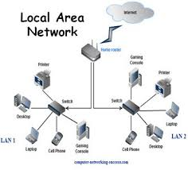
2. Local Area Network
Xerox Corporation worked in collaboration with DEC and Intel to create Ethernet, which is the most pervasive LAN architecture used today.
Ethernet has evolved and has seen significant improvements in regard to speed and efficiency.
An upside of a LAN is fast data transfer with data speed that can reach up to 10Gbps.
Other significant LAN technologies are Fiber Distributed Data Interface (FDDI) and token ring.
Notes:
I kept the graphic the same as the previous graphic representing the Local Area Network in hopes of creating a degree familiarity. I also include some basic facts about it.

Slide 5
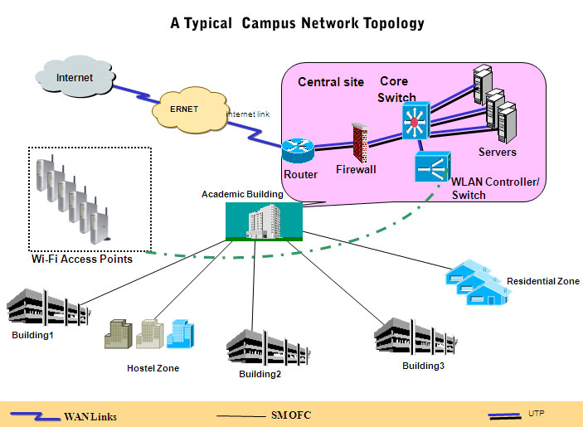
3. Campus Area Network
Larger than LANs, but smaller than metropolitan area networks these types of networks are typically seen in universities, large K-12 school districts or small businesses.
They can be spread across several buildings that are fairly close to each other so users can share resources
Notes:
I kept the graphic the same as the previous graphic representing the Local Area Network in hopes of creating a degree familiarity. I also include some basic facts about it.

Slide 6
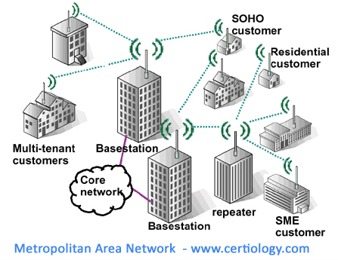
4. Metropolitan Area Network
A MAN is larger than a LAN but smaller than or equal in size to a WAN.
The size range anywhere from 5 to 50km in diameter.
MANs are typically owned and managed by a single entity.
This could be an ISP or telecommunications company that sells its services to end-users in that metropolitan area.
For all intents and purposes, a MAN has the same characteristics as a WAN with distance constraints.
Notes:
I kept the graphic the same as the previous graphic representing the Wide Area Network in hopes of creating a degree familiarity. I also include some basic facts about it.

Slide 7

5. Wide Area Network
A Wide Area Network exist over a large area
Data travels through telephone or cable lines
Usually requires a Modem
The world’s largest Wide Area Network in the Internet
Notes:
I kept the graphic the same as the previous graphic representing the Wide Area Network in hopes of creating a degree familiarity. I also include some basic facts about it.

Slide 8
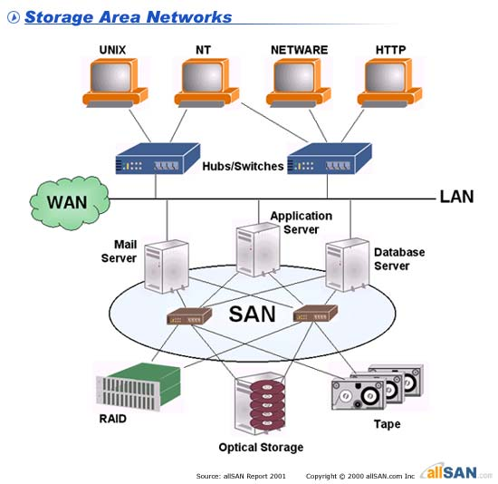
6. Storage Area Network
SAN may be referred to as a Sub network or special purpose network.
Its special purpose is to allow users on a larger network to connect various data storage devices with clusters of data servers.
SANs can be accessed in the same fashion as a drive attached to a server.
Notes:
I kept the graphic the same as the previous graphic representing the Wide Area Network in hopes of creating a degree familiarity. I also include some basic facts about it.

Slide 9
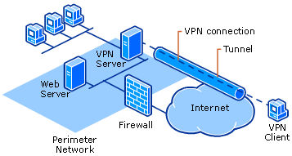
7. Virtual Private Network
VPN is a private network that can access public networks remotely. VPN uses encryption and security protocols to retain privacy while it accesses outside resources.
When employed on a network, VPN enables an end user to create a virtual tunnel to a remote location. Typically, telecommuters use VPN to log in to their company networks from home.
Authentication is provided to validate the identities of the two peers.
Confidentiality provides encryption of the data to keep it private from prying eyes.
Integrity is used to ensure that the data sent between the two devices or sites has not been tampered with.

Slide 10
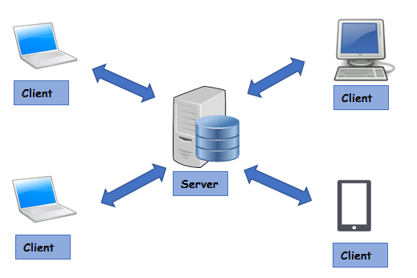
8. Client/Server Network
In a client/server arrangement, network services are located on a dedicated computer called a server.
The server responds to the requests of clients.
The server is a central computer that is continuously available to respond to requests from clients for file, print, application, and other services.
Most network operating systems adopt the form of a client/server relationship.
Typically, desktop computers function as clients, and one or more computers with additional processing power, memory, and specialized software function as servers.

Slide 11
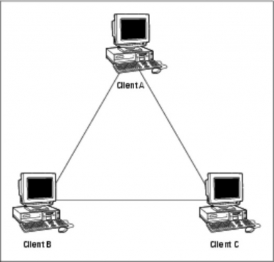
9. Peer to Peer Network
Usually very small networks
Each workstation has equivalent capabilities and responsibilities
Does not require a switch or a hub.
These types of networks do not perform well under heavy data loads.
Notes:
I kept the graphic the same as the previous graphic representing the Peer to Peer Area Network in hopes of creating a degree familiarity. I also include some basic facts about it.

Slide 12
Network Topologies
Network topology defines the structure of the network.
Physical topology:- It define the actual layout of the wire or media.
Bus
Ring
Star
Tree(Hierarchical)
Mesh
Logical topology:- It defines how the hosts access the media to send data.
Broadcast
Token passing
Hybrid Topology
Notes:
The topology section of my presentation may have been a little confusing for those who are not in the IT or networking field. I tried to explain the process and function of topologies using the three subsequent slides and the features of each topology.

Slide 13
1. Bus Topology
All devices are connected to a central cable, called bus or backbone.
There are terminators at each end of the bus that stops the signal and keeps it from traveling backwards.
T
T
Advantages:
There is no central controller.
Control resides in each station
The less interconnecting wire is required.
Ease of installation.
Backbone cable can be laid along the most efficient path, and then connected to the nodes by drop lines of various lengths
Disadvantages:
It is possible that more than one station may attempt transmission simultaneously (collision or contention).
Difficult reconfiguration and fault isolation.
A fault or break in the bus cable stops all transmission, even between devices on the same side of the problem.
The damaged area reflects signals in the direction of origin, creating noise in both directions
Notes:
I wanted to beak each of these down so it could be explained and understood better. While topology diagrams can be easily understood in the IT field they may be a little hard to grasp to average person.

Slide 14
2. Ring Topology
All devices are connected to one another in the shape of a closed loop.
Each device is connected directly to two other devices, one on either side of it.
Advantages:
Avoids the collisions that are possible in the bus topology.
Each pair of stations has a point-to-point connection.
A signal is passed along the ring in one direction, from device to another, until it reaches its destination.
Each device incorporates a repeater.
Relatively easy to install and reconfigure.
Fault isolation is simplified.
Disadvantages:
A break in the ring (such as station disabled) can disable the entire network.
Unidirectional traffic.
Notes:
I wanted to beak each of these down so it could be explained and understood better. While topology diagrams can be easily understood in the IT field they may be a little hard to grasp to average person.

Slide 15
3. Star Topology
All devices are connected to a central hub.
Nodes communicate across the network by passing data through the hub or switch.
Advantages:
1. Easy to install and reconfigure.
2. Robustness, if one link fails; only that link is affected. All other links remain active.
3. Easy fault identification and isolation. As long as the hub is working, it can be used to monitor link problems and bypass defective links.
Disadvantages:
1. The devices are not linked to each other.
2. If one device wants to send data to another, it sends it to the controller, which then relays the data to the other connected device.
Notes:
I wanted to beak each of these down so it could be explained and understood better. While topology diagrams can be easily understood in the IT field they may be a little hard to grasp to average person.

Slide 16
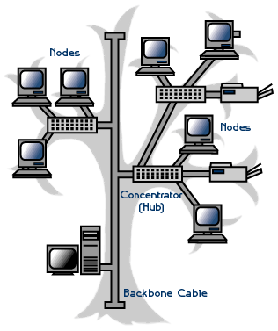
4. Tree/Hierarchical Topology
Advantages:
It allows more devices to be attached to a single central hub and can therefore increase the distance a signal can travel between devices.
It allows the network to isolate and prioritize communications from different computers.
Disadvantages:
The devices are not linked to each other.
If one device wants to send data to another, it sends it to the controller, which then relays the data to the other connected device.
The addition of secondary hubs brings two further advantages.
Notes:
I wanted to beak each of these down so it could be explained and understood better. While topology diagrams can be easily understood in the IT field they may be a little hard to grasp to average person.

Slide 17
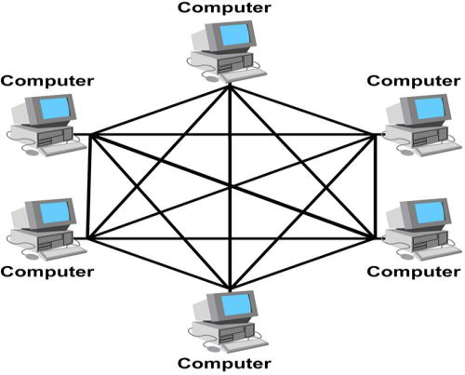
6. Mesh Topology
Each host has its connections to all other hosts.
Mesh topology is implemented to provide as much protection as possible from interruption of service.
A nuclear power plant might use a mesh topology in the networked control systems.
Although the Internet has multiple paths to any one location, it does not adopt the full mesh topology.
Advantages:
1. The use of dedicated links guarantees that each connection can carry its data load, thus eliminating the traffic problems that can occur when links must be shared by multiple devices.
2. It is robust, if one link becomes unusable, it does not incapacitate (affect) the entire system.
3. Privacy and Security (every message sent travels along a dedicated line; only the intended recipient sees it).
4. Point-to-point links make fault identification and fault isolation easy.
Disadvantages:
1. A large amount of cabling required.
2. A large amount of I/O ports required.
3. Installation and reconfiguration are difficult.
4. The sheer bulk of the wiring can be greater than the available space (in the walls, ceiling, or floors) can accommodate.
5. The hardware required to connect each link (I/O ports and cables) can be prohibitively expensive.
Notes:
I wanted to beak each of these down so it could be explained and understood better. While topology diagrams can be easily understood in the IT field they may be a little hard to grasp to average person.

Slide 18
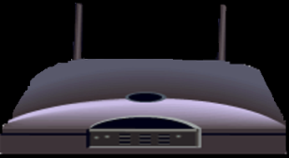
Wireless Networks
Wireless network is a type of computer network that uses wireless data connections for connecting network nodes.
Example
Bluetooth
Wi-Fi

Slide 19

Bluetooth
Bluetooth is a short-range wireless technology standard used for exchanging data between fixed and mobile devices over short distances.
It is using UHF radio waves in the ISM bands, from 2.402 GHz to 2.48 GHz.
The IEEE standardized Bluetooth as IEEE 802.15.1, but no longer maintains the standard.

Slide 20
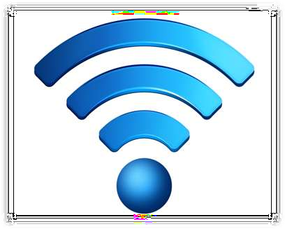
Wi-Fi
Wi-Fi Stands for Wireless Fidelity.
Wi-Fi, is a Local Area Wireless technology.
Wi-Fi networks use radio technologies to transmit and receive data at high speed.
It is based on the IEEE 802.11 family of standards.
Access point: The access point is a wireless LAN transceiver or “ base station” that can connect one or many wireless devices simultaneously to the internet

Slide 21

The Internet
The simplest definition of the Internet is that it's a network of computer networks
How Information Travel Through the Internet
A page on the Internet—whether it's full of words, images or both—doesn't come to you in one shipment. It's translated into digital information, chopped into 1500 byte pieces called PACKETS, and sent to you like a puzzle that needs to be reassembled. Each part of the packet has a specific function:
Sequence ID
ID’s where the information belongs in relation to the rest of the information
Header
Provides the complete destination address for the packet
End of Message
ID’s the end of the packet
Data Block
The portion of the overall information carried by the packet
Notes:
I used three slides to go over the Internet. I wanted to start of the first slide with a basic statement but, it would have an impact on the viewer.

Slide 22
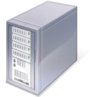

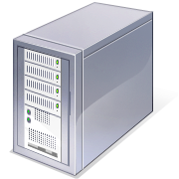
The Internet
How Information Travel Through the Internet
When you connect to a Web site through an ISP and start exchanging information, there isn't a fixed connection between your computer and the Web server computer hosting the Web site. Instead, information is exchanged using the best possible path at that particular time. Special computers called routers determine these paths, avoiding slow links and favoring fast ones.
Your Computer
Web Servers
ISP
Routers
Notes:
I would have like to use some animation for this but it would have been very difficult so I went ahead and use green and red colors to represent the flowing in data into the Internet and the flowing of data out of the Internet. I wanted to stress that data does not take the same path all the time when traveling to and from the Internet.

Slide 23
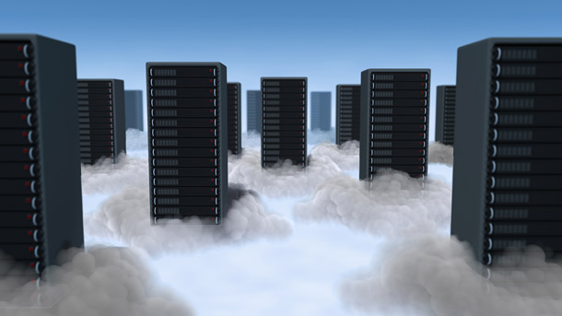
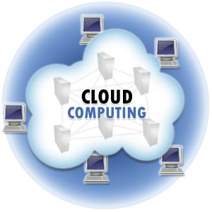
Cloud Computing
Cloud computing is Internet-based computing, whereby shared resources, software, and information are provided to computers and other devices on demand, like the electricity grid.
A Cloud is a type of parallel and distributed system consisting of a collection of interconnected and virtualized computers that are dynamically provisioned and presented as one or more unified computing resources based on service-level agreements established through negotiation between the service provider and consumers.
Notes:
IP addresses tend to go along with servers, especially web servers in that they store data for websites. Once again there is a good deal of information on this slide and I might could have separated Static and Temporary IP addresses into separate slides but I felt a side by side comparison was effective.

Slide 24

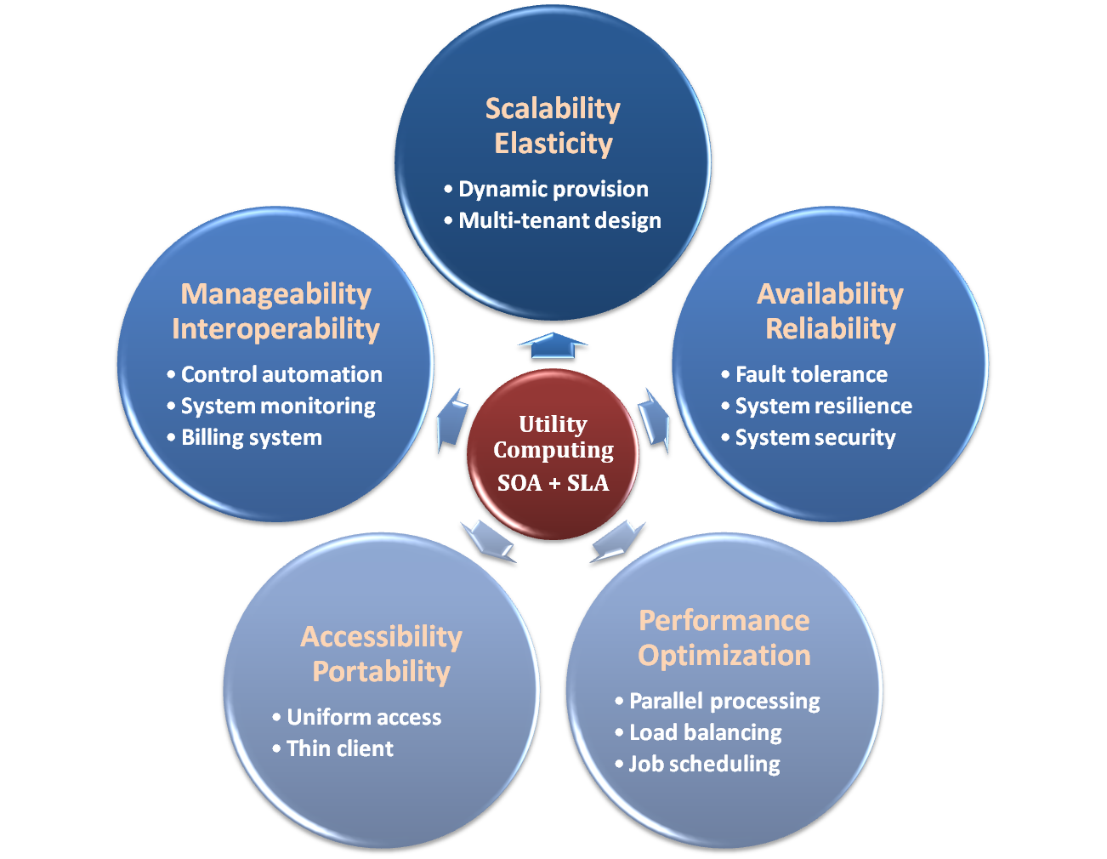
Properties & Characteristics
Notes:
IP addresses tend to go along with servers, especially web servers in that they store data for websites. Once again there is a good deal of information on this slide and I might could have separated Static and Temporary IP addresses into separate slides but I felt a side by side comparison was effective.

Slide 25
IaaS
Infrastructure as a Service – IaaS
The capability provided to the consumer is to provision processing, storage, networks, and other fundamental computing resources where the consumer is able to deploy and run arbitrary software, which can include operating systems and applications.
The consumer does not manage or control the underlying cloud infrastructure but has control over operating systems, storage, deployed applications, and possibly limited control of select networking components .
Examples :
Amazon EC2
Eucalyputs
OpenNebula
… etc
Notes:
IP addresses tend to go along with servers, especially web servers in that they store data for websites. Once again there is a good deal of information on this slide and I might could have separated Static and Temporary IP addresses into separate slides but I felt a side by side comparison was effective.

Slide 26
PaaS
Platform as a Service – PaaS
The capability provided to the consumer is to deploy onto the cloud infrastructure consumer-created or acquired applications created using programming languages and tools supported by the provider.
The consumer does not manage or control the underlying cloud infrastructure including network, servers, operating systems, or storage, but has control over the deployed applications and possibly application hosting environment configurations.
Examples :
Microsoft Windows Azure
Google App Engine
Hadoop(High Availability Distributed Object Oriented Platform)
… etc
Notes:
IP addresses tend to go along with servers, especially web servers in that they store data for websites. Once again there is a good deal of information on this slide and I might could have separated Static and Temporary IP addresses into separate slides but I felt a side by side comparison was effective.

Slide 27
SaaS
Software as a Service – SaaS
The capability provided to the consumer is to use the provider’s applications running on a cloud infrastructure. The applications are accessible from various client devices through a thin client interface such as a web browser (e.g., web-based email).
The consumer does not manage or control the underlying cloud infrastructure including network, servers, operating systems, storage, or even individual application capabilities, with the possible exception of limited user-specific application configuration settings.
Examples :
Google Apps (e.g., Gmail, Google Docs, Google sites, …etc)
Notes:
IP addresses tend to go along with servers, especially web servers in that they store data for websites. Once again there is a good deal of information on this slide and I might could have separated Static and Temporary IP addresses into separate slides but I felt a side by side comparison was effective.

Slide 28
Cloud-Deployment Model
There are four primary cloud deployment models :
Public Cloud
Private Cloud
Community Cloud
Hybrid Cloud
 | Public Cloud | Private Cloud
Infrastructure | Homogeneous | Heterogeneous
Policy Model | Common defined | Customized & Tailored
Resource Model | Shared & Multi-tenant | Dedicated
Cost Model | Operational expenditure | Capital expenditure
Economy Model | Large economy of scale | End-to-end control
Homogeneous

