Slide 1

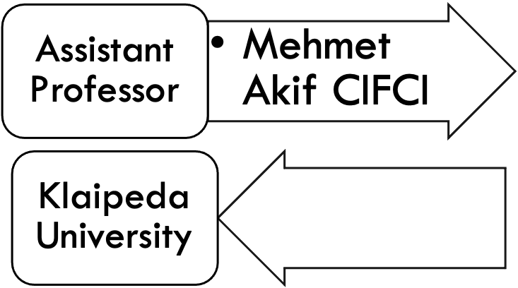
INTRODUCTION TO NETWORK ADMINISTRATION

Slide 2
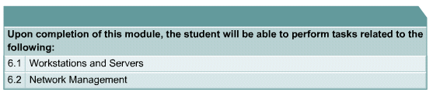
OBJECTIVES

Slide 3
WHAT IS COMPUTER NETWORK ADMINISTRATION?
NETWORK ADMINISTRATION AIMS TO MANAGE, MONITOR, MAINTAIN, SECURE, AND SERVICE AN ORGANIZATION'S NETWORK. HOWEVER, THE SPECIFIC TASKS AND PROCEDURES MAY VARY DEPENDING ON THE SIZE AND TYPE OF AN ORGANIZATION.

Slide 4
NETWORK MONITORING
NETWORK MONITORING IS ESSENTIAL TO MONITOR UNUSUAL TRAFFIC PATTERNS, THE HEALTH OF THE NETWORK INFRASTRUCTURE, AND DEVICES CONNECTED TO THE NETWORK. IT HELPS DETECT ABNORMAL ACTIVITY, NETWORK ISSUES, OR EXCESSIVE BANDWIDTH CONSUMPTION EARLY ON AND TAKE PREVENTATIVE AND REMEDIAL ACTIONS TO UPHOLD THE NETWORK QUALITY AND SEC
NETWORK MANAGEMENT ENCOMPASSES MULTIPLE ADMINISTRATIVE FUNCTIONS, INCLUDING NETWORK PLANNING, IMPLEMENTATION, AND CONFIGURATION. IT INVOLVES:
REPLANNING THE NETWORK BASED ON CHANGING ORGANIZATIONAL REQUIREMENTS
IMPLEMENTING THE NETWORK FOR MAXIMUM EFFICIENCY
CONFIGURING VARIOUS NETWORKING AND SECURITY PROTOCOLS
APPLYING SECURITY PATCHES AND UPDATING THE FIRMWARE OF THE NETWORKING INFRASTRUCTURE, SUCH AS ROUTERS, HUBS, SWITCHES, AND FIREWALLS
ASSESSING THE NETWORK FOR WEAKNESSES
EVALUATING QUALITY AND CAPACITY TO INCREASE OR DECREASE NETWORK CAPACITY AND MANAGE RESOURCE WASTAGE.

Slide 5
NETWORK MONITORING 2
NETWORK SECURITY EMPLOYS VARIOUS TECHNIQUES TO ENSURE A NETWORK IS SECURE. FOR EXAMPLE, IT USES MULTIPLE TOOLS SUCH AS FIREWALLS, INTRUSION DETECTION OR PREVENTION SYSTEMS, AND ANTI-MALWARE SOFTWARE TO PREVENT OR DETECT MALICIOUS ACTIVITY.
NETWORK ADMINISTRATION GOALS
NETWORK ADMINISTRATION AIMS TO ENSURE A RELIABLE, SECURE NETWORK CONDUCIVE TO BUSINESS OPERATIONS.
GENERALLY, NETWORK ADMINISTRATION GOALS INCLUDE:
MAINTAIN A RESILIENT, HIGH-QUALITY NETWORK
PLAN AND IMPROVE NETWORK CAPACITY TO ENABLE SEAMLESS NETWORK ACCESS AND OPERATIONS
LEVERAGE NETWORKING TOOLS FOR NETWORK SYSTEMS ADMINISTRATION AND BETTER NETWORK ADMINISTRATION CONTROL
TRACK AND DOCUMENT RELEVANT CHANGES
EVALUATE POSSIBLE RISKS AND ORCHESTRATE EFFECTIVE MITIGATIONS
PREVENT ACTIVITIES COMPROMISING OR USING THE NETWORK AS AN ATTACK VECTOR
IDENTIFY AND MITIGATE INTRUSIONS TO AVOID SECURITY BREACHES

Slide 6
NETWORK ADMINISTRATION KEY AREAS
NETWORKS ADMINISTRATION CONSISTS OF 5 KEY AREAS:
FAULT MANAGEMENT: MONITORS THE NETWORK INFRASTRUCTURE TO IDENTIFY AND ADDRESS ISSUES POTENTIALLY AFFECTING THE NETWORK. IT USES STANDARD PROTOCOLS SUCH AS SIMPLE NETWORK MANAGEMENT PROTOCOL (SNMP) TO MONITOR NETWORK INFRASTRUCTURE.
CONFIGURATION MANAGEMENT: TRACKS CONFIGURATION AND RELATED CHANGES OF NETWORK COMPONENTS, INCLUDING SWITCHES, FIREWALLS, HUBS, AND ROUTERS. AS UNPLANNED CHANGES CAN AFFECT THE NETWORK DRASTICALLY AND POTENTIALLY CAUSE DOWNTIME, IT’S ESSENTIAL TO STREAMLINE, TRACK, AND MANAGE CONFIGURATION CHANGES.
ACCOUNT MANAGEMENT: TRACKS NETWORK UTILIZATION TO BILL AND ESTIMATE THE USAGE OF VARIOUS DEPARTMENTS OF AN ORGANIZATION. IN SMALLER ORGANIZATIONS, BILLING MAY BE IRRELEVANT. HOWEVER, MONITORING UTILIZATION HELPS SPOT SPECIFIC TRENDS AND INEFFICIENCIES.
PERFORMANCE MANAGEMENT: FOCUSES ON MAINTAINING SERVICE LEVELS NEEDED FOR EFFICIENT OPERATIONS. IT COLLECTS VARIOUS METRICS AND ANALYTICAL DATA TO CONTINUALLY ASSESS NETWORK PERFORMANCE, INCLUDING RESPONSE TIMES, PACKET LOSS, AND LINK UTILIZATION.
SECURITY MANAGEMENT: AIMS TO ENSURE ONLY AUTHORIZED ACTIVITY AND AUTHENTICATED DEVICES AND USERS CAN ACCESS THE NETWORK. IT EMPLOYS SEVERAL DISCIPLINES SUCH AS THREAT MANAGEMENT, INTRUSION DETECTION, AND FIREWALL MANAGEMENT. IT ALSO COLLECTS AND ANALYZES RELEVANT NETWORK INFORMATION TO DETECT AND BLOCK MALICIOUS OR SUSPICIOUS ACTIVITY.

Slide 7
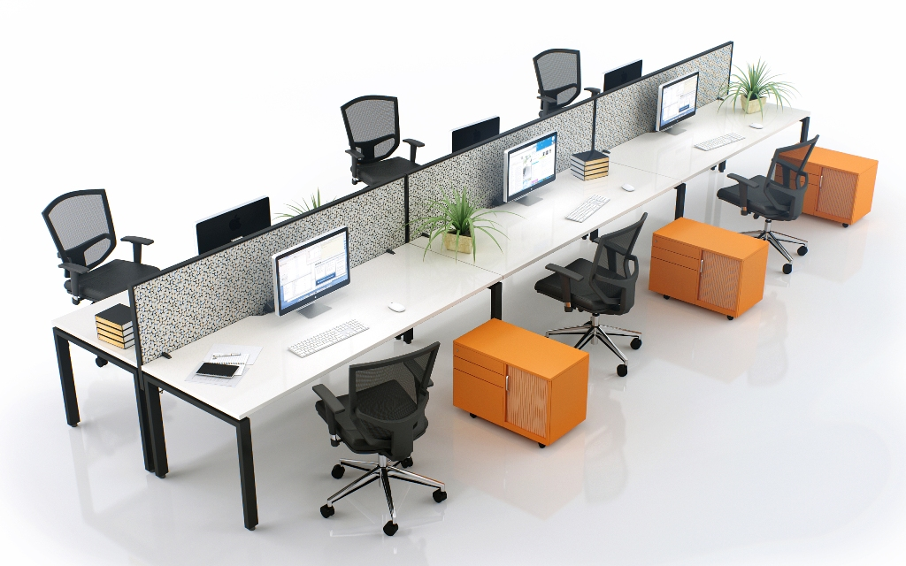
WORKSTATIONS
A workstation is a client computer that is used to run applications and is connected to a server from which it obtains data shared with other computers.

Slide 8
WORKSTATIONS
What meant by workstations?
workstation, a high-performance computer system that is basically designed for a single user and has advanced graphics capabilities, large storage capacity, and a powerful central processing unit.
What's the difference between desktops and workstations?
A desktop is any computer that can be fit on top of a table or a desk. This was to differentiate against the older and bigger computers. A workstation is the term used for high end computers that are used for scientific or any other heavy usage application.
A powerful Windows PC that can be used to run complex database programs is an example of a workstation. A cubicle where you perform your job is an example of a workstation.

Slide 9
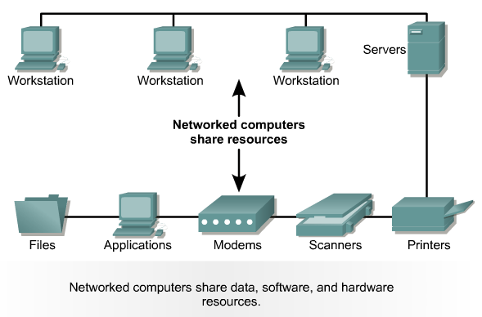
SERVERS: CONNECTING COMPUTER SYSTEMS

Slide 10
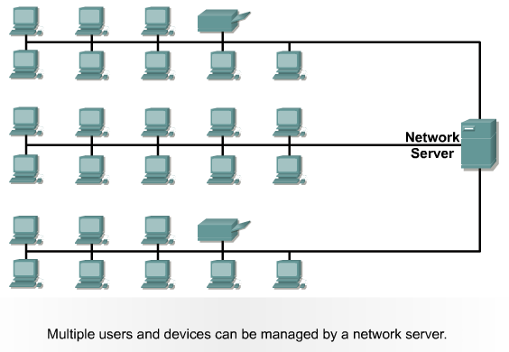
NETWORK SERVER ENVIRONMENT
Network servers are high-powered computers used as a central repository for data and various programs shared by users within a network. Users have a universe of programs and files they retain on their PCs, laptops, and devices

Slide 11
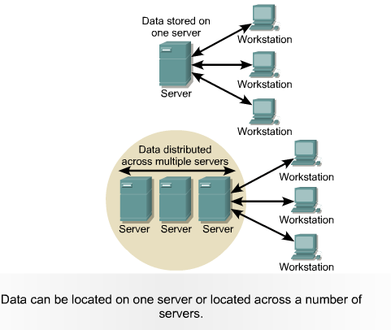
CLIENT/SERVER ENVIRONMENT
A client/server environment is an environment in which multiple applications connect to Derby over the network. Derby runs embedded in a server framework that allows multiple network connections. (The framework itself starts an instance of Derby and runs in an embedded environment.
Notes:
Apache Derby (previously distributed as IBM Cloudscape) is a relational database management system (RDBMS) developed by the Apache Software Foundation that can be embedded in Java programs and used for online transaction processing. It has a 3.5 MB disk-space footprint.

Slide 12
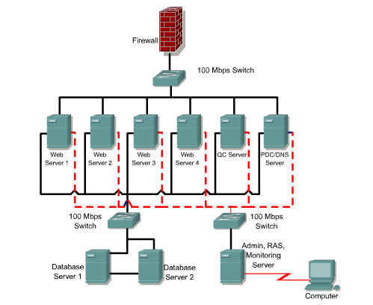
SERVER FARM
A server farm or server cluster is a collection of computer servers, usually maintained by an organization to supply server functionality far beyond the capability of a single machine. They often consist of thousands of computers which require a large amount of power to run and to keep cool.

Slide 13
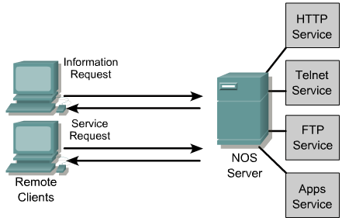
CLIENT-SERVER INTERACTION
Client/server is a model of interaction in which a program sends a request to another program and awaits a response. The requesting program is called a client; the answering program is called a server.
The client-server network model can be used over a LAN (local area network) or the Internet. Common examples of client-server networks include DNS (Domain Name Systems), web browsers and web servers, and FTP (file transfer protocol) clients.

Slide 14
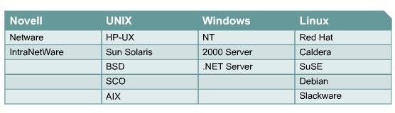
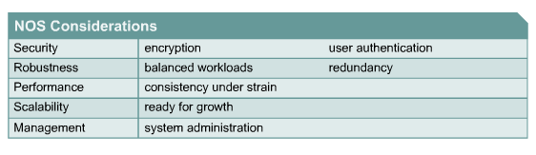
NETWORK OPERATING SYSTEMS

Slide 15
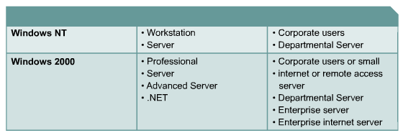
WINDOWS OS

Slide 16
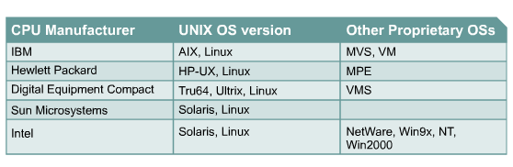
UNIX TYPES
Popular versions of Linux include the following:
  Red Hat Linux
  OpenLinux
  Corel Linux
  Slackware
  Debian GNU/Linux
  SuSE Linux

Slide 17
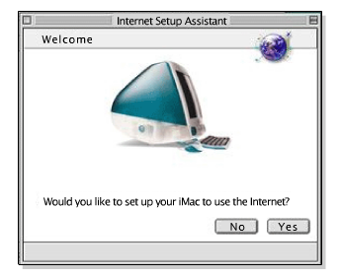
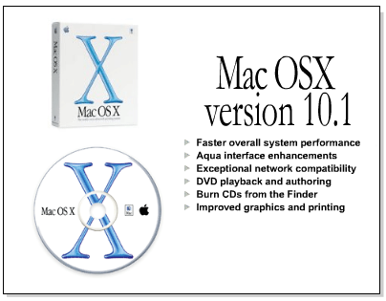
APPLE

Slide 18
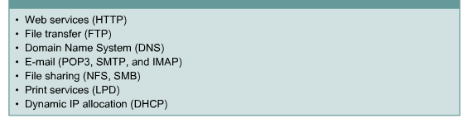
SERVICE APPLICATIONS AND PROTOCOLS

Slide 19
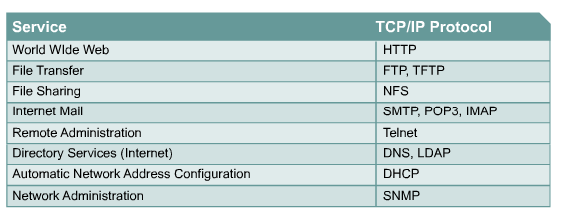
TCP/IP BASED SERVICES

Slide 20
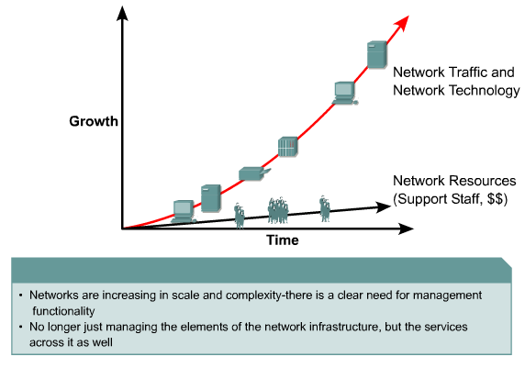
EVOLUTION OF NETWORK MANAGEMENT

Slide 21
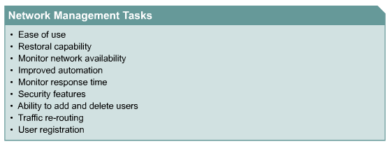
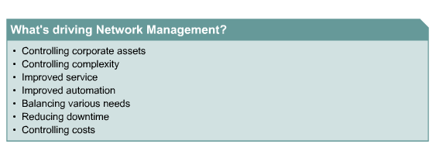
NETWORK MANAGEMENT REQUIREMENTS

Slide 22
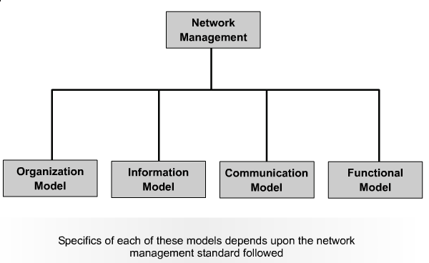
NETWORK MANAGEMENT MODEL

Slide 23
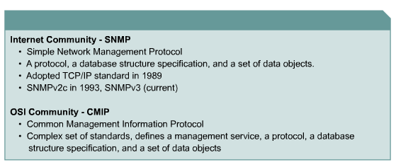
SNMP AND CMIP STANDARDS

Slide 24
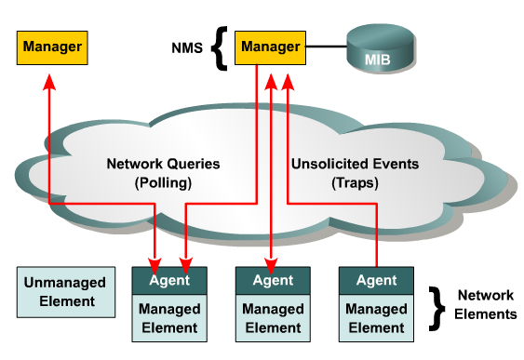
COMPONENTS OF THE ORGANIZATION MODEL
The network management station (NMS) is usually a standalone workstation, but it may be implemented over several systems.

Slide 25
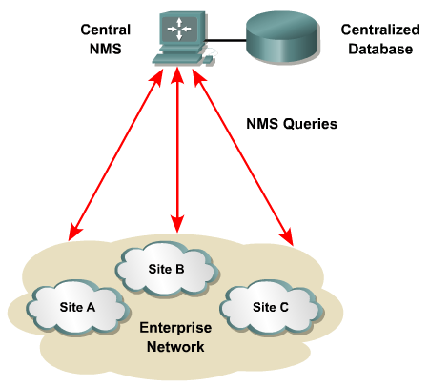
CENTRALIZED NETWORK MANAGEMENT ARCHITECTURE

Slide 26
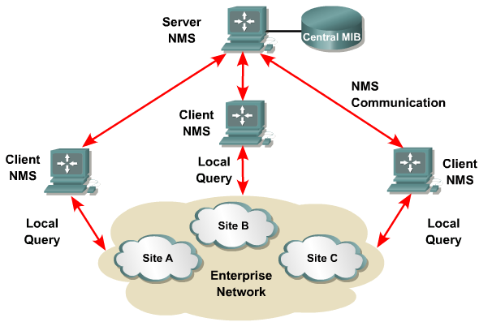
HIERARCHICAL NETWORK MANAGEMENT ARCHITECTURE

Slide 27
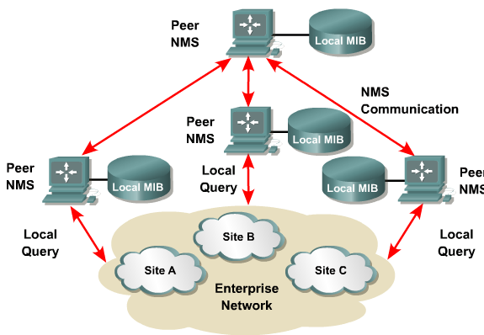
DISTRIBUTED NETWORK
MANAGEMENT ARCHITECTURE

Slide 28
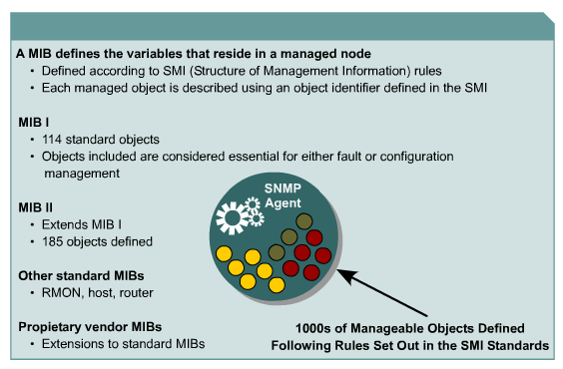
MANAGEMENT INFORMATION BASES

Slide 29
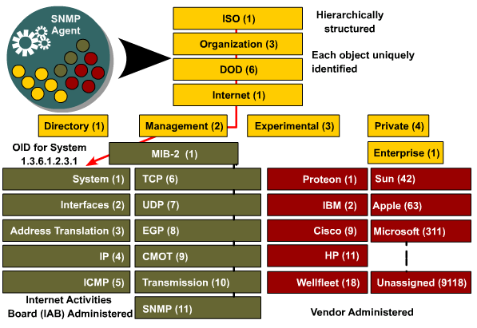
OBJECT IDENTIFIERS

Slide 30
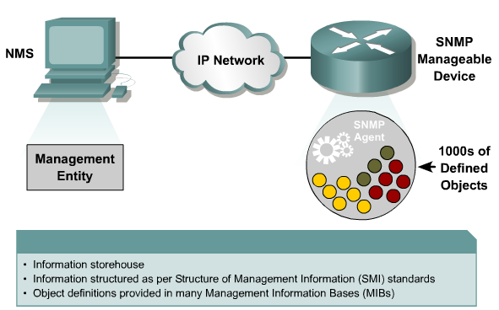
SNMP PROTOCOL: UNDERSTANDING THE AGENT

Slide 31
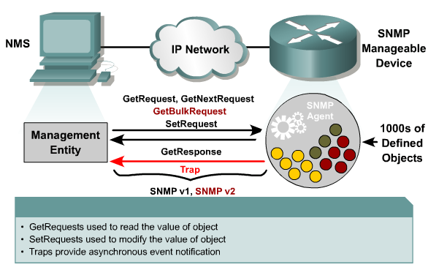
SNMP PROTOCOL: UNDERSTANDING THE PROTOCOL

Slide 32
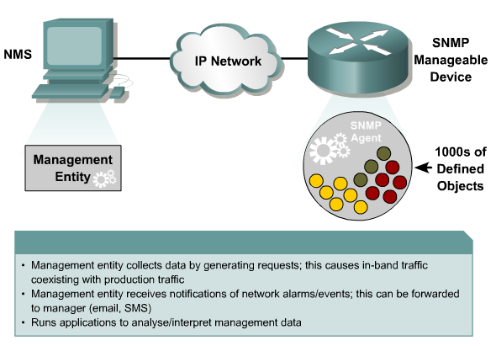
SNMP PROTOCOL: UNDERSTANDING THE MANAGEMENT ENTITY

Slide 33
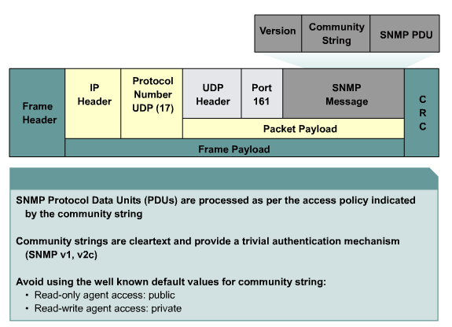
SNMP PROTOCOL: UNDERSTANDING COMMUNITY STRINGS

Slide 34
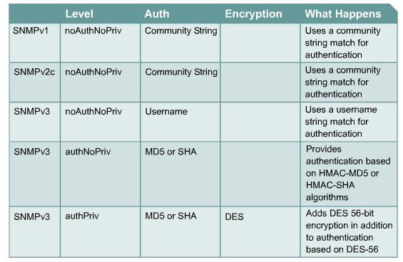
MANAGEMENT PROTOCOLS AND FEATURES

Slide 35
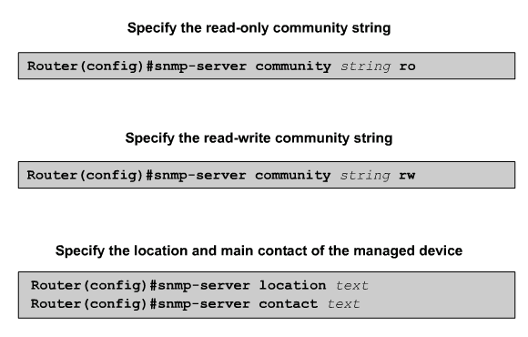
CONFIGURING SNMP

Slide 36
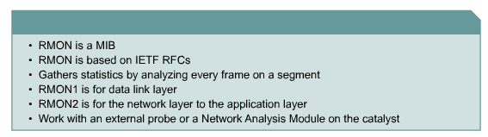
RMON

Slide 37
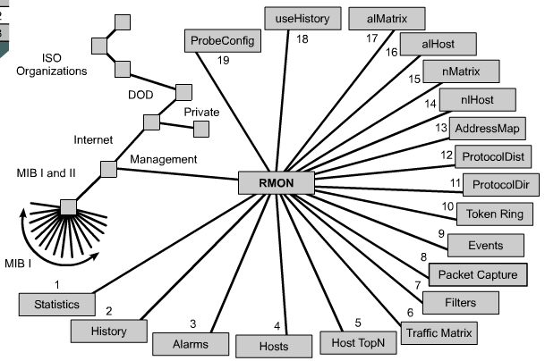
RMON MIB

Slide 38
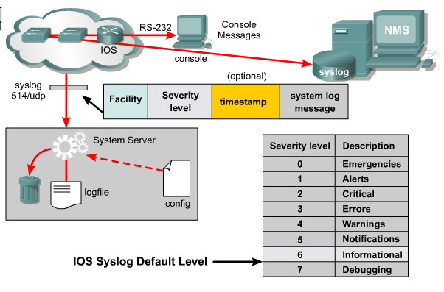
THE SYSLOG FACILITY

Slide 39
SUMMARY
THE FUNCTIONS OF A WORKSTATION AND A SERVER
THE ROLES OF VARIOUS EQUIPMENT IN A CLIENT/SERVER ENVIRONMENT
THE DEVELOPMENT OF NETWORKING OPERATING SYSTEMS (NOS)
AN OVERVIEW OF THE VARIOUS WINDOWS PLATFORMS
AN OVERVIEW OF SOME OF THE ALTERNATIVES TO WINDOWS OPERATING SYSTEMS
REASONS FOR NETWORK MANAGEMENT
THE LAYERS OF OSI AND NETWORK MANAGEMENT MODEL
THE TYPE AND APPLICATION OF NETWORK MANAGEMENT TOOLS
THE ROLE THAT SNMP AND CMIP PLAY IN NETWORK MONITORING
HOW MANAGEMENT SOFTWARE GATHERS INFORMATION AND RECORDS PROBLEMS
HOW TO GATHER REPORTS ON NETWORK PERFORMANCE

