Slide 1
CUSTOMER DATA
ANALYSIS
Customer shopping behaviour across 10 malls in Istanbul, Türkiye
SQL ANALYSIS | POWER BI DASHBOARD | BUSINESS INSIGHTS

Slide 2
Project overview
From raw retail transactions to actionable business insights
SHOPPING RECORDS
PRODUCTS SOLD
TOTAL REVENUE
SHOPPING MALLS
99,457
298,712
251.51M TL
10
Understand who shops, what they buy, and how they pay.
Compare customer behaviour by gender and age group.
Identify leading product categories and shopping mall activity.
Present the findings in an interactive Power BI dashboard.
2

Slide 3
Dataset at a glance
Retail shopping transaction data from Istanbul, Türkiye
ROWS
COLUMNS
CATEGORIES
PAYMENT METHODS
99,457
10
8
3
Fields included
Customer profile: customer_id, gender, age
Purchase details: invoice_no, category, quantity, price
Transaction details: payment_method, invoice_date, shopping_mall
Age range: 18–69 years • 10 shopping malls
Data period: 1 January 2021 – 8 March 2023
3

Slide 4
Data quality & validation
Initial checks performed in MySQL Workbench
SQL NULL VALUES
EXACT DUPLICATE ROWS
INVALID QUANTITY / PRICE
0
0
0
Across the 10 columns
Compared across all columns
No zero or negative values
Invoice numbers and customer IDs were unique across the dataset.
Age: minimum 18, maximum 69, average 43.43 years.
Quantity: minimum 1, maximum 5, average 3.00.
Price: minimum 5.23 TL, maximum 5,250 TL, average 689.26 TL.
4

Slide 5
Customer analysis by gender
Female customers account for a larger share of records and revenue
FEMALE RECORDS
MALE RECORDS
59,482
39,975
Female customers generated 150.21M TL (59.72% of revenue). Male customers generated 101.30M TL (40.28%).
Products sold: Female 178,659 | Male 120,053
5

Slide 6
Customer analysis by age group
Age bands were created for this analysis
HIGHEST REVENUE GROUP
56–69
67.10M TL
This group also recorded the highest shopping activity and product quantity.
The 18–25 age group generated the lowest revenue: 38.12M TL.
6

Slide 7
Payment method preferences
Cash is the most frequently used payment method
CASH SHARE
CREDIT CARD SHARE
44.69%
35.12%
Cash leads across every analysed age group, gender, product category, and shopping mall.
Debit card share: 20.19% • 20,079 shopping records
7

Slide 8
Product categories & shopping malls
Patterns observed across the eight categories and ten malls
Product category
Shopping mall activity
Clothing was the highest-revenue category.
Shoes and Technology were also important revenue contributors.
Clothing led across genders, age groups, payment methods, and malls.
Mall of Istanbul: 19,943 shopping records.
Kanyon: 19,823 shopping records.
Metrocity: 15,011 shopping records.
Mall of Istanbul and Kanyon recorded the highest transaction volumes.
Note: mall ranking here is based on shopping record counts, not revenue ranking.
8

Slide 9
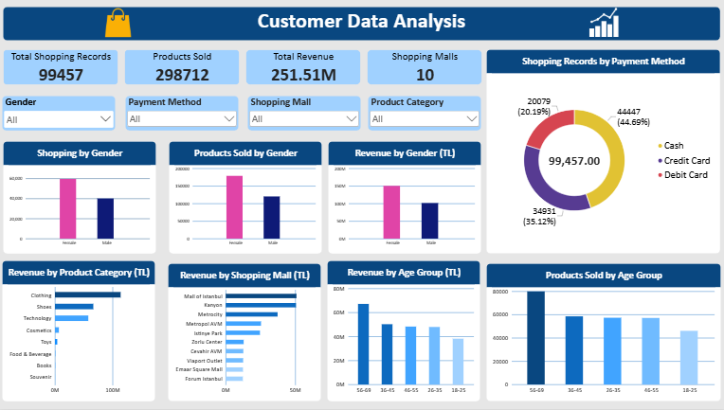
Interactive Power BI dashboard
Four KPI cards • Eight visuals • Four slicers
9

Slide 10
Business insights & recommendations
Translate observed patterns into practical next steps
Key insights
Recommendations
Female customers generated the larger share of revenue.
Customers aged 56–69 generated the highest revenue.
Clothing was the leading revenue category.
Cash was the most common payment method.
Tailor promotions to customer segments while engaging all age groups.
Maintain strong clothing availability and test category-specific campaigns.
Encourage convenient digital payments with suitable loyalty offers.
Monitor mall-level performance and use dashboard filters for deeper review.
10

Slide 11
Conclusion & limitations
A practical workflow from SQL analysis to business intelligence
Conclusion
Limitations
The project analysed 99,457 retail shopping records and used SQL and Power BI to identify customer, product, payment, and mall-level patterns. The interactive dashboard makes these findings easier to explore and communicate.
The verified dataset covers 1 January 2021 to 8 March 2023 (part of 2023, not the full calendar year).
Revenue is calculated as quantity × price, assuming price is a unit price.
All customer IDs are unique in this file; repeat-customer retention cannot be assessed. Findings are descriptive and do not establish causation.
THANK YOU
11

