Slide 1
HR ANALYTICS
Workforce insights, hiring trends and employee demographics
PROJECT PRESENTATION
A data-driven view of the employee workforce
Dataset: 22,214 employee records | Analysis: SQL | Visualisation: Power BI

Slide 2
HR Analytics Dashboard
02
Total Employees
Headquarters
Remote
Average Age
22,214
75.25%
24.75%
38.43 years
Employee Hiring Trend (2000–2020)
Workforce Gender Distribution
Employee Distribution by Department
Employee Distribution by Race
Employee Distribution by State
Largest department: Engineering (6,686) | Largest state workforce: Ohio (18,025)

Slide 3
Workforce Overview
03
Total Employees
Headquarters
Remote
Average Age
22,214
75.25%
24.75%
38.43 years
Headquarters vs Remote Workforce
KPI Interpretation
22,214
employee records included in the analysis.
75.25%
of employees are assigned to headquarters locations.
24.75%
of employees are classified as remote.
38.43 years
average age using the dataset's supplied Age field.

Slide 4
Employee Hiring Trend
04
Employees Hired by Year
HIGHEST ANNUAL HIRING
1,147
1,147 employees
2018
LOWEST ANNUAL HIRING
220 employees
2000
2000
2002
2004
2006
2008
2010
2012
2014
2016
2018
2020
Hiring volume remained broadly stable after 2001, with annual counts mostly around 1,000–1,150.
4

Slide 5
Employee Gender Distribution
05
Gender Mix
DISTRIBUTION
Male
11,288
50.81%
Female
10,321
46.46%
Non-Conforming
605
2.72%

Slide 6
Employee Distribution by Department
06
Employees by Department
KEY TAKEAWAYS
6,686
Engineering employees
3,333
Accounting employees
13
departments represented
Engineering is the largest department. Auditing is the smallest, with 52 employees.

Slide 7
Employee Distribution by Race
07
Employees by Race
DATA OBSERVATIONS
• White: 6,328
• Two or More Races: 3,648
• Black or African American: 3,619
• Asian: 3,562
• Hispanic or Latino: 2,501
• American Indian or Alaska Native: 1,327
• Native Hawaiian or Other Pacific Islander: 1,229

Slide 8
Employee Distribution by State
08
Employees by State
GEOGRAPHIC INSIGHT
18,025
employees in Ohio
81.14%
of all employee records
Ohio's workforce concentration is substantial. The company may assess geographic concentration and continuity risks when planning future workforce expansion.

Slide 9
Workforce Analysis
09
Current vs Former Employees
Workforce Location Distribution
Current employees
19,299 (86.88%)
Former employees
2,915 (13.12%)

Slide 10
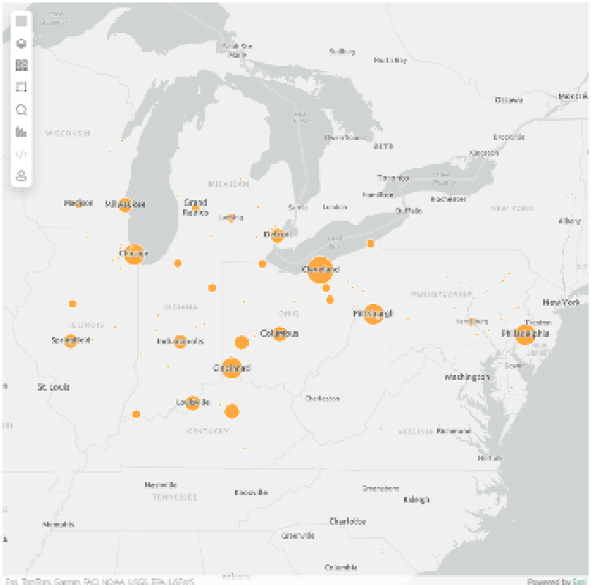
Geographical Workforce Distribution
10
CITY-LEVEL FINDINGS
16,871
Cleveland employees
75.95% of all employee records
80
unique city–state combinations
18,025
Ohio employees (81.14%)
Interpretation
The workforce is highly concentrated in Cleveland and Ohio. Review regional continuity and future hiring diversification.

Slide 11
Key Insights & Recommendations
11
KEY INSIGHTS
RECOMMENDATIONS
Workforce size
The dataset contains 22,214 employee records.
1.
Review workforce planning for Engineering and other high-volume departments to ensure capacity matches business demand.
Work arrangement
75.25% are assigned to headquarters and 24.75% are remote.
2.
Assess the effectiveness of the current hybrid work arrangement using productivity, engagement and retention measures.
Hiring pattern
Annual hiring was broadly stable after 2001; the highest count was 1,147 in 2018.
3.
Evaluate geographic concentration in Ohio and consider whether future hiring should diversify locations.
Department mix
Engineering is the largest department with 6,686 employees.
4.
Continue monitoring representation across gender and race categories while applying fair and consistent hiring practices.
Geographic mix
Ohio accounts for 18,025 employees, approximately 81.14% of records.
5.
Validate the source Age field against date of birth before using age-based workforce decisions.

Slide 12
Conclusion & Data Considerations
12
PROJECT CONCLUSION
DATA CONSIDERATIONS
The HR dataset provides a broad view of workforce size, hiring activity, employee demographics, department composition and geographic distribution. The Power BI report turns these measures into a visual summary that can support workforce planning and management review.
• Average age (38.43) uses the supplied Age column.
• The supplied Age values do not match ages recalculated from birth dates using the 03 November 2026 reference date; the source field should be validated.
NEXT STEPS
• Validate key source fields and maintain consistent data definitions.
• There are 1,014 future termination dates relative to 03 November 2026. These are treated as current for the employee-status analysis.
• Combine workforce metrics with retention, performance and engagement data for deeper analysis.
• Employee status is date-dependent and should be refreshed when the reporting date changes.
• Review the dashboard periodically as new employee records become available.

